Slide 1
Supervision
Remote supervision
Training (on practice)
Checkpoints and checkpoint cards
Full supervision on campsite

Slide 2
Checkpoint Cards
For each checkpoint you will complete a checkpoint card and leave it tied up in a plastic wallet. You will also prepare another one to estimate when you will get to the next checkpoint and take it with you.
Team Name:
Group Members:
Day - Checkpoint Number -
6 fig Grid Reference –
Estimated time of arrival –
Actual time of arrival -
Time of departure –
Any Issues -

Slide 3
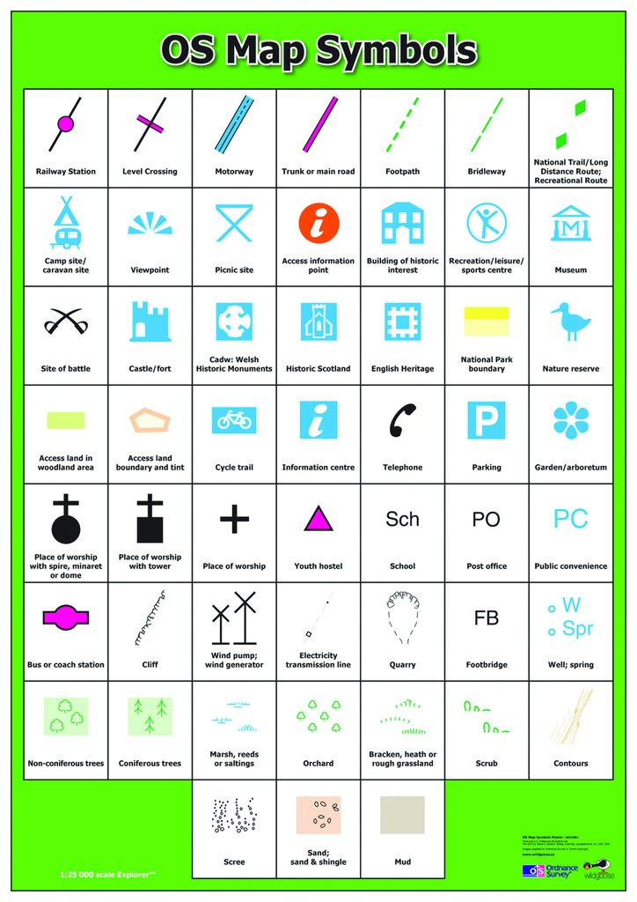
Symbols
Maps use symbols rather than writing what to expect at a location
The more you use a map the more confident you will become with symbols
Maps come with a key that will show what each symbol means – you can use this as a reference point both during planning and expeditions.

Slide 4
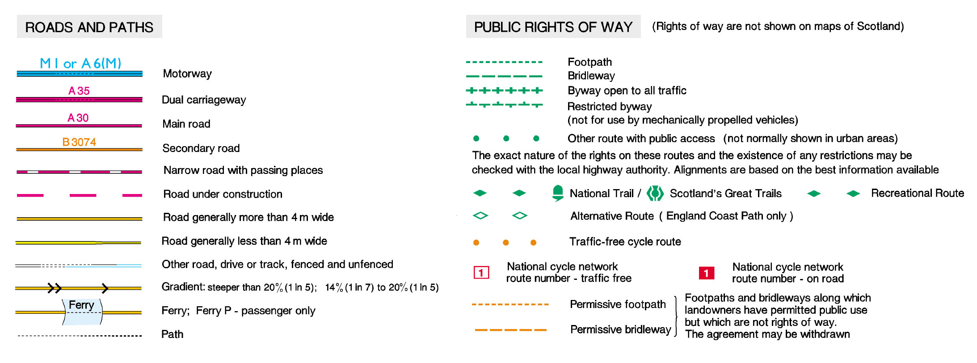
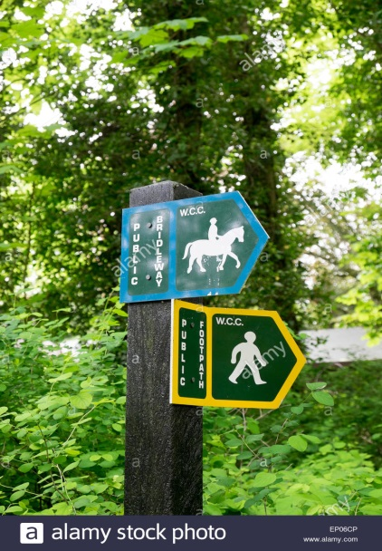
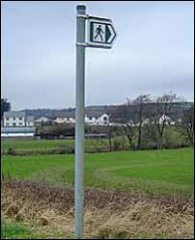
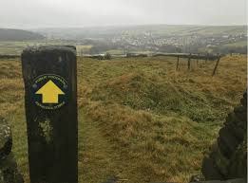
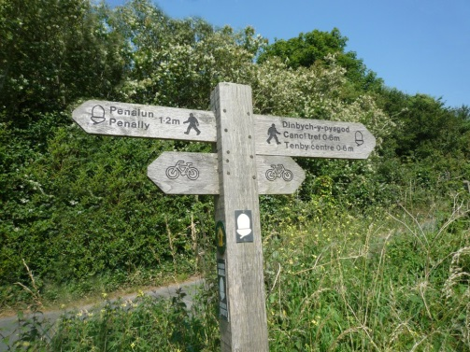
Types of Path and Footpath Signs

Slide 5
Distance
Each grid square is 1km across – 1.5km on a diagonal
The size of the squares is different depending on the detail of the map – we will be using 1:50000 maps where each grid square is 2cm
You group will probably walk:
2 km/hour on average with a rucksack
3 km/hour if fit and on flat, easy to walk ground
1 km/hour walking uphill or difficult terrain

Slide 6
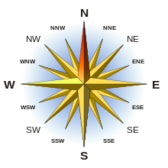
Direction

Slide 7
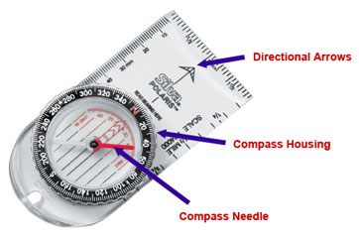
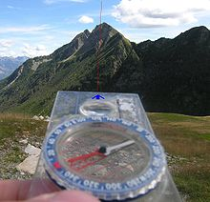
Using A Compass

Slide 8
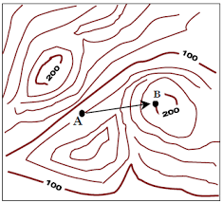
Calculating Height

