Slide 1
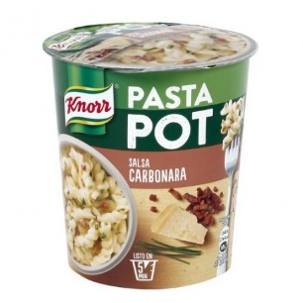
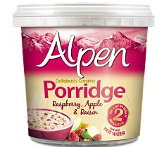
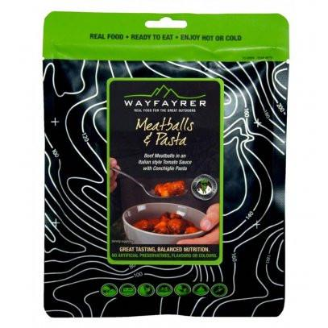
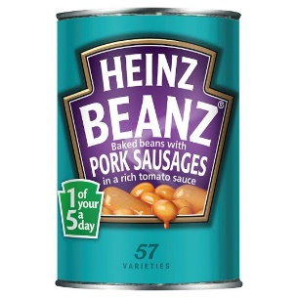
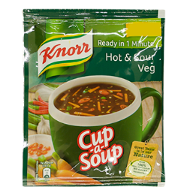
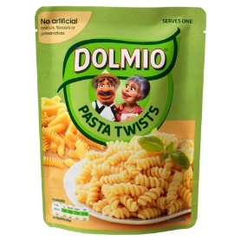
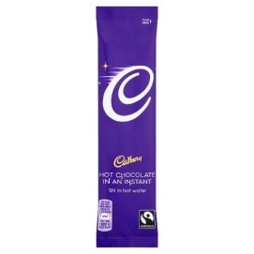
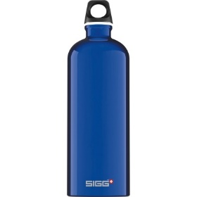
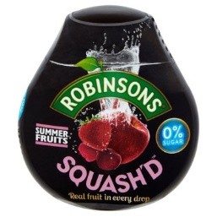
Menu Ideas
Practice Expedition
We will be using a Trangia to cook evening meals and breakfast during the expedition. The following items are popular with past students. It is a requirement for students to plan and cook a substantial meal. Depending on what they choose to cook depends on what cutlery they will need and if they need a plate or bowl.
Pupils will need to arrive having had a significant breakfast.
A water bottle will be required to ensure pupils are hydrated.
Something for lunch they will carry in their bags and snacks to keep them going.
We will use the Trangias after walking to ensure students can use them efficiently and safely before the expedition.
Porridge pots are often a popular breakfast choice
Pasta style pots are handy as they only require hot water. They may have a lower calorie content than other options.
Ready prepared packets are high in calories and cook within the packets
Tinned food tends to be heavier than those in packets but can be emptied and cooked in a Trangia bowl
Qualifying Expedition
Arriving having had breakfast
Water bottle to ensure fully hydrated – can be filled at checkpoints along the way
Something for day 1 lunch and snacks
A substantial meal to be cooked on a Trangia at the campsite – part of assessment
Breakfast to be made on the campsite at the start of day 2
Lunch and snacks to be consumed while on the route to make sure energy levels remain high.
Cup-a-soup may be used as a starter
Pasta and rice with a sauce can be cooked in a Trangia bowl with hot water.
School staff will ensure water is available at checkpoints. Pupils may want to flavour the water.
Students may enjoy a hot chocolate, tea or coffee while relaxing on the campsite
1 Litre metal water bottle. Easy to clip on to the ruck sack and wont burst.

