Slide 1
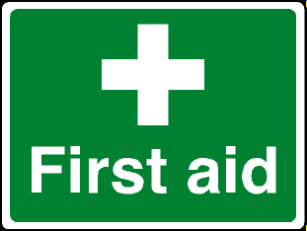
First Aid and Expedition Safety
Bronze Duke of Edinburgh

Slide 2
Prevention

Slide 3
What injuries and issues
could occur on your
Bronze DoE?

Slide 4
Most likely/common
cuts and scrapes
blisters
burns
penetration wounds – broken glass, rock, stick etc
head injuries
Hypothermia (Cold)
Hyperthermia (Hot)
twists eg ankle
Sprains eg ankle
Breaks

Slide 5
Minor Cuts & Abrasions
Treatment:
Clean with fresh water, ideally running and cold
Do not use cotton wool as this can leave traces in the wound
Use a plaster or bandage depending on size of wound

Slide 6
Minor Burns & Scalds
Prevention:
Always take care when cooking
Always place the stove on the ground, never on a rock or other elevated surface
Ensure the whole group is aware of hot pans and boiling water
Avoid spillages
Always take burns seriously and report to a supervisor
Treatment:
Immerse in cold, running water for at least 10 mins
Remove any rings from fingers, watches or bracelets from wrists
Cover with a sterile, non-fluffy dressing, clear cling film or small plastic bag
DO NOT apply creams or lotions to the injury

Slide 7
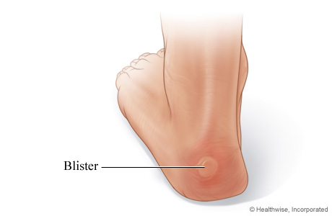
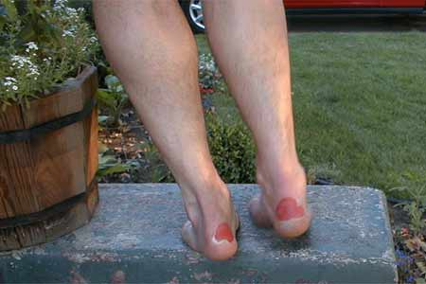
Blisters
Prevention:
Ensure footwear is broken in
Wear good walking socks, clean & dry
Change into dry socks & different footwear at campsite
STOP IMMEDIATELY if you begin to feel discomfort
Treatment:
If friction but no blister – cover affected & surrounding area with plaster, or other thin adhesive tape
If blister has developed, pad it & apply clean dressing

Slide 8
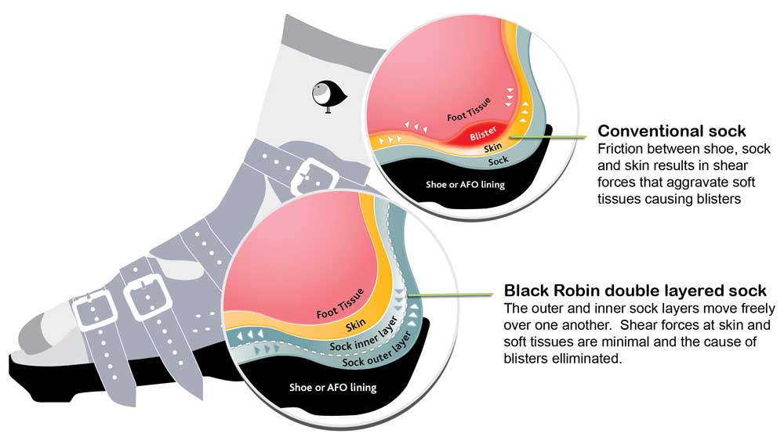
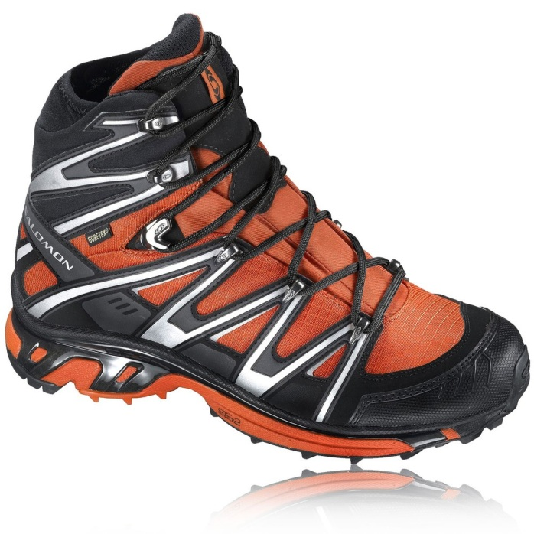
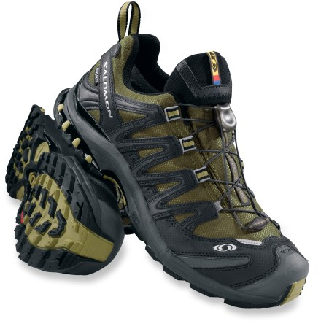
Correct Footwear
Walking Boots
Approach shoes

Slide 9
Sunburn
Prevention:
Cover up
Apply water-resistant sun block every few hours
Treatment:
Treat as a minor burn and inform your supervisor

Slide 10
Insect Bites
Prevention:
Use insect repellent
Treatment:
Keep clean and treat as minor abrasion
Some people suffer a reaction to bites – report this to your supervisor
If known to suffer a reaction, keep anti-histamine cream or tablets in your personal first aid kit and use as necessary

Slide 11
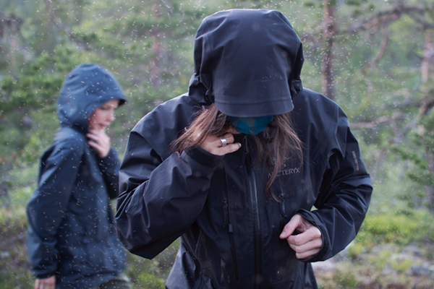

Slide 12
Mosquito Head Net

Slide 13
Hypothermia – too COLD Core temp drops below 35˚C (95˚F)
Symptoms
Shivering; cold, pale skin
Apathy & disorientation
Slow &shallow breathing
Slow &weakening pulse
Action
Spot early: keep warm
Keep/get dry
Drink hot coffee/tea with sugar
GET HELP

Slide 14
Hyperthermia – too HOT Core temp goes above 37.5–38.3°C (100–101°F)
Symptoms
Hot, dry skin
Nausea & vomiting
Headaches/fainting/dizzy
Confused or hostile
May appear drunk
Action
Drink water
Get in shade
Fresh air
GET HELP

Slide 15
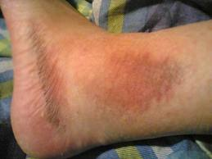
Twists and Sprains
Treatment:
R
I
C
E
est
ce
ompression
levation
Stop and rest
Apply a damp towel or t-shirt to help reduce swelling
Elevate injured limb to reduce swelling
If the pain does not ease, treat as a more serious sprain or fracture

Slide 16
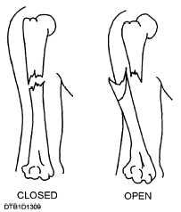
Breaks/Fracture
A break or crack in the bone is called a fracture.
Open – bone is exposed at the surface where it breaks the skin. The casualty may suffer bleeding and shock, infection is a risk.
Closed fracture – the skin is not broken, although the bone ends may damage nearby tissues and blood vessels. Internal bleeding is a risk.

Slide 17
Head Injury
Blow to the head (fall, hit tree/bridge) – concussion (brain movement in the skull)
Always suspect a neck injury as well.
Casualty maybe confused, blurred vision, headache, loss of memory, dizziness or nausea.
Monitor vital signs, support neck injuries.

Slide 18
Unresponsive

Slide 19
Cattle

Slide 20
http://www.ramblers.org.uk/advice/safety/walking-near-livestock.aspx

Slide 21
Lightning
Do not sit under a tree, for example, to stay dry. Lightning will strike trees as they are high, and you don't want to be close by!
Do not seek shelter in a cave or old mine. If lightning strikes the ground above the cave, it will take the shortest route downwards, which will be through the empty air of the cave.
Place any metal and/or electrical objects away from you; at least 20 metres away. Such items include; mobile phone.
If possible and safe to do so, descend to lower ground.
Sit on your rucksack (which insulates you from the ground) on the hillside, with feet off the ground too, and wait for the storm to pass. Do not sit in a large group.

Slide 22
Options if something goes wrong for example: lost, angry farmer/public
Fixing and carrying on
Staying still
Going forward to next checkpoint
Going back to last checkpoint
If serious 999, and explain the situation to the police
If group splits it is important at least 1 person stays with casualty and at least two seek help. Those who stay behind could use a tent for shelter, apply warm clothes.

Slide 23
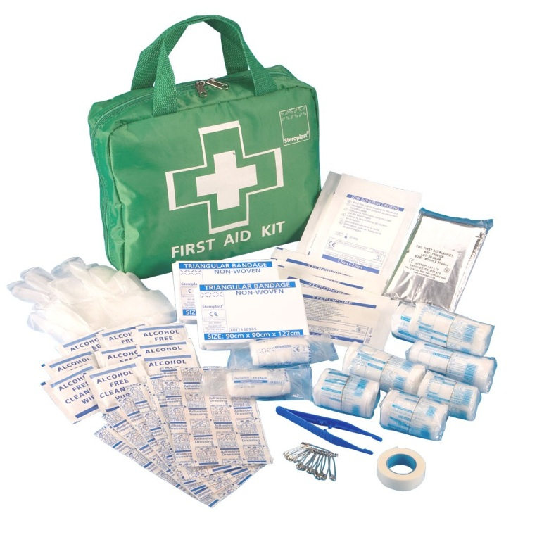
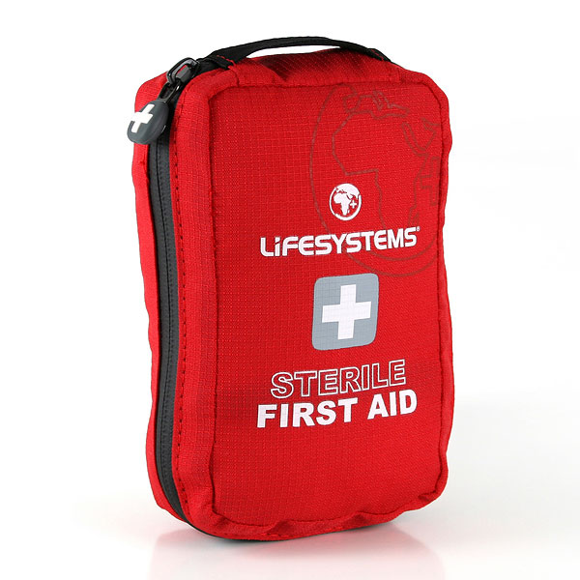
First Aid Kit
What should be in it? Where should it be?
Have a look at the first aid kit examples.
Must have pass/fail

Slide 24
Ensure hot food is cooked all the way through. Thorough cooking kills harmful bacteria in food. So, it’s important to make sure that your meals are cooked properly. Always check that food is piping hot all the way through – it should be steaming. Stirring food when it is cooking allows the heat to be evenly distributed. Remember: don’t use the same utensils or containers for raw and cooked food, and never reheat your meals more than once.
Make sure you clean up and wash up after every meal. Leftover food and waste can cause stomach upsets and will attract all sorts of pests, so make sure you dispose of it responsibility (whilst also considering the Countryside Code). However, don’t wash up in streams or
under campsite taps or forget to wash your hands as often as you would at home – antibacterial wipes or gel can be helpful.
Check your water is safe to drink. Don’t take water from canals or streams, since there is a high chance it is contaminated. You will need to boil the water or use a filtration device or sterilisation process before you can drink or cook with it. You could consider boiling a pan of water and using it to make soup as a starter or a hot drink, then using the rest to cook a boil-in-the-bag pudding. Don’t throw the excess water away – this can be used to do the washing up.
Keep your feet clean and dry. In the evenings, wash and dry your feet and use talcum powder if possible. Pack as many pairs of socks with you as expedition days so you have a clean, dry pair every day (always take at least two pairs).
Ensure your boots fit properly. Before purchasing a new pair of boots, try them on to make sure they’re big enough to allow your feet to swell yet not too loose that they don’t feel secure. Remember to break in your new boots, wearing them around your house or to and from school to ensure your feet feel comfortable and that you get used to walking around in them. This will help you avoid blisters and sore feet. If your foot is moving in your boot, try putting on another pair of socks.
Take a blister kit. Prevention is better than cure, so put some plasters on where you’ve had blisters before to protect your feet from the very start of your expedition. Alternatively, wearing two pairs of socks (one thin, one thick) can significantly reduce friction in the boot and prevent blisters. It’s worth investing in good expedition socks, but thick sports socks will do to save money – don’t wear cotton stocks. If you feel that you have a ‘hot spot’ rubbing on your feet, ask your team to stop and let you fix the problem before it becomes a blister, so you don’t struggle the rest of the way.
Protect your skin. Don’t get caught out by sun and wind burn – particularly over long expedition days when you may not realise you’re getting burnt. Cover your skin in loose fitting clothing that doesn’t prevent sweating and use suitable, high factor sun cream. Your head and neck should be very carefully protected.
Carry a first aid kit. You should carry your own first aid kit with you on expedition, adapting it to your needs, conditions or allergies. The kit should also contain plenty of disposable plastic gloves to prevent contact with bodily fluids, especially blood.

