Slide 1
Water / hydration
Number of calories
Can’t buy anything during expedition
Snacks + lunch day 1
Evening meal (20 conditions)
Breakfast day 2
Snacks and lunch day 2

Slide 2
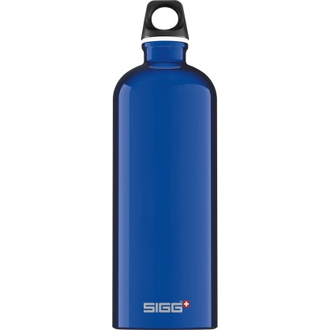
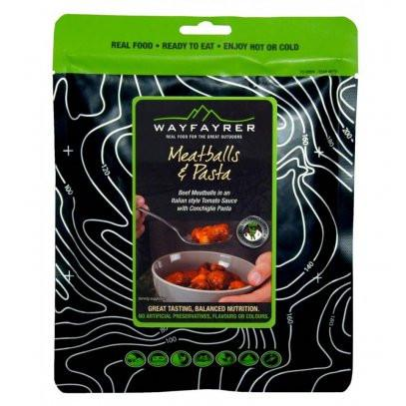
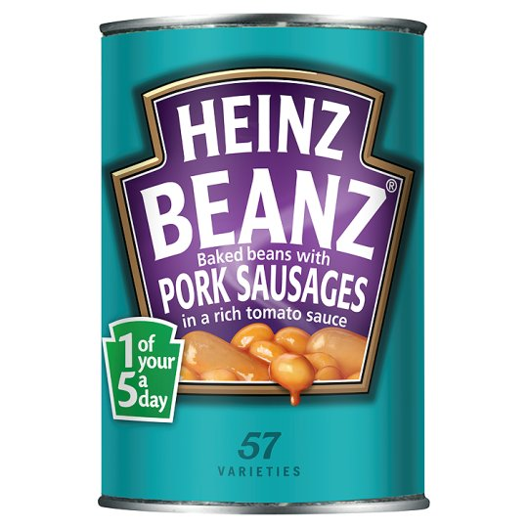
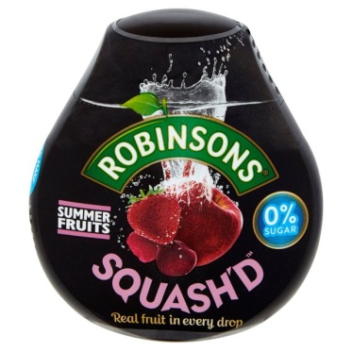
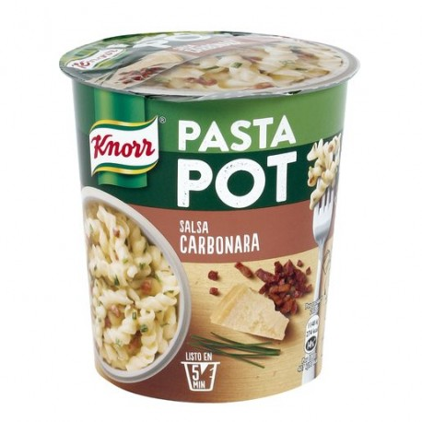
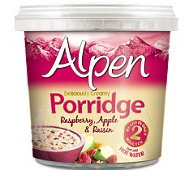
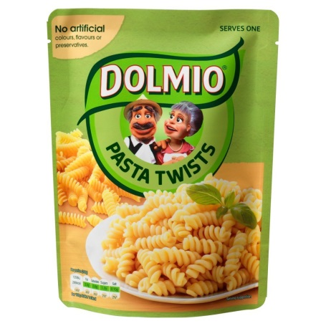

Slide 3
You have to cook a substantial meal – pass or fail on qualifier
Breakfast
Depending on what you have depends on what you need – plate/bowl/mug/cutlery
Be careful with fresh produce
1 trangia between 2 or 3
If your organised can be quicker and easier to have same meals
Cleaning of the trangia
There should be no sign that you have cooked there

Slide 4
Trangia Safety
Cook on a flat surface away from tents and paths
Don’t cook in or near tents
Everything will be very hot use the handle
Keep you trangia clean – hygiene
Methylated spirits is flammable – fill up using a safety bottle away from flames
Flame can be invisible in daylight
Use the appropriate amount of methylated spirits – let the rest burn out
You will cook in front of qualified member of staff
NEVER REFILL A WARM BURNER – let it cool down or use another one (available from staff)

