Slide 1
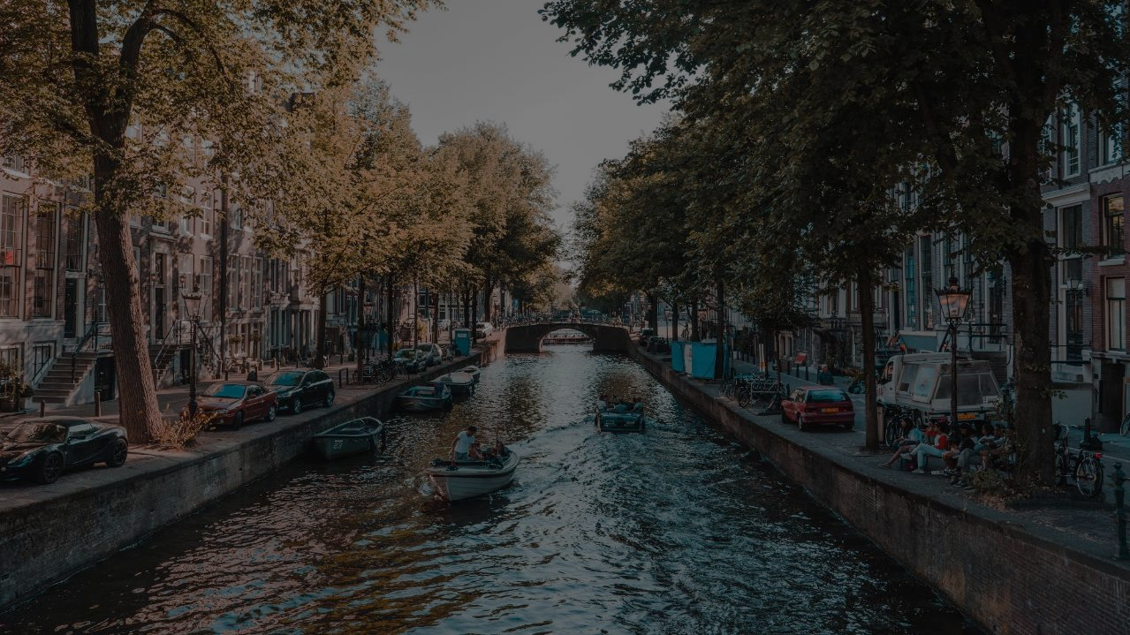
Training Kit
ULF SONNTAG| NIT, KIEL | 28.05.2021

Slide 2
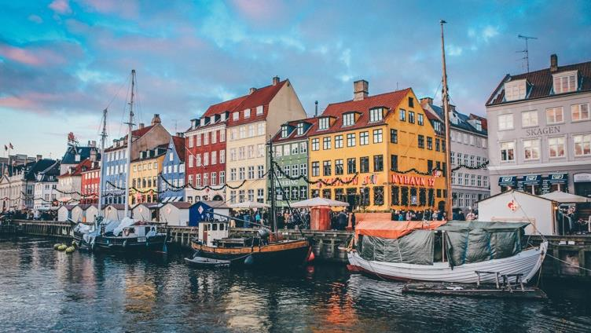
content
Project Presentation
Challenges in the Pilot cities
Challenges in YOUR CITY
Transforming Initiatives
Best Practices
Inventory of Labels
Acceleration Programme
Participation in Tourban

Slide 3
PROJECT PRESENTATION

Slide 4
Key project information
Project Title: ​Tourban - Accelerating SME capacity and innovation for sustainable urban tourism
Funding Programme: Competitiveness of Enterprises and Small and Medium-sized Enterprises (COSME)​
Call: COS-TOURCOOP-2019-3-01: Boosting sustainable tourism development and capacity of tourism SMEs through transnational cooperation and knowledge transfer​
​
Duration:​
16th September 2020 – 15th March 2023 (30 Months)​
Budget: ​
Total: 1.327.777 €​ (Co-financing rate: 75%)
Thereof: 600.000 € financial support to third parties (to SMEs)​

Slide 5
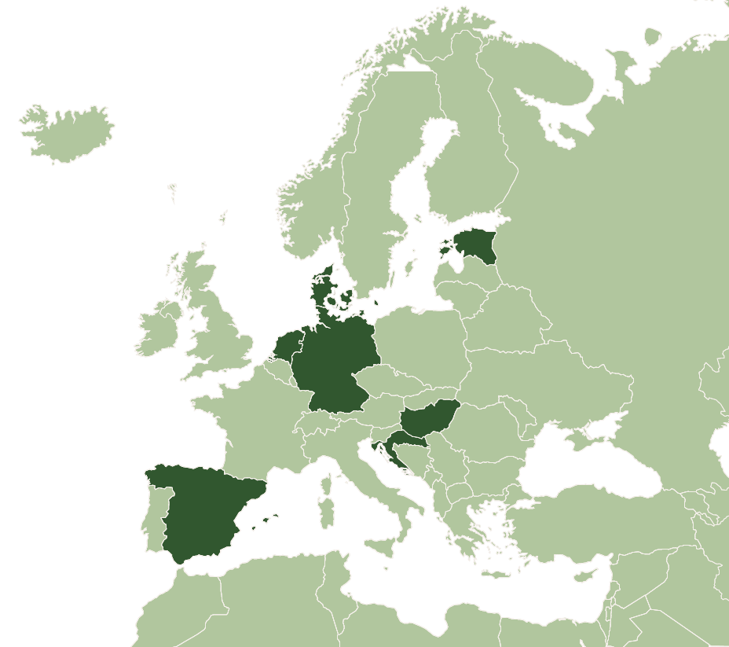
PROJECT PARTNERSHIP
Barcelona Chamber of Commerce, Industry, Services and Navigation (BCC) – Barcelona, SPAIN​
B.LINK Barcelona Strategic Projects S.L. (B.Link) – Barcelona, SPAIN​
Institute for Tourism Research in Northern Europe (NIT) – Kiel, GERMANY​
Estonian Chamber of Commerce and Industry (KODA) – Tallinn, ESTONIA​
Breda University of Applied Sciences (BUAS) – Breda, NETHERLANDS​
City of Dubrovnik Development Agency (DURA) – Dubrovnik, CROATIA​
Creative Business Network (CBN) – Copenhagen, DENMARK​
Hungarian Hospitality Employers' Association (VIMOSZ) – Budapest, HUNGARY

Slide 6
objectives
“Support urban tourism SMEs in the adaptation towards more sustainable business models.”
Promote and establish a transnational and cross-sectorial network in between different actors from the tourism industry (SMEs, technology and sustainable solution providers, public and private decision makers, investors etc.)
Create and spread knowledge and skills among tourism SMEs to facilitate the adoption of solutions, practices and experiences tackling challenges in urban tourism sustainability.
Deliver technical and financial support services to SMEs to help them achieve their individual sustainability projects and goals same as possibly a sustain- ability certification.
How?
Online Community
& Events
1
Research
Training
Workshops
2
Acceleration Programme (incl. grant)
3

Slide 7
Activities
Transnational and cross-sectorial cooperation and network:
Online community: https://community.tourban.eu
International events (online and offline) – Final Conference Dubrovnik (2023)
Create and spread knowledge and skills among tourism SMEs:
Research and analysis about urban tourism sustainability challenges + best practices (DONE)
‘Peer to peer sessions’ (= thematic training workshops) – international/English
‘Communities of practice’ (= online working groups) – international/English
Design Thinking Lab Barcelona (2022) - international/English
Deliver technical and financial support services:
Acceleration Programme (incl. up to 10.000 € grant/ SME)
Upcoming: Webinar on the application process and requirements
Investor Pitch Copenhagen (2022) - international/English
1
2
3

Slide 8
Target Groups
10+
BUSINESS SUPPORT ORGANISATIONS (BSOs)
As many as possible
INVESTORS AND FINANCIERS
SUSTAINABILITY EXPERTS
TOURISM SMES AND START-UPS
7+
7
LOCAL AUTHORITIES AND OTHER GOVERNMENT ORGANISATIONS
PROVIDERS OF SUSTAINABLE TOURISM SOLUTIONS, PRACTICES AND TECHNOLOGIES
40+
LOCAL COMMUNITIES AND NEIGHBOURS

Slide 9
Calendar
1
Launch of the online community: https://community.tourban.eu
Analysis
Secundary data collection
Interviews with SMEs
Focus groups
Capacity building
2
‘Communities of practice’
‘Peer to Peer sessions’
Investor Pitch (Copenhagen)
Design Thinking Lab (Barcelona)
ACCELERATION PROGRAMME
3
Call for Proposals
Technical and financial support (12 months)
Sep 2020
Mar 2021
Jul 2021
Jan 2022
Dec 2022
Mar 2023

Slide 10
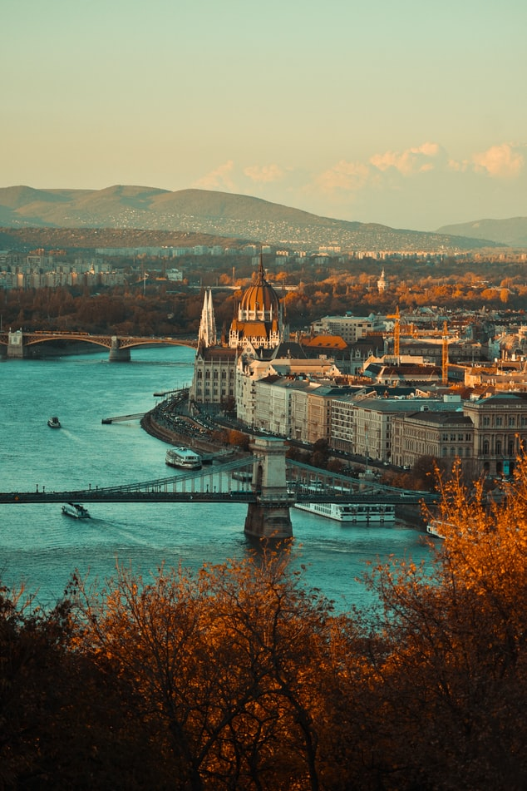
How can I stay informed?
Joining the Tourban Community: https://community.tourban.eu/
Through Tourban social media channels:
Facebook: https://www.facebook.com/TourbanEU
Twitter: https://twitter.com/Tourban6
LinkedIn: https://www.linkedin.com/company/tourban/
Through your local contact point (Tourban project partner)
INSERT NAME OF PARTNER

Slide 11
WP 2.1 LINK to other work packages
WP 1
WP 2
Secondary data collection
TRAININGS
Online Communities
Interviews
Peer to peer services
Focus groups
Best practices
WP 3
the inventory of certificates / labels
Sustainable Urban Tourism Acceleration Programme
time

Slide 12
CHALLENGES in the Pilot Cities

Slide 13
Mapping THE urban tourism challenges
Methodological approach:
1st Step: Secondary data collection conducted by partners in each pilot city
Destination Level
Preliminary insights into SMEs level
2nd Step: In depth semi-structured interviews with SMEs
3rd Step: validation of results through focus groups conducted in each pilot city
4th step: Report Urban tourism challenges in the 7 pilot cities

Slide 14
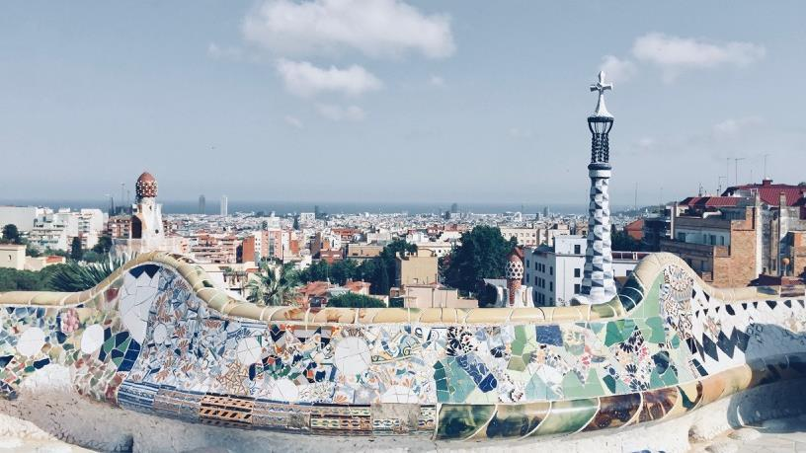
URBAN TOURISM CHALLENGES IN THE TOURBAN CITIES
Pre-Covid 19: significant increase in terms of tourism → increasing tourism pressure
Overtourism and unbalanced tourism development
Social impacts
Environmental impacts
Devastating impact of Covid-19 pandemic, several uncertainties about the future
19.07.2021
Tourban Project Presentation
14

Slide 15
WE INTERVIEWED MORE THAN 100 tourism SME TO UNCOVER THE CHALLENGES THAT ARE LIMITING THEIR TRANFORMATION into more sustainable businesses. WHAT DID THEY TELL US?

Slide 16
What smes think about sustainability
In general SMEs see sustainability in tourism as a relevant concept
Some of the SMEs owners see sustainability as a moral entrepreneurial responsibility
They see sustainability as a 360˚ concept, involving not only the environment but also social and cultural dimensions
Most of them acknowledge the opportunity that tourism provides in balancing the “triple bottom line”

Slide 17
Can sustainability make companies more competitive?
It is important but it’s not a decisive factor (Price, quality of service etc. are still more important)
Customers see it as “nice to have”, but not as something essential
The relevance of the concept is increasing (becoming a standard in the future)
Especially important for domestic market

Slide 18
What keeps SMEs managers away from being more sustainable?
Lack of knowledge seems to be the main constrain
Lack of financial resources (though not always the most important)
Lack of time and/or vision
Lack of dedicated staff (no specific employees for driving a sustainability transformation) or trained staff
Many SME owners agree → strict government rules (and compliance) key to scale up sustainable development

Slide 19
SMEs financial challenges concerning investments in sustainability?
Difficult to find your own resources to invest in sustainability (especially now, with Covid-19...)
Lack of governmental support in terms of funding sustainable transformations (and/or lack of knowledge about this support)
When they have knowledge about governmental support, discouraged by the bureaucratical process
It is challenging to think about “big revolutions”, very expensive... Better to take small steps

Slide 20
challenges in marketing OF sustainability and sustainable products/services
SMEs experience significant challenges in “selling” sustainability and or including it in their USP
It is a very difficult message to include in communication/mktg
Sustainability has a price, and often this is an issue for customers
Risk of being perceived as a “greenwashing” brand/business
Sustainable certification schemes help in terms of internal processes, but sometimes are not perceived as added value externally

Slide 21
CHANGE-RELATED CHALLENGES
Becoming more sustainable means implementing a certain degree of change in the way a business operates
Change is recognized by SMEs as something necessary, “if you don’t change, you die”
Nevertheless, SMEs perceive several challenges:
Commitment from staff, they need to be ‘on board’
Commitment from customers, they need to understand the change
Lack of network: change is easier when you can rely on a network

Slide 22
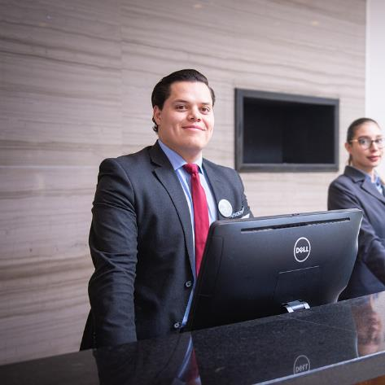
TRAINING AND HR CHALLENGES
SMEs acknowledge that appropriate training and HR practices are crucial for embracing a sustainable transformation
Nevertheless:
When implemented, training on sustainability topics are generally limited to the initial training
Several SMEs perceive regular training on sustainability for their employees as too costly and time consuming
HR practices. Generally, SMEs recognize sustainable and fair employment conditions (e.g. equal opportunities and a good work/life balance) as important, but only few have set an HR protocol concerning these matters

Slide 23
Sustainability transformation: “THE MOST relevant CHALLENGEs”
Not knowing where to begin: the whole topic of sustainability seems too big and overwhelming.
Lack of time to dive into what is possible to do and what the benefit might be
Financial resources, especially now (Covid-19)
Customers’ demands and marketing: guests are not willing to pay more for sustainable products or services
Unclear regulatory framework: Government and local authorities must implement clear sustainable policies

Slide 24
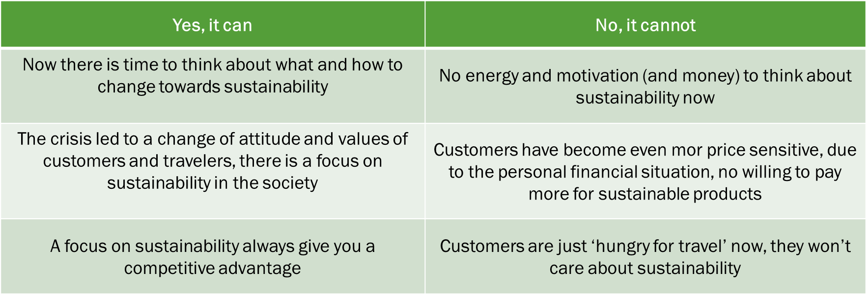
CAN A SUSTAINABLE TRANSFORMATION HELP SMES TO recover from the Covid-19 crisis?

Slide 25
beyond SUSTAINABILITY… urgency for other changes
Change of target markets: more focus on domestic market, not only international markets
More collaboration and network with other players in the industry
Technology should be implemented more in business operations
More focus on hygiene and cleanliness
More focus on quality

Slide 26
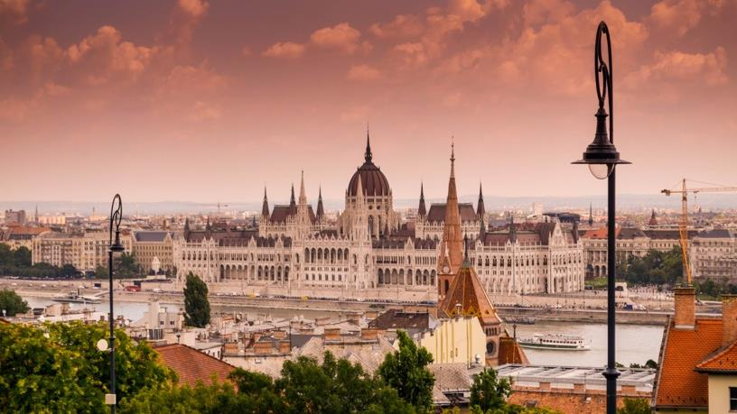
It is not the strongest of the species that survive, nor the most intelligent, but the one most responsive to change
Charles Darwin
19.07.2021
Tourban Project Presentation
26

Slide 27
CHALLENGES in your City

Slide 28
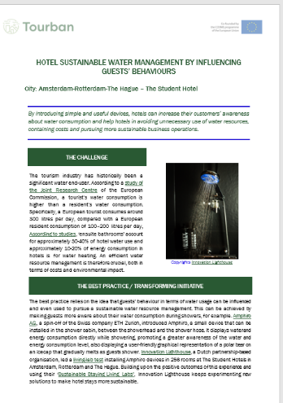
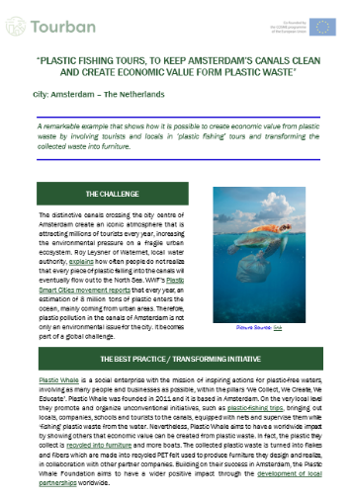
NOT ONLY CHALLENGES…
https://usercontent.one/wp/www.tourban.eu/wp-content/uploads/2021/04/Tourban-D1.2-eManual-Sustainable-urban-tourism-for-cities-and-SME-managers-16.04.21-def.pdf

Slide 29
Transforming Initiative

Slide 30
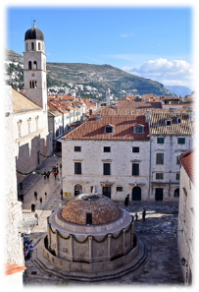
Dubrovnik – ‚Respect the city‘
Why: To reduce negative effects of overtourism
(to prevent a further degradation of life quality, preserve the fragile cultural and natural heritage of the city, enhance the quality of the visitors’ experience)
How: Through a combination of measures and the establishment of a continued cooperation among stakeholders (Measures: a cap of cruise ship tourists to 4,000/day, the implementation of smart IT solutions monitor and manage crowds, a comprehensive action plan balancing short and long-term measures and the establishment of a more inclusive decision-making process, based on the active participation of tourism stakeholders)

Slide 31
Copenhagen – ,Tourism for Good‘
Why: To support positive effects of tourism regarding sustainability and to prevent negative effects of overtourism
How: 1. Sustainable choices considering the available knowledge in terms of positive and negative impacts of tourism must be made (important to measure impacts, as they are crucial to make appropriate choices)
2. Wonderful Copenhagen = connecting point between stakeholders, must be used to develop and disseminate knowledge, should set up an agenda for collaborations involving all parties that are relevant to sustainable tourism
3. Collaborations around events can support sustainable tourism development (with sustainability as a central theme)

Slide 32
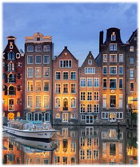
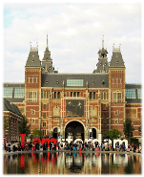
Amsterdam – ,The image of the free city‘
Why: To redesign the visitor economy of the city that adds value and does not cause disturbance or disruption
How: 1. Attract visitors who come for the uniqueness of Amsterdam and add value
2. Responsible use of data/guidance of visitors through the city
3. Encourage, facilitate, reward and communicate good business practices
4. Develop neighbourhoods focusing on their identity
(enhancing their role in decision-making)
5. Clear strategy (enriches the night offer and reduces disturbances)
6. Design an integrated plan to restore the balance among living/working/visitors
7. Redesign public spaces

Slide 33
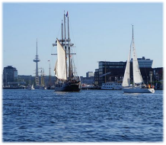
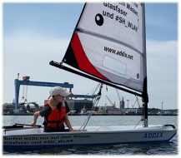
kiel – ,meeresschutzstadt‘
Why: To summarize one shared vision under which sustainable products/ services/ initiatives can be implemented and communicated under an overall brand strategy
How: 1. ‚Meeresschutzstadt‘ can be used as a label for the city itself
2. It should be used along the entire tourism values chain, to communicate a commitment to sustainable tourism development, including very tangible and practical measures that can be linked to the broader theme of ocean protection

Slide 34
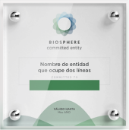
Barcelona – ,Biosphere Responsible Tourism‘
Why: To remedy the compley situation of the adoption process for sustainability certificates and labels for tourism businesses
How: Businesses are supported in the label adoption process through trainings, individual mentorship and guidance during the administrative process and on technical matters:
1. Labelled as ‘Biosphere Committed Entities’ (after one year on average)
2. Awarded with the Safe Travels certificate of the World Travel Tourism Council
3. Based on three individual sustainability goals and the completion of a minimum of one additional training, the commitment is renewed (year after year)
4. Labelled businesses are automatically included in the network ‘Barcelona + sostenible’ (which helps them to connect to like-minded businesses)

Slide 35
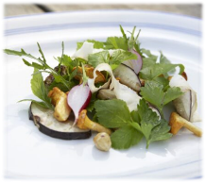
Kiel – ,Feinheimisch - fine food from Schleswig-Holstein‘
Why: To promote regional sustainably sourced products under a recognisable label because of the growing importance on regional, organic food for tourists
How: 1. Used for the promotion of local cuisine and cultured gastronomy
2. top priorities: freshness and quality (mission is focused on high-quality local food combined with culinary craft skills)
3. Members feel responsible for sensible and healthy eating, environmentally sound food production and enhanced quality consciousness (focus on cultural and traditional roots without standing in the way of new developments)

Slide 36
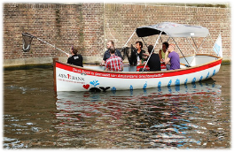
Amsterdam – ,plastic fishing tours‘
Why: To clean the canals from plastic pollution and to create economic value from plastic waste by involving tourists and locals
How: 1. Bringing out locals, companies, schools and tourists to the canals, equipped with nets and supervise them while ‘fishing’ plastic waste from the water
2. The plastic they collect is recycled into furniture and boats
(the collected plastic waste is turned into flakes and fibers which are made into recycled PET felt used to produce furniture they design and realise, in collaboration with other partner companies)

Slide 37
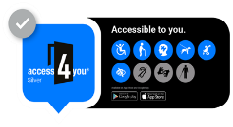
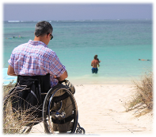
budapest – ,Access4you‘
Why: To supports people with special needs in terms of accessibility by providing real and detailed information
How: 1. Encourage accessibility by providing information free of charge for users (while the trademark user fee is reimbursed by the owner or operator of the location)
2. Promote accessibility by encouraging organisations to develop accessible environments and provide real and detailed information
3. The certificated sites are visited and assessed according to a set of 550 criteria
4. Characteristics of the environment are documented with photos (shared on website and mobile App, together with important technical parameters)
5. Determination: for which groups with special needs is the location suitable for (the higher the accessibility the higher the level of certification)

Slide 38
Tallinn – ,JCI World Congress ‘
Why: To lower the overall environmental impact of a sustainable conference as much as possible
How: 1. Plastic-, paper- and gift bag- free
2. Delegates were encouraged to use public transportation (before the arrival, all delegates received a special QR code for free transport)
3. Totally paper free: materials = available digitally/ digital notes
4. Own coffee mugs and water bottles (Circup quick-wash stations to wash the cups)
5. Lunch made entirely of donated food that would have otherwise gone to waste

Slide 39
Best Practice

Slide 40
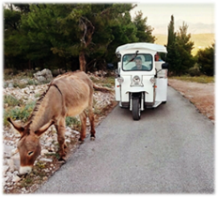
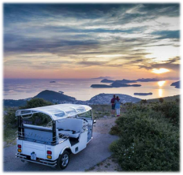
Dubrovnik – Eco tuk tuk tours
Why: To combat overtourism with a new product focusing on sustainability principles
How: Focus on sustainability in every aspect of their business (transport, providers, products, etc.)
Bring tourists away from the Old Town and other main tourism spots
Educate tourists about the local history, traditions, culture and nature

Slide 41
Budapest – Try:budapest
Why: To combat overtourism and to lead tourists to areas of the city with less tourism pressure, where they can enjoy a more authentic experience
How: Personalised city-walks, according to the specific interests of their costumers are organized
When booking a tour, the visitors provide their preferences, based on which they will get a programme designed specifically for them
Where possible, meaningful interactions with locals are involved
Notes:
Where or when/if?

Slide 42
Zagreb – Eventful
Why: To organise fully sustainable events and consult businesses in relation to the sustainability of their events
How: They opt for local suppliers, environmentally friendly packaging and decorations that are not harmful to the environment
(ordering seasonal food from local suppliers; ordering 20% less food for event; event waste management plan and waste bins for different kind of waste; recyclable materials and accreditation badges that can be reused; gift bags made of cotton or jute; USB-drives with brochures - exclusion of paper and other potential waste; certain degree of inclusion of the local community in the events)

Slide 43
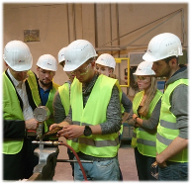
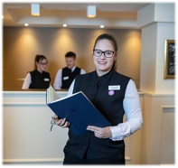
kiel – Energy scout
Why: To effectively implement sustainable practices in tourism SME’s
How: The Chamber of Commerce and Industry in Kiel (IHK) offers a qualification programme, allowing SME’s to get qualified as ‘Energy Scouts’
Apprentices learn about basic energy engineering and measures for energy saving
They also gain skills to plan and implement their own projects in their companies and to communicate the topic of energy efficiency among their superiors and co-workers

Slide 44
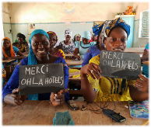
Barcelona – ‚12 months, 12 SDGs‘
Why: To engage hotel staff in a sustainability transformation (commitment and motivation of staff members to follow, engage or even lead the process is important for success)
How: United Nations Sustainable Development Goals are embraced as a framework for a unique project aimed at defining and implementing own sustainability objectives (involving their staff at all levels into the process)
1. Internal task force of 10 people from different departments
2. Team picked 12 out of the 17 SDGs (one for each month of the year)
3. They identified a specific objective for each of them and concrete ways to achieve them

Slide 45
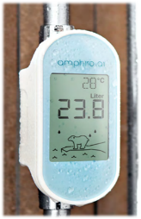
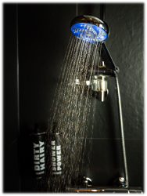
Amsterdam/Rotterdam/The Hague – water management
Why: To avoid unnecessary use of water resources by tourists
How: Achieved by making guests more aware about their water consumption:
Amphiro (a small device that can be installed in the shower cabin)
displays water and energy consumption directly while showering, also displaying a graphical representation of a polar bear on an icecap that gradually melts as guests shower

Slide 46
copenhagen – carbon emission offsets
Why: To implement sustainability in an industry with a fragmented value chain and to allow tourists to calculate and offset carbon emissions associated with their tours
How: 1. Platform that allows customers to book entire trip in one single flow (including flight tickets, hotels, transfer and travel insurance)
2. Carbon footprint is calculated and offset (as a simple add-on)
3. Once payment is completed: customers receive travel documents and certificate stating they have compensated the CO2 emissions of their trip

Slide 47
copenhagen – Travel kollekt
Why: To enable travellers and businesses to have a direct impact (sustainable) on the environment during their travel planning activities, even before starting a trip
How: For the way of operating it is important to reduce the environmental impact of activities as much as possible:
1. Handpicked suppliers
2. Using only certified paper
3. Partially offsetting the environmental impact by planting a tree for every printed book (through an established partnership with onetreeplanted.org)
4. Stimulate a change in tourists’ behaviours by embedding the responsible tourism manifesto from UNWTO into every book that is created

Slide 48
Inventory of Labels

Slide 49
Why a sustainability certificate or Label?
Certificates guide you the right way for the sustainability and competitiveness of your business.
Business related advantages:
Cost savings in energy, water and waste management through optimised environmental management and use of efficient devices
Inclusion into marketing streams (at destination level, in booking systems (filter), marketing of the certificate itself)
Inclusion into community of like-minded
Cost of certification usually amortised after max 1 year
Customer orientation (excellence and quality)
Environment-related advantages:
Reduction of CO2 emissions through decreased energy consumption or use of renewable energy sources, local supply chains (less emission from transport)
Limitation of food waste, plastic and water consumption
Reduction of products that harm the environment (chemicals, pesticides, plastic)

Slide 50
Which Certificate should I choose?
Criteria to bear in mind when selecting your label or certificate:
Category and profile of your business
Location and operation of your business
Operational level of the certificate (global, national, regional, local)
Volume of already certified businesses in your area/ market (visibility and joint marketing)
Environmental management vs. sustainability performance
Level of sustainability required at start
Sustainability criteria applied (e.g. GSTC recognised?)
Credibility level (Is there a 3rd party audit?)
Cost of certification and period for renovation
Extra services or accompaniment provided

Slide 51
ACCeleration Programme

Slide 52
ABOUT THE Sustainable Urban Tourism Acceleration Programme
Background
The specific challenges that European cities are facing because of over-tourism, and how SMEs can contribute to mitigate them by adopting new and innovative measures.
These specific challenges will be further detailed in the Call for Proposals, so that applicant SMEs can design their own projects addressing them appropriately.

Slide 53
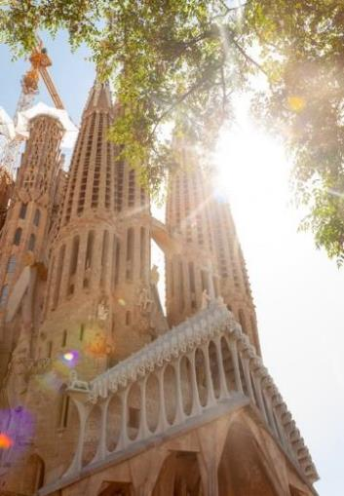
ABOUT THE Acceleration Programme
Objective: bring support to urban tourism SMEs in their transformation journey towards sustainability
Funding: max. €10.000 per SME (grant), 100% funding rate
Purpose of the funding: to implement your own project / sustainability initiative in your own business
Duration: 12 months
Type of support: financial (grant), technical (mentor), business support/knowledge (experts, consultants, trainers)

Slide 54
Why should i send my application?
What does the Programme offer you?
What does the Programme expect from you?
Mentoring and technical support during the whole duration of your project
Improving your knowledge and skills through training and support from experts
Access to an international network, including networking events
Financial support: 100% reimbursement of eligible costs, up to max. € 10.000
Eligible costs: Labels & certificates, mentor fees, consultants, travels, etc.
Relevant & innovative projects impacting on the environmental / social / economic sustainability of your business and of your operational ecosystem (urban/city)
Engagement in Tourban activities (Final Conference, Design Thinking Lab or Investor’s Pitch, Communities of Practice; Peer to Peer sessions)
Engagement, time, effort to achieve results
Improving the SUSTAINABILITY & COMPETITIVENESS of urban tourism companies

Slide 55
Eligibility SMES (1) – Who can be financed?
Who is considered an SME?
EU recommendation 2003/361
SME user guide
SME self-assessment tool

Slide 56
Eligibility SMEs (2) – Who can be financed?
Categories of SMEs:
Hotels and similar accommodation
Holiday and other short-stay accommodation
Camping grounds, recreational vehicle parks and trailer parks
Travel agency, tour operator reservation service and related activities.
Correspond to NACE codes: I55, N79.
Please verify the correspondence of these NACE codes in your country!
... based in [respective county/region] and operating or proving the capacity to impact in the sustainability of city tourism in [respective pilot city].

Slide 57
Cost Eligibility - What can be financed?
General: “cover costs of their participation in the project activities and to build their capacity to uptake solutions, which would improve their sustainable management and tourism sustainability in general”
Travel, registration and accommodation costs allowing active participation of tourism SMEs in support activities
Sustainable and green investments, which may include:
o Compliance adaptations necessary to apply for relevant and achievable certification schemes, including costs of certification or standardisation. Compliance adaptation may include different costs such as adaptation of operational procedures, documentation, data collection etc.
o Costs of advisory services and skills improvement (for example: in mapping specific sustainability related needs to be addressed by an individual SME; in measuring the environmental and social impact of the operations of SMEs, in managing operations in a more environmentally-friendly manner etc.).
Staff costs of SMEs (human resources) are NOT eligible
Investments in a physical infrastructure are NOT eligible

Slide 58
Calendar (acceleraTION PROGRAMME)
EVALUATION & SELECTION OF SUCCESFUL PROJECTS
LAUNCHING THE ACCELERATION PROGRAMME
(12 MONTHS)
LAUNCHING THE CALL
(OPEN 2 MONTHS)
July 2021
September - November 2021
End of 2021/Begin of 2022
(December - January)

Slide 59
Participation in Tourban

Slide 60
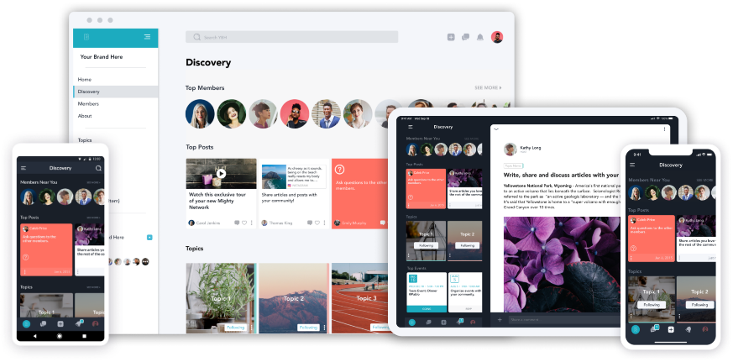
Join Tourban ONLINE COMMUNITY in the Mighty Networks!
https://community.tourban.eu
Notes:
Mighty Networks is an online community platform which has similar functions to other social media platforms like Facebook function “groups”. It focuses on driving engagement of members and building a community.

Slide 61
What is hAppening in the community?
10 international online working groups composed of tourism SMEs and other stakeholders on a certain topic. Every working group is assigned specialist adviser.
WHO ARE INVOLVED?
Tourism entrepreneurs and SMEs – accommodation services, travel agencies, tour operators and similar
Technological solution providers
Sustainability experts
Investors and financiers
Business support organisations
Public authorities
Local communities
Notes:
10 international online working groups composed of tourism SMEs and other stakeholders on a certain topic.

Slide 62
Smart resource use: Energy and water
Sustainable destination strategy
Circular economy and waste management
Technology and digitalisation
G
R
O
U
P
S
Visitor engagement and satisfaction
Communicationmarketing and sales
Accessibility and social inclusion
Human resources and internal management
Access to finance and incentives
Sustainability certificates and labels
Notes:
Working group topics.

Slide 63
What MORE is hAppening in the community?
Online meet-ups!
Every group has online meet-up sessions.
The sessions are dedicated to connect community members from the different Tourban countries including SMEs, but also other project stakeholders with the aim to discuss and provide possible solutions to a specific challenge in urban tourism sustainability shared among the Tourban cities.
10 training workshops during 2022!
Training are dedicated to urban tourism SMEs in Europe including Tourban acceleration programme beneficiaries.

Slide 64
Contact:
LEONIE HEHN
Project Manager – European projects and innovation
Barcelona Chamber of Commerce
Av. Diagonal 452 – 08006 Barcelona
lhehn@cambrabcn.org
www.cambrabcn.org
More information about tourban:
https://www.tourban.eu
Join our community:
https://community.tourban.eu
Thank you!

