Slide 1
GAME of stones

Slide 2
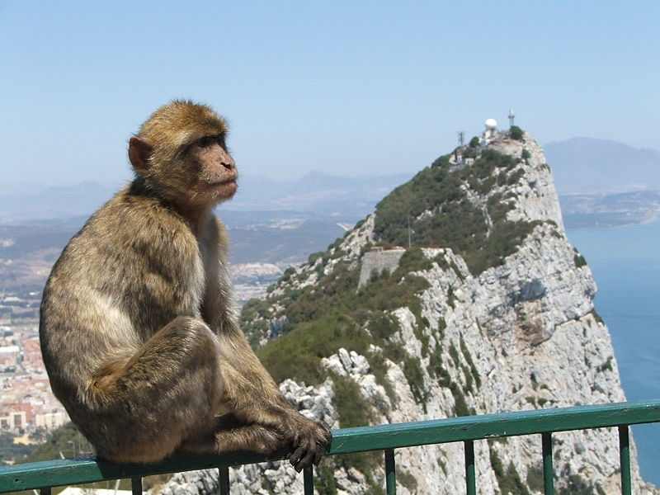

Slide 3
The rock of Gibraltar
The Barbary macaque population in Gibraltar is the only wild monkey population in the
European continent.

Slide 5
Brighton Rock

Slide 7
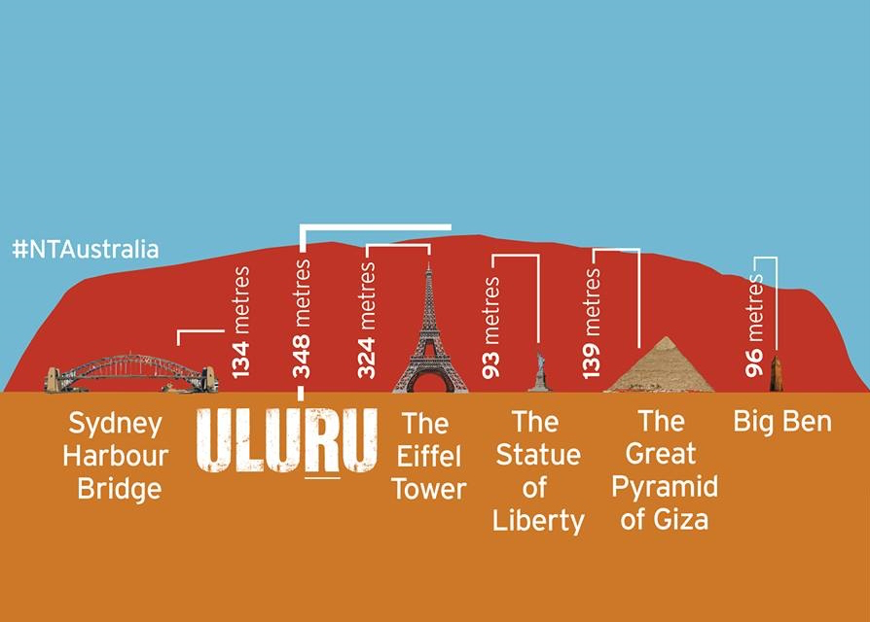
Uluru (AYerS ROCK)

Slide 9
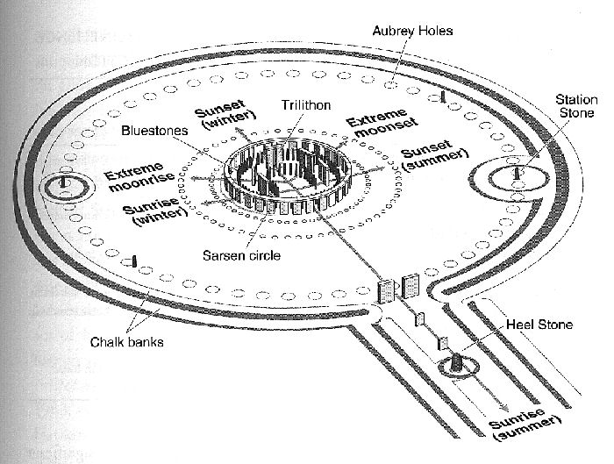
STONEHENGE
Stonehenge could have been a burial ground from its earliest beginnings, with deposits containing human bone from as early as 3,000 BC, when the ditch and bank were first dug.

Slide 11
Spinal Tap, Stonehenge.
(https://www.youtube.com/watch?v=qAXzzHM8zLw)

Slide 12
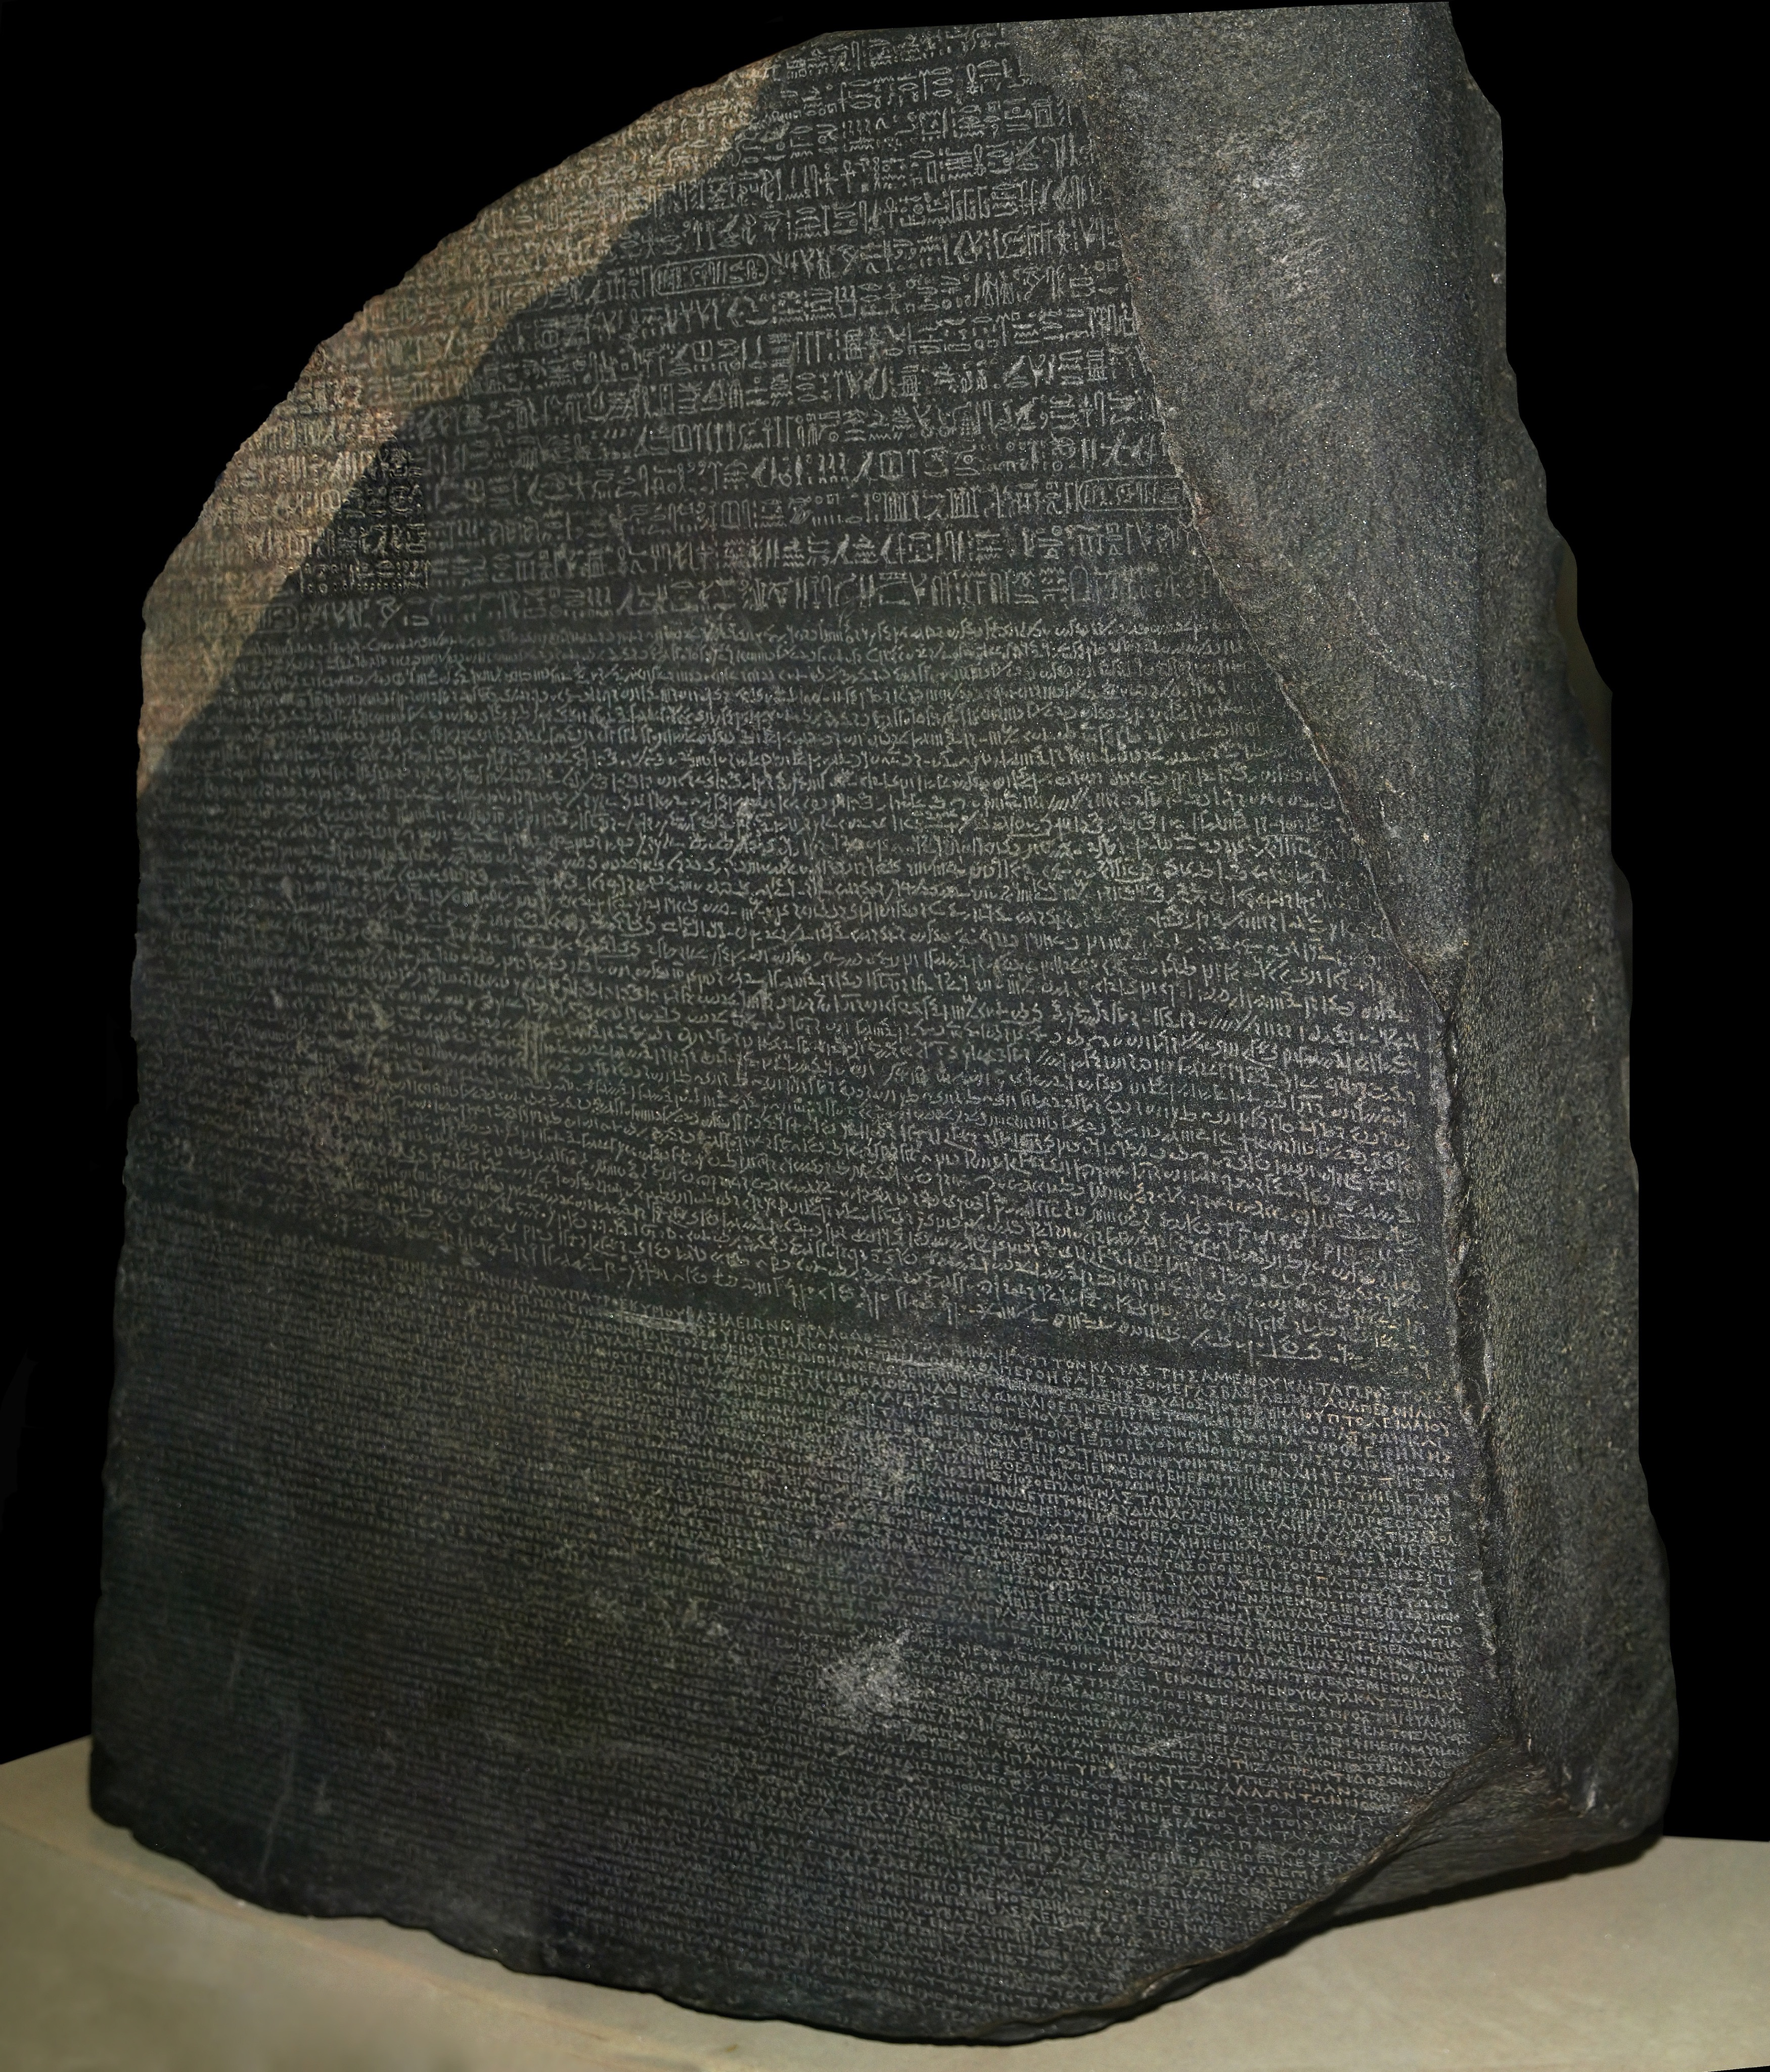

Slide 13
THE ROSETTA STONE
The Rosetta Stone is a granodiorite stele inscribed with the decree (laws) issued at Memphis, Egypt, in 196 BC on behalf of King Ptolemy V.
The decree appears in three scripts: the top text is Ancient Egyptian hieroglyphs, the middle section is Egyptian Demotic script, and the bottom bit is in Ancient Greek.
Because it presents essentially the same text in all three scripts (with some minor differences among them), it provided the key to the modern understanding of Egyptian hieroglyphs.
https://www.history.co.uk/this-day-in-history/19-july/the-rosetta-stone-is-discovered

Slide 15
THE BLARNEY STONE
Kissing the blarney stone is said to make a person eloquent and persuasive in language.
https://www.history.com/news/why-do-people-kiss-the-blarney-stone

Slide 17
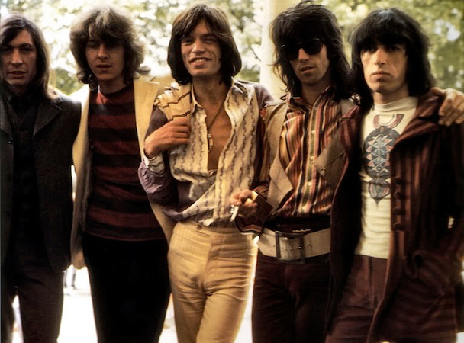
THE ROLLING STONES

Slide 19
STONE of SCONE
AKA the stone of destiny and the symbol of scottish sovereignty
https://www.history.com/news/what-is-the-stone-of-scone

Slide 21
THE Giant's causeway

Slide 22
THE Giant's causeway
WEATHERED
BASALT
laterite
BASALT

