Slide 1
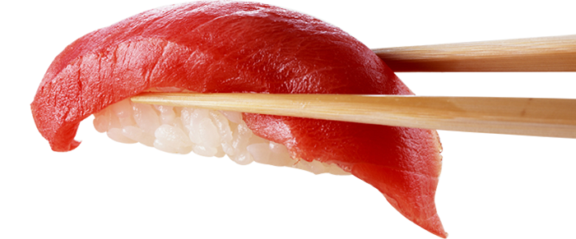
THE LATIN TOUCH OF SUSHI IN LONDON
VEGETARIAN SUSHI BAR 2022

Slide 2
MENU
Please find below a sample menu which is based on 12 to 15 pieces of sushi and sashimi , the sushi will be presented in different types like hosomaki, uramaki, dragon rolls.
SASHIMI
Chilli pineaaple, Teriyaki watermelon, Ponzu Tofu
NIGIRIS
Mushroom, crushed avocado and jalapeño salsa.
Bok choi, chilli mayo and coriander.
FISH ROLLS
Mushrooms, spicy mayo, mango and coriander hosomaki.
Ponzu tofu, avocado and chives uramaki
Vegan ceviche roll.
Kimchi and bokchoi, cucumber and spring onions uramaki with sriracha sauce
VEGETERIAN ROLLS
Crispy sweet potato and sichimi dragon roll.
Mixed vegetables and asparagus futomaki with
wasabi cream.
Avocado and cucumber maki
Soya –wasabi-pickle ginger-spicy mayo
Please advice any allergies
__________________________________________________________________

