Slide 1
Sierra Leone Medium Term National Development Plan (2019-2023)
Ministry of Planning & Economic Development
Freetown

Slide 2
8 CLUSTERS OF SL MTNDP (2019-2023)
7 ASPIRATIONS OF AU AGENDA 2063
1
Human Capital Development
2
Diversify the Economy & Promote Economic Growth
3
Infrastructure & Economic Competitiveness
4
Governance & Accountability for Results
5
Women, Children and Persons with Disability
6
Youth, Sports & Migration
7
Addressing Vulnerability & Building Resilience
8
Means of Implementation
1
Inclusive Growth & Sustainable Development
2
Political Unity
3
Good Governance and Rule of Law
4
Peace and Security
5
Cultural Identity and Value
6
People Driven Development
7
Partnership for Development
THE SDGS
THE SDGS

Slide 3
Vision, Goals & Outcomes

Slide 4
Cluster One: Human Capital Development
Free Quality Basic and Secondary Education
Target
Increase enrolment rates by 30 percent for pre-primary, 20 percent at the primary level and 10 at the senior secondary level;
Increase BECE pass rates and completion rates by 8 percent and 16 percent, respectively for both sexes;
The WASSCE pass rates and completion rates for both sexes increased by 7 and 15 percent respectively, relative to 2018 rates;
Strengthening Tertiary and Higher Education
Target
1. Increase Research output of universities;
2. Graduates from higher institutions serve the labour market;
3. Increase middle man-power available;
Policy Action
Target
1. Review and make functional the Teaching Service Commission;
2. Introduce Special Scheme for STEM Teachers, teachers in rural communities and those in Special Needs Institutions;
3.Introduce BEST Teacher Award Scheme and provide free University Education for three (3) of every school teacher with at least ten (10) years teaching experience.
Policy Actions
1.Decentralised basic and senior secondary school education;
2.Revert from the 6-3-4-4 system of education to the 6-3-3-4 system;
3.Provide facilities and structures including health needs to favour students with disabilities and girls in both primary and secondary schools;
4.Undertake Free and quality education programme

Slide 5
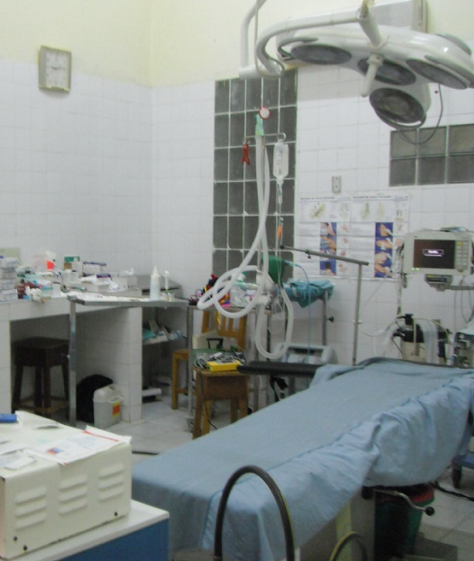
Cluster One: Human Capital Development
Heath Care Improvement
Target
1. Neonatal mortality, Infant mortality and under-five mortality rates reduced by 50 percent (MICS6, 2017)
2. Maternal mortality ratio reduced by 50 percent from 2013 DHS rate of 1,165 deaths per 100 000 live births;
3.Total fertility rate reduced from 4.9 (DHS 2013) to 4.1;
4.Prevalence rates of HIV/AIDS reduced by 20 percent from 1.5 percent (DHS, 2013) to 1.2 percent;
Policy Action
1. Enhance Disease Prevention, Control and Surveillance;
2. Strengthen Health Management and Information System (HMIS);
3. Invest in securing modern diagnostic facilities;
4.Embark on special recruitment for specialists;
5. Policy and legal framework for PPP in the health sector.

Slide 6
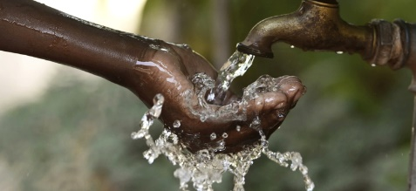
Cluster One: Human Capital Development
Environmental Sanitation and Hygiene
Target
1. About 50 percent of rural/urban households are with hygienic/improved on-site latrines;
2.Reduce deaths and property loss from natural and man-made disasters and climate extreme events by at least 30 percent.
3.Reduced outbreak of diseases in vulnerable communities
Strengthening Social Protection
1. Use social transfers to ensure that 145,000 poor and vulnerable households have access to education, health and income security in all 16 districts by 2023;
2. Increase the average earning capacity and acquisition of assets by 50 percent for women and young persons;
3. Adopt policies, especially fiscal, wage and social protection policies, and progressively achieve greater equality;
4.All persons working in the formal sector are provided with social security;
Key Policy Actions
1. Utilise a minimum social protection package to provide cash transfers to 145,000 chronically poor households using a proxy means test (PMT) for targeting and a biometric system to confirm the identify of beneficiaries;
2. Establish a National Social Protection Authority to coordinate all national social protection programmes;
3. Pursue a national Biometric ID card system for identification to target beneficiaries;
Key Policy Actions
1. Review and update IVM and IWM policies and strategies.
2. Develop and implement guidelines for Housing Sanitation Programme.
3. Develop implementation guidelines for the WASH Programme and increase communication and dissemination of information on WASH.

Slide 7
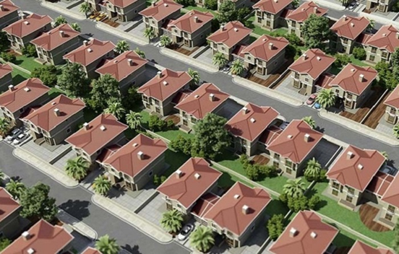
Cluster One: Human Capital Development
Lands and Housing
Targets
1. At least 20 percent of women in rural areas have access to and control over land resources and housing facilities;
2. Ease access to land for productive agriculture and other land use for economic development;
3. Ensure houses are built to standard and are well layout.
Policy Action
Land management and spatial development
Housing and informal settlement

Slide 8
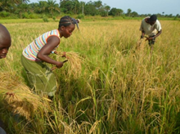
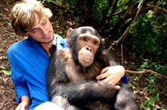
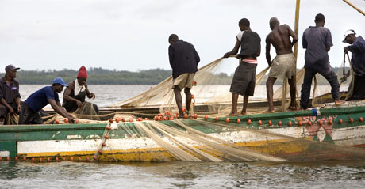
Cluster Two: Diversifying the Economy
Improving Productivity and Commercialization of the Agricultural Sector
Targets
1. Achieve food self-sufficiency;
2. Reduce 2013 levels of proportion of the population who suffer from hunger by at least 80 percent;
3. Reduce stunting in children to 10 percent and underweight to 5 percent.
4. Increase youth and women participation in integrated agricultural value chains by at least 30 percent.
Improving productivity and Sustainable Management of Fisheries and Marine Sector
Target
1. By 2023, the fisheries sector generates at least US$15-20 million in government revenue and contributes at least 16 percent to the country’s GDP;
2. By 2023, sustainably manage and protect marine and coastal ecosystems;
3. By 2020, effectively regulate harvesting and end overfishing, illegal, unreported and unregulated fishing
Revitalising the Tourism Sector
Target
1. Increase skill capacity in the hospitality industry by a quarter;
2. Annual revenue from tourism drastically increased;
3. Contribution of tourism to GDP in real terms is increased by at least 100 percent.
Policy Actions
1. Improve the policy and legal environment on tourism;
2. Improve the international image of Sierra Leone and diversify marketing of the country;
3. Promote competition in the sector;
4. Designate and develop tourist attraction areas
Key Policy Targets
1. Increase in rice production
2.Encourage and improve the production of other food crops to ensure household food security
3. Increase the production and export of diversified cash crops
4. Encourage poultry and small ruminants production
Key Policy Targets
1. Understate fish stock assessment surveys;
2. Secure the European Union Export Market Certification for fish exports;
3. Construct fish harbor complexes in the country.

Slide 9
Cluster Two: Diversifying the Economy
Improving the Management of Oil and Gas Exploration/Production
Targets
1. At least two off-shore discoveries made in the oil and gas sector with operationalisation plans completed;
2. Establish a petroleum commission
Manufacturing and Services
Targets
1. Improvement in “Ease of Doing Business Ranking” to at least the levels of 2016;
2. Contribution of manufacturing to GDP increased from 2 percent in 2017 to at least 5 percent;
3. Contribution of services to GDP increased from 36 percent in 2017 to 45 percent;
4. Wastage of local produced minimised by 20% of current.
Policy Actions
1. Improve infrastructure and competitiveness for attraction of visitors;
2. Promote financial intermediation and financial inclusion within a stable financial system;
3. Restore and safeguard macroeconomic stability through the implementation of prudent fiscal policies;
Improve the business regulatory environment.
Policy Actions
1. Ensure attraction and retention of oil and gas corporations by undertaking aggressive marketing campaigns
2. Activate the expansion of the frontiers of oil and gas exploration activities by facilitating the incorporation of onshore exploration activities into the country’s exploration space
3. Update the Petroleum Exploration and Production Act 2011 to cover onshore activities;

Slide 10
Cluster Two: Diversifying the Economy
Improving the Management of Mineral Resources
Target
1. Mining revenue increased from 10 percent of domestic revenue in 2017 to 20 percent;
2. Share of mining in GDP increased from 5 percent in 2017 to 20 percent;
3. Environmental rehabilitation completed in 5 mined sites in the country
Policy Action
1. Undertake countrywide airborne geophysical survey
2. Manage the effects of price volatility on Government revenue
3. Review of mineral legislation and implement the EIRA:
4. Improve governance of the mining sector
5. Formalising the artisanal mining sector

Slide 11
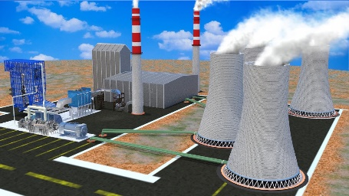
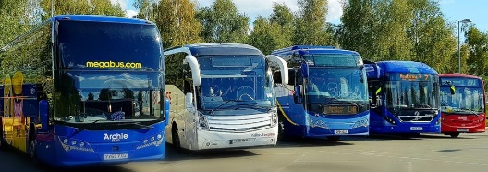
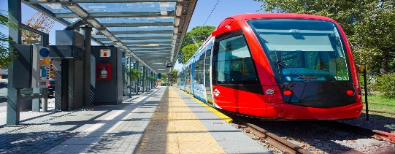
Cluster Three: Infrastructure & Economic Competitiveness
Transforming Transportation Systems
Targets
1. Greater connectivity of all cities and district headquarter towns by various means of transport;
2. Improved safety levels of all transport sector to above the 60% target set in Abuja.
Energy
Targets
1. Electrification increased from current 25% to 60%;
2. 65% of affordable electricity and power are from renewable sources/energy;
3. All regional district, headquarter towns and cities are electrified;
4. Reduced dependence on wood and charcoal to less than 5%.
Policy Action
1. Improve governance, strengthen oversight and Coordination;
2. Invest in technology for safety of transport infrastructure;
3. Mobilize private sector;
4. Modernize transport infrastructure
5. Integrate and properly coordinate transport infrastructure; etc.
Policy Action
1. Improve on policy and regulatory environment
2. Restore electricity supply to all district headquarter towns and cities;
3. Increase investment in low-cost renewable energy;
4. Improve on the human capacity of the sector; etc.

Slide 12
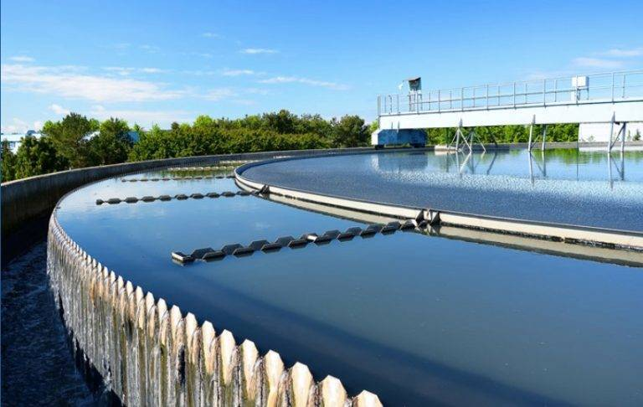
Cluster Three: Infrastructure & Economic Competitiveness
Improving Water Infrastructure System
Target
1. By 2023, increase access to reliable, safe, portable water supply for the population in all the cities and district capitals
Waste Management System
Targets
1. All cities and district headquarters have sewage and solid waste disposal system;
2. Wastes are recycled with biomass converted into energy and manure/fertilizers in all cities within the country etc.
Policy Actions
1. Review and improve the legal framework on waste management;
2. Invest in waste management systems;
3. Empower the cities and councils through decentralization to be fully in charge of wastes;
4. Mobilize the population (education/orientation and involvement) waste collection and disposal etc.
Policy Action
1. Provision of better policies and legislation governing the water sector;
2. Increase budgetary allocation from the government sector financing;
3. Improve coordination, collaboration, planning and implementation;
4. Mobilise and attract private sector investment; etc.

Slide 13
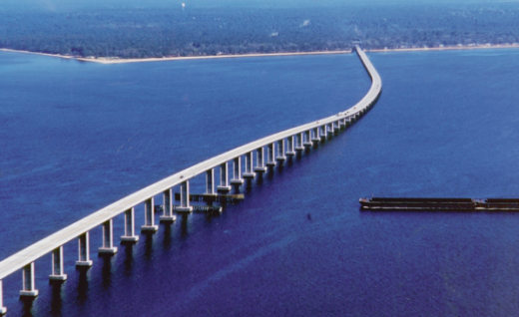
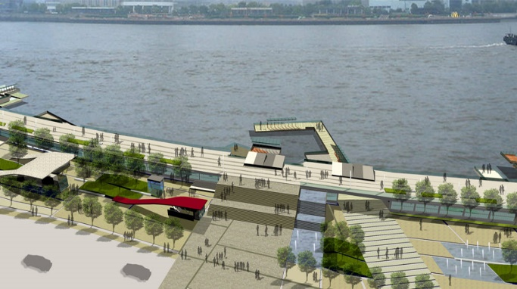
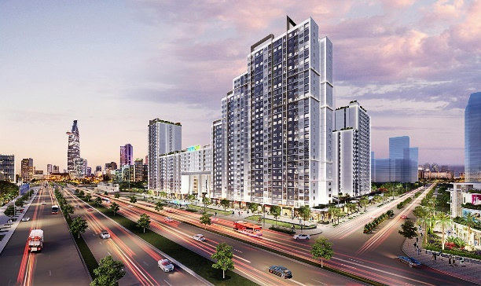
Cluster Three: Infrastructure & Economic Competitiveness
Information Communications Technologies (ICT)
Targets
1. All cities and district headquarter towns are accessible by modern ICT services
2. 30% of the population penetrated by Broadband
3. Mobile penetration increased to 80 percent of by the population up to chiefdom levels
4. Knowledge and awareness of ICT usage by population increased to 70%
Presidential Infrastructure Initiatives
Targets
1. 5000 jobs created across the country;
2. Ease of commuting between Freetown and Lungi
3. Available water supply in Bo and Kenema
4. Ease of traffic congestion in Freetown; etc
Policy Actions
1. Review regulatory and legal framework for the ICT landscape
2. Expanded ICT coverage in Sierra Leone
3. Develop viable environment for ICT services deployment nationwide
4. Digitalize government and public operations; etc.
Policy Actions
1. Secure the requisite legal and operating environment for implementation
2. Create partnership with private investors
3. Mobilise of resources
4. Coordination of various actors and stakeholders
5. Monitoring and evaluation of implementation
New City Initiative

Slide 14
Cluster Three: Infrastructure & Economic Competitiveness
Fostering Private Sector Growth and Manufacturing
Targets
Manufacturing sector share GDP increased to above 5%;
2. Above 50% of local businesses have access to finance;
3. Industrial and Economic zones established in all regions nationwide;
4. Middle class of entrepreneurs established with increased local business ownership;
5. Improved rating on the World Bank Index.
Policy Actions
1. Improve legal and regulatory environment for private sector development;
2. Expand manufacturing and include value addition for local products;
3. Develop infrastructure and requisite skills to reduce cost of doing business;
4. Provision of capital and increase access to finance for local and small businesses; etc.

Slide 15
Cluster Four: Governance and Accountability for Results
Fighting Corruption and Illicit Financial Flows
Targets
1. Substantially reduce corruption and bribery in all their forms and significantly reduce illicit financial and arms flows;
2. A Special Anti-Corruption Court established within the High Court of judicature;
3. Strengthen Public Expenditure Tracking Survey (PETS) and District Budget Oversight (DBO) by citizens;
Political Development for National Cohesion
Targets
1. Creation of a critical mass of Sierra Leoneans with knowledge on political and party issues;
2. Adequate and consistent regulatory and legal environment;
3. Functional and effective Political Institutions;
4. Participatory and inclusive decision making within political parties structures
Policy Actions
1. Establishment of a National Commission for Civic Education and Development;
2. Review of legislative, legal and policy framework;
3. Capacity building of political institutions;
4. Develop political inclusion and participatory policies;
Policy Actions
1. Adopt a new framework to ensure accountability and transparency in the public sector in the form of National Public Sector Transparency and Accountability Initiative (NAPSTAI) ;
2. Develop policies to enhance inter-agency cooperation at the local and national government levels;
3. Set up a system for planning, monitoring and reporting on development results referred to as Results-Based Management (RBM)

Slide 16
Cluster Four: Governance and Accountability for Results
Strengthening Public Financial Management
Target
1. Strategic policy and budget planning is made more effective;
2. Budget execution, reporting, monitoring and evaluation is more effective;
3. Revenue to GDP ratio increased to at least 20 percent.
Strengthening Audit Service
Target
1. Annual number of performance audits increased significantly;
2. Revenue audit conducted, and report submitted to Parliament annually;
3. One procurement audit, one IT audit, and one environmental audit conducted and report submitted annually;
4. Effective Parliament Account Committee in reviewing the Auditor General’s Annual Report.
Policy Action
1. All activities in the new PFM Strategy 2018-2021, will be effectively implemented within the timeframe stipulated;
2. Develop internal policies to enhance quality control, prompt reporting and effective monitoring;
3. Initiate innovative revenue mobilization strategies;
Policy Action
1. Strengthen the human resource capacity at the ASSL particularly in the area of modern techniques of auditing;
2. Increase the number of performance audits;
3. Increase access to necessary revenue-related information;
4. Undertake and coordinate specialized audits, including procurement audit, IT audit and environmental audit.

Slide 17
Cluster Four: Governance and Accountability for Results
Promoting Inclusive and Accountable Justice Institutions
Target
1. Improved public confidence in the Justice Sector;
2. Justice is easily accessible locally;
3. Justice is expedited;
4. Respect for Rights and strengthened accountability.
Building Public Trust in State Institutions
Target
1. Positive public perception about effectiveness of public service delivery significantly increased;
2. Corruption perception index drastically decreased;
3. Develop effective, accountable and transparent institutions at all levels.
Policy Action
1. Review the appointments and recruitment of Justice Sector Actors including judges;
2. Judicial and Legal Service Commission and Legal Training Institute are strengthened;
3. Court Room Technology introduced in order to substantially expedite cases;
4. Review Criminal Procedure Bill;
5. Harmonisation of Bail Application; etc.
Policy Action
1. Build and Promote National Cohesion through the eradication of tribalism, nepotism and other forms of discrimination;
2. Strengthen the Independence of the Judiciary and the Rule of Law;
3. Strengthen Human Rights and Democratic Institutions; etc.

Slide 18
Cluster Four: Governance and Accountability for Results
Strengthening Public Service Delivery
Targets
1. The civil service highly incentivised to deliver development results;
2. Public sector delivery capacity significantly increased;
3. Promote the rule of law at the national and international levels and ensure equal access to justice for all comment.
Strengthening Decentralization, Local Governance and Rural Development
Targets
1. Devolve the remaining 25 sector functions by 2023;
2. Increase the number of remaining chiefdoms de-amalgamated by 10 percent each year;
3. Operationalise the Local Councils Development Operational Guidelines in all 22 local councils; and
4. Build the capacity of local councils.
Policy Actions
1. Enact the Public Service Bill;
2. Review the Public Service Regulations of 1982;
3. Fill at least 300 critical vacancies in MDAs;
4. Decentralize the PSC interview process to the regions.
Policy Actions
1. Review the National Decentralization Policy and amend the Local Government Act 2004;
2. Submit the revised Local Government Act 2004 to Parliament for enactment and ensure full implementation of the new Act;
3. Facilitate completion of the devolution process; etc.

Slide 19
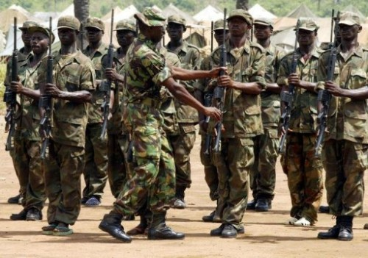
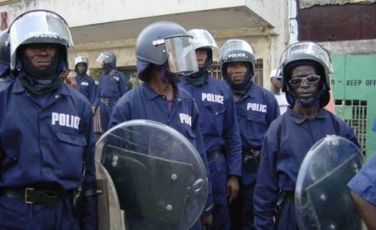
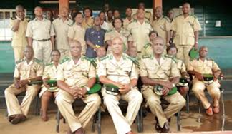
Cluster Four: Governance and Accountability for Results
Strengthen Security Institutions
Targets
1. The early warning and response capacity of the security institutions annually increased;
2. Public perception score about the operations of the security institutions positively increased;
3.Significantly reduce all forms of violence and related death rates everywhere;
Policy Actions
1. Improve the general capacity of security personnel;
2. Develop participatory strategies geared towards improve the conditions of service of all service men and women;
3. Re-introduce fairness, transparency, professionalism and merit approach recruitment, promotions, transfers and deployment of service personnel are conducted in a fair and transparent manner taking due account of professionalism;
4. Re-introduce stringent community screening of recruits into the RSLAF and SLP; etc.

Slide 20
Cluster Five: Empowering Women, Children Adolescents & Persons with Disabilities
Women
Targets
1. Strengthen policy, legal and institutional capacities in order to enhance the enabling environment for the empowerment of women;
2. Strengthen the implementation and enforcement of existing laws and policies to promote women’s empowerment;
3. Implement a robust data and information management system
Children and Adolescents
Targets
1. Service Delivery for children and adolescents enhanced;
2. Legal and Policy Framework strengthened;
3. Data and Information Management for children improved considerably;
4. Social Mobilization and Community Engagement for the protection of children against All Forms of Abuse stepped up; etc.
Policy Actions
1. Strengthen legislative frameworks to promote gender balance;
2. Strengthen the capacities of electoral stakeholders to promote gender balanced Electoral systems (for example EMBs);
6. Review policies and laws to ensure that they are gender responsive; etc.
Policy Actions
1. Review the Child Rights Act of 2007 to address emerging issues on child protection;
2. Ratify and domesticate The Hague Convention on Adoption;
3. Develop, fund and roll out costed implementation plans for the Child Welfare Policy; etc.

Slide 21
Cluster Five: Empowering Women, Children Adolescents & Persons with Disabilities
Empowering Persons with Disabilities
Targets
1. Health, rehabilitation, water and sanitation services adequately met needs of PWDs;
2. Accessible, quality, inclusive, specialized education adequately provided for children with disabilities;
3.Increased economic empowerment of persons with disabilities;
4.The full participation of people with disabilities in public life;
Policy Actions
1. Government will provide Free Education for PWDs at pre-school, primary, secondary levels;
2. Provide teaching and learning materials and assistive devises required by the PWDs;
3. Provide training to teachers and other education officers to deliver inclusive and special needs education and reduce stigma and discrimination; etc.

Slide 22
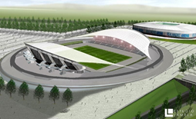
Cluster Six: Youth, Empowerment, Sports & Migration
Youth Entrepreneurship (Employment and Empowerment)
Target
1. Small and Medium Enterprises, technical and life skills of young people are developed and enhanced;
2.Increased support to young people to access finance;
3.Increased number of sustainable youth enterprises in rural communities;
4. Review of Policies and legislations with a view to empowering young Sierra Leoneans;
Sport
Target
1. Increased sporting activities in all cities and district headquarter towns;
2. Stable funding for major sporting activities;
3. Presence of sport professionals and highly trained and qualified athletes in cities and district headquarter towns;
4. Selection of athletes to represent the country in international sporting competitions is based on merit;
5. Recommence national competitions for all sporting activities;
Key Policy Actions
1. Skills Training for youth through TVET;
2. Review the current design of the National Youth Service and enforce its implementation;
3. Establish Youth Empowerment Fund to support youth to engage in small and medium scale entrepreneurship ventures;
4. Promote youth engagement in agriculture
Key Policy Actions
1. Establish Sport Development Fund to be financed by corporate establishments, international sporting organizations and the government;
2. Review the policy and legal environment for sport development in the country
3. Increase budgetary support to sporting activities;
4. Develop and implement a comprehensive capacity building programme for all sporting disciplines;

Slide 23
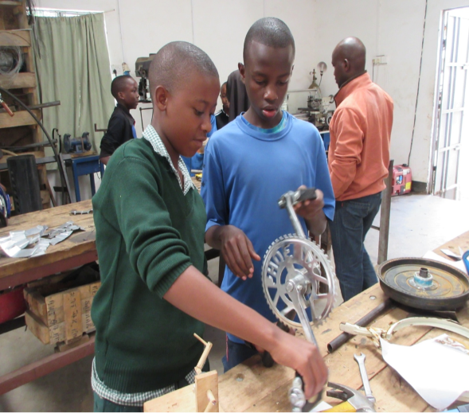
Cluster Six: Youth Empowerment, Sports & Migration
Addressing Migration Challenges
Target
1. Significant number of youth engaged in economic activities;
2. Young people included in decision making in their respective communities;
3. Comprehensive migration policy in place by 2023;
4. National database on migration in place by 2023; and
5. Basic social amenities provided in rural communities.
Skills Development Programs for Youth
Key Policy Actions
1. Awareness campaign on irregular migration, human trafficking, and violent extremism conducted in partnership with youth and women groups;
2. Leadership and skills training for youth;
3. Develop coherence policy and legal framework on migration.

Slide 24
Cluster Seven: Addressing Vulnerabilities & Building Resilience
Addressing Vulnerabilities and Building Resilience
Targets
1. Cities and district headquarters properly planned;
2. Enlightened and resilience population on environmental and disaster issues; and
3. Disaster prone areas demarcated and evacuated by people in all regions.
Building National Environmental Resilience
Targets
1. Increase forest cover 20%
2. Environmental repair and rehabilitation completed in all cities across the country
3. Enlightened population on environment, climate change and disasters
4. Renewable energy is the main source of electricity and power
Policy Actions
1. Review legislation to strengthen and enhance legal framework for enforcement and compliance;
2. Ensure Environmental protection and regulation agencies function efficiently;
3. Improve Coordination among MDAs with environmental responsibilities;
4. Improve and Expand data availability and quality;
5. Increase financial capacity of the sector by including private sector
Policy Actions
1. Develop and enact appropriate policies, laws and regulations on vulnerability and resilience
2. Coordinate national climate change and environmental program,
3. Promote investments that are risk-informed;
4. Enhance Policy, regulatory and protection frameworks
5. Promote alternative livelihoods as a means to reduce pressure on natural resources; etc.

Slide 25
Cluster Seven: Addressing Vulnerabilities & Building Resilience
Forestry Management and Wetlands Conservations
Targets
1. Forest cover increased to 38.5% (2,754,000 hectares) and fully conserved
2. 10% of damaged environment from mining rehabilitated;
3. Database on forest and wetlands available;
4. Enlightened population (70% aware of the importance of forest and wetlands).
Improving Disaster Management Governance
Targets
1. Prepared population for disaster response
2. Disaster effect on human lives reduced by 50%
Policy Actions
1. Improve legal and enforcement mechanisms with appropriate law;
2. Enhance Management and oversight capacity of regulatory agencies;
3. Combat environmental degradation;
4. Educate and mobilise the population through awareness Raising;
5. Improve and Expand available Data and information; etc.
Policy Actions
1. Develop policies and legal framework on vulnerability and disasters
2. Establish National Disaster Management Agency established and operationalized
3. Strengthen early warning mechanisms and legal framework
4. Increase capacity for disaster management
5. Increase community involvement in responding to disasters

