Slide 1
Update on the Gypsy Roma, Traveller Health Outreach Project
( 2019-21)
Children and Family Health
Surrey
@CFHS_Surrey
www.childrenshealthsurrey.nhs.uk

Slide 2

Who are we?
A Specialist team made up of a Health Visitor, a Community Health Care assistant and our Administrator and Team Manager. We are part of the Children and Family Health Surrey’s 0-19 Community Health Service. The service manager is also the Manager for for Homeless families (Inclusion Health)
We deliver a targeted and enhanced version of the Universal “Healthy Child Program” to Gypsy, Romany and Traveller families across Surrey, in a culturally accessible way. We also address unmet health needs, across the age spectrum by “assertive outreach” integrating this work with partner agencies and linking GRT to health and other services.
We offer Cultural awareness training to staff and advocacy to clients.

Slide 3
Cultural factors: How can we help?
Understanding the barriers…
Feeling judged
Nervous about forms, leaflets, information,
Feeling excluded, “looked down on”
language
Unfamiliar environment
Not understanding the “rules”
Different washing, eating, social arrangements
Cut off from family support/family pressure
Social taboos
Distrust of outsiders
Historical persecution
Solution:
Don’t assume! ASK!
Offer simple and clear explanations
Involve family
Welcome, explain processes
Expect large crowds and manage expectations
Avoid jargon
Be aware of language
Broach literacy with sensitivity
Don’t routinely offer leaflets
Check address and contact details (explain why)
Follow up…
Challenge:

Slide 4
4,041 contacts in 2 years
456 contacts on Un-Authorised encampments
16% of contacts live on permanent Council sites

Slide 5
Referrals, Signposting and Advocacy
These are examples of the most common referrals and areas that the team are signposting to and helping to advocate on for the GRT Community.
Dental
GP
Sexual Health
One Stop
Action for Carers
REMA
A&E
EPU
District Nurse
SALT
Opticians
Imms
Notes:
Audiology 1 Dental 20 EPU 1 A&E 1 Action for Carers 3 GP 16 Opticians 3 Pharmacy 1 Sexual Health Clinic 6 Walk in Centre 1 CNN 4 Audiology 1 Enuresis 3 DN 1 One Stop 2 Rema 4 Adult Social Services 3 Midwife 2 MIU 1 HV Team 1 Speech and Language 2 MASH 1 School Nurse 1 Safeguarding 1 Podiatry 1 Children's Centre 2 Total 83

Slide 6
152 Referrals to GP services
28 Referrals into Dental services
15 Referrals into Midwifery teams
30 Referrals into local baby bank
25 Mum 2 Mum gift bags
260 Covid Vaccinations delivered in collaboration with local vaccination offers
112 Hep A vaccinations delivered

Slide 7
What have we achieved?
Building trust
Contact with 80+ private and Council sites
Better in-reach for housed Travellers
Collaboration with FFT
Emergency support/advocacy throughout pandemic
Funding extended for third year
Direct engagement and delivery of Covid vaccs for GRT
Emergency response for Hep A outbreak
Multiagency GRT Strategy Group (RNA)
GRT Film to promote Covid Vaccs uptake: https://www.youtube.com/watch?v=D4-S7xdnsec
#givecovidthejab
https://www.gypsy-traveller.org/wp-content/uploads/2020/11/SS00-Health-inequalities_FINAL.pdf

Slide 8
Breakdown of contacts by borough

Slide 9
Training
Collaboration with Surrey Community Gypsy Forum
On-line training Package
Face to Face presentations
Notes:
A&E Staff, all maternity leads, 0-19 teams meetings and forums. Hospital safeguarding , multi agency, children's services and teams, charities etc.
FCHC staff, working on CSH L&D (figures)
Facilitated agreement so now on SSPB, available to all agencies, facilitated by GRT Reps.
83 People have completed the online package via LMS.

Slide 10

Working with partners
Maternity services / 0-19 teams / safeguarding teams
GPs/ to PCNs, identifying link GPs (PHA) for imms catch ups
PHE / QNI / WHO (provide evidence / influence local and national policy)
GRT Advocacy and resource organisations (Joint Bids)
CCGs, District and Borough Councils, incl EHH and SCS
Surrey Community Action/Action for Carers
Cancer Alliance, including end-of-life care and hospices
Diabetes UK
Children’s Services, Traveller education support (REMA)
Acute hospitals (A & E’s, Paeds, Maternity)
Local Schools
St Johns Ambulance etc.

Slide 11
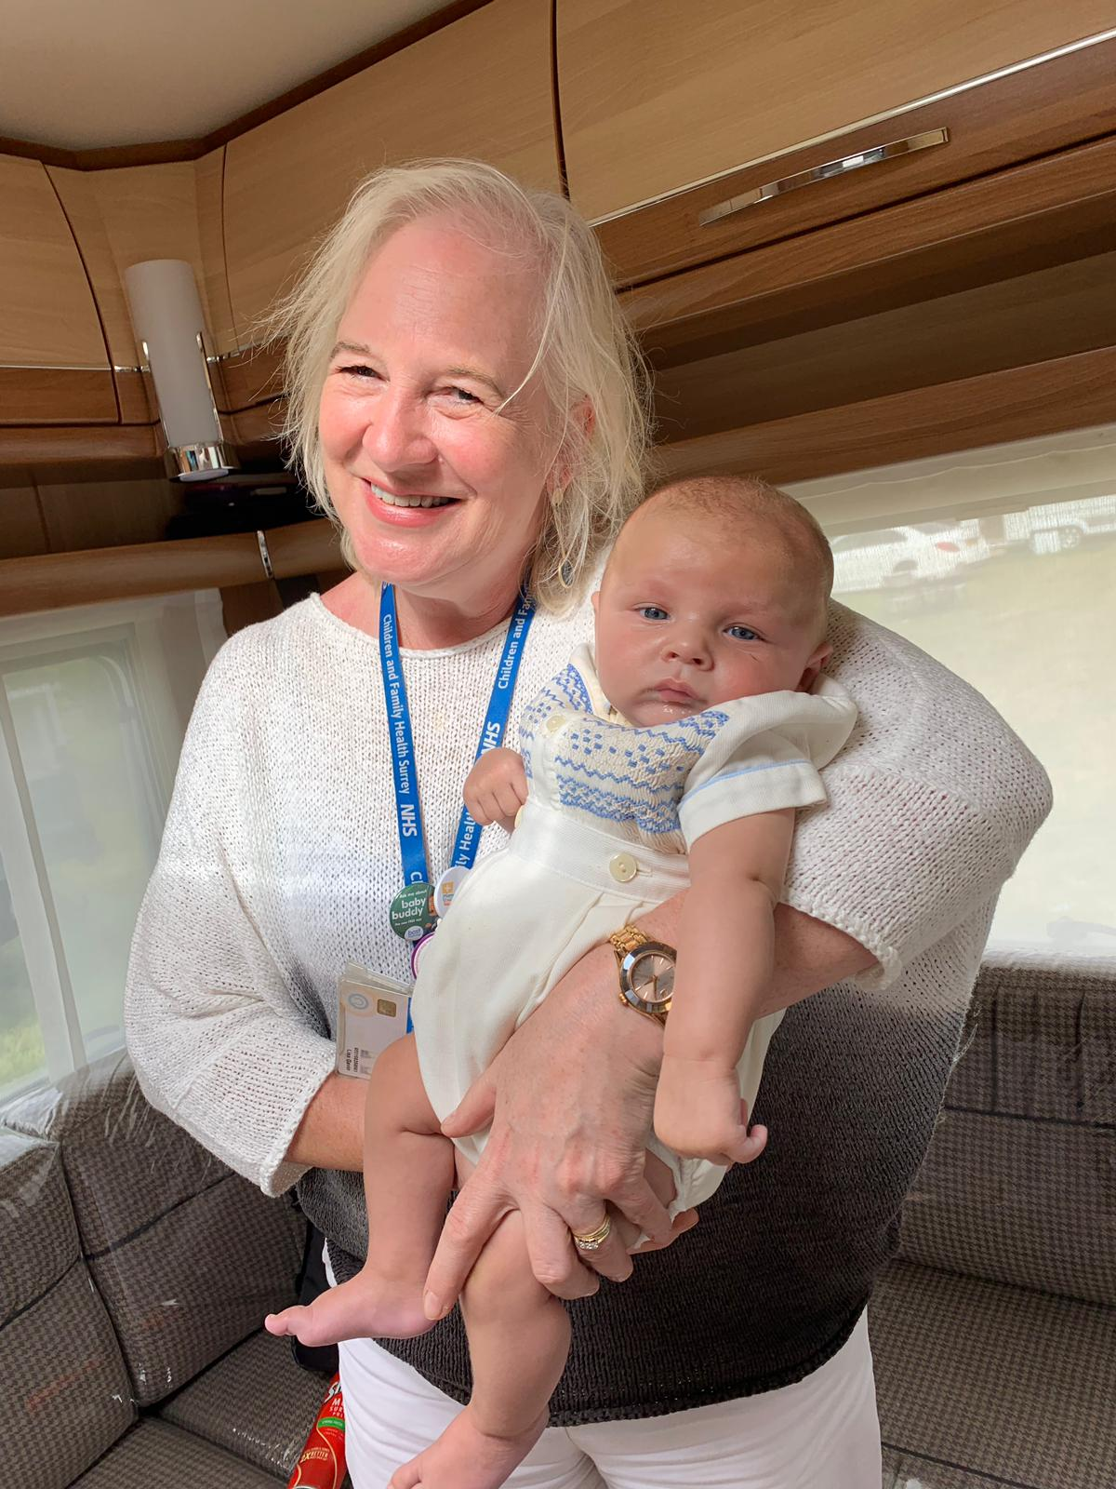
“Thank you for getting ‘them’ (paediatricians) to finally listen to me and take me seriously’
“No-one does nothing for us gypsies, you do it like you LIKE Gypsies!”
“I can’t thank you enough for all your help”
“You’re Health Nurses just for Gypsies?? Wow!”

Slide 12
Where do we go from here?
Improving engagement
Building trust
Reducing A&E
Embedding good practice
Disseminating findings
Developing culturally competent workforce
Inclusion Health Team
Notes:
Improving access: Maternity Voices/Peer, Community representation.GRT CHAMPIONS?Police
Disseminating: Case studies, article writing, Speaking at national and international conferences, collaboration, Channel 4

Slide 13
What’s next?
Better engagement
More contact with housed Travellers
Boaters?
GRT One Stop monthly surgery
“Health and Help”??
Dissemination of Covid vaccs film, MORE IMMS UPTAKE
Challenging discriminatory legislation/issues (stopping places)
SURREYGATE!

Slide 14
Contact Details: lisa.gavin@nhs.net fchc.grtproject@nhs.net
Call Advice Line on: 01883 340922

