Slide 1
RETURN TO TRAINING DUNDEE

Slide 2
AGENDA
Current Scottish Government Guidelines
Return to Training
Health Check
Daily Training Process
Further Training Information
Venue Information

Slide 3
Scottish Government Guidelines
Performance / Professional sport can return to close contact training providing they have all the necessary risk assessments and mitigations in place which has also been ‘signed off’ by sportscotland on behalf of the Scottish Government (SG)
Ensure you download the NHS Scotland Test & Protect app https://protect.scot/
https://www.gov.scot/collections/coronavirus-covid-19-guidance/ for COVID-19 Scottish Government guidance
If contacted via Test and Protect you must follow their guidance and contact the Scotland Wheelchair Covid-19 Officer, Peter Lowis
If someone you live with has COVID-19 symptoms you must self-isolate as a household for 14 days or until they have a negative test result
If someone you live with tests positive for COVID-19 you must self-isolate for 14 days

Slide 4
Return to Training
Complete Medical Screening:
This must be read and completed ASAP
Once completed return to COVID-19 Medical Officer
Attend follow-up 1-1 with Chris Quinn – Scotland Rugby League COVID-19 Medical Officer
Attend 1-1 with Coach / Scotland Wheelchair COVID-19 Officer
Complete Opt-In paperwork to return to training – you can opt-out at any time
As performance athletes and staff you will all have a responsibility to adhere to the guidelines and the performance exemption privileges that we have been given to train for the RLWC

Slide 5
Scotland Wheelchair Performance Athlete Opt-In
1. I seek to train at the organised training environment or the defined performance facility and I am not being compelled to train;
2. I have been given access to and fully understand the Scottish Government guidance (on social distancing, return to training and use of sports facilities) and the Scotland Wheelchair Risk Assessment and Risk Mitigation Plan (and my obligations under these and I acknowledge that I require to follow the Scottish Government guidance and the Scotland Wheelchair
3. I acknowledge that the Scottish Government guidance and the Scotland Wheelchair Risk Assessment and Risk Mitigation Plan may be updated, and I will keep myself up to date, knowledgeable and compliant with all updates;
4. I hereby assume all risks both known and unknown concerning COVID-19 of participating in training at the organised training environment or the defined performance facility during this time;

Slide 6
Scotland Wheelchair Performance Athlete Opt-In
5. A failure to follow Scottish Government guidance or the Scotland Wheelchair Risk Assessment and Risk Mitigation Plan carries with it the risk of contracting or spreading COVID-19; I will encourage compliance by all other users of the organised training environment or the defined performance facility who are in my presence if there appears to be non-compliance and report any concerns I may have to the Scotland Wheelchair COVID-19 Office Peter Lowis or the Scotland Rugby League COVID-19 Medical Officer Dr Andrew Hogg
6. I hereby assume all risks both known and unknown of either my failing to follow the Scottish Government guidance or the Scotland Wheelchair Risk Assessment and Risk Mitigation Plan or any other person who is present at the organised training environment or the defined performance facility failing to follow the same;
7. I understand and accept the sport-specific risk associated with a return to training at the organised training environment or the defined performance facility and certify that I am physically and mentally well enough to return to training and that I am allowed to participate in training under current Scottish Government guidance;
8. I have declared my recent medical history (relative to COVID-19); I am not deemed clinically extremely vulnerable, nor am I required to shield, nor are any members of my household;

Slide 7
Scotland Wheelchair Performance Athlete Opt-In
9. If I experience any COVID-19 symptoms or suspected COVID-19 symptoms at any time hereon, I will bring such to the attention of the Scotland Wheelchair COVID-19 Officer Peter Lowis or Scotland Rugby League COVID-19 Medical Officer Dr Andrew Hogg immediately and if experienced during my presence on site at the organised training environment or the defined performance facility, I will also immediately cease participation and isolate;
10. If I am contacted and advised to isolate as a result of the contact tracing processes outlined by the Scottish Government, I will comply with the Scottish Government guidance and inform the Scotland Wheelchair COVID-19 Officer or Scotland Rugby League COVID-19 Medical Officer.
11. I understand that I have the ability to cease training at the organised training environment or the defined performance facility at any time if I have concerns as to COVID-19 or associated risks and I confirm that it has been explained to me that I will not be subject to any unreasonable detriment in connection with the same;

Slide 8
Health Check
Complete NHS Inform COVID-19 Assessment Online before arrival
You will NOT be allowed into training without evidence that you have completed this
Do NOT leave home if displaying signs/symptoms of COVID-19. Report this to the Scotland Wheelchair COVID-19 Officer Peter Lowis and Scotland Rugby League COVID-19 Medical Officer Dr Andrew Hogg
Do you have the following symptoms?
Cough Headache
Fever (37.5 or above) Diarrhoea, vomiting or nausea
Sore throat or hoarse voce Abnormal fatigue or drowsiness
Loss of taste or smell Abnormal muscle or joint pain
Loss of appetite Nasal congestion
Any confusion or disorientation Shortness of breath, chest pain or tightness
NHS Self Help Guide
https://www.nhsinform.scot/self-help-guides/self-help-guide-coronavirus-covid-19

Slide 9
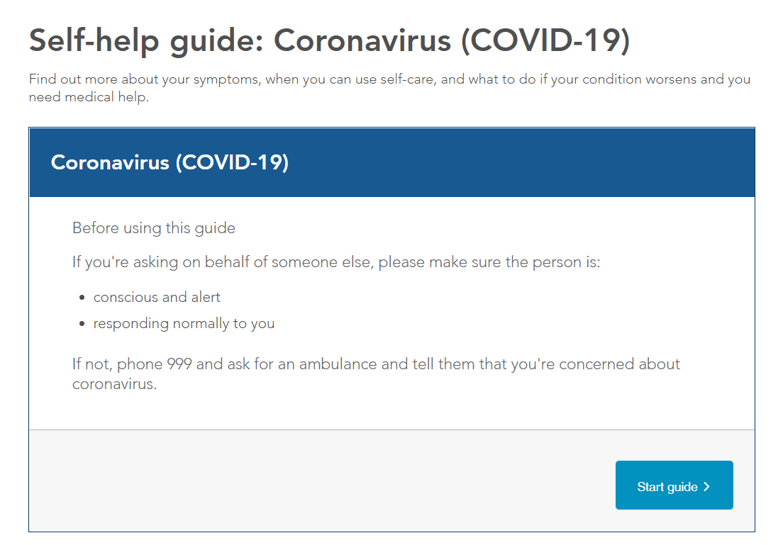
NHS Health Check

Slide 10
Medical Information
The Scotland Wheelchair COVID-19 Officer will check your temperature on arrival for training
Lower than 37.5 degrees Celsius: proceed to training
37.5 degrees Celsius or higher: you will asked to leave and self isolate at home
If contacted via Test and Protect you must follow their guidance and contact the Scotland Wheelchair Covid-19 Officer.
If someone you live with has COVID-19 symptoms you must self-isolate as a household for 14 days or until they have a negative test result
If someone you live with tests positive for COVID-19 you must self-isolate for 14 days
If you become unwell at the venue:
You must immediately inform the Scotland Wheelchair COVID-19 Officer and Scotland Rugby League COVID-19 Medical Officer.
Put on a face covering
leave the venue immediately
do not travel on public transport
Refer to NHS inform symptom checker.
If you meet the criteria for testing you should arrange an NHS COVID-19 test online and isolate until the result is available. If you do not meet the criteria do not get tested and discuss with the on-call institute doctor during the next office hours.

Slide 11
Medical Information
Common COVID –Related Symptoms
a high temperature – feel hot to touch on your chest or back
a new, continuous cough – coughing a lot for more than an hour, or 3 or more coughing episodes in 24 hours (if you usually have a cough, it may be worse than usual)
a loss or change to your sense of smell or taste – you cannot smell or taste anything, or things smell or taste different to normal
If you have concerns with your health that you do not think are COVID related, speak to one of the team doctors.

Slide 12
Daily Training Process
Wash hands before leaving home
Travel to training (adhering to current Scot Gov Guidelines on travel)
Arrive at Dundee & Angus College at the designated time and location, wearing a face covering
Use hand sanitiser on entering the venue
Follow health check/sign-in process upon entering the venue by COVID-19 Medical Officer or Scotland Wheelchair appointed COVID-19 Officer. Your temperature will be checked outside of venue if daily questionnaire has been completed. If temperature is above threshold, you must follow the self-isolation process
Move directly to allocated area on the court, following the venue one-way system, remove face covering. Changing Rooms will be closed so arrive ready to train.
Go to your designated ‘station’ and have water and hand sanitiser ready to use whenever required
Maintain social-distancing and follow instructions from coaches/COVID-19 Officer
At the end of the session, return to your ‘station’, hand sanitise, gather your belongings, put on face covering and follow exit through the fire exits directly connected to the training area

Slide 13
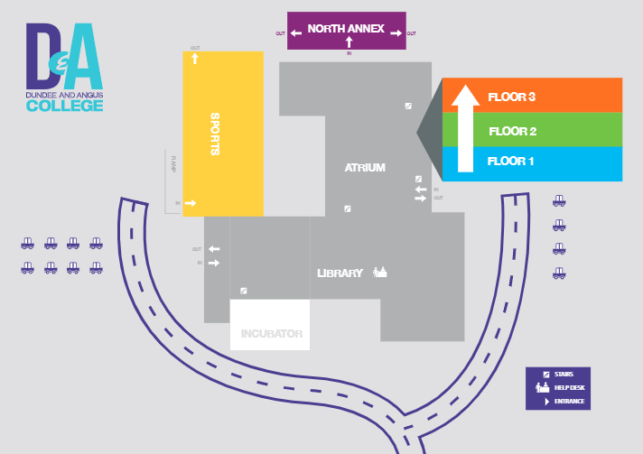
Temperature testing (outside)

Slide 14
Group sizes will gradually increase, athletes will be sharing a rugby ball with minimal physical contact followed by the progression towards groups working together without contact, then progressing to full court match play (starting at approx. 10 mins and gradually increasing).
Swapping between groups will be kept to a minimum and only when required to allow specific sessions to be carried out.
Athletes will maintain social distancing during practices as much as possible.
When taking breaks in training, stay in your designated area at the side of the court.
Rugby balls will be replaced every 30 minutes. You will be provided with new ones. All balls will be sanitised after training.
Tags will be sanitised after every removal
With the gradual increase of contesting and larger group numbers, this presents a greater risk if one group member tests positive. In this instance, all athletes who were in the same group as the positive athlete will self-isolate for 14 days.
Do not share clothing with other players
Continue to contact the COVID-19 Officer and COVID-19 Medical Officer if you or any members of your household have tested positive/come into contact with a positive case or experiencing any symptoms relating to COVID-19

Slide 15
Gradual Training Format
To make sure everyone is safe in their return to full contact training; we will be undertaking a multi-stage return to training.
This is a gradual progression, and YOU will be directly involved in giving feedback throughout
- you can do this through discussions with your coaches which they will organise
- any specific concerns or questions can be answered by the coaches or COVID Medical Officers
The coaches & Medical Officers will be meeting regularly to discuss progress made and any safety concerns we may have.
This process will be dynamic to make sure all personnel are comfortable with the next stages for both your safety and ours.

Slide 16
PHASE 1 (Athletes all training in separation)
All rugby balls sanitised before session
Each individual only using own rugby ball 2m distance throughout practice
All rugby balls sanitised after practice
PHASE 2 (4 Groups of 5 athletes)
All rugby balls sanitised before session
Non contact drills sharing rugby balls, rugby balls sanitised every 30 minutes and replaced
All rugby balls sanitised after session
PHASE 3 (4 Groups of 5 athletes)
All rugby balls sanitised before session
Sharing rugby balls but involved in minimal contact, rugby balls sanitised and replaced every 30 minutes
Athletes will be required to wear a face mask while doing any contact work
All tags sanitised after each removal
All rugby balls sanitised after session

Slide 17
PHASE 4 (2 Groups of 10 athletes)
All rugby balls sanitised before session
Sharing rugby balls, engaging in full contact, balls sanitised and replaced every 30 minutes
All tags sanitised after each removal
All rugby balls sanitised after session
PHASE 5 (2 Groups of 10 athletes)
All rugby balls sanitised before session
Sharing rugby balls, engaging in full contact, balls sanitised and replaced every 30 minutes
All tags sanitised after each removal
All rugby balls sanitised after session

Slide 18
PHASE 6 (1 Group of 20 athletes)
All rugby balls sanitised before session
Sharing rugby balls, engaging in full contact, balls sanitised and replaced every 30 minutes
All tags sanitised after each removal
All rugby balls sanitised after session
If you have any concerns or questions, you can talk to your coaches or the Scotland Wheelchair COVID Officer

Slide 19
Personal Protective Equipment (PPE)
Athletes:
Required to wear a face covering upon entering the venue until you reach courtside and when your session is complete as soon as you leave courtside until you exit the venue
Coaches:
Required to wear a face mask for the entirety of the session
COVID-19 Officer
Required to wear protective shield, apron and gloves for the entirety of the time beside or around the court.

Slide 20
Venue
Temperature testing (outside)
Everyone to enter via the ramped door into the Sports Hall, maintain 2m distance at all times
Follow the one-way system to the court
Exit via fire exit in all

Slide 21
Next Steps...
Complete Medical Questionnaire sent to you
1-1 conversation as a follow-up to this meeting with Scotland Rugby League COVID-19 Medical Officer
Complete Opt-In paperwork with Coach or Scotland Wheelchair COVID-19 Officer

