Slide 1

TAPE - Tool for Agroecology Performance Evaluation
Animal Production and Health Division (AGA)
Plant Production and Protection division (AGP)
Strategic Program 2 (SP2)
Anne Mottet, Abram Bicksler, Dario Lucantoni, Fabrizia De Rosa

Slide 2
Agroecology: what are we talking about?
30’s: agroecology as a science
70’s: practices to protect environment, by promoting use of ecological theories
80-90’s: + food sovereignty of local populations (LAC) and social, economic and political sciences, while partly spreading from field to food system
00’s: + food security and climate
Not an agroecological zoning or a type of production systems

Slide 3
Latest definitions
Ecology of the entire food system (Francis et al., 2003)
A science, a movement and a practice (Wezel, 2009)
Interactions between plants, animals, humans and the environment for food security and nutrition (HLPE, 2016)

Slide 4
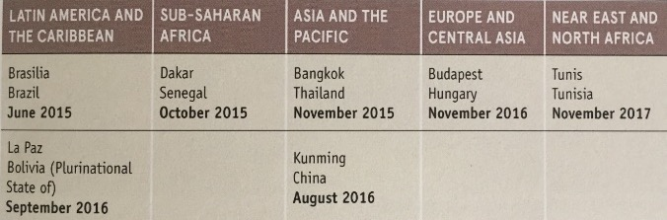
FAO: International and Regional Multistakeholder meetings
TAPE in more than 160 countries
2014 : International Symposium « Agroecology for food security and nutrition » (Rome)
2015-2017 : A series of 7 regional seminars
2018: 2nd International Symposium « Scaling up Agroecology to achieve the SDGs » (Rome)
Notes:
ACTIVE ROLE OF RESEARCHERS AND CSOs
2nd symposium: end of the consultation: moving from dialogue to actions
--------
1st seminar showed the power of ae for Food SECURITY
Led to regional meetings to hear the regional understanding of the concept and needs: consultative and participatory process, understand cso and ff
SDG call for a different thinking: AE and we will see that with the epistemiology of research
Transformative role of agroecology
Role of CSO and researcher: open letters from researchers, active participation of SOCLA
The seminars showed that agroecology is strongly supported by stakholders (CSO and Academia cf open letter) as an holistic approach to transforming food systems.
It was recalled that agroecology goes beyond technical solutions and innovations based on incremental changes and can drive genuine transformative change in fa systems by moving towards socio-ecological systems that place people (farmers and consumers) at the center of food systems. Agroecology takes a system approach to tackle of root causes of poverty and unsustainable practices which often lies outside farms.
Presrvation of natural resource base, access to natural resources (land, water, fisheries, forests and genetic resources), balance of power throughout the food system, resilience of farm regarding CC, capacity builiding and knowledge systems, gender equity, producing more where it is needed, nutrition and health, income earning opportunities in rural areas, particularly for young people, territorial approaches for sustainable food systems
Insisting on the system approach, agroecology is more than a set of practices, but an opportunity to rethink our system
Very wealthy conceptual thinking

Slide 5
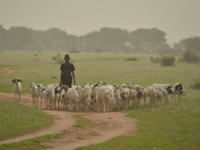
How do we assess performance in agriculture?
Yield/ha? $/farm? Kcal/person?
Nitrogen leaching/ha? Number of healthy people?
Notes:
Given the diversity of production systems and environments
Given the fact that things have changed over time and yield is not the only indicator of productivity anymore. What were considered “externalities” in the 90s are now dimensions of performance to assess

Slide 6
What is the objective of TAPE ?
To produce global and harmonized evidence on the multi-dimensional performance of agroecological systems.
Build knowledge and empower producers through the collective process of producing data and evidence on their own practices;
Support agroecological transitions at different scales and in different locations by proposing a diagnostic of performances over time and by identifying areas of strengths/weaknesses and enabling/disabling environment;
Inform policy makers and development institutions by creating references on the multi- dimensional performance of agroecology and its potential to contribute to the SDGs.
Notes:
The objectives

Slide 7
TAPE, step by step
Primary and secondary information:
- Production systems, type of household, agroecological zones
- Existing policies (incl. climate change)
- Enabling environment
DESCRIPTION OF SYSTEMS AND CONTEXT
STEP 0
CHARACTERISATION OF AGROECOLOGICAL TRANSITIONS (CAET)
On farm/household survey:
- Describe current status
- Based on 10 elements of agroecology with descriptive scales
- Can be self assessment by producer
STEP 1
Statistical and/or participatory clustering to reduce sample size if large number of observations in CAET
STEP 1bis
TRANSITION TYPOLOGY
On farm/household survey:
- Measure progress and quantify impact
- Addressing 5 key dimensions for policy makers and SDGs
- Time/cost constraints: keep it simple!
STEP 2
CRITERIA OF PERFORMANCE
At territory/community scale:
- Review CAET results, explain with context, enabling environment
- Review Performance results and explain with CAET
- Analyze contribution to SDGs
ANALYSIS AND PARTICIPATORY INTERPRETATION
STEP 3

Slide 8
TAPE survey in Russian is available here

Slide 9
STEP 1: CAET (CHARACTERISATION OF AGROECOLOGICAL TRANSITIONS)
Based on the 10 Elements of Agroecology:
Guiding Transition To Sustainable Food and Agricultural Systems
See documents in Russian http://www.fao.org/agroecology/overview/10-elements/ru/
Notes:
FAO proposed 10 Elements to support countries to scale-up agroecology. They help to define FAO’s work on agroecology in an inclusive way, without privileging one definition, stakeholder group, or region.
Some are characteristics of agroecological systems (synergies, recycling, co-creation and sharing of knowledge), some are emerging properties (efficiency, resilience).
The 10 Elements point to different entry points for the work of FAO and partners to strengthen agroecology.
The 26th Session of COAG (October 2018):
Welcomed the Scaling Up Agroecology Initiative and requested FAO to develop an action plan with partners
Supported the 10 elements on agroecology
Requested FAO to continue applying agroecology as one of the approaches to implement the five principles of SFA to support the SDGs

Slide 10
STEP 1: CAET - Diversity
 | Index | 0 | 1 | 2 | 3 | 4
DIVERSITY | Crops | Monoculture (or no crops cultivated) | One crop covering more than 80% of cultivated area | Two or three crops | More than 3 crops adapted to local and changing climatic conditions | More than 3 crops and varieties adapted to local conditions. Spatially diversified farm by multi-, poly- or inter-cropping
 | Animals (including fish and insects) | No animals raised | One species only | Several species, with few animals | Several species with significant number of animals | High number of species with different breeds well adapted to local and changing climatic conditions
 | Trees (and other perennials) | No trees (nor other perennials) | Few trees (and/or other perennials) of one species only | Some trees (and/or other perennials) of more than one species | Significant number of trees (and/or other perennials) of different species | High number of trees (and/or other perennials) of different species integrated within the farm land
 | Diversity of activities, products and services | One productive activity only (e.g. selling only one crop) | Two or three productive activities (e.g. selling 2 crops, or one crop and one type of animals) | More than 3 productive activities | More than 3 productive activities and one service (e.g. processing products on the farm, ecotourism, transport of agricultural goods, training etc.) | More than 3 productive activities, and several services

Slide 11
STEP 1: CAET - Human and Social values
 | Index | 0 | 1 | 2 | 3 | 4
HUMAN AND SOCIAL VALUES | Women's empowerment | Women do not normally have a voice in decision making, not in the household nor in the community. No organisation for women empowerment exists | Women may have a voice in their household but not in the community. And/or one form of women association exist but is not fully functional | Women can influence decision making, both at household and community level, but are not decision makers. They don't have access to resources. And/or some forms of women associations exist but are not fully functional | Women take fully part in decision making processes but still don't have full access to resources. And/or women organisations exist and are used | Women are completely empowered in terms of decision making and access to resources. And/or women organisations exist, are functional and operational
 | Labour (productive conditions, social inequalities) | Agricultural supply chains are integrated and managed by agribusiness. Social and economic distance between landowners and workers. And/or workers don't have decent working conditions, make low wages and are highly exposed to risks | Most of agricultural production is Working conditions are hard, workers have average wages for the local context and may be exposed to risks | Agriculture is mostly based on family farming but producers have limited access to capital and decision-making processes. Workers have the minimum decent labour conditions | Agriculture is mostly based on family farming and producers have access to capital and decision-making processes. Workers have decent labour conditions | Agriculture is based on by family farmers or farmers have full access to capital and decision-making processes. Social and economic proximity between farmers and employees
 | Youth empowerment and emigration | Young people see no future in agriculture and are eager to emigrate | Most young people think that agriculture is too hard and many wish to emigrate. | Most young people do not want to emigrate, despite hard working conditions, and wish to improve their livelihoods and living conditions within their community | Most young people (both boys and girls) are satisfied with working conditions and do not want to emigrate | Young people (both boys and girls) see their future in agriculture and are eager to continue and improve the activity of their parents
 | Animal welfare [if applicable] | Animals suffer periodically/seasonally from hunger and thirst, stress or diseases, and are slaughtered without avoiding unnecessary pain | Animals suffer periodically/seasonally from hunger and thirst, stress or diseases, and are slaughtered without avoiding unnecessary pain | Animals do not suffer from hunger or thirst, but suffer from stress, may be prone to diseases and can suffer from pain at slaughter | Animals do not suffer from hunger, thirst or diseases but can experience stress, especially at slaughter | Animals do not suffer from stress, hunger, thirst, pain, or diseases, and are slaughtered in a way to avoid unnecessary pain

Slide 12
STEP 1: CAET – Other elements

Slide 13
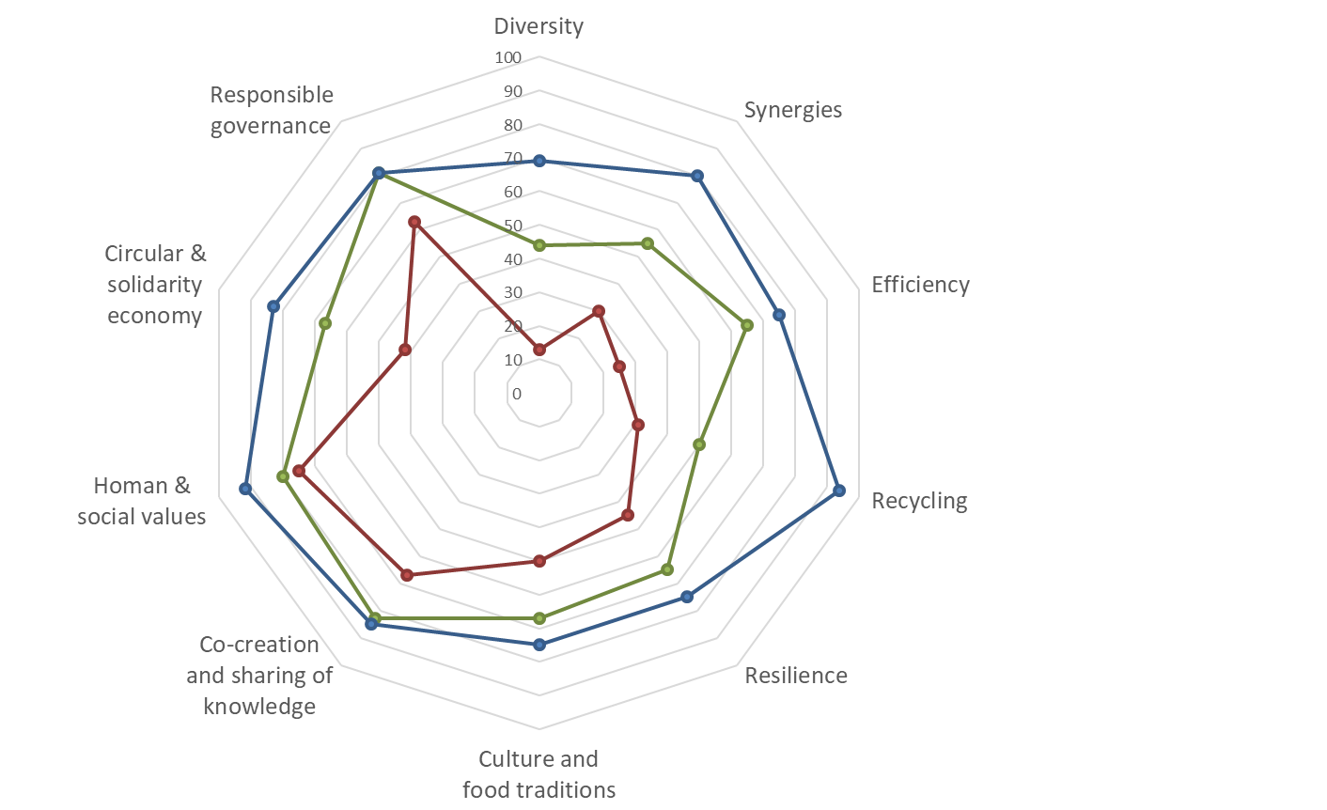
Step 1 CAET – results of 3 farms in Cuba
Spider graph
Conventional farm (tobacco monoculture) (CAET=44%)
Farm in transition to agroecology (CAET=66%)
Diversified agroecological farm (CAET=81%)
Lucantoni, 2020

Slide 14
STEP 2: Core criteria of performance
Main dimension | # | Core criteria of performance | Proposed method of assessment in survey
Governance | 1 | Secure land tenure (mobility for pastoralists) | Type of tenure over land: property, lease + duration, verbal, not explicit (SDG 1.4.2, 5.a.1 and 2.4.1 sub-indicator 11) Existence and use of pastoral agreements and mobility corridors
Economy | 2 | Productivity | Gross output value per hectare (SDG 2.4.1 sub-indicator 1) Gross output value per person
 | 3 | Income | Income from crops +animals +other activities +subsidies –inputs –operating expenses –depreciation –taxes –interests (SDG 2.4.1 sub-indicator 2)
 | 4 | Added value | Gross output value –depreciation –expenditures for inputs
Health & nutrition | 5 | Exposure to pesticides | Quantity applied, area, toxicity and existence of risk mitigation equipment and practices
 | 6 | Dietary diversity | Minimum Dietary Diversity for Women - FAO & FHI (2016)
Society & Culture | 7 | Women's empowerment | Abbreviated Women’s Empowerment in Agriculture Index, A-WEAI (IFPRI, 2012)
 | 8 | Youth employment | Access to jobs, training, education or migration (SDG 8.6.1)
Environment | 9 | Agricultural biodiversity | Relative importance of crops varieties, livestock breeds, trees and semi-natural environments on farm (SDG 2.4.1 sub-indicator 8.1, 8.6 and 8.7)
 | 10 | Soil health | SOCLA agroecological method to assess soil health, based on 10 indicators (Nicholls et al., 2004)
Notes:
How do to the different systems perform on these dimensions? Now and along time (monitoring progress while transitioning)
A limited set of indicators which is the result of a long consultation process and many reviews of existing lists of indicators.
The proposed methods here are based on questionnaire on farm (including with women and a quick tour/walk)
But possible to collect more in one dimension with advanced indicators (see next slide)

Slide 15
Non exhaustive list of advance criteria
Main dimension | Advanced criteria | Possible methodologies for assessment | SDG
Economy | Resilience | -Self-evaluation and Holistic Assessment of climate Resilience of farmers and Pastoralists (SHARP) | 1 2 8
Health & nutrition | Food security & nutrition | - Food self-sufficiency ratio: production x100/(production +purchases -sales) - Nutritional value of agricultural production | 2 3
Society & Culture | Decent work Access to market | - Decent Work Indicators for agriculture and rural areas (FAO, 2015) - Territorial Markets (ESN) | 8
Environment | Water | -Water use efficiency (e.g. LEAP guidelines for livestock) -Water pollution (e.g. LEAP guidelines on nutrient use) | 3 6
 | Climate change mitigation | -GHG emissions (e.g. Ex-Act, GLEAM-i, Cool Farm tool) -Carbon sequestration (under development for GLEAM) - GTAE Memento pour l'évaluation de l'agroécologie (Levard et al., 2019) | 13

Slide 16
STEP 1 and 2 : Example from 2 farms in Cambodia
STEP 1 CAET
STEP 2: Criteria of Performance
Core criteria of performance | Takeo farm | Kampong Chhnang farm
Secure land tenure | Formal document of possession of land | Formal document of possession of land
Productivity | N/A | N/A
Income | 12.223 USD | 0 USD
Added value | 12.330 USD | -1.000 USD
Exposure to pesticides
Dietary diversity | 9/10 | 5/10
Women's empowerment | 93.9% | 55.7%
Youth employment | N/A | N/A
Agricultural biodiversity | 42% | 33%
Soil health | 3.2 | 3.5

Slide 17
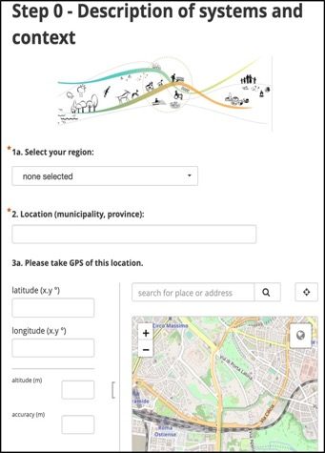
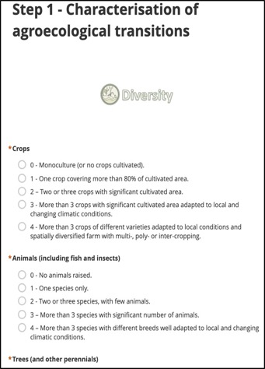
On-line tool for data collection
Using Open Data Kit (Kobo Toolbox)
Works also offline
Secured on UN server
Available on Android mobile devices and all others via URL
Available in many languages
https://ee.humanitarianresponse.info/x/#mEov3aos

