Slide 1

Support Trust for African Development
Presentation of STAD’s Work
To
SJSP’s Church Council
By
Florence A. Andrew (MA)
Chairperson
13 May 2019

Slide 2
Brief background
Founded: 2000 as Sudanese Orphans Support Trust (SOST)
Legally registered: 2002 at the Chamber of Commerce
Den Haag. The Netherlands
ANBI (Algemeen Nut Beogende Instelling). RSIN kenmerk : 8109.65.501 ( 2018)
Founding goal : support Sudanese refugees orphans
education in Northern Uganda
In 2004: included empowerment, capacity building, income generation, peace building & health programs.
In 2009: SOST mission, vision & operation areas reviewed
In 2010 : SOST became STAD

Slide 3
Background cont.
Mission: STAD strives to support the less privileged groups: orphans, women, youth & the elderly through education & t empowerment in life skills for self reliance &
Vision: STAD envisions improved living conditions and access to better health services, peaceful co-existence etc. in N. Uganda & South Sudan
Motivation: derived from the famous Chinese saying “ feed a hungry man today, he will be hungry; teach him to fish, he can have food tomorrow; educate his child(ren), you have given him a future” & Nelson Mandela: “ Education is the most powerful weapon to change the world, eliminating gender inequality & to reduce poverty”.
ANBI (Algemeen Nut Beogende Instelling). Fiscaal nummer RSIN kenmerk is: 8109.65.501 ( 2018)
Website: www.s-t-a-d.org

Slide 4
Administration
STAD staff ( all volunteers)
Chairperson : Florence Andrew
Secretary General : Bert Biemold
Finance secretary: Dedi Bullen Gaga
Accountant : E. Dominic
Consultant Accountant : Donald Okeke
Website: Niall Morrison (youngest)
More information visit: www. s-t-a-d.org

Slide 5
Sources of funds
St. John & St. Philips Church (regula)
MoFA: Dutch NAP3: UNSCRN 1325:Women Peace & Security project (2017-2019)
ETWA ( on project basis)
Individuals /well-wishers
Fundraising activities
Audited in 2018 and is currently being audited

Slide 6
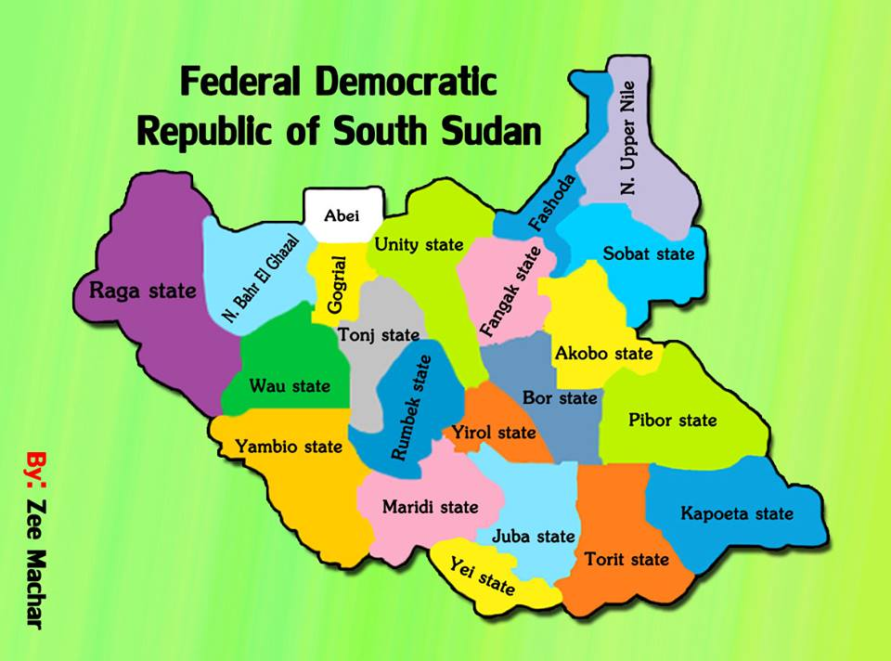
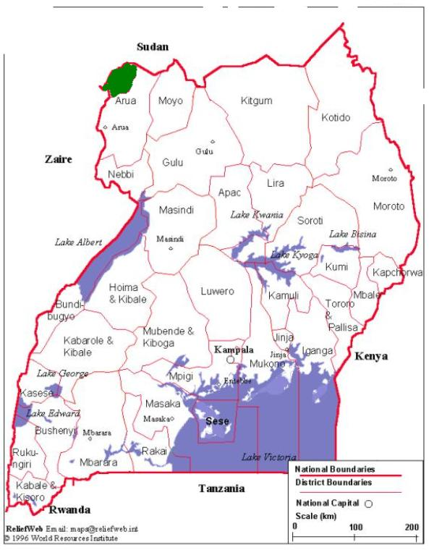
Countries and Areas of operation
Northern Uganda
KOBOKO DISTRICT
Arrow showing Koboko District (green) Arrow showing Yei ( yellow) Torit States ( brown)

Slide 7
Partner organisations
YWCD0 – Northern Uganda
EW0 - South Sudan
PPHCC - South Sudan (on hold insecurity)
ST. Mark Church -South Sudan (on hold)

Slide 8
Youth & Women Community Development Organisation
Founded: as Youth & Women Training Centre (YWCTC)
Merge: of Youth Action for Development (YAOD) & Nyarilo Progressive Women Club ( NPWC)
Merging goal: to have Community centre
Legally registered: in 2006 at the Min. of Gender, Labour & Social Development – Koboko District, Uganda
Initiative & ownership is of the YWCD0 members
Members: refugees of refugees from DRC, S. Sudan & Ugandans

Slide 9
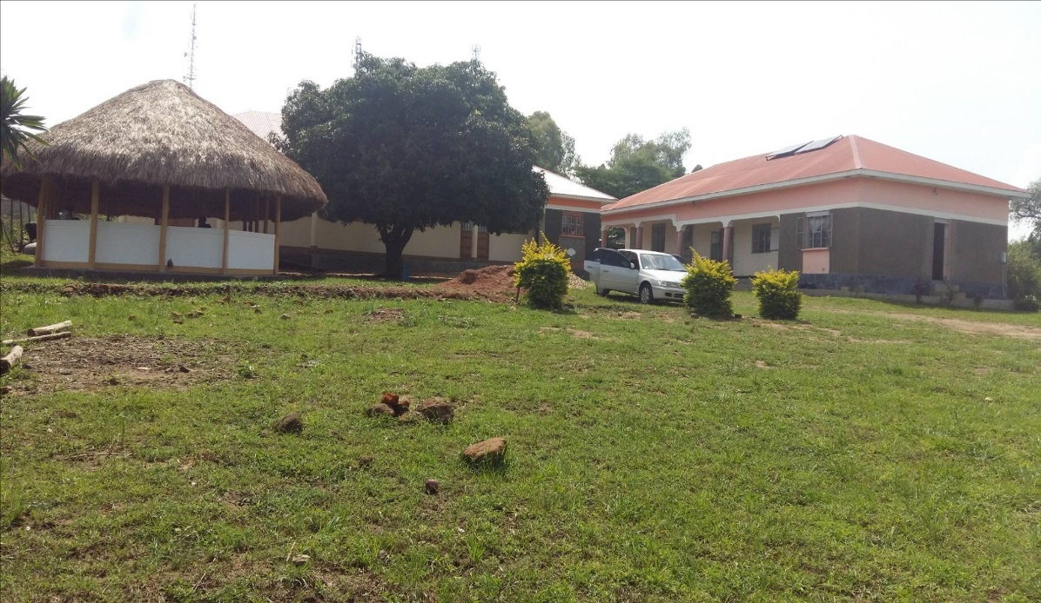
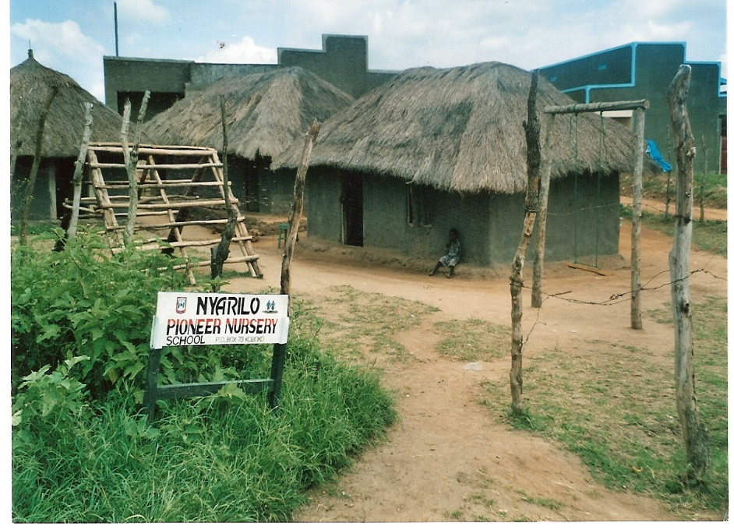
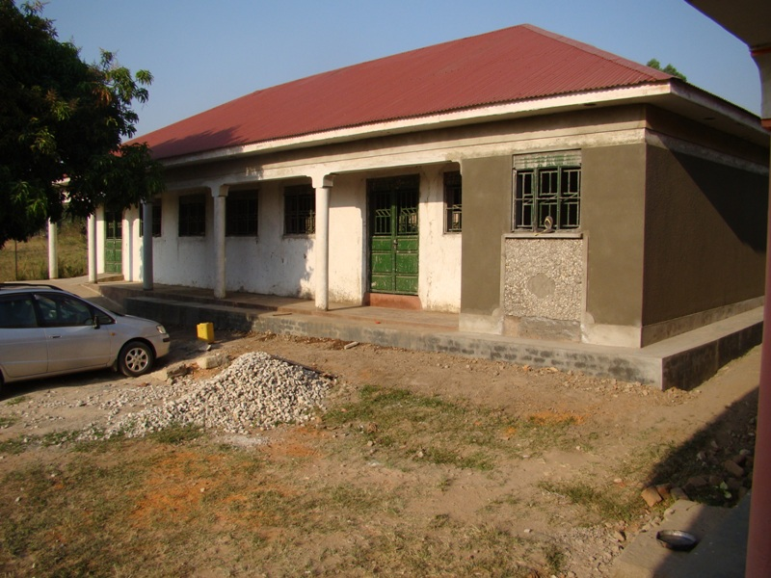
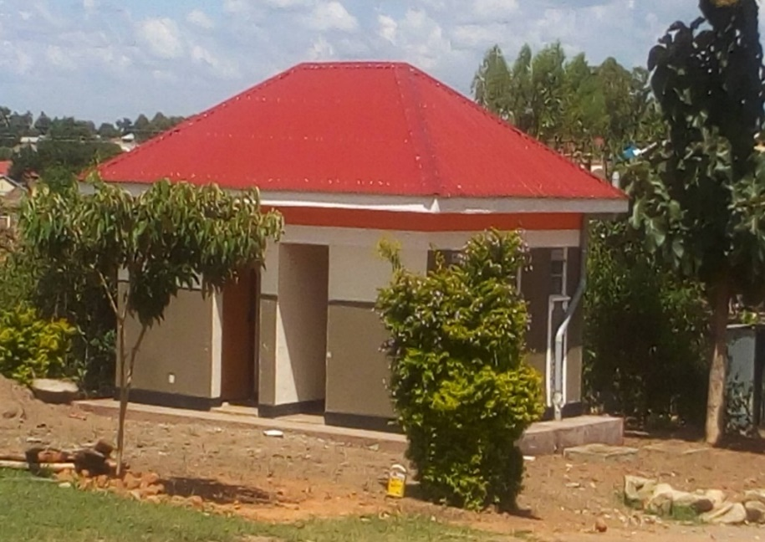
YWCD0 Compound : What a difference!
PEACE HALL (Meetings & Training etc.)
First nursery school in Koboko District
The VIP toilet 2018

Slide 10
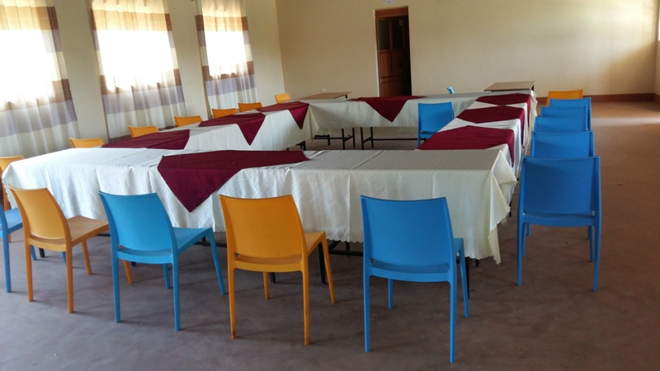
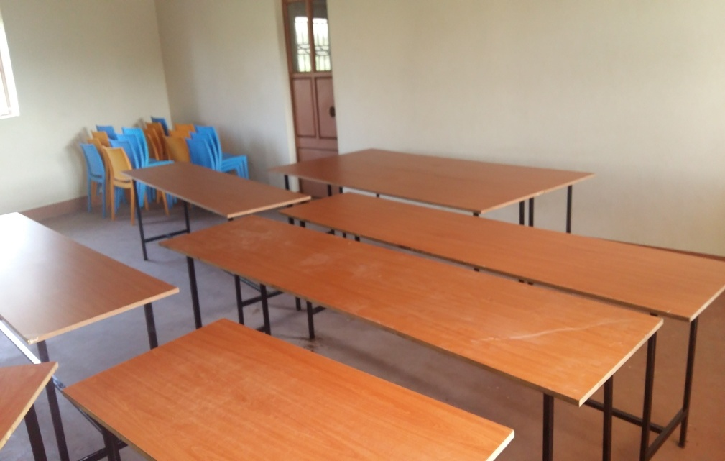
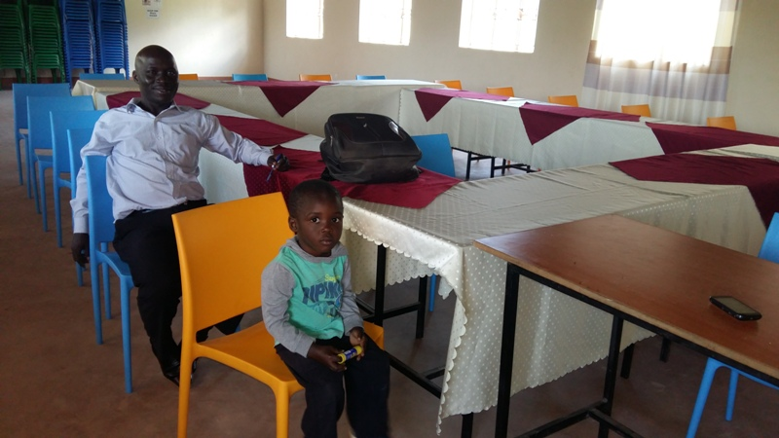
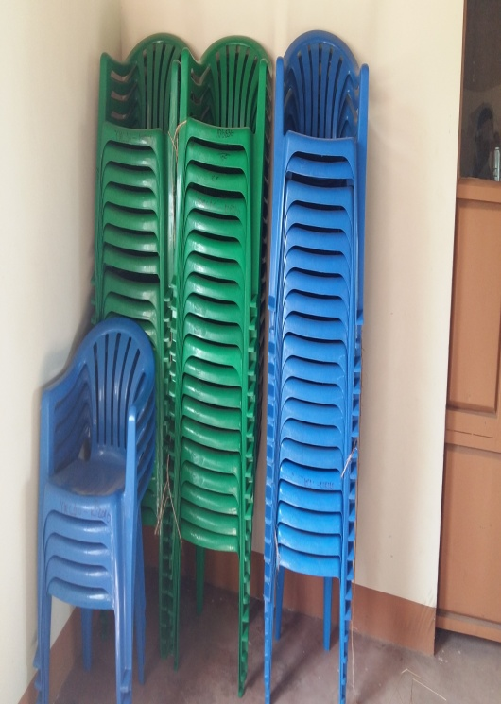
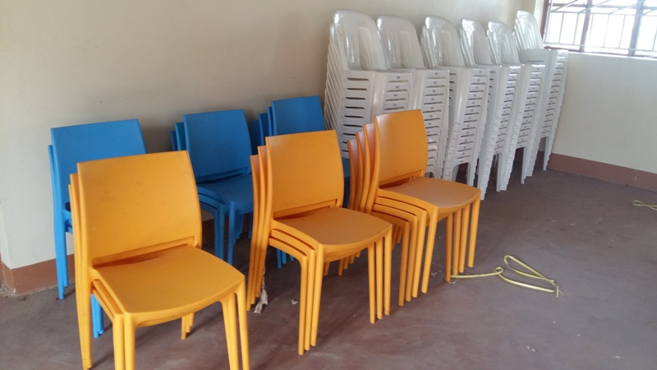
The Peace Hall furnished with funds from STSTP

Slide 11
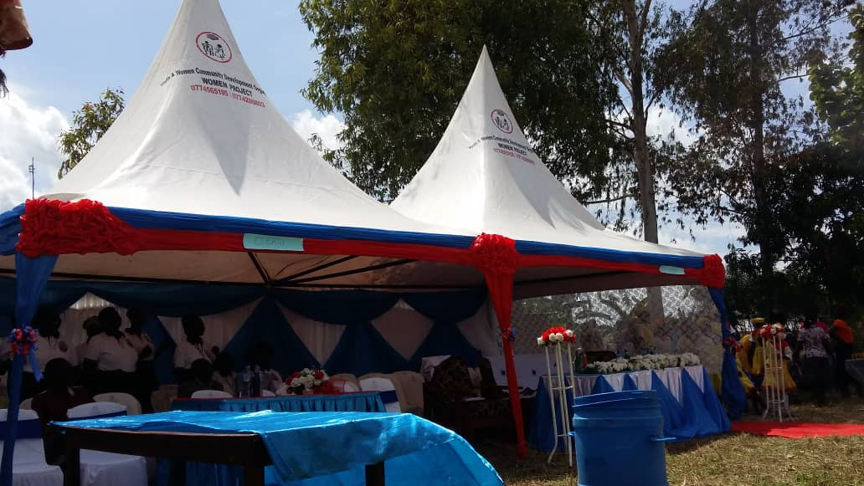
YWCD0 Tents

Slide 12
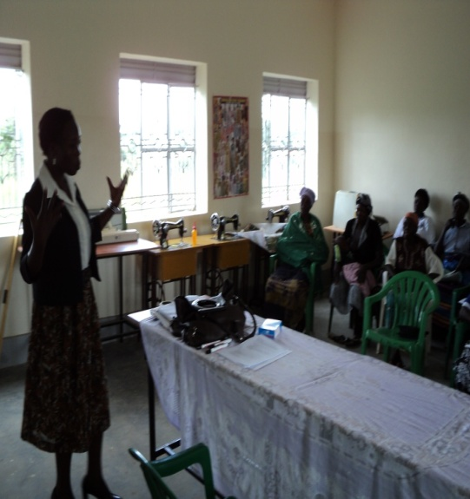
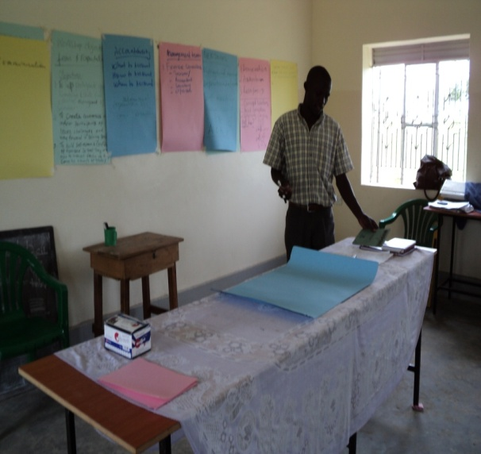
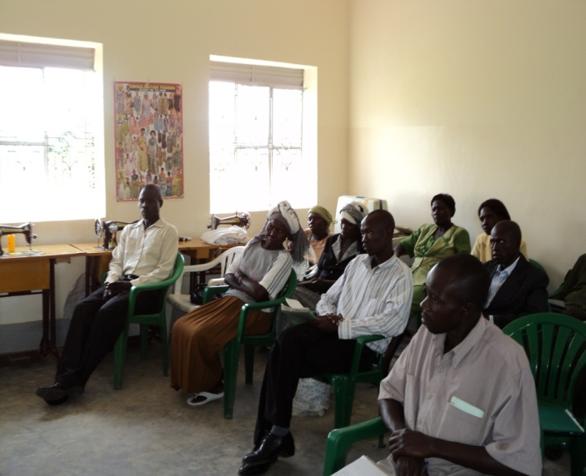
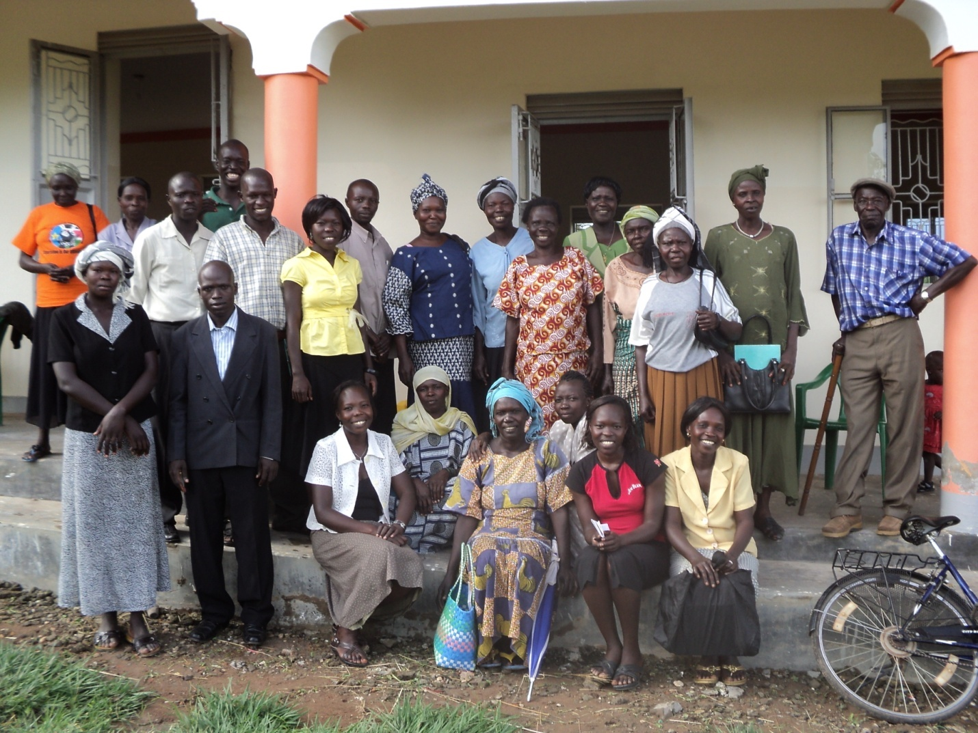
Capacity training of YWCDTC members

Slide 13
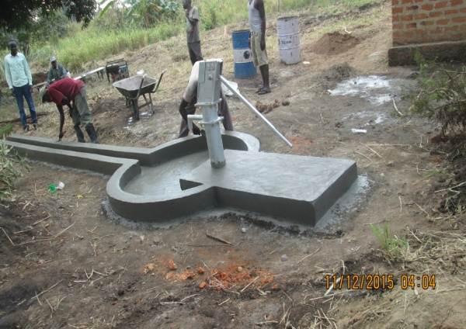
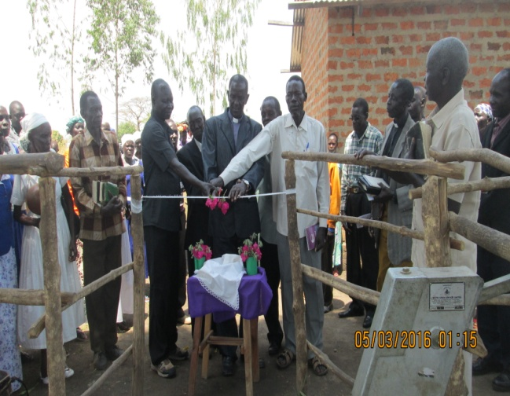
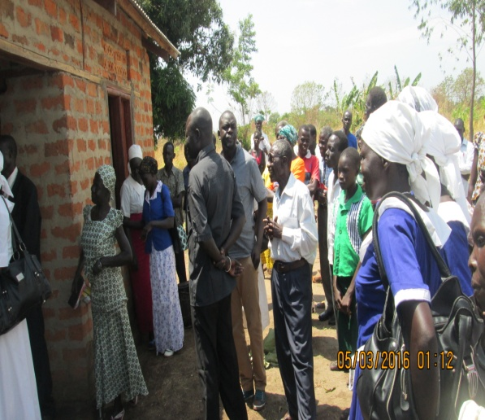
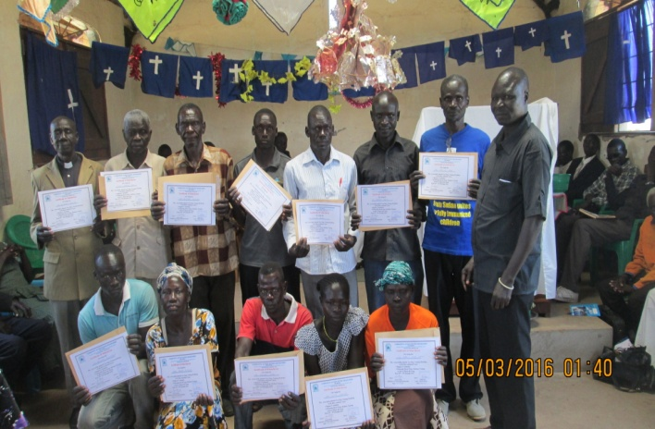
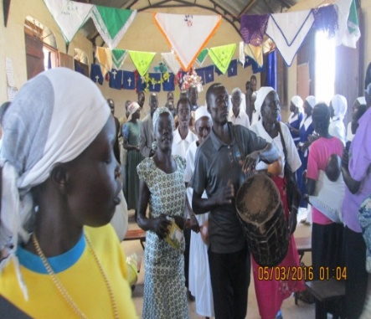
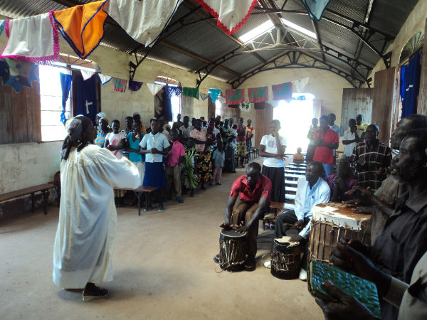
Commissioning of the water bore and pastors house
Water management committee

Slide 14
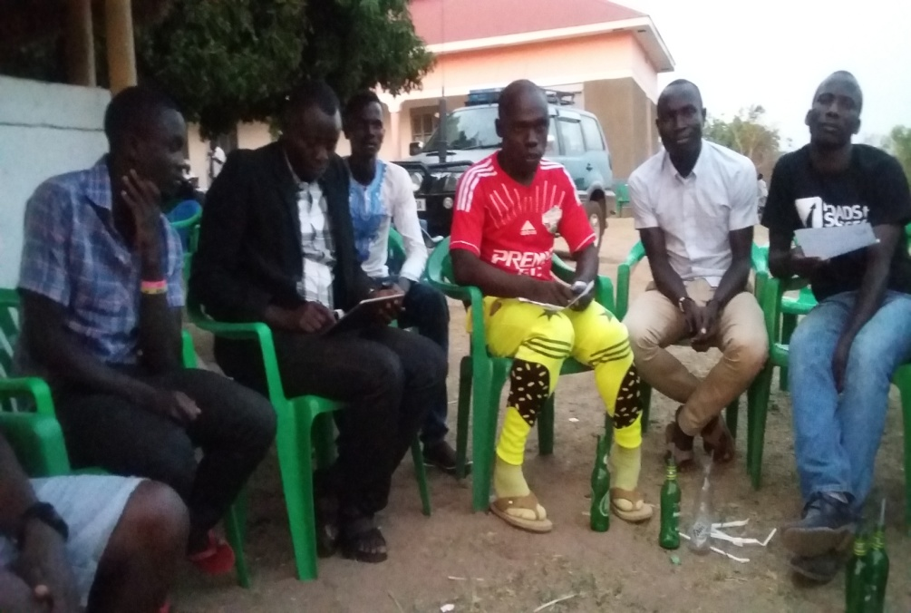
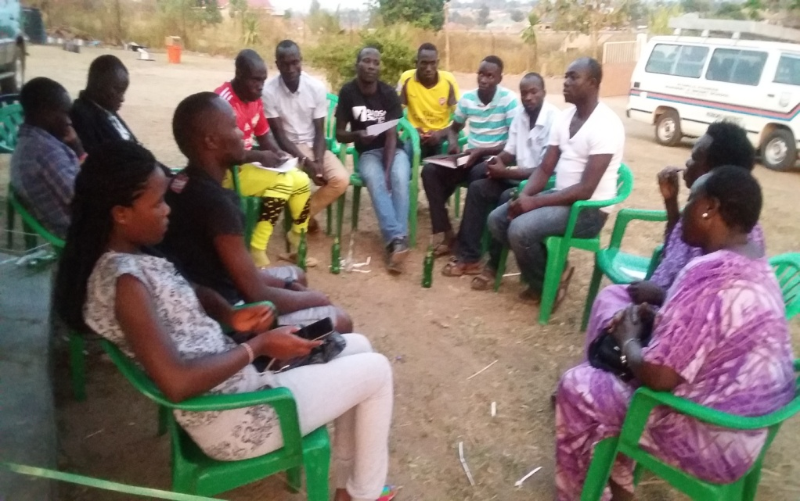
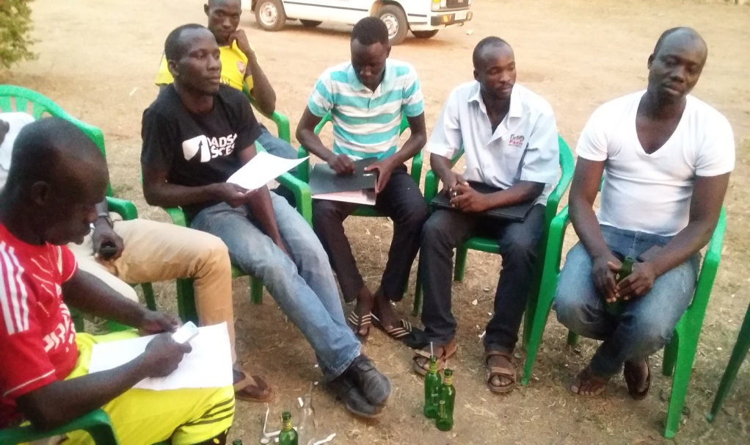
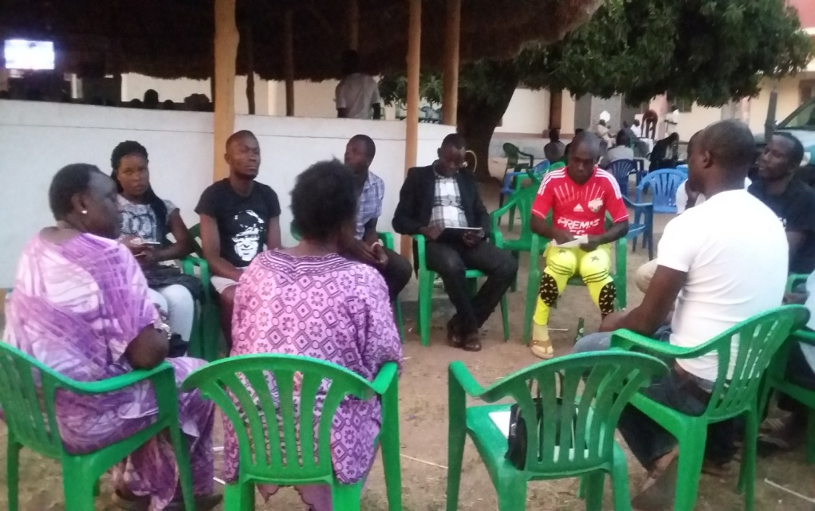
Meeting with the Youth group 2017
Notes:
Members of the Pre-mio football club, Koboko (Feb. 2017)

Slide 15
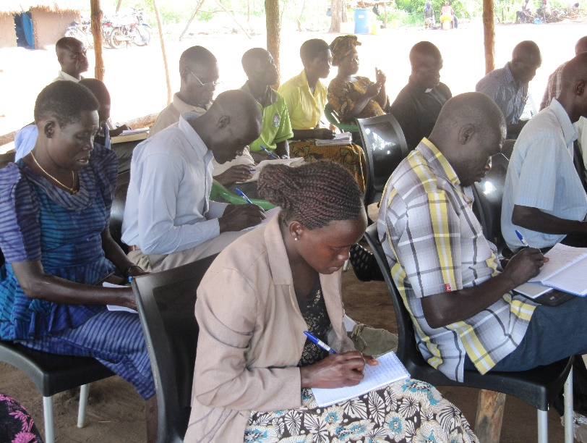
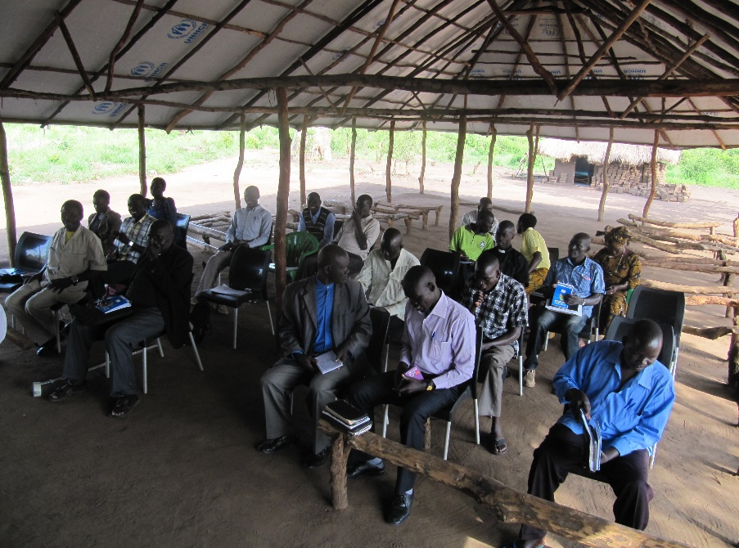
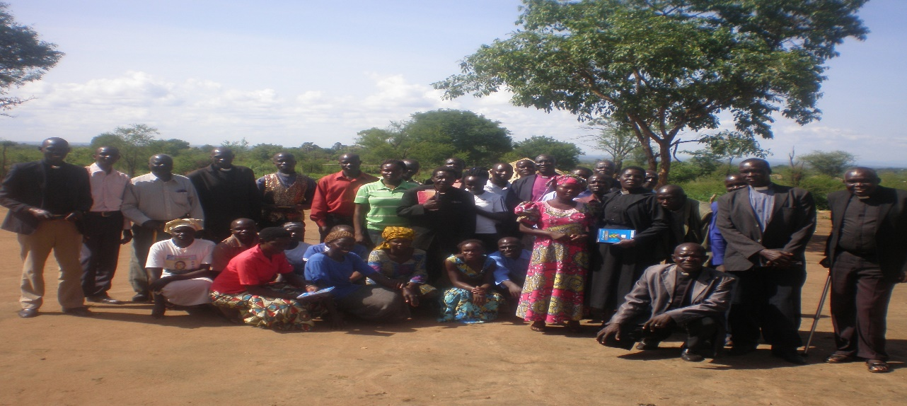
Peace Building, Trauma Healing, and Reconciliation.
Participants busy taking notes
Notes:
The training for church leaders, youth & women leaders and elders took place on 12 – 16 June 2017 in the Bidi-bidi, South Sudanese Refugees
in Yumbe District, Northern Uganda.

Slide 16
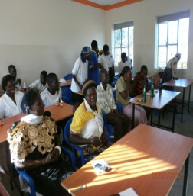
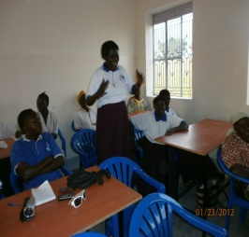
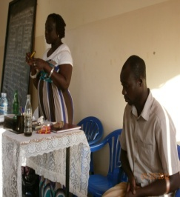
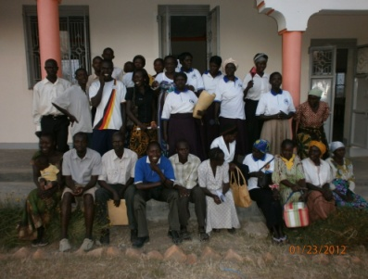
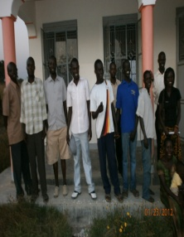
Project monitoring & Evaluation 2012

Slide 17
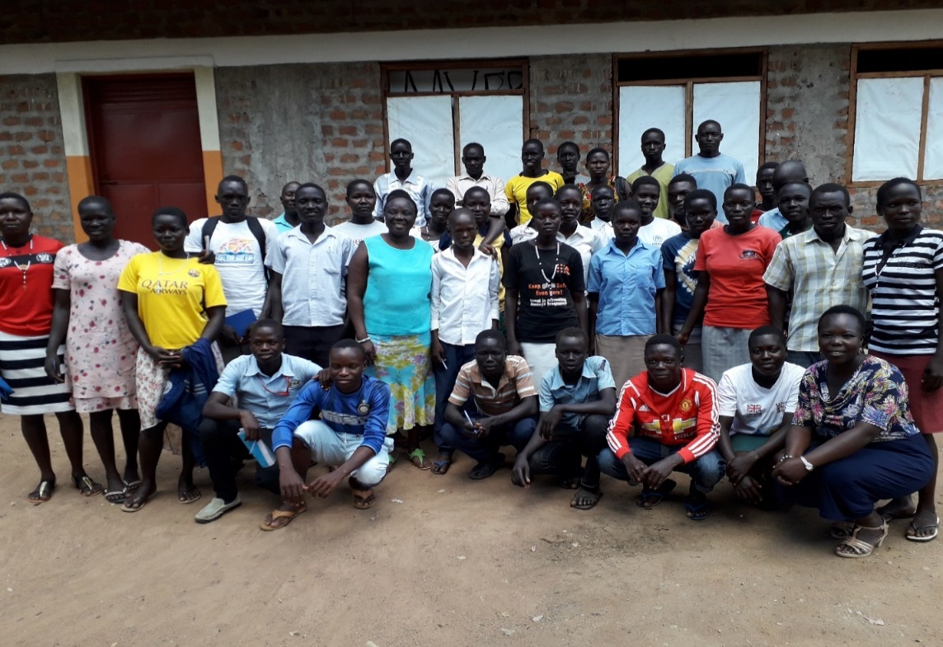
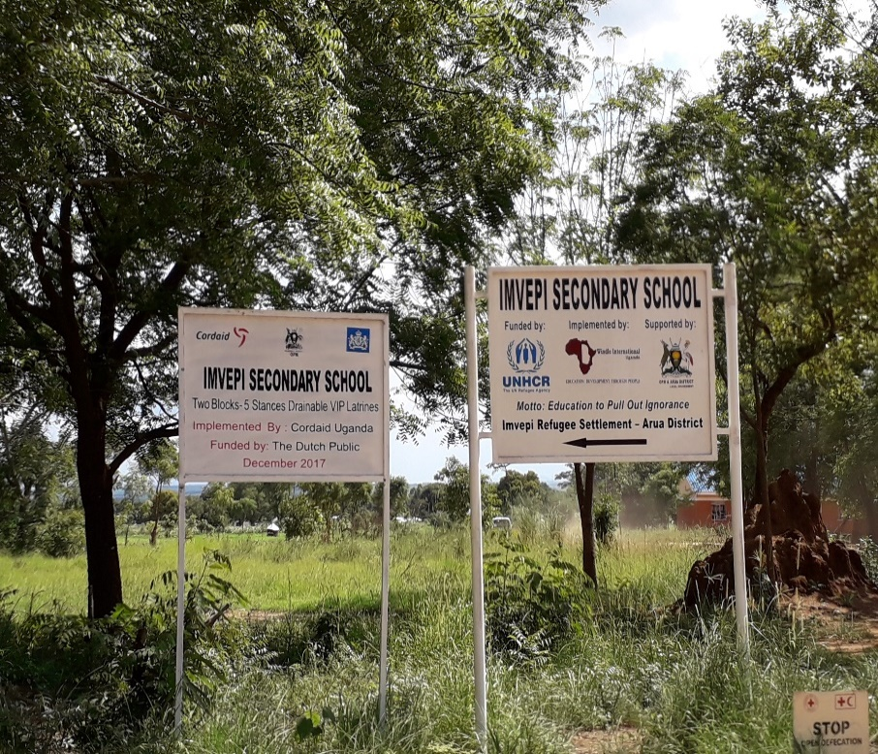
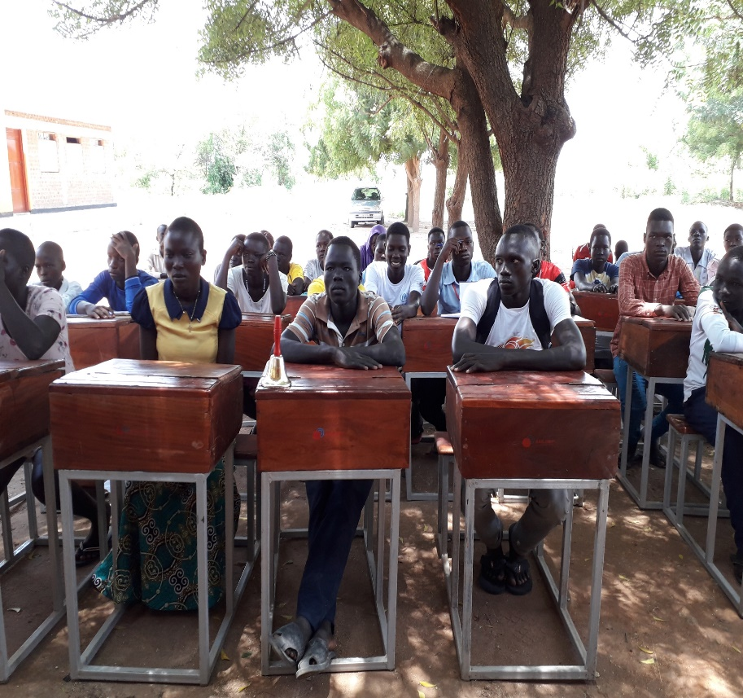
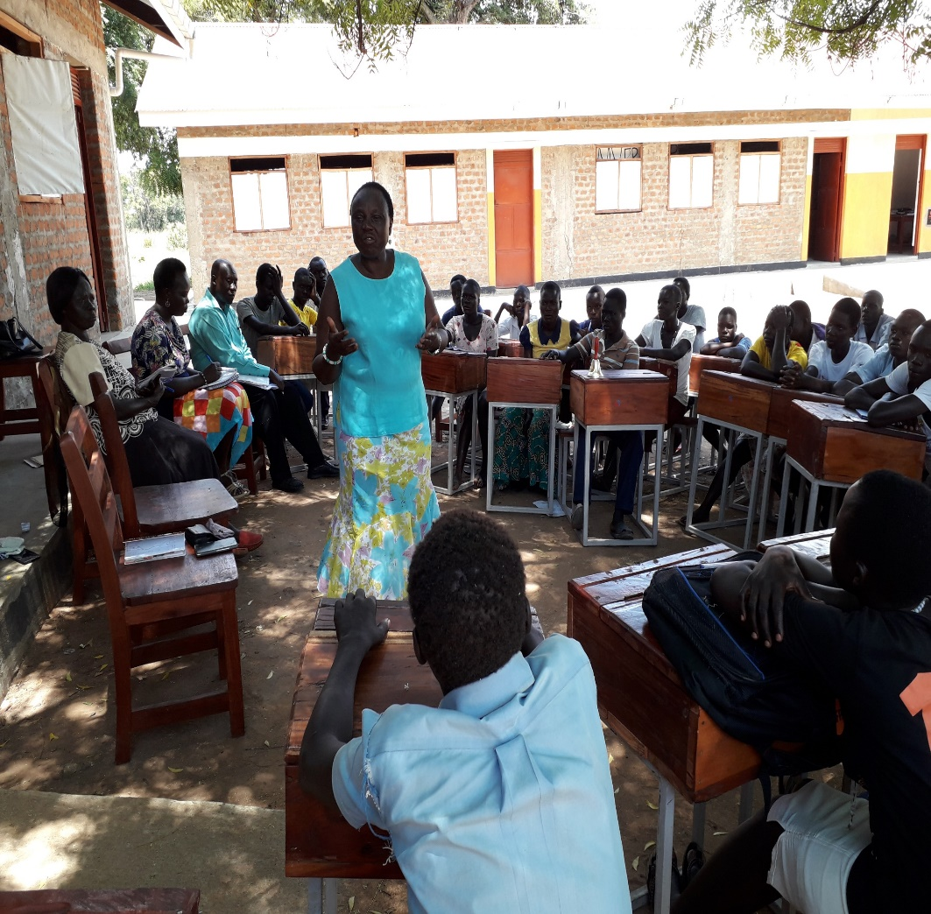
STAD chairperson visits refugee students at Imvepi 2018

Slide 18
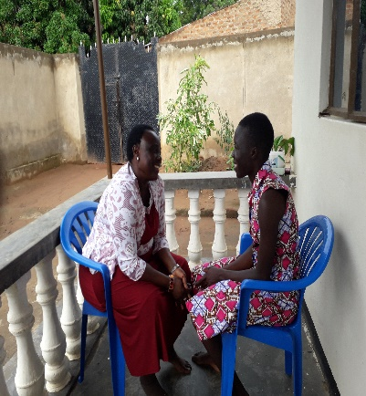
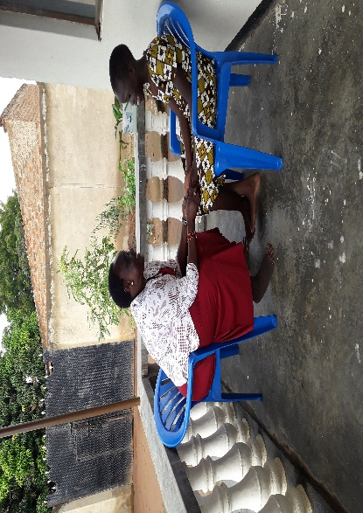
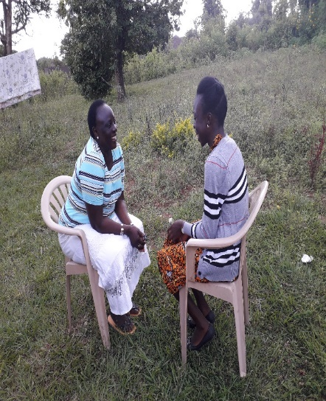
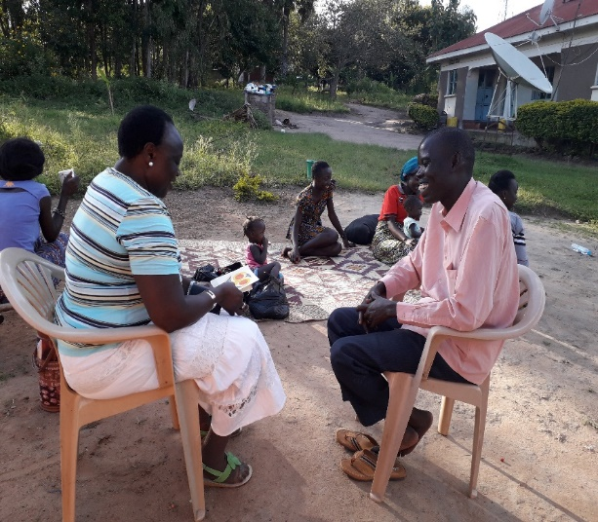
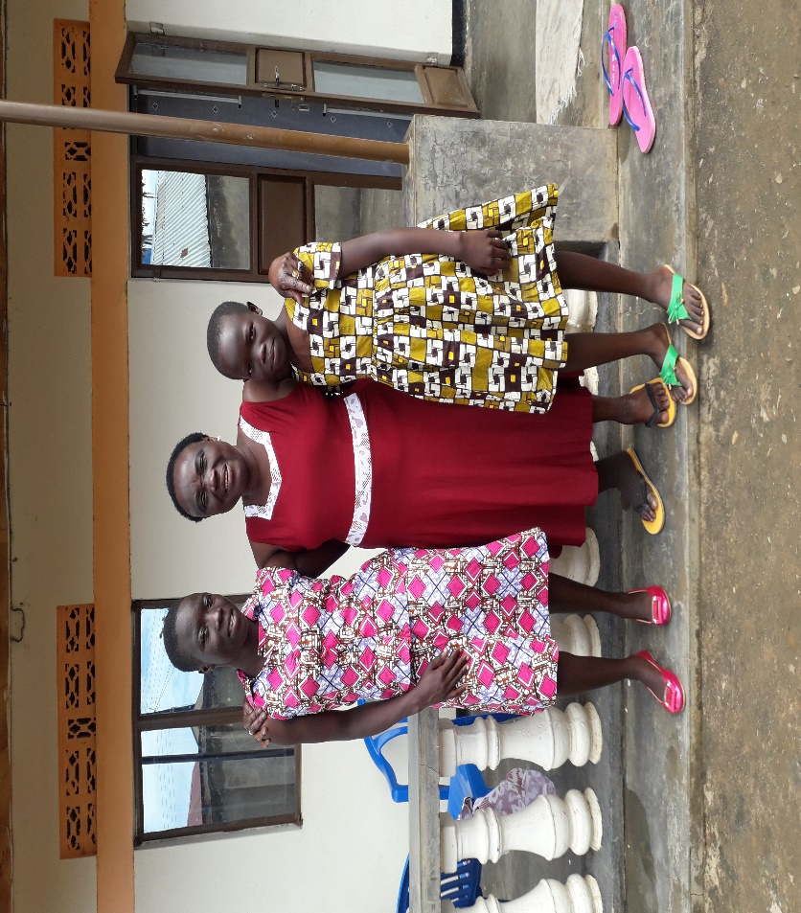
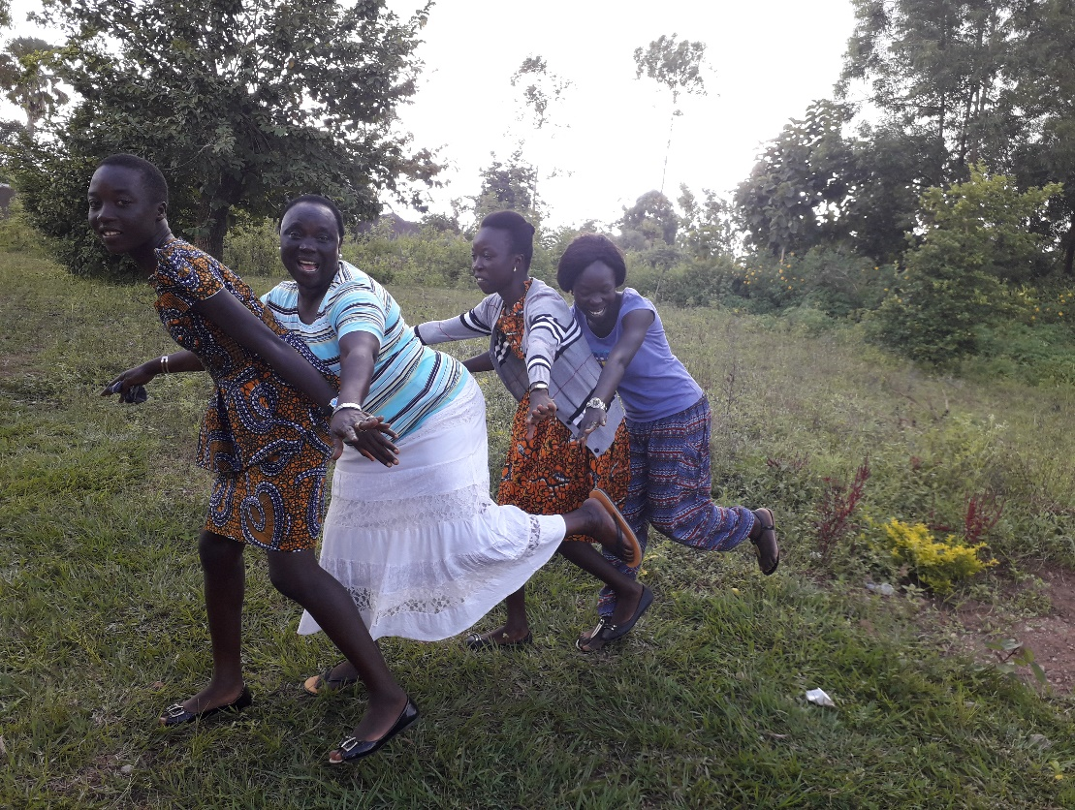
Meeting with Some of the students sponsored by STAD

Slide 19
Khemis Ben : STAD sponsored student
First Class Honours in Social Work and Social Administration: Currently working as Headmaster at a Christian School in the Nuba Mountains – Sudan

Slide 20
Asiki Diploma student in Journalism
DREAM & HOPE FOR A BRIGHTER FUTURE CAME TRUE; Had a short work with UNHCR. Back to school & volunteering at YWCD0

Slide 21
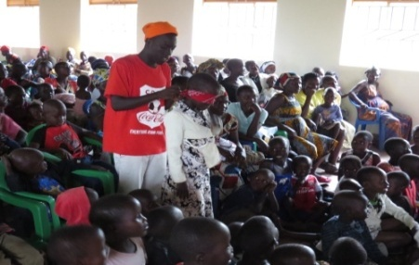
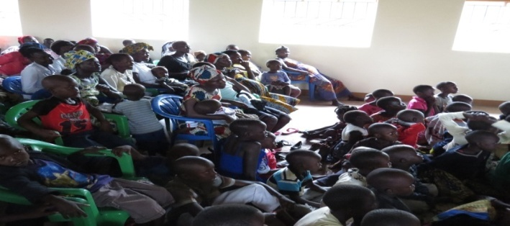
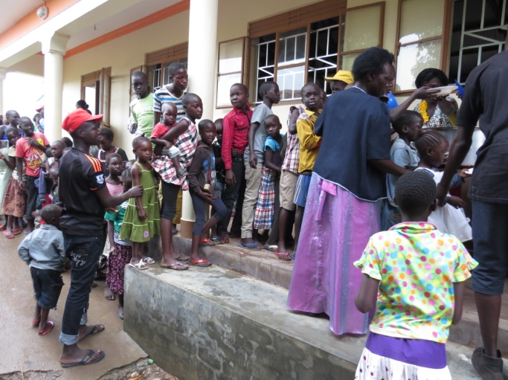
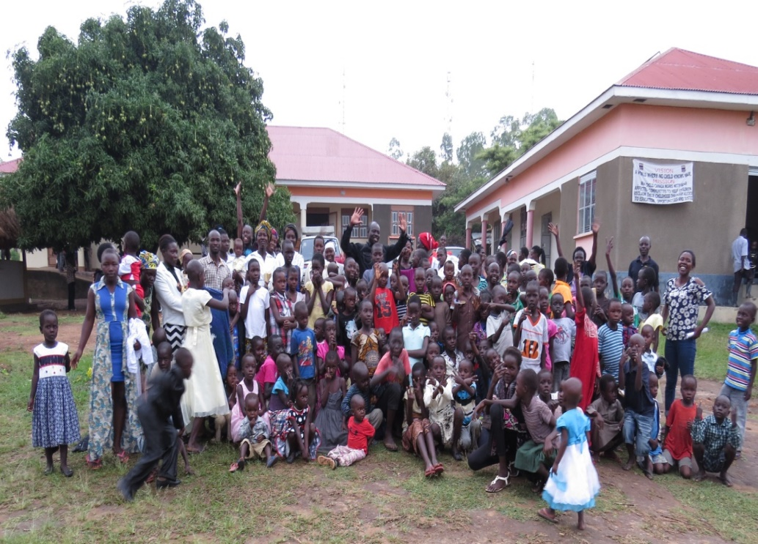
EASTER CELEBRATION
GIVE THEM HOPE: TO GOD BE THE GLORY
21

Slide 22
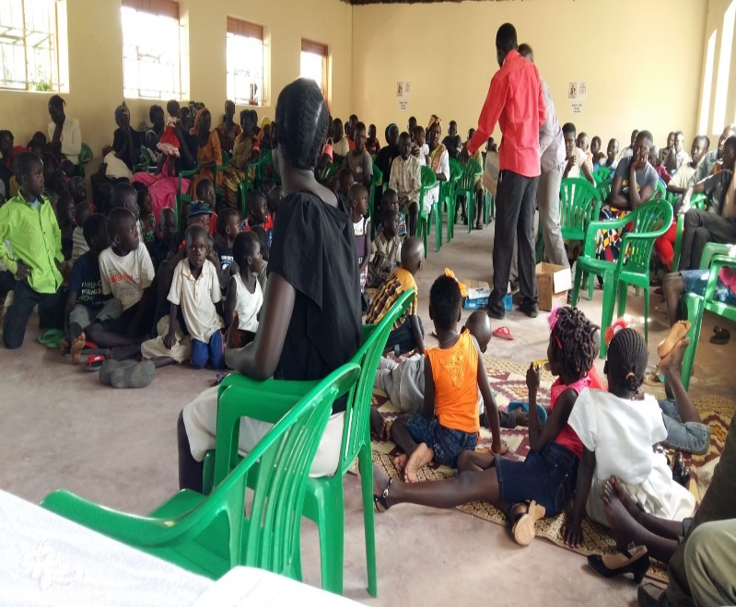
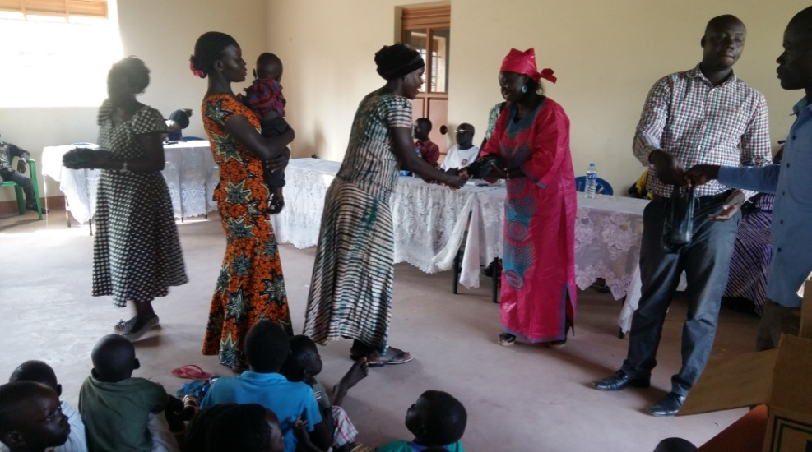

Christmas Celebration at YWCD0
GIVING THEM HOPE: TO GOD BE THE GLORY

Slide 23
Project in South Sudan
Current running project in South Sudan
UNSCR 1325 under the NAP 3: Women and Girls for Change Alliance (WG4C) 2017-2019
Project in at hold due to insecurity
1. Payawa Primary Health Care Centre(PPHCC)
2. ST. Mark Parish Church, Alero Boma

Slide 24


NAP 3 Women & Girls for Change Alliance Feb 2017
Meeting with Women Leaders and Government representatives, Imatong Torit, Eastern Equatoria

Slide 25



Women leadership training

Slide 26






Payawa Primary Health Care centre (PPHCC) 2010
The Old health centre, built by GTZ in 1979
The Mother & Child care Unit 2013
The New Mother & Child care Unit 2011
Renovated old centre used outpatient unit

Slide 27





ST. Mark Parish Church, Alero Boma
The old church buildings complete unusable New church built by the Samaritan purse
Merel STAD’s PR & Rev. James old house New Pastor’s house 2014

Slide 28





Bricks laying for proposed pre-school project
Women carrying water from wells Men digging soil for bricks laying
Community laying bricks for construction of proposed pre-school

