Slide 1
Presentation to SJSP’s Church Council
by Debbie Yip
13 May 2019

Slide 2
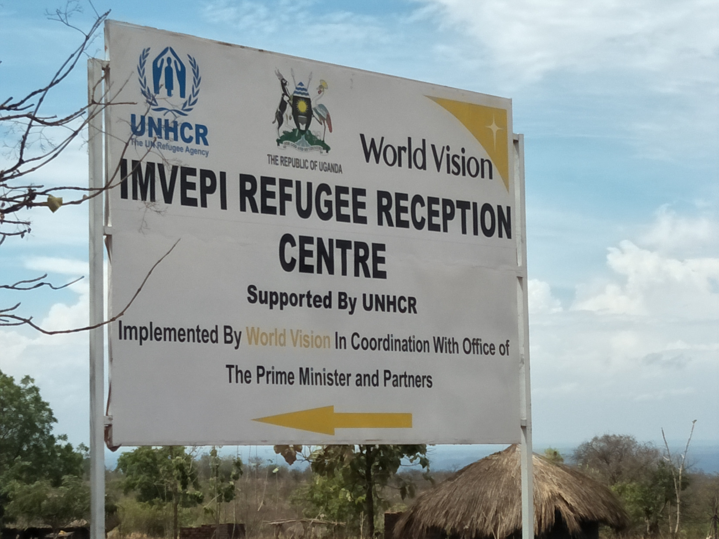

Slide 3
Imvepi Secondary School - STAD currently supports 50 most vulnerable (the unaccompanied minors) out of the 813 students

Slide 4
Observations:
There is possibility of a better future for the students and their family, as they can get integrated into the Ugandan system and society
The teachers and staff provide Christian role modelling & nurturing and are a constant inspiration to the students
The students show willingness to learn and potential of developing Christian virtues
The Imvepi staff, the organisation in-charge (Windle) and the STAD Gender Technical Advsior all have a strong sense of accountability
We should stand in solidarity with the students in their cries to God for South Sudan to be delivered from war and internal conflicts

Slide 5
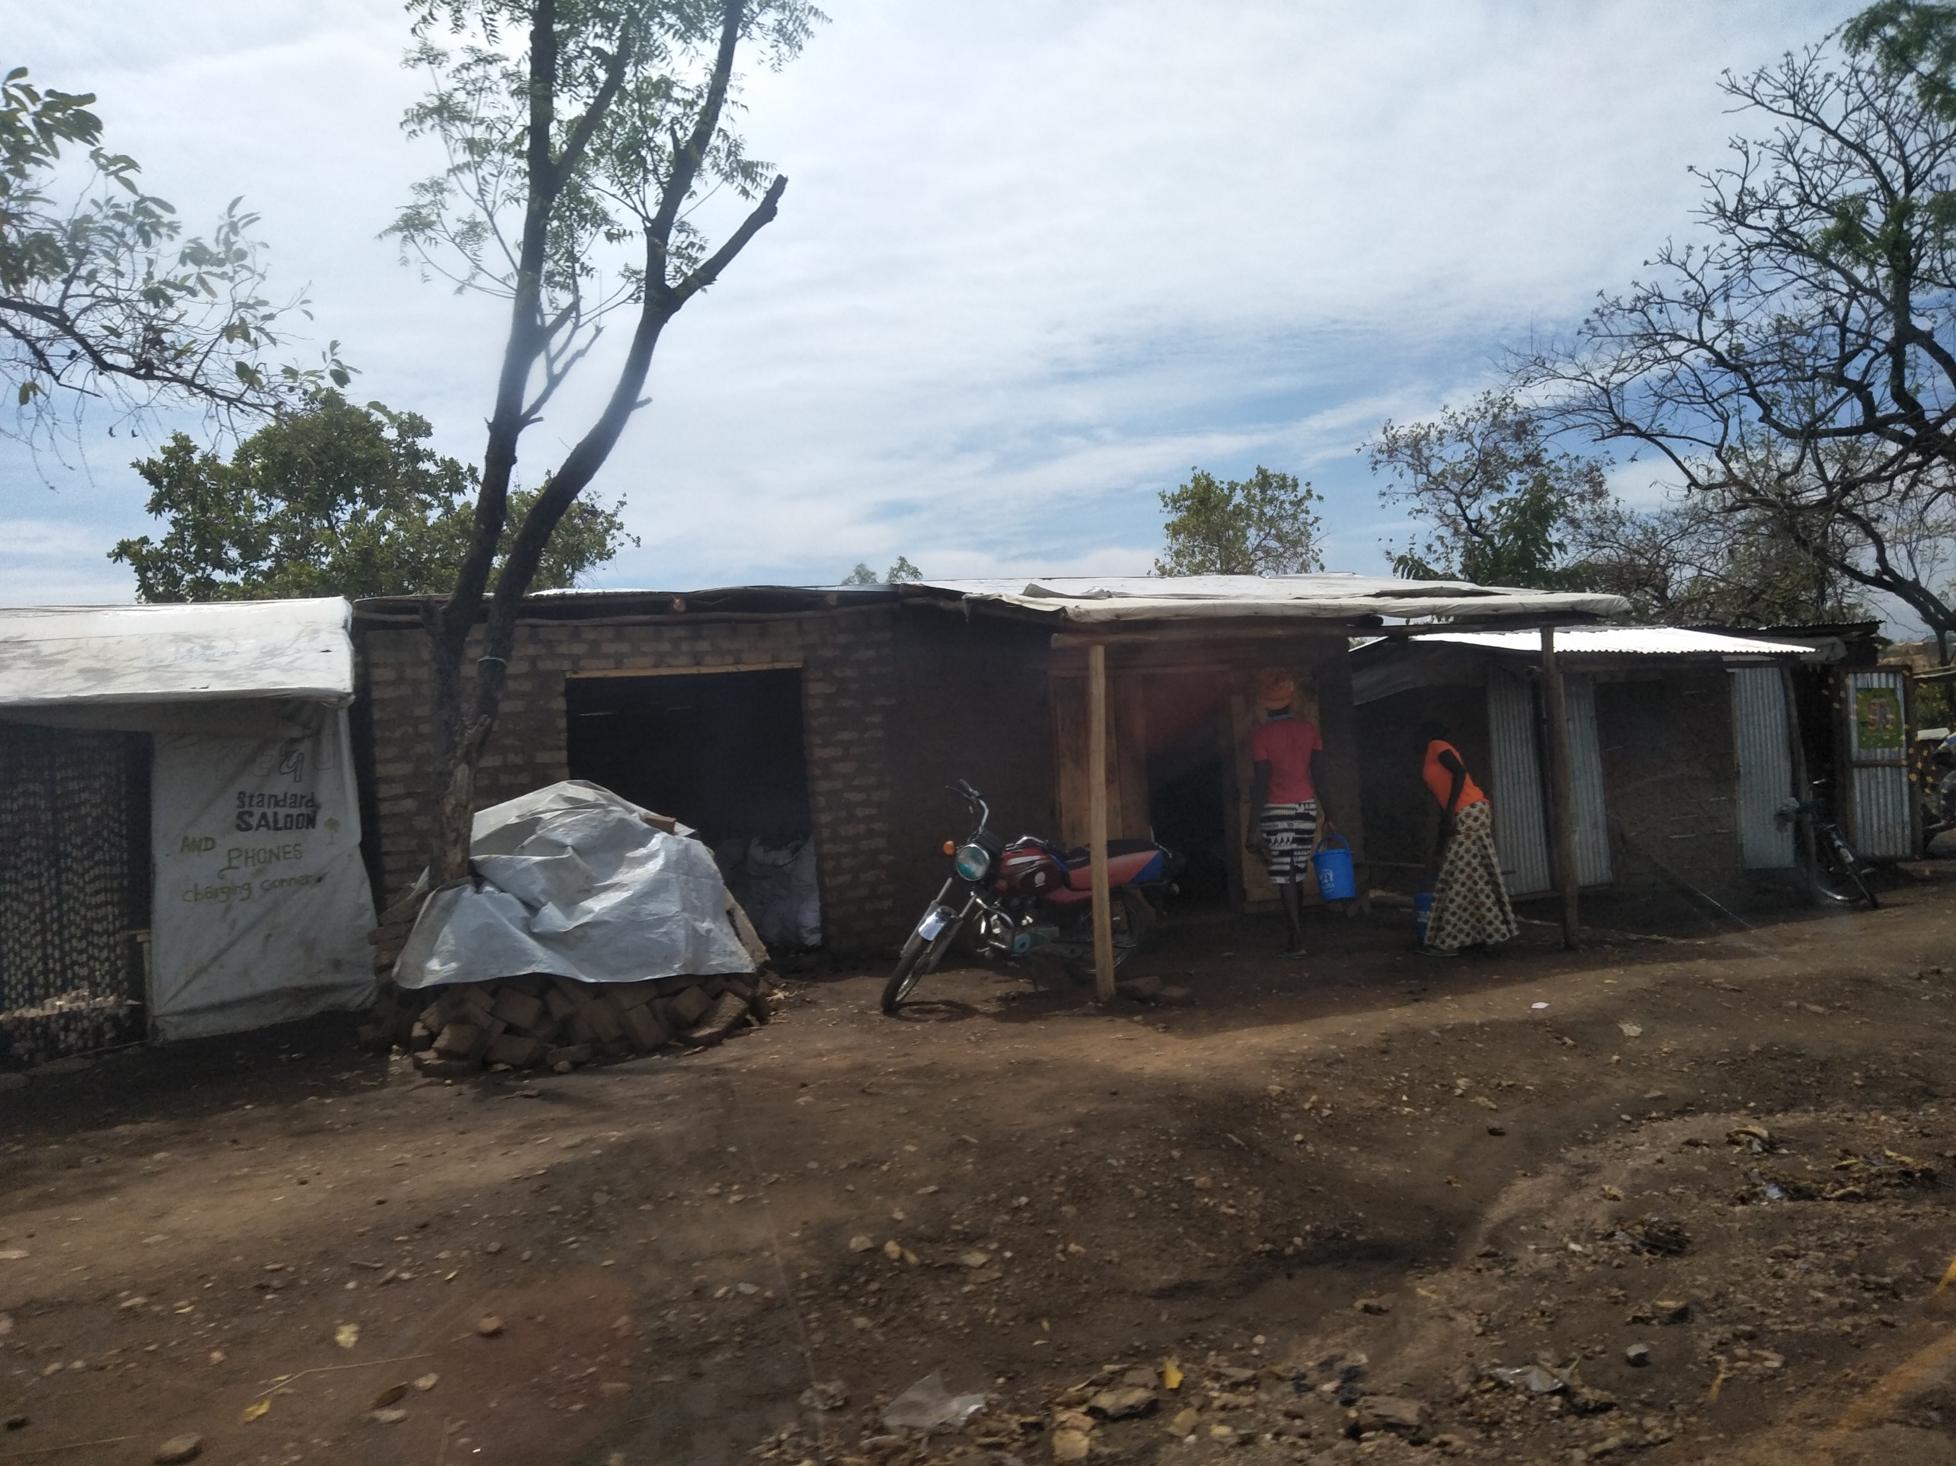
A refugee ‘settlement’

Slide 6
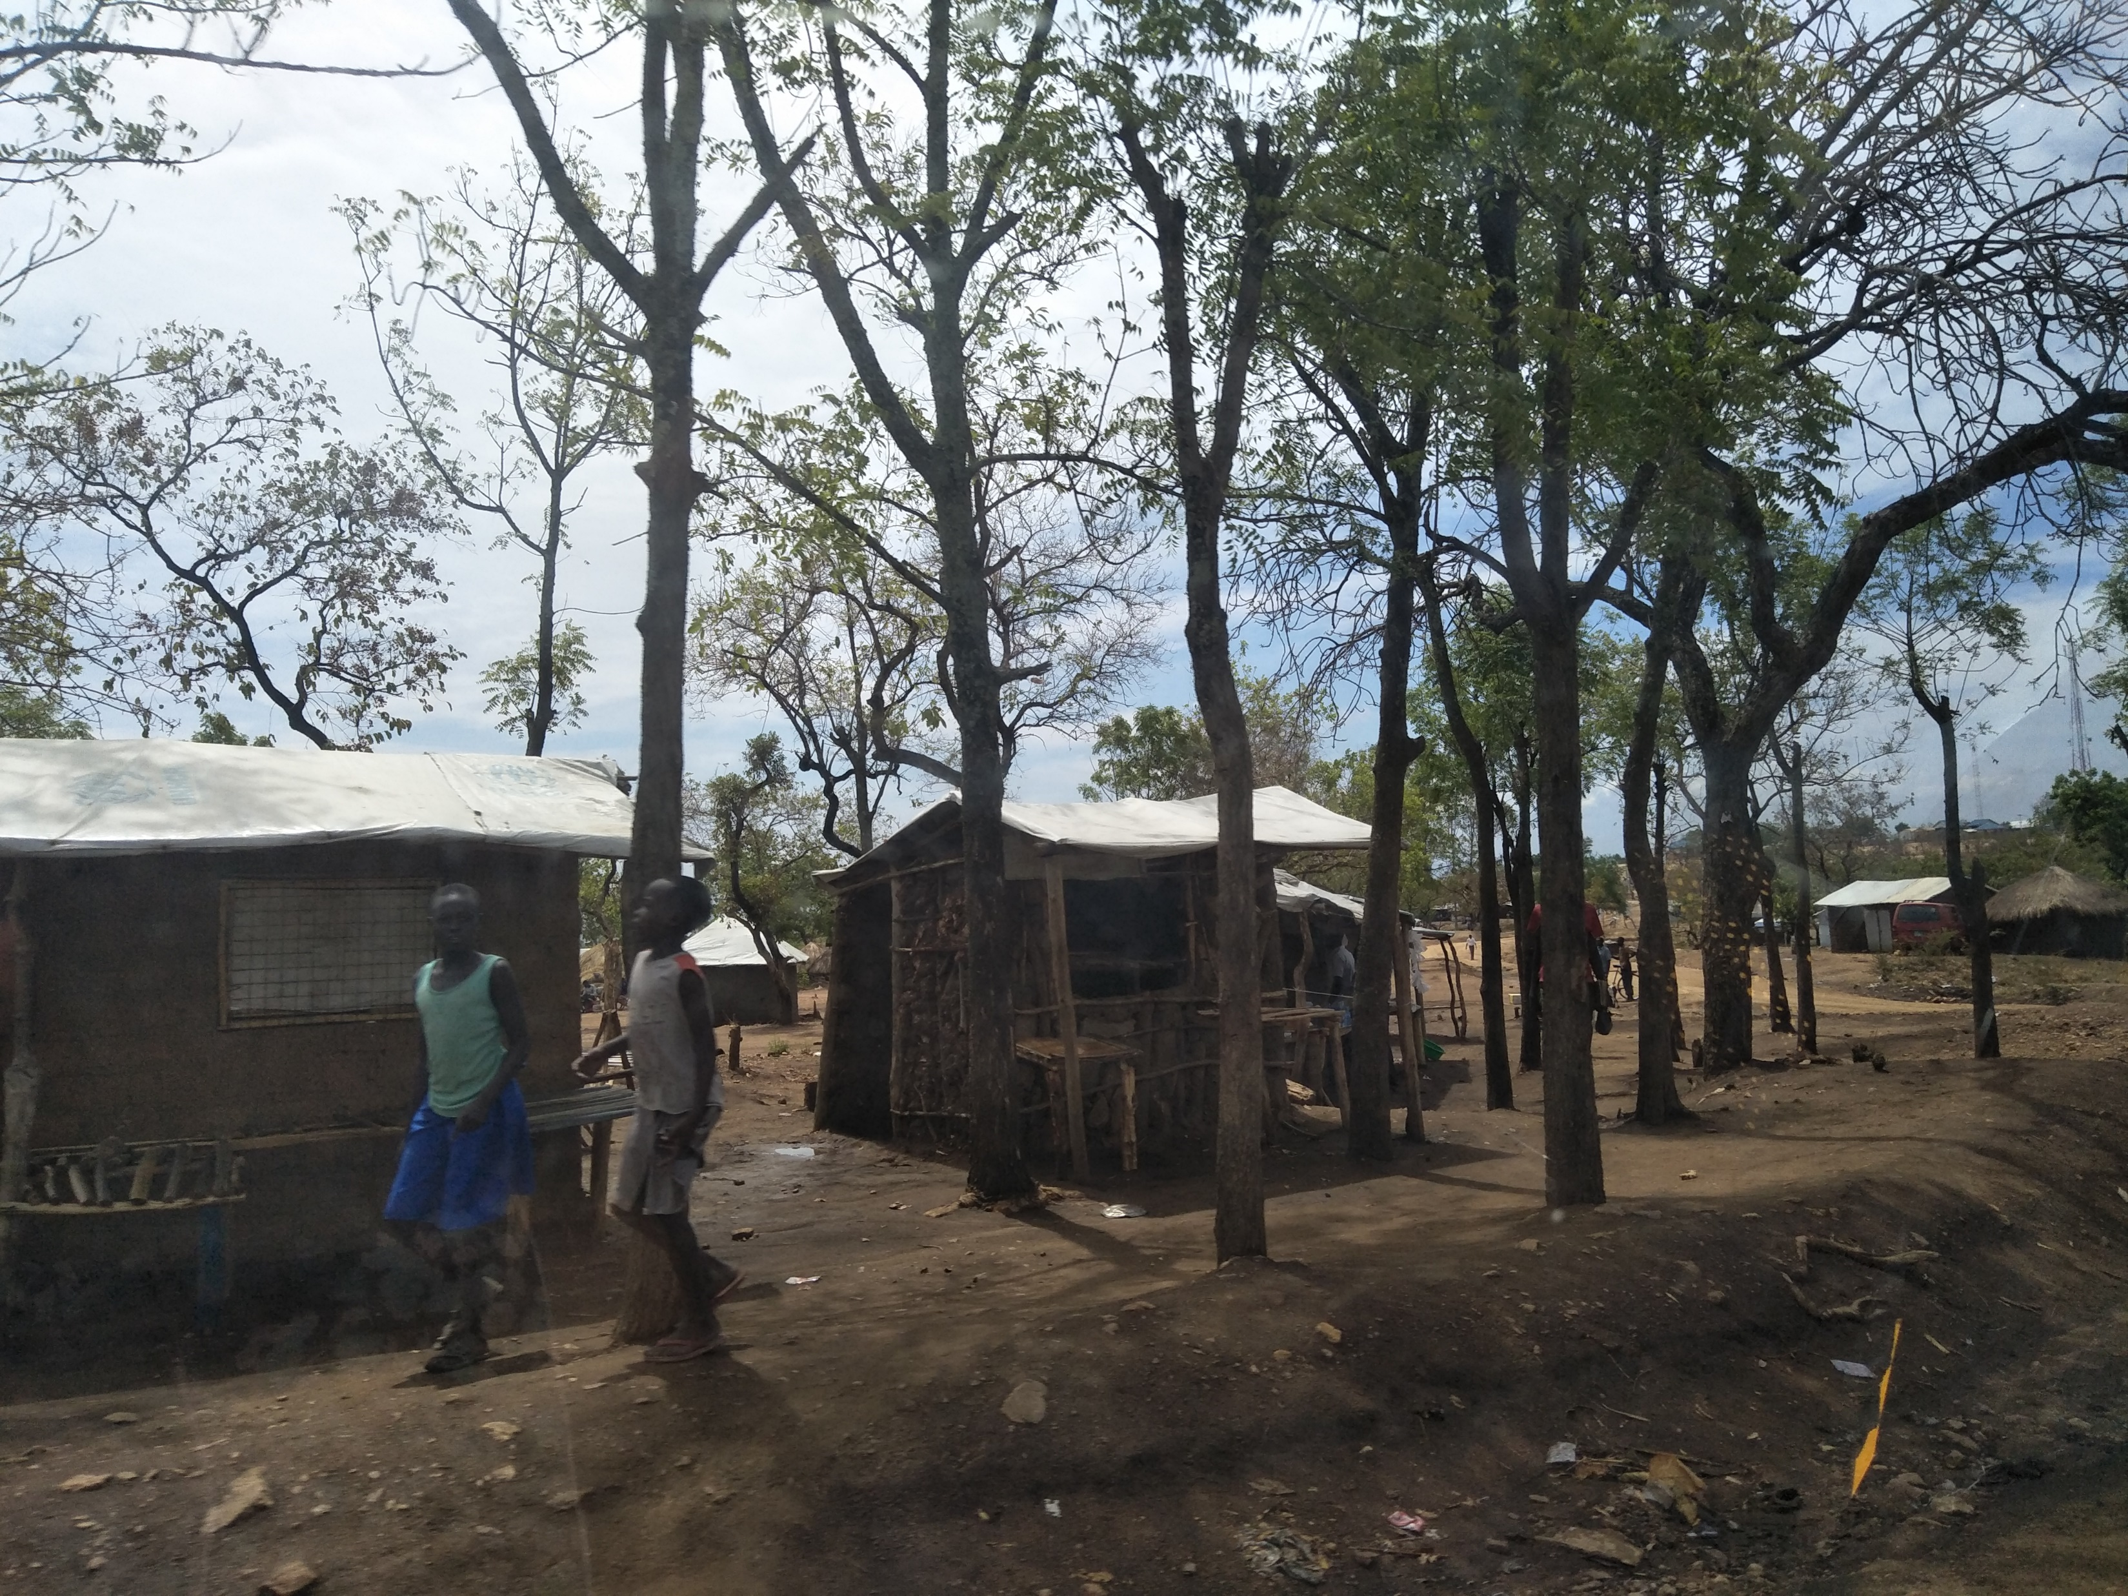
Housing similar to local community

Slide 7
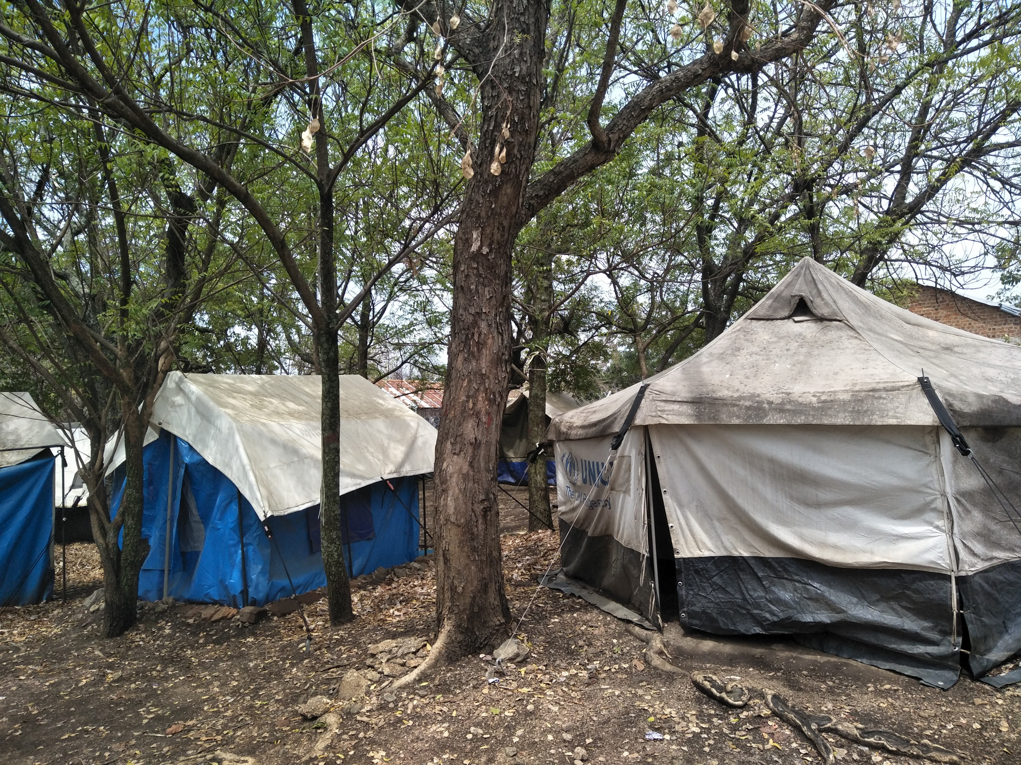
Not made-shift tents

Slide 8
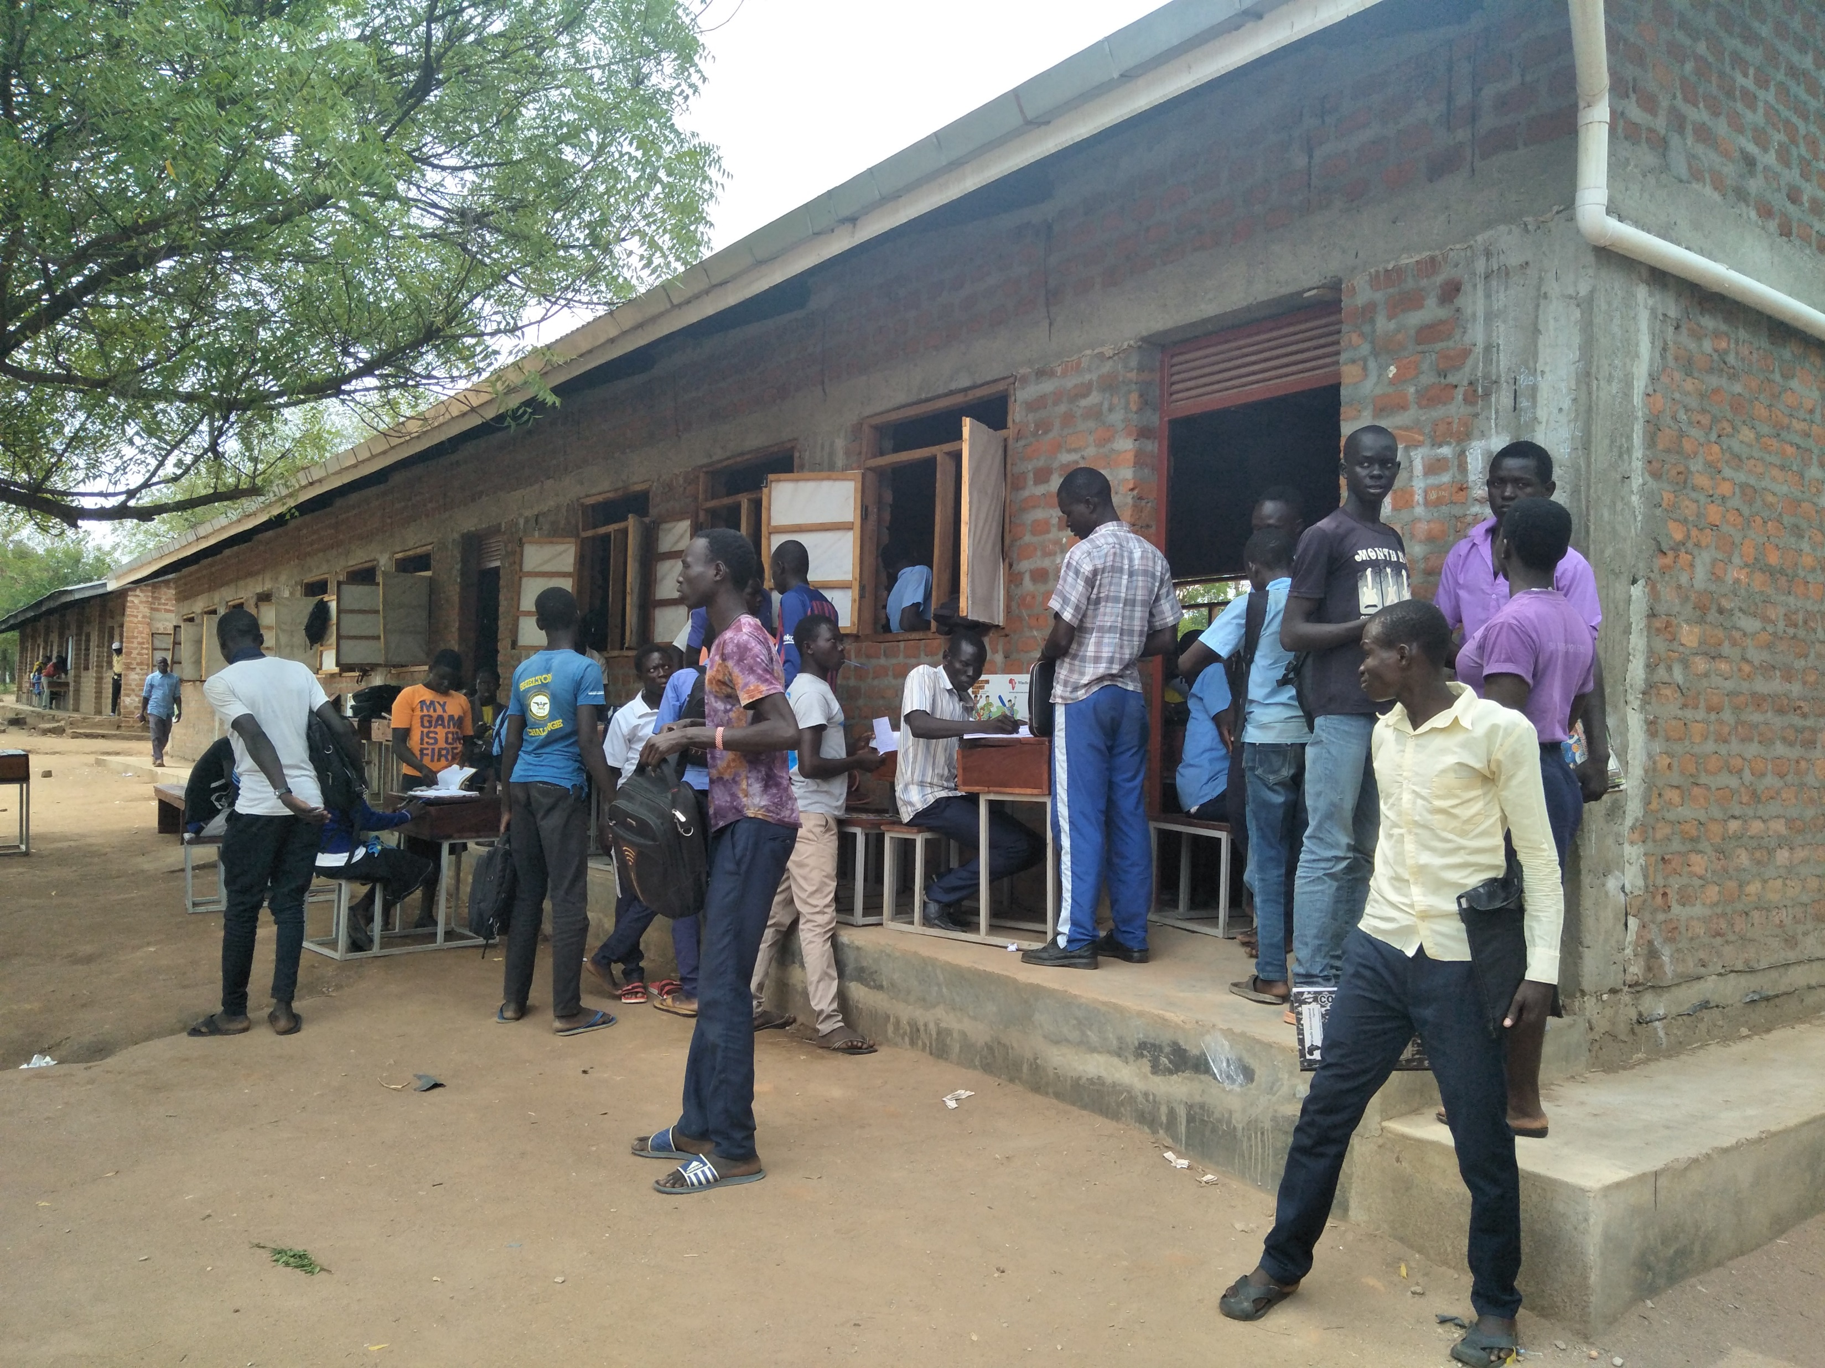
Students have the chance to go to school

Slide 9
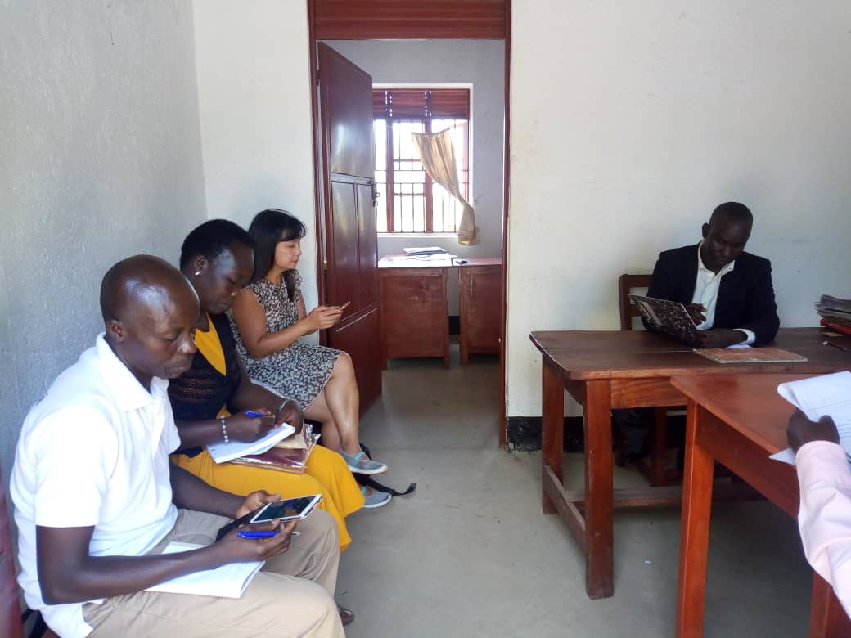
Briefing by the Headmaster

Slide 10
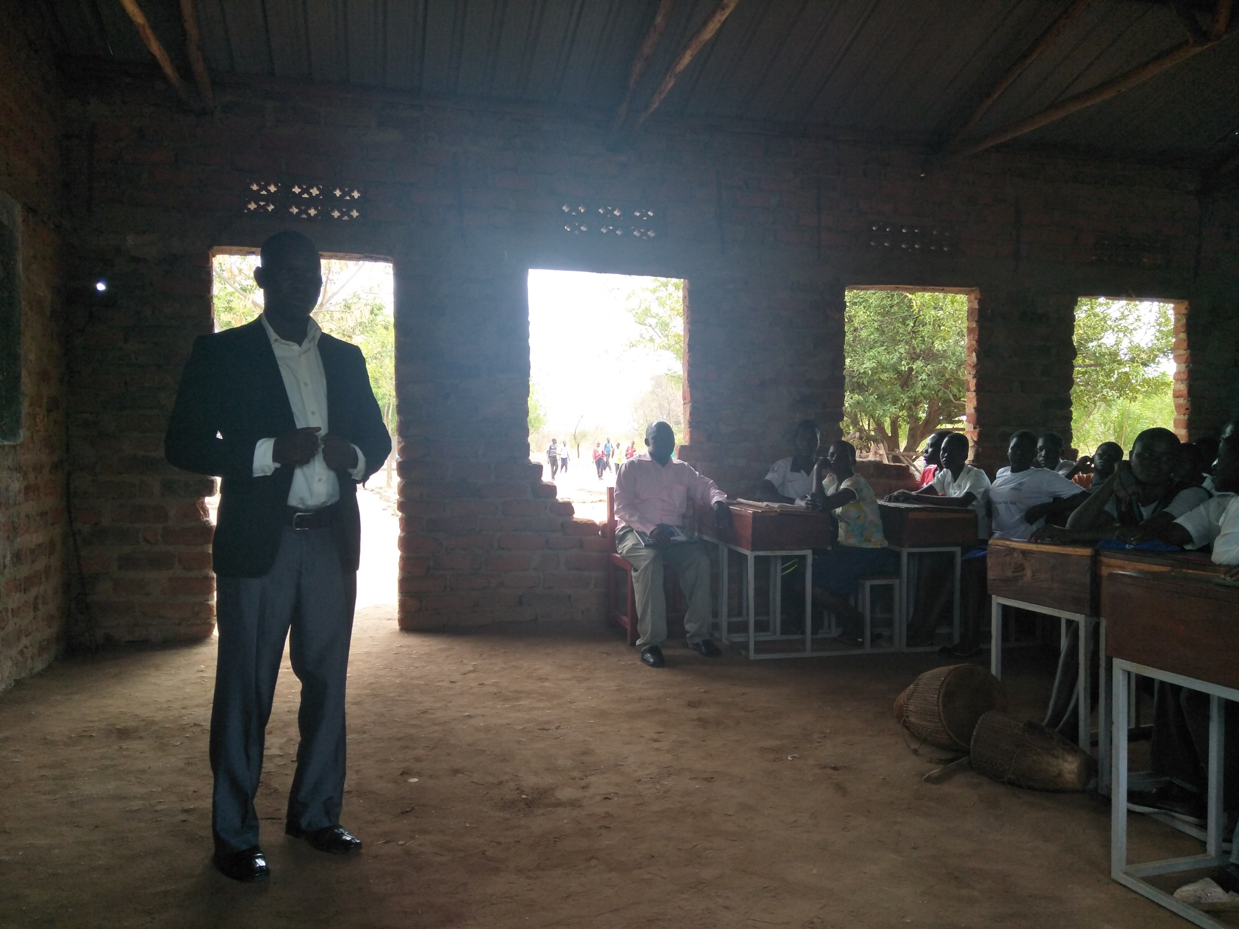
Headmaster giving a speech

Slide 11
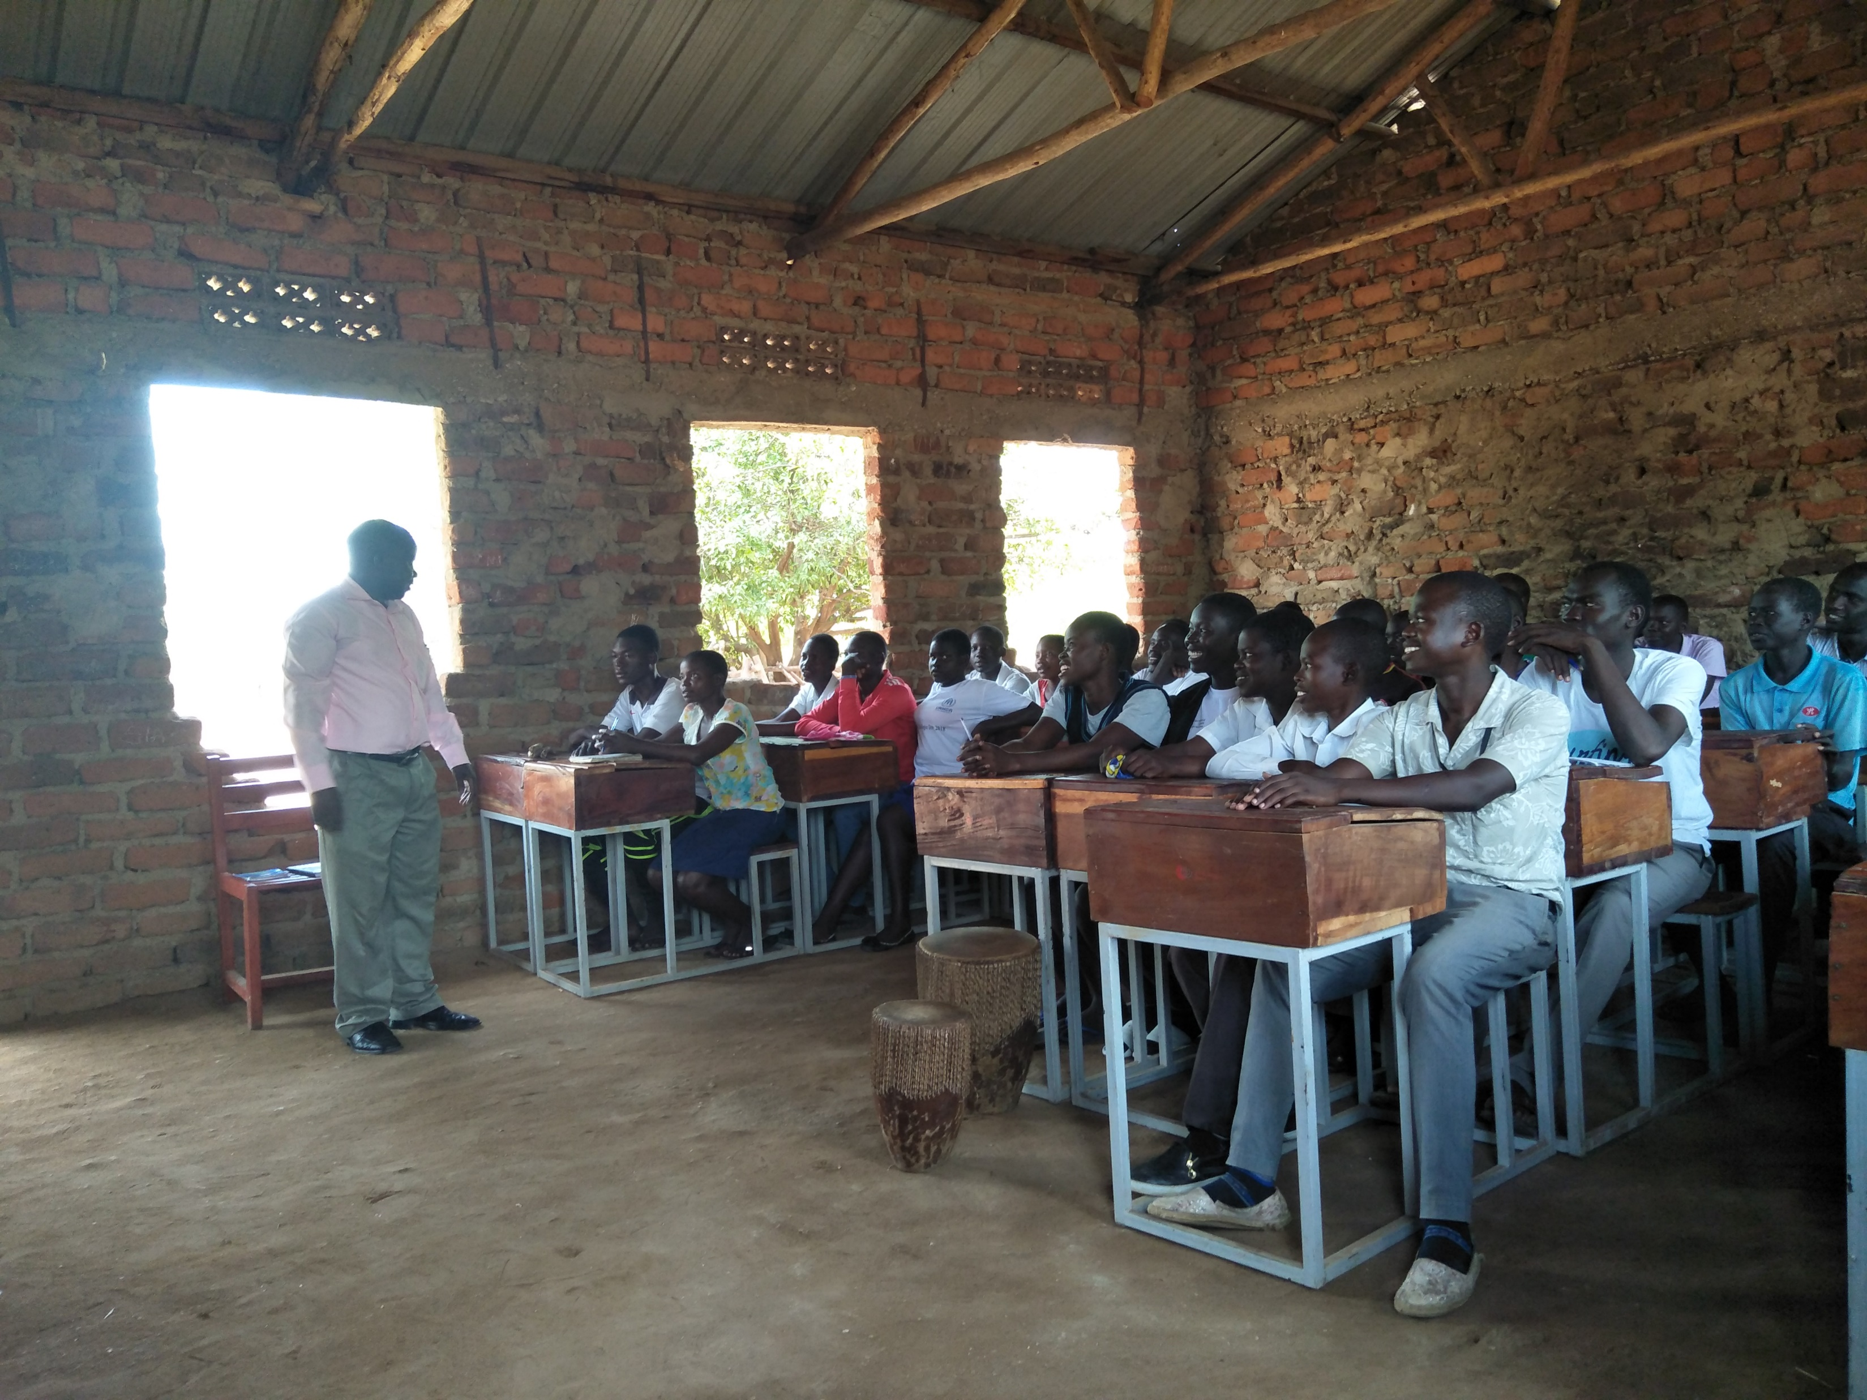
Deputy Head treating the students as friends

Slide 12
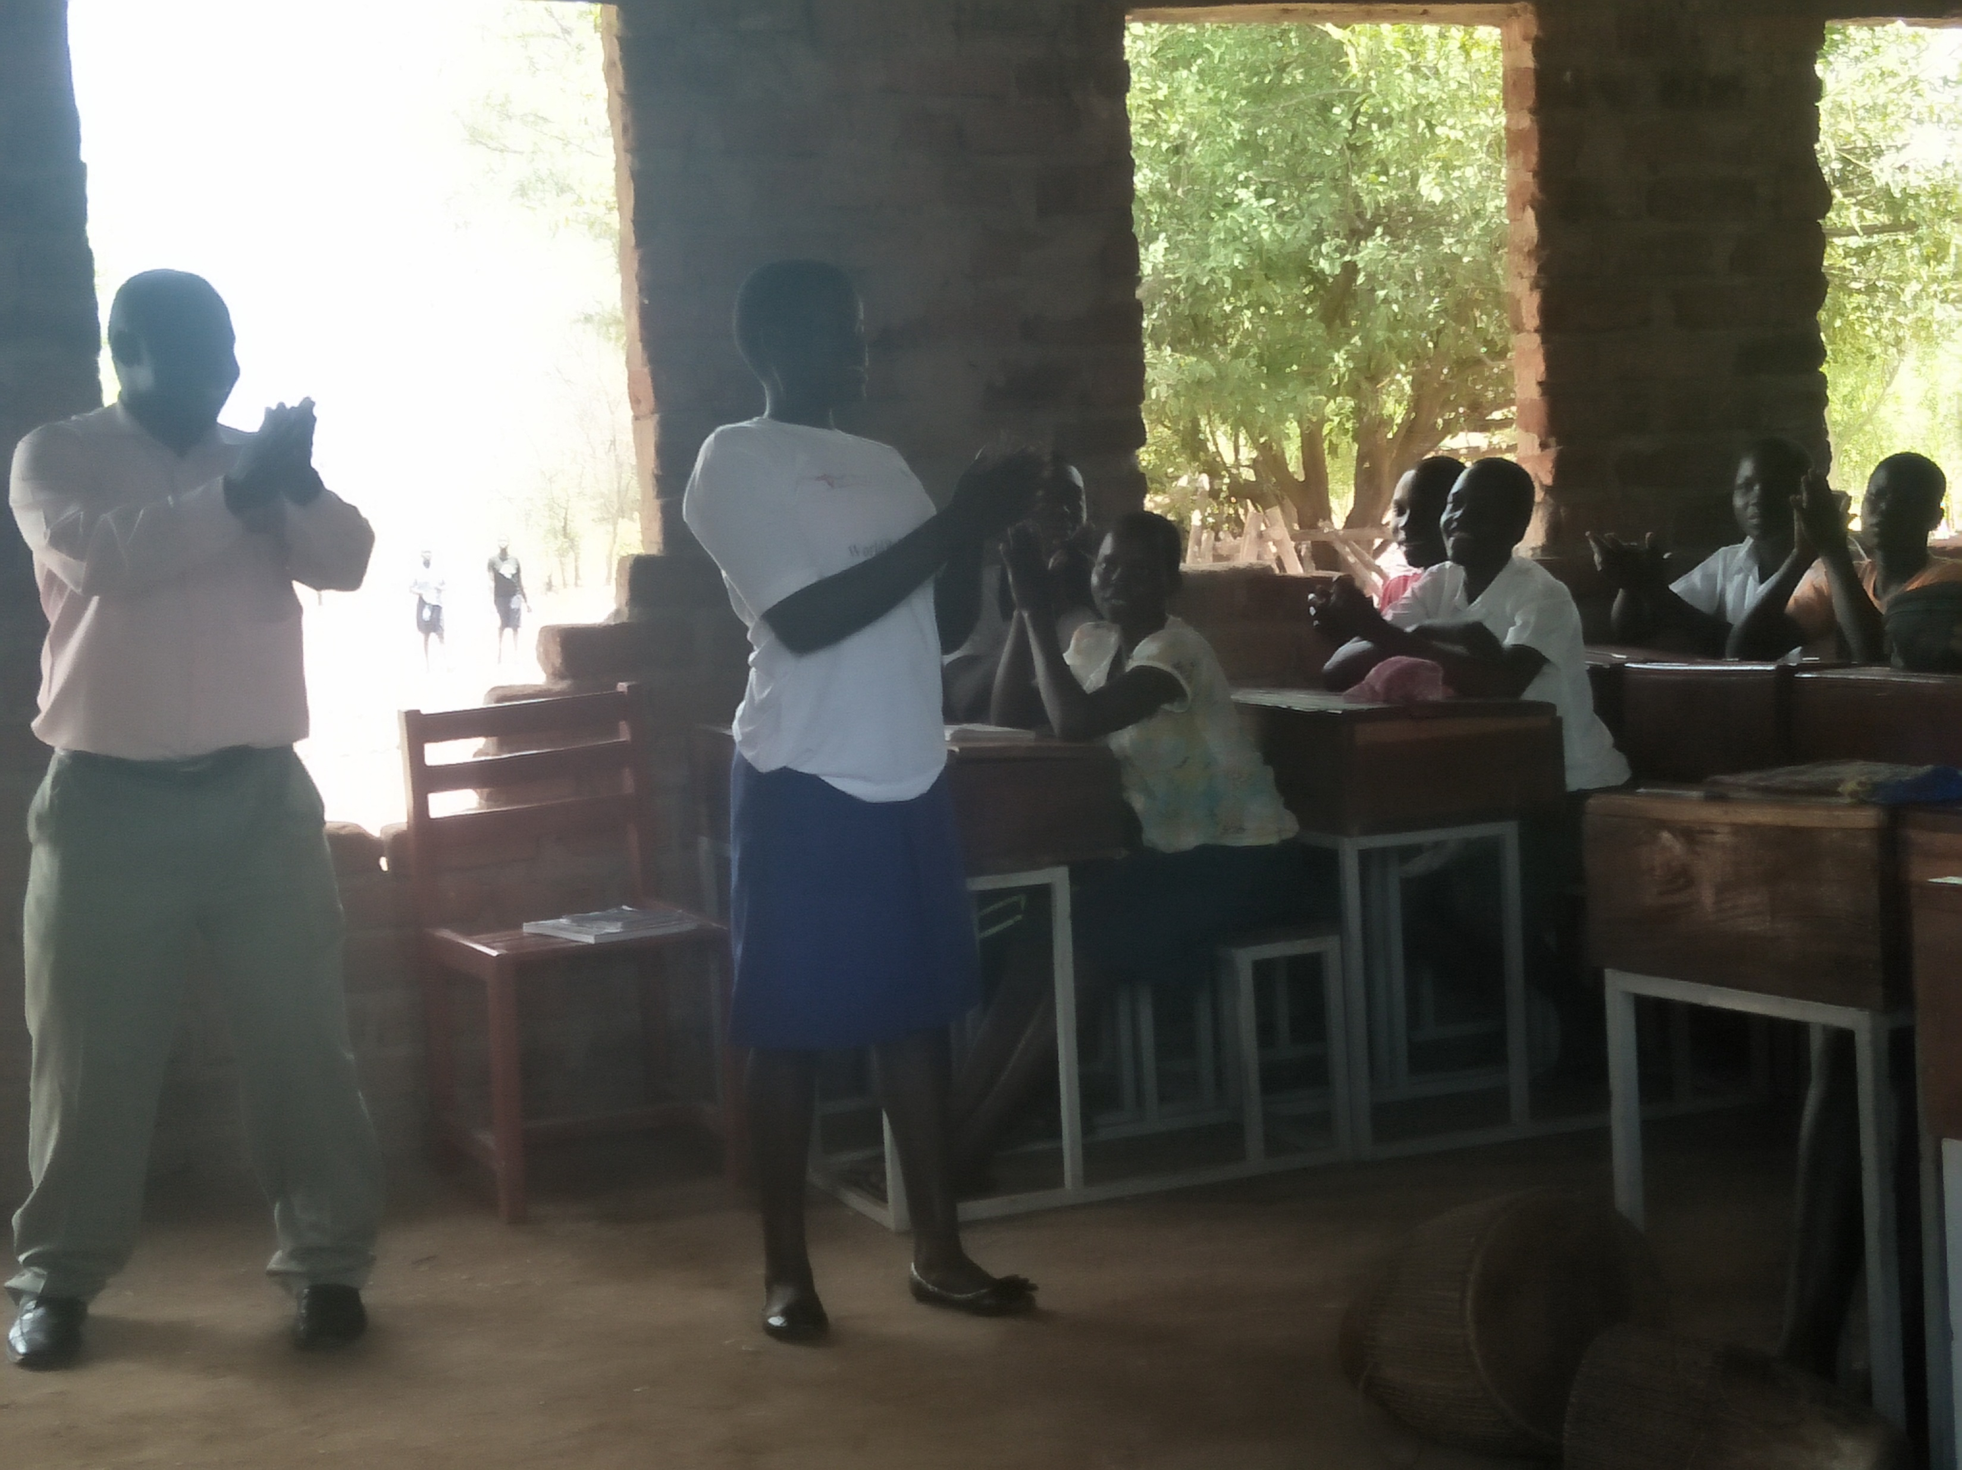
Deputy Head engaging with the students

Slide 13
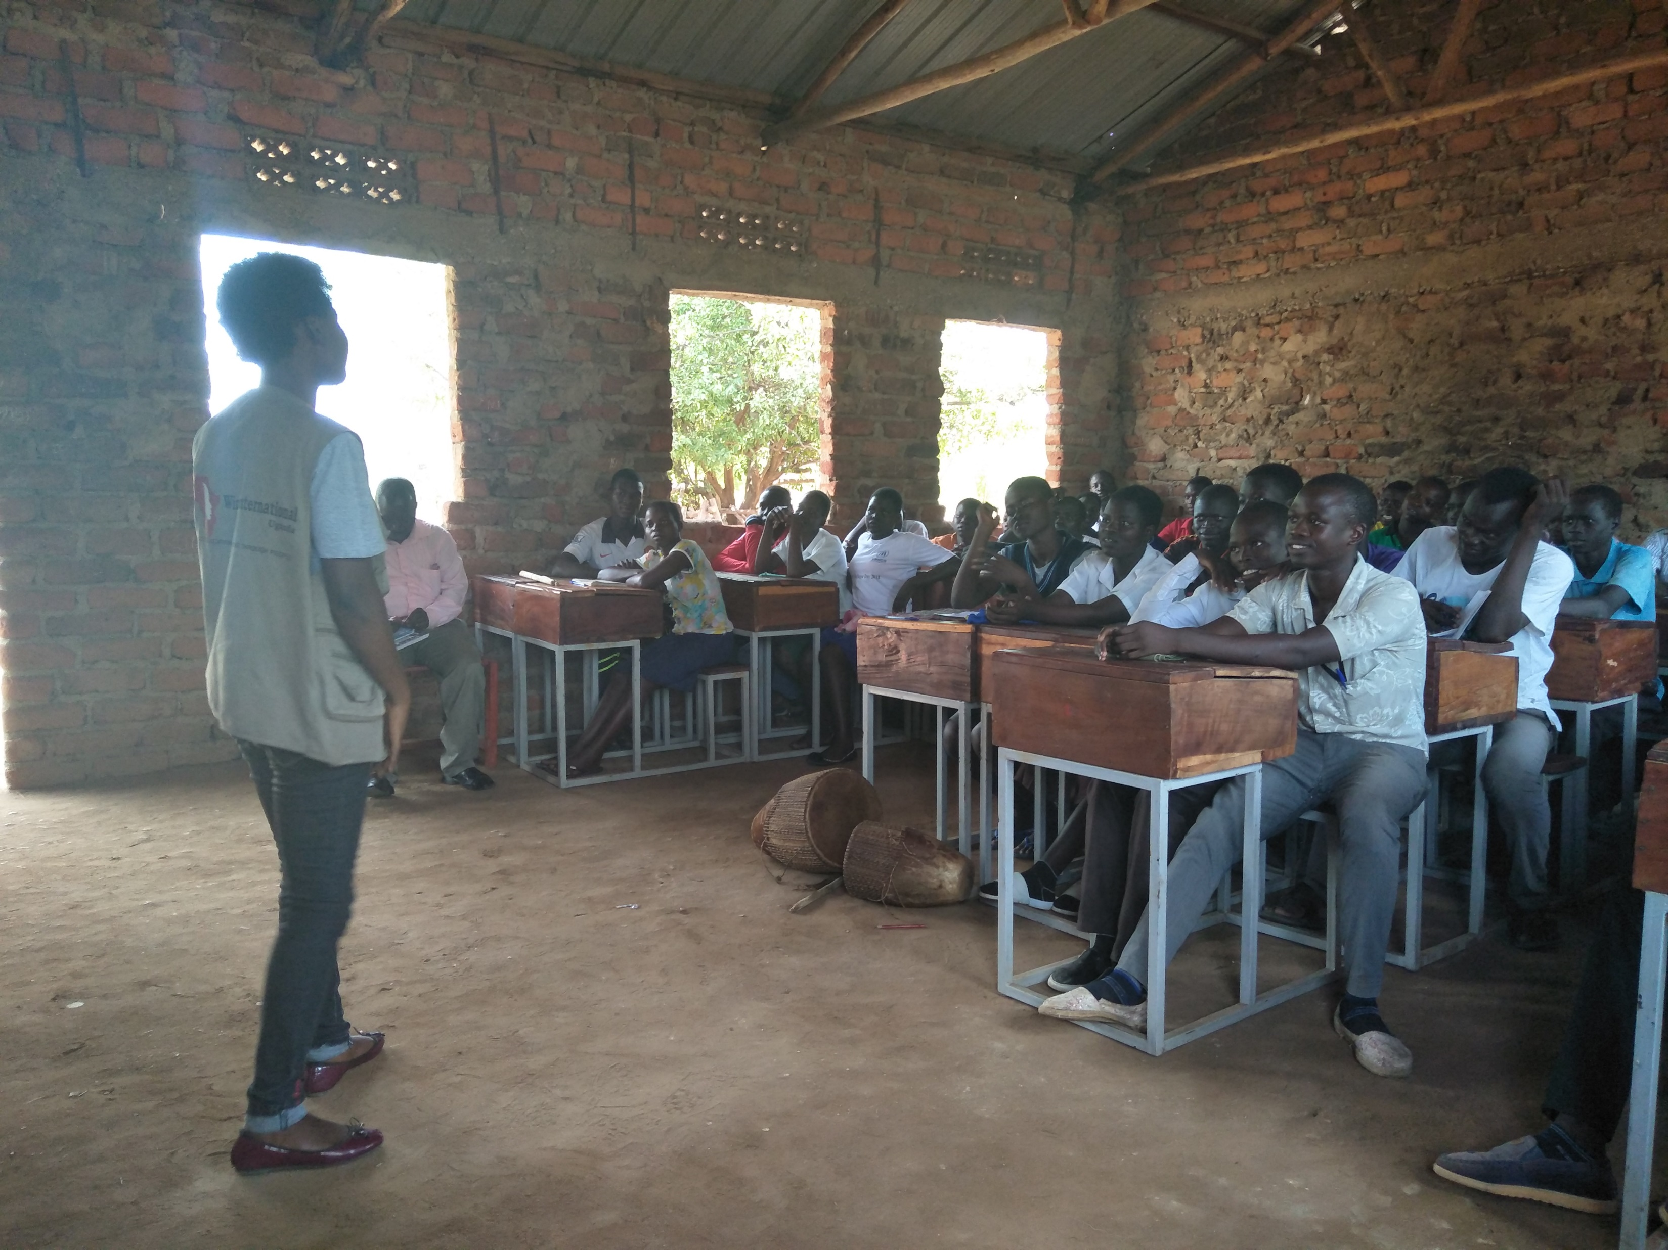
EPO encouraging the students to work hard

Slide 14
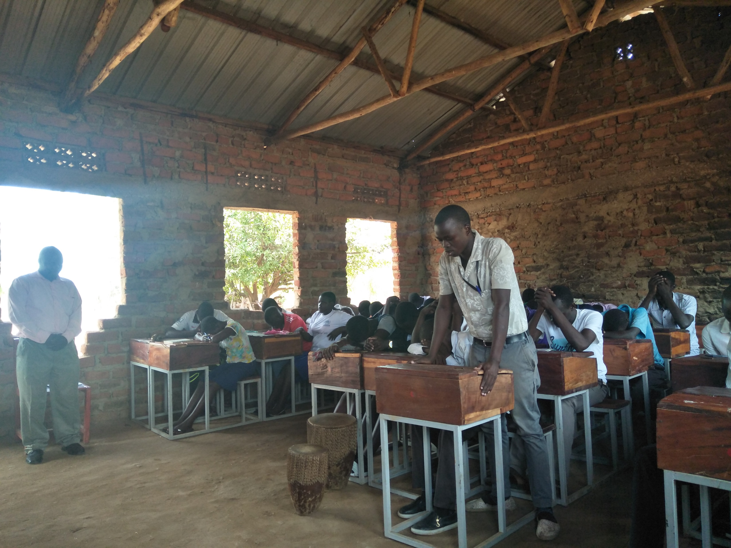
Student saying the opening prayer

Slide 15
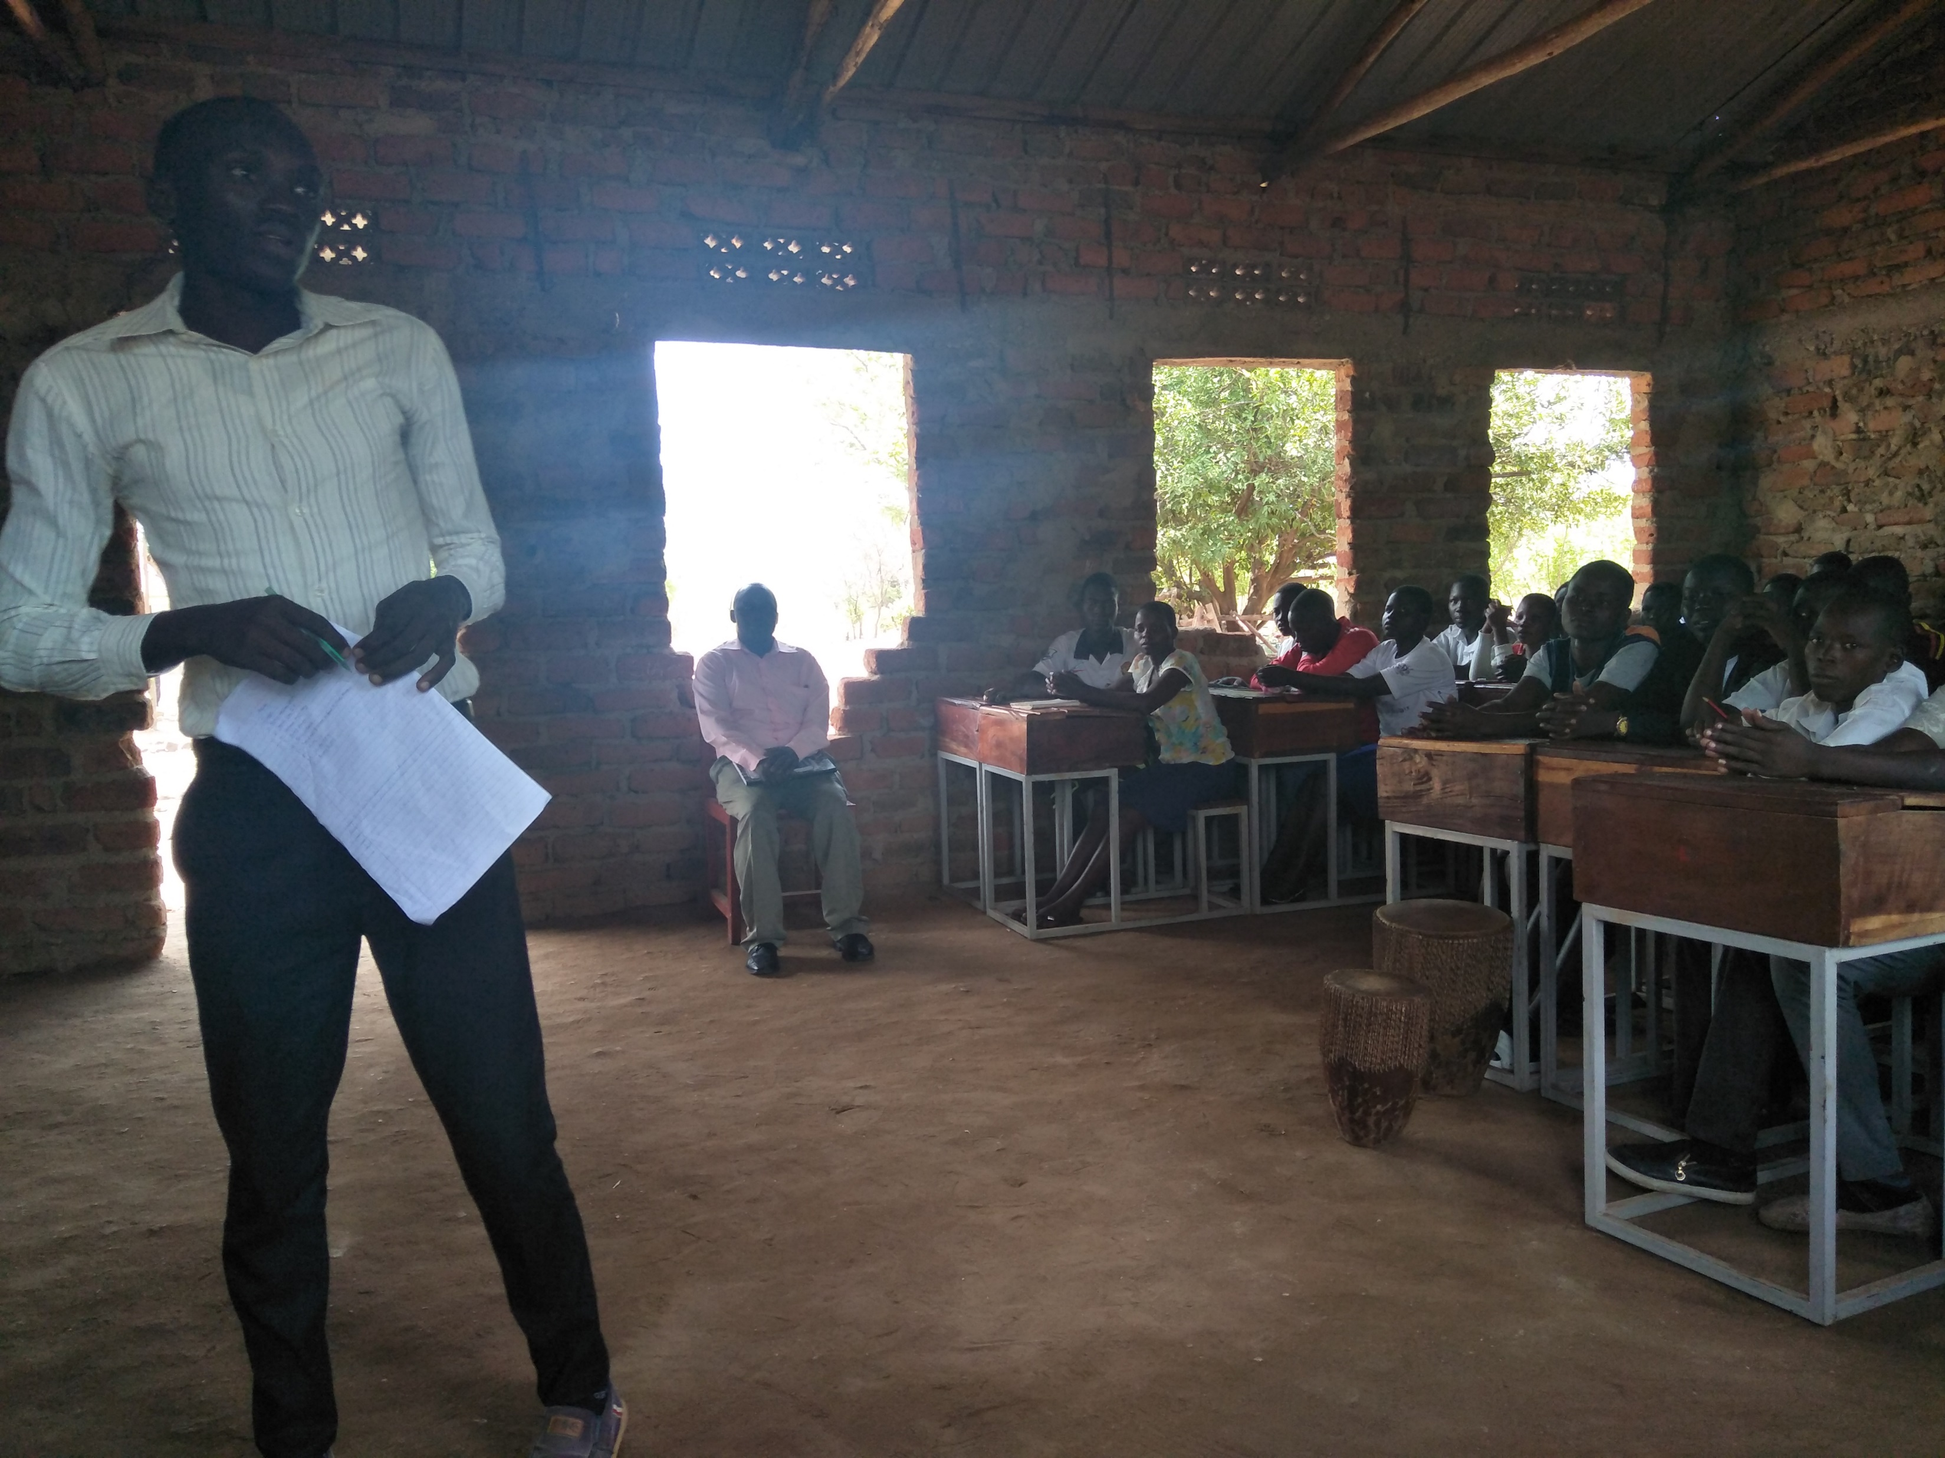
Student presenting their needs, and not theirs only but that of the other 793

Slide 16
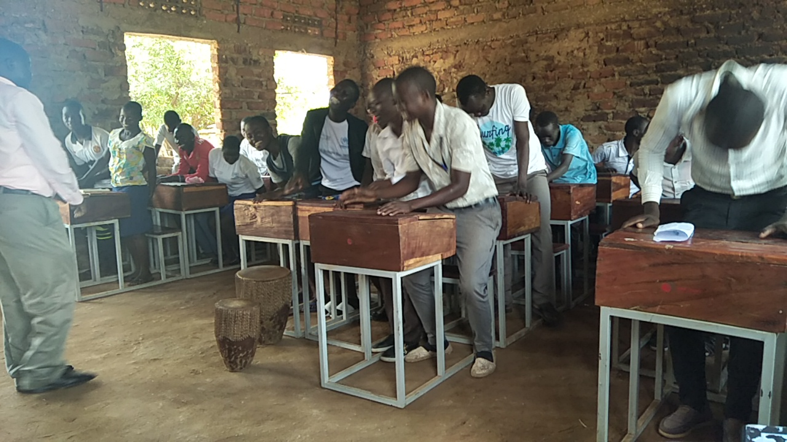
Students with their creative way of saying thanks

Slide 17
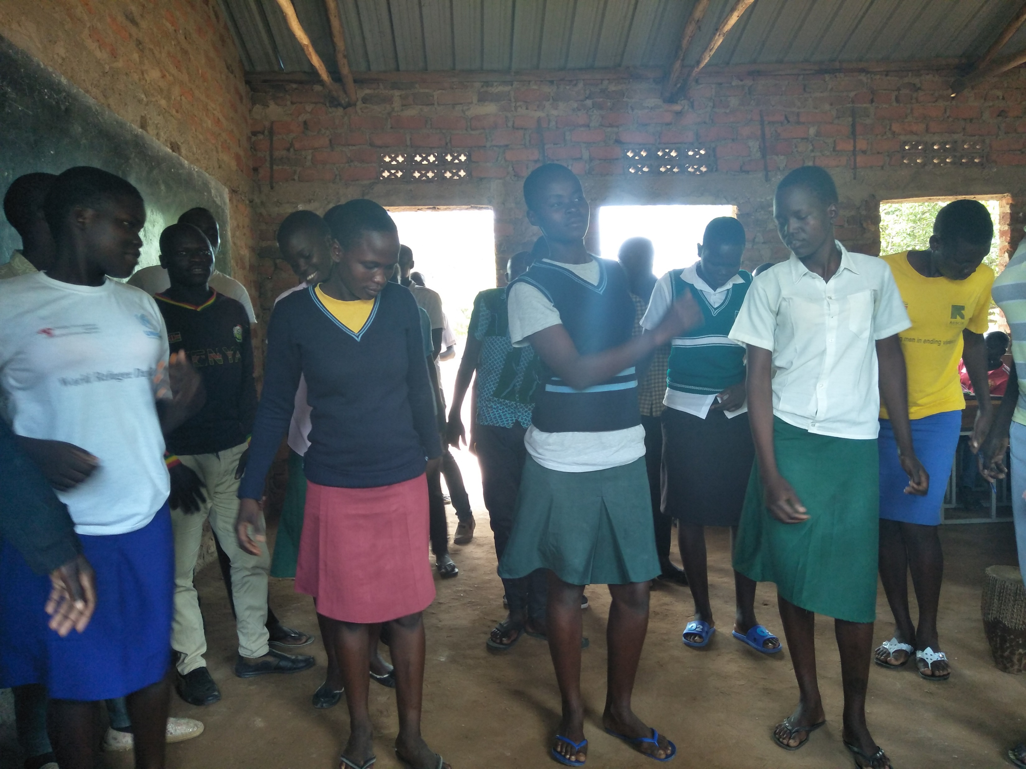
Students presenting a song and dance

Slide 18
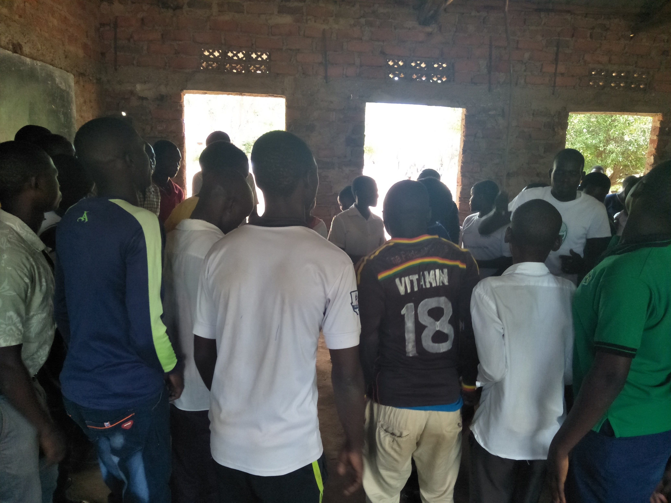
Another song item to say thanks to STAD

Slide 19
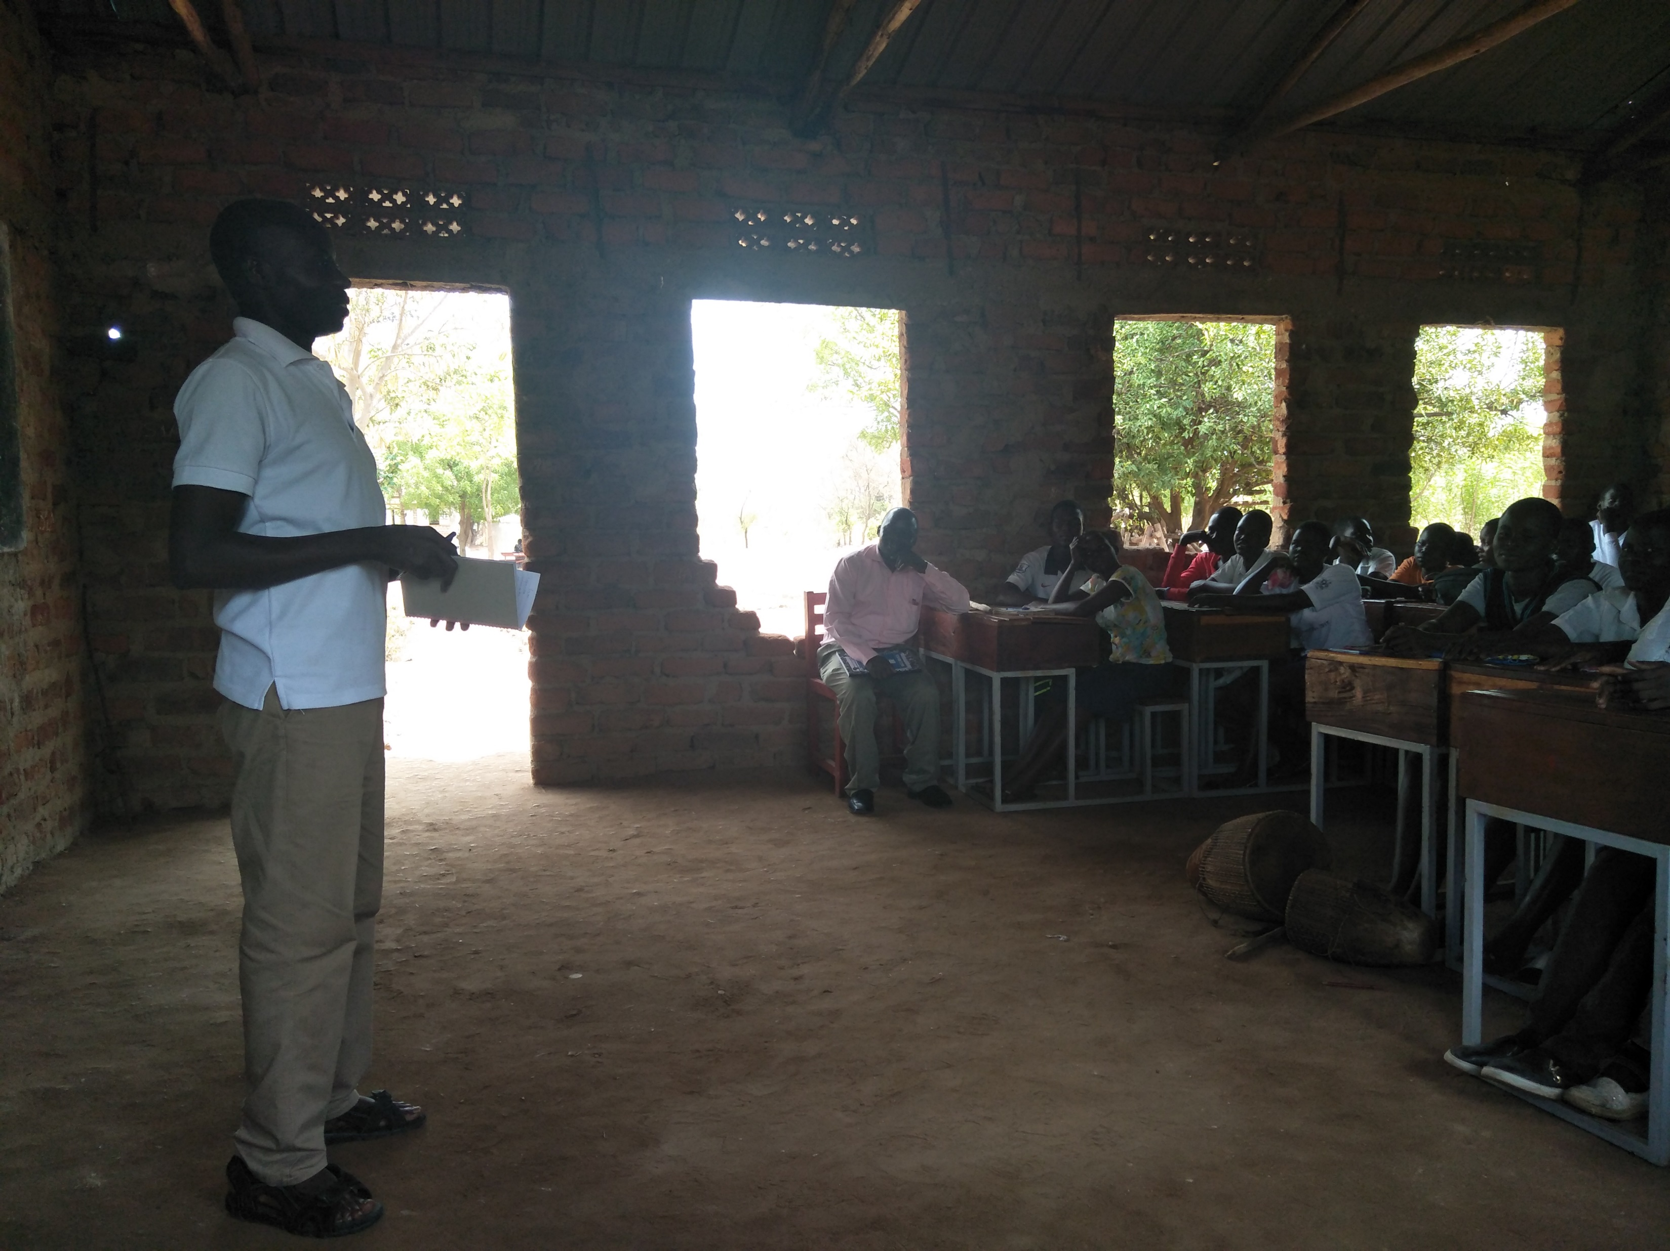
Windle staff with a strong sense of accountability

Slide 20
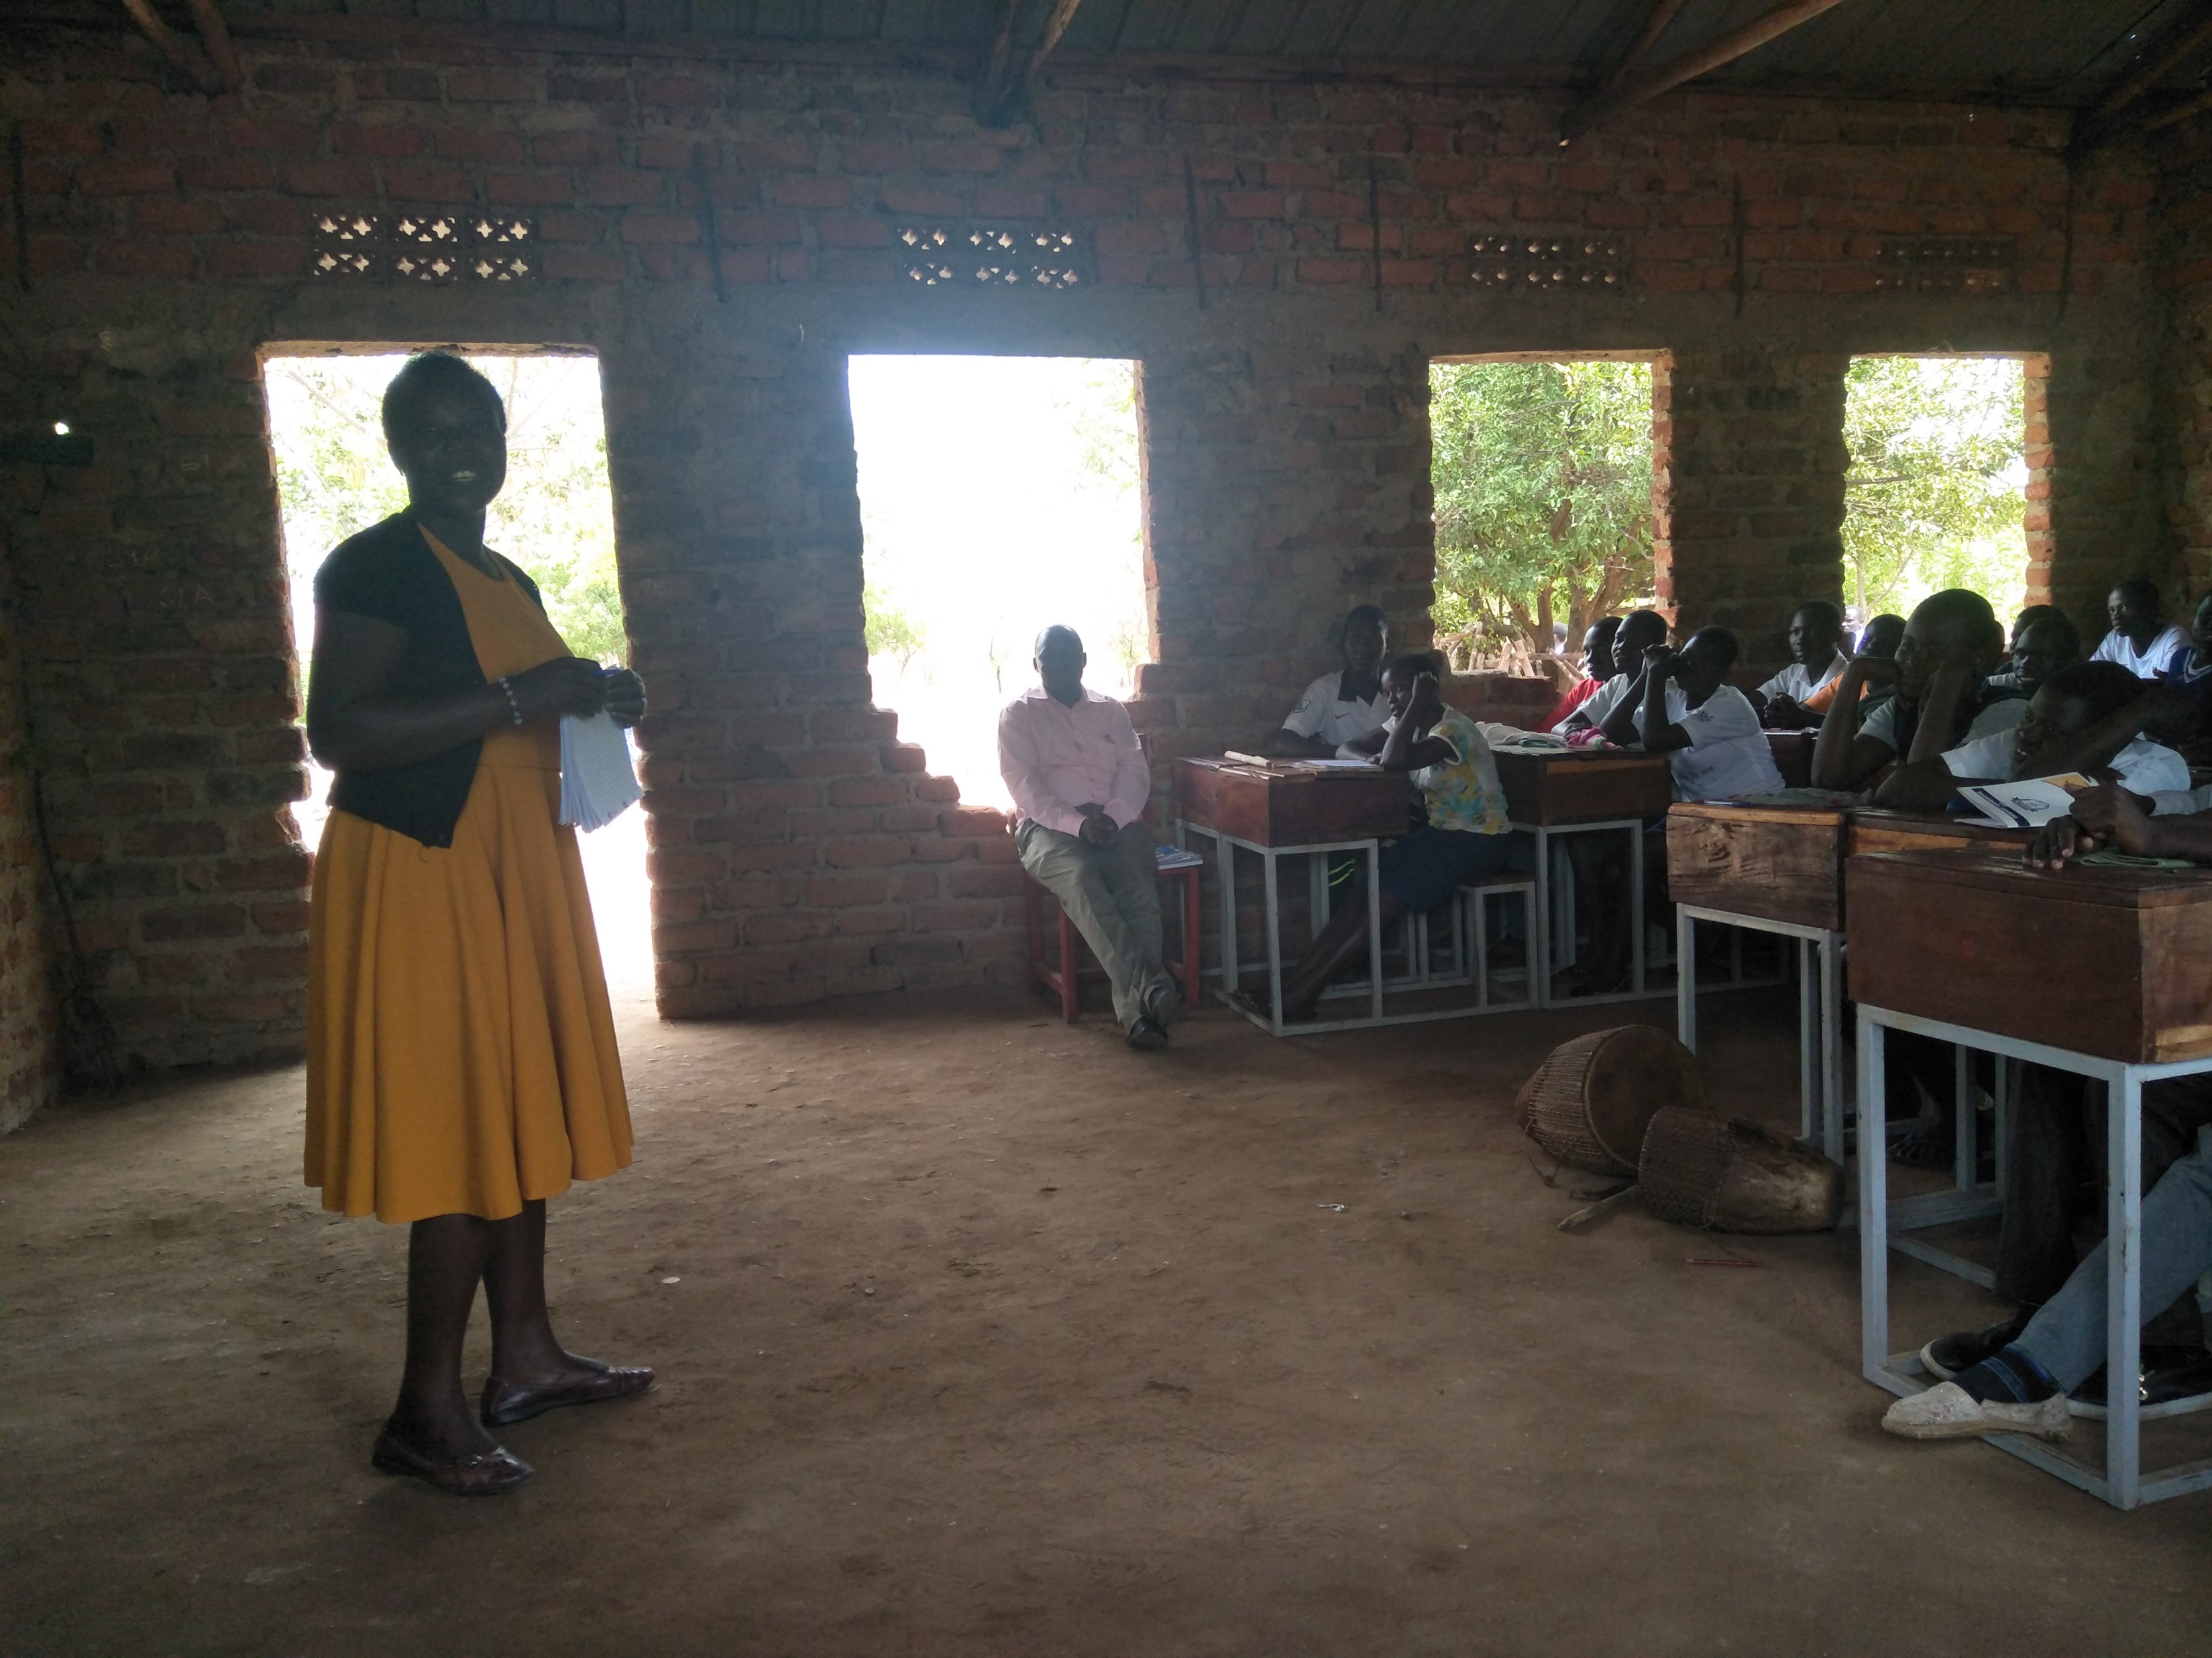
STAD’s own GTA who handles the funds

Slide 21
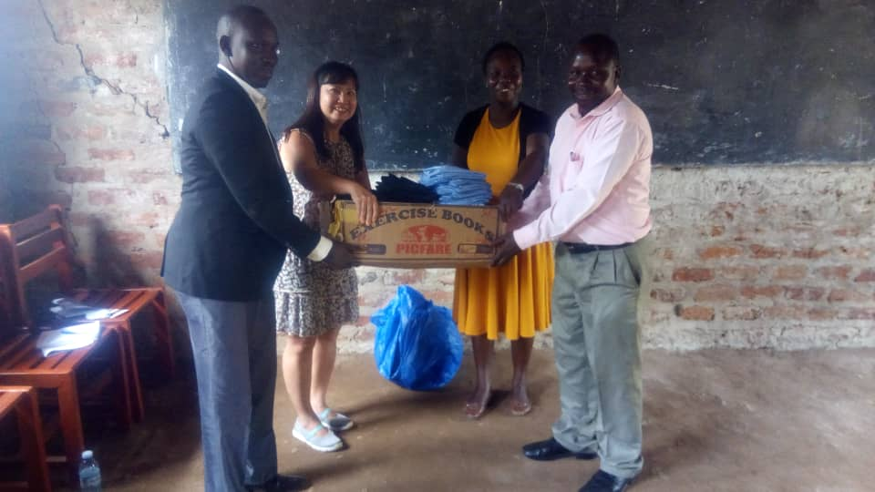
Presenting the school uniforms STAD donated

Slide 22
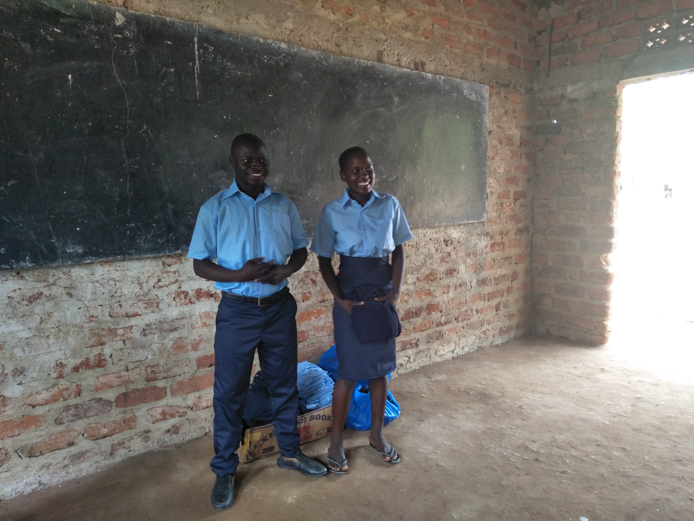
2 students proudly wearing their new uniforms

Slide 23
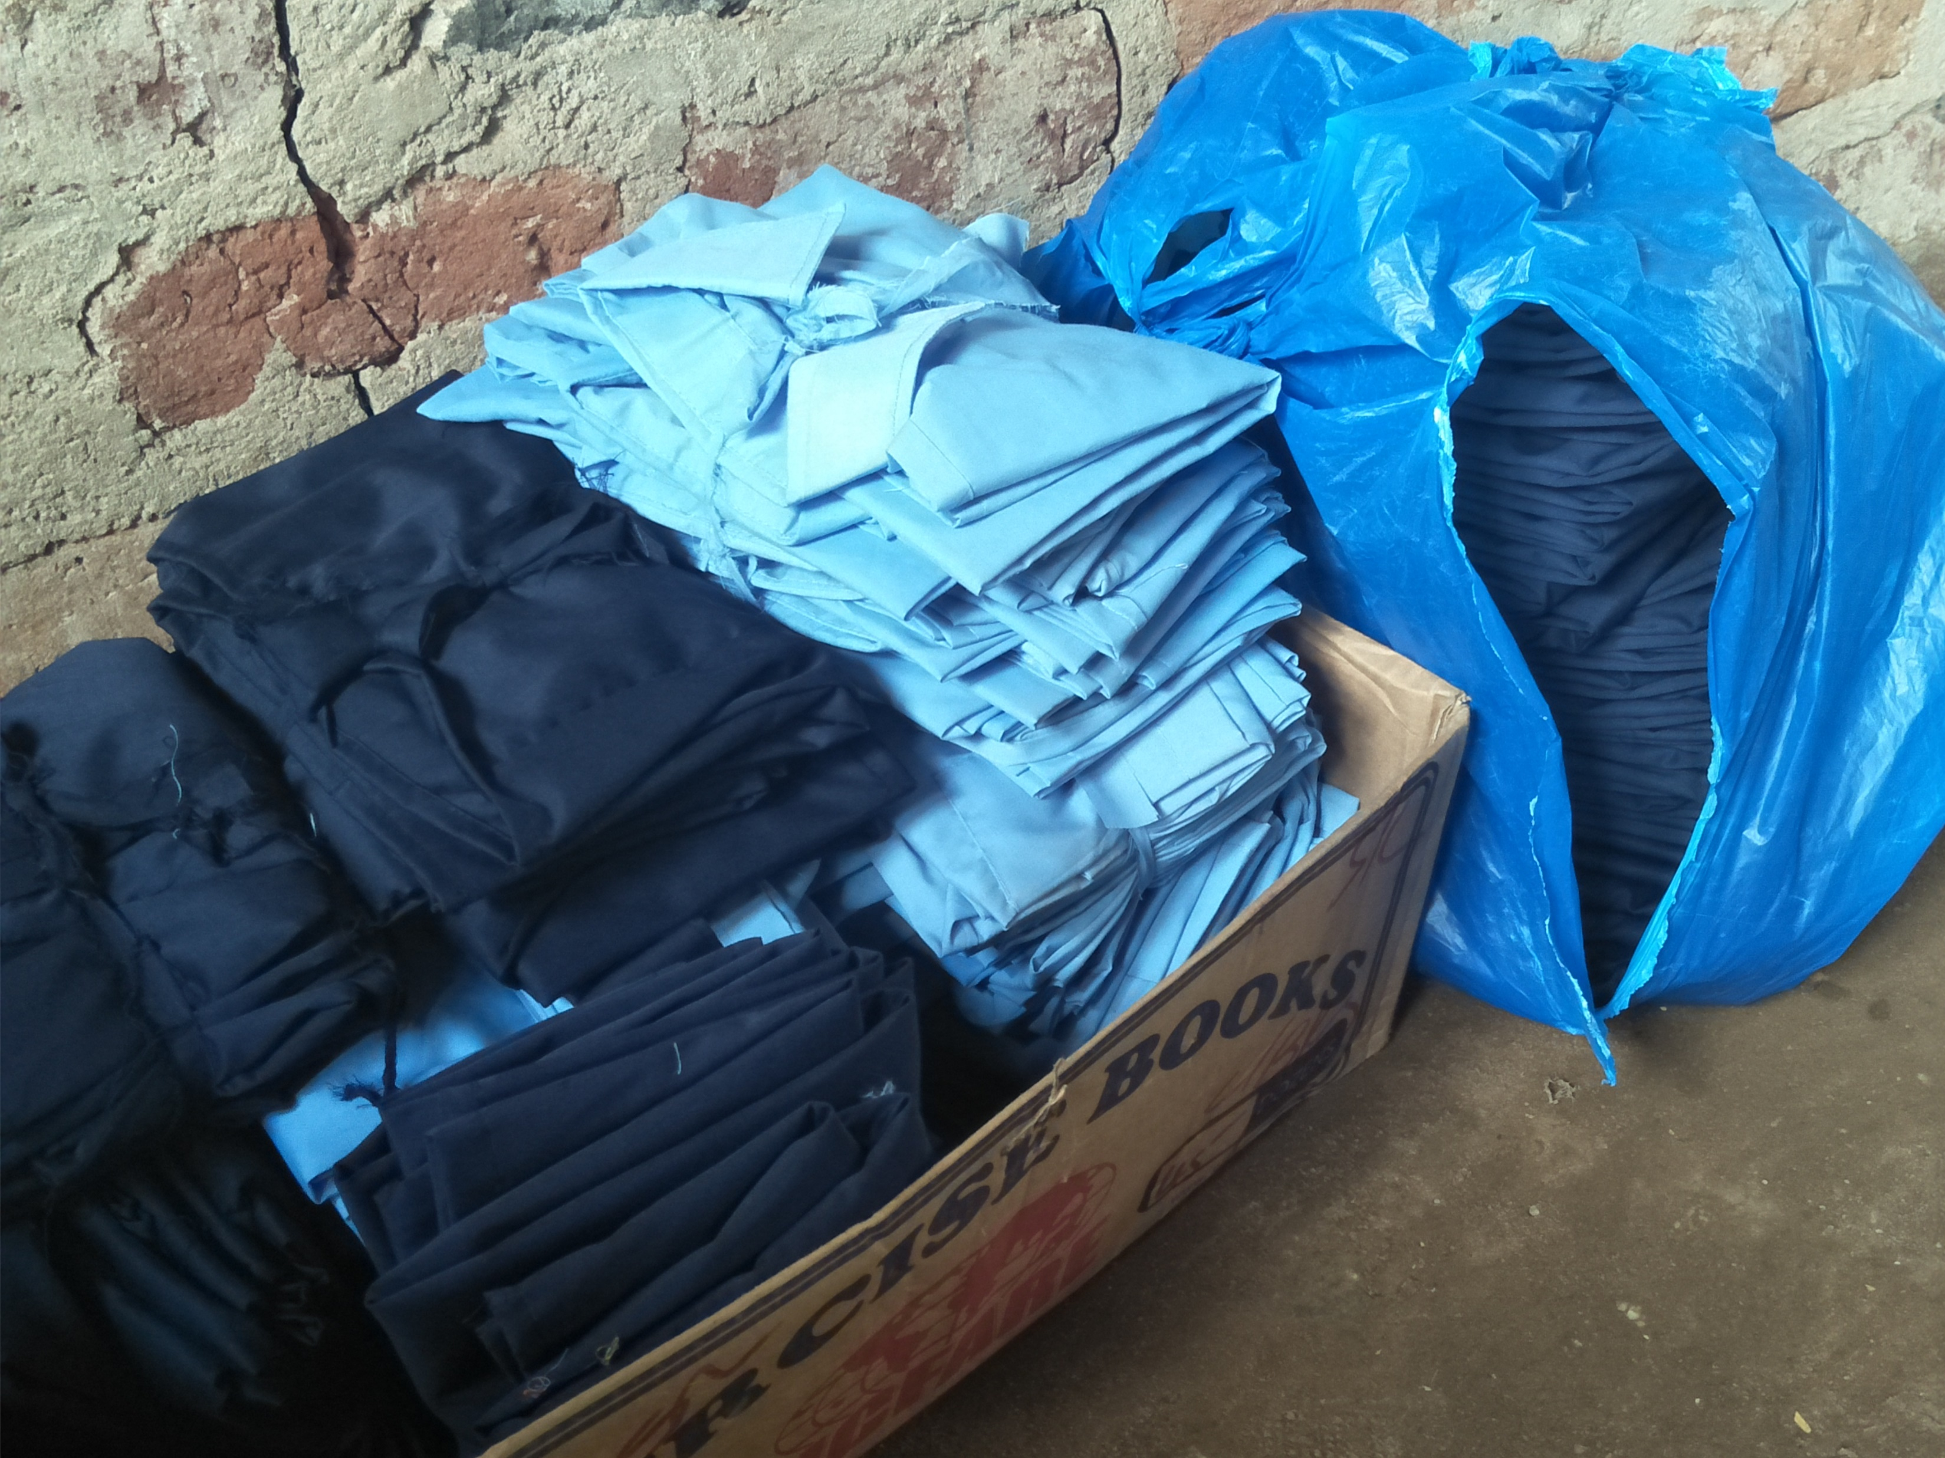
STAD’s donation meant a lot to them

Slide 24
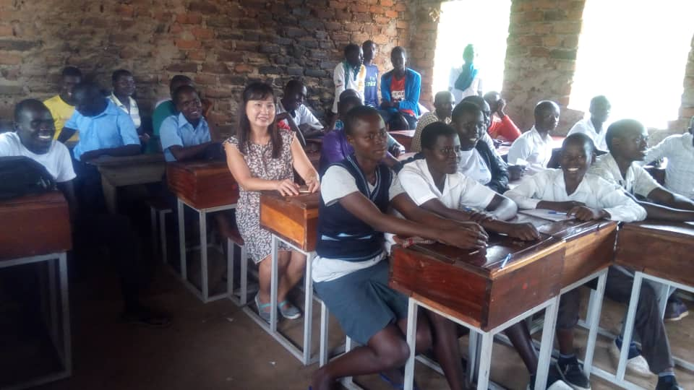
But a moment in solidarity meant even more

Slide 25
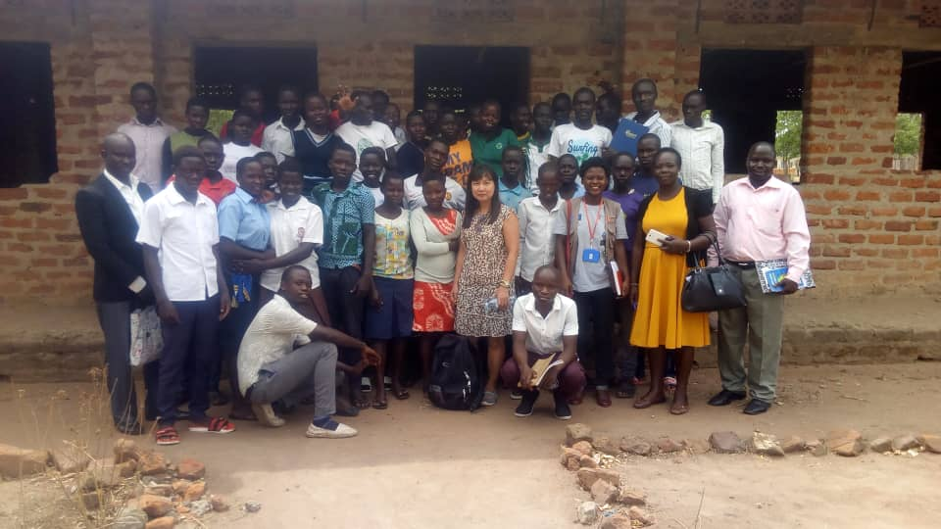
Currently, STAD supports 50 students – could we do more?

Slide 26
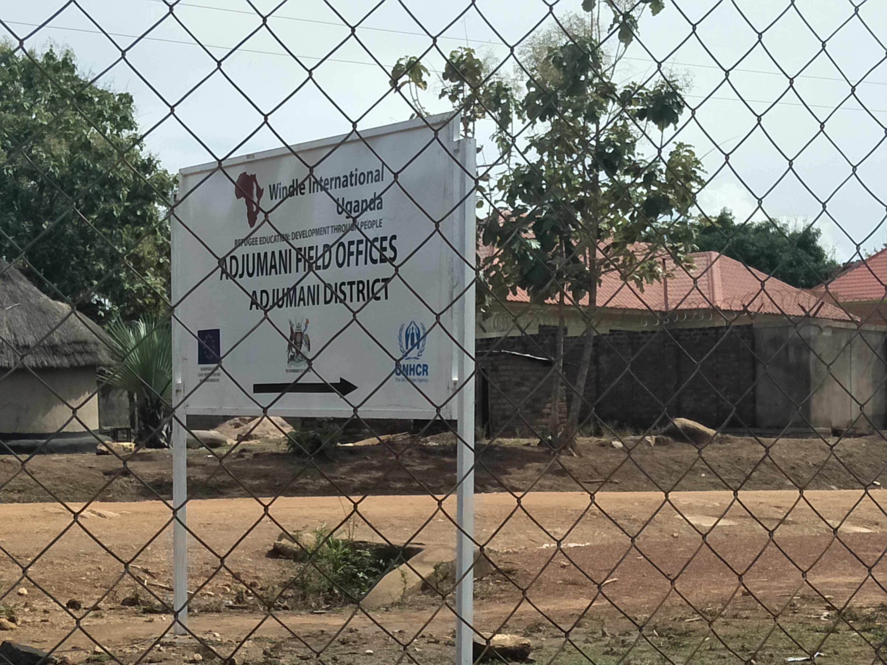
Adjumani Refugee Settlement

Slide 27
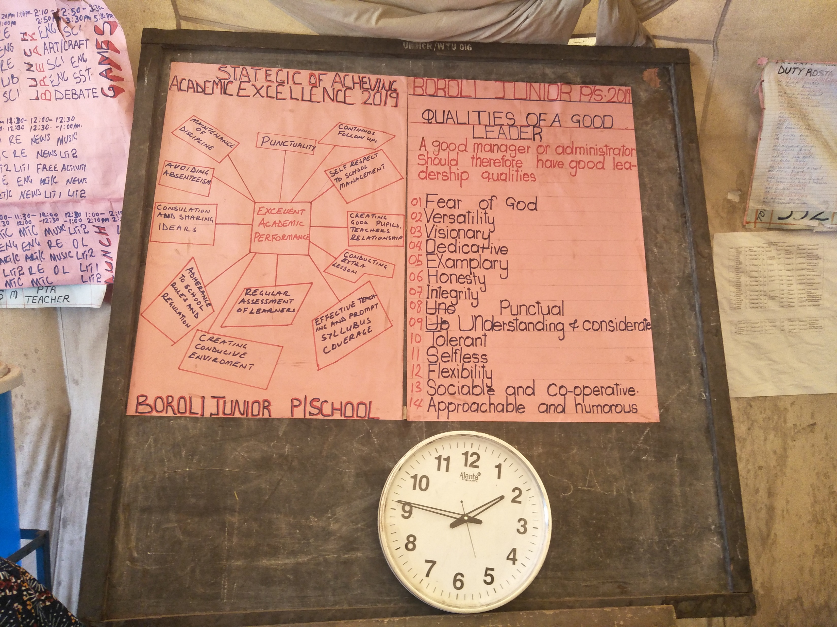
Boroli Primary School – currently not supported by STAD

Slide 28
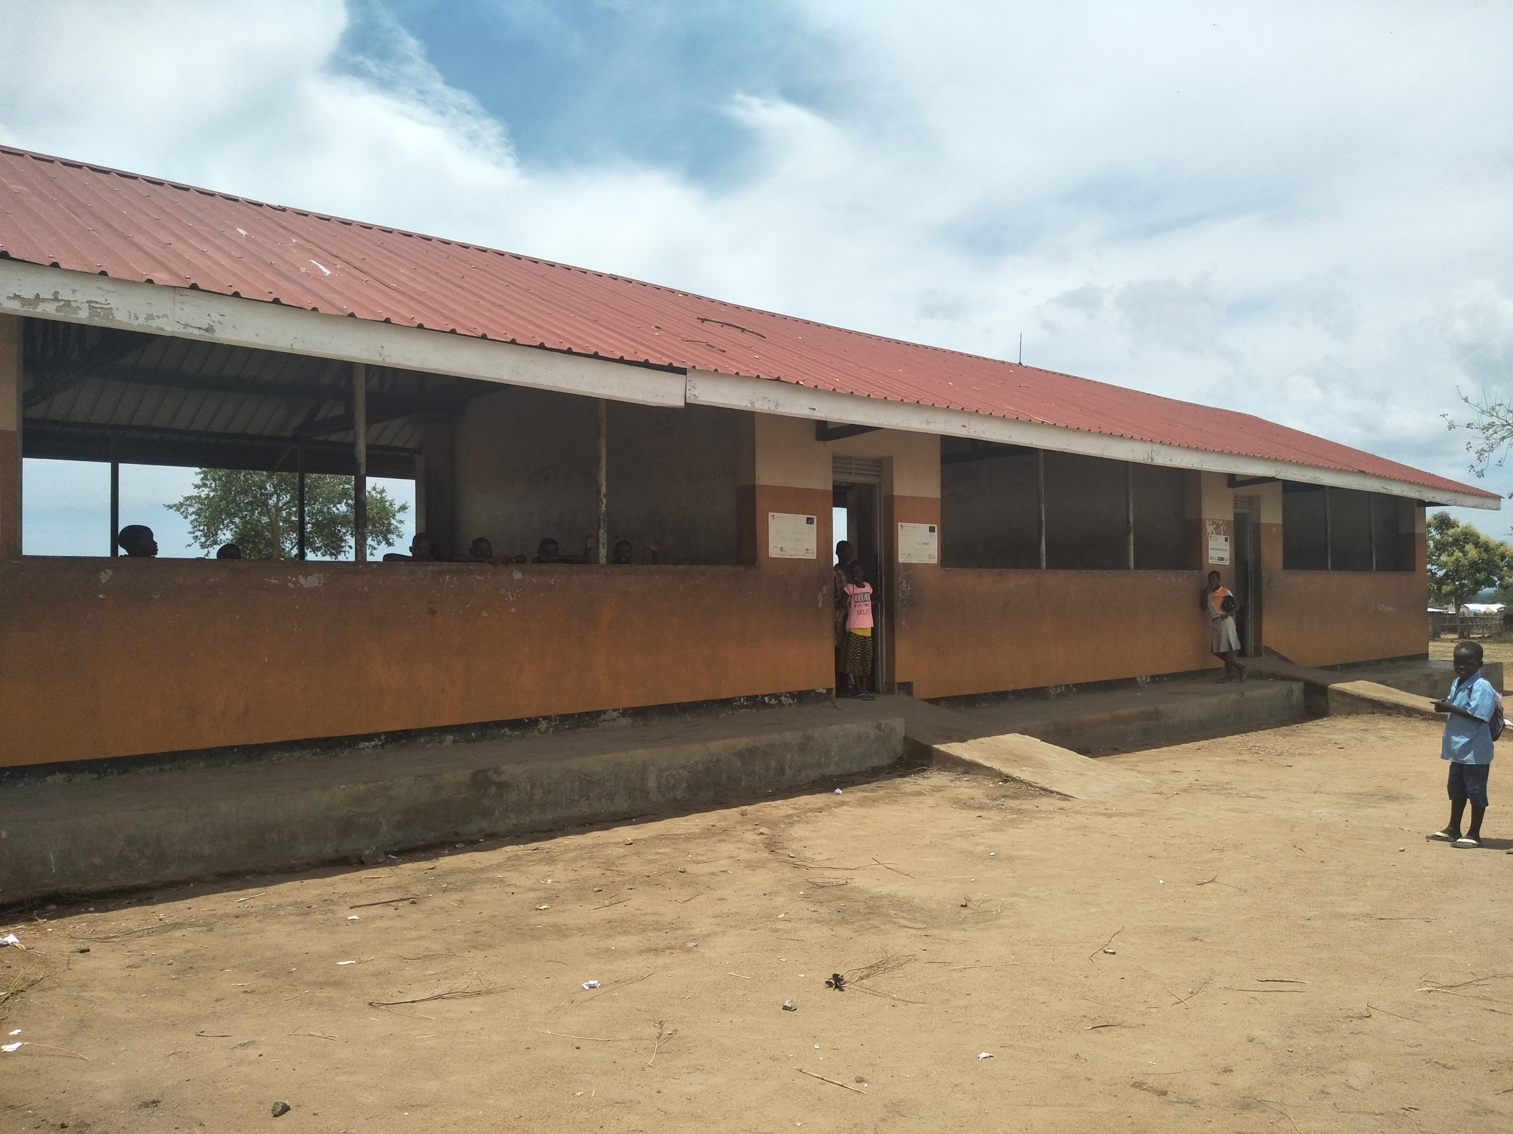
School has only 2 blocks…

Slide 29
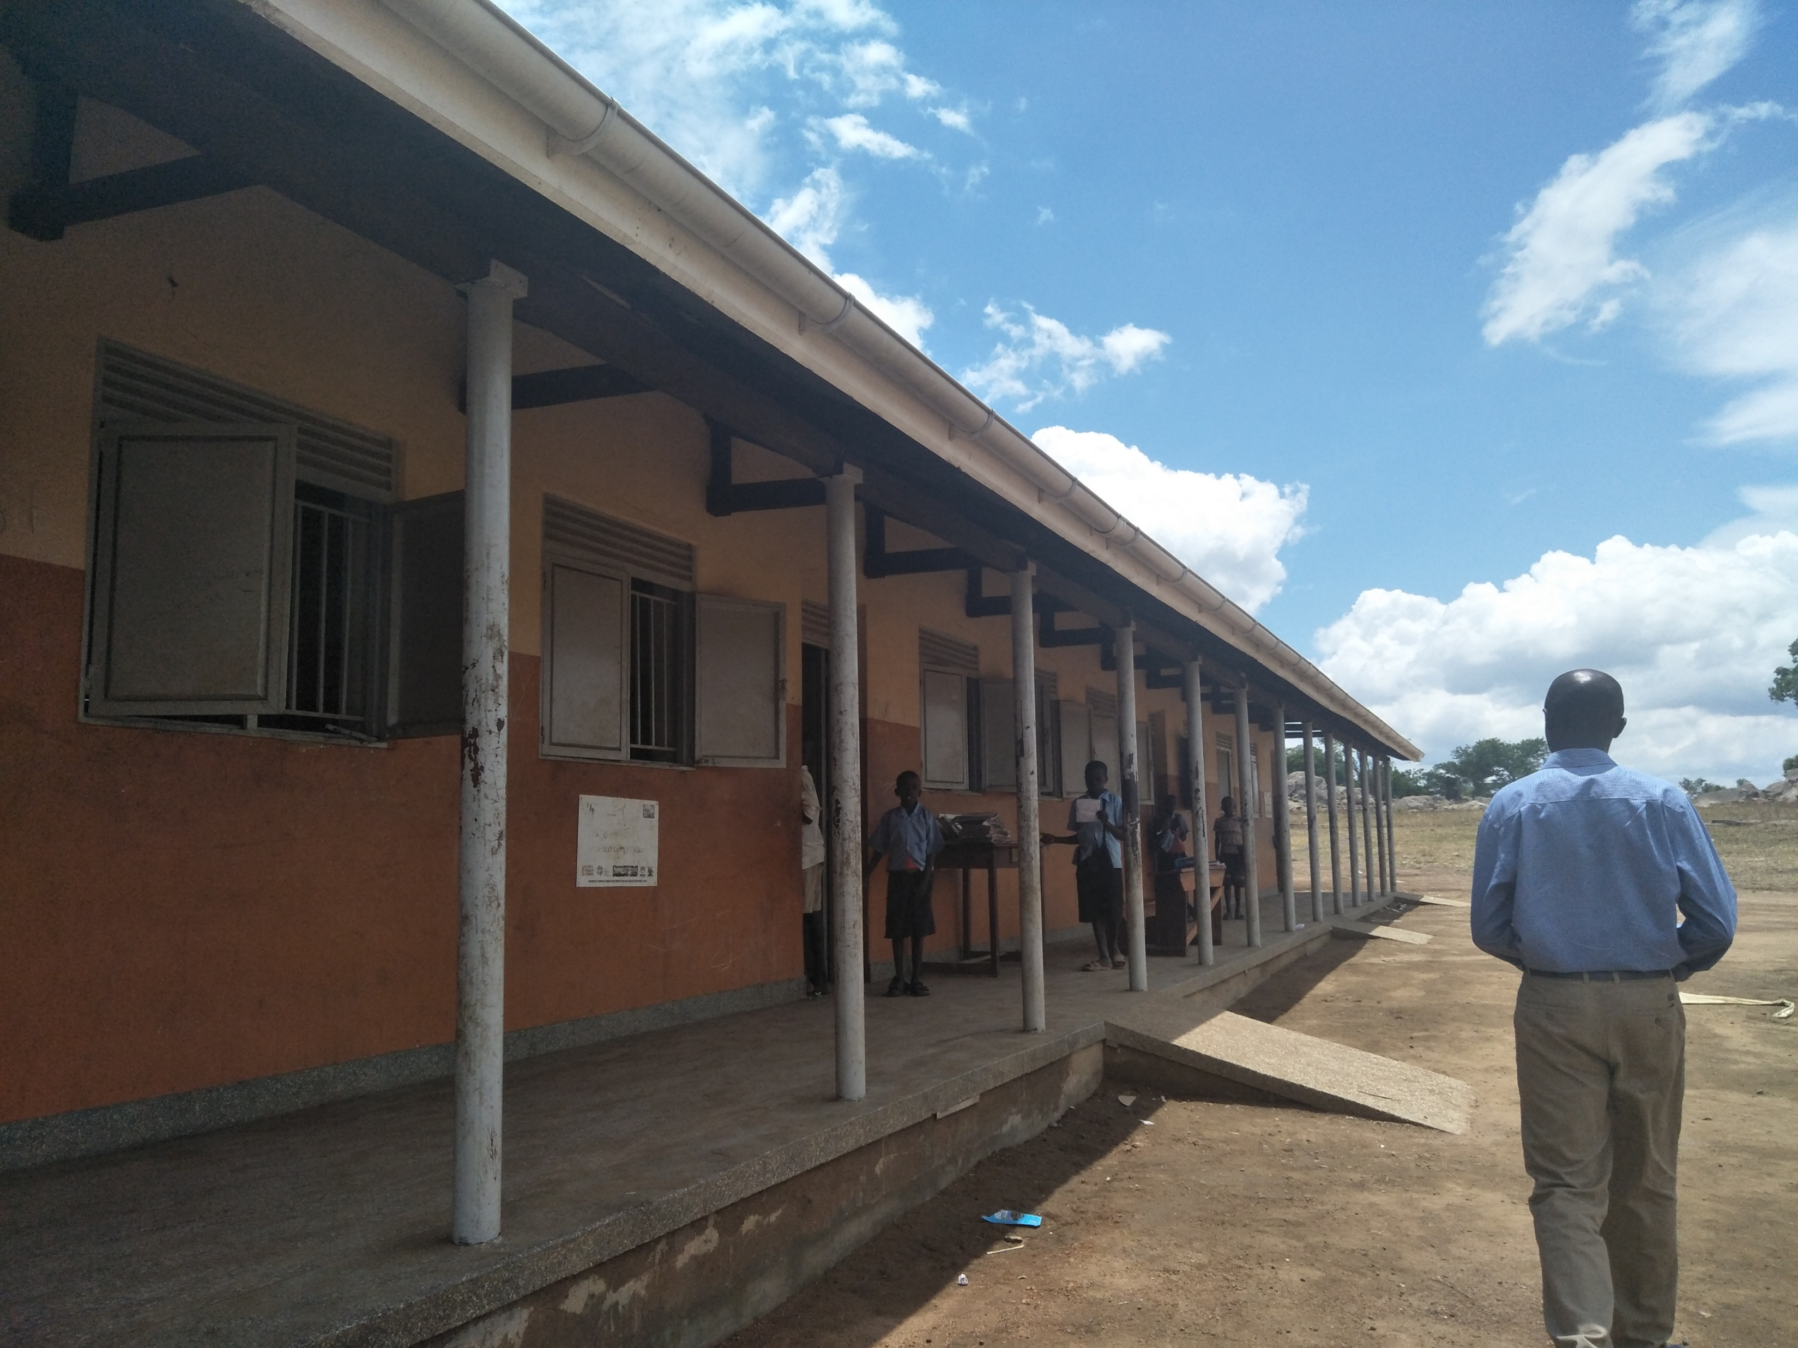
…with 3 classrooms in each block

Slide 30
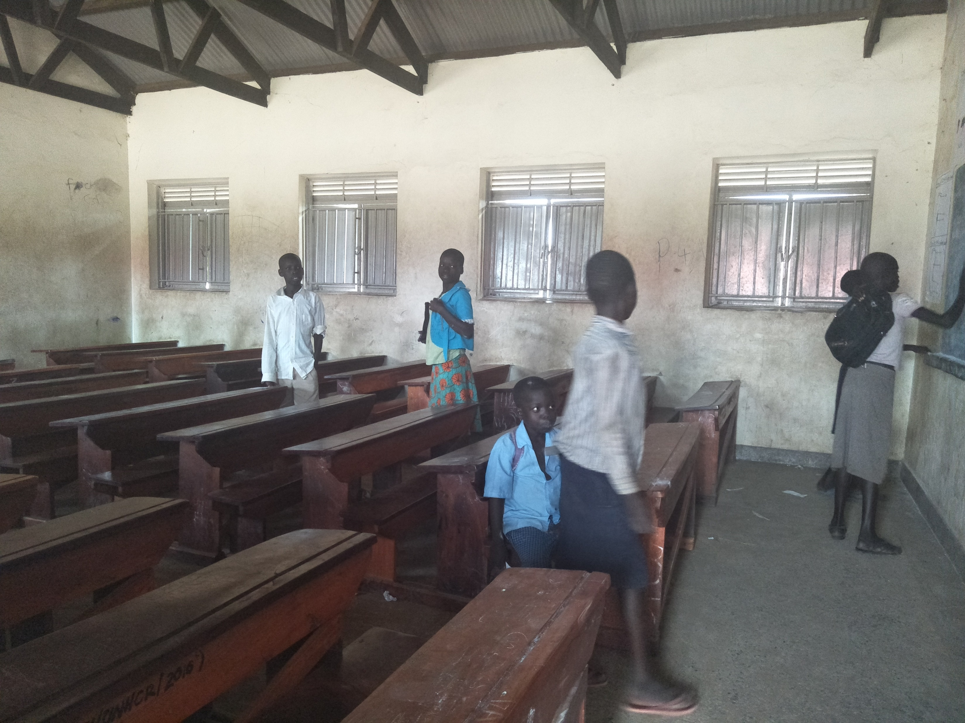
…housing a total population of 1154 students

Slide 31
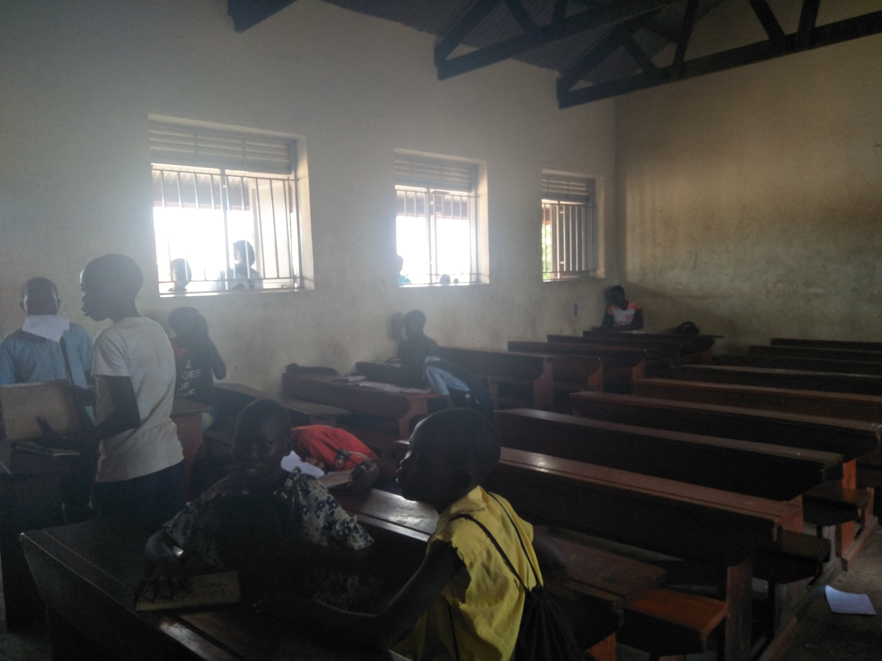
About 150 students squeeze into one classroom for lessons…

Slide 32
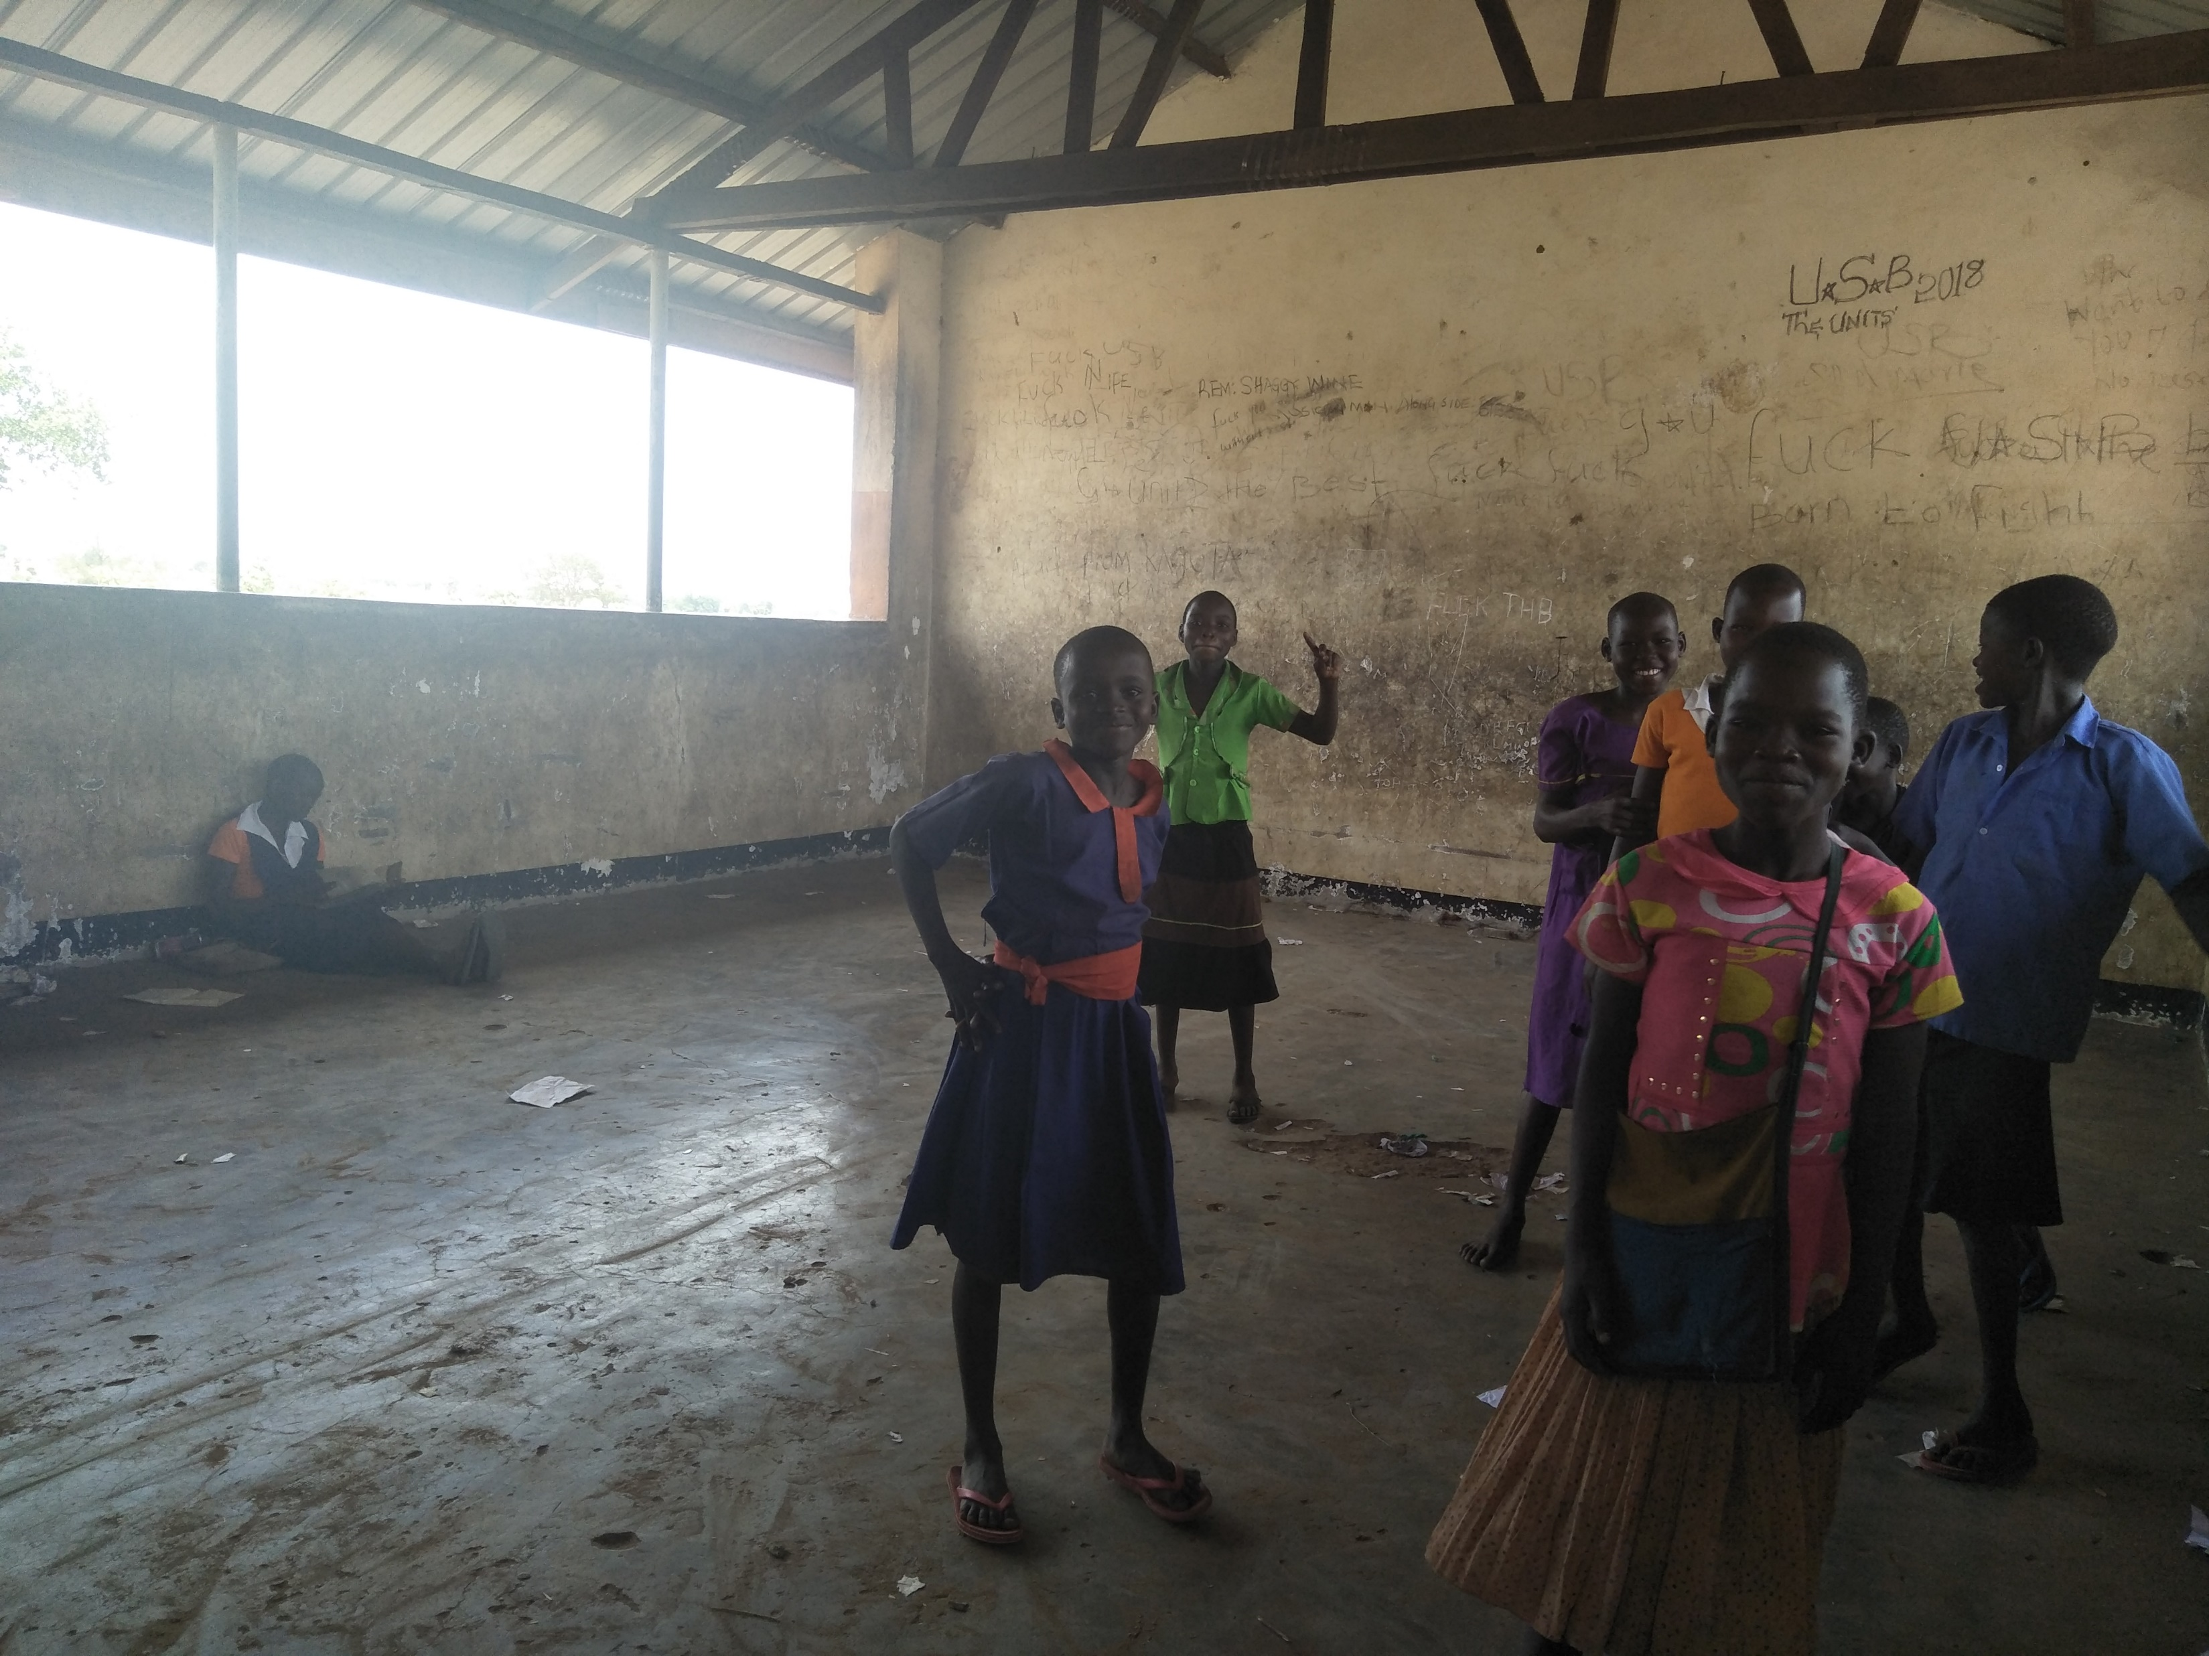
Primary 1s and 2s have no desks

Slide 33
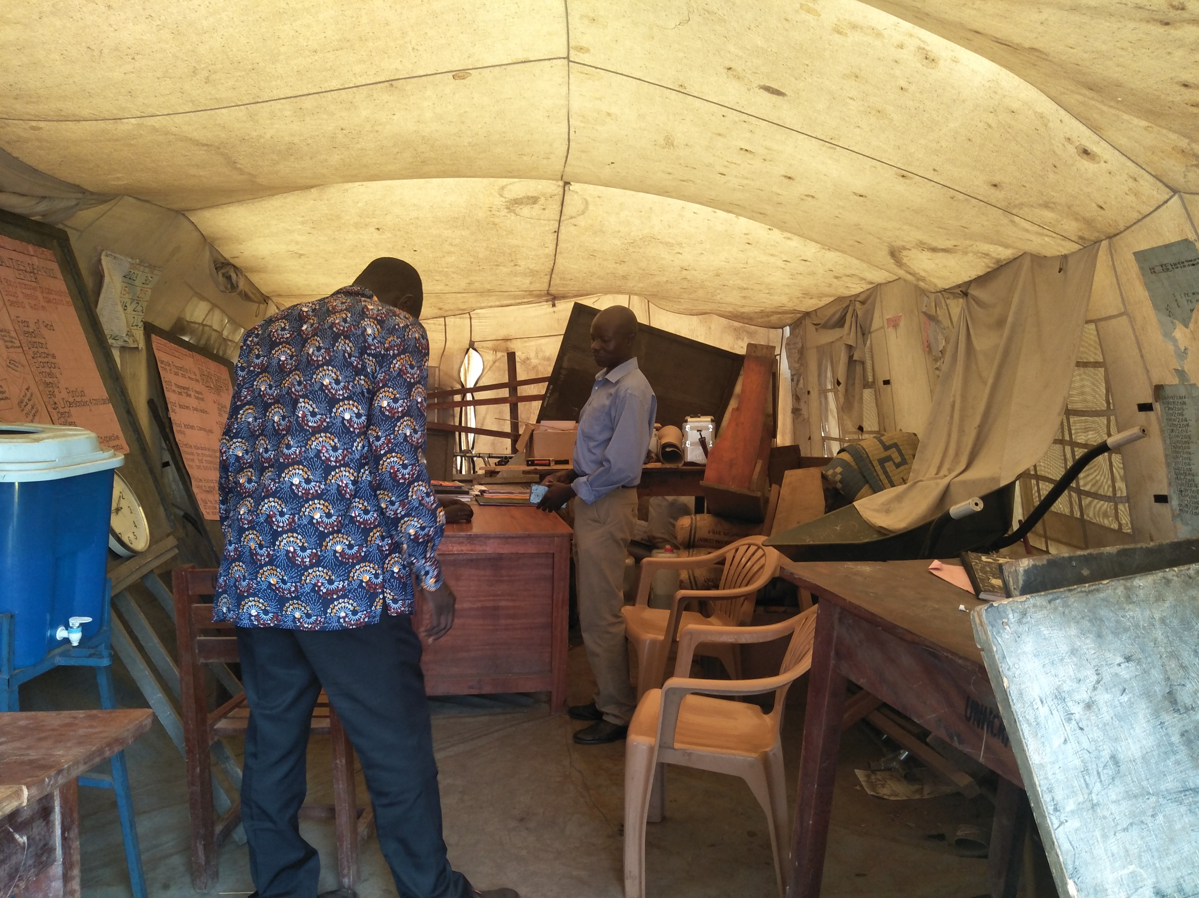
Staff office flooded by heavy rain

Slide 34
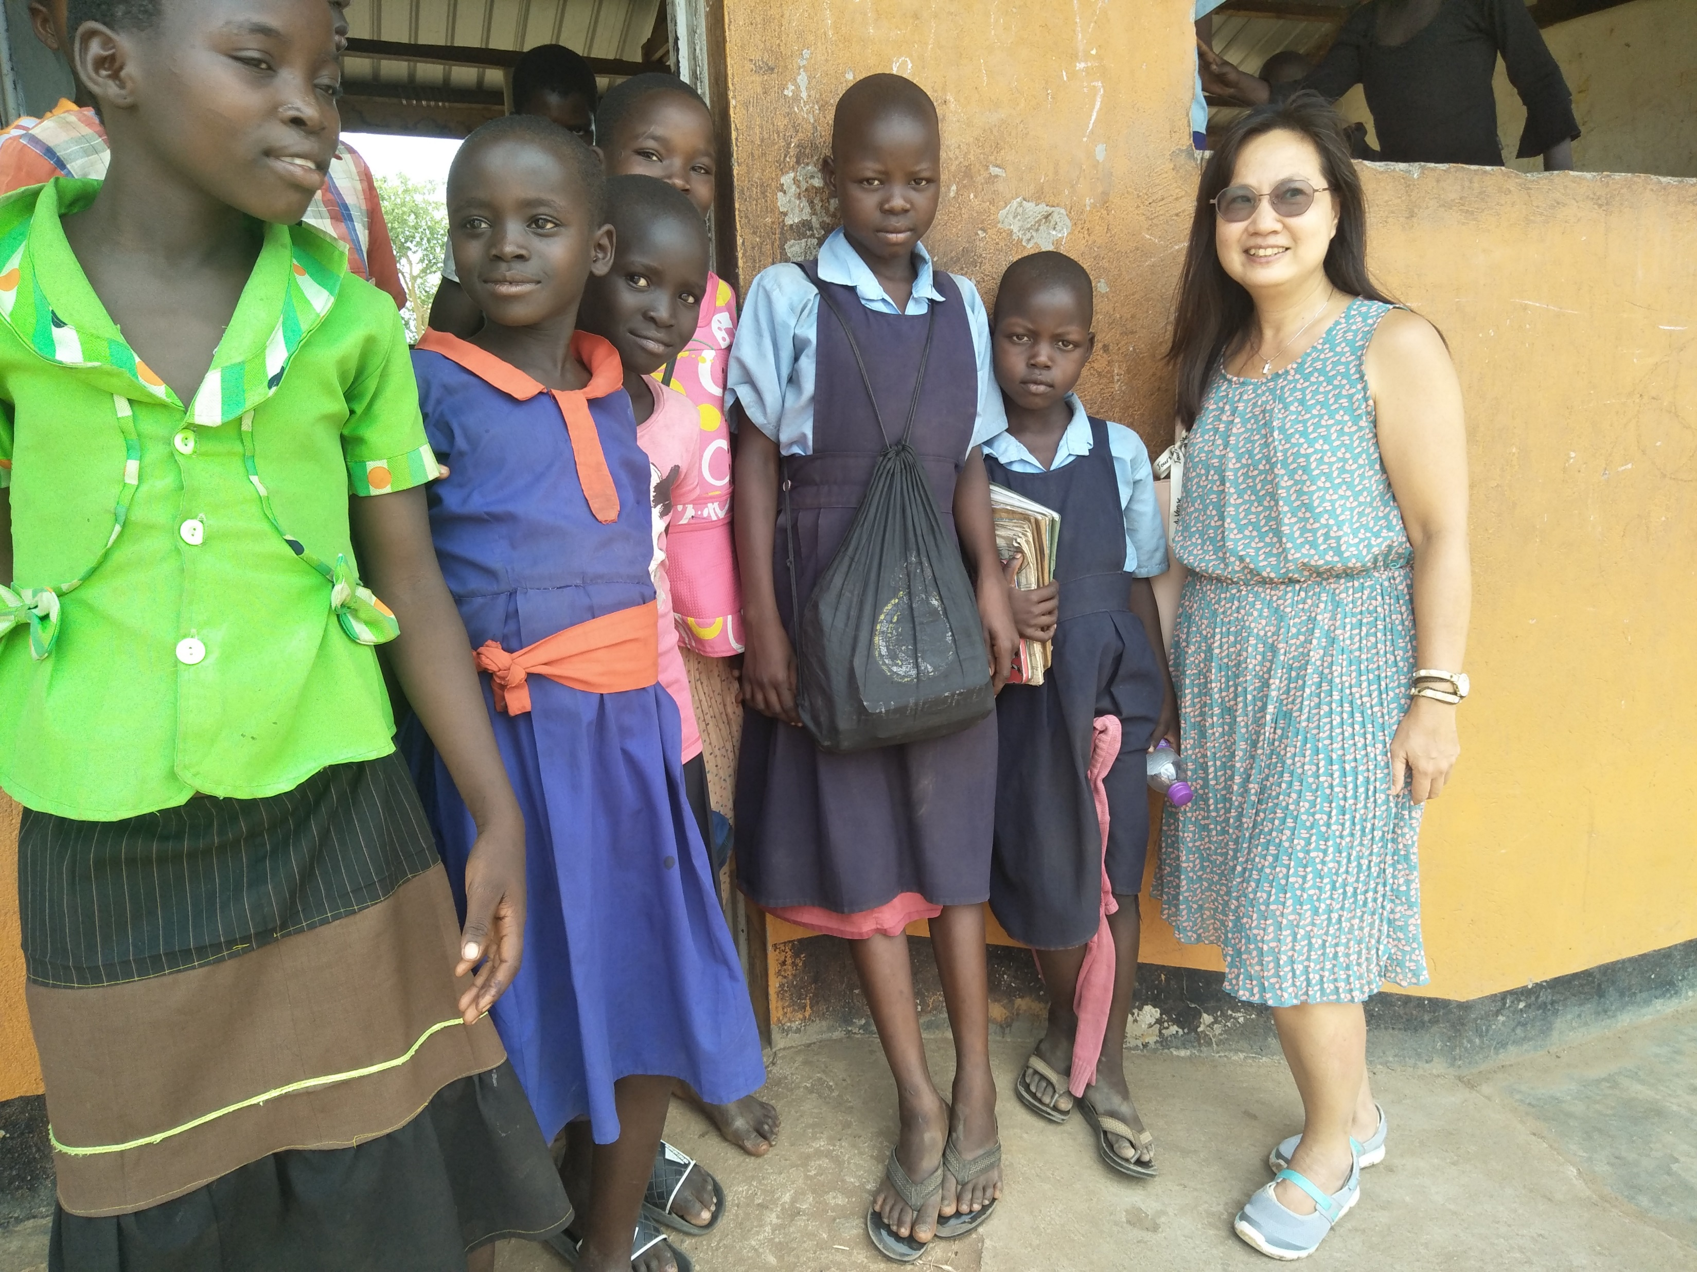
Students felt special because we visited…

Slide 35
The needs are really immense, so what can we do?

Slide 36
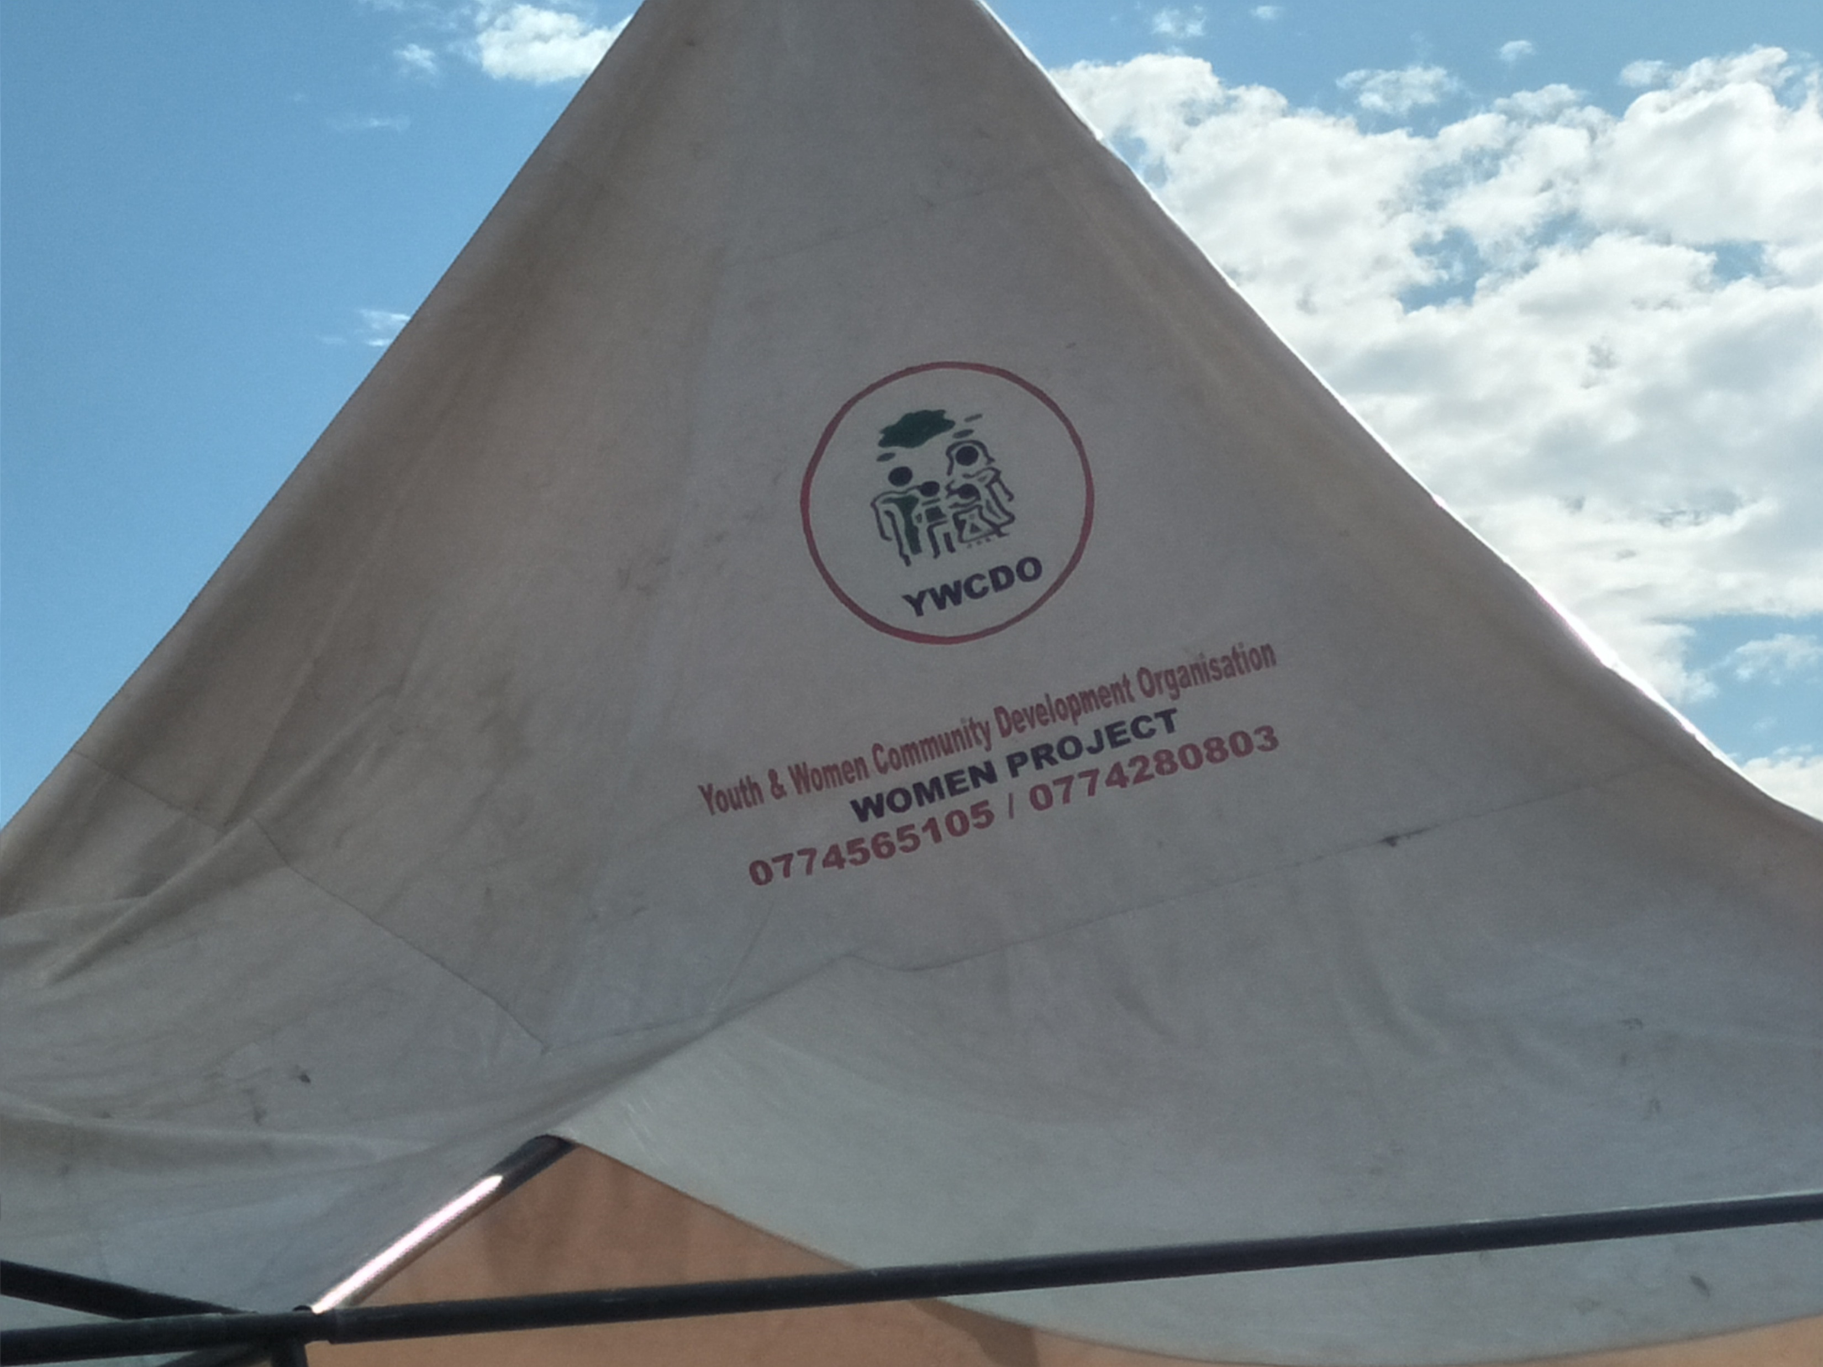

Slide 37
Observations:
Effective use of the Peace Hall and other facilities to conduct training and reach out to women, youth and children
Work went beyond mandate to reach out to the poor and marginalised (e.g. handicapped) in nearby villages
Work done solely by volunteers; STAD may like to consider sourcing and funding for 2 staff members to ensure continuity

Slide 38
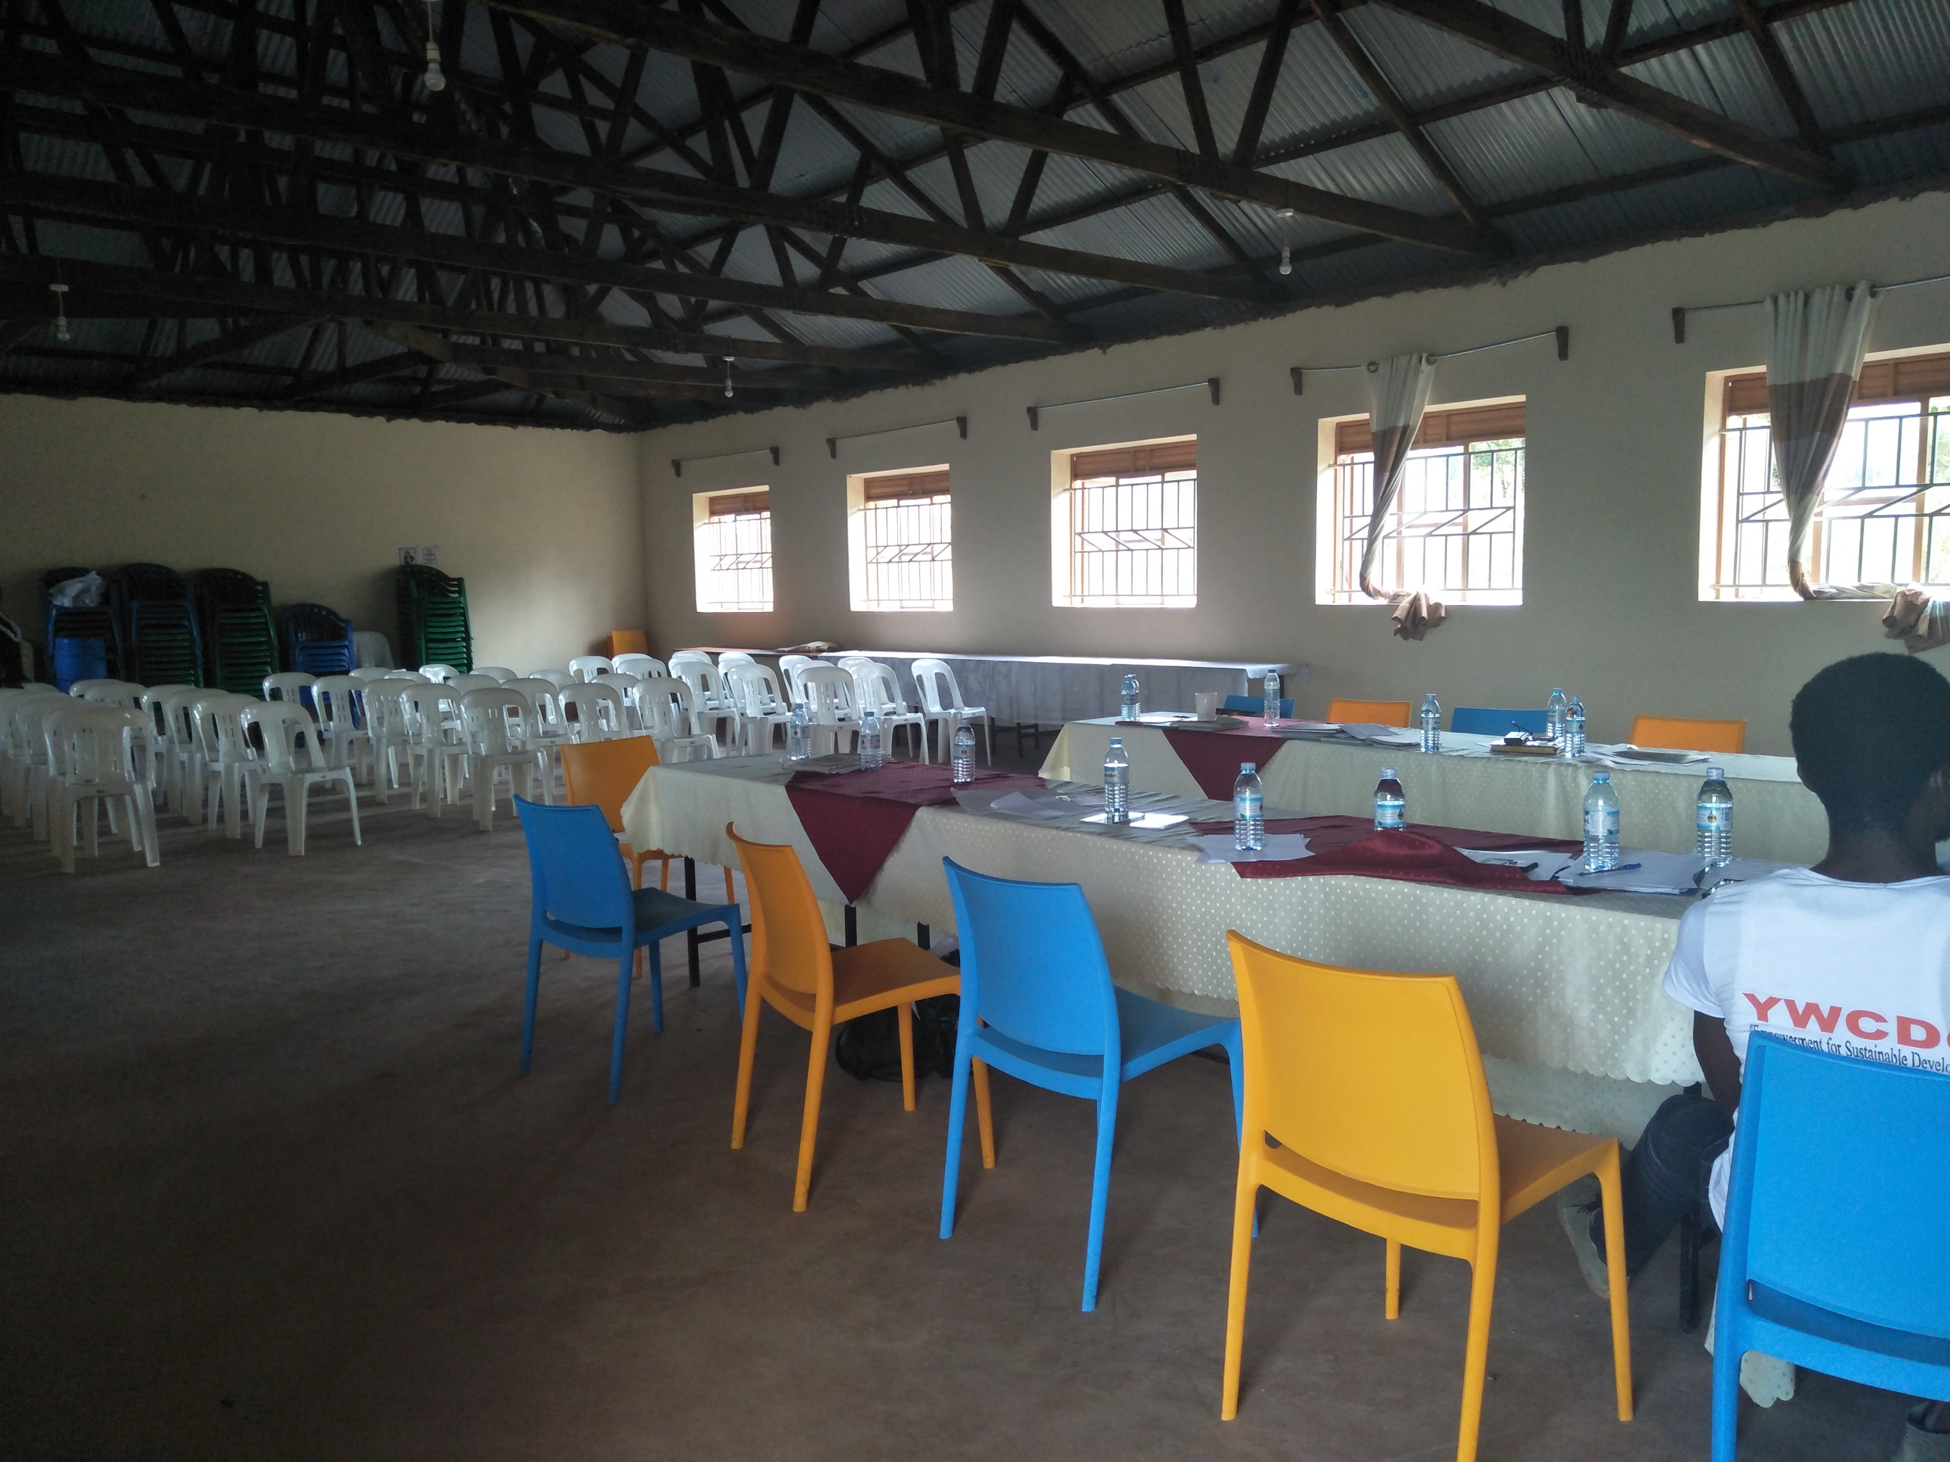
The Peace Hall

Slide 39
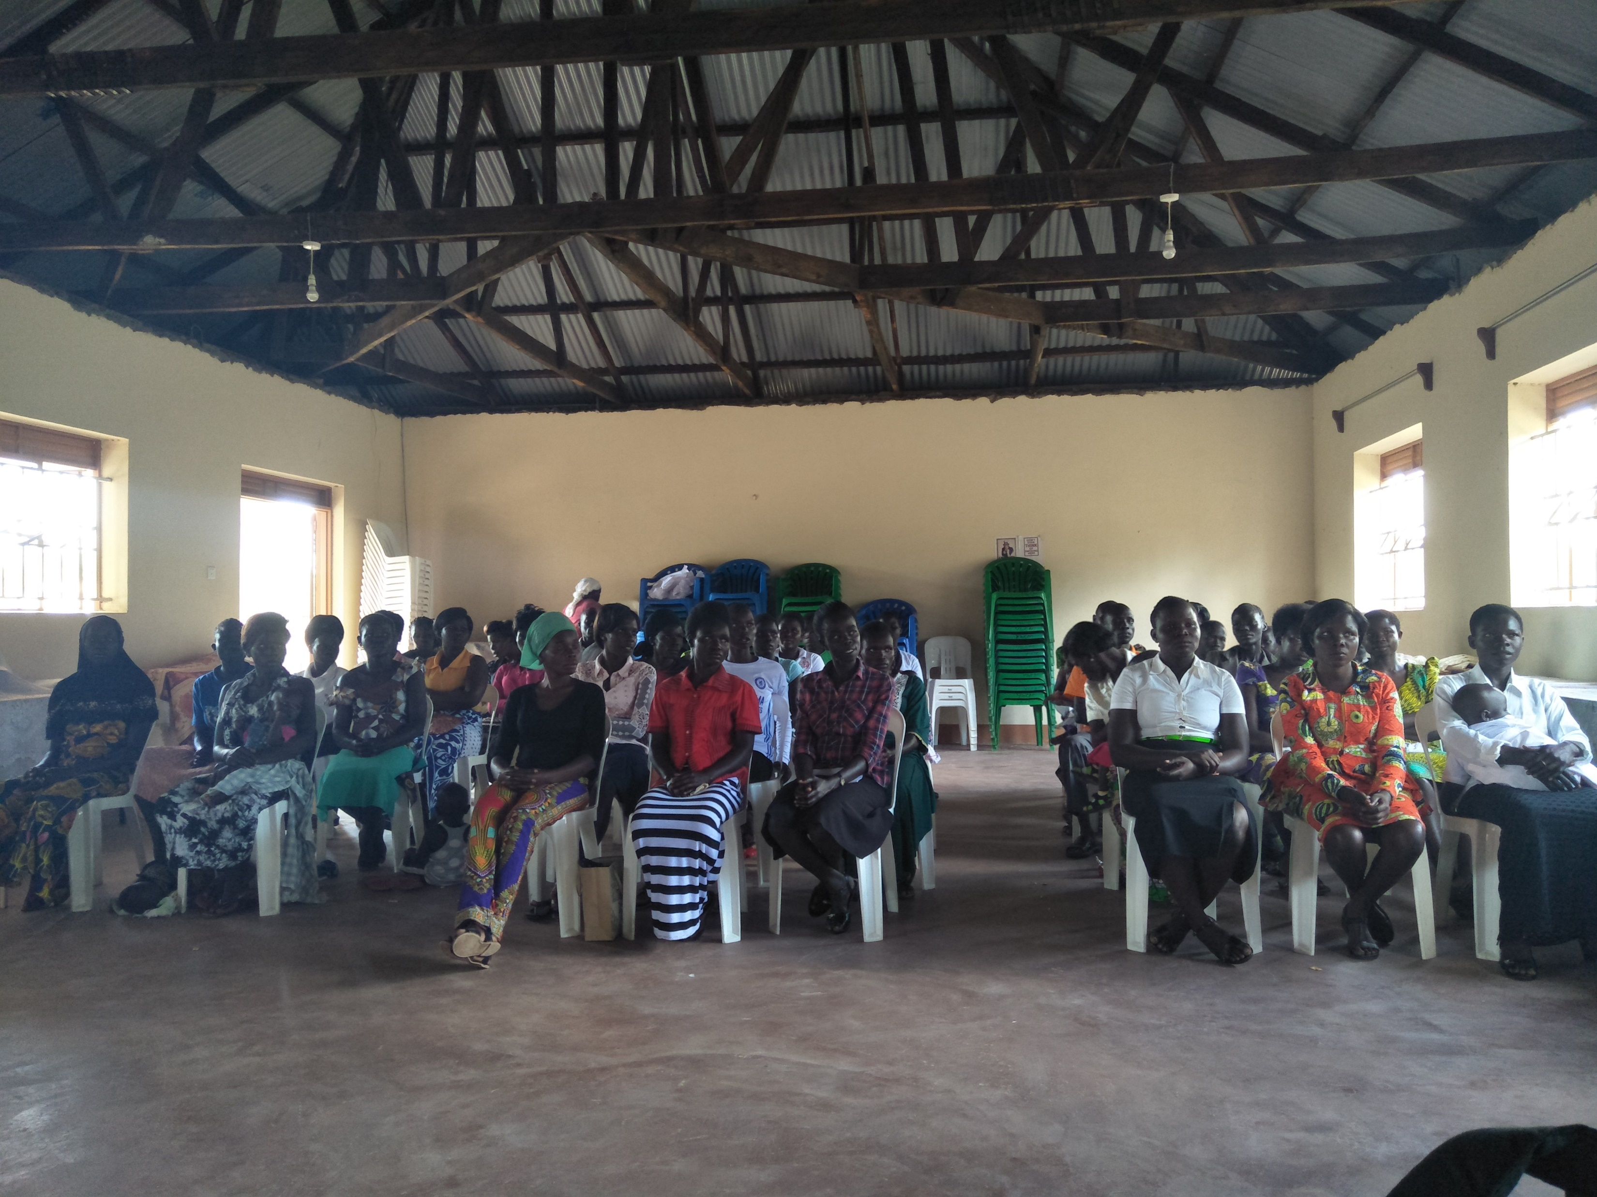
Peace Hall used to conduct training for women, youth and children

Slide 40
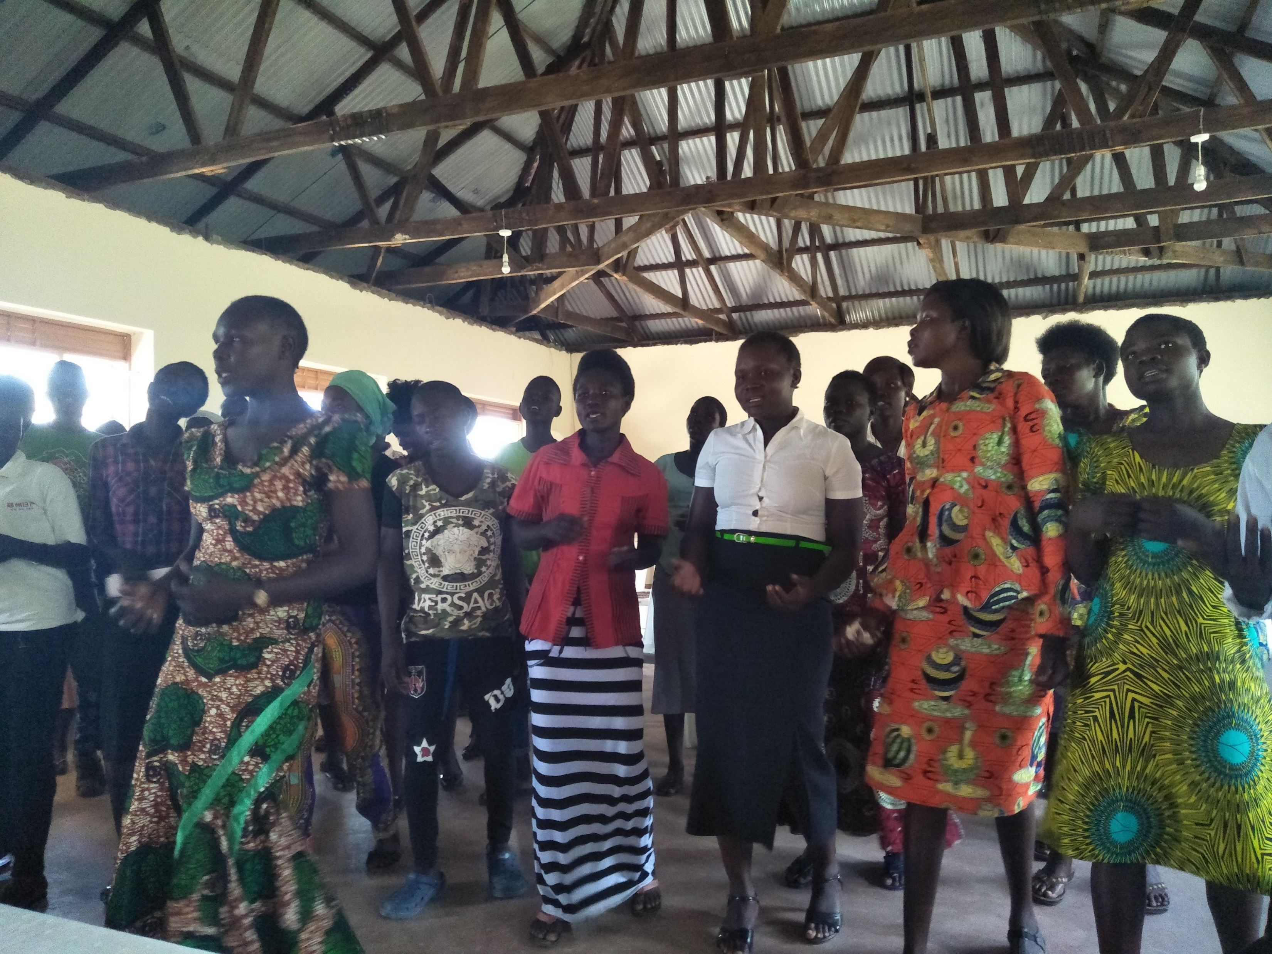
Women presenting song and dance item

Slide 41
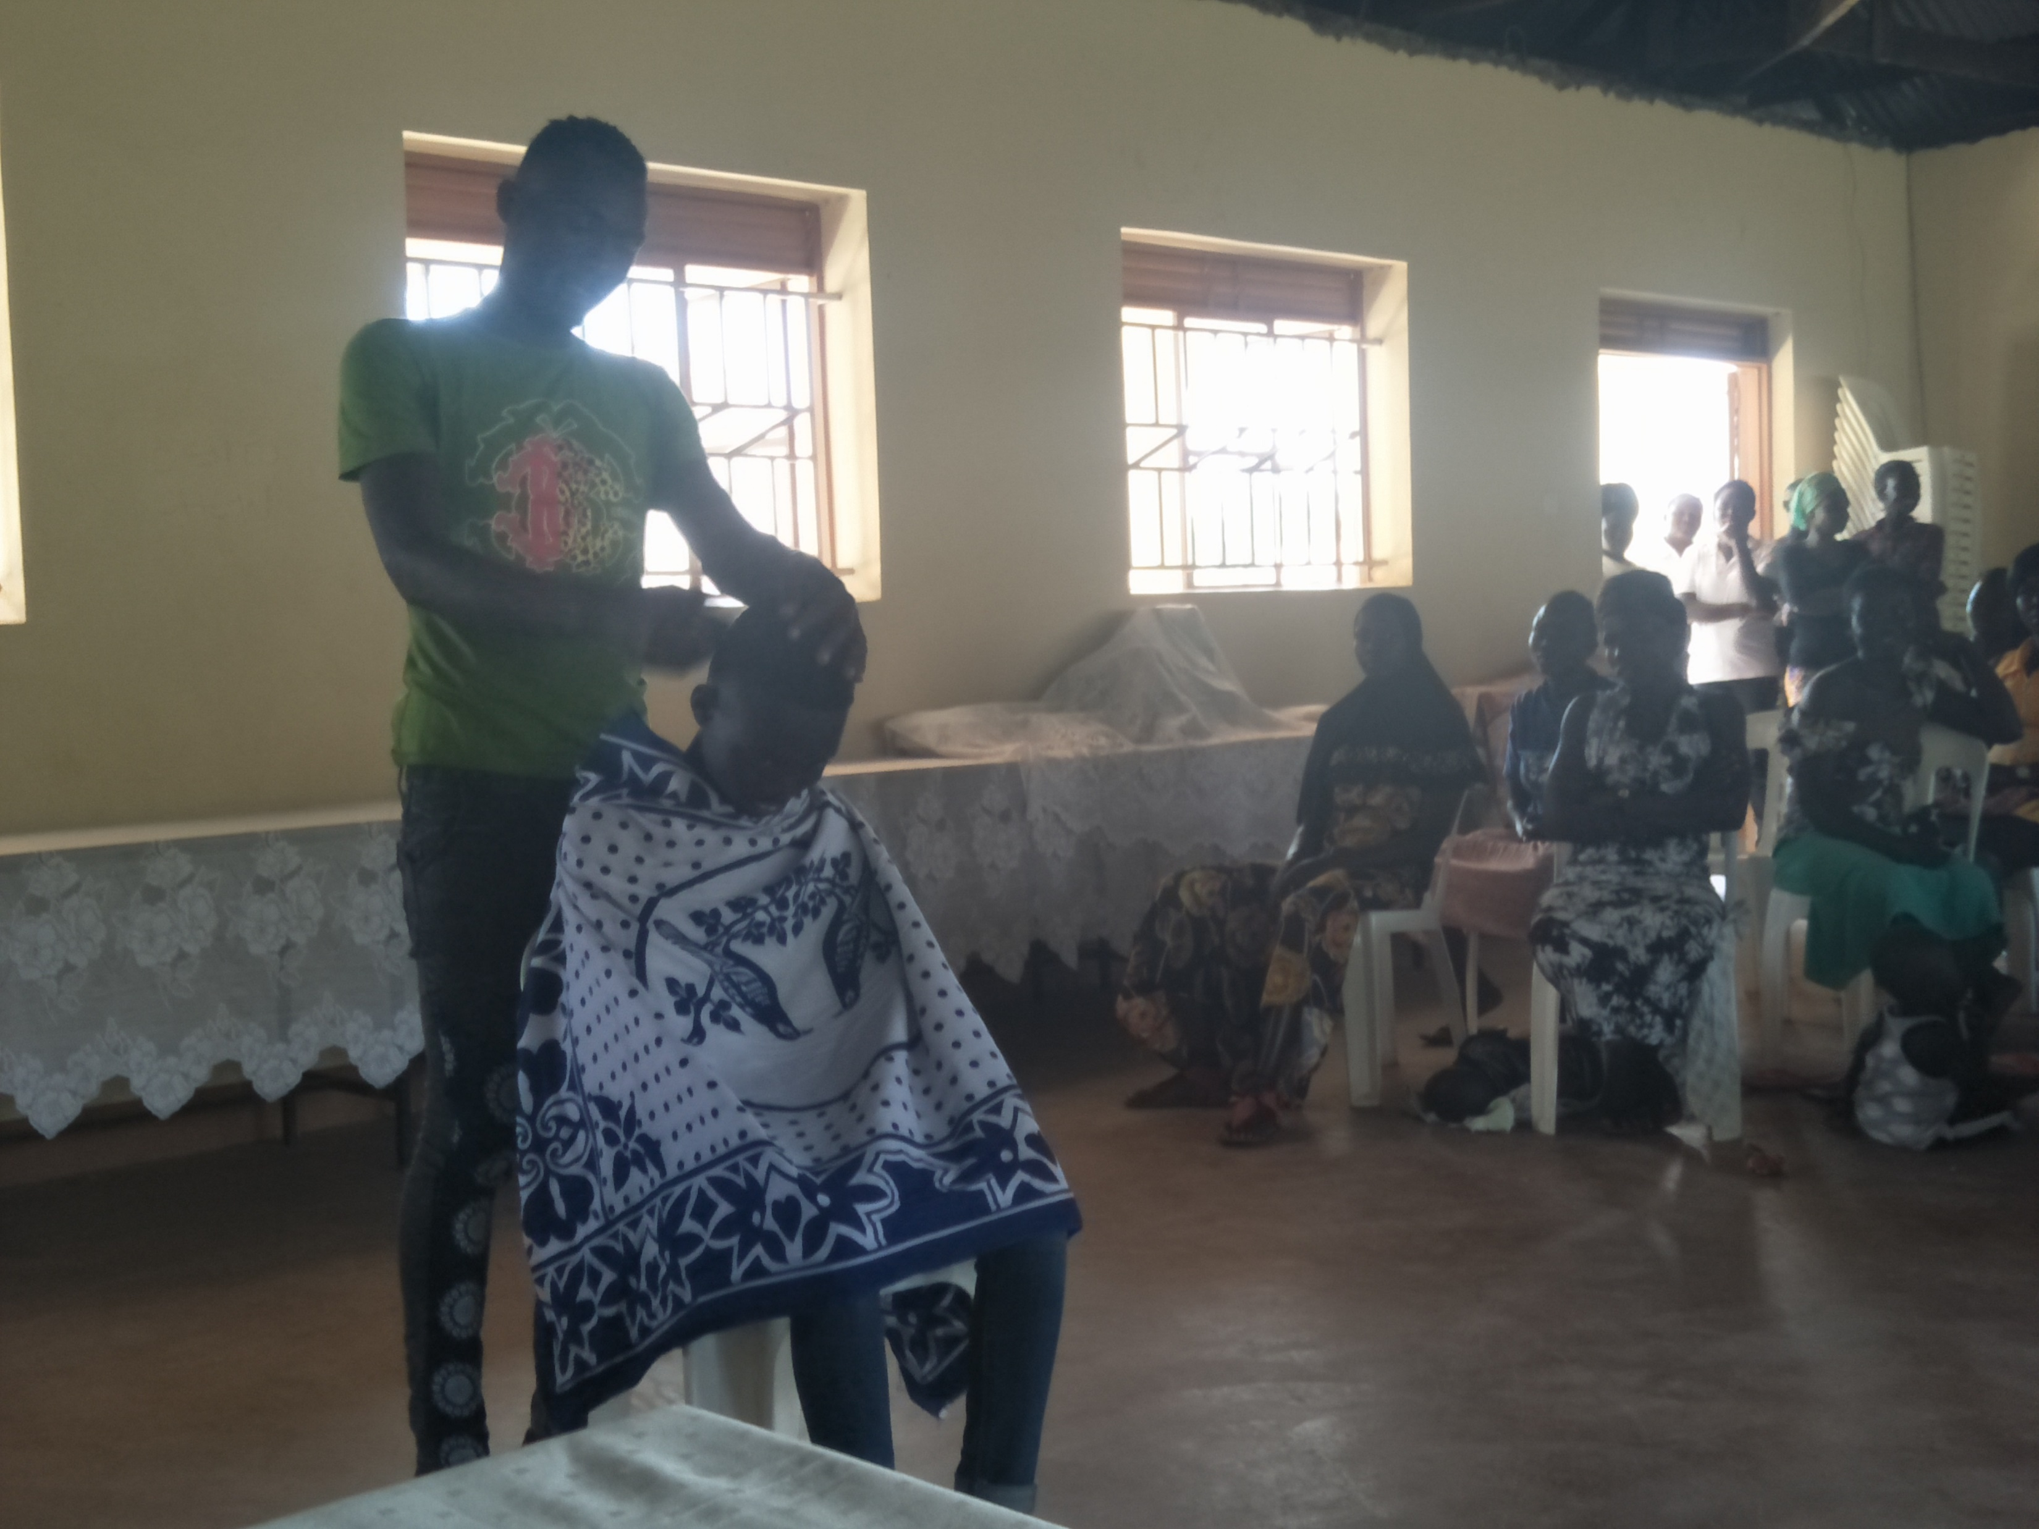
Youth presenting a skit

Slide 42
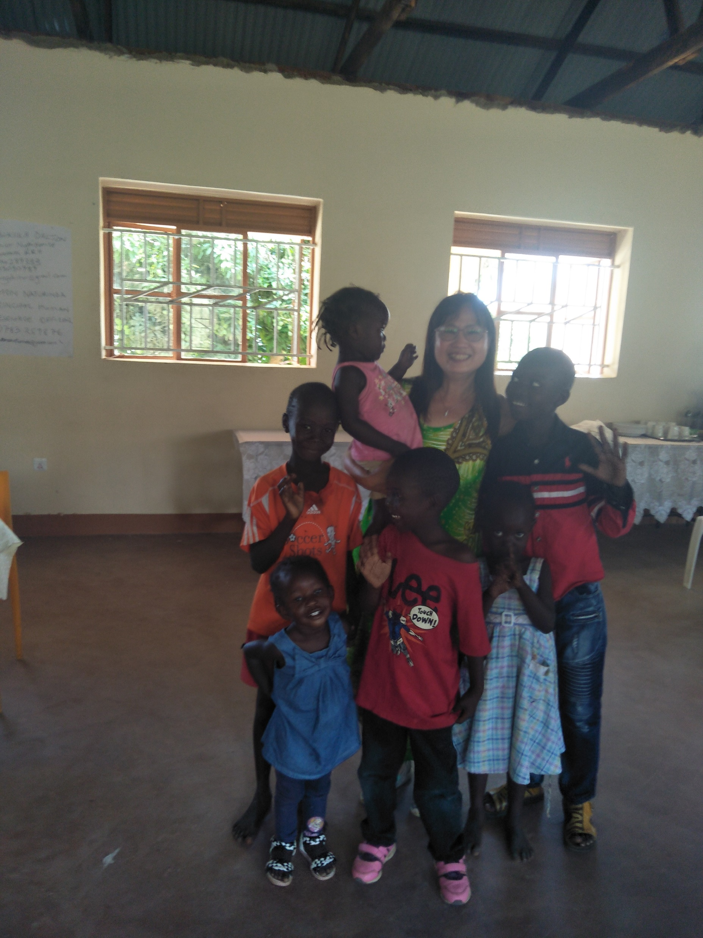
Children are not excluded

Slide 43
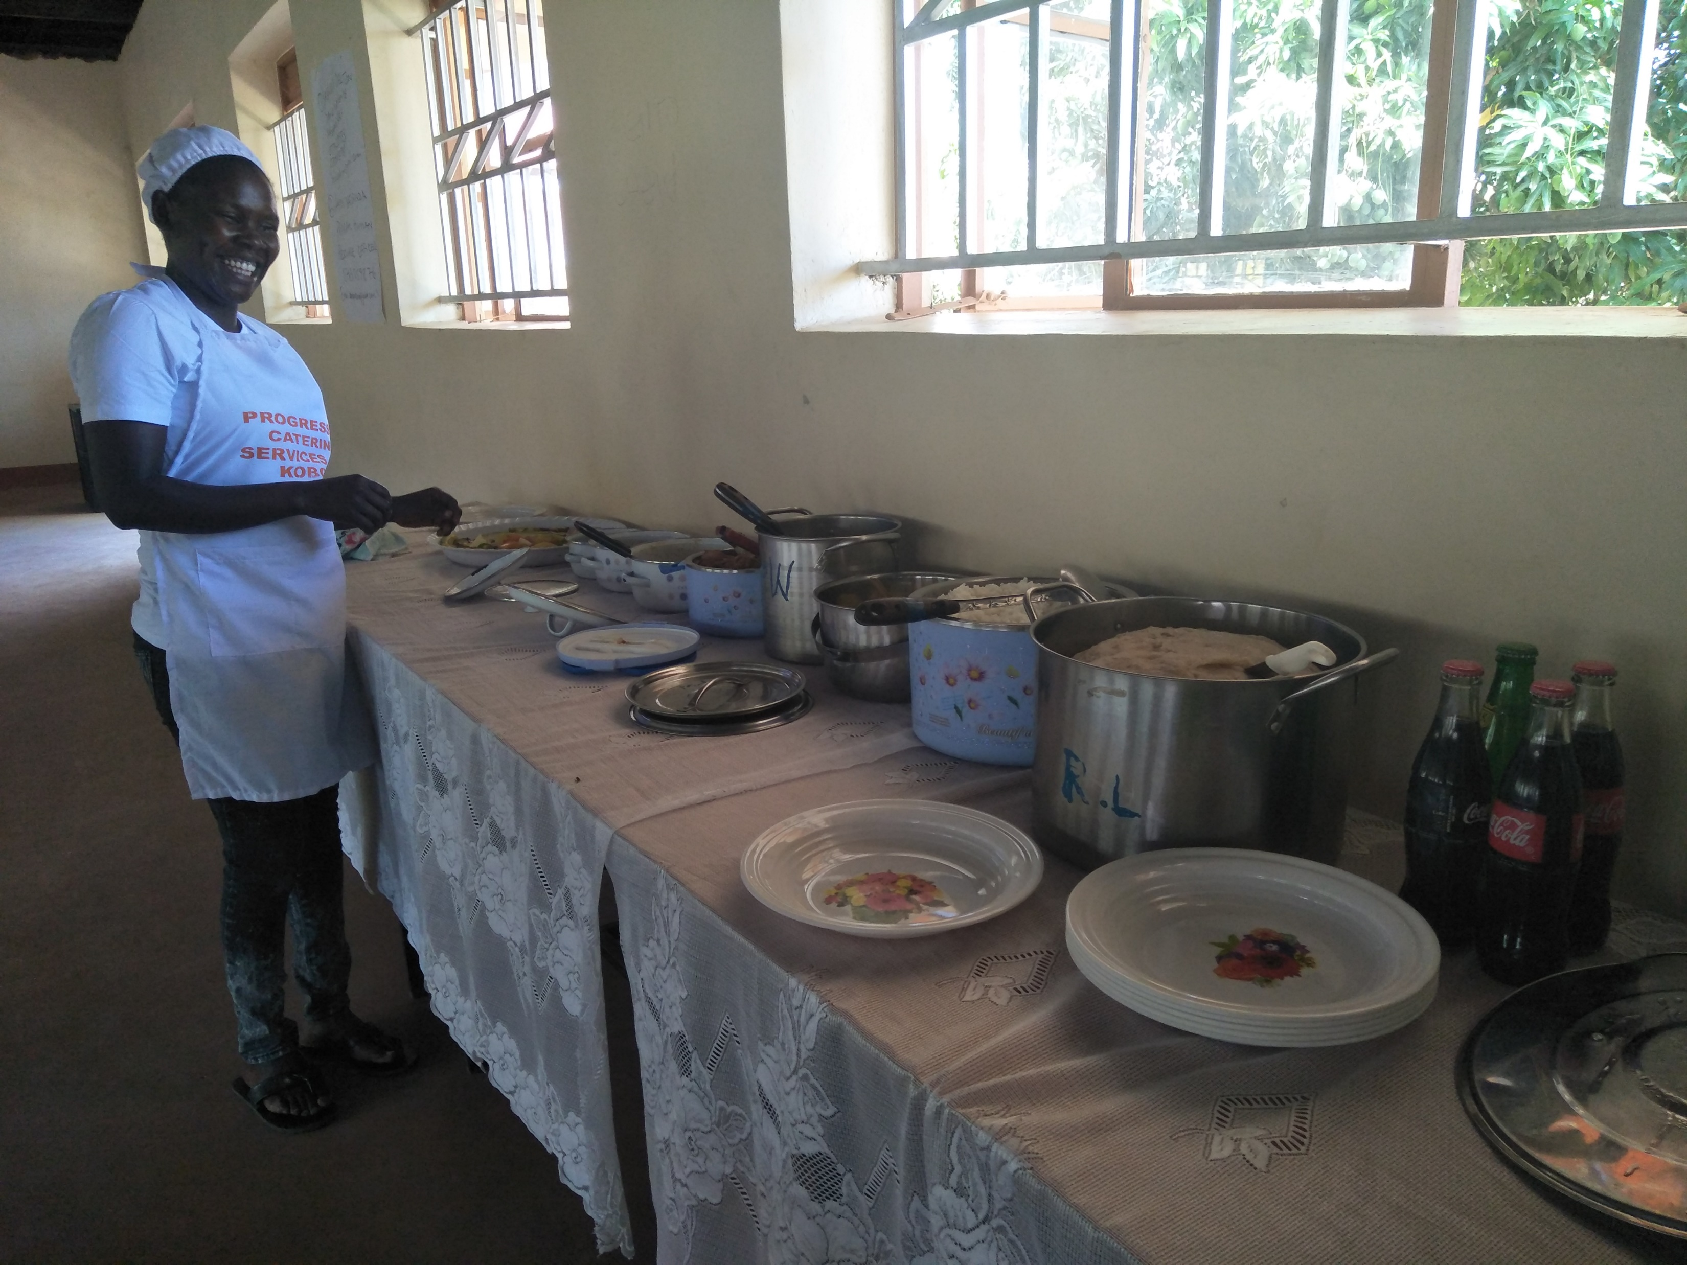
Catering service

Slide 44
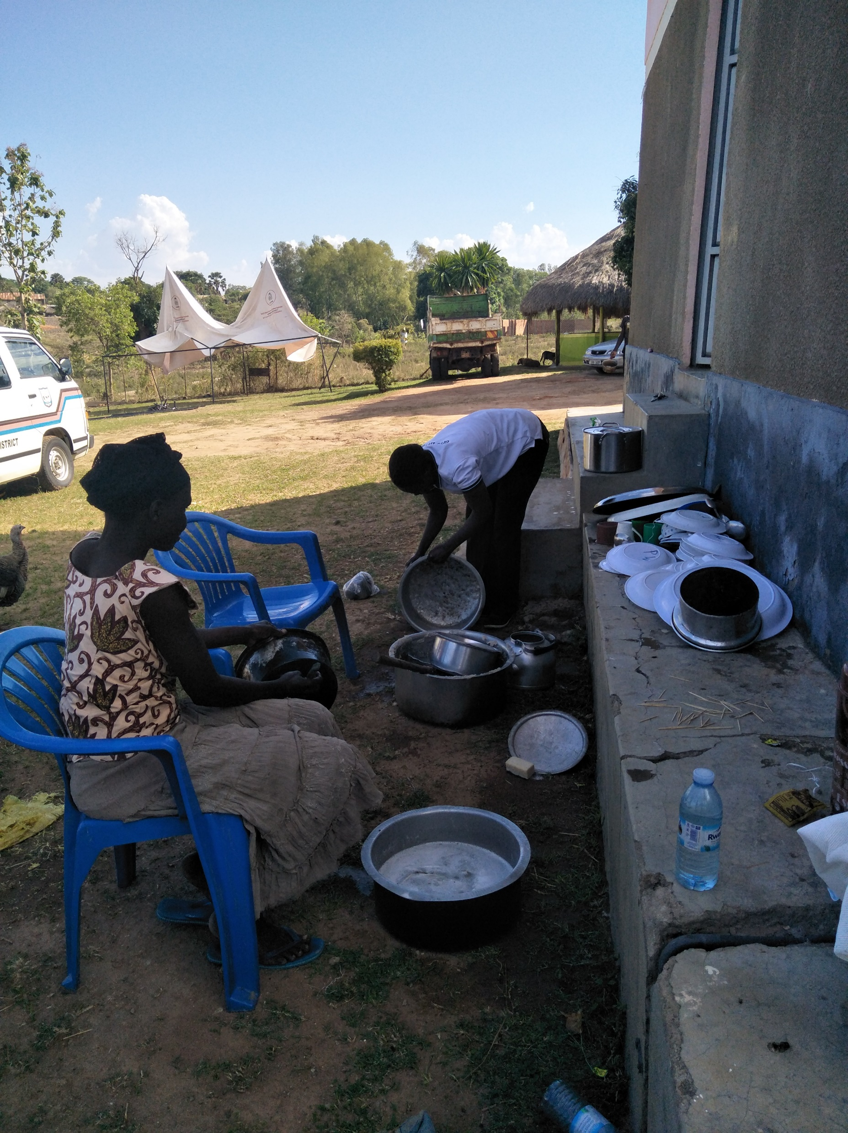
“Kitchen” used by Catering Service

Slide 45
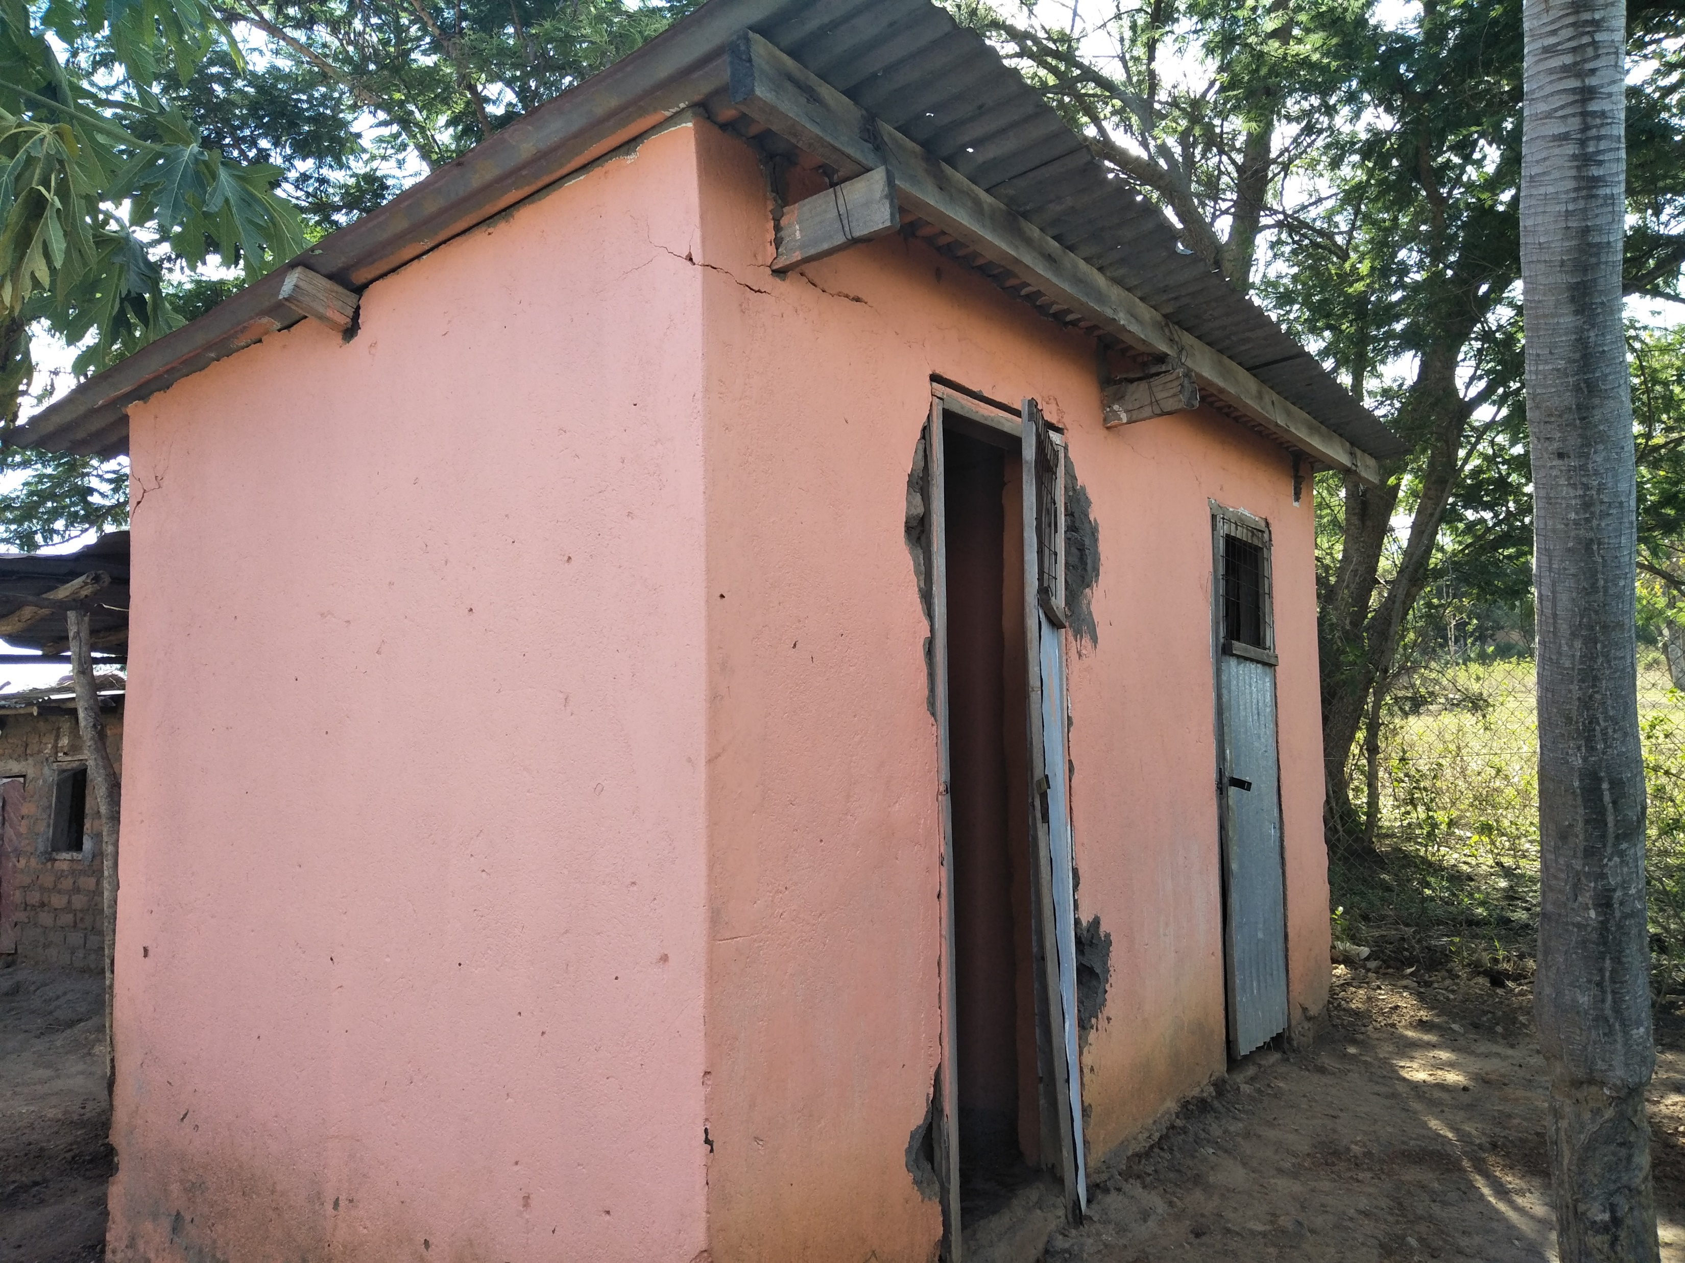
The old latrine

Slide 46
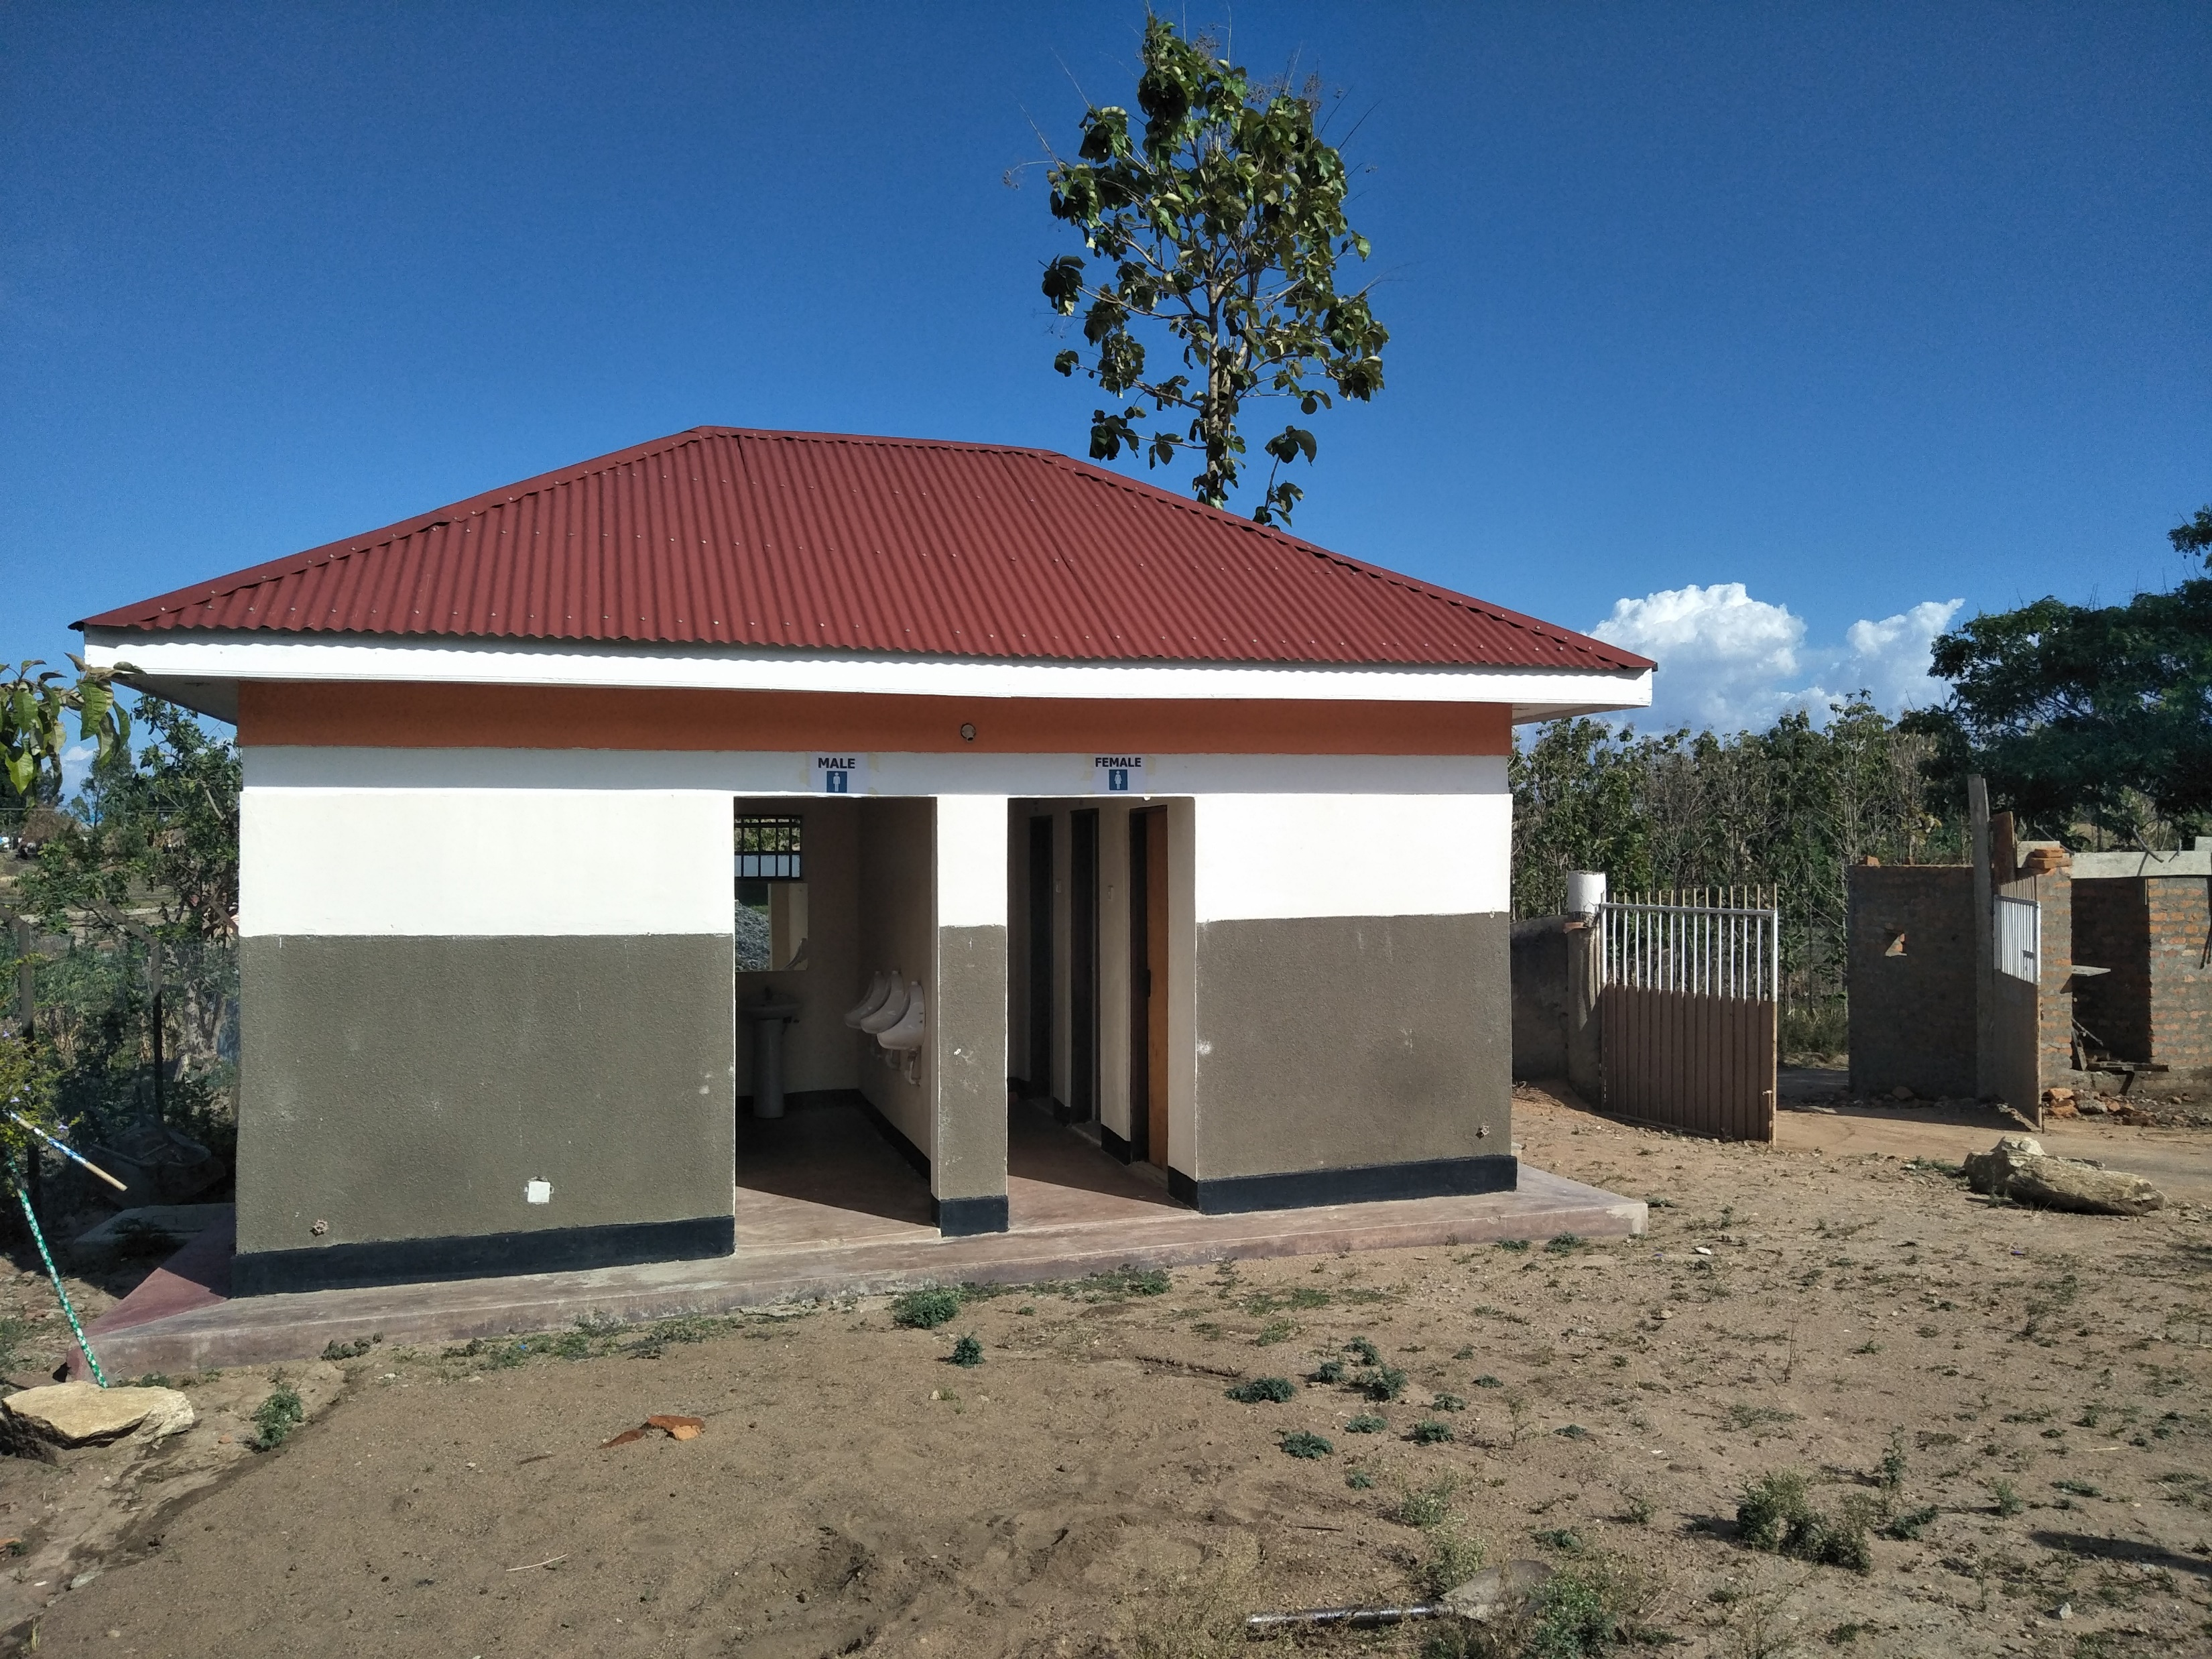
The VIP toilets STAD sponsored

Slide 47
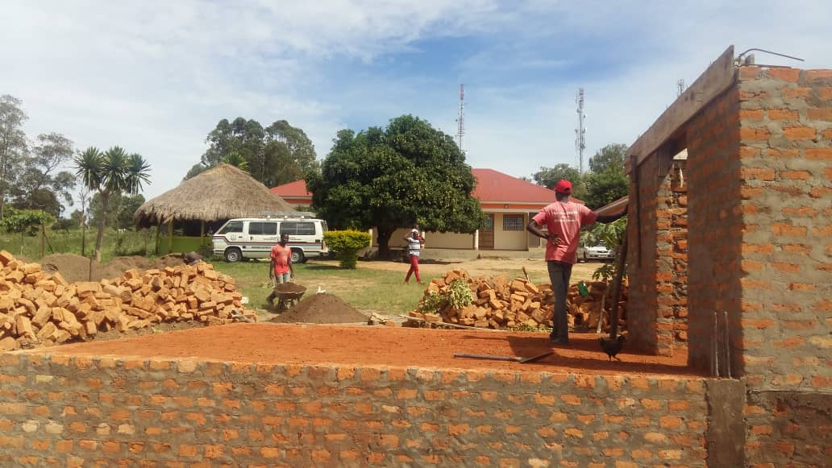
More building projects

Slide 48
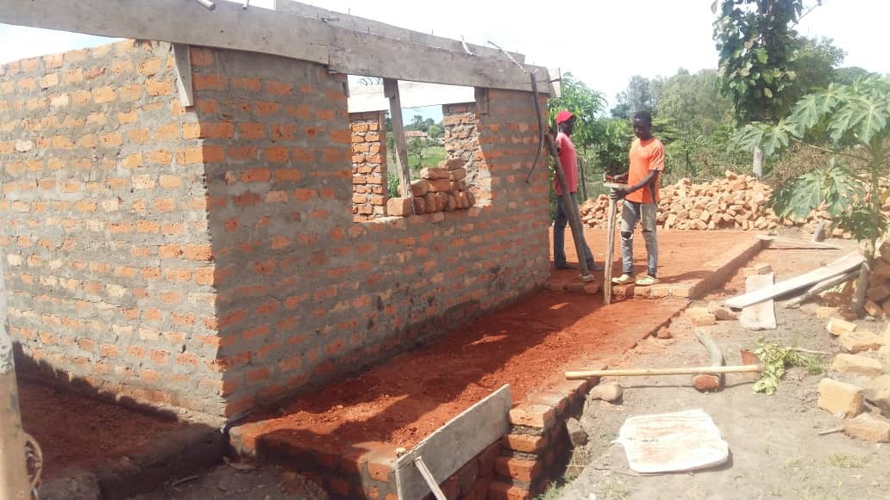
Canteen, for example…

Slide 49
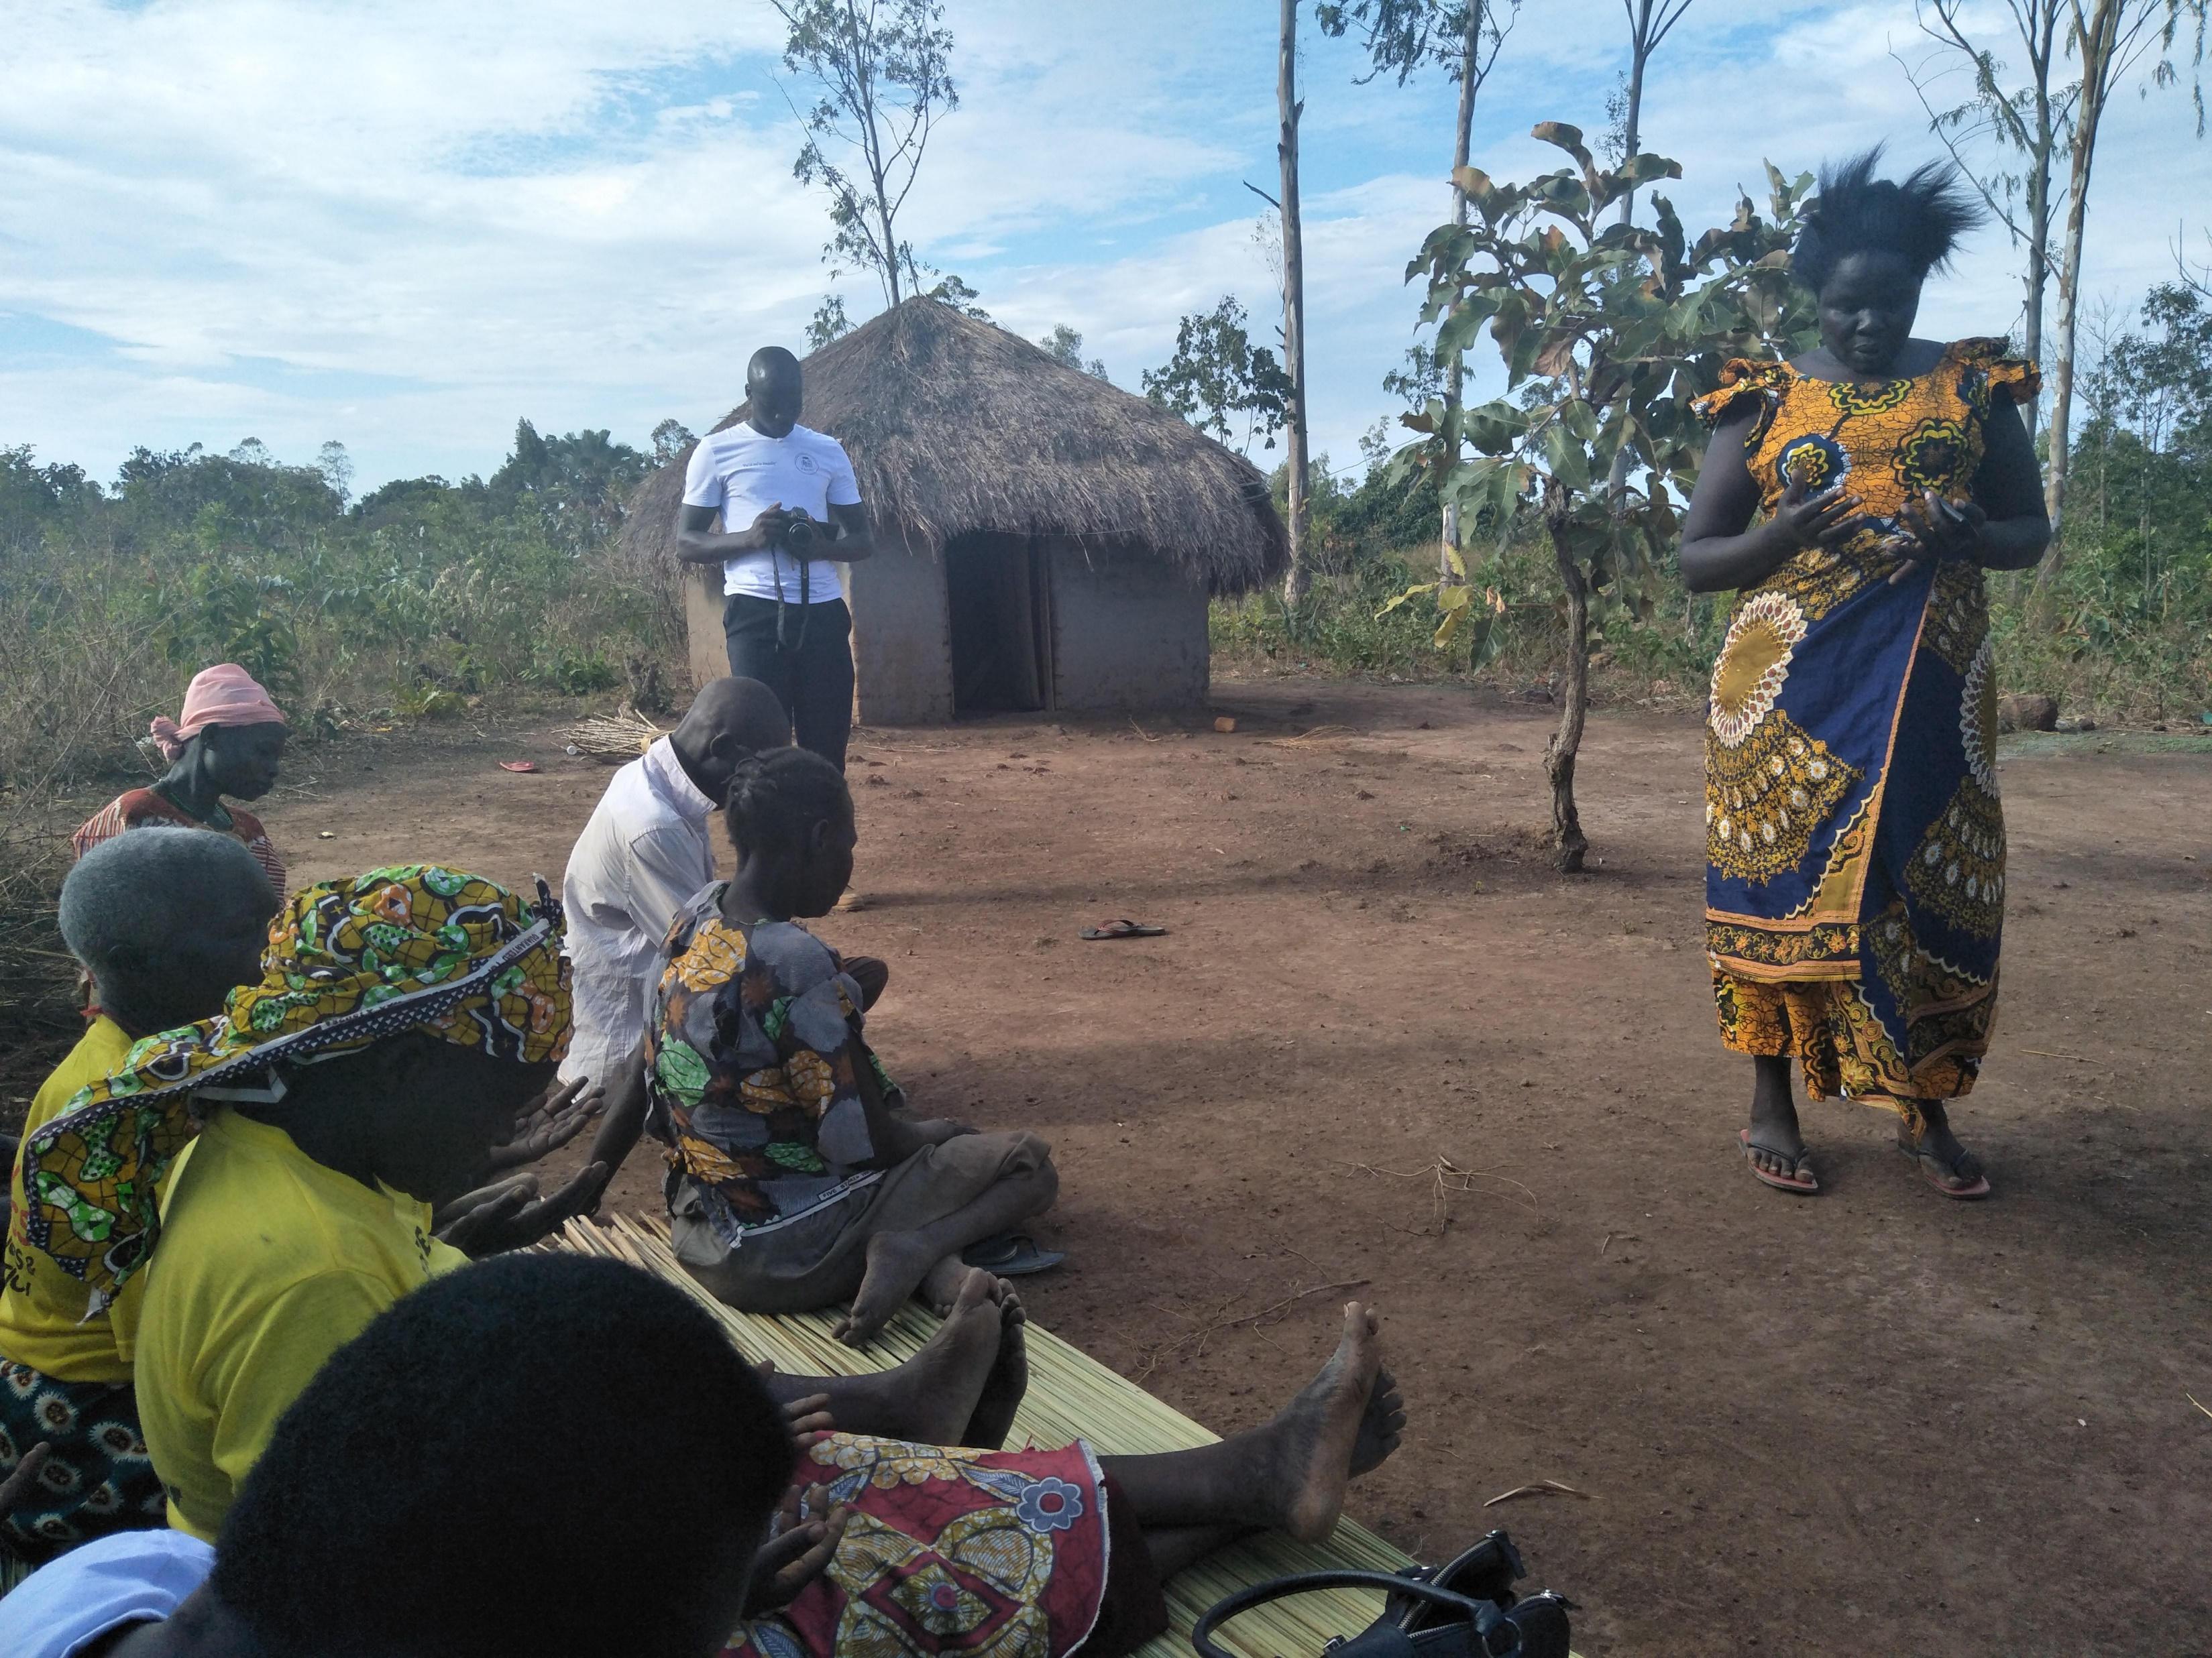
Reaching Beyond…Gosu Village

Slide 50
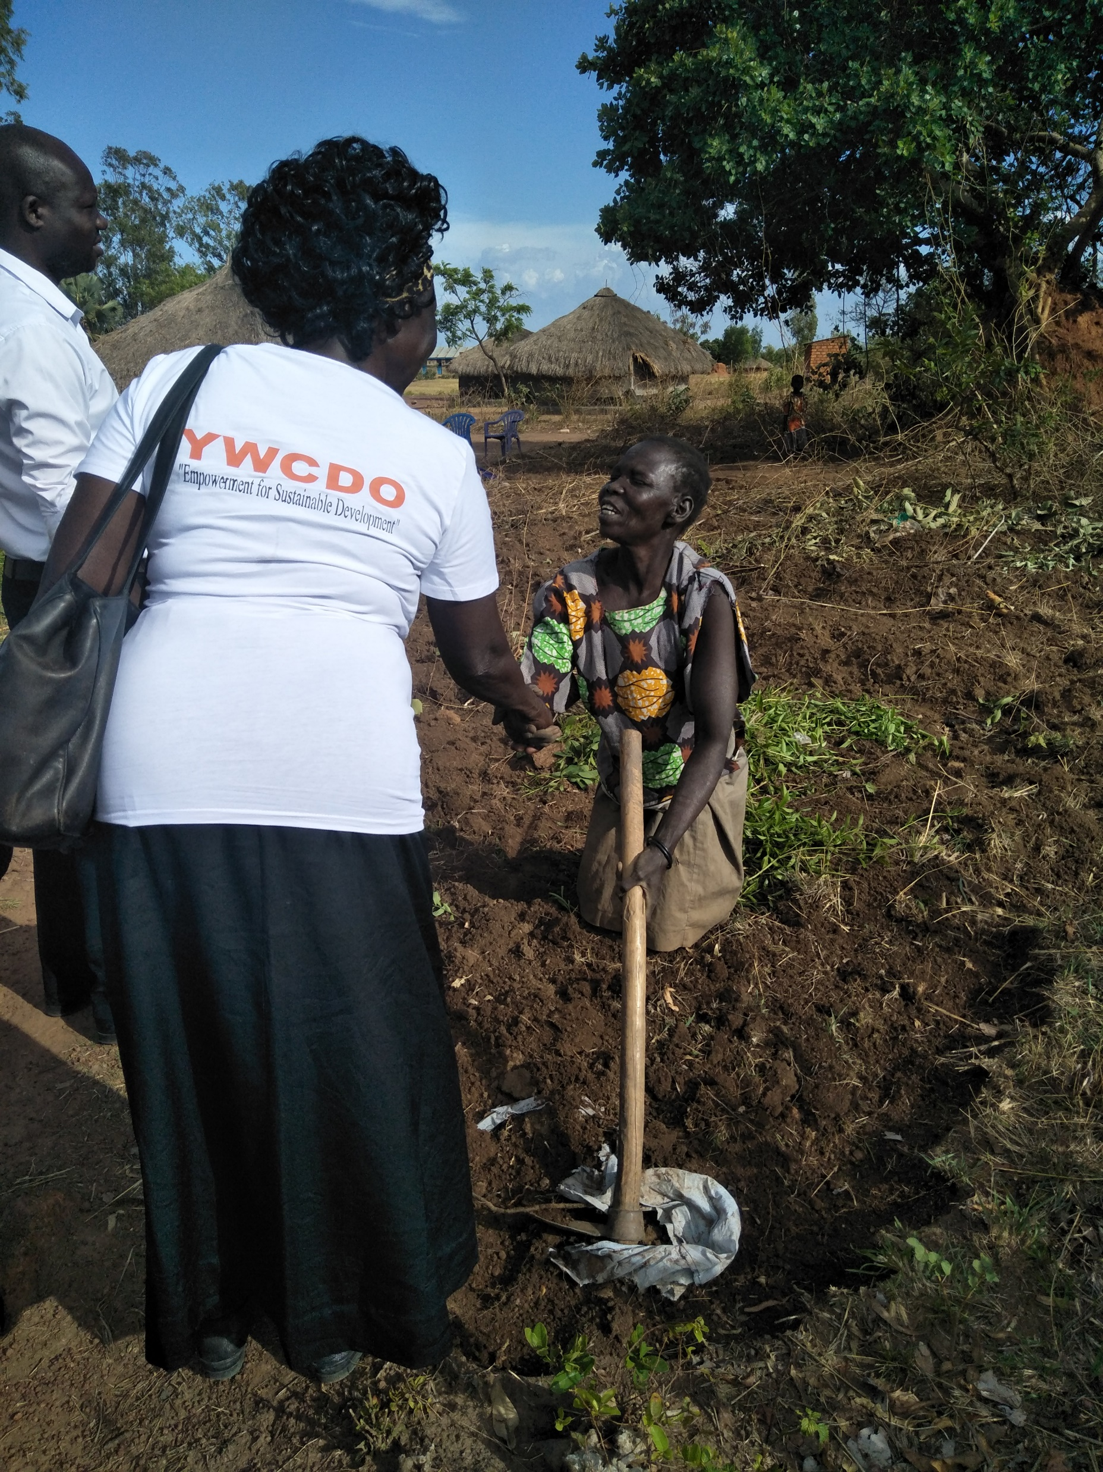
Ministering to the handicapped

Slide 51
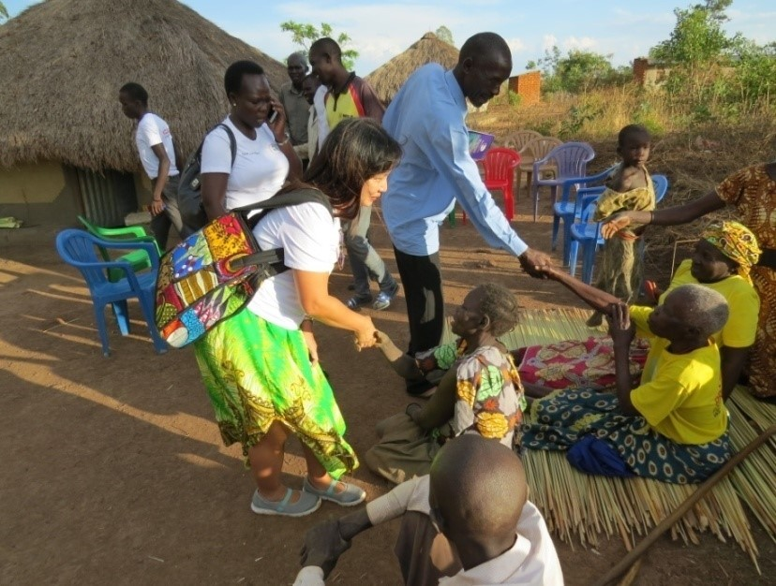
How they appreciated our visit!

Slide 52
The work is plentiful, but the labourers are all volunteers…how could STAD help to get full-time staff to ensure continuity of the work?

