Slide 1
Respacing Global Collaboration for Peace
Scenarios of the Future, 2024 – 2035​

Slide 2
Why RESPACE? Why now?
Recognition of polycrisis
International institutions for peace and global cooperation falling short
Gap between aspiration and reality to support to local actors
Contested powers and power structures – locally and internationally
Demand to make global governance structures more relevant

Slide 3
RESPACE Scenarios
Stories that provide orientation on the possible future environments for global collaboration and serve as a starting point to explore our individual and collective capacities for co-creating equitable global spaces and infrastructures that enable sustainable peace.
Spaces are environments that foster informal collaboration among people or groups
Infrastructures are the systems or governance needed to maintain these collaborative environments over time

Slide 4
RESPACE Scenarios
Scenarios are NOT PREDICTIONS
Scenarios are NOT PROPOSALS
They need to be RELEVANT, CHALLENGING, PLAUSIBLE, AND CLEAR.
They are multiple STORIES that describe possible pathways into a future, and which help us talk and think about our lived reality.

Slide 5
Why Scenarios?
Broaden the collaboration
Engage diverse stakeholders and communities
Think boldly about options
Build on existing momentum & change processes

Slide 6
How were the scenarios created?
Global team of 23 change agents, thought leaders, movement actors from 17 different countries
Collaborative imagining and drafting process - series of online/in-person workshops – April - August 2024
Team members participated in a personal capacity
Contributed their expertise, personal experience and networks

Slide 7
Structure of the scenarios
Scenarios extend from now to 2035
They are a set and are meant to be read together
Each scenario:
starts with a snapshot of reality that foregrounds current dynamics
tells a unique story of possible developments that influence how collaboration for building peace around the world could play out from now to 2035

Slide 8
THE RESPACE SCENARIOS

Slide 9
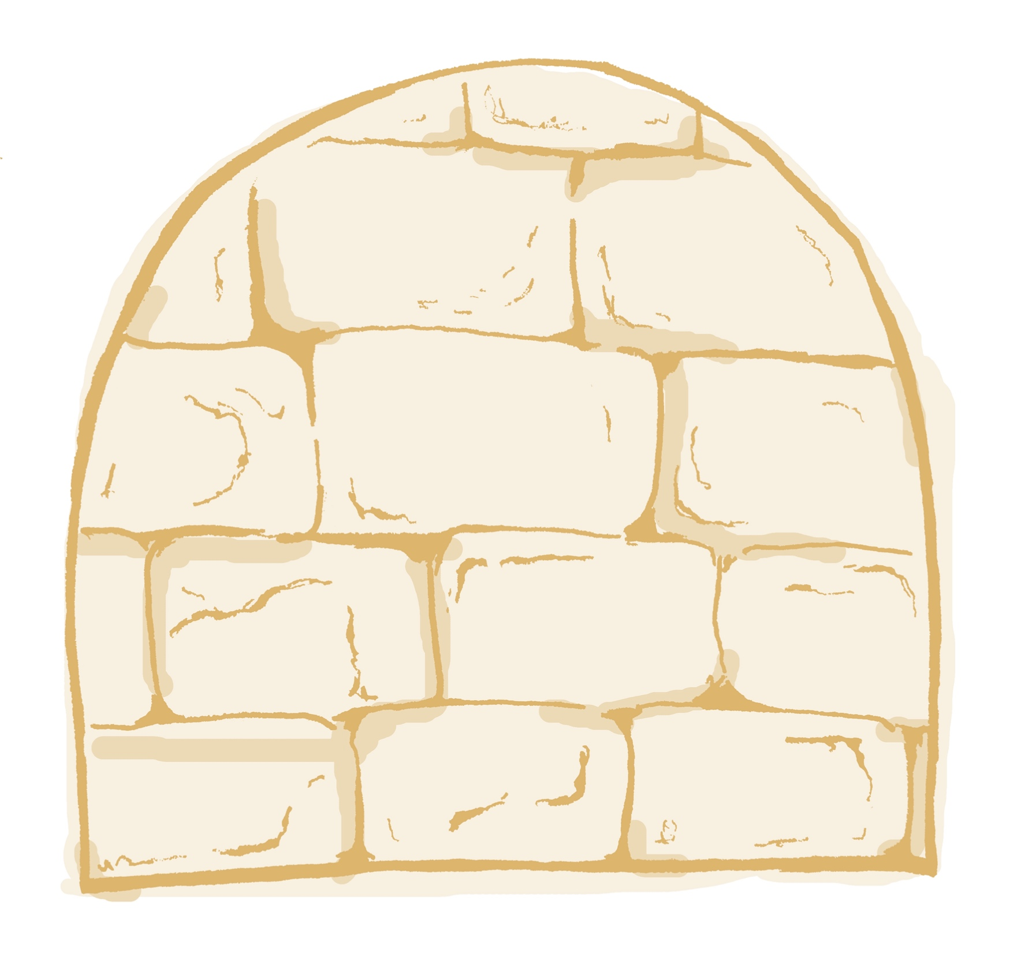
the world of
Global unrest, political instability: Right-wing policies rise globally, fueled by disinformation, increasing mistrust and instability.
Conflict Escalation: Wars in Ukraine and the Middle East draw in global powers, diverting focus to military buildup over diplomacy.
Inequality and Climate Crisis: Climate impacts displace millions, worsening tensions and leading to unrest and emergency state responses.
Pandemic and Nationalism: A new pandemic triggers border closures, rising xenophobia, and deepening global inequality.
Geopolitical Rivalries and Fragmentation: Increased surveillance and geopolitical rivalries lead to a fractured, authoritarian global order.
WALLS
Notes:
Insert summary points

Slide 10
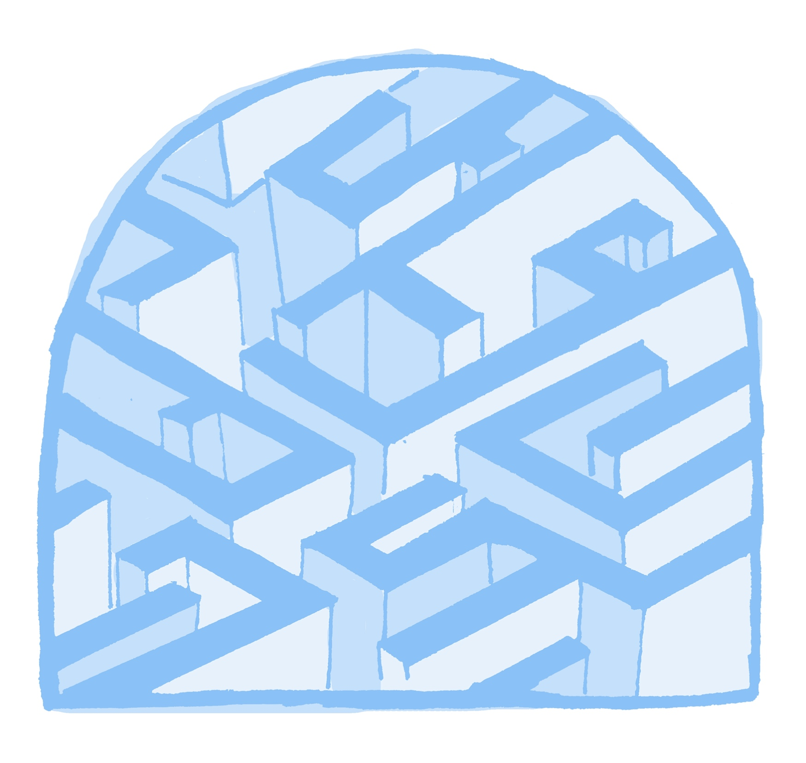
the world of
Rising Global Risks: Wars in Ukraine and Gaza escalate, with the UN unable to act due to divisions in the Security Council, sparking calls for reform.
Calls for UN Reform: Civil society and nations push for changes to the UN Security Council, seeking a more inclusive and democratic global system.
Public Campaigns for Change: Global campaigns highlight military spending and the planetary crisis, mobilizing public support for UN reform.
Diplomatic Progress: Diplomatic pressure builds, with countries and civil society advocating for expanded UN representation and transparency.
UN Structural Reform: The Security Council expands, veto power is reduced, and the General Assembly gains authority, offering hope for a more equitable international system.
MAZE
Notes:
Insert summary points

Slide 11
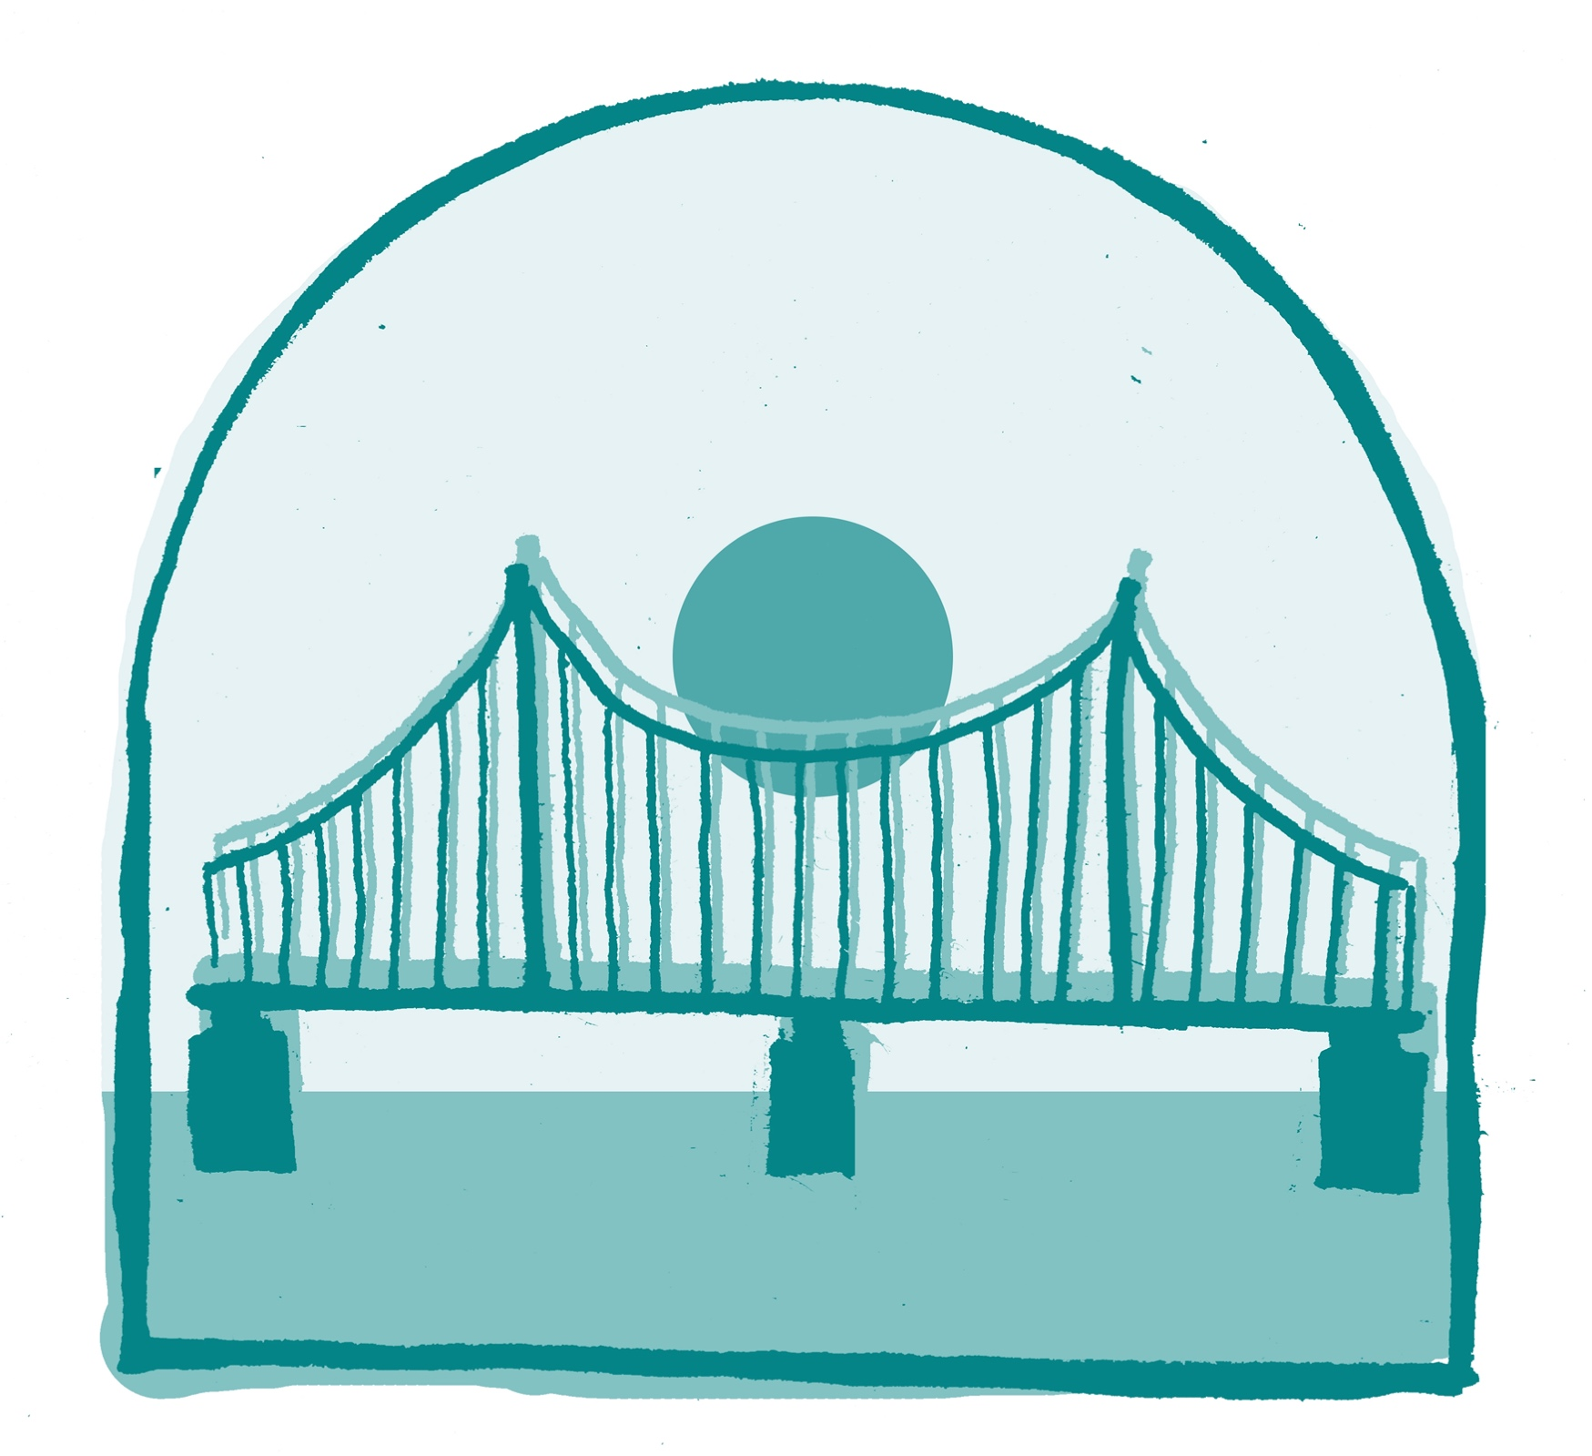
the world of
Multiple Crises: The world faces climate change, conflict, inequality, and displacement, with civil society stepping in as governments and institutions struggle to respond.
Narrative Shifts: The #InvestInEquitableNarratives campaign, led by youth, challenges dominant media portrayals, amplifying diverse voices and grassroots movements globally.
Civil Society Influences Politics: Grassroots activism reshapes politics; civil society drives democratic transitions in Pakistan and the rise of a third party in the US Congress, promoting inclusive governance.
Economic Transformation: Worker activism drives wage growth and fairer resource distribution, while countries adopt sustainable technologies and local economies become more resilient.
Citizen Assemblies and Global Cooperation: Community-led platforms thrive, and the Global Climate Governance (GCG) framework is launched, fostering global peace and cooperation through collective responsibility and inclusive governance.
BRIDGES
Notes:
Insert summary points

Slide 12
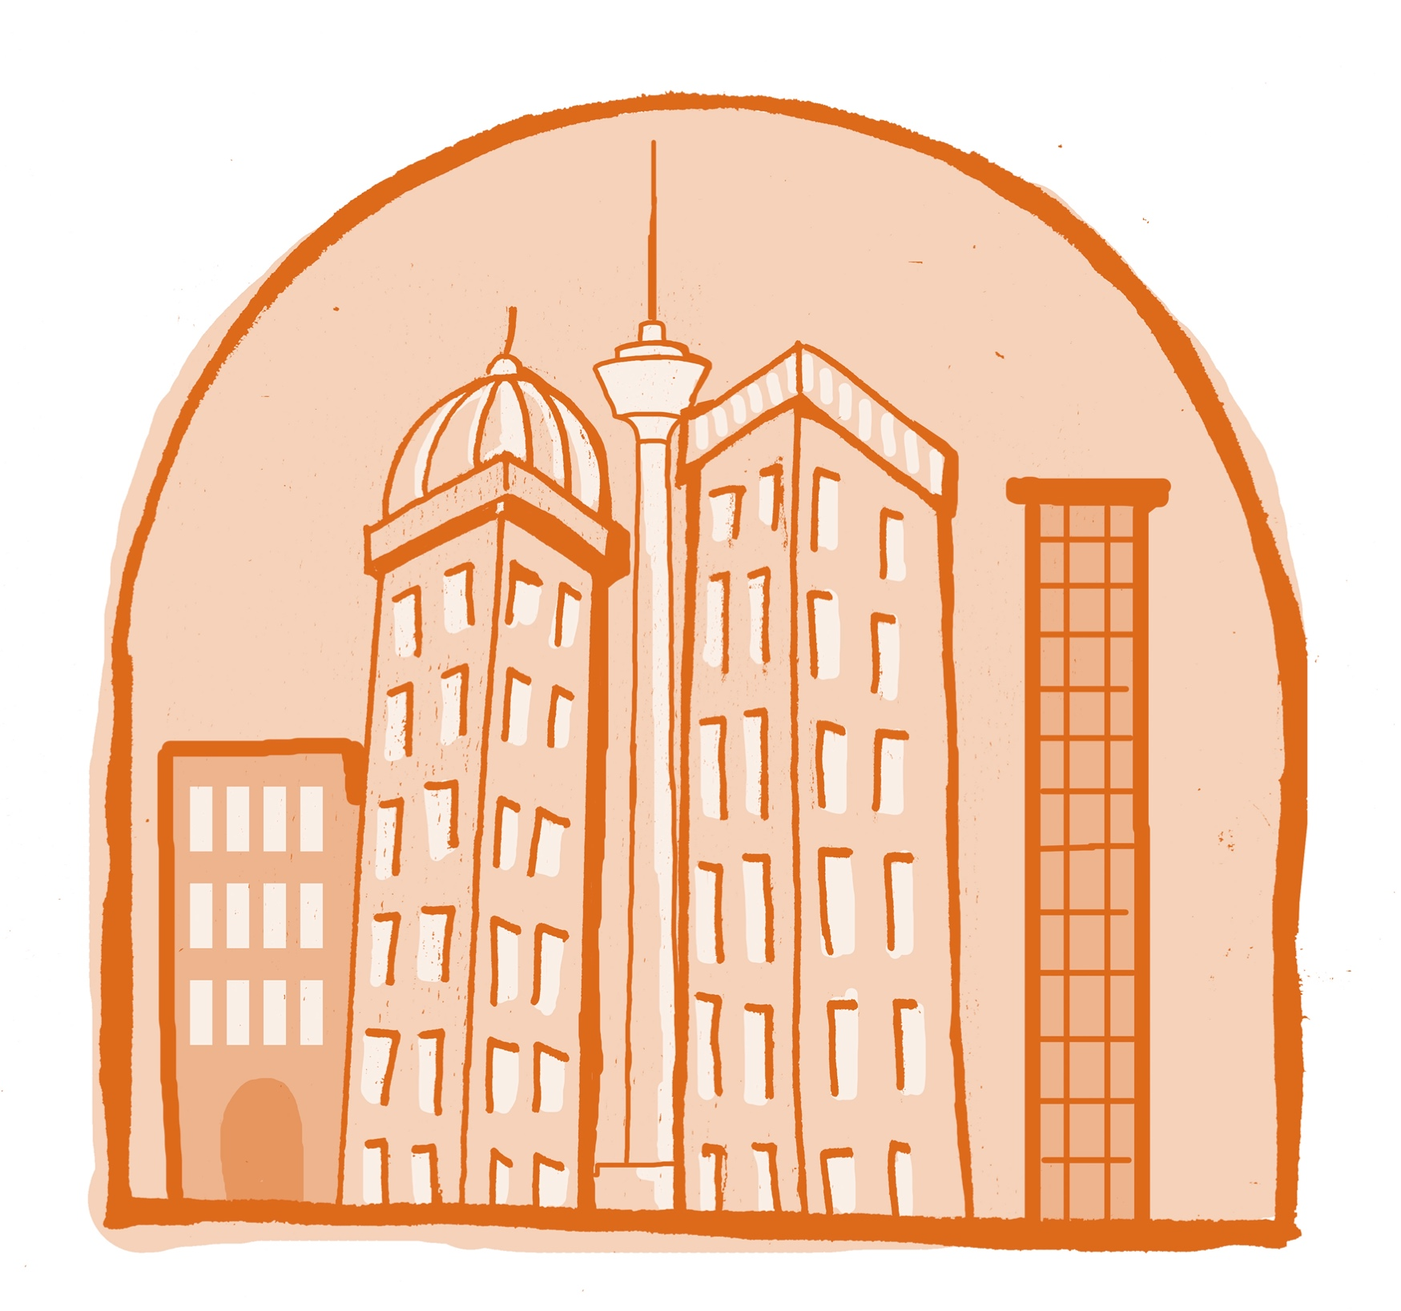
the world of
Rising Global Tensions: Authoritarianism and populism grow in Europe and North America, while BRICS+ countries challenge Western dominance, sparking economic and diplomatic tensions.
Domestic Crises in the US/Europe: Unrest and militias disrupt the US, while Europe focuses on economic protectionism and stricter border controls amid migration concerns.
Climate Disasters and Isolation: Severe climate impacts displace millions in West Asia, Africa, Latin America, and Southern China, as the US and Europe isolate, leaving regions to manage crises independently.
Shift to Regionalism: The global order fractures, with regional alliances focused on trade and climate adaptation, bypassing traditional global institutions.
Fragmented Global Order: Power struggles continue, regional governance takes hold, but civil society's influence weakens, and proactive global cooperation remains uncertain.
TOWERS
Notes:
Insert summary points

Slide 13
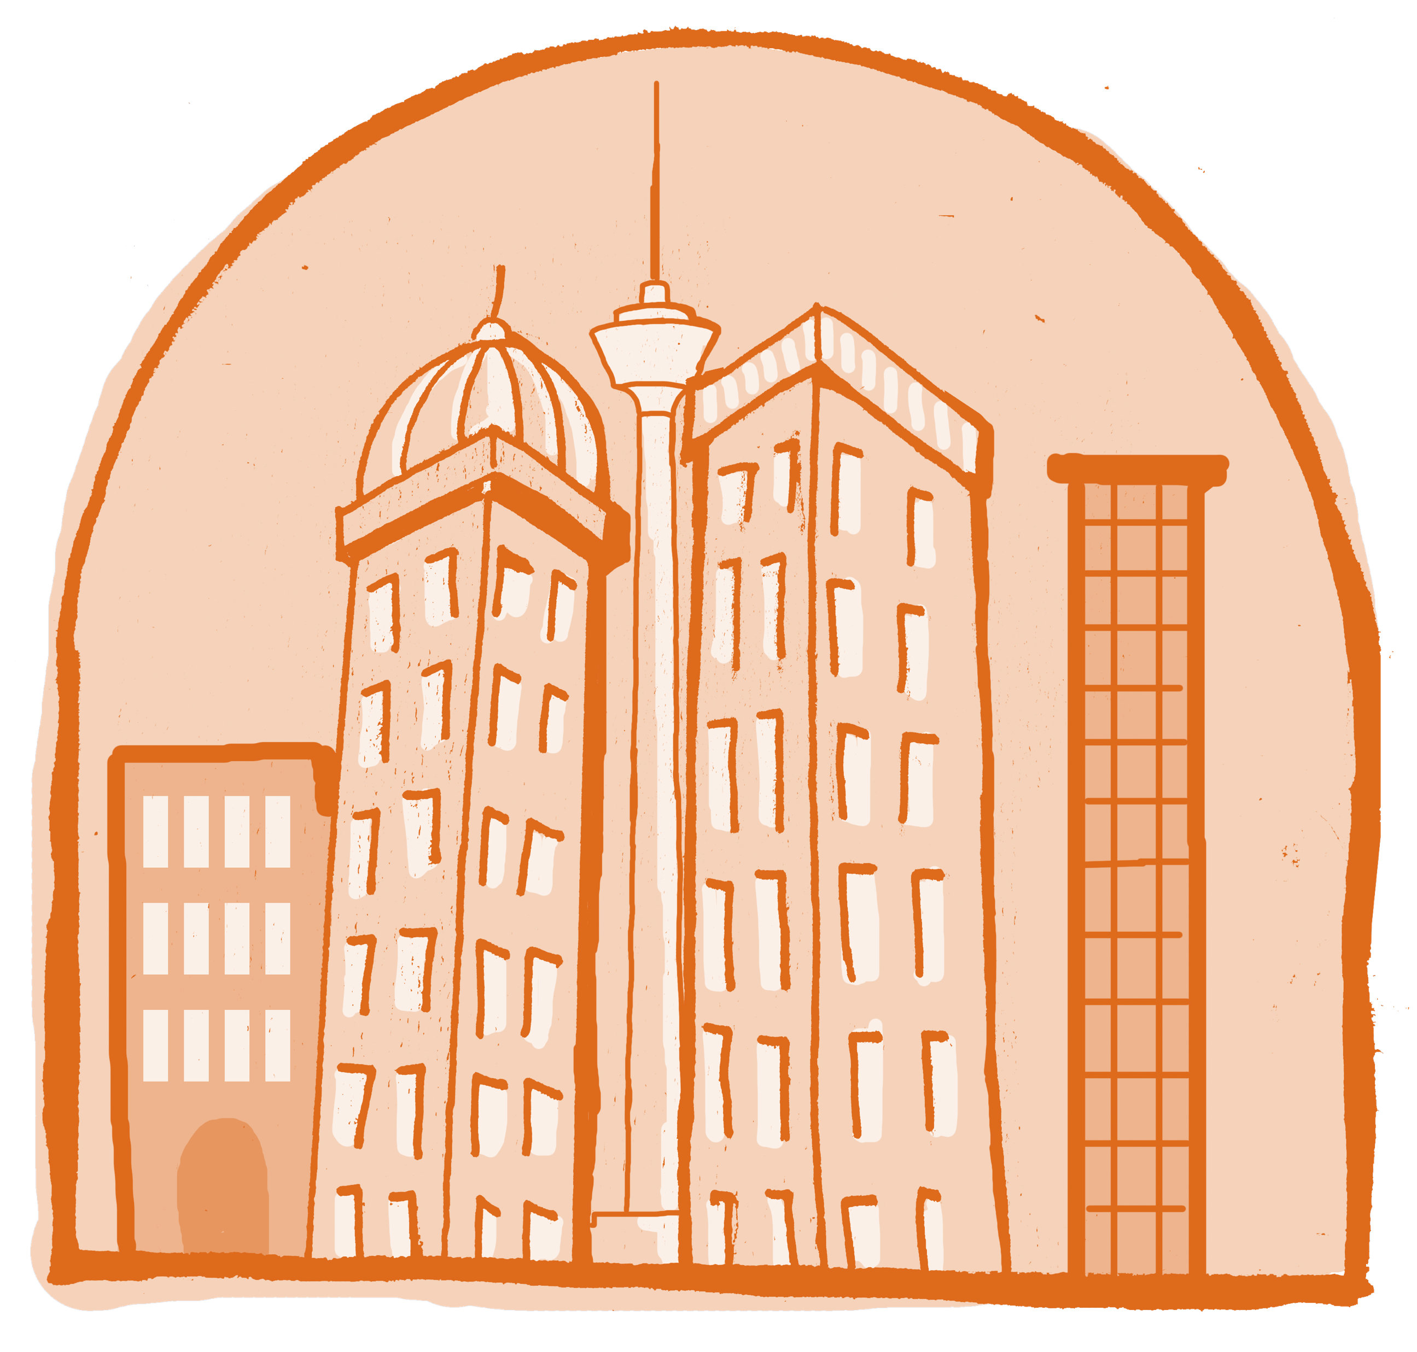
The RESPACE Scenarios
Walls
Maze
Bridges
Towers

Slide 14
Resonance
What signs are we seeing that one or more of them are emerging?
Considering each of these scenarios, if they happened, what impact it have on you, your organisation, and the groups you belong to?

Slide 15
Implications
If this were to happen, what impact would it have on:
Your local ecosystem – how will the spaces that you occupy, share and work in be impacted?
The global environment – how will global spaces and infrastructures for peace be impacted?

Slide 16
WHO | Who are you collaborating with? Who are your partners? Your allies? Which networks do you belong to?
HOW | How are you collaborating? Communicating? Locally? Regionally? Cross border? Globally?
WHAT | What issues are you working on? What are the most important/pressing issues facing your community? What is bringing people together?
RESOURCES | How are you resourcing your working? Who are supporters? Are resource abundant? Scarce?
WELLBEING | Do you feel safe? Are you secure? Do you have the space to operate openly? What is the state of peace & security?
OTHER ?

Slide 17
What do we see as the most important forces influencing how we collaborate for global peace?

Slide 18
Positive Potential & Opportunities
Identify 2-3 opportunities for change/examples of positive potential across the 4 stories.
Next consider how we as a collective can support this positive potential to grow and/or take advantage of this opportunity for change.

Slide 19
The RESPACE Scenarios
Read the complete RESPACE scenarios here:

Slide 20
