Slide 1
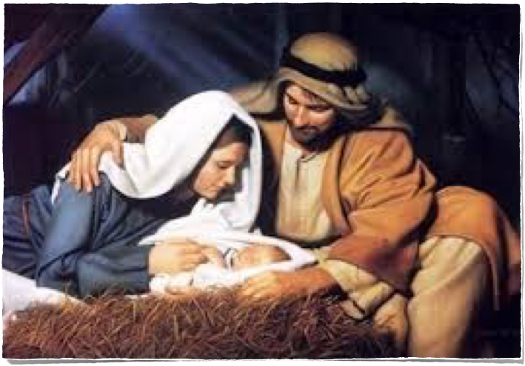

OMI Japan-Korea
Online Christmas Gathering

Slide 2


Slide 3
Leader: Today, we join the whole Church in celebrating the Year of St. Joseph. We all know that St. Joseph, aside from being the Spouse of the Blessed Virgin Mary, has also played a vital role in the incarnation of the Word of God. We know Joseph was a carpenter because people called Jesus the “carpenter’s son” (Matthew 13:55). Let us reflect now on what else Scripture tells us about St. Joseph and on how we can learn from him.

Slide 4

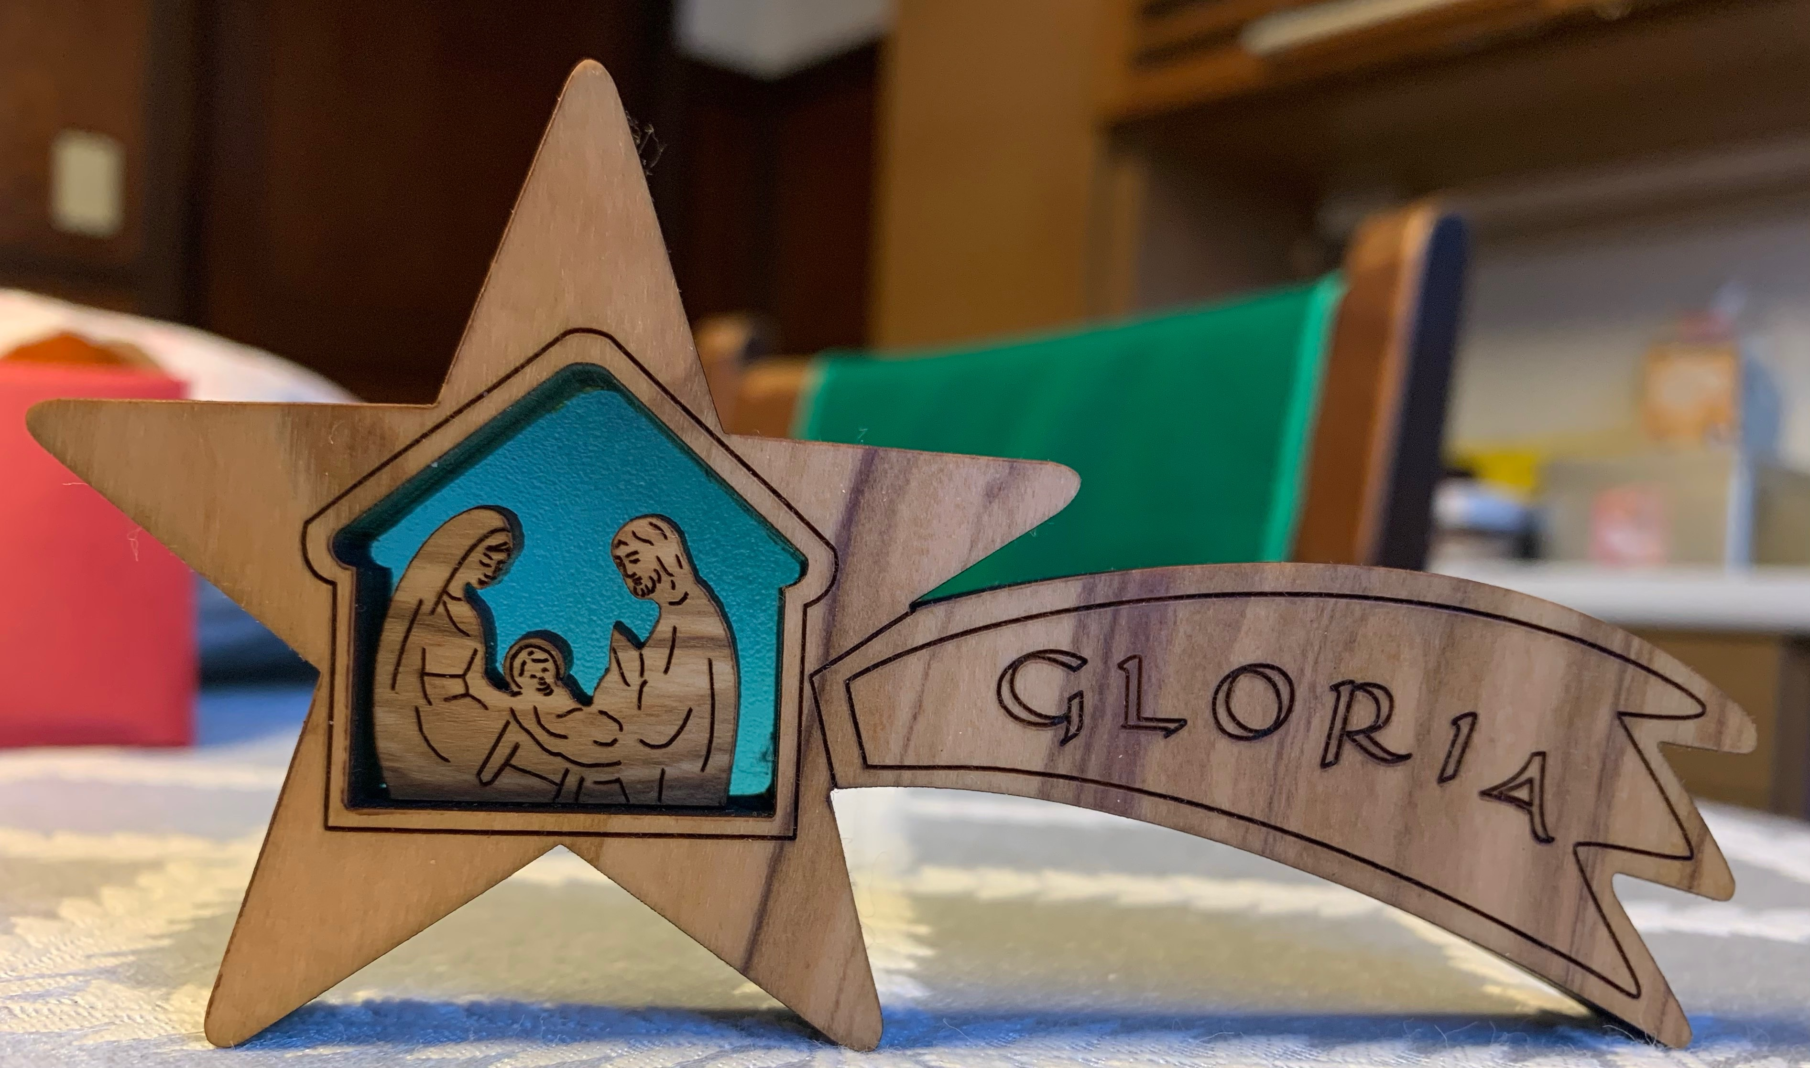
Oblate 1 (See Matthew 1:18-21.)
Mary was engaged to Joseph, but before they were married, she learned she was with child. Joseph wasn’t sure what to do. An angel came to him in a dream and said, “Joseph, the baby that Mary will have is from the Holy Spirit. Go ahead and marry her. Then after her baby is born, name him Jesus”

Slide 5
Oblate 2
During times when we are confused and not sure what to do, we can look to you, St. Joseph. You trusted God’s message and followed it even though you didn’t understand it. From your trust in God’s word, we, too, learn to trust even if we don’t understand what is being asked of us. (silence)
All: St. Joseph, pray for us.

Slide 6

Oblate 3 (See Luke 2:1-7.)
Emperor Caesar Augustus gave orders that all the people in the land had to go to their hometown to be registered. So Joseph set out for his hometown of Bethlehem. Mary went with him even though she was going to have a baby. While they were there, she gave birth to a son and laid him on a bed of hay, for there was no room for
them in the inn.

Slide 7
Oblate 4
How hard it must have been to obey the emperor’s order. What if the time came for the baby to be born? What if you couldn’t find a place to stay? So many people were traveling at once. Yet you were a good countryman, St. Joseph. You followed its laws. Sometimes rules and laws of the government aren’t easy or convenient to follow. From your example of good citizenship, St. Joseph, we, too, learn to be good citizens.(silence)
All: St. Joseph, pray for us.

Slide 8

Oblate 5 (See Matthew 2:13, 19-21.)
After the wise men left, an angel appeared to Joseph in a dream and told him to take Mary and the baby to Egypt. King Herod was looking for the child to kill him. Joseph, Mary, and Jesus were to stay in Egypt until the angel came again to say it was safe to go home. After King Herod died, the angel told Joseph it was safe to
return to Israel.

Slide 9
Oblate 6
Hurry, hurry! Pack fast. Run to safety, far from those who want to kill the baby. You are his protector and guardian, St. Joseph. You leave quickly and move to another country, even farther from your home in Nazareth. You obey the Lord and do what is necessary. we learn from you, St. Joseph, that sometimes it takes great courage to protect those we love. (silence)
All: St. Joseph, pray for us.

Slide 10

Oblate 7 (See Luke 2:41-52.)
Every year, Jesus’ parents went to Jerusalem for Passover. When Jesus was twelve years old, they took him along. After Passover, his parents left to go home, but they did not know that Jesus had stayed in the city. They searched for three days and finally found him teaching in the Temple. Then they all went home to Nazareth, where Jesus grew up wise and strong and obedient to his parents.

Slide 11
Oblate 8
Through all the years of Jesus’ young life, you were there for him, St. Joseph. Through word and example, you taught him to respect the ways of his ancestors and to be faithful to God, to family, and to community. Guide us, too, St. Joseph, as we grow. Keep our hearts and minds on becoming wise and strong, faithful and loving, trusting and obeying God in all things.(silence)
All: St. Joseph, pray for us.

Slide 12

Leader: We honor and praise you, St. Joseph, for being the perfect model of obedience, trust, and steadfast love. Just as Mary and Jesus relied on your protection and guidance, we ask you to protect us and guide us always closer to your son on earth, and God’s Son, Jesus Christ, our Lord.
All: Amen

Slide 13
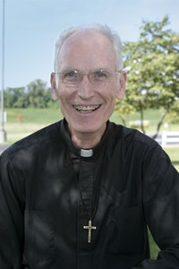
Christmas message

Slide 14
Prayers of the Faithful
Response: Lord, graciously hear us.

Slide 15
The Lord’s Prayer
* in Tamil

Slide 16



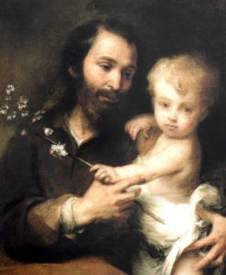

THE YEAR OF ST. JOSEPH PRAYER
Hail, Guardian of the Redeemer,
Spouse of the Blessed Virgin Mary.
To you God entrusted his only Son;
in you Mary placed her trust;
with you Christ became man.
Blessed Joseph, to us too,
show yourself a father
and guide us in the path of life.
Obtain for us grace, mercy, and courage,
and defend us from every evil. Amen.

Slide 17


Slide 18
OMI Japan-Korea
Online Christmas Gathering

