Slide 1
Wabi-Sabi
“beauty of things imperfect”

Slide 2
Some initial definitions/impressions…
Wabi-sabi is a beauty of things imperfect, impermanent, and incomplete.
It is a beauty of things modest and humble.
It is a beauty of things unconventional.
Wabi-Sabi for Artists, Designers, Poets and Philosophers, by Leonard Koren

Slide 3
Some initial definitions/impressions…
Pared down to its barest essence, wabi-sabi is the Japanese art of finding beauty in imperfection and profundity in nature, of accepting the natural cycle of growth, decay, and death.
"the wabi-sabi house; the Japanese art of imperfect beauty" www.wabisabihouse.com by Robyn Griggs Lawrence.

Slide 4
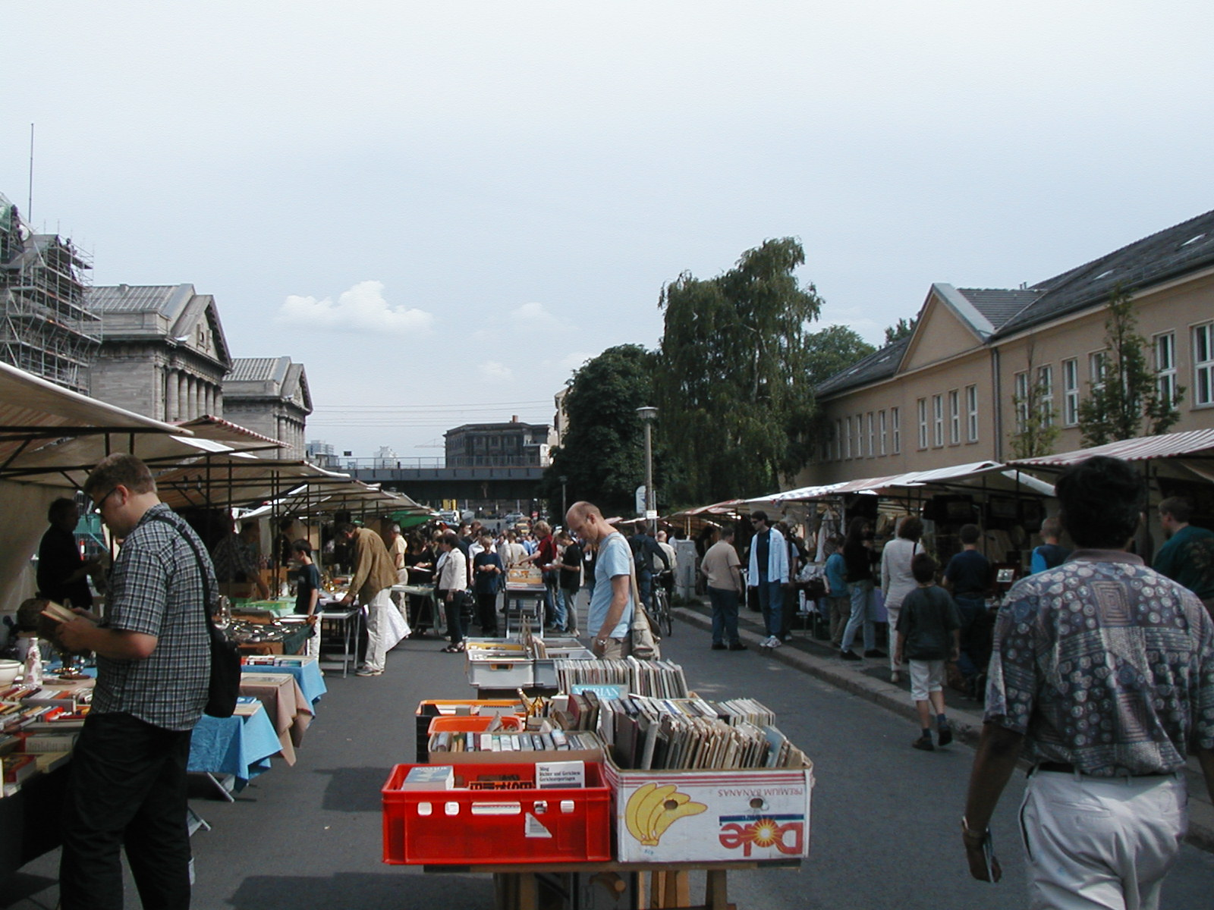

Slide 5
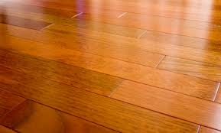
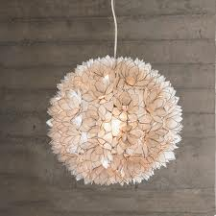

Slide 6
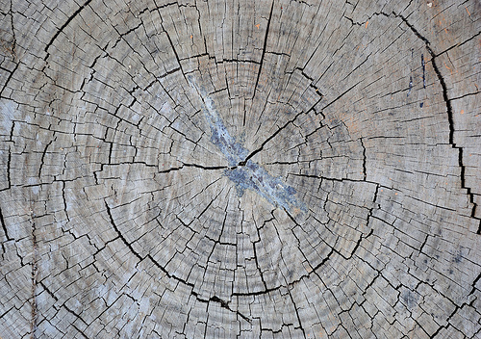
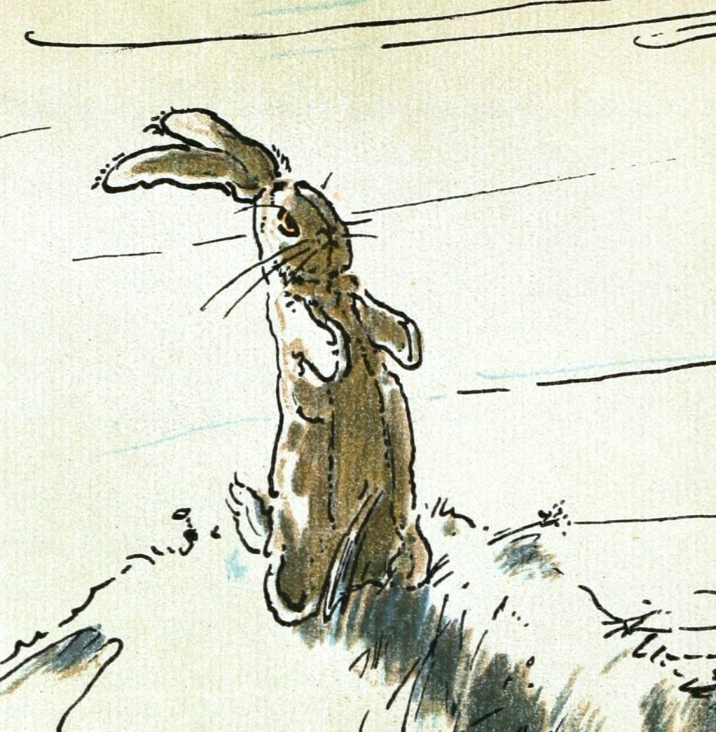
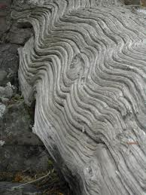

Slide 7
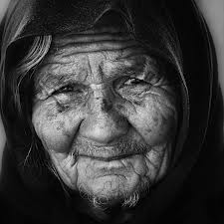
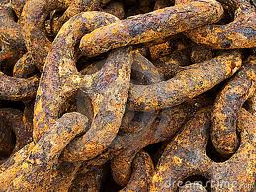
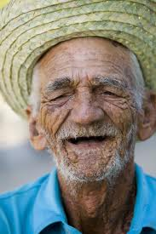
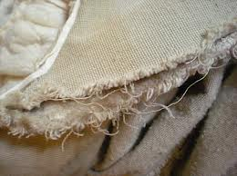
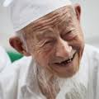

Slide 8
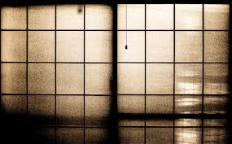
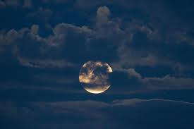
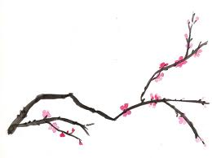

Slide 9
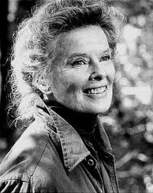
VS.

Slide 10
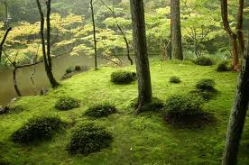
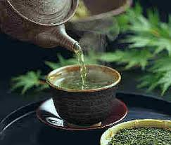
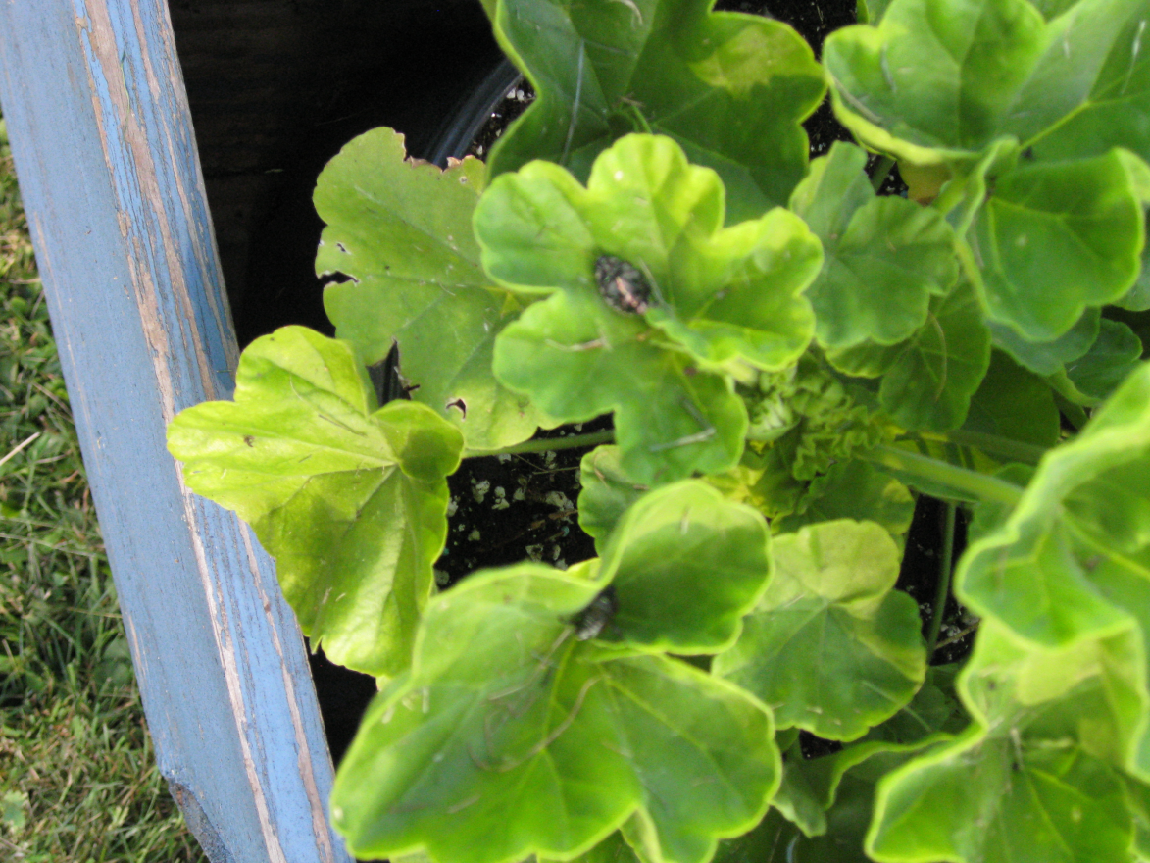
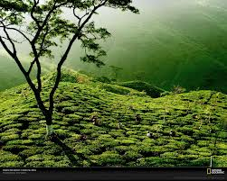

Slide 11
Origin of term wabi-sabi
WABI
SABI
WA– root word for harmony, peace, tranquility, balance…
Wabi originally meant “sad, desolate, lonely…”
Came to mean “simple, unmaterialistic, humble by choice, in tune with nature…”
Sabi alone = “the bloom of time”
Connotes natural progression– tarnish, rust… after-glow of fleeting beauty.
Earliest use of sabi meant “to be desolate”

Slide 12
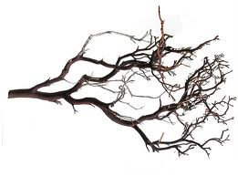
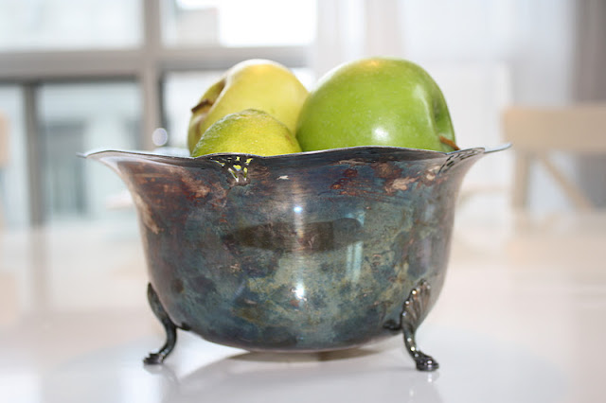
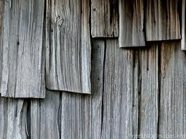
Origin of term wabi-sabi
SABI evolved in meaning to a more neutral expression for growing old, and now means the taking of pleasure in things that are old and faded.
Sabi things carry the burden of their years with dignity and grace…

Slide 13
Origin of term wabi-sabi
The closest English word to wabi-sabi is probably “rustic.” Webster’s defines “rustic” as “simple, artless, or unsophisticated… [with] surfaces rough or irregular.” … Wabi-sabi does share some characteristics with what we commonly call “primitive art,” that is, objects that are earthy, simple, unpretentious, and fashioned out of natural materials.
Leonard Koren -- Wabi-Sabi for Artists, Designers, Poets and Philosophers

Slide 14
Similarities between modernism & wabi-sabi
Both apply to all manner of manmade objects, spaces and designs…
Both are strong reactions against the dominant, established sensibilities of their time. Modernism was a radical departure from 19th century classisim and eclecticism. Wabi-sabi was a radical departure from the Chinese perfection and gorgeousness of the 16th century and earlier…

Slide 15
Similarities between modernism & wabi-sabi
Both hold that decoration must be integral to structure…
Both are abstract, nonrepresentational ideals of beauty…
And both have readily identifiable surface characteristics. Modernism is seamless, polished, and smooth. Wabi-sabi is earthy, imperfect, and variegated.

Slide 16
Differences between modernism & wabi-sabi
MODERNISM
WABI-SABI
Primarily expressed in the public domain
Implies a logical, rational worldview
Absolute
Looks for universal, prototypical solutions
Mass produced/ modular
Future-oriented
Primarily expressed in the private domain
Implies an intuitive view
Relative
Looks for personal, idiosyncratic solutions
One-of-a-kind/ variable
Present-oriented

Slide 17
Differences between modernism & wabi-sabi
MODERNISM
WABI-SABI
Believes in the control of nature
Romanticizes technology
People adapting to machines
Geometric organization of form (sharp, precise, definite shapes and edges)
Box as metaphor (rectilinear, precise, contained)
Believes in the fundamental uncontrollability of nature
Romanticizes nature
People adapting to nature
Organic organization of form (soft, vague shapes and edges)
Bowl as metaphor (free shape, open at top)

Slide 18
Differences between modernism & wabi-sabi
MODERNISM
WABI-SABI
Manmade materials
Ostensibly slick
Needs to be well-maintained
Is intolerant of ambiguity and contradiction
Cool
Generally light and bright
Function and utility are primary values
Everlasting
Natural materials
Ostensibly crude
Accommodates to degradation and attrition
Is comfortable with ambiguity and contradiction
Warm
Generally dark and dim
Function and utility are not so important
To every thing there is a season

Slide 19
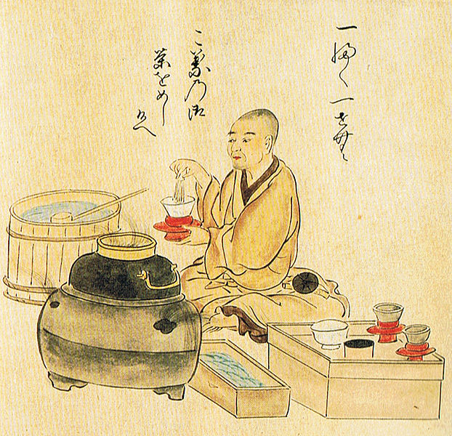
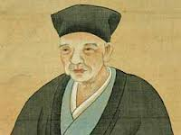
Tea Time for wabi-sabi
The most comprehensive example of the Japanese aesthetic of wabi-sabi is found within the traditions of the tea ceremony.
One of the greatest developers of the tea ceremony was Sen no Rikyu …
appreciating the sacred
in the everyday.

Slide 20
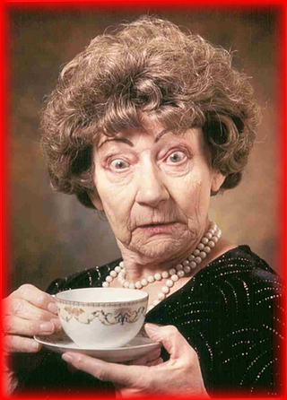
Tea time for wabi-sabi
If a friend visits you, make him tea, wish him welcome warmly with hospitality. Set some flowers and make him feel comfortable. (Jo-o, 16th century tea master)
"shaza kissa,” = "Well, sit down and have some tea."

Slide 21
Tea time for wabi-sabi
In learning tea, we're constantly reminded that every meeting is a once-in-a-lifetime occasion to enjoy good company, beautiful art, and a cup of tea. We never know what might happen tomorrow, or even later today. Stopping whatever it is that's so important (dishes, bill paying, work deadlines) to share conversation and a cup of tea with someone you love-or might love-is an easy opportunity to promote peace. It is from this place of peace, harmony, and fellowship that the true wabi-sabi spirit emerges.

Slide 22
Tea time for wabi-sabi
Wabi-sabi is not a decorating "style" but rather a mind-set. There's no list of rules; we can't hang crystals or move our beds and wait for peace to befall us. Creating a wabi-sabi home is the direct result of developing our wabigokoro, or wabi mind and heart: living modestly, learning to be satisfied with life as it can be once we strip away the unnecessary, living in the moment. …

Slide 23
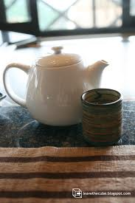
Tea time for wabi-sabi
… You can start cultivating this mind-set in small ways, taking a lesson from tea. In learning to conduct tea, we're taught to handle every utensil, from the bamboo water scoop to the tea bowl, as if it were precious, with the same respect and care we would use to handle a rare antique. You can do the same thing with the items you use every day.
--Robyn Griggs Lawrence

Slide 24
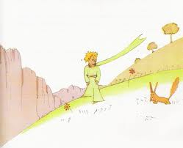
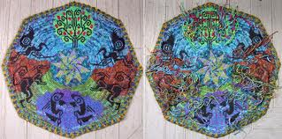
Caveat…
"Translation can at best be only the reverse side of a brocade, - all the threads are there, but not the subtlety of color or design." – Kakuzo Okakura
“It is only with the heart that one can see rightly. What is essential is invisible to the eye.”– The Little Prince

Slide 25
Reflection questions
Where do you encounter imperfection in your life? How do you relate to flaws or imperfections, within yourself or in the objects/people around you?
Where do you experience tension, stress, or hurriedness in your day? What actions or rituals might you enjoy to slow down, settle down, and cherish the moment?
Where in poetry, song, art work or literature might you find examples of the spirit exemplified in wabi-sabi?
“A bruised reed he will not break, and a smoldering wick he will not quench” (Is 42:3/ Mt 12:20) reflects a wabi-sabi spirit of compassion and humility. What other scripture images may resonate with this mindset?

Slide 26
sources
Wabi-Sabi for Artists, Designers, Poets and Philosophers, by Leonard Koren. Stone Bridge Press, 1994
"the wabi-sabi house,the Japanese art of imperfect beauty" by Robyn Griggs Lawrence. (www.wabisabihouse.com)
侘 寂 Wabi Sabi - Learning to See the Invisible, by Tim Wong, Ph.D. & Akiko Hirano, Ph.D. Copyright © Touching Stone Gallery

