Slide 1
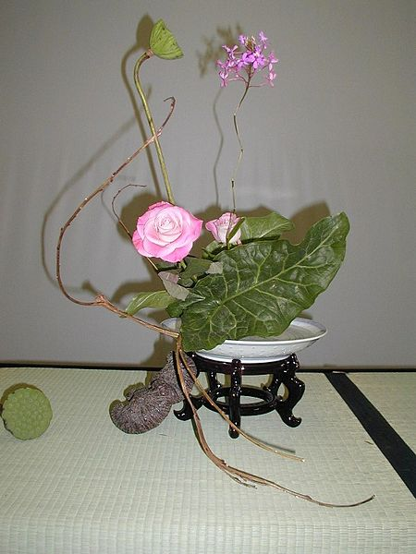
APOSTOLIC COMMUNITY & MISSION
Japan Korea

Slide 2
Articulating the Strategic Direction
OBLATE PRESENCE 1948
Ground situation of the Church in Japan, in 1940s
Post war context, complete destruction of moral, physical, spiritual and economic.
It is around this time that there was a call for missionaries who could respond positively to the spiritual and other basic needs of this devastated country.
At the invitation of Bishop Yoshigoro Taguchi, Ordinary of Osaka for missionaries from overseas, Fr. Leo Deschatelets, OMI, the then Superior General, who is reported to have said: “If no one else will, then we must go!”. Thus was born the Oblate mission in the Land of the Rising Sun.

Slide 3
Ground situation of the Oblates: RESPONSE – 1948
the first missionaries from Eastern American Province and Belgium arrived Japan on November 29, 1948.
they were entrusted to a quasi-parish Shin Itami and a small Kindergarten. Thereafter the Oblate apostolate spread out to other area
popular missions were: parishes and Kindergartens

Slide 4
Ground situation of the Church today
the church in Japan continues to remain a minority.
the immigration from various countries doubled the Catholic population; Church in Japan needs to realize this fact and envisage a whole new structure and vision.
the Bishops are realizing that these immigrants are their responsibility. The Bishops want the missionaries to respond to this situation and help them.

Slide 5
Ground situation of the Oblates today
The Oblates co-exist with the struggling Japanese Church. Oblates came to Japan to answer a need at the time, and Oblates continue to be present and to be of service to the local Church especially in areas where they think they are needed most.

Slide 6
Specialized Apostolate
prison
apostolate to substance-abuse dependents,
orphanage,
centre for battered women,
psychological and counselling services for juvenile delinquents and parents, apostolate to the hearing impaired and in recent years,
pro-Life apostolate and the vast area of apostolate to foreign migrant workers.

Slide 7
Priorities & Future Ministries
There is now an influx of a younger generation with new ideas. With the new vision the priorities have been identified as:
Youth Ministry, Advocacy , Justice, Peace and Integrity of Creation (JPIC).
With the new restructuring of the Delegation that the greater portion of the members of the mission are/will be from the third world with new visions and ways of approaching problems.

Slide 8
Mefu - Osaka Meeting: April 2007 & Follow Up July 2007
The purpose of Mefu meeting was to clarify Delegation’s MISSION VISION statement for next 10 years:
“As Jesus ‘mission was to bring hope to the poor and since the OMI charism is to serve the most abandoned, we in, Japan also want to walk in this direction. Those who cry out for salvation in Japan now and for the next 10 years seem to be the migrant, the youth, the laity, the children and other marginalized. We conceive our mission to be done in community with God, our brother oblates, church and Society."

Slide 9
OBLATE RESPONSE
According to the need of the local church, OMIs highlighted four ministries according to the opportunities that are available:
l. Ministry to the Migrant
2. Ministry to the youth
3. Ministry in parishes and Kindergartens
4. Ministry of Advocacy

Slide 10
as APOSTOLIC MEN
We perform this ministry as apostolic men:
With God
We, as a community, commit ourselves, we listen with docility to God's word spoken in the Scriptures. We seek to become more aware of why we have been called here.
We therefore commit ourselves to take time together in order to deepen our relationship with Him, so that we can discern where He would have us go.

Slide 11
With our brother Oblates
while recognizing the various forms that Oblate community life can take, some men expressed the need to live together in actual communities in order to better enable them to serve and to witness.
we will make it a priority to take the time and effort to create an atmosphere, within our self and among ourselves, wherein we sit down and recognize where we are at this moment, and share what we are doing.

Slide 12
With the Church
We invite the laity to discover their baptismal vocation to serve the church and society, we will seek 'to be with them' as brothers and shepherds who accompany them in their search.
We will actively seek out co-operators, fellow workers for the vineyard, both lay and religious, We will also put the youth in a central place in our Christian communities“
We will be present for the church in her attempt to serve the foreign community pastorally.

Slide 13
With Society
We are called to be in tune with and to be able to read the signs of the times and to listen to the voice of the people.
We will foster: special training in order to build competencies, capacity building as part of ongoing formation.

Slide 14
KOREAN MISSION - 1999
Evaluation: 10th Anniversary of Oblate presence:
evaluation session on Oblate life, mission, finances and administration.
an opportunity to come to know each other and to have a better understand the joys, pains and expectations of one another in the community.
made us aware to go deeper and to reflect on how to share our Oblate charism with the Korean Church at large.

Slide 15
KOREAN MISSION
a felt need to clarify the meaning of our presence in Korea.
Though we are a small community, yet our presence has made a big ‘difference’ in the life of the people and to some extend to the religious men and women.

Slide 16
RECENT PAST: “Call for Conversion”
Our conversion as a Delegation starts with:
Developing community-based mission;
Reflecting on the quality of our life-style and why it is not the kind of witness that we want it to be;
Having the courage to put into practice our past decisions as a delegation;
Leaving our fear of change and insecurity behind and focusing on the vast potentials of the future:
Respecting the views of the “Southern Hemisphere” OMIs (“South” being associated with the poor);

Slide 17
“Call for Conversion”
Paying more attention to the newly arrived Oblates;
Promoting the role of the laity in our mission, encouraging them to be more integrated in their surrounding communities
Plenary Session Summary
Spring Meeting, Japan/Korea, 2011

Slide 18
PROJECTION: Strategic Direction - Delegation
WHERE WE ARE TODAY AS OMI of JAPAN – KOREA DELEGATION?
Are the original reasons for Oblate presence: “If no one else will, then we must go!” is still valid?
Resources: Mefi + “Call for Conversion”
WHERE WE ARE GOING? and
HOW DO WE GET THERE?

Slide 19
RESOURCES FOR ORIENTATION
Guided by the sources:
Scriptures: roots
Oblate tradition: Charism of St. Eugene de Mazenod: roots
Japan: Oblate roots
Five calls for conversion (General Chapter 2010)
Oblate Triennium: Life in Apostolic Community

Slide 20
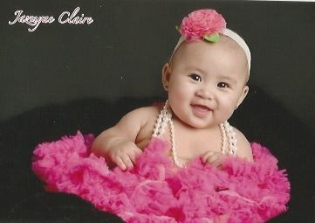
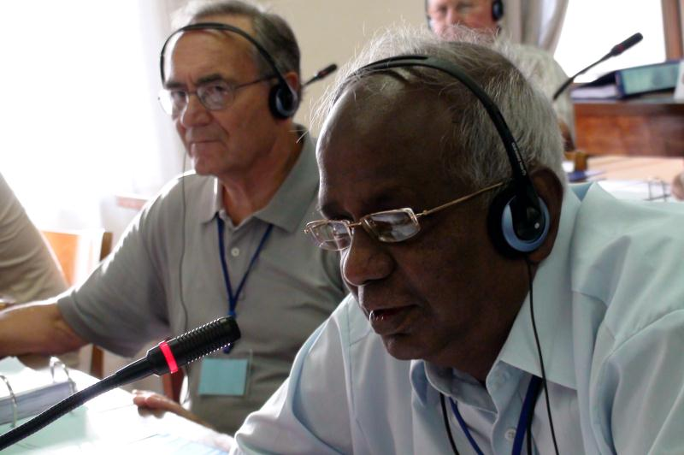
THANK YOU

