Slide 1
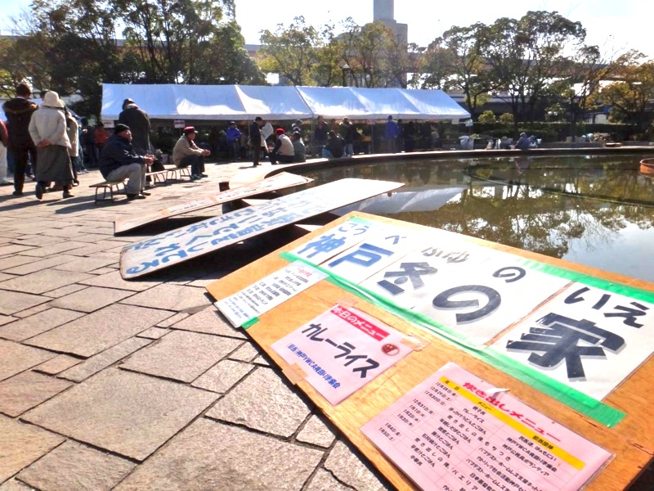
Winter Tent in Kobe brings HOPE to the Poor

Slide 2
The Catholic Social Action Center in Kobe, together with the other social welfare groups in the city (YWCA, Civil Federation, Baptists etc.) organizes a program every end of the year for the homeless, jobless and the dropouts of the society. It is held at a park in Kobe from Dec. 28 – Jan 5.
The poor look forward to this, because they are sure to get a decent meal continuously for 9 days!

Slide 4
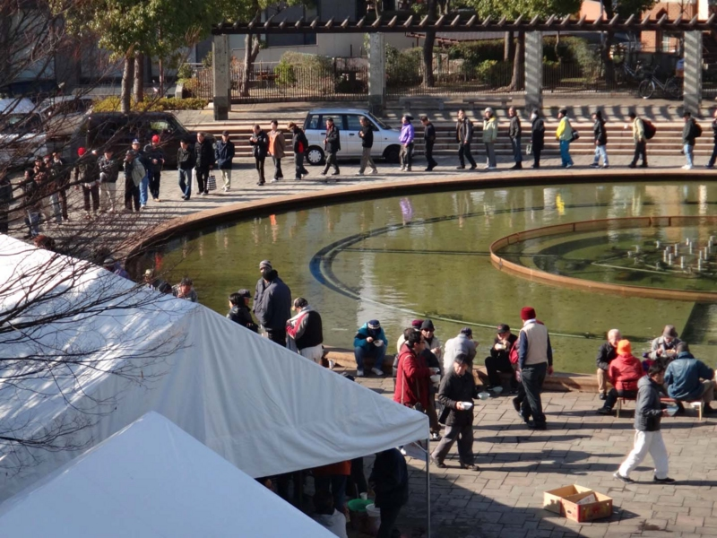

Slide 5
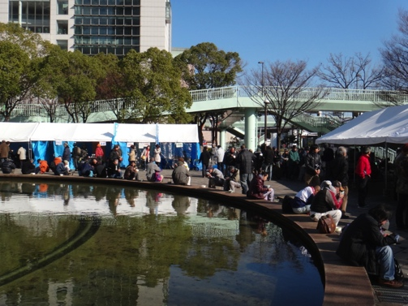

Slide 6
During this period of time (Dec. 28 – Jan 5), apart from food, the poor are also given a free medical check up, hair cut, advice on social welfare etc.
Many volunteers come forward to entertain them with songs and games.
In the park there will always be a corner dedicated to the homeless who have died.
December 29th is the day to remember the dead, whose names are written and placed on a board. Many gather in front of it, offer flowers and pray for their friends in heaven.
At least in this place the poor, even after their death are remembered by their own.

Slide 7
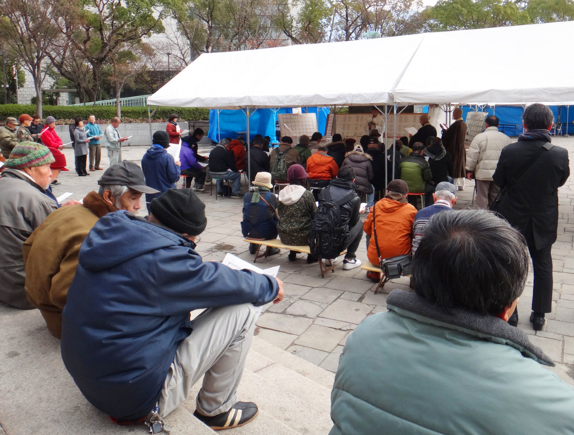

Slide 8
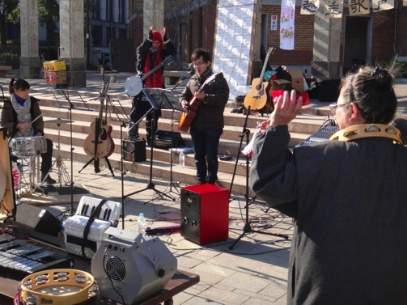

Slide 9
Thanks to the Kobe City Hall for providing the space etc. and also to many generous people and volunteers, if not for them, the poor will not be given this opportunity to celebrate the beginning of a new year.

Slide 10
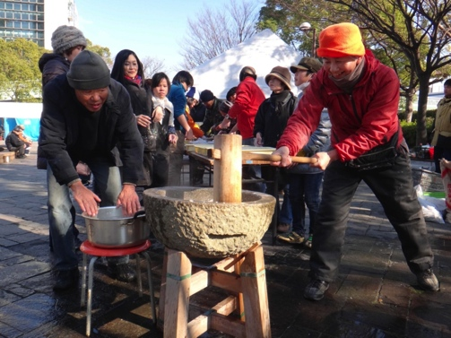

Slide 11
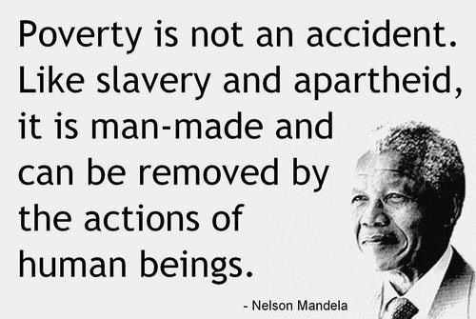
Bradly Rozairo OMI

