Slide 1
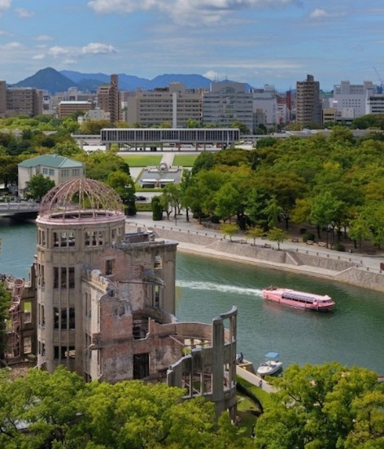
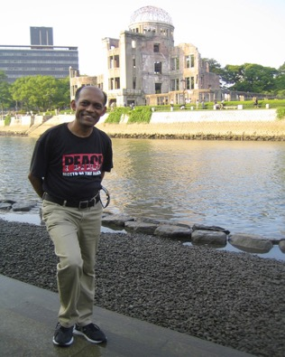
PEACE from Hiroshima

Slide 2
Peace Events in
Pictures
Aug. 5 ~ 6, 2015

Slide 3
Peace walk

Slide 4
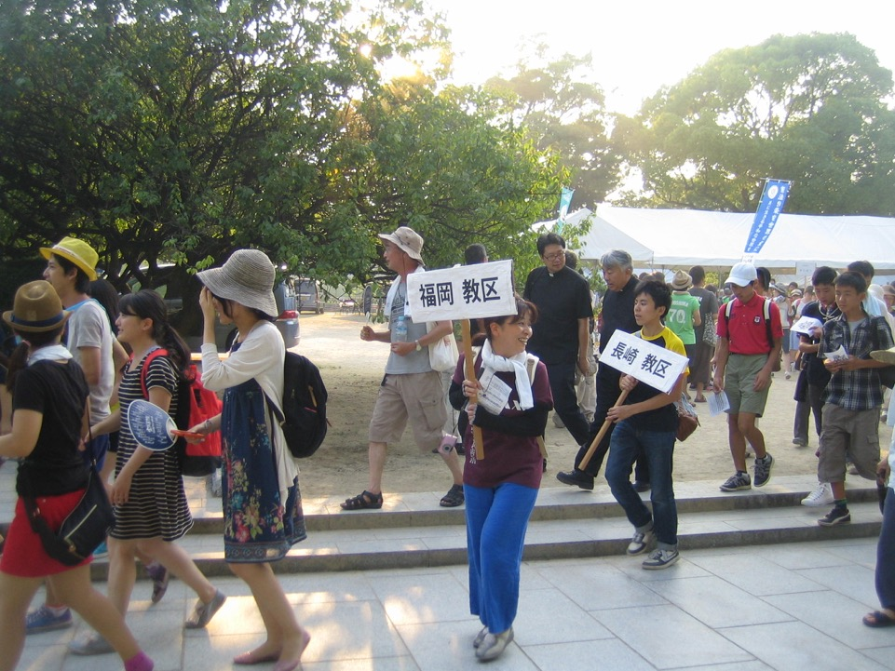

Slide 5
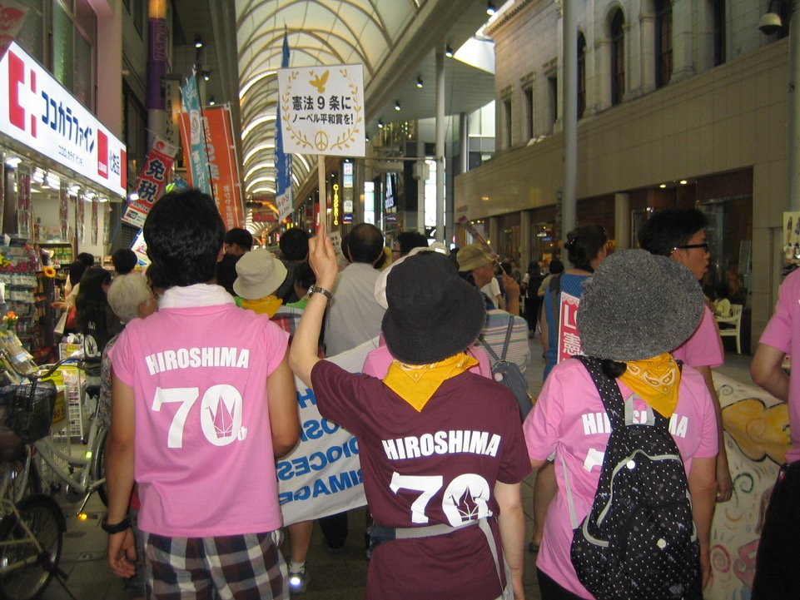

Slide 6
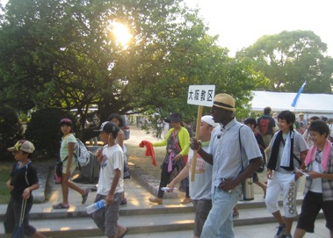
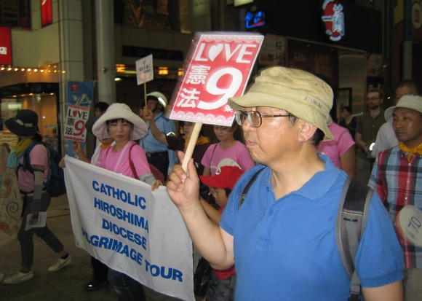
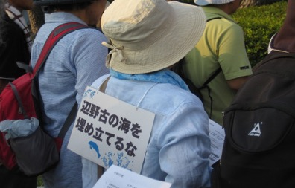

Slide 7
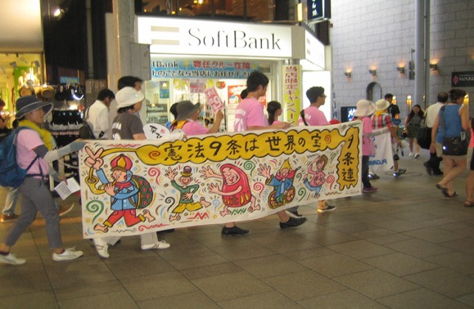
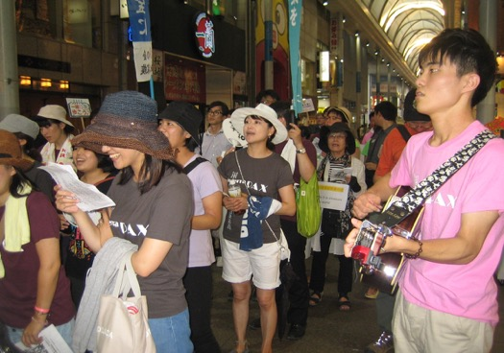

Slide 8
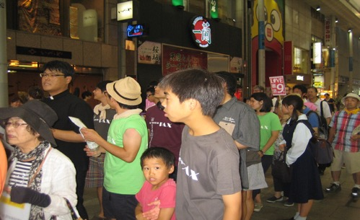

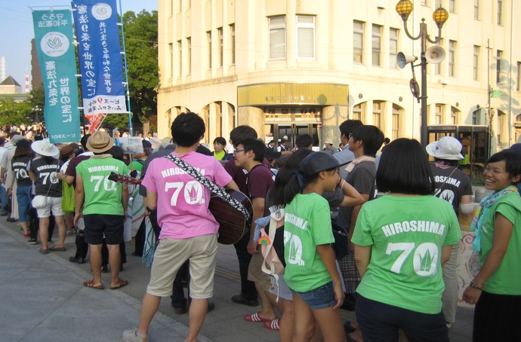

Slide 9
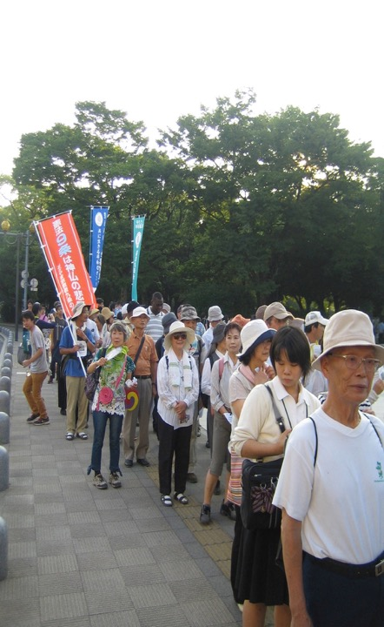
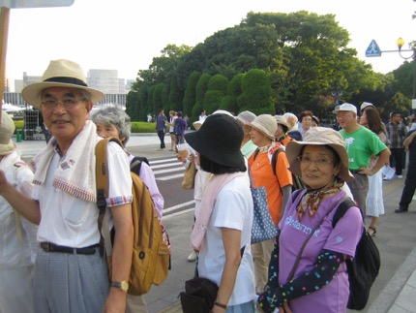
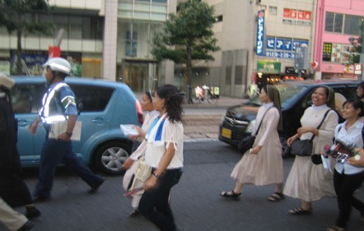

Slide 10
Peace Songs

Slide 11
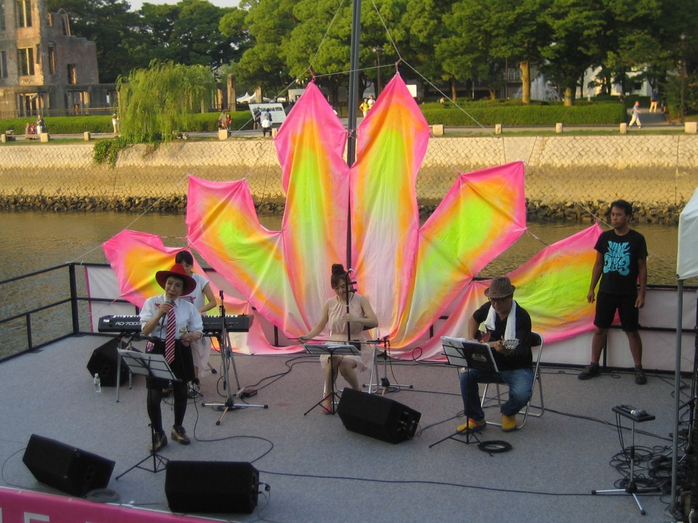

Slide 12
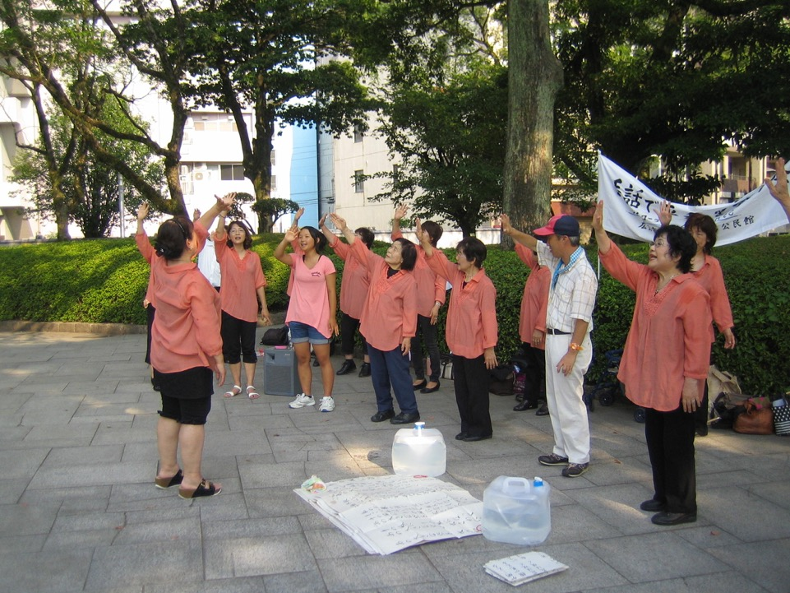

Slide 13
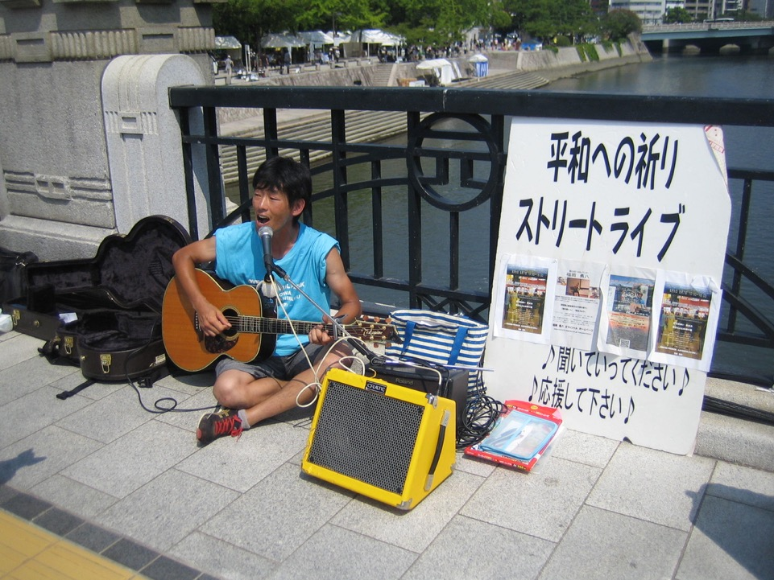

Slide 14
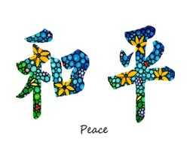
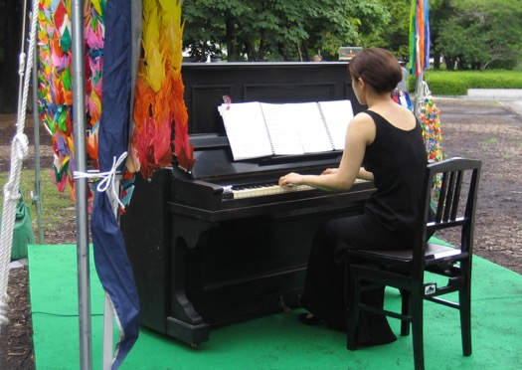
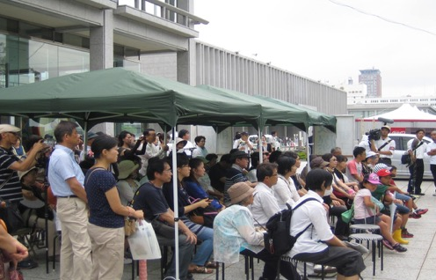


Slide 15
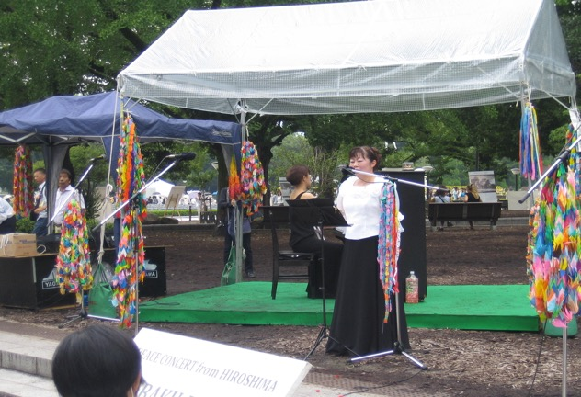

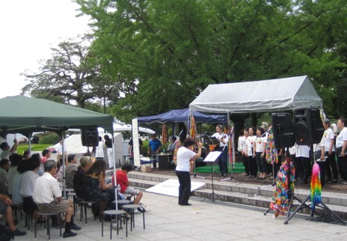


Slide 16
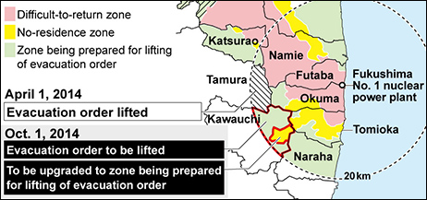
Peace Appeal
Fukushima?
No, its NOT over yet

Slide 17
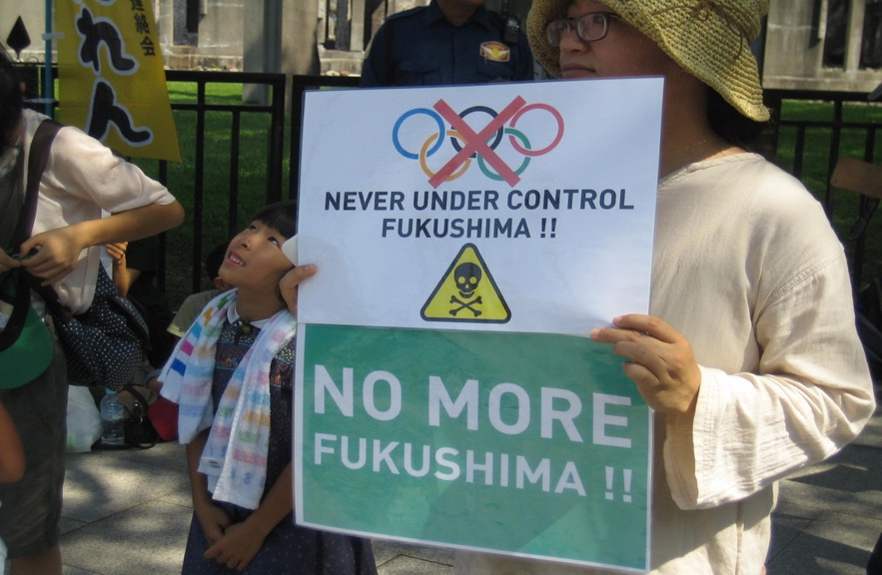

Slide 18
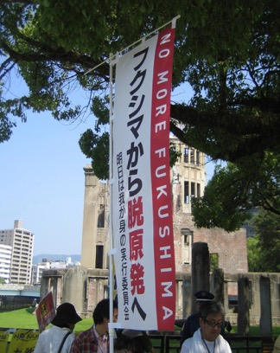
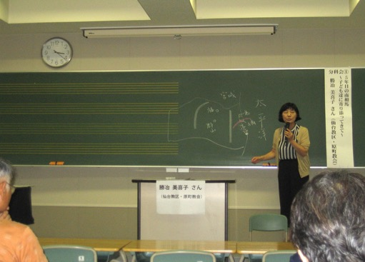
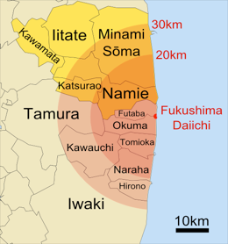
Tokyo Under Fire
For Plans To Speed Return Of
Fukushima Evacuees

Slide 19
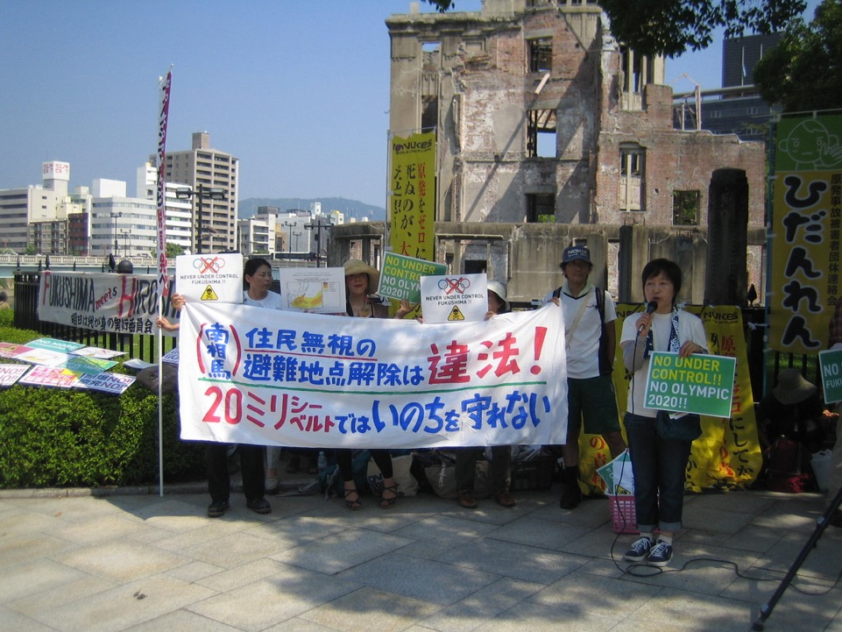

Slide 20
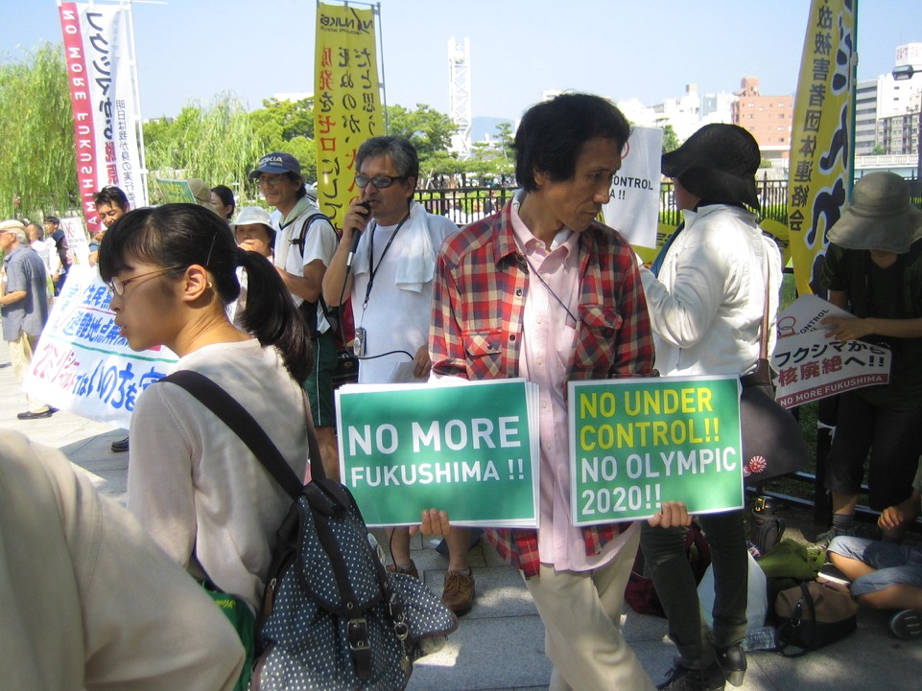

Slide 21
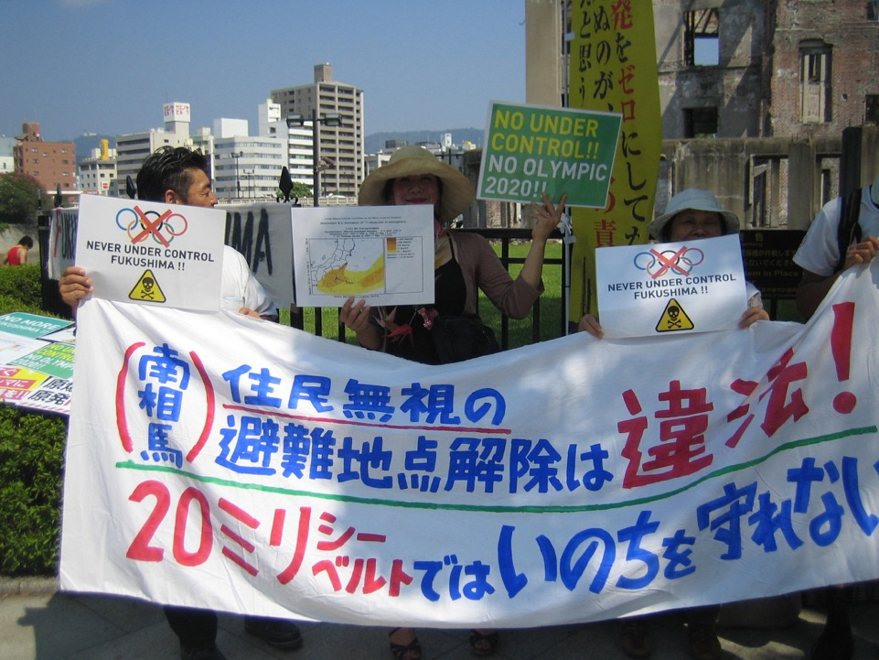

Slide 22
Prayers for World Peace

Slide 23
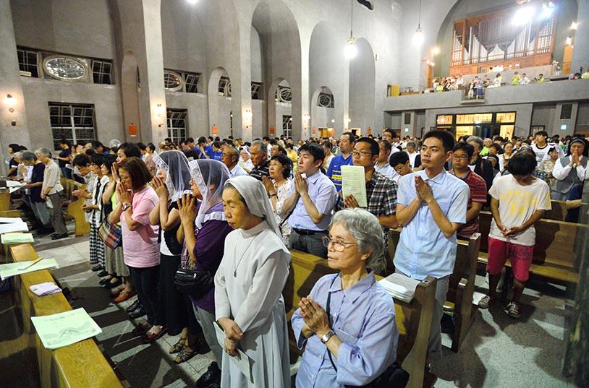

Slide 24
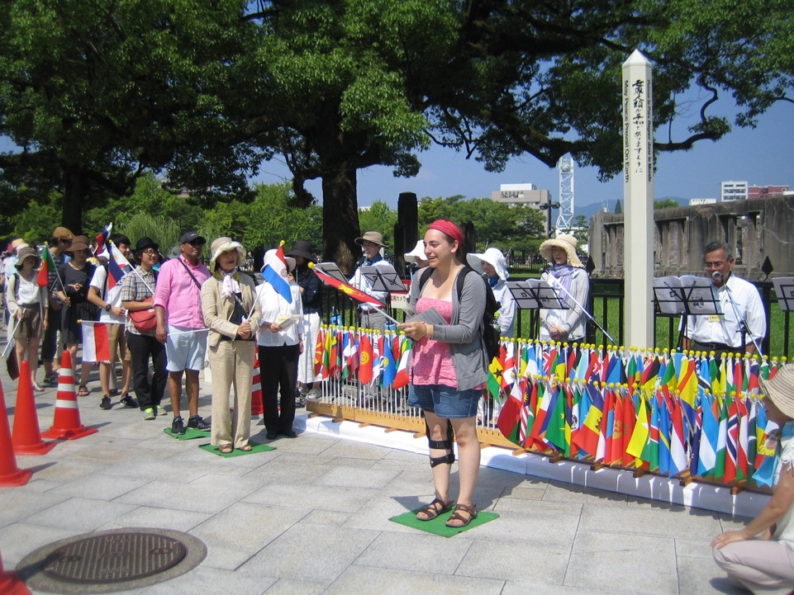

Slide 25
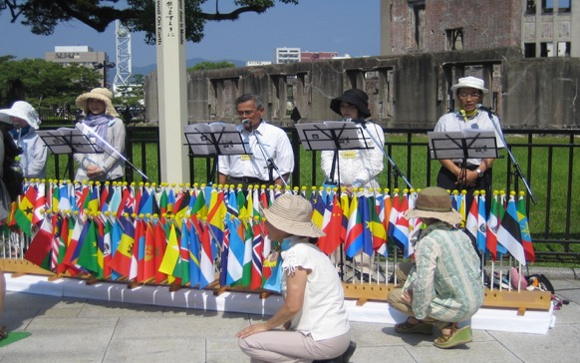
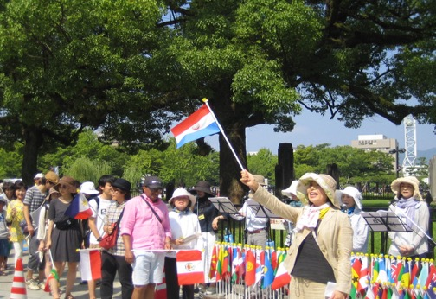

Slide 26
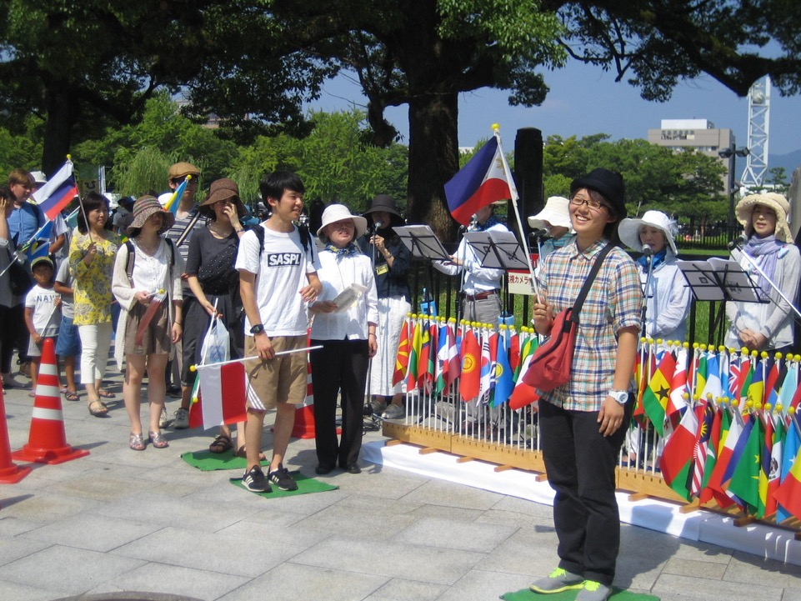

Slide 27
Commitment to Peace

Slide 28
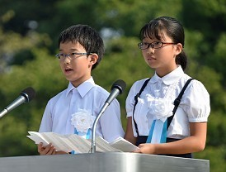
August 6, 2015
On August 20 last year, we lost one of our fellow students in a disastrous landslide.
We came to know the grief that comes from suddenly losing a friend we took for granted.

Slide 29
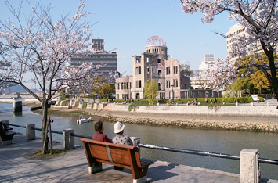
8:15 a.m., August 6, 1945 under the blazing sun, a single atomic bomb stole away buildings, nature, and countless precious lives.
Though we didn’t experience what happened that day, we can now better imagine the despair that comes with losing loved ones.
Seventy years have passed.
Now, Hiroshima is a beautiful city with lush greenery and colorful, blooming flowers where we can all smile and be happy.

Slide 30

In this city we feel the desire for peace.
All around us are things that bring peace to mind:
The many paper cranes we see in Peace Memorial Park;
The A-bomb damage we see in the Peace Memorial Museum;
The hibakusha stories, with their sorrow, agony, and powerful desire for peace; And this Commitment to Peace, which we, Children’s Representatives, now read aloud.
Our grandparents survived the bombing and lived on these past 70 years in Hiroshima, passing life on to us.
Accepting this legacy of life and love of peace, we think about what we can do and work to create “everyday peace.”
Won’t you, too, think more about peace with close friends, people of different generations, and people who live in other countries and regions?

Slide 31
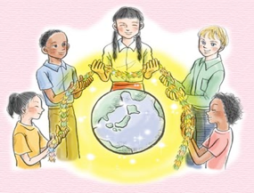
We, children of Hiroshima,
Vow one by one
To connect the truth,
The hopes and desires of the hibakusha,
And our own desire for peace.
From the past and present
To the future.
Children’s Representatives:
Yuro Kuwahara (6th grade, Hiroshima City Hakushima Elementary School)
Yuka Hosokawa (6th grade, Hiroshima City Yano-minami Elementary School)

Slide 32
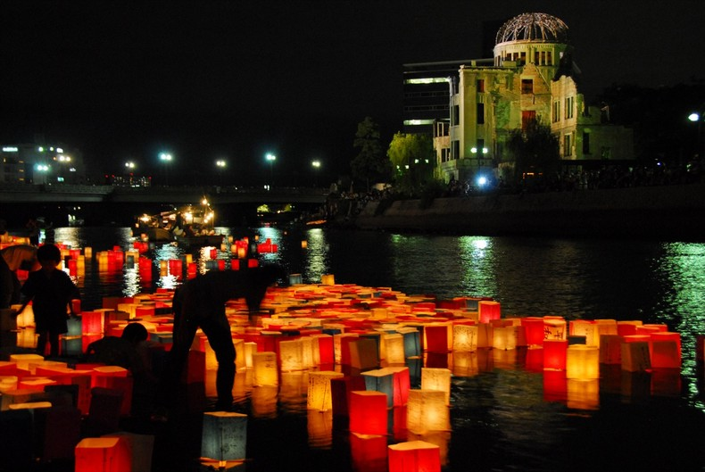
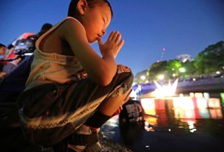
Paper lanterns bearing prayerful words for peace float in Motoyasu River just upriver of the Hiroshima Peace Memorial.
The floating lanterns symbolize the journey to the afterlife.

