Slide 1
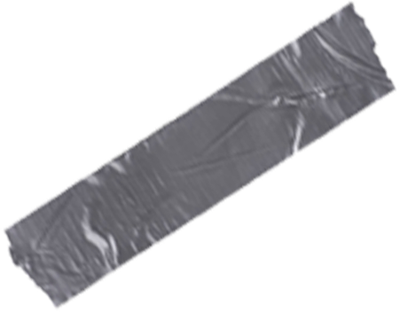
The Prostitutional System
What is the evidence and what can we do?

Slide 2
What we know about women in prostitution...
What we
know about those who profit...
What we have done and can do...

Slide 3
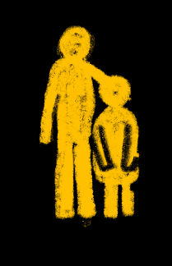
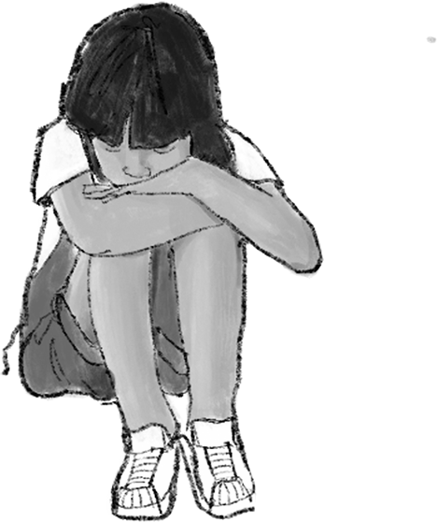
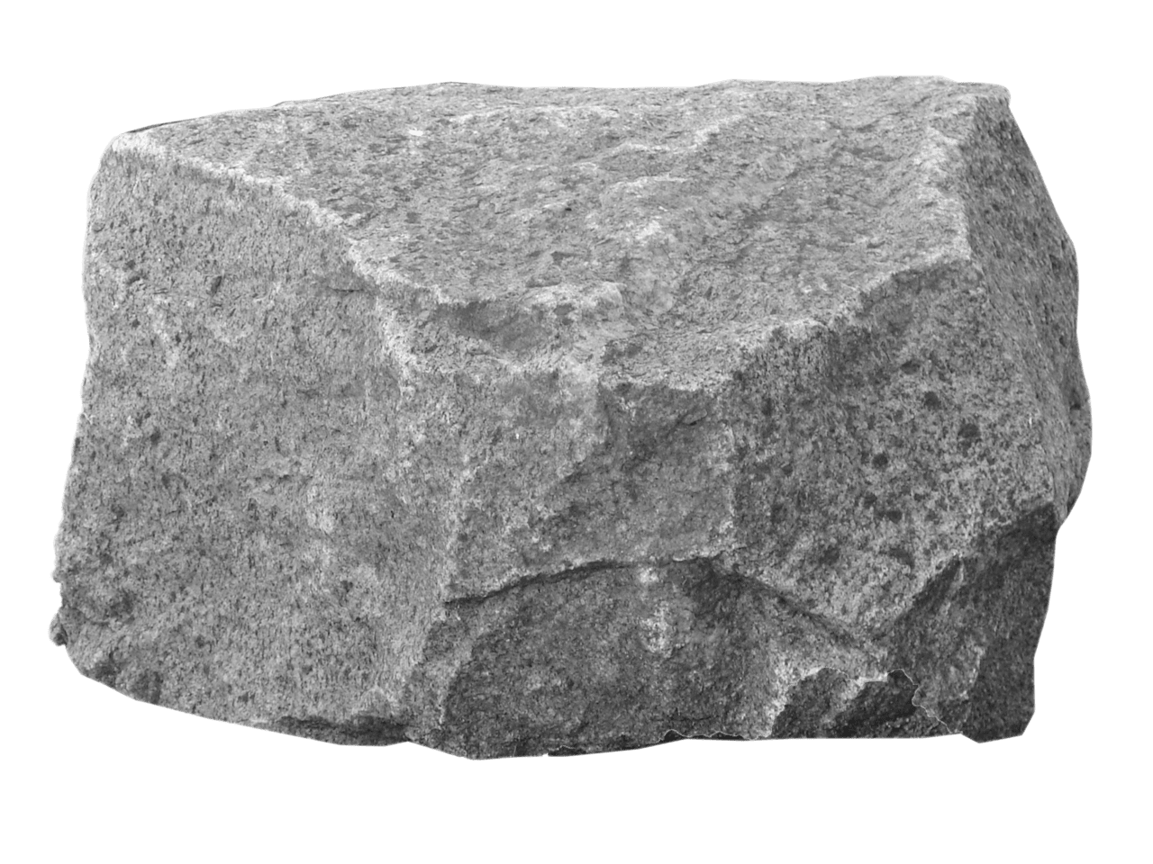
Trauma
Strong childhood violence
Sexual abuse
from relatives or community
Physical abuse, domestic violence
What we know about women in prostitution...
Emotional neglect
Verbal abuse and domination

Slide 4
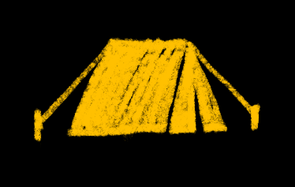
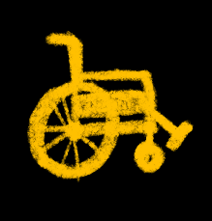
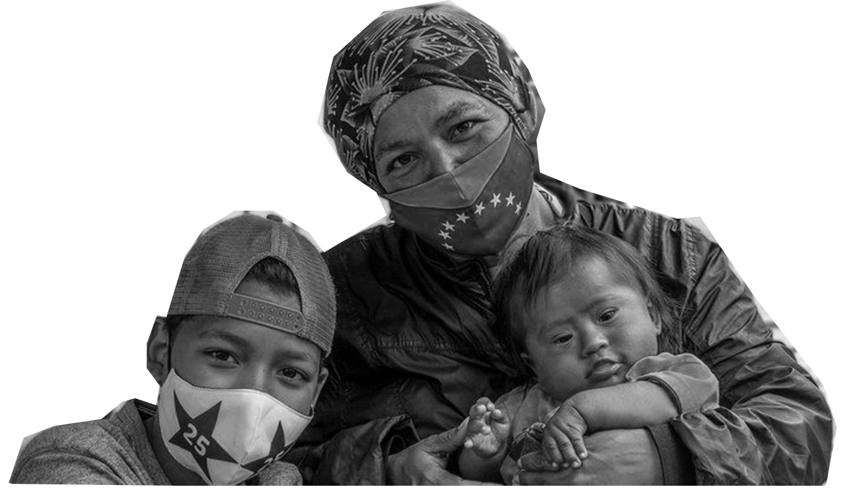
Vulnerability
Women from diverse groups in society
Indigenous, black and ethnic minorities
Migrant, stateless, refugee and asylum seekers
What we know about women in prostitution...
Women and girls with disabilities and deprived of care
Rural women
Displaced, conflict and post-conflict victims

Slide 5
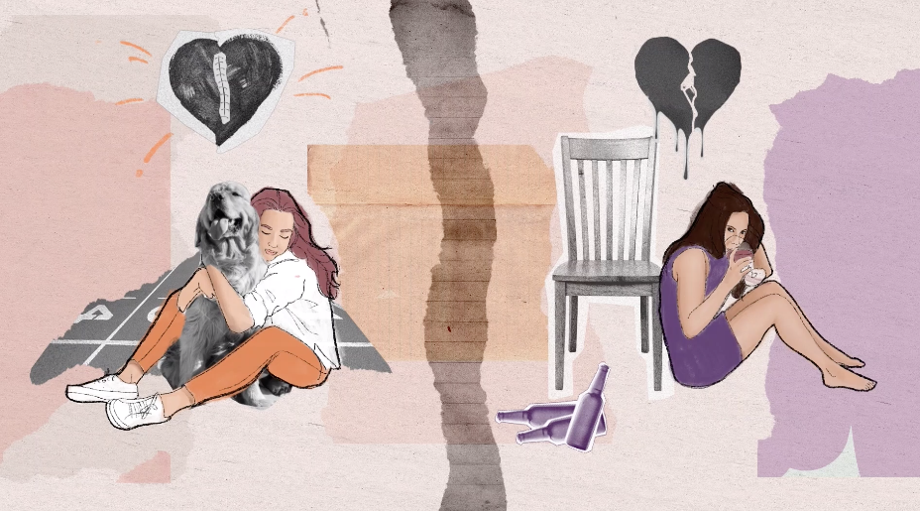
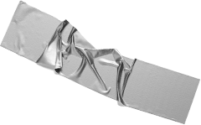
Learn more about trauma and traumatization
in the lives of two women here:
https://youtu.be/Lxwb29V9Mko

Slide 6
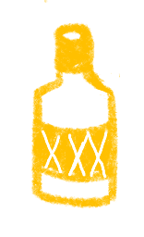
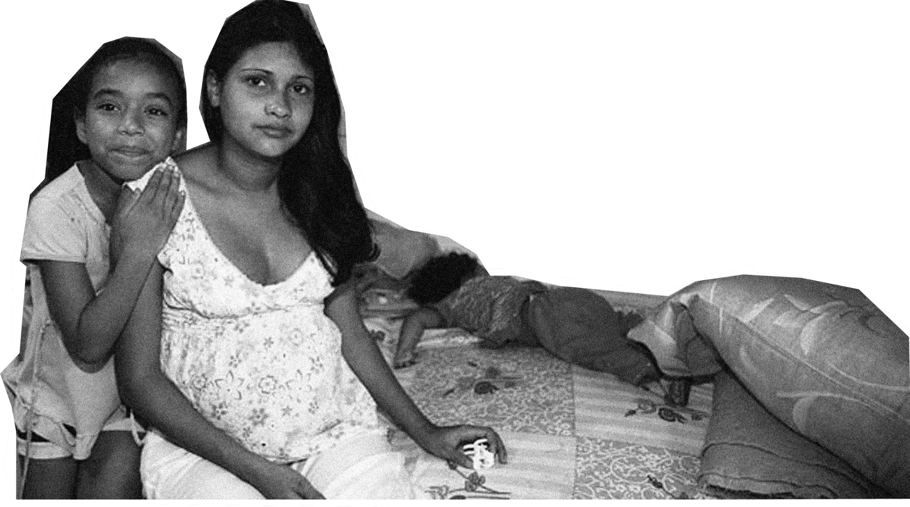
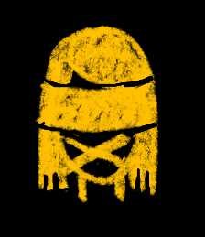
Exploitation
of their vulnerability
Flattery and infatuation
Transportation and debt bondage
through various techniques
What we know about women in prostitution...
Inducement into pornography and prostitution
Forced addictions and isolation
Threats, degradation and torture

Slide 7
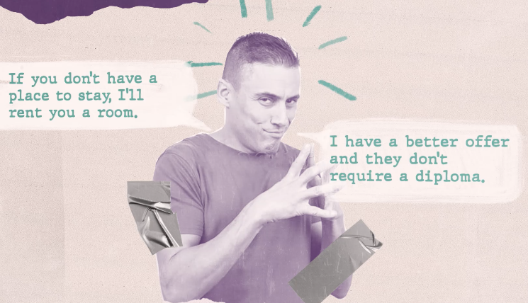
Learn more about the techniques used by
pimps and traffickers here: https://youtu.be/gbn6OUhK_SQ

Slide 8
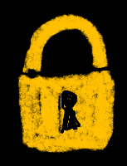
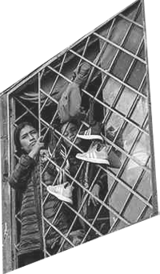
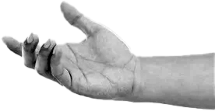
Wanting to leave and not being able to escape
Socio-economic injustice
Discrimination in migration and asylum regimes
Impossibility due to structural causes
What we know about women in prostitution...
Conflict situations and humanitarian emergencies
Demand that fosters exploitation
Use of digital technology in trafficking

Slide 9
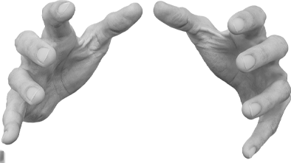
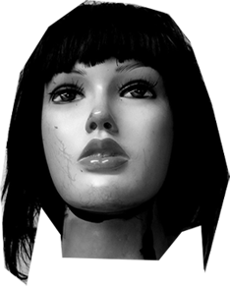
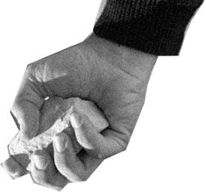
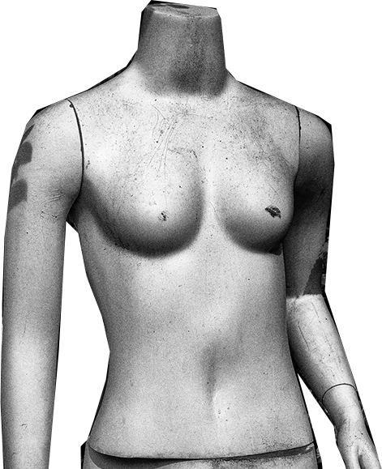
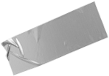
Slapping, arm twisting, kicking, punching, strangulation, tying up, confinement, burns, and threats with knives or guns
Chronic abdominal, joint, muscle, and chest pain
Bruises, wounds, bone fractures, and even internal injuries
Head trauma and concussion from violence against them
Gastrointestinal and digestive problems, malnutrition, intestinal inflammation, anal tears, fissures, injuries and prolapse
Increased risk of cervical cancer, risk of HIV/AIDS
Cystitis, incontinence, sexually transmitted diseases, irregular and painful menstruation
Fetal injury and miscarriage in pregnant prostitution, death at birth
Infections, bruising, swelling, scarring, pain and death related to surgical and cosmetic interventions to follow "beauty trends"
Murders due to "dissatisfaction" of buyers who take advantage of nudity, penetration, BDSM practices, drugs or drunkenness
Grave impacts
to their
physical health
Produced by sex buyers and pimps in order to control them

Slide 10
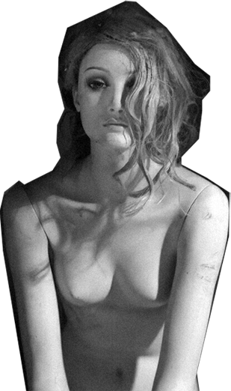
Grave impacts
to their
mental health
Forced and tortured recreation of pornographic scene
Verbal abuse, threats, unwanted touching or kissing and harassment
Hypersomnia and chronic nightmares
Dizziness, exhaustion, nausea, vomiting, abdominal cramps, skin disorders, hair loss and premature aging
Low self-esteem, irritability, depression, anxiety, panic attacks, obsessive-compulsive behaviors, compulsive spending, dissociation
Self-injury, suicidal thoughts and suicide
Substance abuse, painkillers, sedatives, sleeping pills, antidepressants and anxiolytics, psychostimulants
Death by overdose or accident or HIV AIDS
Eating and dissociative disorders
Post-traumatic stress disorder
Multi-trauma and psychological symptoms as a result of prostitution

Slide 11
We understand that lack of alternatives is not a choice

Slide 12
But behind women, there are many more...

Slide 13
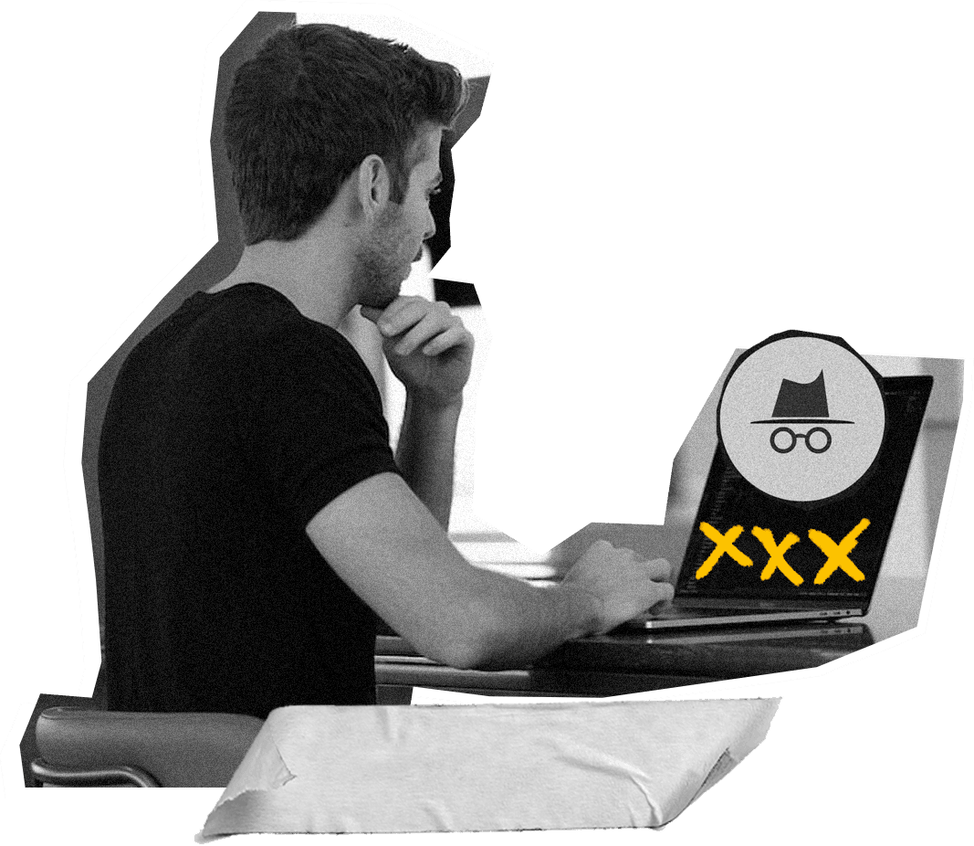
Sex buyer
Pornography initiates them
Promotes harmful stereotypes and subordination of women
Dehumanizes women
Normalizes violence against women
Increases the probability of rape
Increases frequency of prostitution sex buying
What we
know about
sex buyers...

Slide 14
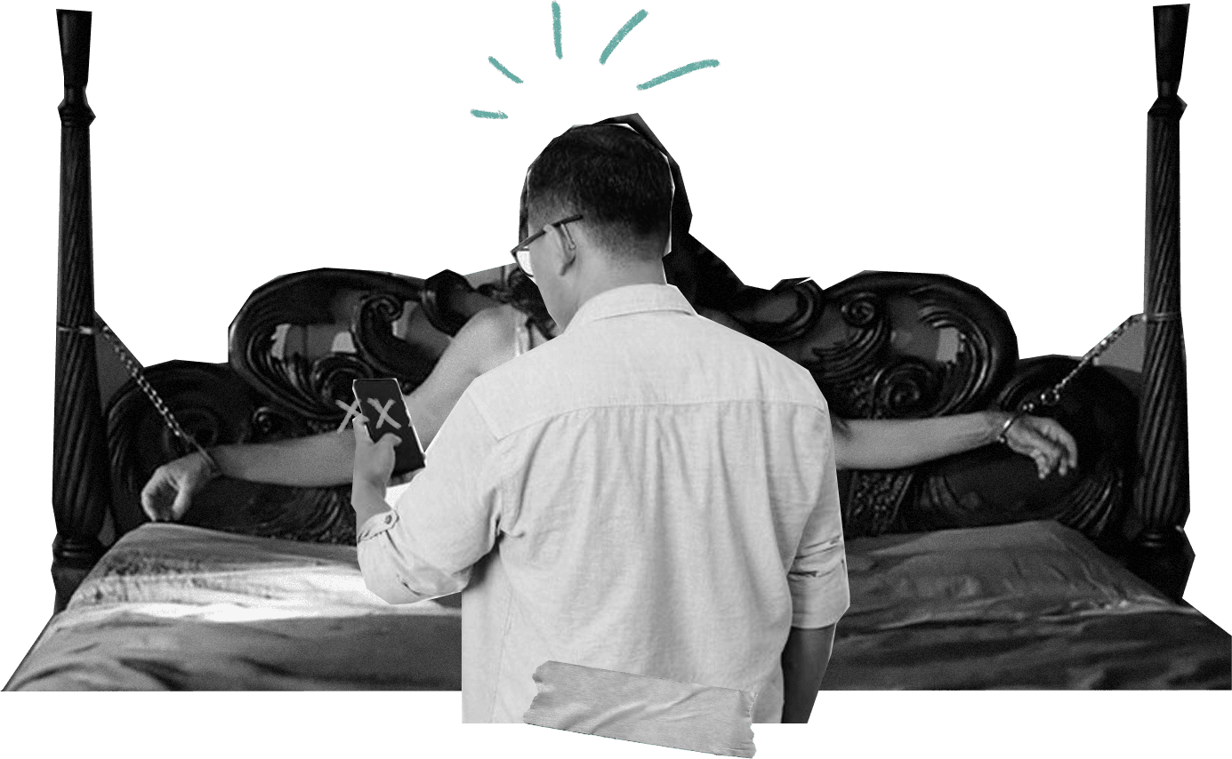
Sex buyer
In prostitution they
become sex offenders
Payment frees them from any obligation to treat the person as a human being
They become aroused by more violent behavior and blame women for
their reaction
They enjoy women's pain, fear,
and subjugation
Are unempathetic and indifferent to their difficulties and sufferings
They avoid thinking about the consequences of their actions, they deny or minimize them
What we
know about
sex buyers...

Slide 15
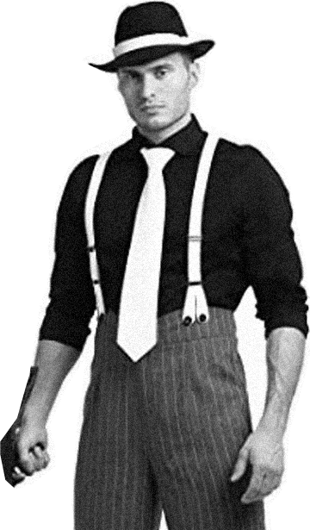
Learn more about the sex buyer
How he is made: from pornography to prostitution
Slideshare
https://www.slideshare.net/CAPint1/1-the-sex-buyer-engpptx

Slide 16
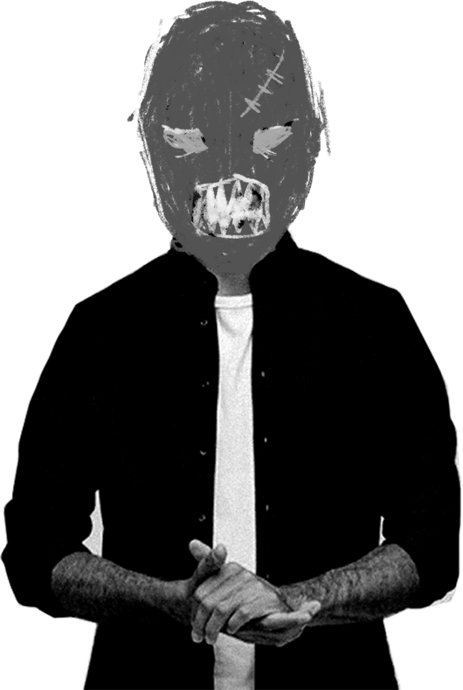
Pimps and
traffickers
They use techniques to control and manipulate women to stay in prostitution, believing its their "will"
What we
know about pimps...
They are part of an industry that lobbies to naturalize their crimes (human trafficking, rape, torture, assault, sexual harassment, femicide) under euphemisms like "sex work" and "adult entertainment"
They count on pimp governments that allow and profit from women, without considering their international responsibilities in achieving women's equality

Slide 17
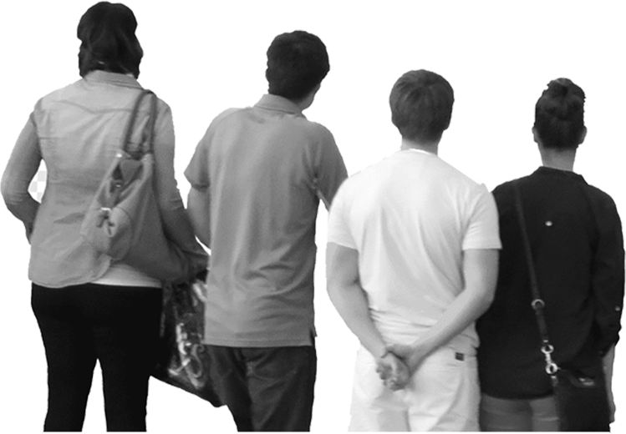
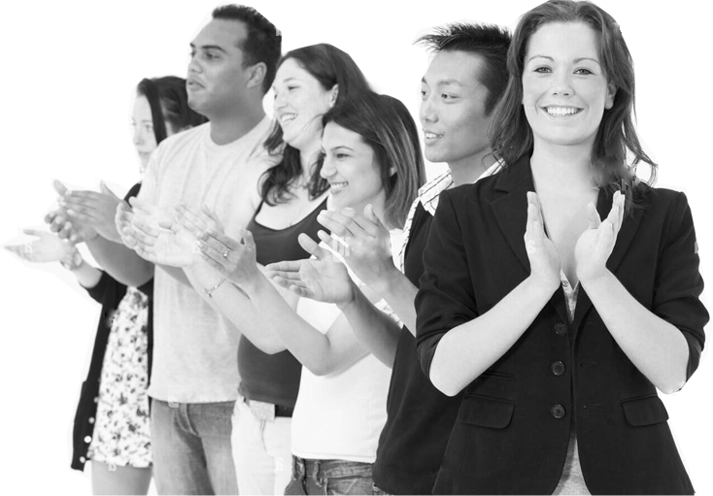
And what about us?
SHE ASKED FOR IT
SHE LIKES IT

Slide 18
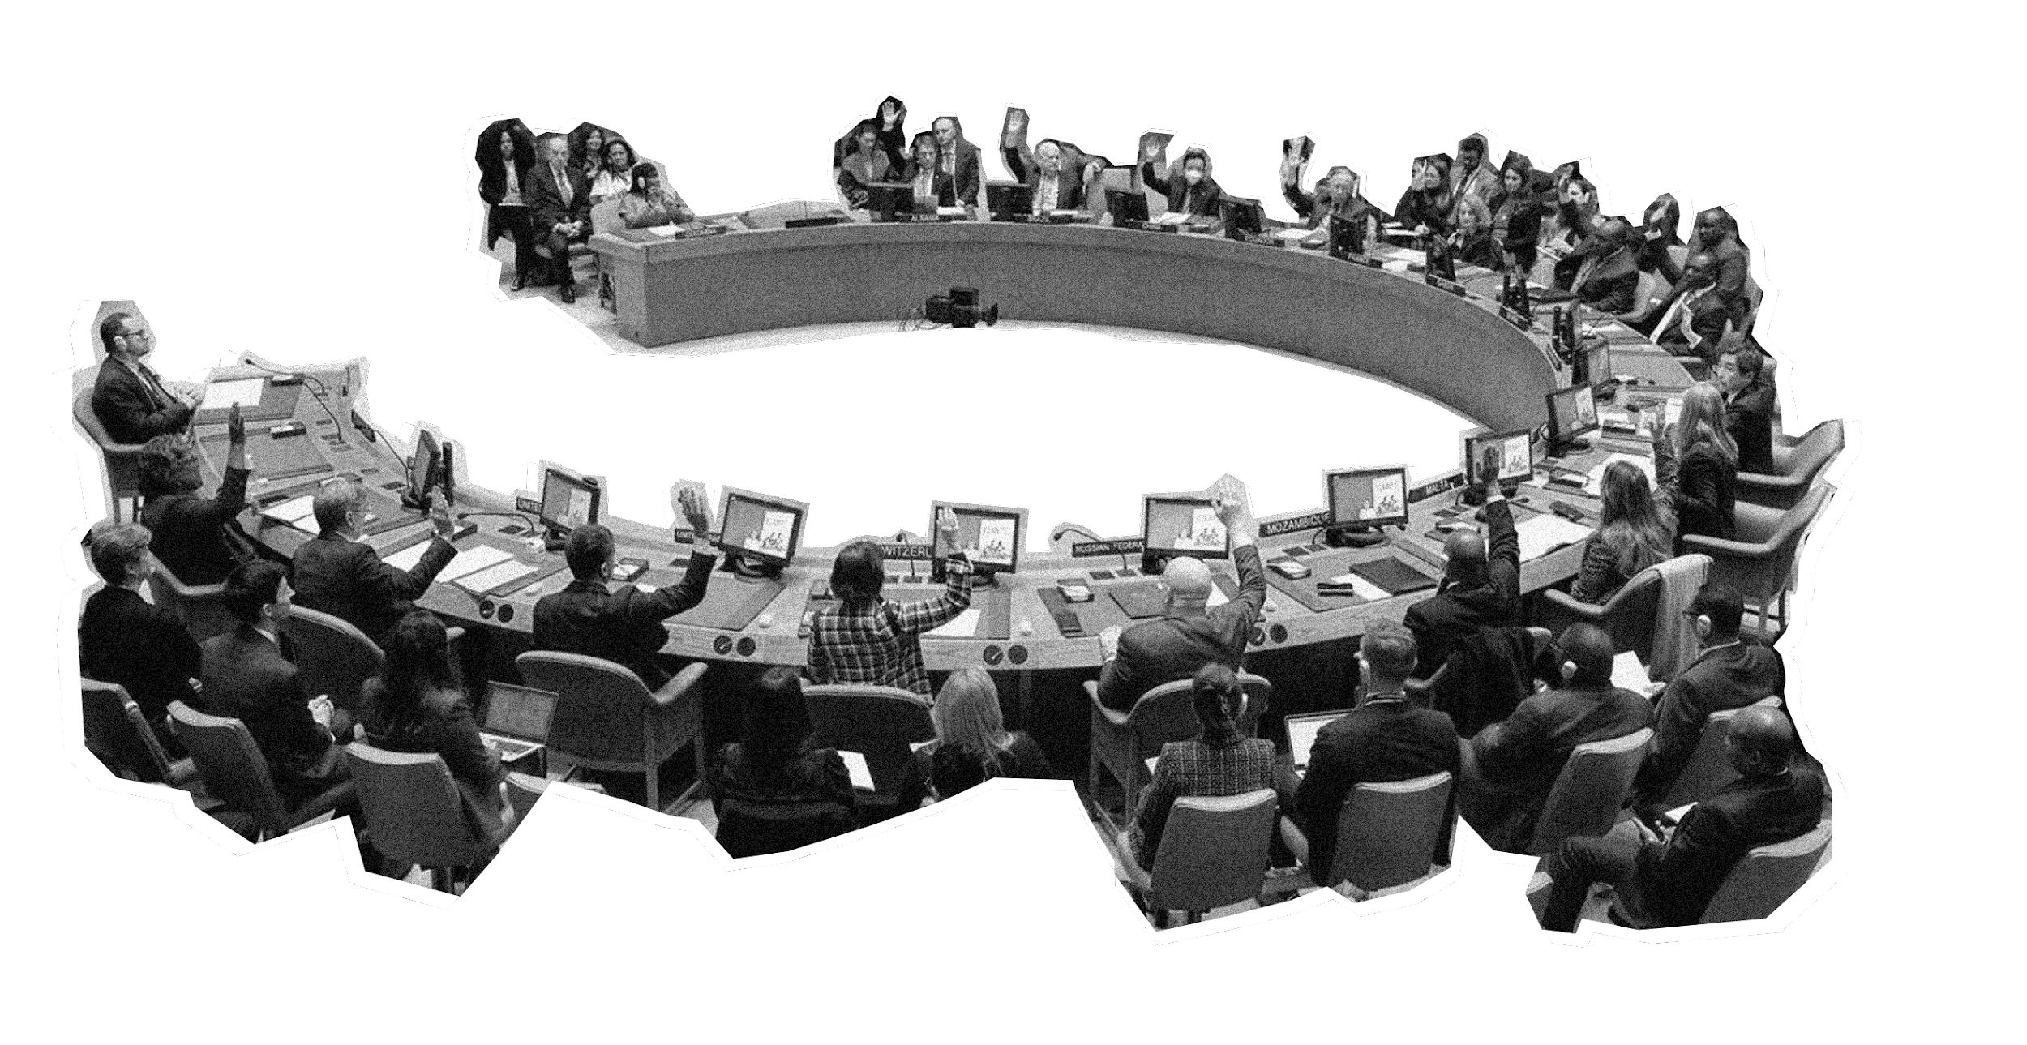
In the United Nations system, several international conventions with fundamental agreements have been negotiated since 1949
People are not commodities. Desires are not rights
We owe special protection to the most vulnerable people in society
The exploitation of the prostitution of others is incompatible with human dignity
Sexual exploitation is a system of discrimination and inequality based on sex
Exploitation of the prostitution of others is violence against women
It amounts to torture and slavery
Consent on behalf of victims is irrelevant
Profits obtained (exploitation) are punished
Preparatory acts (trafficking in persons) are punished

Slide 19
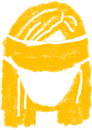
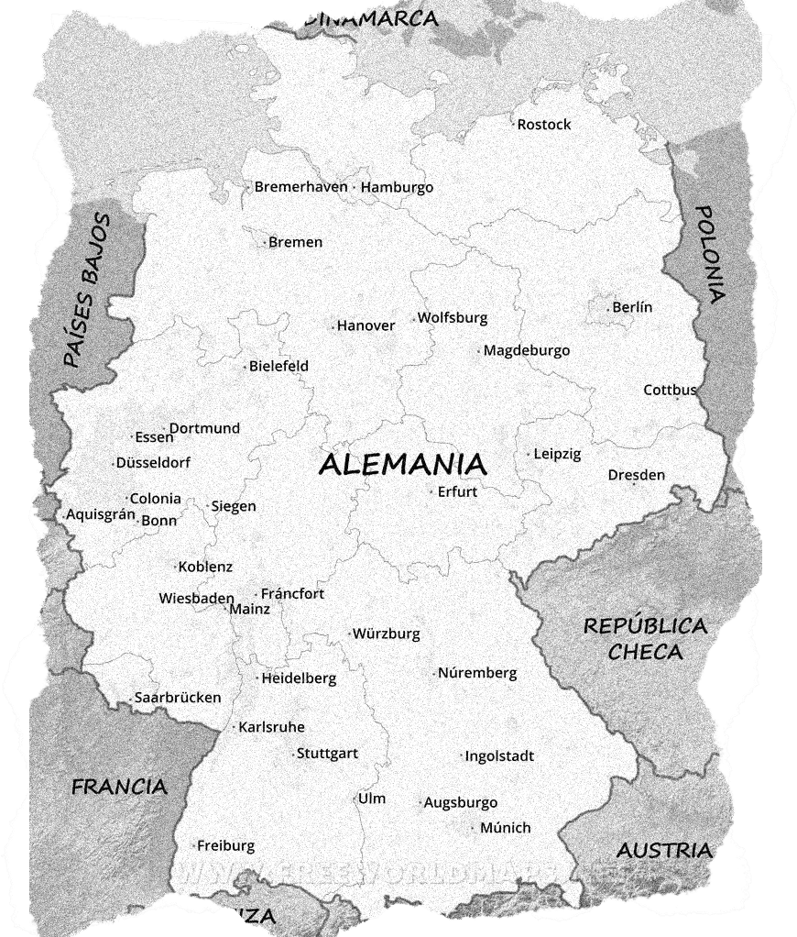
Although some societies decided that it was better to legalize prostitution as "sex work", it turned out that...
Legal prostitution does not make prostitution safer
Legalizing is equivalent to decriminalizing pimps and traffickers
It does not reduce violence against prostituted women or trafficking for the purpose of exploitation in prostitution and other forms of sexual exploitation
It does not reduce organized crime's control over the sex industry
Legal prostitution does not prevent
or reduce rape of women
Many women in prostitution report having been physically and/or sexually assaulted by sex buyers,
with total impunity
Sex buyers are unlikely to report trafficking

Slide 20
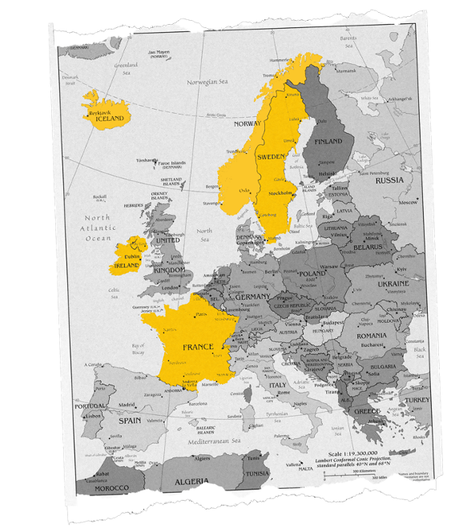
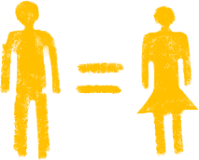
Other societies understood that it was a system of exploitation
With several actors and measures to be taken
The prostitutional system
Criminalizing
sex buyers
Decriminalizing women
Criminalizing pimps
and traffickers
Preventing among vulnerable populations
Educating society on economic, sex and ethnic equality

Slide 21
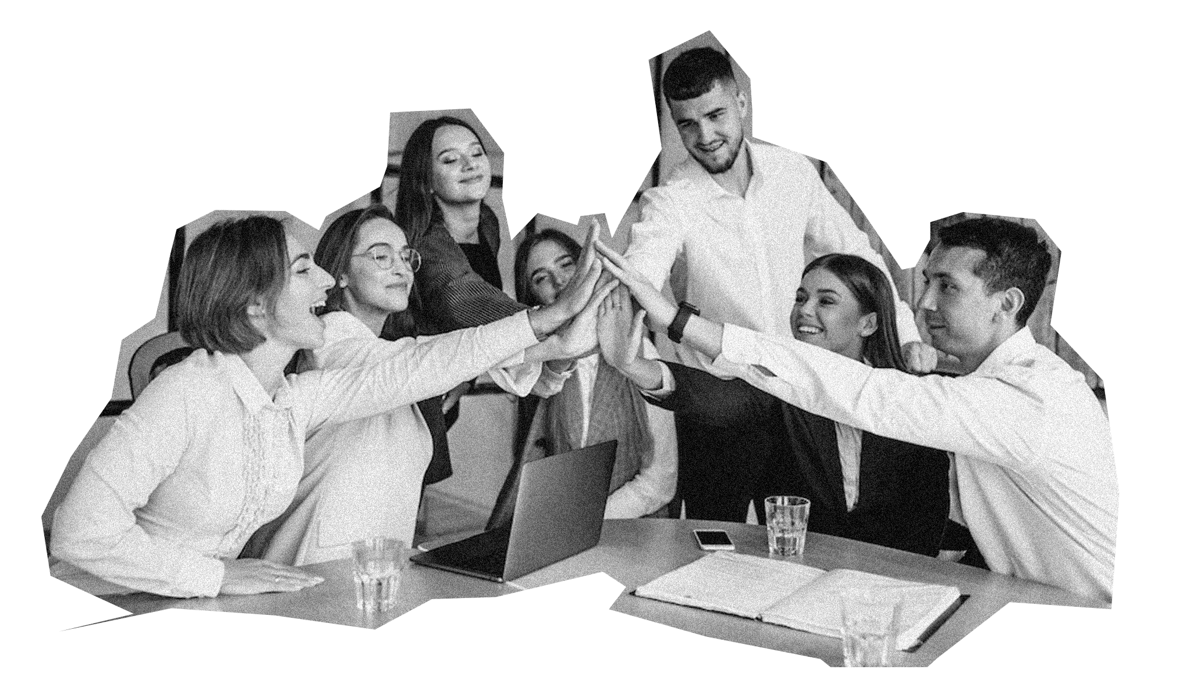
Some societies wanted to go further...
They decided to abolish the prostitutional system
They do not normalize or accept payment for sex and consider it violence against women
They criminalize the purchase of sex acts as the root of the problem
Prostituted persons are NOT considered criminals and are offered prevention, protection, mental, physical and emotional health support
They offer exit alternatives, work permits, residency, debt forgiveness and housing support
They don’t allow impunity for traffickers and pimps, who profit from pornography and prostitution
Educate their youth in respectful, empathetic and desired sexuality and equality between women and men

Slide 22
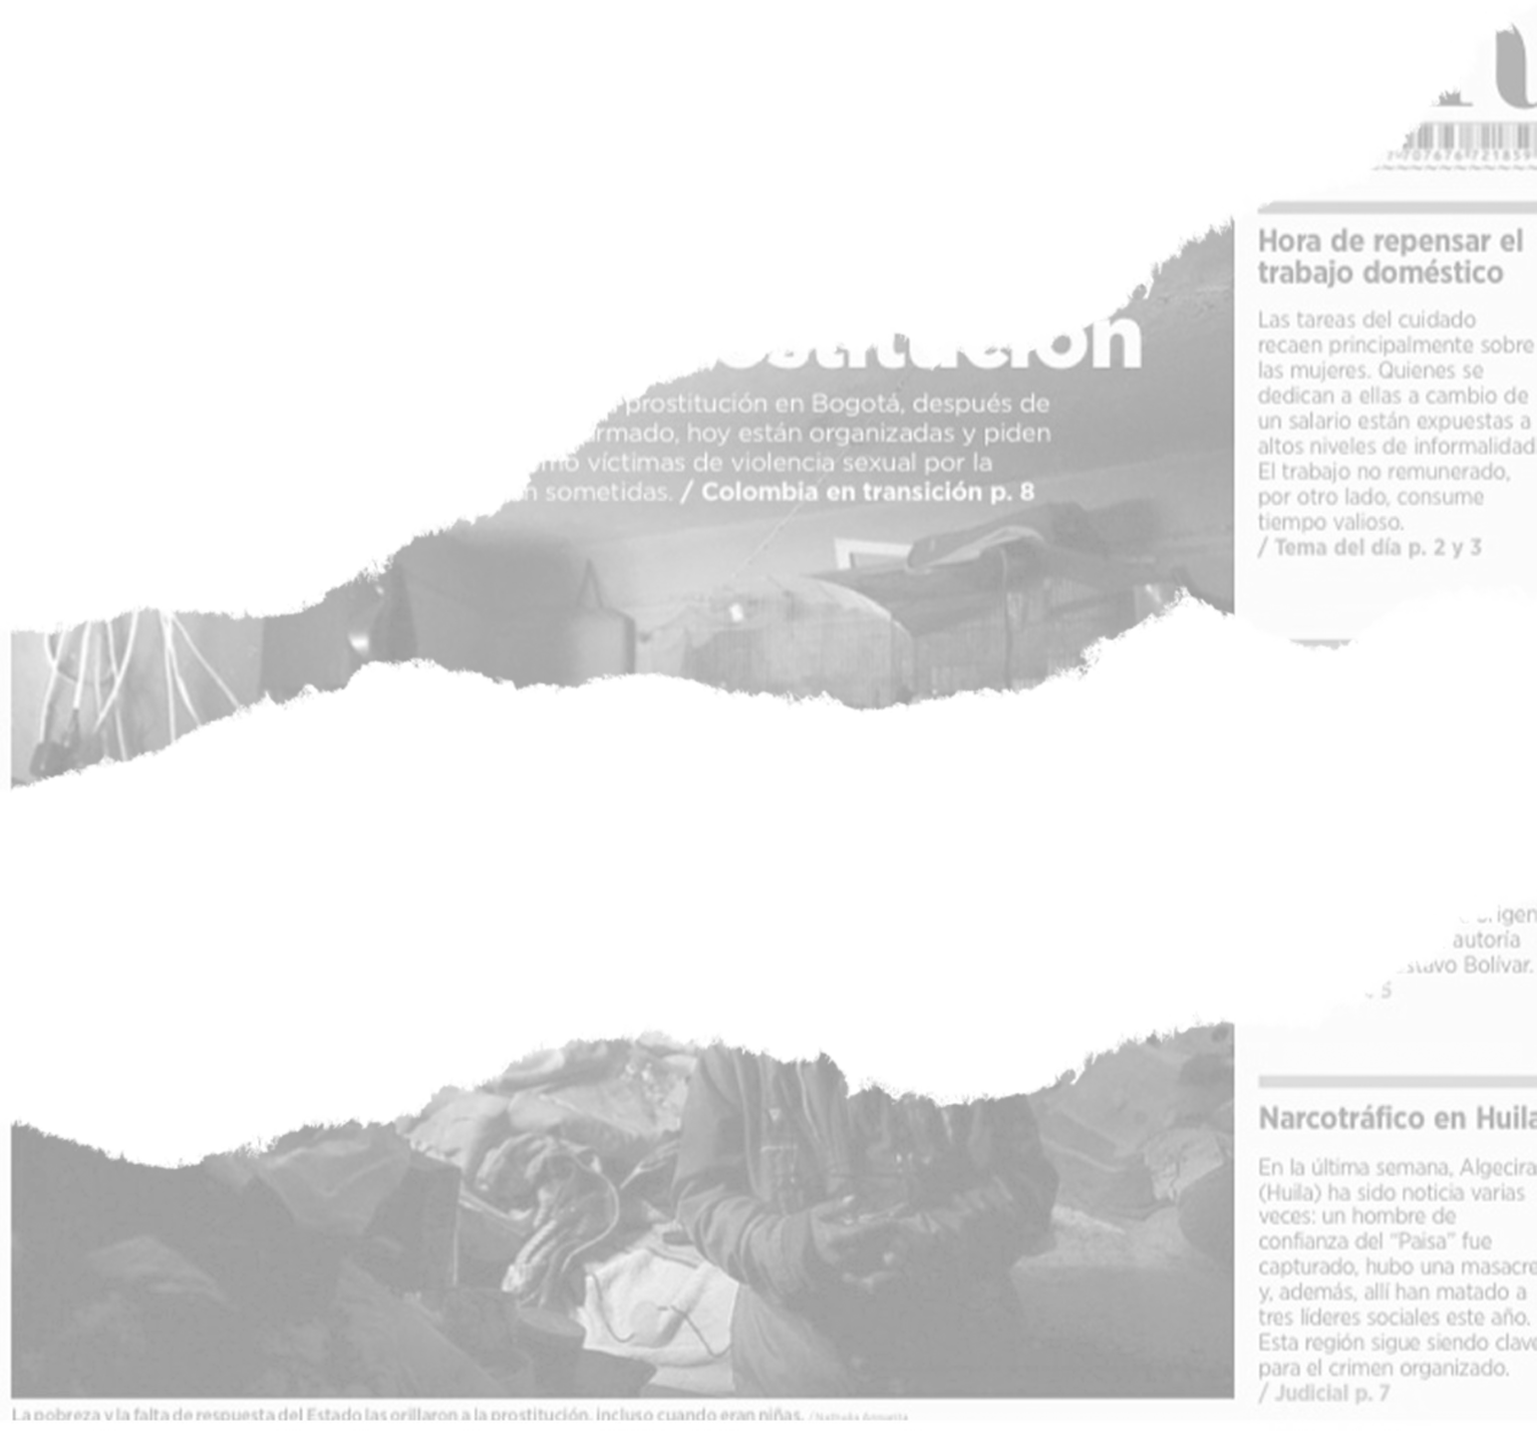
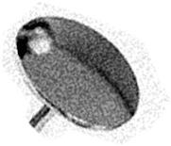
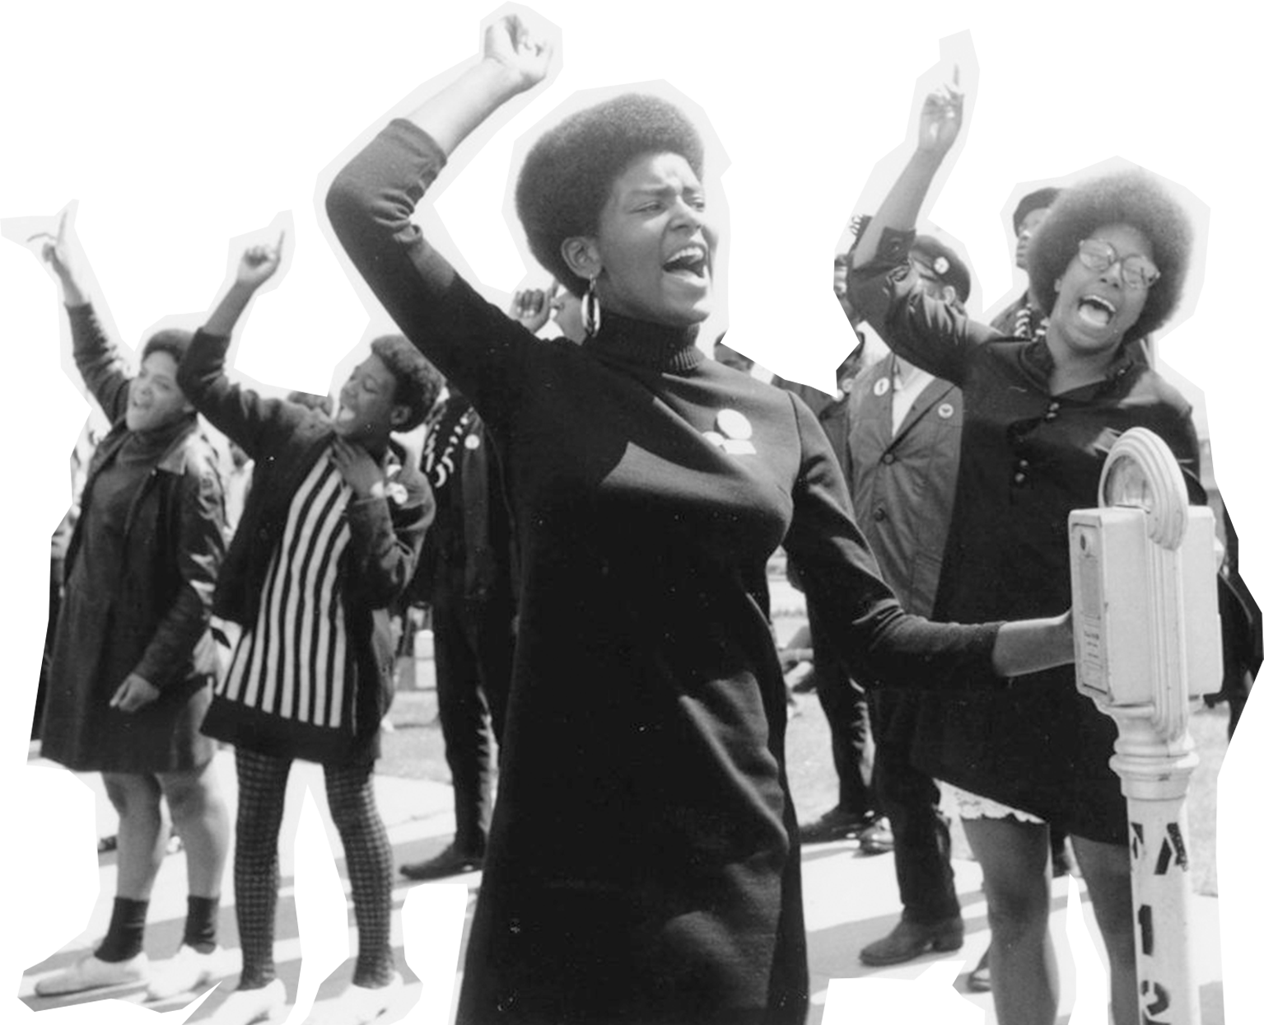
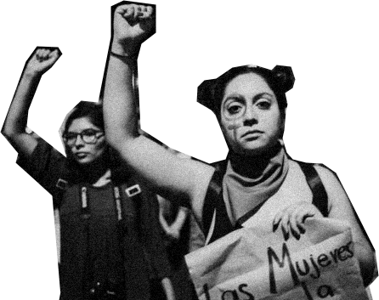
IT IS TIME TO STOP THE DAMAGE
Abolishing the prostitutional system is the solution

Slide 23
SOURCES:
United Nations Convention for the Suppression of the Traffic in Persons and of the Exploitation of the Prostitution of Others (1949).
Convention on the Elimination of All Forms of Discrimination against Women -CEDAW (1979)
United Nations General Assembly Declaration on the Elimination of Violence against Women (1992)
CEDAW Committee's General Recommendation No. 19 on Violence against Women (1992)
Protocol to Prevent, Suppress and Punish Trafficking in Persons Palermo Protocol supplementing the United Nations Convention against Transnational Organized Crime (2000)
Model Law on Trafficking in Persons, UNODC (2010)
CEDAW Committee General Recommendation No. 38 on Trafficking in Women and Girls in Global Migration Contexts (2020)
Disproportionate and Unique Risks to Women in Prostitution, Elly Arrow (2023)
Laws against the prostitution system in Sweden, France, Canada, Norway, Ireland, Iceland, Israel
Law legalizing prostitution in Germany and New Zealand

Slide 24
Share and be part of the change

