Slide 1
The Sex Buyer

Slide 2
Part 1
Part 2
Part 3
Part 4
Pornography:
An addictive, criminal and very lucrative business
Prostitution: men’s "right" to sexually access women and the license to be a sex offender
How a Sex Buyer is created and how that affects women
Change: Towards equality between women and men

Slide 3
How a Sex Buyer is created
And how that affects women
Part 1

Slide 4
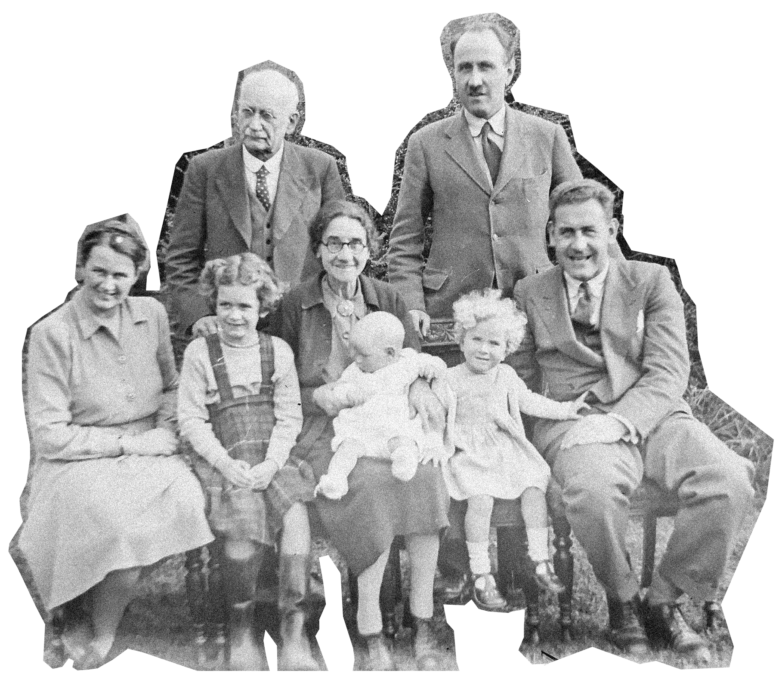
At home, school and in society, stereotypical roles are promoted that define women and men in various areas of their lives.
Physical Sphere
Social Sphere
Emotional Sphere
Sexual Sphere

Slide 5
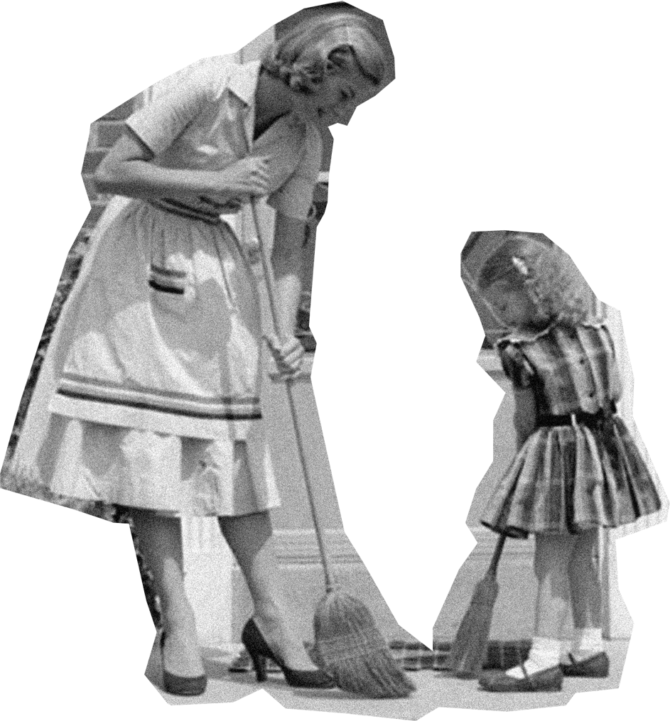
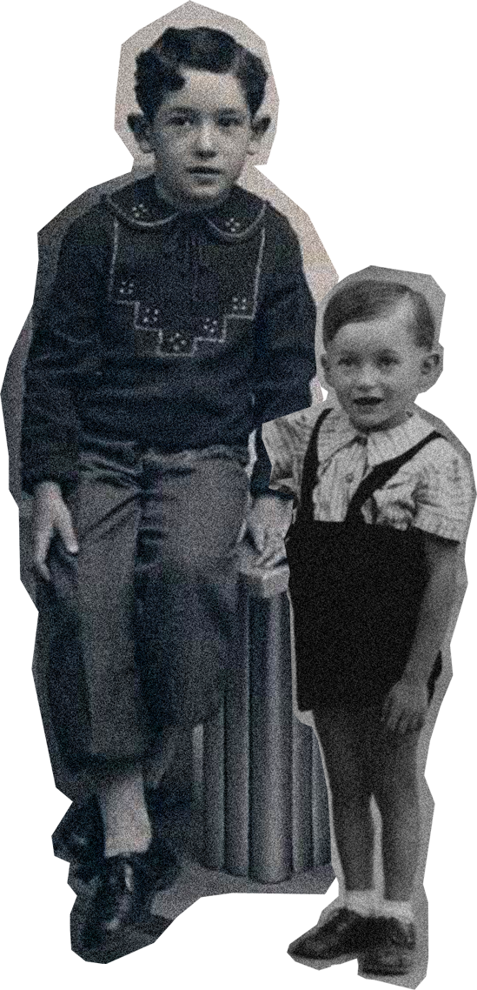
Upbringing
The girl should:
The boy should:
Both girls and boys are bombarded by the same images and expectations about women
Engage in domestic and "safe" activities
Be or demonstrate
dependence
Serve and care, they are not that important
Do more, receive less credit for what they do
Accept emotions,
be pleasing, apologizing
Take care of herself
and everyone around her
Be pretty and willing
Engage in bold and adventurous activities
Be strong, determined
Be independent
Do less and receive more credit for any achievement
Accept no emotions, no mistakes, no blame
Take care of himself as the most important and no one else
Have several girlfriends

Slide 6
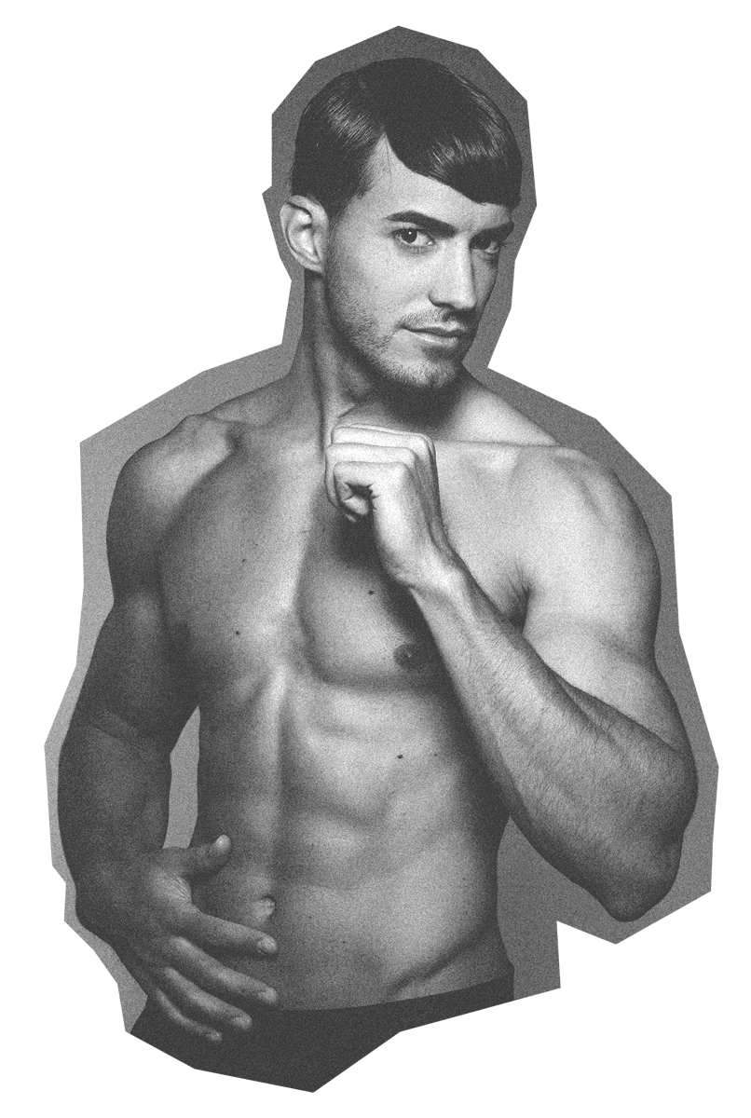
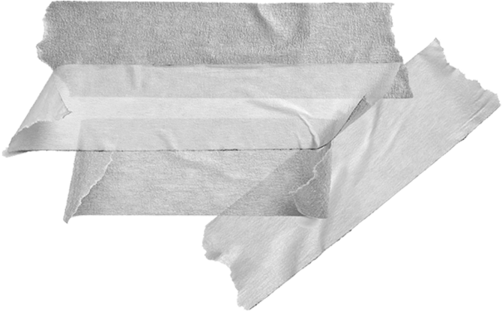
Youth
The young woman should:
The young man should:
They reach adolescence and explore their sexuality differently
Learn to be "feminine", attractive and "sexy"
Permissive seeking external acceptance
Accept alcohol to relax
or hold back
Accept her vulnerability
and shut up
Saying "NO" is not an option
Her pleasure does
not matter
Must be compliant no matter how painful, hurtful or humiliating
Learn to be "masculine", aggressive, predatory, dominant and manipulative
Consume alcohol and drugs to "relax" and "unleash" themselves
Educate himself with pornography
Feel that the only pleasure is to ejaculate
Have unlimited access to available and compliant women

Slide 7
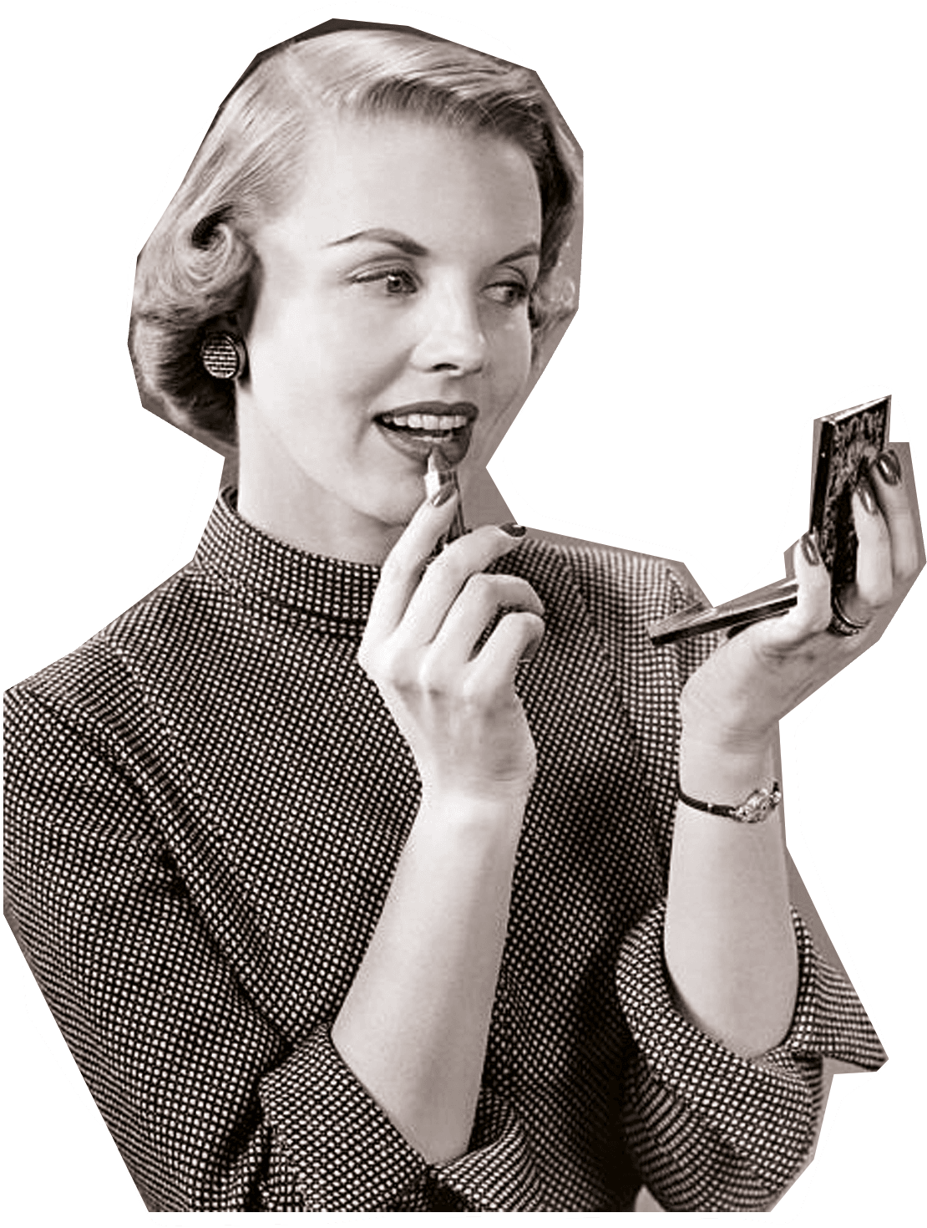
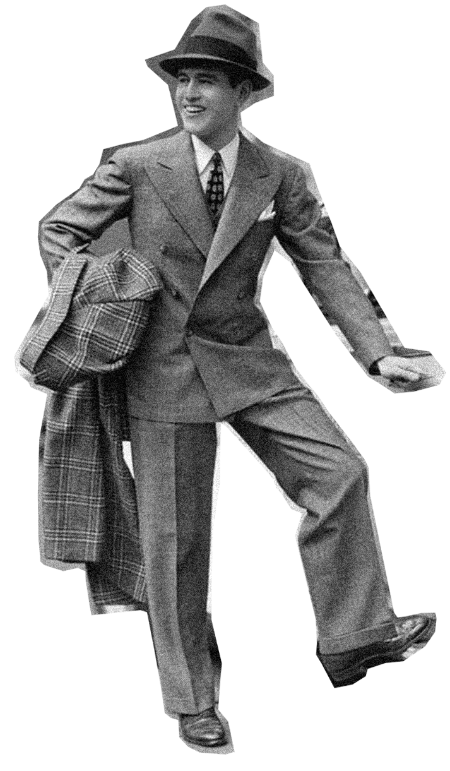
Adulthood
Women are expected to:
Men are expected to:
Women turn out to have fewer opportunities, and pleasure in their lives
To invest in "beauty" even if it is detrimental to their physical and mental health
Fewer opportunities , for educational, employment and income advancement
Little access to technology, science and finances
Lower self-esteem and more family responsibilities
Are expected to endure more sexual and verbal abuse, physical violence and economic exploitation
To use contraceptives, early childbearing or marriage
To invest in their desires and pleasures
More options for education, employment and remuneration
More access to means or jobs that guarantee autonomy
Less family and partner responsibility than women
The right to commit violence against women (rape, sexual harassment, enjoy pornography and prostitution)
Experiment with multiple partners
Little o no responsibility for contraception and raising children

Slide 8
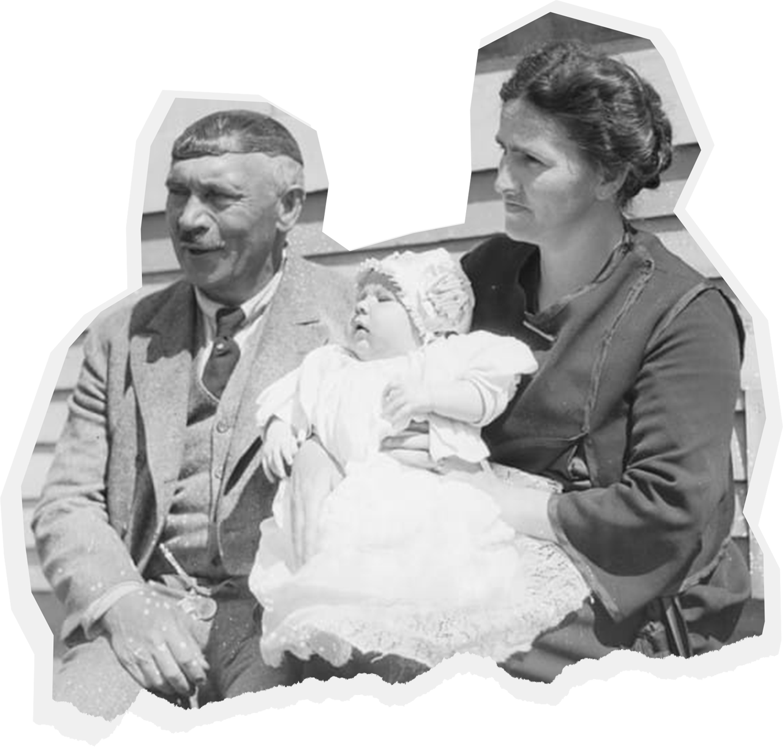
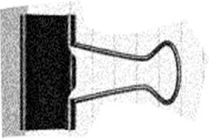
Social Sphere
Sexual Sphere
The result of sexist stereotypes is the subordination of women to men
Physical Sphere
Emotional Sphere
More power, slight dissatisfaction
Less power,
more inequality,
more dissatisfaction

Slide 9
Pornography:
an addictive, criminal and very lucrative business
Part 2

Slide 10
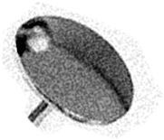
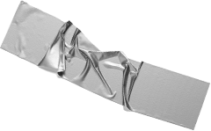
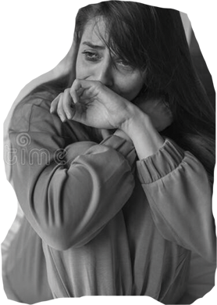
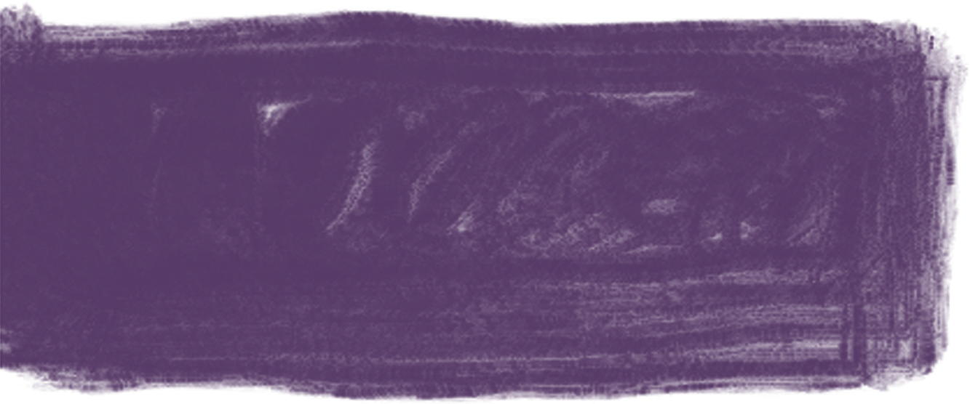
What is the porn industry like?
Pornography follows a scheme:
SEX
Men are the subjects who’s sexual desires must be satisfied
Women are the objects used men’s satisfaction
It is the material through which men learn how to sexually dominate women
It sends a message that what women feel, want or desire is irrelevant
Includes violent sex or humiliation
The physically and emotionally traumatic consequences of filmed prostitution on women, are made invisible by pornography

Slide 11
How is the porn
industry evolving?
It relies on technology for its dissemination, easy payment and maintaining consumer privacy
Its business model is based on increasing views to increase traffic for content, thus increasing advertising revenues and profits
Developing marketing techniques and funding lobby to naturalize what they sell as "free expression", "adult entertainment", "webcam modeling", "therapeutic practices", "women's liberation"
It produces an online consumer who then moves on to live prostitution

Slide 12
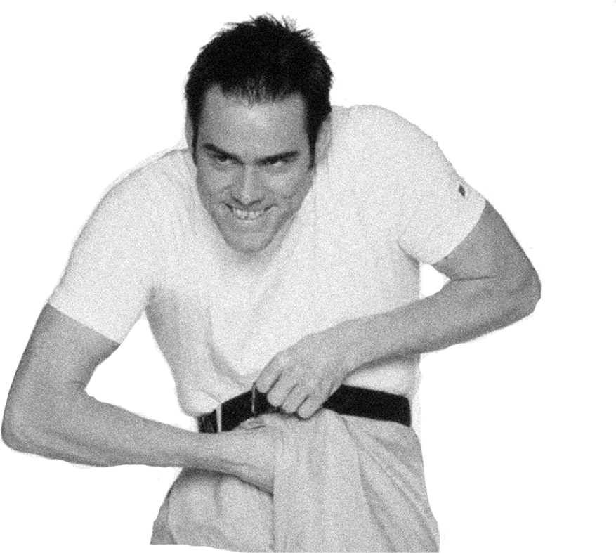
Which are the most popular acts among among porn consumers?
Porn eroticizes women’s subordination.
Women are not in circumstances to consent, nor desire
(asleep, drugged, drunk, unconscious or in a state of shock, need money or are deceived )
Men seek for more aggressive and extreme content. The sex men want, not what women choose.
Sodomy
Porn teaches men to ignore women’s physical and psychological pain. They must smile even if hurt.
Group ejaculation on women’s faces
Individual and gang rape
It teaches men to experience sexual pleasure and arousal from violence and justify it as "women enjoy it"
Swallowing urine
Beatings & Slapping and Choking
Anal sex, Double penetration

Slide 13
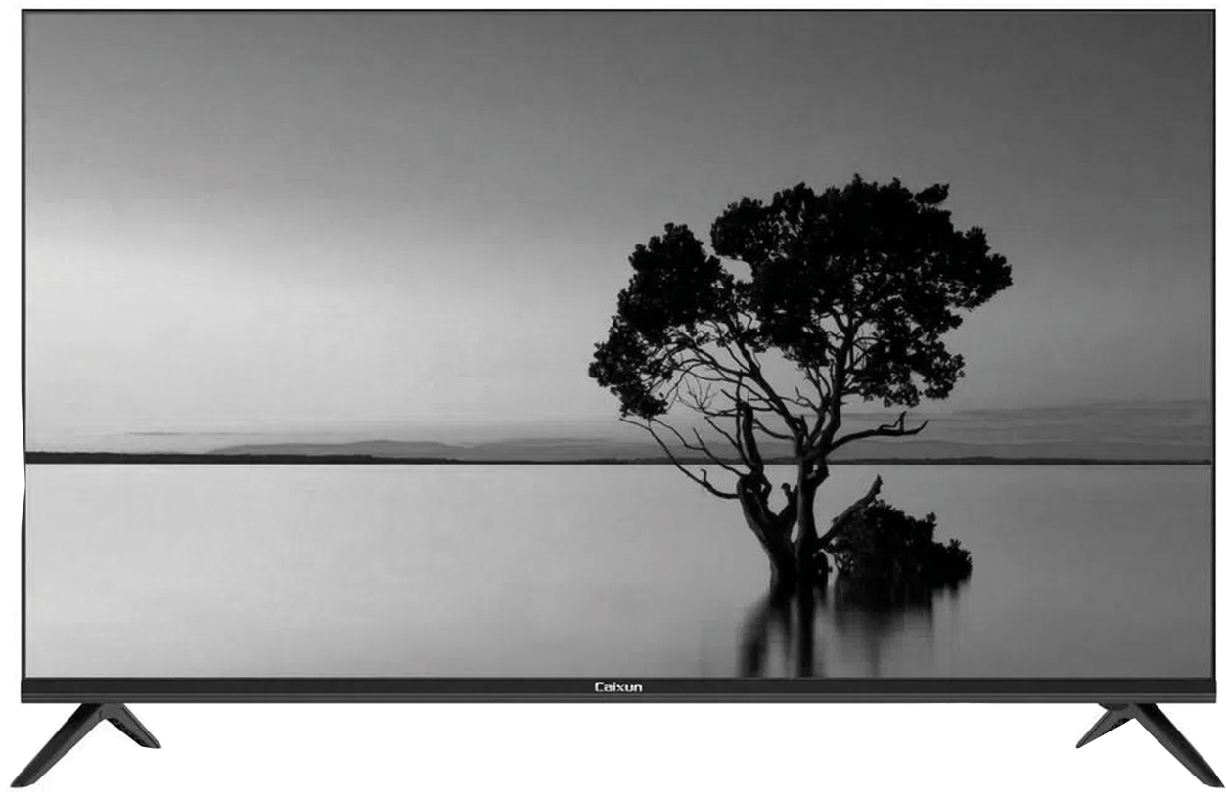
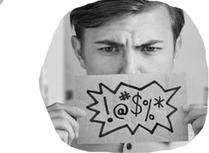
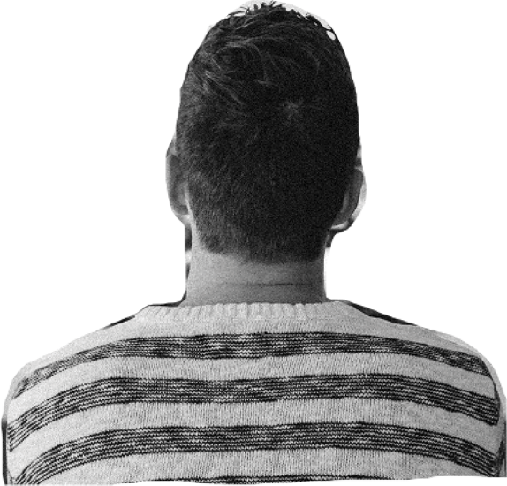
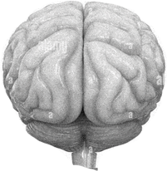
49%
88%
of the scenes contain verbal violence
of the most popular videos contain physical violence
95%
What you find in porn content
87%
of women's responses to violence are shown as neutral or even pleasurable
of these scenes are verbally abusing scenes and men abusing women
This type of content alters the brain chemistry generating addiction
Humans are susceptible to forming addictions to substances or behaviors that stimulate the brain's dopamine center, which causes intense feelings of pleasure
Like drugs, alcohol, video games, and sugar, pornography triggers a dopamine release in the brain

Slide 14
Some facts about pornography platforms
2019
+42 Billion
runs a global online porn monopoly, with over 100 porn sites, collecting more data than Netflix and Hulu
visits to the PornHub site, or 6 visits to the site for every person on earth
Porn industry revenues are estimated at $97 billion, globally.
In comparison, Netflix receives $11.7 billion approx
2020
porn sites received more traffic than some popular social networks combined
6.8 million new videos were posted
on PornHub in 2019,
equivalent to half of Netflix's library

Slide 15
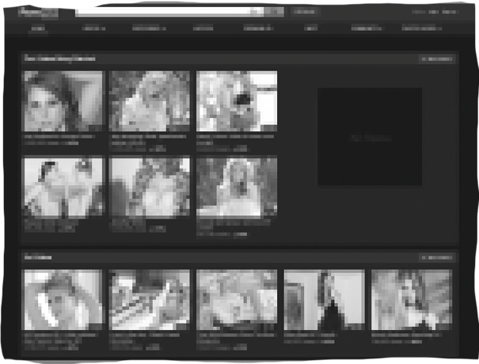
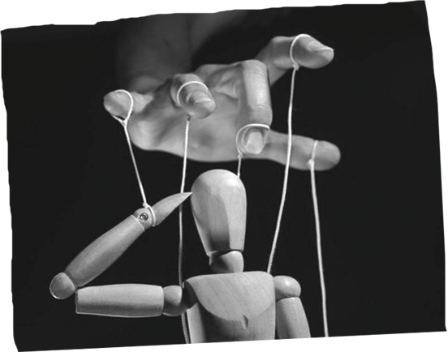
Criminal techniques used by
the porn industry
These are some criminal techniques used for the creation, distribution and replication of pornographic content:
Recruiting, commissioning, paying and soliciting content through human trafficking and slavery
Producing non-consensual sexual content and sexual exploitation of children and youth
Instructing international networks
of traffickers to upload videos, and evade criminal responsibility
Allowing content to be downloaded anonymously, making it impossible to permanently remove victims' videos from the web
Creating playlists for viewers interested in child pornography and other illegal content
Manipulating content, tagging and duplicating it to make it appear user-made

Slide 16
Prostitution:
Men’s "right" to sexually access women and the license to be a sex offender
Part 3

Slide 17
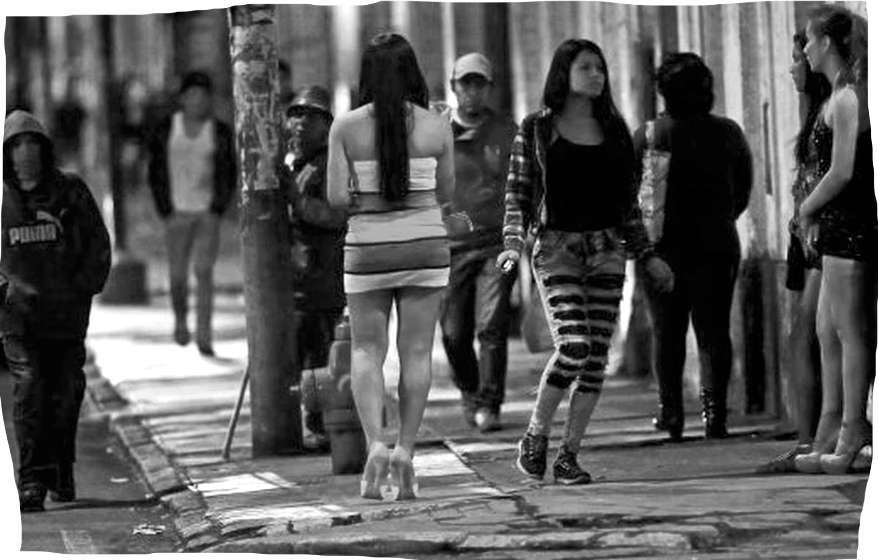
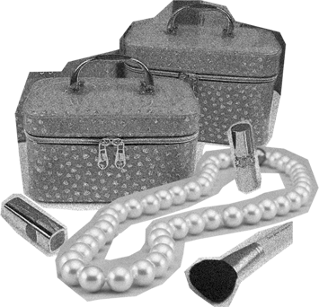
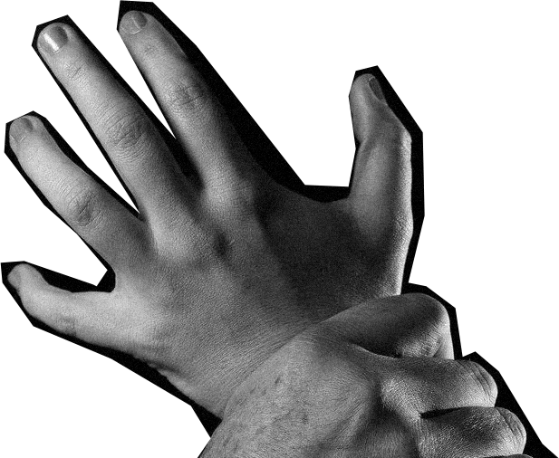
Myths about prostitution are connected to myths about rape
Motivations sex buyers
have when demanding prostitution
1. Accepting myths about prostitution makes it more likely
2.To accept myths about rape
3.Which is associated to sexual assault
Women in prostitution can´t
be raped, prostitution prevents rape
Avoiding rejection
Loneliness
Most prostitutes earn a lot of money and enjoy their work
Emotional crisis
Contempt for women
Many women secretly desire to be raped, their [no] was ambiguous
Enjoying risky
activities

Slide 18
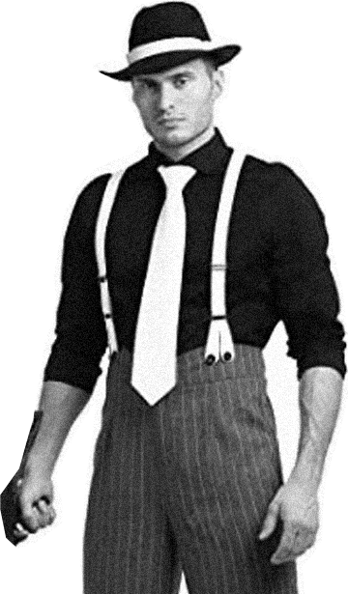
Factors that interact and predict likelihood of rape or other sexual violence
Promiscuity and impersonal sex
Narcissism
Hostile masculine self identification
Delinquency in adolescence
A history of sexual violence
Frequent use of pornography
Characteristics of the sex buyer
First purchase of sex between the ages of 19 to 23
Prone to report ten or more sexual partners in the last five years
The vast majority are heterosexual and married or living with a partner
Commits crimes most frequently: violence against women, rape, assault and battery, homicide, robbery, burglary, theft, property crime, drug sales and possession, weapon offenses, crimes against authority, disorderly conduct and driving offenses
Have paid for an average of 55-85 women in their lifetime
Selects women based on his racist stereotypes, youth, low prices, being foreign or "exotic" and unable to speak local language

Slide 19
Places where men buy sex in Germany
and in United States, UK, Scotland, Cambodia and India
53%
48%
Indoors
Outdoors
Brothel
Hotel or guesthouse
Bar
Massage parlor
Escort agency
Private party
Karaoke
Strip club
Sauna
Drug/crack house
71%
55%
49%
48%
42%
39%
38%
36%
25%
12%
On the street:
In a park:
In a car or vehicle:
82%
59%
43%

Slide 20
If there is an opportunity,
if prostitution is accessible and legal, men tend to pay for sexual use of women, than when it isn’t legal
They consider payment relieves them from any obligation to treat the person as a human being
The pay to break rules
such as the use of condoms or engaging in extreme violence
If their expectations are not met, they blame the women for producing their violent reactions
Are sexually aroused by more violent behaviors: ejaculating in the face, gang raping of a woman, sexual abuse of pregnant women
They are aroused by women’s pain, fear and humiliation
They are unempathetic and indifferent to the suffering, illness, aging of women
They avoid thinking about the consequences of their actions, deny or minimize them
Little likelihood that they will report human trafficking if they recognize it
Common behaviors and concepts
among sex buyers

Slide 21
They acknowledge and recognize economic
coercion of prostituted women
They acknowledge symptoms it produces:
dissociation
low self-esteem
self-harm
suicide attempts
depression
disorder anxiety and panic attacks
post-traumatic stress
as well as drug and alcohol use to endure
Most have observed a trafficked or pimped woman
controlled by her "manager"
They know of violent acts by pimps towards them
that amount to torture:
verbal abuse
pushed, beaten, slapped, cut
choked, dragged, thrown against the wall
fingernails pulled out, teeth knocked out
starved
threats against their relatives
Also, sex buyers know of organized crime's control over women

Slide 22
Adding their names to a sex offender registry along with rapists and pedophiles
Increased penalty
What
would
deter men from
buying sex according to them?
Photo or name in local newspaper, billboard or internet
Higher fines
Spending any amount of time in jail, even as brief as a few hours
Educational program
for sex buyers
A letter sent to their family
stating arrest for soliciting a
woman in prostitution

Slide 23
Change:
Equality between women and men
The sex buyers…
Part 4

Slide 24
A change is needed in upbringing patterns for boys and girls
They must be raised far from sexist stereotypes,
neither blue nor pink
Equal education, recreation and sports experiences and opportunities
Equal creative possibilities and physical and emotional support
Equal responsibilities and rights at home,
before family and friends
Differential treatment based on biological sex differences
Boys and young men should consider it offensive to consume, buy, exploit, abuse or use a girl or woman online or physically
Paying for sex is not what real men do

Slide 25
A decisive change is needed among men so that they STOP demand of porn and prostitution
Relationships between equals imply that both people involved, have sexual desire
Respect is the basis of a relationships between equals
If only one desires, there should be no relationship
Sexual intercourse is not the only way to have pleasure
Greater sexual satisfaction is found through self-exploration and empathy for others
VIOLENCE AGAINST WOMEN IS
Any act that causes physical, mental or sexual harm or suffering
Threats, coercion, harassment, use of force
Any practice that justifies the subordination of women (such as paying for sexual access to women)

Slide 26
We need a change
in society
Policies that discourage and disrupt men's confidentiality and privilege to pay for sex
Hold men accountable for violence against women and girls
Survivors of trafficking, prostitution and pornography can raise awareness of these serious harms
To end the business and this form of violence, legislate against the demand
No demand
No supply

Slide 27
Eradicate the demand for prostitution,
is an obligation under international law
- Discourage the demand that fosters all forms of exploitation, especially women and children, that leads to trafficking (Palermo Protocol Art. 9.5)
- Prostitution exists because of stereotypes of dominance and the need to impose male control or power (Parr 30 RG 38 of CEDAW)
- All actors involved in trafficking, including those on the demand side, must be investigated, prosecuted and convicted (CEDAW Parr 63rd RG 38)
- Detect online recruitment and uncover and identify cases of trafficking through digital media and messaging platforms, including on the demand side (Parr 71 and 73 CEDAW RG 38)
- Pornography and other forms of commercial exploitation of women as sexual objects contribute to violence against women (Parr 11-12, CEDAW RG 19)

Slide 28
SOURCES
Pornography
Serena Fleites and Jane Does 1-33, Complaint against Mindgeek for 13 crimes, https://brownrudnick.com, 2021
Mónica Alario Gavilán, La Manada en el Porno, 2018.
Pornography and Public Health, National Center on Sexual Exploitation, 2018
De Sousa, A., & Lodha, P. Neurobiology of Pornography Addiction - A clinical review Telangana Journal of Psychiatry, 3(2), 2017.
Malamuth, N.M. & Hald, G.M. The Confluence Mediational Model of Sexual Aggression. In T. Ward & A. Beech (Eds.) Theories of sexual aggression. New York: Wiley, 2017.
Peter Szil, Men, pornography and prostitution, 2015.
Gail Dines, Pornland: How Porn has Hijacked our Sexuality, 2010
Malamuth, N. M., & Pitpitan, E. V. The effects of pornography are moderated by men's sexual aggression risk. Pornography: Driving the demand in international sex trafficking, 2007.
Prostitution
Melissa Farley, Inge Kleine, Kerstin Neuhaus, et al. Men who pay for sex in Germany and what they teach us about the failure of the legal prostitution: a 6-country report on the sex trade from the perspective of the socially invisible puteros or sex buyers, 2022.
From Impunity to Accountability. Deterring Sex Buyers in the New York State and Beyond, Coalition Against Trafficking in Women, 2022.
OSCE, Discouraging The Demand that fosters trafficking for the purpose of sexual exploitation, 2021
De Meyer, Sara "Boys Should Have the Courage to Ask a Girl Out": Gender Norms in Early Adolescent Romantic Relationships, 2017
Farley, Melissa & Golding, Jacqueline & Schucman, Emily & Malamuth, Neil & Jarrett, Laura, Comparing Sex Buyers With Men Who Do Not Buy Sex: New Data on Prostitution and Trafficking. Journal of Interpersonal Violence, 2015.

Slide 29
SHARE AND BE PART OF THE CHANGE

