Slide 1
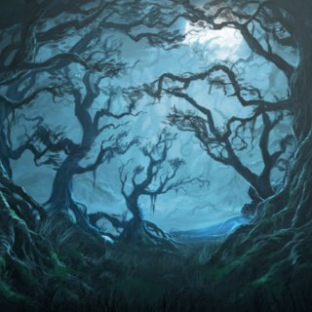
Imaginative Writing
LO: How do I use nouns and adjectives to create good description?
Starter:
Glue the extract in your English book.
Then read it.

Slide 2
Task 1: Highlight or circle all of the nouns
So Harry set off into the heart of the Forest with Malfoy and Fang. They walked for nearly half an hour, deeper and deeper into the Forest, until the path became almost impossible to follow because the trees were so thick. Harry thought the blood seemed to be getting thicker. There were splashes on the roots of a tree, as though the poor creature had been thrashing around in pain close by. Harry could see a clearing ahead, through the tangled branches of an ancient oak.
Nouns are:

Slide 3
Task 1: Highlight or circle all of the nouns
So Harry set off into the heart of the Forest with Malfoy and Fang. They walked for nearly half an hour, deeper and deeper into the Forest, until the path became almost impossible to follow because the trees were so thick. Harry thought the blood seemed to be getting thicker. There were splashes on the roots of a tree, as though the poor creature had been thrashing around in pain close by. Harry could see a clearing ahead, through the tangled branches of an ancient oak.
Nouns are:

Slide 4
Task 2: Highlight or underline all of the adjectives
So Harry set off into the heart of the Forest with Malfoy and Fang. They walked for nearly half an hour, deeper and deeper into the Forest, until the path became almost impossible to follow because the trees were so thick. Harry thought the blood seemed to be getting thicker. There were splashes on the roots of a tree, as though the poor creature had been thrashing around in pain close by. Harry could see a clearing ahead, through the tangled branches of an ancient oak.
Nouns are:

Slide 5
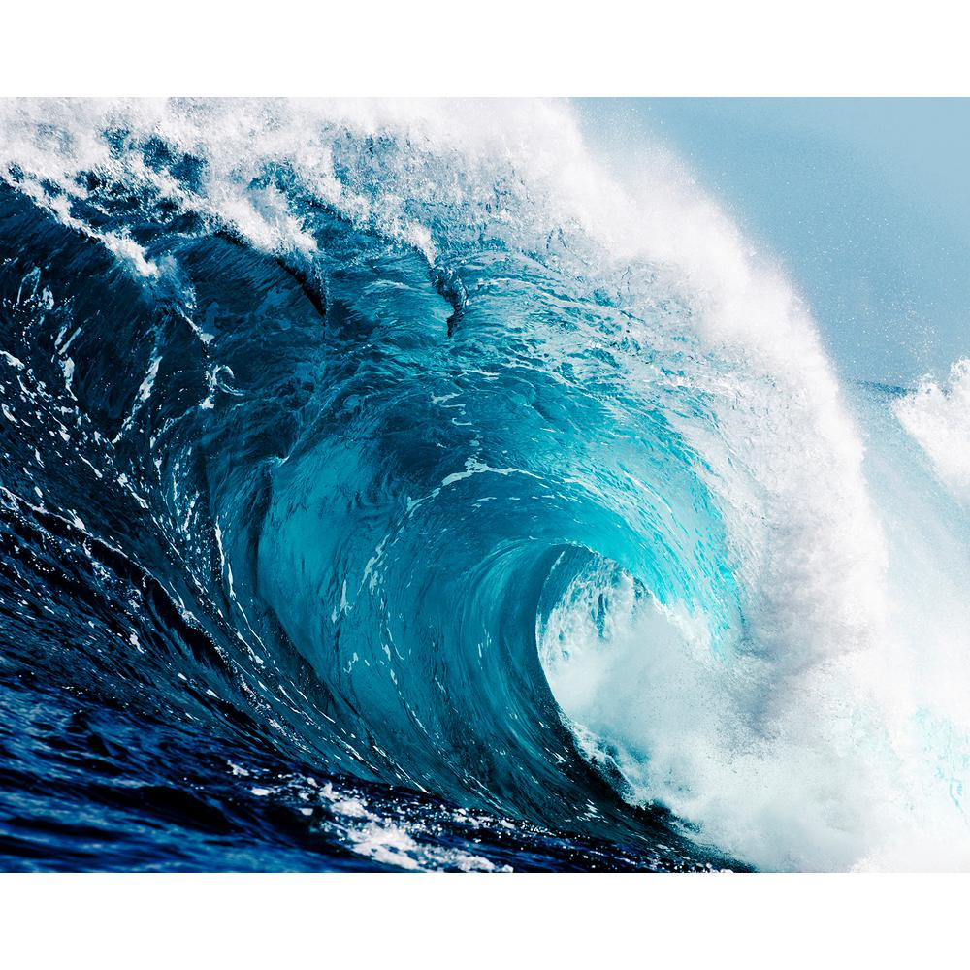
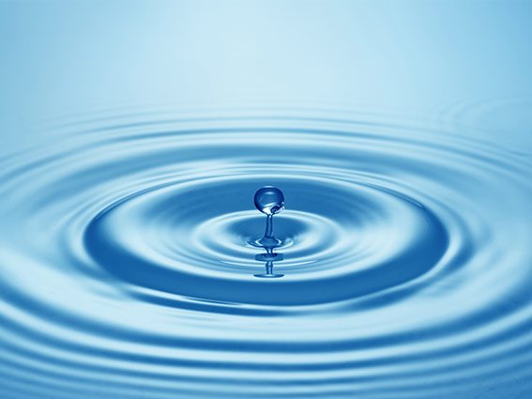
Nouns are the first STEP towards creating a vivid description

Slide 6
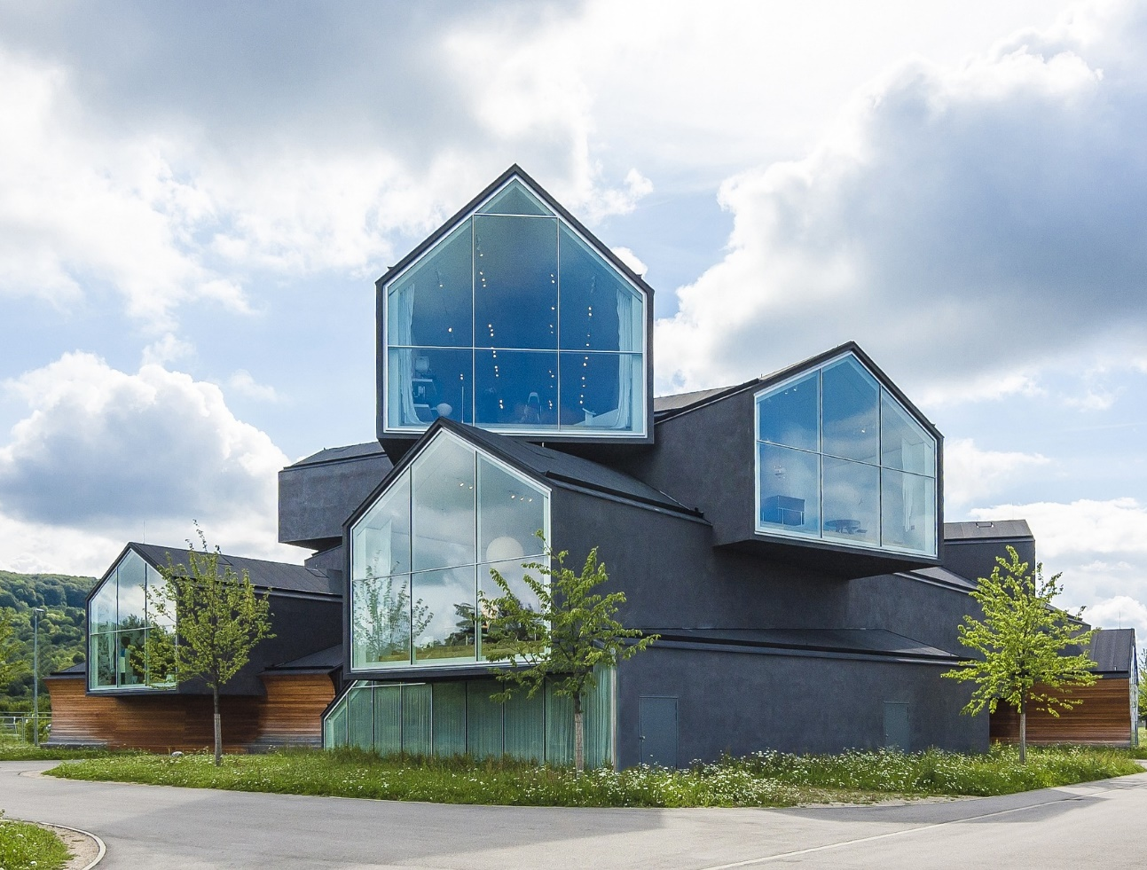
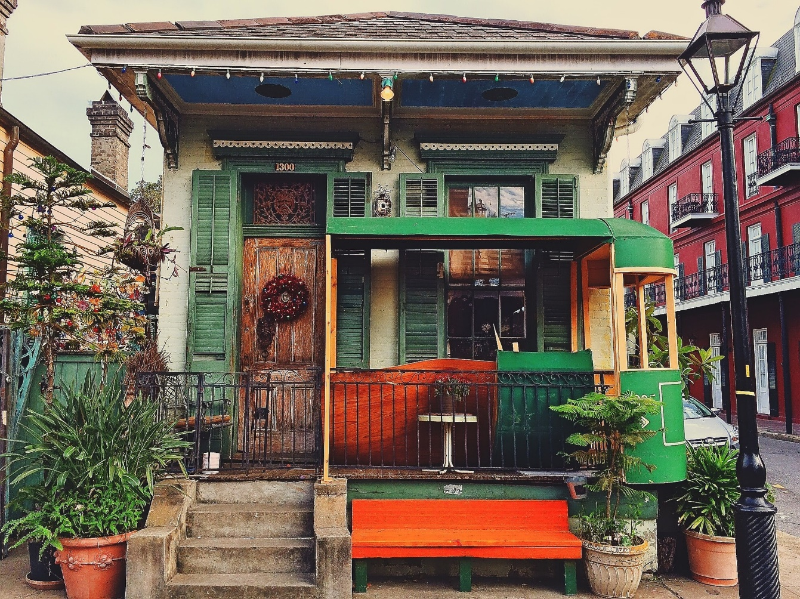
Nouns are the first STEP towards creating a vivid description

Slide 7
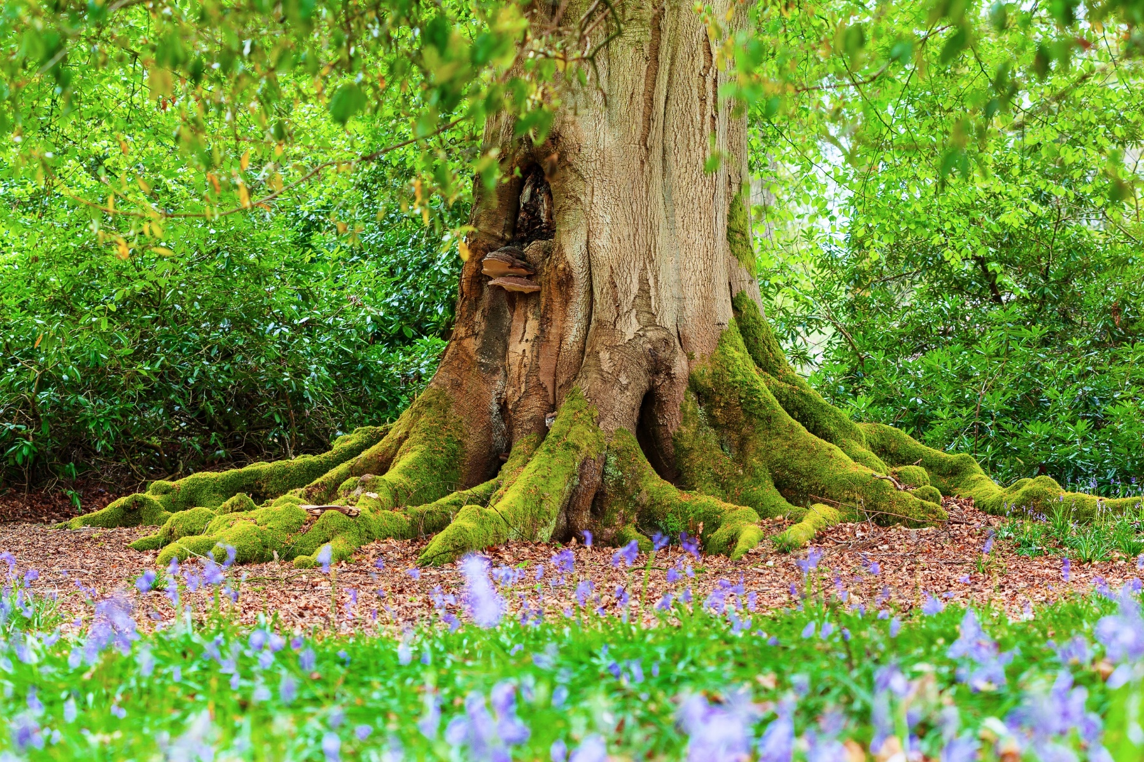
Glue this image in the middle of your page. Write around it all the THINGS you can see (those are the NOUNS). Aim for 10 things.
We are aiming for scientific, observational and precise description

Slide 8
Now include adjectives that add detail to shape, size, texture, age, colour. No emotive words allowed.
We are aiming for scientific, observational and precise description

Slide 9
Which of these is description? 1. There is a big tree. OR 2. The green and brown tree stretched high into the sky
We are aiming for scientific, observational and precise description

Slide 10
What is description then? Let’s work on a definition before you write it.
We are aiming for scientific, observational and precise description

Slide 11
What is description?
Description is when we clearly inform the reader of the facts and details of a place, a person, or a thing.

Slide 12
Are these description?
The tree had lots of leaves.
The grass is very green.
There are animals in the forest.

Slide 13
Extended writing task: Write a description of this place, make it seem real. ½ page. Use the ideas sheet to help you!
We are aiming for scientific, observational and precise description

Slide 14
We are aiming for scientific, observational and precise description

