Slide 1
LO: What is good fiction writing?
Use your first page, create 2 mind-maps in the middle of the page. Label one ‘Basic Writing’ and the other ‘Good Writing’.
What are the basic writing skills that I would expect to see without having to remind you? Write 10!
What do you need to do to ensure your writing is GOOD? Write 10!
Basic
Writing
Good writing

Slide 2
LO: What is good fiction writing?
Good writing
Techniques?
Vocabulary?
Structure?
Features of fiction?
Punctuation?
Grammar?
Spelling?

Slide 3
Label up the next two pages in your English book. “Sophisticated Vocabulary”
We are going to use these pages to practice using sophisticated vocab that you can use both in your own writing and in your analytical writing.
Amiable (adjective) to be friendly, social, generally pleasant
Example: The young man greeted me with an amiable “Good morrow!”

Slide 4

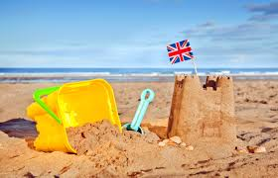
You are going to write a short piece of description (Slow write to focus on skills)
Focus on senses – describe what can be seen, heard, felt, smelt, and tasted.
Focus on word choices – try to use sophisticated vocabulary

