Slide 1
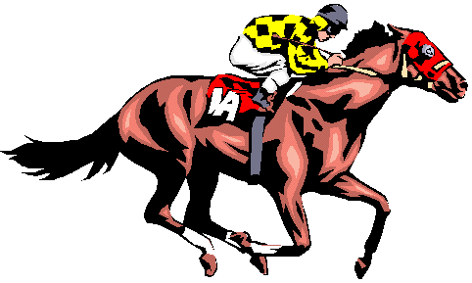
Team activity: Race the horses
Task 1
Task 2
Task 3
Task 4
Task 5
Team 1
20 pts
Team 2
20 pts
Team 3
20 pts
Team 4
20 pts

