Slide 1
Urban Land Nexus and Inclusive Urbanisation in the Cities of
Dar es Salaam and Mwanza
Summary of the Findings
For Policy Consideration
By Kyessi, A. and Kombe, W.
Presented to Annual LANDac Conference 2019
Land Governance in Transition
Held at Utrecht University on 4th and 5th July, 2019

Slide 2
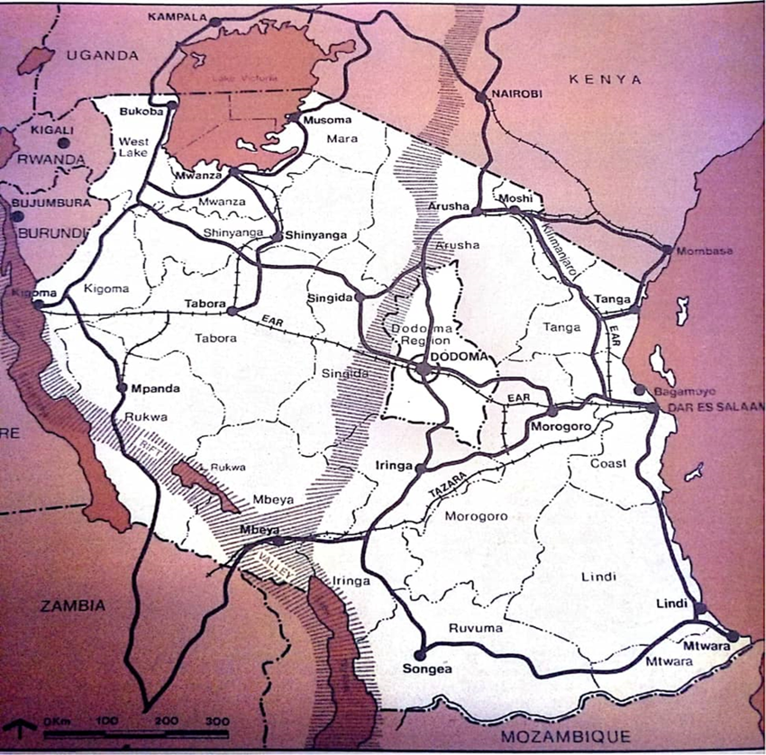
Location of Dar es Salaam and Mwanza City in Tanzania

Slide 3
Presentation Outline
Introduction
Key urban land nexus processes, opportunities and challenges in Dar es Salaam and Mwanza
Policy recommendation areas in the urban land Nexus

Slide 4
Introduction
Unlocking Tanzania’s urban opportunity
  Tanzania is undergoing an urban transformation. By mid-century, the country’s urban population is projected to quintuple, rising from less than 15 million people in 2012 to more than 60 million people.
  Urbanisation and shared prosperity: well-managed urban development
  Tanzania will only be able to achieve its development ambitions if it can manage its urban land sustainably by providing adequate housing, transport, energy, water, and sanitation services, as well as access to decent jobs and essential services for the growing urban population.

Slide 5
The relationship between GDP and levels of urbanisation (% of total population) of African countries (1988 – 2014)
Source: Worall et all. (2017) Citing WDI, 2016

Slide 6
Tanzania Urbanisation Trends (1950 – 2050)
Source: Worall et all. (2017) citing UN DESA, 2015

Slide 7
The population of Tanzania’s six largest cities (1950 – 2050)
Source: Worall et all. (2017) citing UN DESA, 2015

Slide 8
Institutions with critical urban responsibilities
Source: Worall et all., 2017

Slide 9
Major areas of Concern and Issues
Informality and urban settlement formation – Goba in Dar es Salaam and Ruchelele in Mwanza
  Rapid Peri-urban informal growth and transformation (social, environmental, spatial, economic without regulatory frameworks, plans, standards and regulations;
  Absence of land for improving basic public services and facilities including improved sanitation facilities;
  Displacement of the poor – unguided market eviction and formation of more informal settlements; and
  Misuse/destruction of prime agricultural land leading to food scarcity and insecurity.

Slide 10
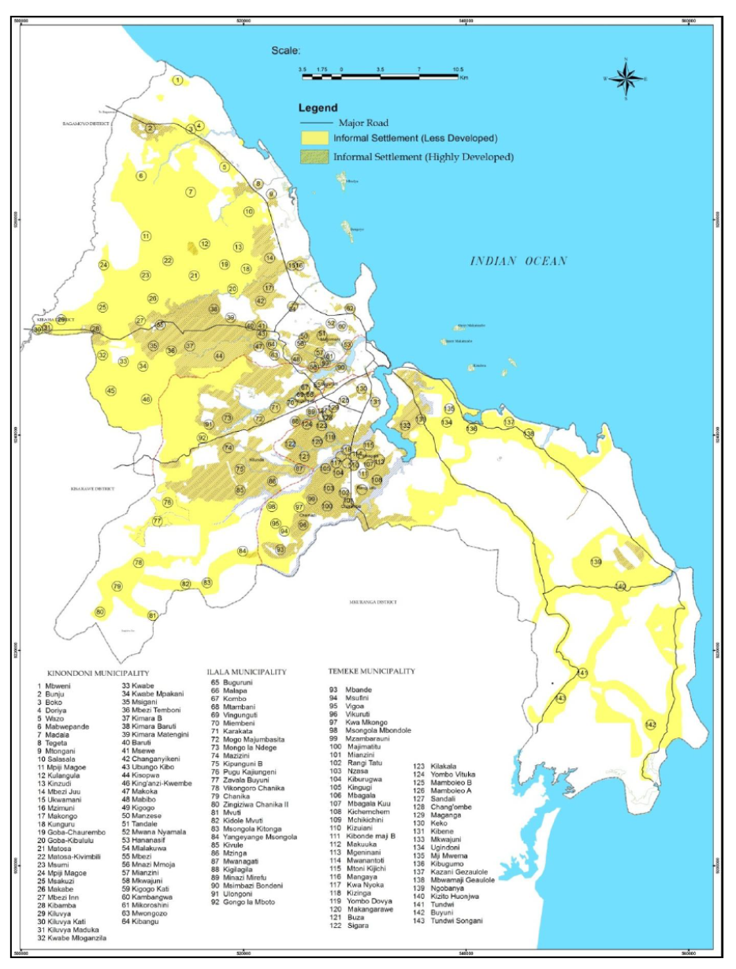
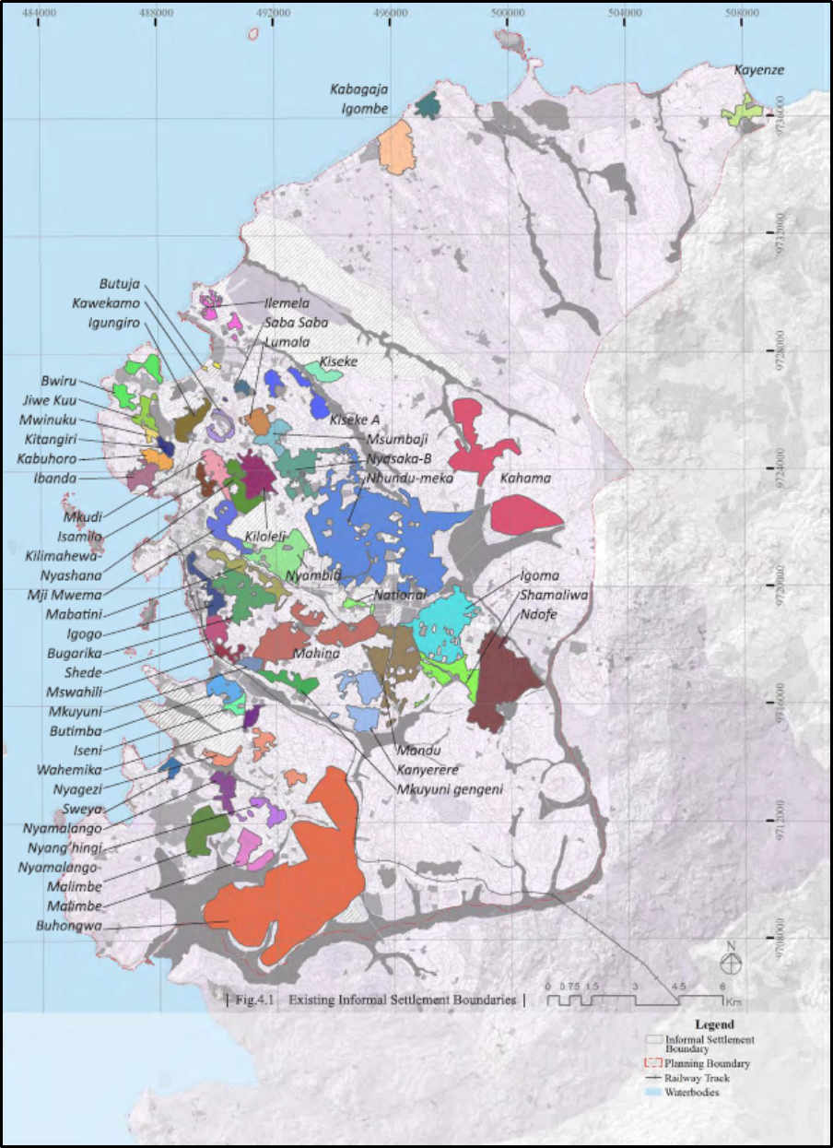
Extent of Informal Settlements
Informal Settlements in Dar es Salaam City, 2012 (URT 2015)
Informal Settlements in Mwanza City, 2015 (URT, 2016)

Slide 11
Major areas of Concern and Issues
  Regularisation and formalisation – Magengeni (Mbande) in Dar es Salaam and isamilo and Ibungilo in Mwanza
    Reactive intervention – not proactive (ex-ante), unable to copy with rate of growth of informality;
    Misconception of regularisation and formalisation as a panacea to informality – regularize/formalise all housing land except on fragile ecosystem areas;
    Over emphasis on protection over private property rights (enormous challenges to secure public rights after titling);
    Under-provision and non-consideration of other prime land uses e.g. industrial and commercial, institutional and recreational land uses;
    Unwillingness of the land owners to designate/denote land for public use without compensation; and
    Ignorance on the value public intervention (land use planning) adds to land occupiers/private land.

Slide 12
Formalisation of property rights by issuing of Residential Licences or Titles in Dar es Salaam and Mwanza
Regularisation Plan (Part of) of Isamilo in Mwanza
Magengeni in Mbande, Dar es Salaam

Slide 13
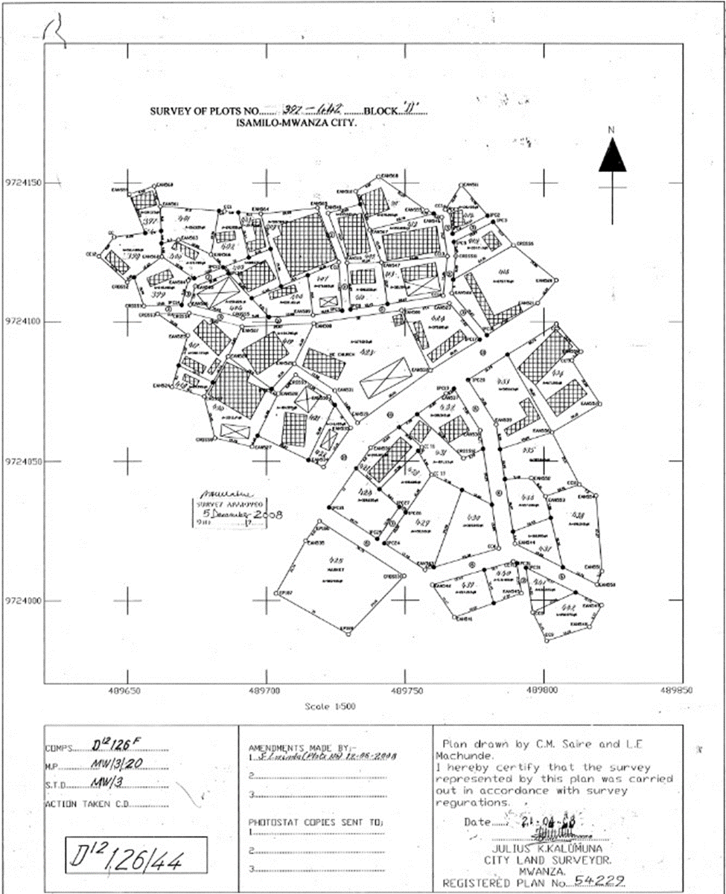

Slide 14
Major areas of Concern and Issues
Urban expansion and new towns/cities – Kigamboni in Dar es Salaam and Buswelu in Mwanza
  Spatial planning without resources - no money for infrastructure services, no money for compensation of third party interests;
  Planning directed by technical and political rationalism and marginalized participation of critical players – drivers of urban growth
  Over-centralisation in decision making despite of development by devolution (D-by-D philosophy);
  Limited transparency and accountability - among bureaucrats (i.e. stakes held by non-technocrats/landowners);
  Lack of policy framework and operational procedures for establishing new towns/cities; and
  Lengthen conflicts due to spatial planning without regard to the contextual factors.

Slide 15
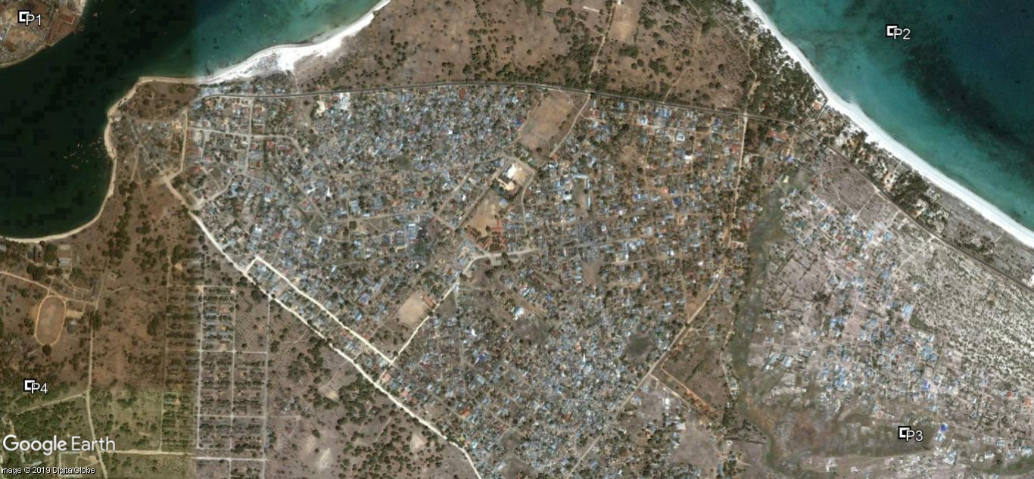
Kigamboni, Dar es Salaam: Existing situation 2018

Slide 16
Unrealised 3D Plan in Kigamboni, Dar es Salaam

Slide 17
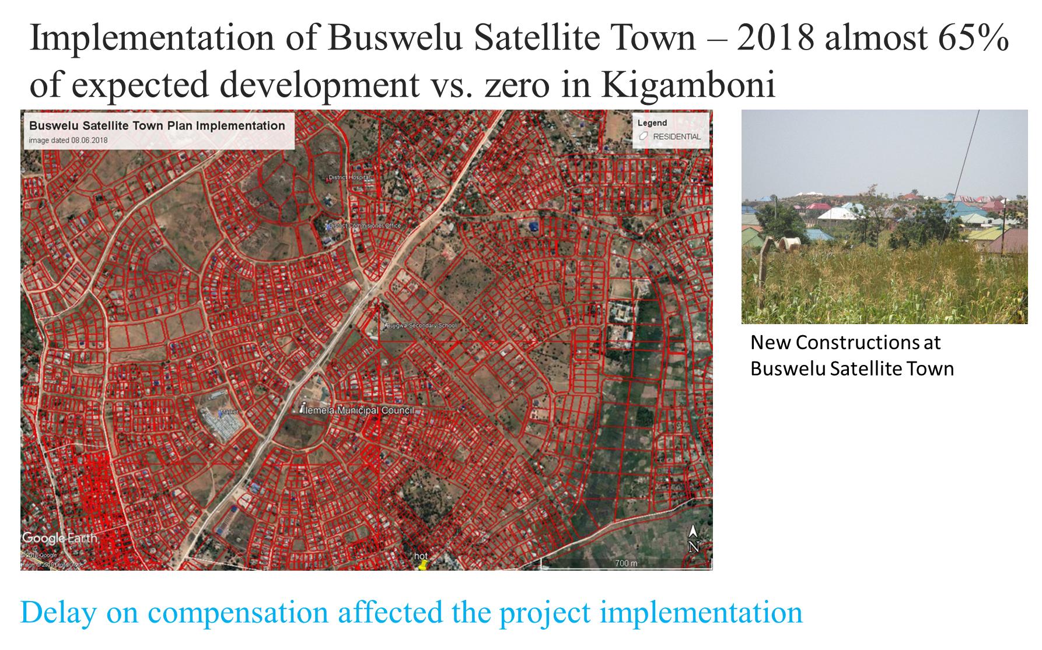

Slide 18
Major areas of concern and issues
Gentrification and redevelopment – Manzese in Dar es Salaam City and Mirongo in Mwana City
  Increasing land values and attraction;
  Displacement of the poor and accentuated informality;
  Lack of comprehensive policy and regulatory instruments to guide gentrification in informal settlements and decayed planned neigbourhoods;
  Lack/limited housing options – owner/tenant; and
  Absence of institutionalised public/private sector support – low income sellers earn large capital

Slide 19
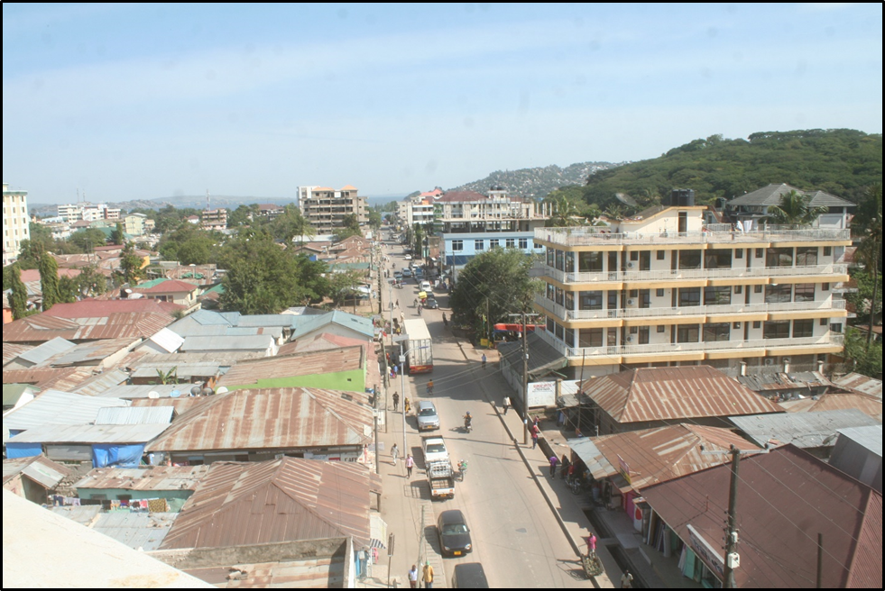
Gentrification and Redevelopment
Mirongo in Mwanza City

Slide 20
Major areas of concern and issues
  Resettlement – Mabwepande in Dar es Salaam and Mabatini in Mwanza
    There is lack of unified national resettlement policy;
    Mabatini /Igogo ijn Mwanza and Magomeni Suna in Dar es Salaam are convenient locations near City Centre but both are flood prone areas;
    Disregard of people’s livelihoods – in resettlement/relocation;
    Breakdown of social safety nets;
    Disregard of tenants – equally relocated/loss of livelihoods; and
    Resisted relocation to Nyamuongolo in mwanza City due lack of basic infrastructure services and fear of losing livelihoods.

Slide 21
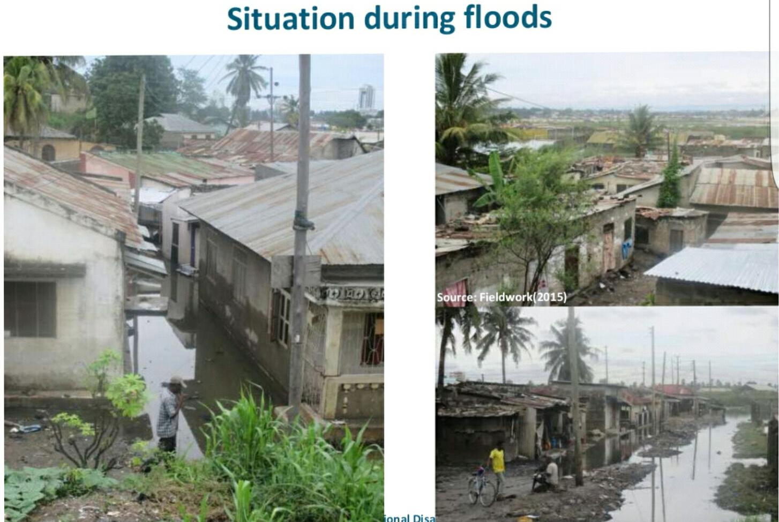
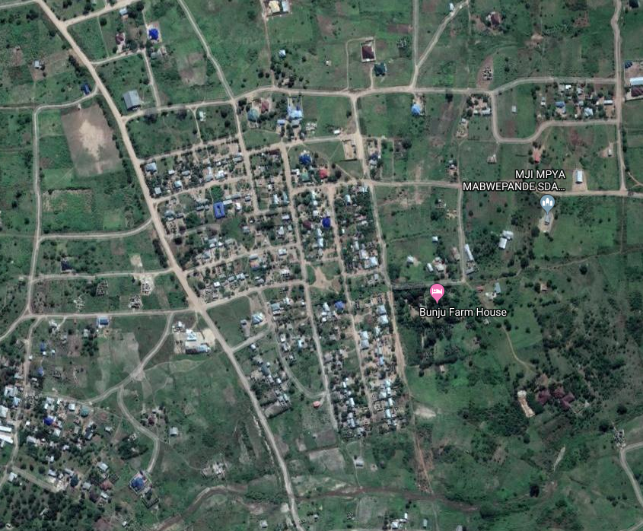
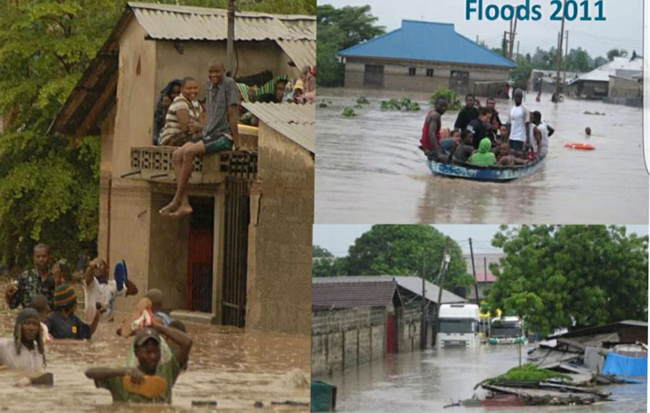
Successful Resettlement in Dar es Salaam
Magomeni Suna
Relocated to Mabwepande

Slide 22
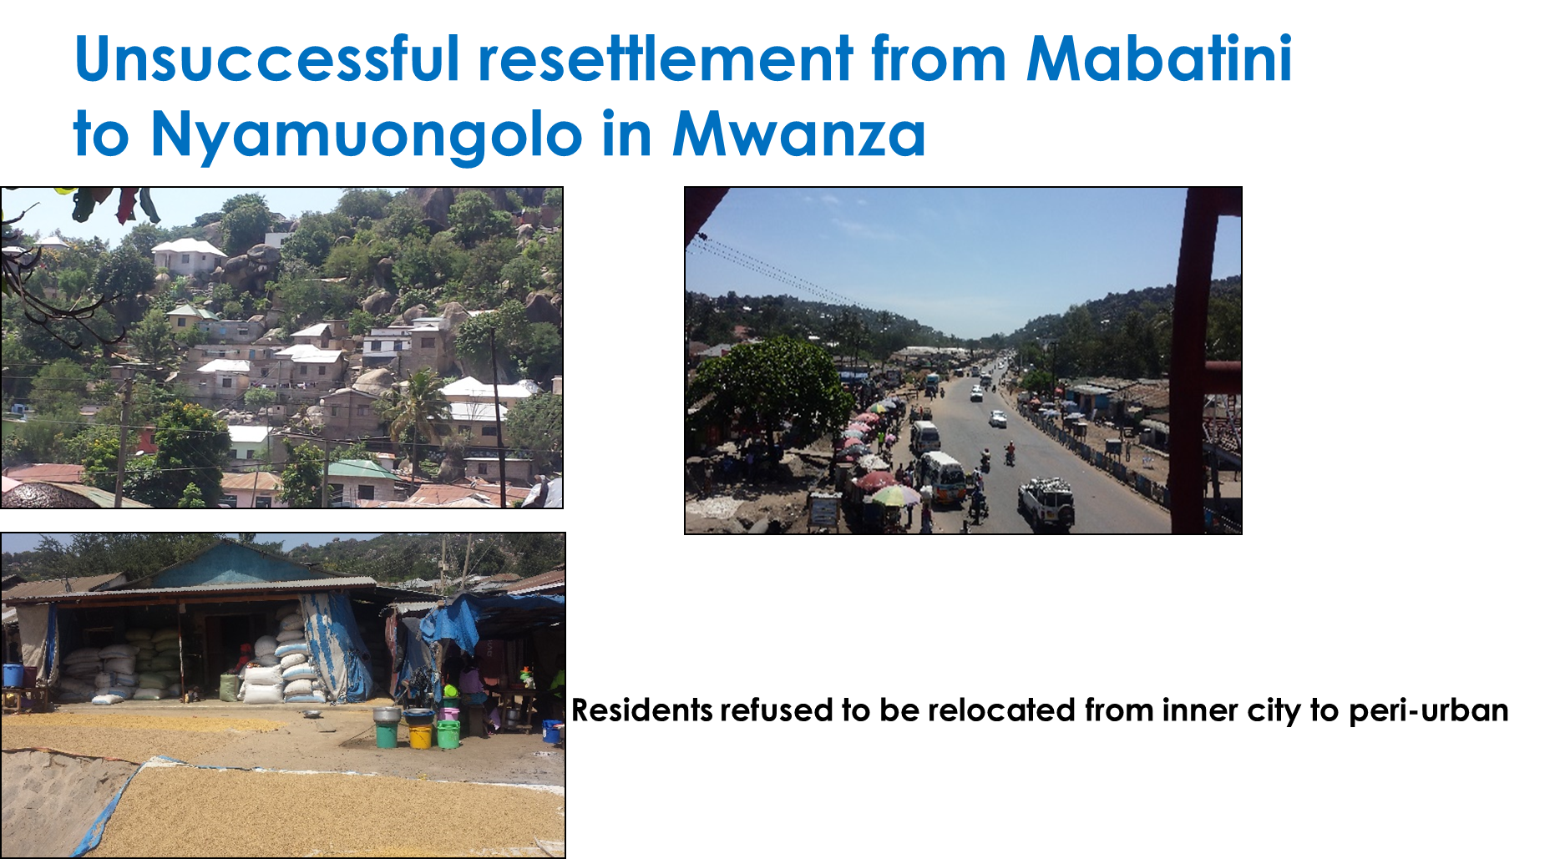

Slide 23
Major areas of concern and issues
Basic infrastructure services – Access to Sanitation - Sewer extension in Mlalakuwa and Sinza in Dar es Salaam and simplified sanitation system in Kilimahewa and Mabatini in Mwanza City
  Affordable and flexible models;
  Lack of space/land for laying basic infrastructure (sewer extension) in informal settlements;
  Non-availability of affordable trunk infrastructure and high connection costs e.g. in most settlements occupied by the urban poor;
  Inadequate institutional mechanisms to enable the poor to gradually access improved sanitation in the long run;
  Lack of policy frameworks for community engagement in maintenance; and
  Lack of tenure security in informal settlements.

Slide 24
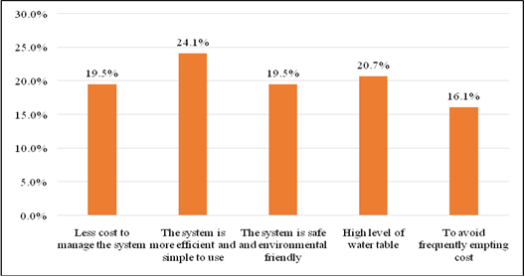
Sewerage extension services to existing settlements through community-based approach
Sinza A Planned Neighbourhood and Mlalakuwa Informal Settlement, Dar es Salaam
Pull factors to connect to the central sewer system

Slide 25
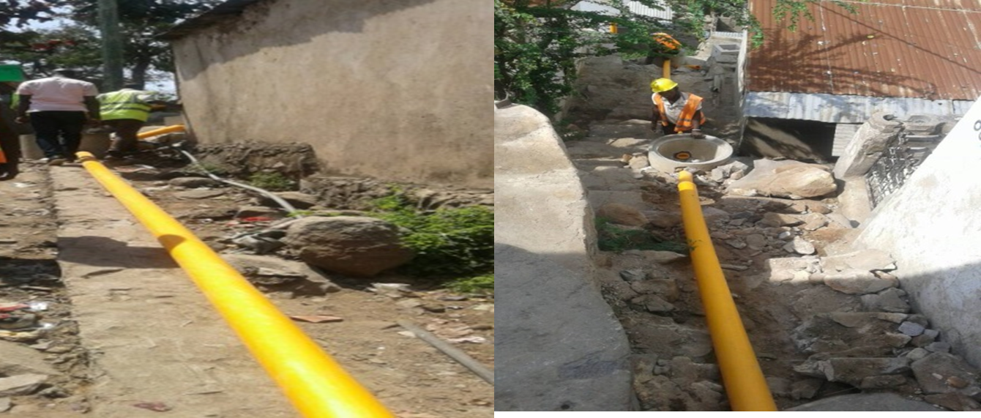
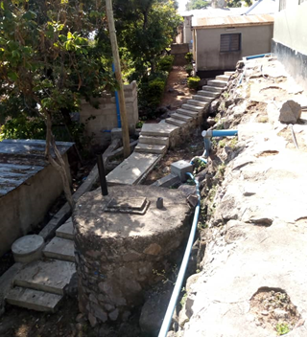
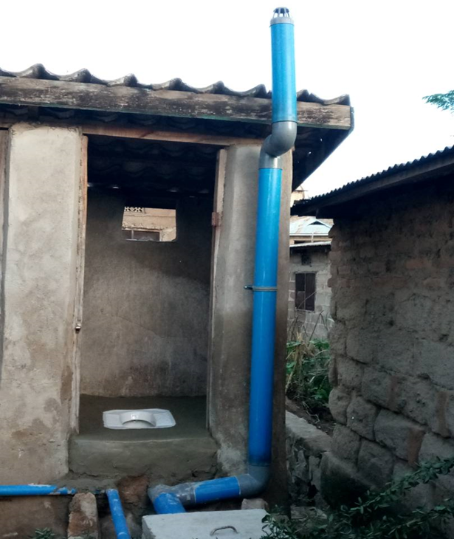
Simplified sewerage system in Mwanza
Simplified sewerage during construction phase
Sewerage system within staircase and installation of squatting pan

Slide 26
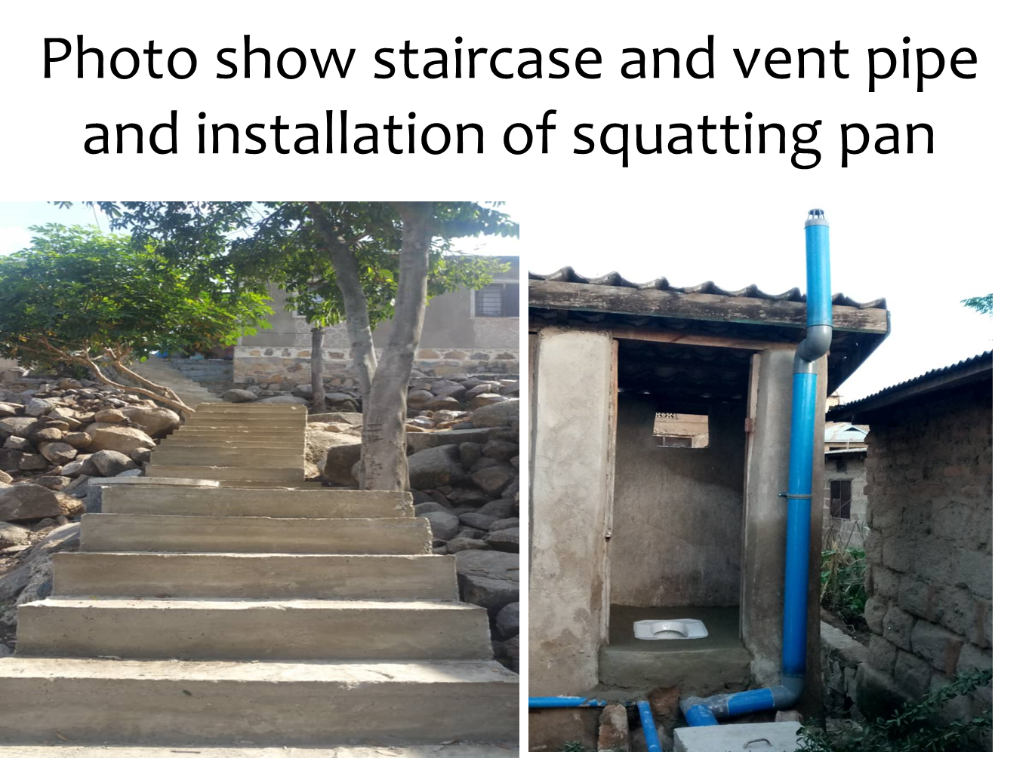

Slide 27
Policy recommendation areas in the urban land nexus
Urbanisation under poverty
Effective and inclusive land use planning;
Good (urban land) governance and institutional coordination;
Stakeholders (including local communities) participation and engagement in municipal services provision;
Capacity building (including financing) for sustainable urban development;
Review of regulatory measures including establishment of a national urban policy framework; and
Developing indicators (including GIS mapping) for monitoring and evaluation system

Slide 28
ACKNOWLEDGEMENT
The research for this presentation was part of a project funded by DFID EARH and titled The Urban Land Nexus and Inclusive Urbanisation in Dar es Salaam, Khartoum and Mwanza, led by the Institute of Development Studies at the University of Sussex.

Slide 29
Aksante sana
Thank you
Vielen danke

