Slide 1
NEW PLATFORM FOR PROFESSIONAL CULTURAL PRACTITIONERS

Slide 2
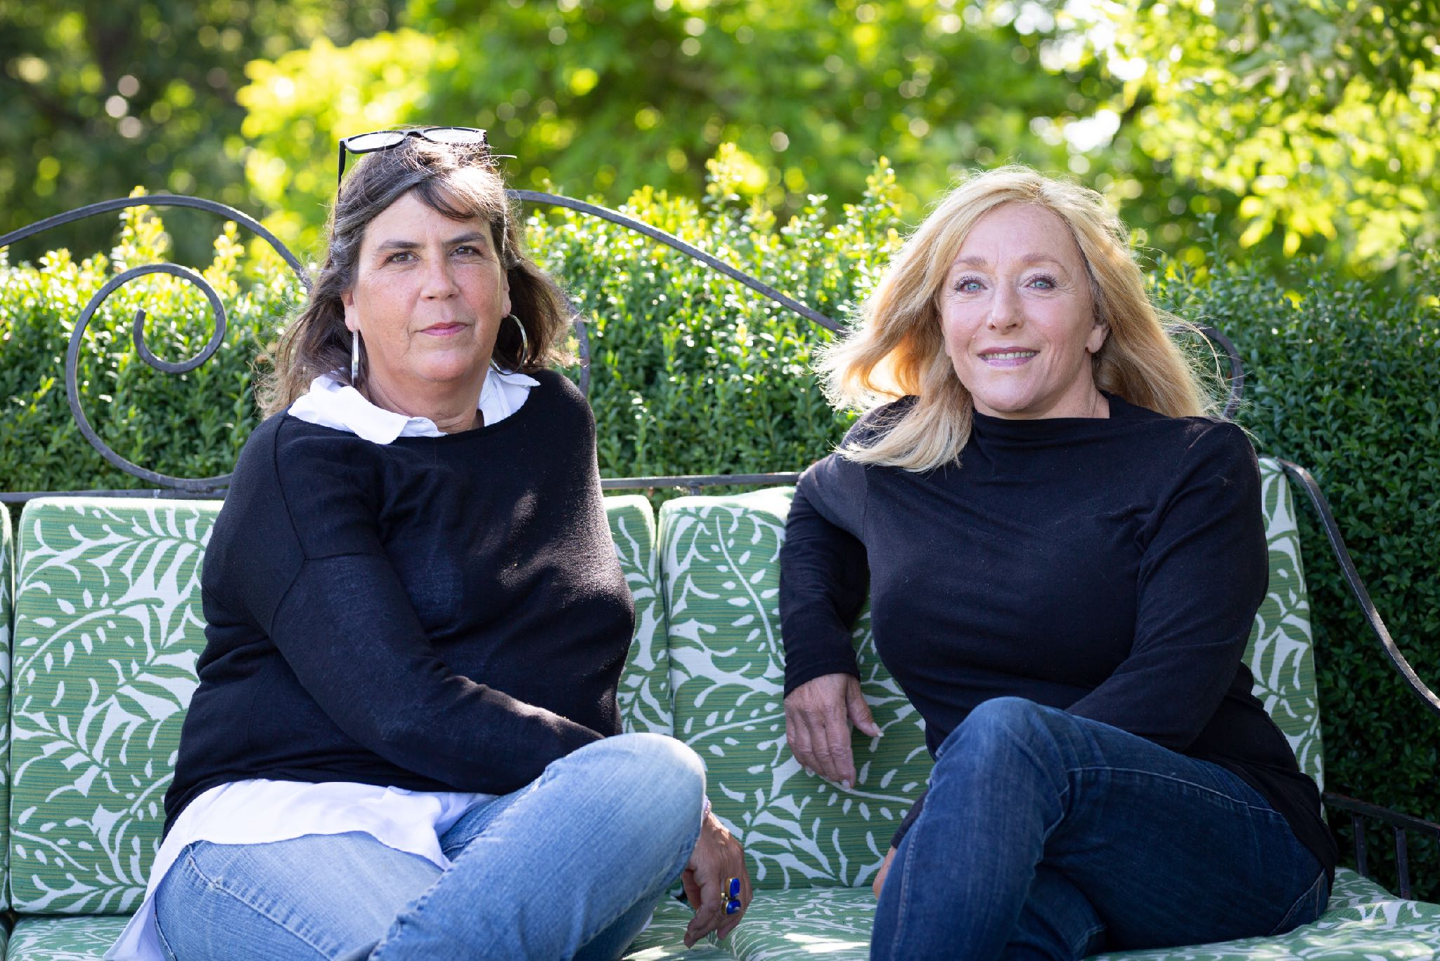
WHO WE ARE
Susan Bolgar, former Cultural Officer in the municipality of Simrishamn, former Head of Culturl Department in Jönköping Municipality, Senior Adviser to Arts & Business in Stockholm. Today Susan runs her own buisiness as cultural producer.
Anna-Carin Uggla, Communications Officer focused on sustainability. Currently employed by the Municipality of Simrishamn as Cultural officer for Childrens Culture. Anna-Carin also has a backgroud in tourism, marketing and the Hospitality Industry.
Kulturnavet Österlen consists of all our members in the network. Together we form a powerful force for sustainable development of arts and culture in South East Scania/Österlen.

Slide 3
WhY kulturnavet österlen?
BECAUSE WE BELIEVE IT TO BE EASIER TO CREATE BETTER CONDITIONS FOR 100 ARTISTS TOGETHER, THAN FOR 100 ARTISTS ACTING ONE BY ONE.

Slide 4
THE PURPOSE
Long-term joint marketing
Communication with local businesses, municipalities and the Scanian Region
Lobbying for better conditions
External monitoring of topics like cultaral policies, cultural funding, grants, etc.
Joint purchases of services like accounting, marketing, etc.
Joint practical services like distribution of printed material, transportation services, etc.

Slide 5
KULTURNAVET TODAY
Mapping of profesional artists/cultural practitioners on Österlen
Mapping of the target group when it comes to requirements, requisits and whishes
Full report of the mapping (Published in March)
Ongoing monitoring of topics of interest
Ongoing dialogue with the municipalities in the region
Membership benefits
Newsletters and communication
Meetings

Slide 6
MEMBERS
Today Kulturnavet Österlen has 163 members representing all cultural professions, but mostly visual artists. They come from all parts of Österlen.
https://www.kulturnavetosterlen.se/medlemssida/

Slide 7
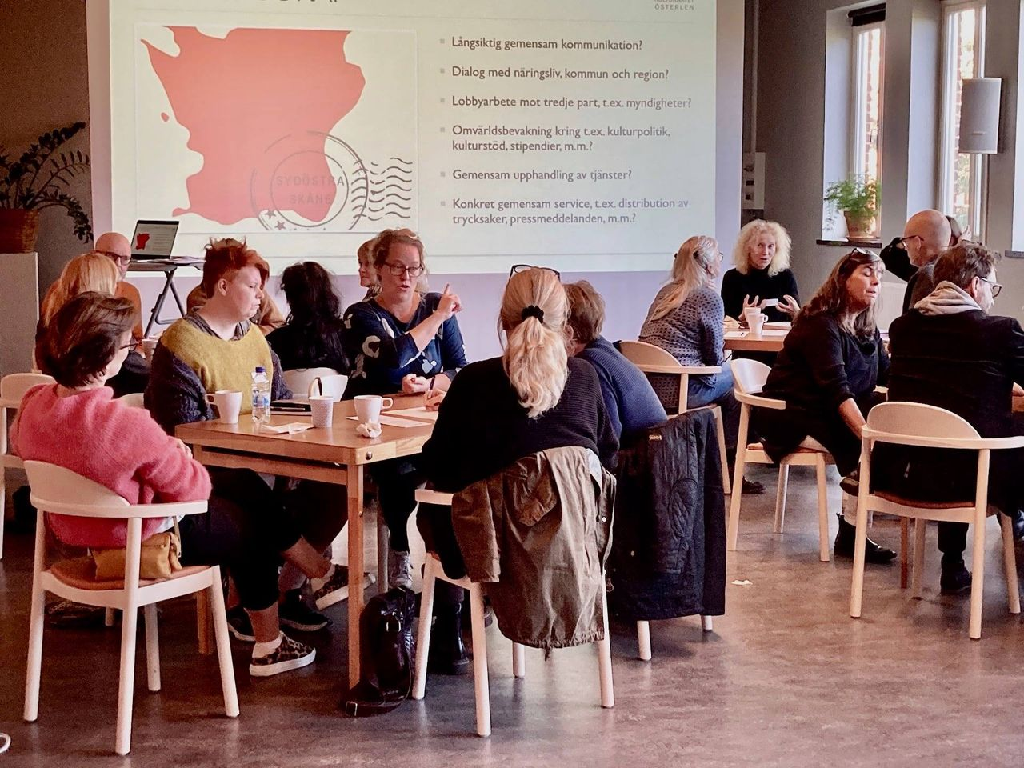
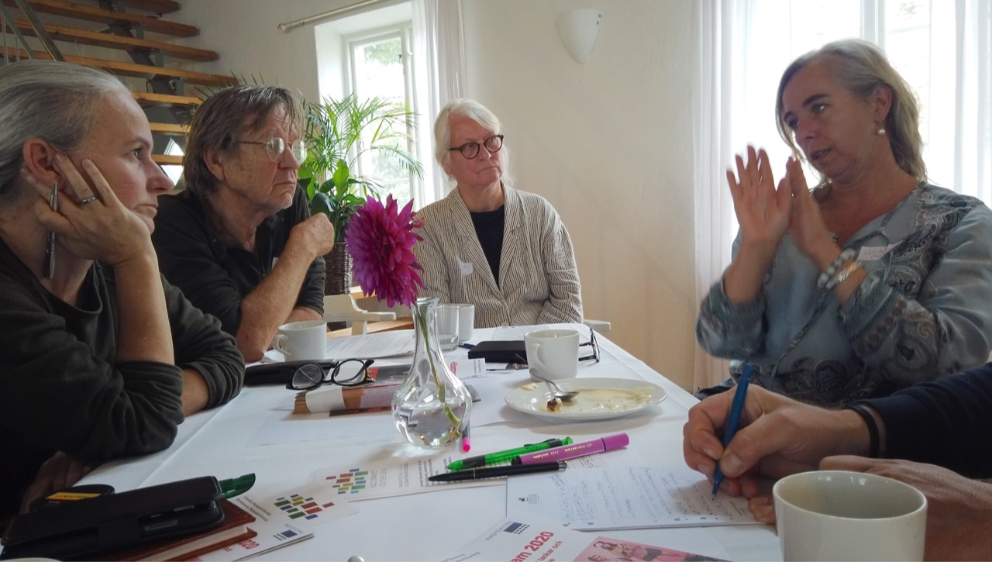
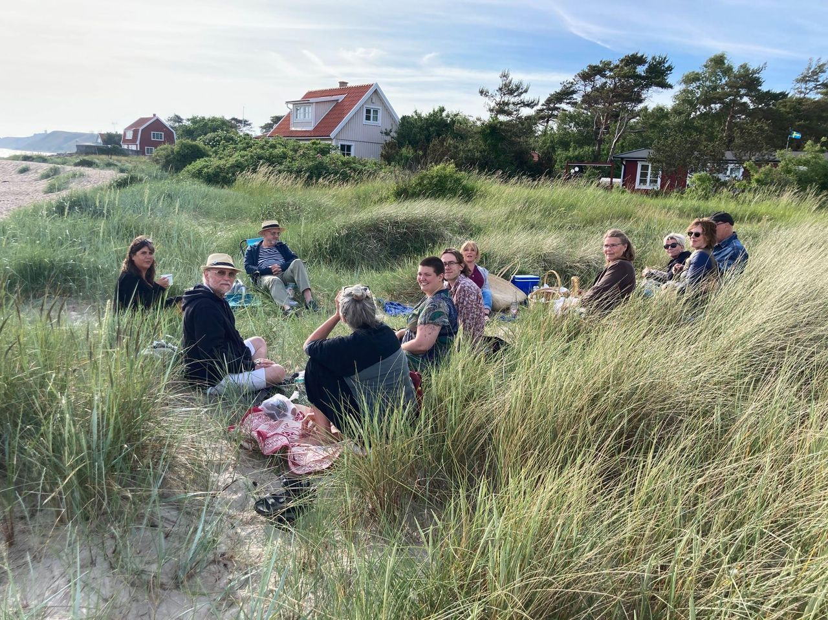
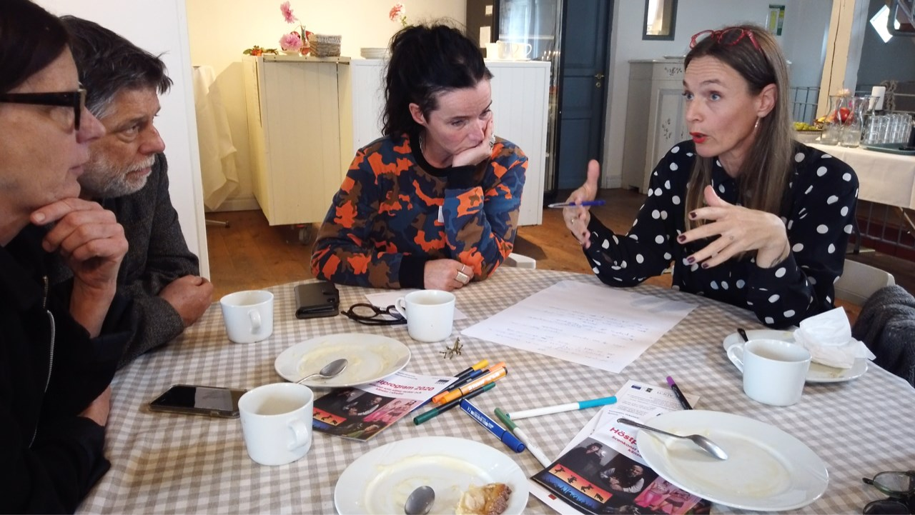
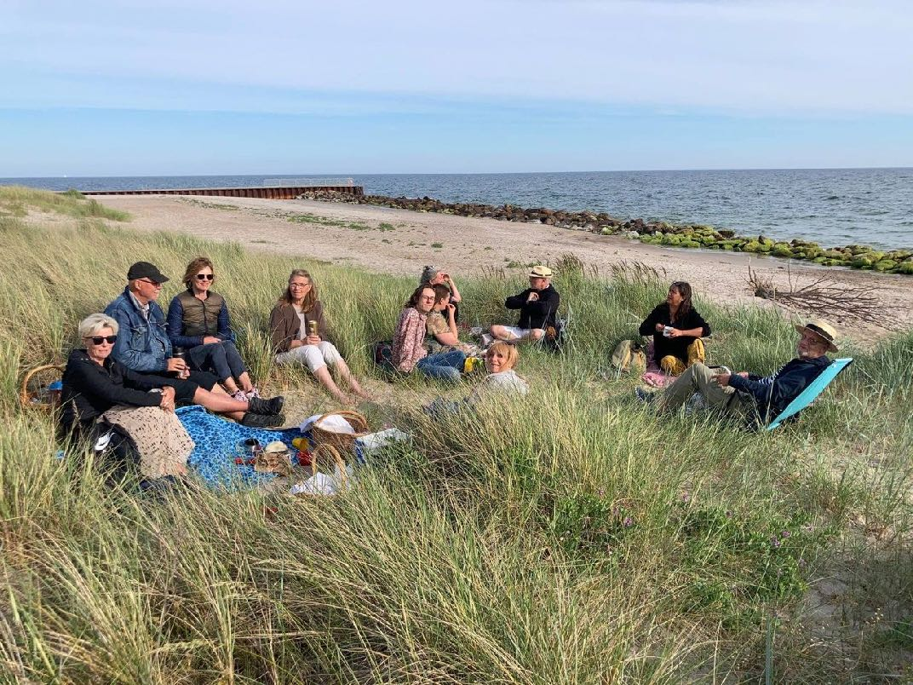
SOCIAL EVENTS AND NETWORKING

Slide 8
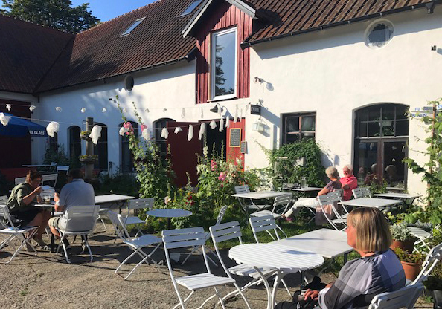
COOPERATION WITH THE HOSPITALITY INDUSTRY

Slide 9
LONG TERM GOALS
A permanent network/organisation for Cultural Practitioners in Österlen
Acknowledgment of Arts/Culture as sustainable businesses and a factor for regional development
Exended service and coaching for, and development of, the target group
Partnership between the Creative Sector and traditional businesses for mutual benefit
International cultural exchange

Slide 10
CONTACT
www.kulturnavetosterlen.se
info@kulturnavetosterlen.se
Susan Bolgar, susan.bolgar@kulturnavetosterlen.se, 0731-84 02 00
Anna-Carin Uggla, anna-carin.uggla@kulturnavetosterlen.se, 0700-30 32 03
Facebook: Kulturnavet Österlen

