Slide 1
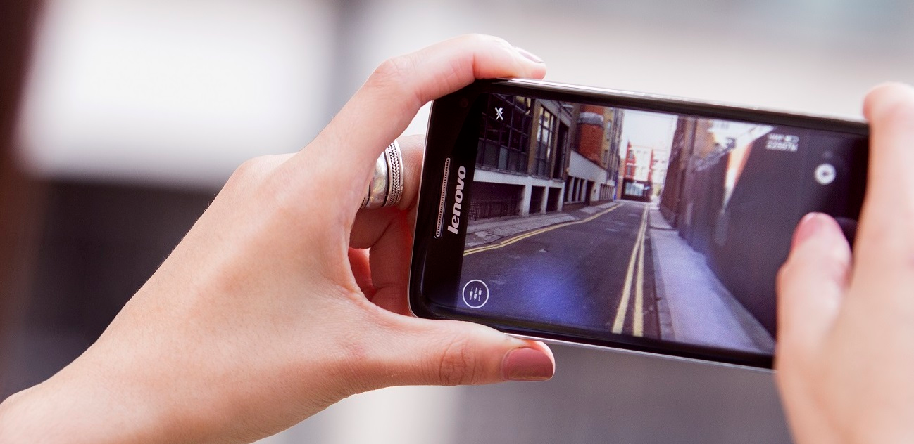
FILMEN MET SMARTPHONE / TOM RUMES

Slide 2

TRENDS

Slide 3
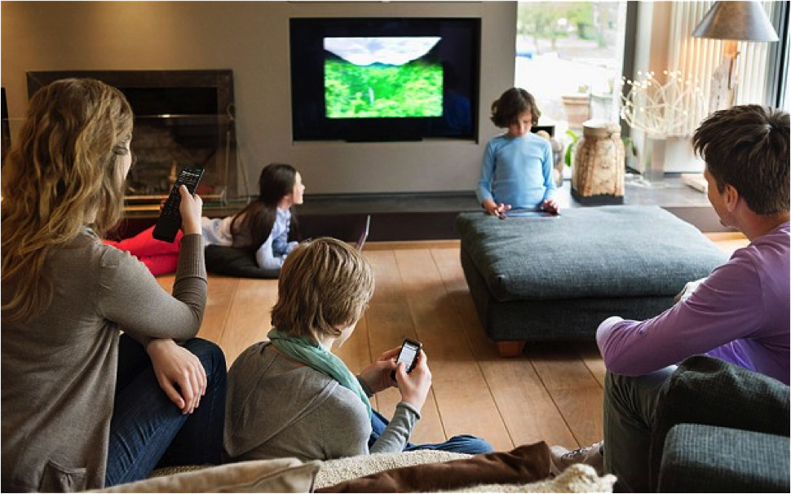
NEW MEDIA CONSUMPTION

Slide 4
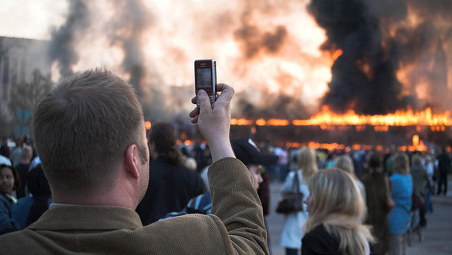
MOBILE FIRST

Slide 5
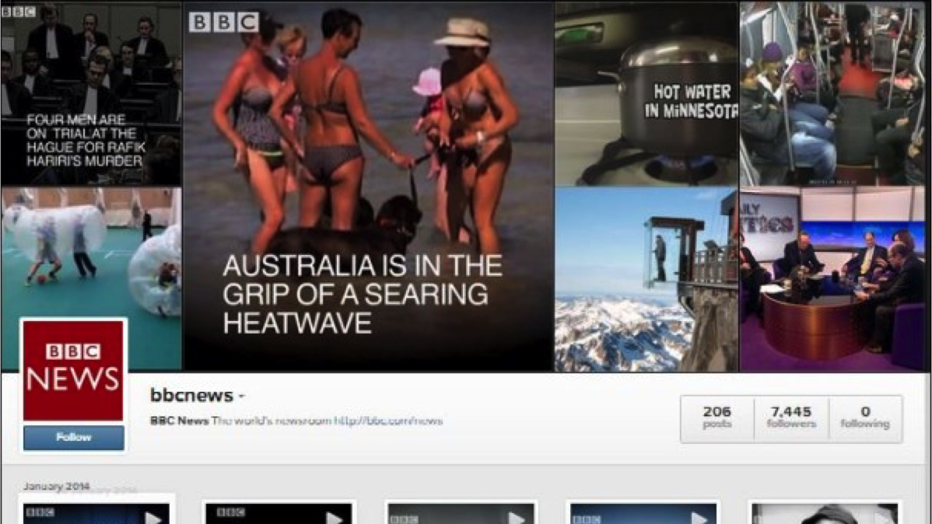
NEW PUBLICATION PLATFORMS

Slide 6
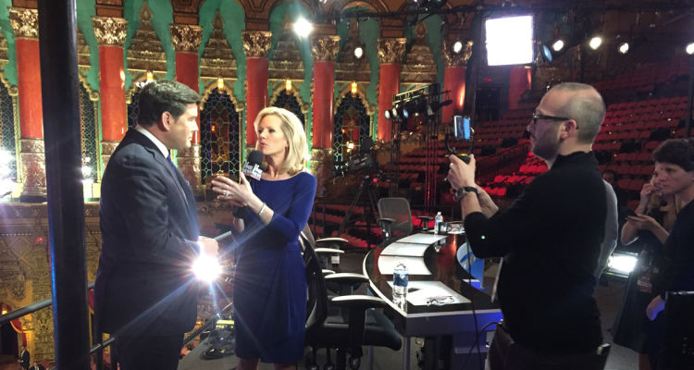
LIVESTREAMING WITHIN SOCIAL MEDIA

Slide 7
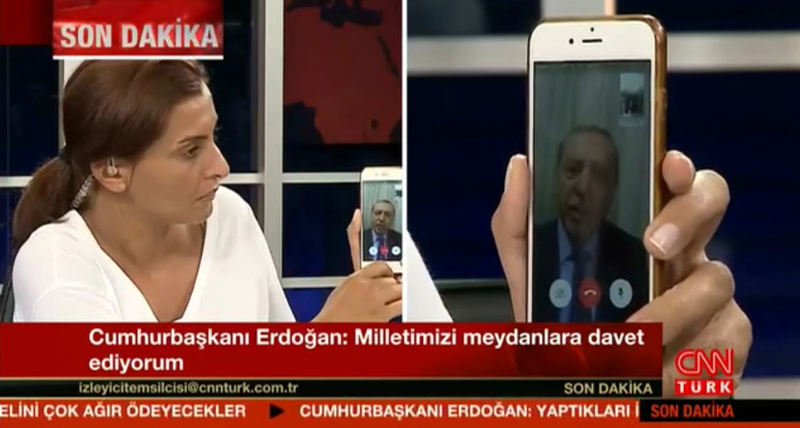
TRENDING TOPICS BECOME NEWS

Slide 8
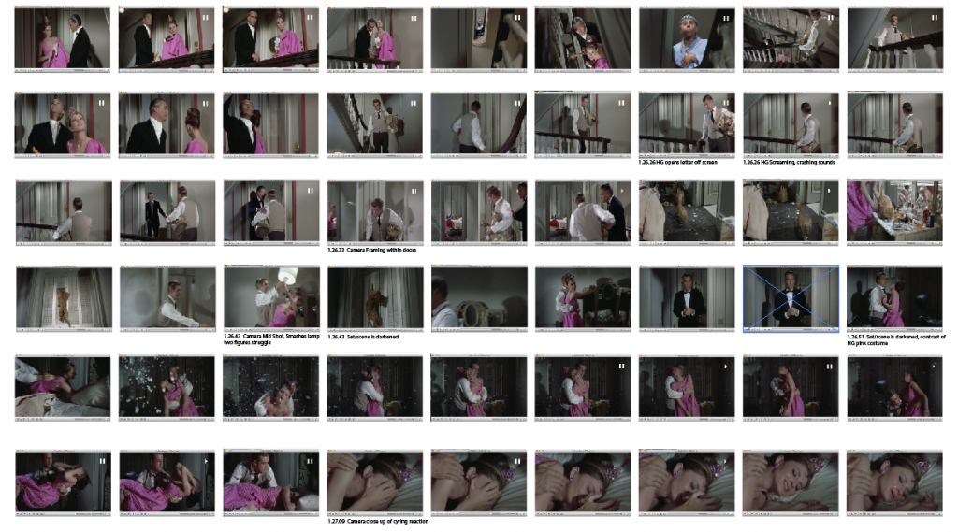
BEELDTAAL

Slide 9
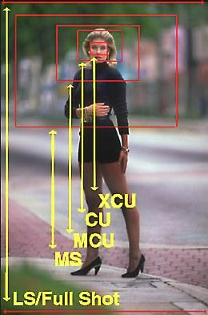
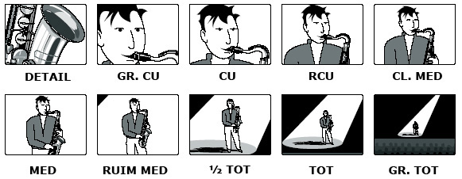
SHOTS

Slide 10
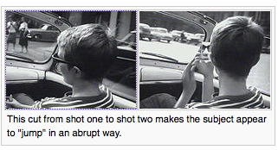

BEELDSPRINGER

Slide 11
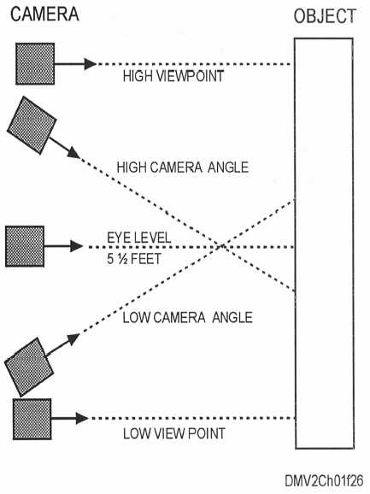
PERSPECTIEF

Slide 12
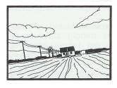
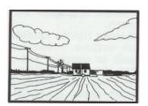
HORIZON

Slide 13
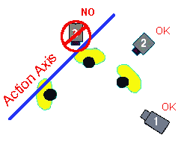
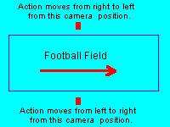
CAMERA AS

Slide 14
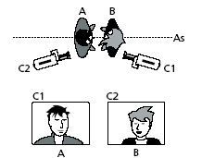
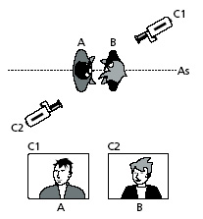

Slide 15
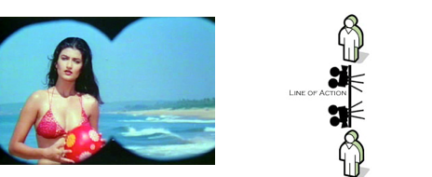
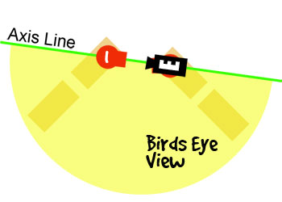
POINT OF VIEW

Slide 16
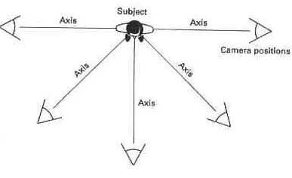
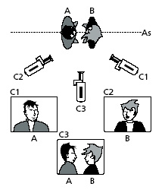


Slide 17
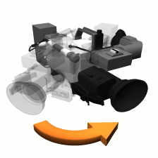
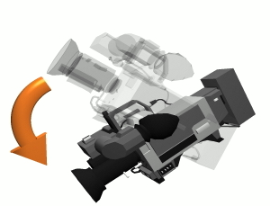
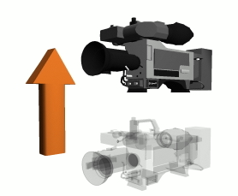
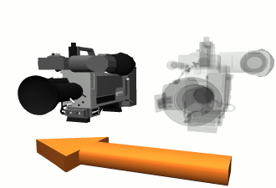
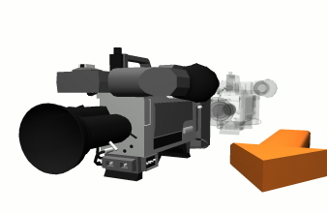
CAMERABEWEGINGEN

Slide 18
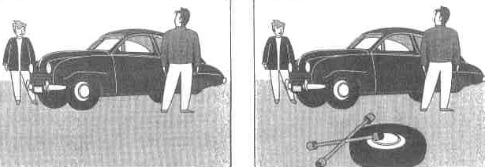
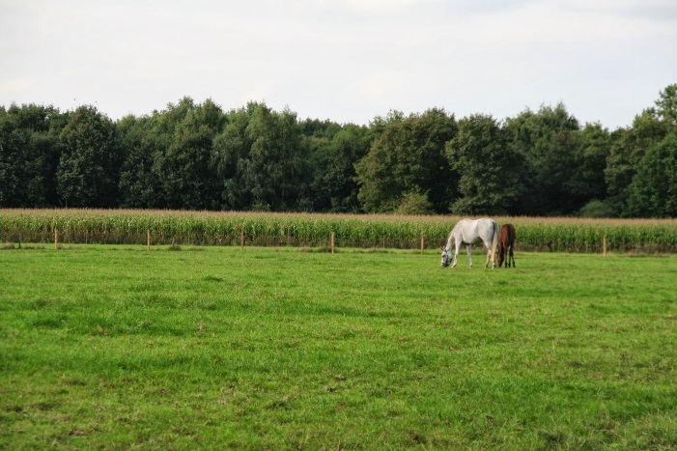
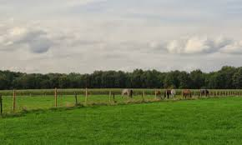
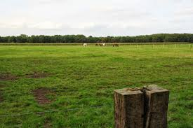
COMPOSITIE →DIEPTE

Slide 19
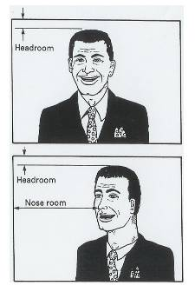
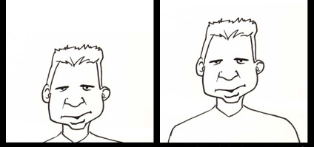
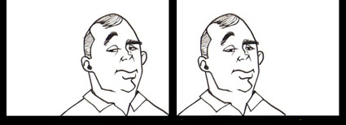
COMPOSITIE →HOOFDRUIMTE EN KIJKRICHTING

Slide 20
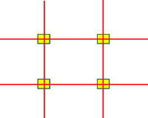
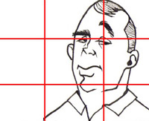
COMPOSITIE → GULDEN SNEDE

Slide 21
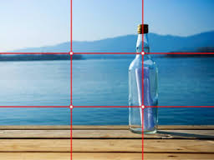
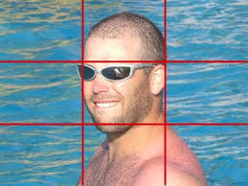


Slide 22
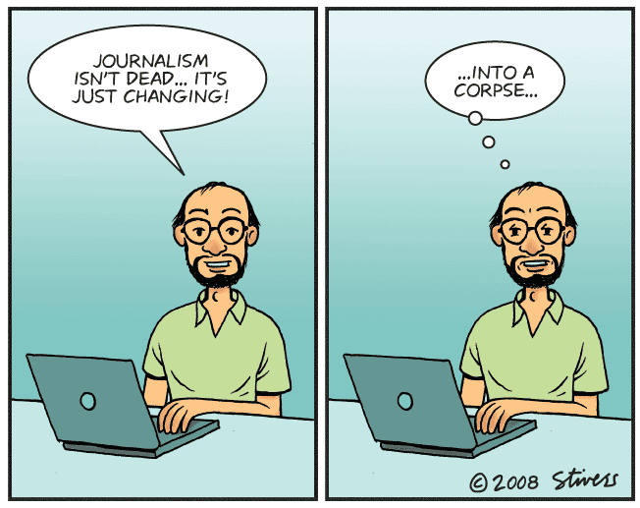
BASIC TIPS

Slide 23
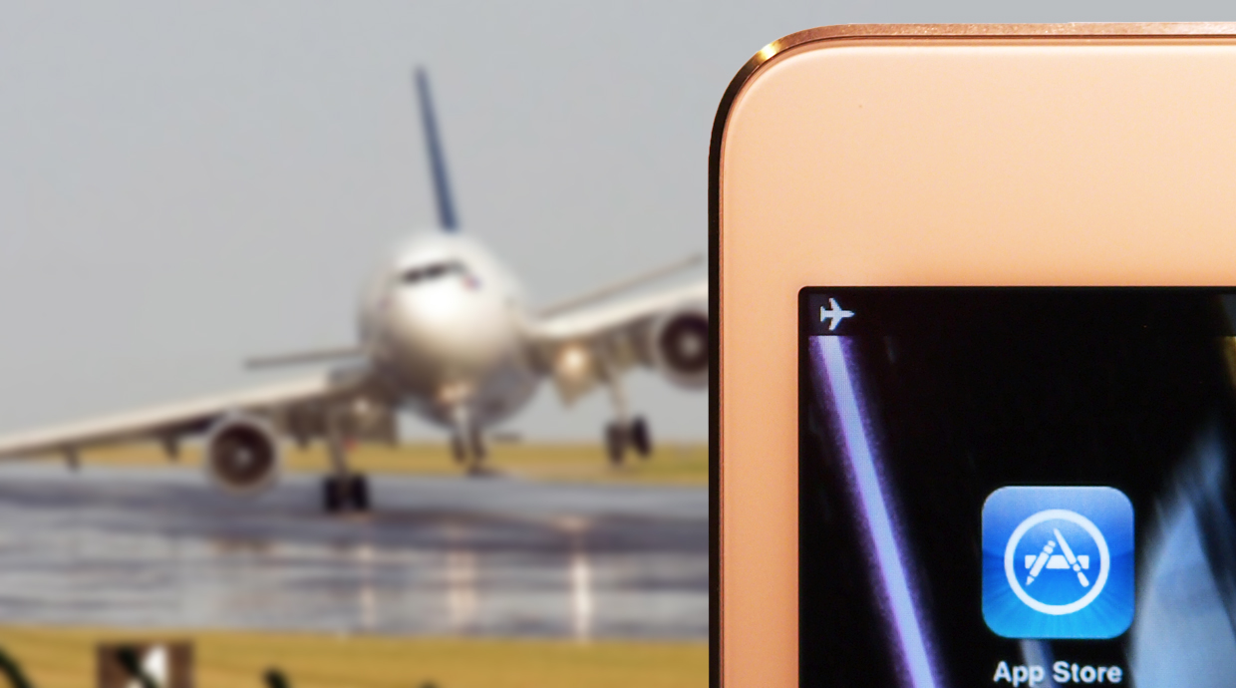
AIRPLANE MODE
Notes:
Start by putting your phone in airplane mode – this stops calls and app notifications coming through and interfering with your reporting, particularly if you're livestreaming.

Slide 24
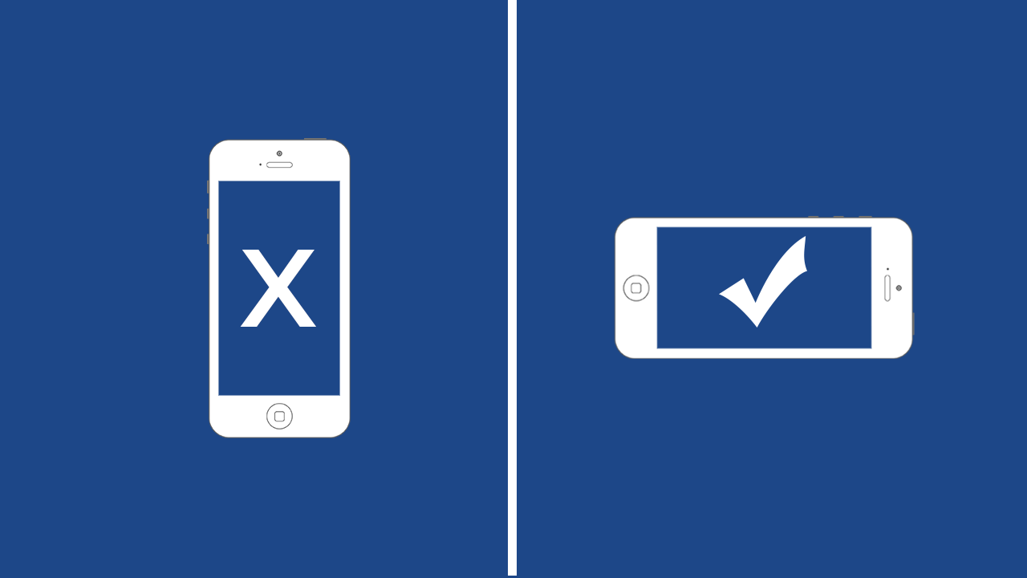
LANDSCAPE
Notes:
Hold your phone horizontally so your phone's home button is on the right hand-side. This prevents you from accidentally shooting upside down, which while a correctable error, it does mean you will have to spend additional time fixing it with editing software. And always film horizontally unless you're using an app that makes it impossible to do so, or filming specifically for an app designed for vertical video such as Snapchat.

Slide 25
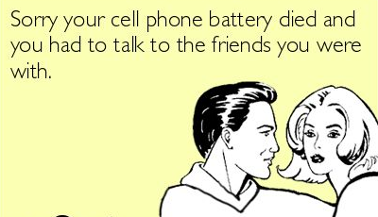
LOW BATTERY SYNDROME

Slide 26

FOCUS
Notes:
Clean your lens. It's not necessarily something smartphone users tend to do very often, but even a small speck of dust on your lens can compromise your shot.

Slide 27

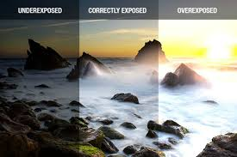
DIAFRAGMA

Slide 28
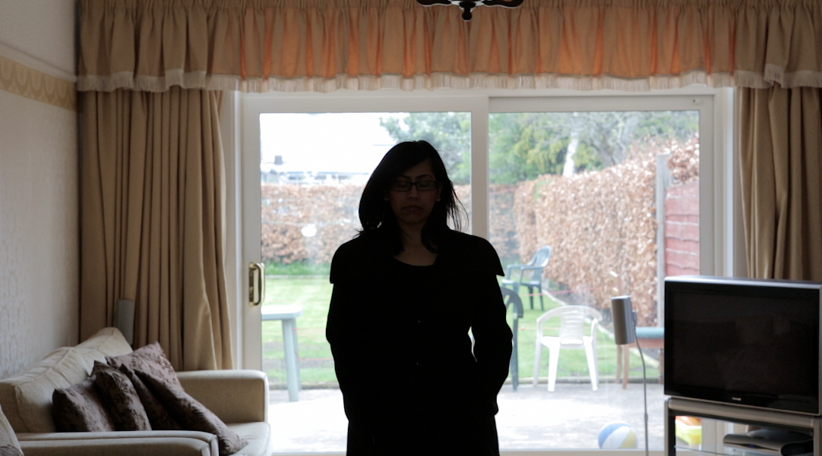
EXPOSURE
Notes:
Take a second each time to lock focus and exposure, adding that shifting focus mid-shot – which your phone is likely to do automatically – means your shot will look "a bit unsettled".

Slide 29
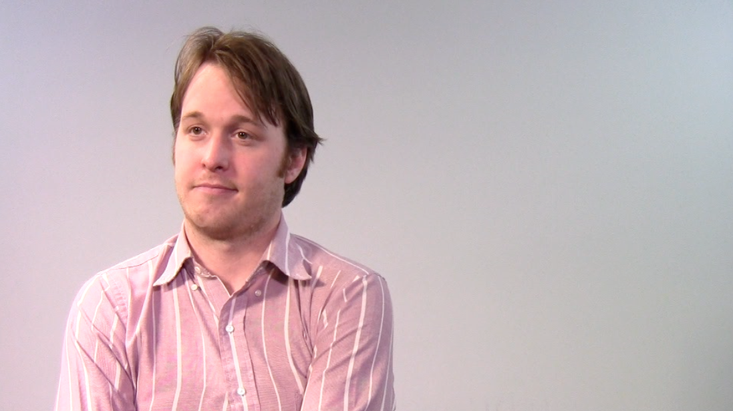
COMPOSITION
Notes:
get close to your subject when filming, as this will not only give you "a look that you can't often get with a big camera", but will also result in better audio if using the phone's internal microphone.
."
"Use the special touches that apps allow, such as timelapses or other features that will make your report look really special."

Slide 30
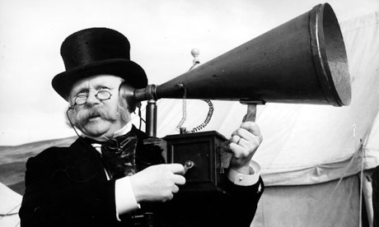
MIND THE … AUDIO
Notes:
check which microphone on your device actually records the audio, as it may be a different one when filming or taking calls.
If you're holding the phone in your hands during filming, make sure your hands aren't blocking the microphone.
If you're recording in a loud environment and have no external microphone, reach for a pair of standard headphones – they usually come with a microphone that can make a huge difference.
And if you're using an external microphone, plug it in before launching any apps to make sure it's detected and used

Slide 31
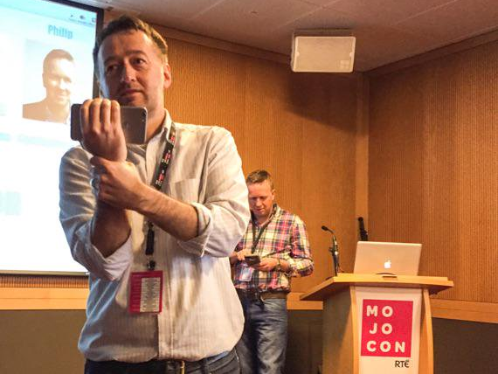
STABILIZE
Notes:
Finally, make sure your shot is stable. If there's no tripod on hand, here's a way to hold your phone that will help:

Slide 32
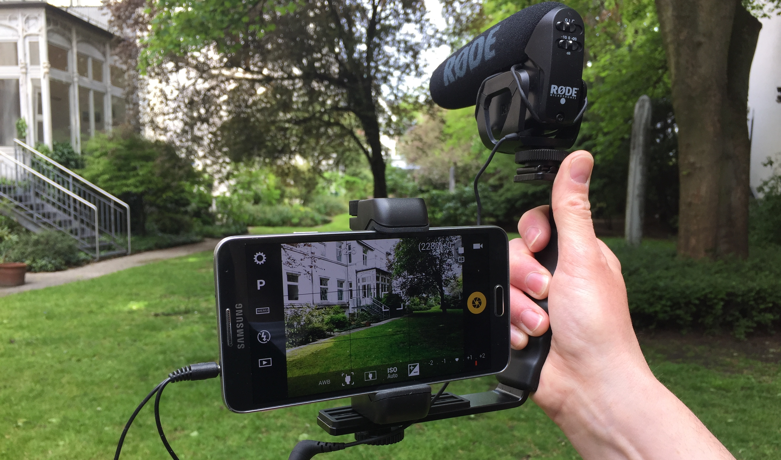
ACCESSORIES

Slide 33
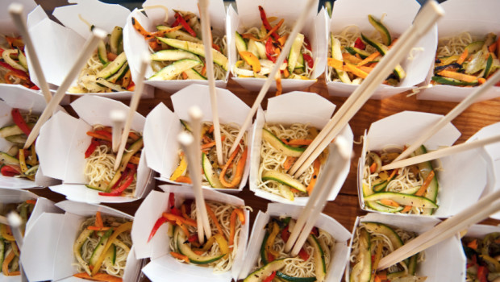
TAKE AWAYS

Slide 34
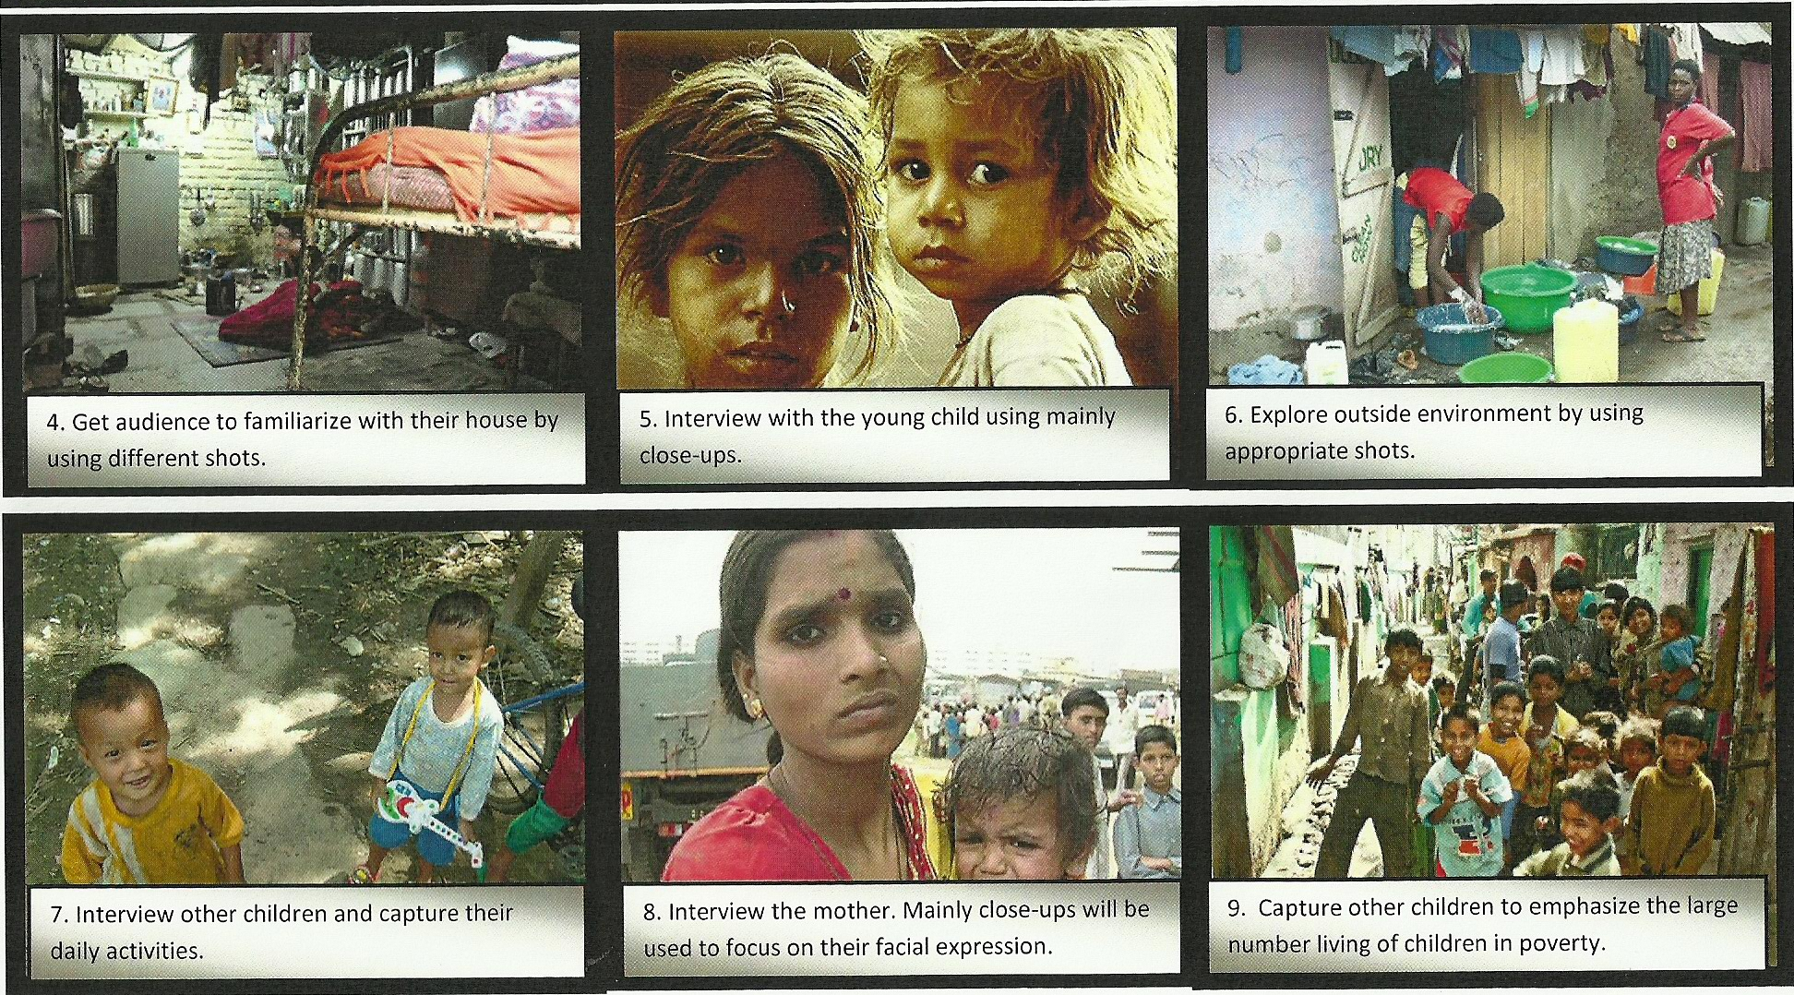
THINK IN SEQUENCES
Notes:
Film a variety of shots and different angles, You can also never have enough close-ups, film in sequences, which really help you to tell the story

Slide 35

WEAKNESSES

Slide 36
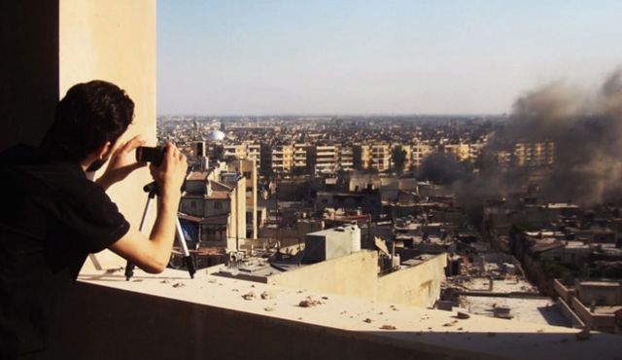
ADVANTAGES

Slide 37

SHOW YOU ARE MOBILE
Notes:
Use the special touches that apps allow, such as timelapses or other features that will make your report look really special.

Slide 38

SWISS ARMY KNIFE

Slide 39

APP WORLD

Slide 40

SMARTPHONE +

Slide 41

FIELD EDITING

