Slide 1
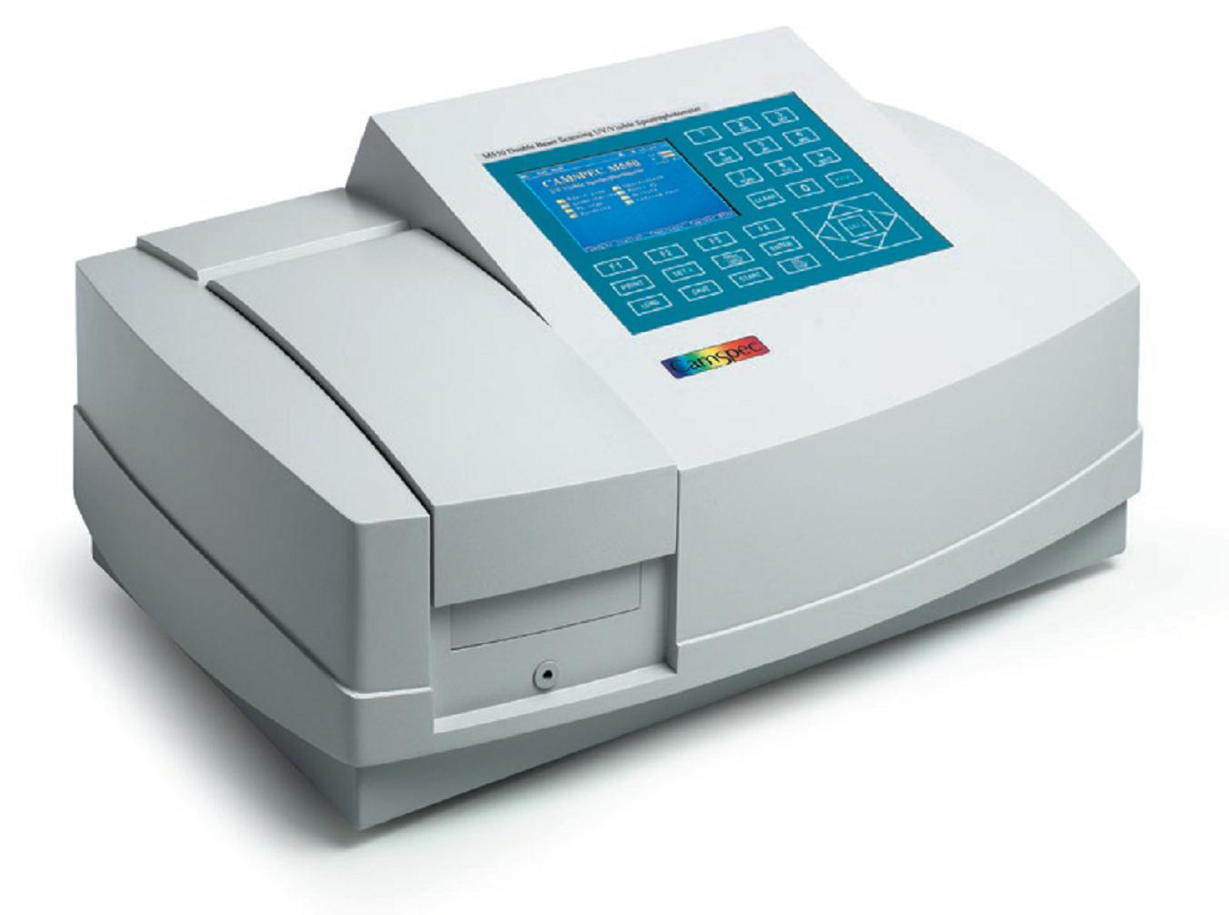
Introduction about Indirect Fotometric Measurement
Of
Glucose, Ethanol, Growth Rate by Optical Density
and CO₂-Production

Slide 2

Estimation of Glucose, Ethanol by Fotometry
Concentrations of glucose and ethanol will be measured by fotometry via enzyme kits.
It`s an indirect measurement because glucose and ethanol have no absorption in the ranges of visible or UV radiation.
Concentration is measured indirect by the absorption of Coenzyme NAD⁺ reduced to NADH + H⁺ at 340 nm by oxidizing glucose or ethanol in an enzyme reaction.

Slide 3
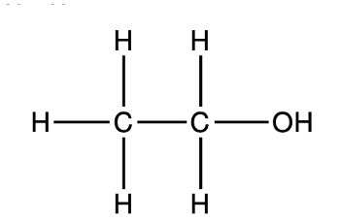
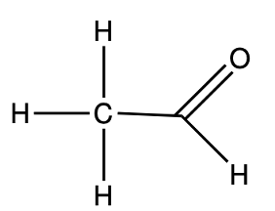
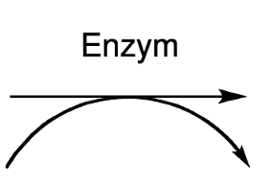


Estimation of Ethanol Concentration
ADH
Ethanol + NAD⁺ → NADH + H⁺ + Ethanal
-I
-I
+I
:
= 1 : 1
ADH: Alcohol Dehydrogenase or Dehydrogenase or Oxidoreductase

Slide 4
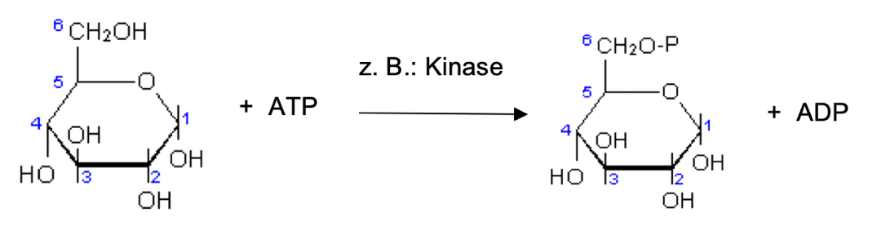
Estimation of Glucose Concentration
Reaction 1:
Kinase
Glucose + ATP → Glucose-6-Phosphate + ADP
Reaction 2:
Oxidase
Glucose-6-Phosphate Gluconat-6-Phosphate

Slide 5
Estimation of Glucose Concentration
Glucose + ATP → Glucose-6-Phophate + ADP →
Gluconat-6-Phophate
Kinase
Oxidase
NAD⁺ NADH + H⁺
Glucose : NADH + H⁺ = 1 : 1

Slide 6
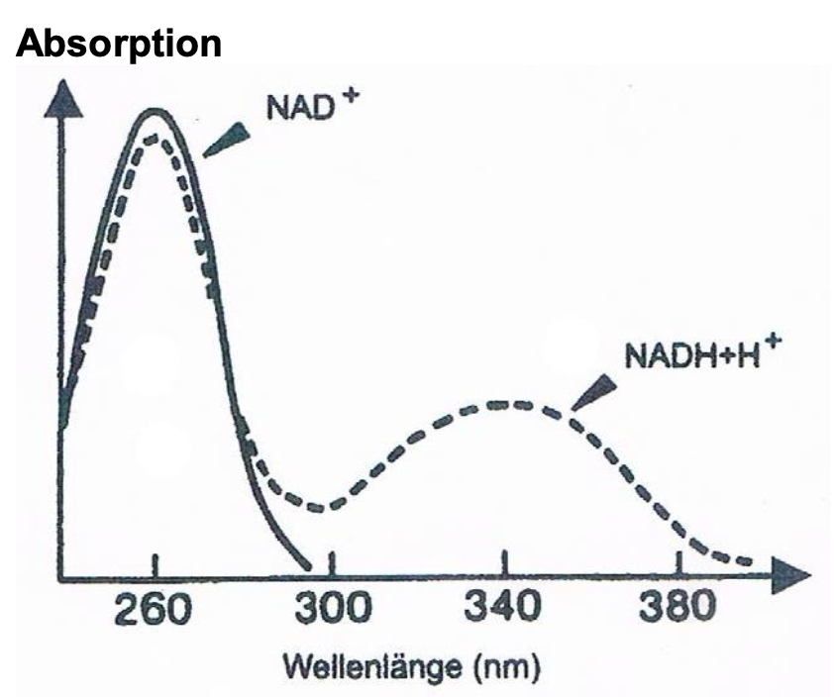
Absorptionspektra of NAD⁺ and NADH + H⁺
Measuring at
340 nm:
Highest Absorption
of NADH + H⁺
→ No Absorption of
NAD⁺.
Wavelength (nm)
Notes:
Direct measurment of glucose- or ethanol concentration by fotometry isn`t possible because both chemicals have no absorption either in the visible nor in the UV range.
But if there is existing a direct dependancy in the relation of glucose or ethanol to another reaction partner which has an absorption in the visible or UV range concentration of glucose and ethanol could be measured indirect by the relationship to the reaction partner.
The relationsship between metabolised glucose- or ethanol molecule and the produced NADH + H+ is in both test kits (see chemical equiations) 1 : 1.
Diagram shows that at 340 nm NAD+ isn´t absorbing UV light but NADH+H+ is highly absorbing UV light with a wavelength of 340 nm.

Slide 7
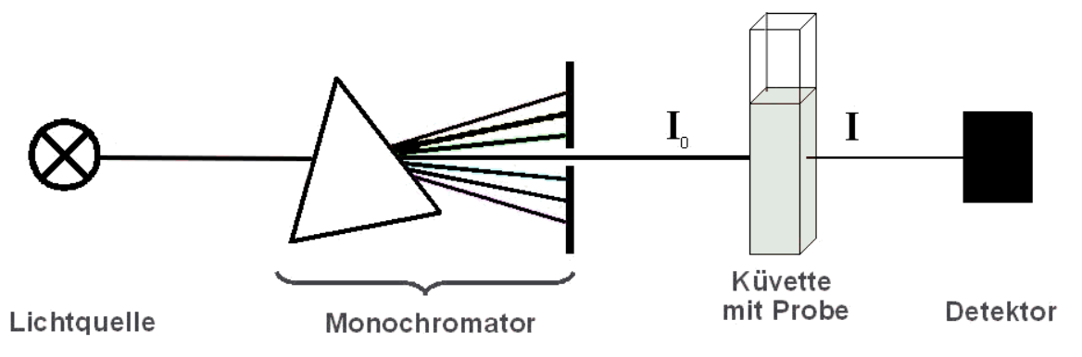
Absorptionsspektra of NAD⁺ und NADH + H
Fotometry Principe
Cuvette + sample
Detector
Fotocell
Light Source
Monochromator
E = ɛ ⋅ c ⋅ d
E ∼ c = f (I/I₀)

Slide 8
Estimation of Cell Mass by Optical Density
Cell mass (number of cells) is measured by optical density (OD) at 600 nm.
Optical density (OD) is a turbidity measurement at 600 nm
→ yeast cells don`t absorb light at
600 nm but they are scattering and
reflecting the light.

Slide 9
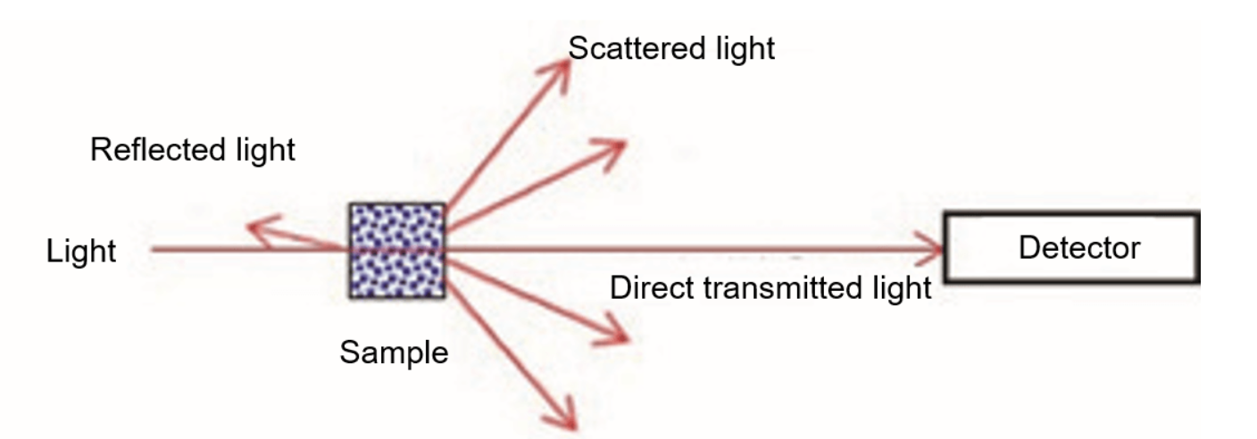
Estimation of Cell Mass by Optical Density (OD)
Light
600 nm (orange)
Sample containing yeast cells
Notes:
yeast cells in the sample don`t absorb light at 600 nm but they are scattering and reflecting the 600 nm, orange light.
As higher the number of yeast cells (produced biomass) as more light is reflected and scattered and as less light is direct transmitted and is reaching the detector.

Slide 10
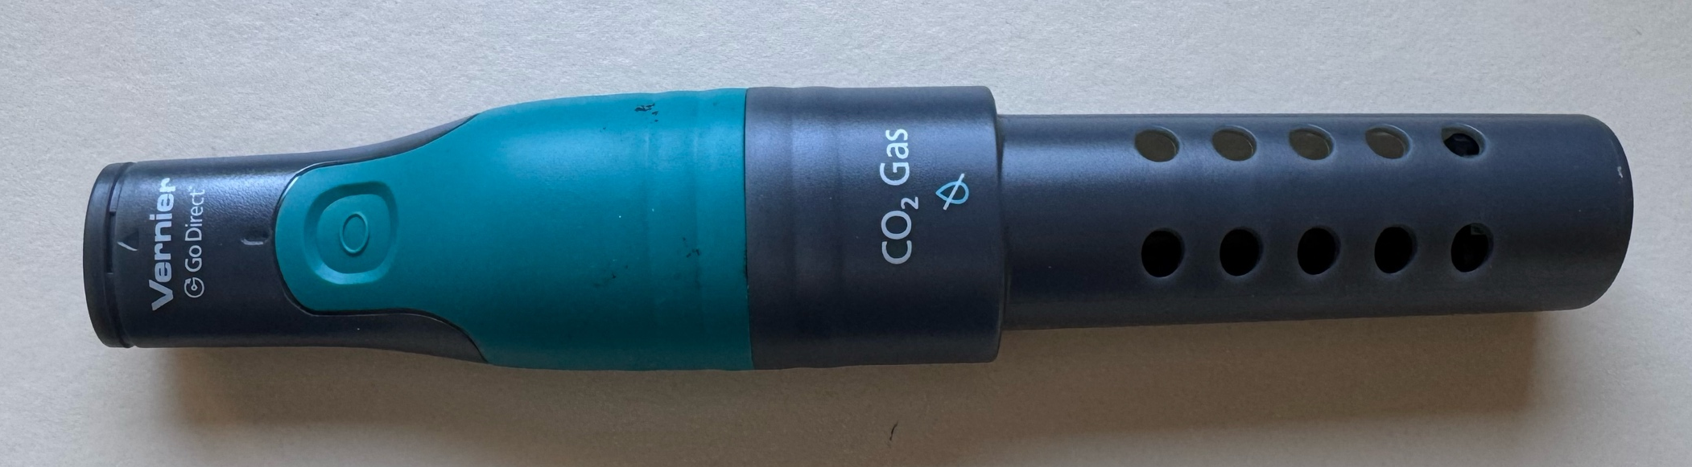
Estimation of CO₂-Production
CO₂ in parts per million (ppm) is measured by a CO₂ sensor.

