Slide 1
Summary of Results From Group 7

Slide 2
Group Members
Group Members
Emirhan Yaşar
Lucia Bizoňová
Tereza Treskova

Slide 3
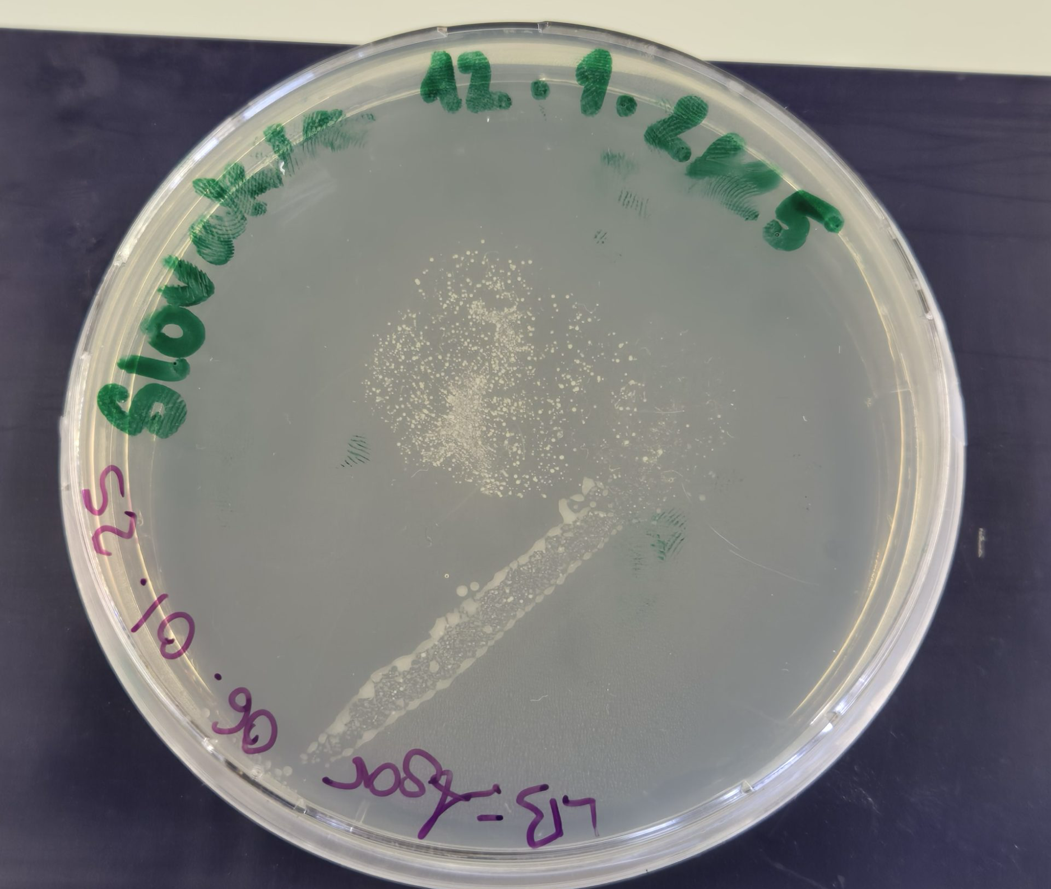
Photo of petri dish with investigated microbiome

Slide 4
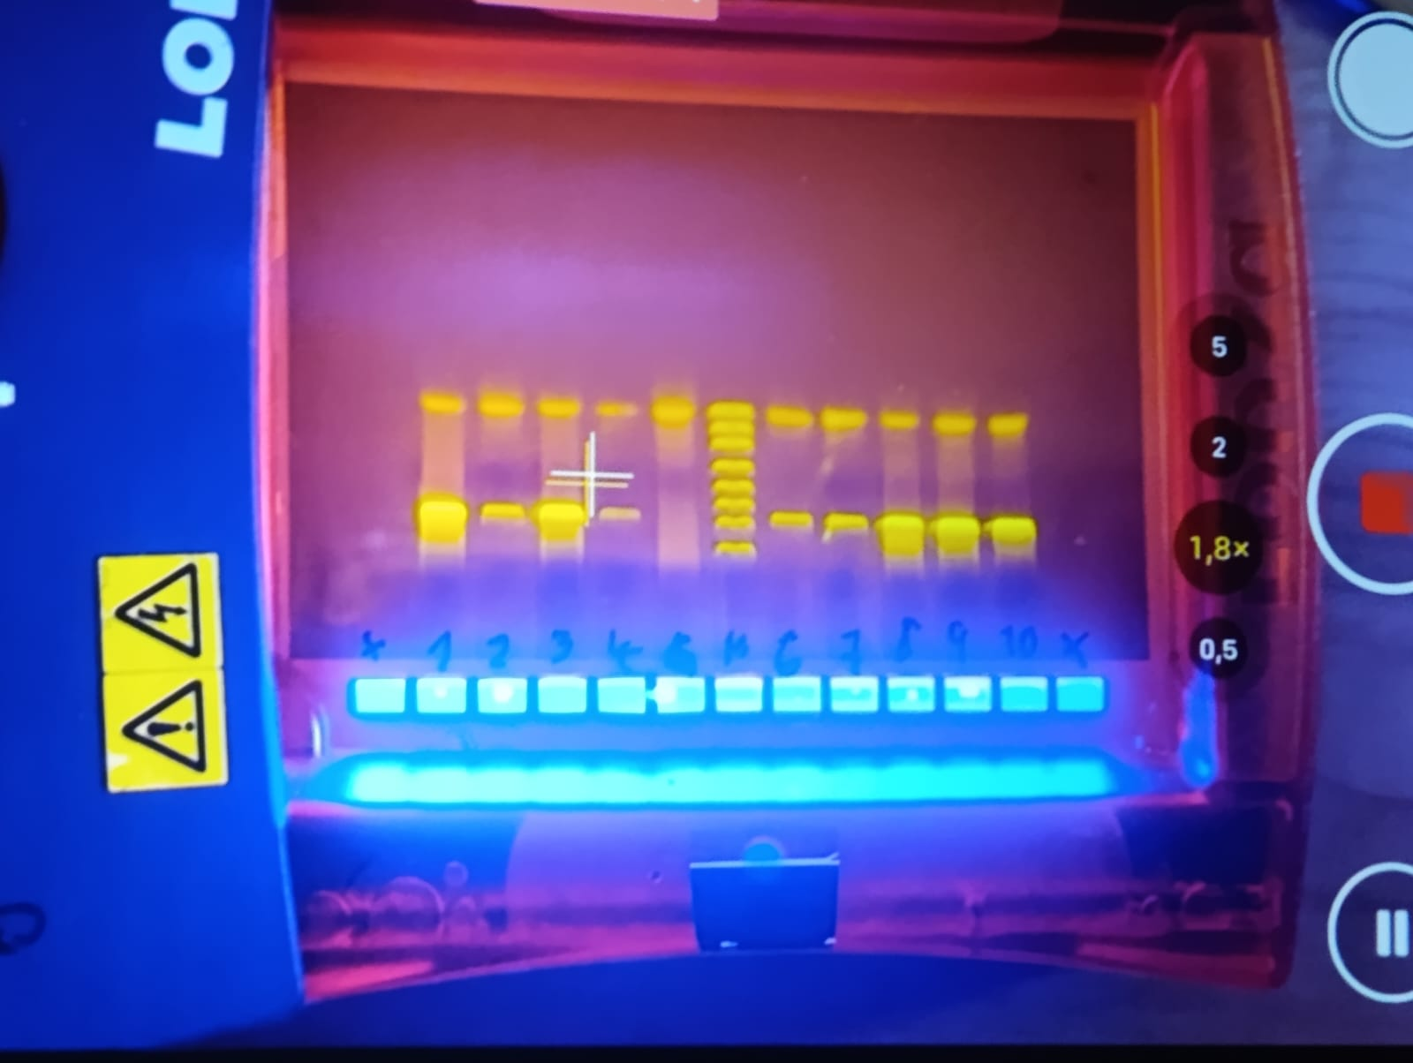
PCR Results - Gel Electrophoresis
Observation: we see a band on - 1500 bp, and primers at the top
Evaluation: the 16S gene was amplified
Conclusion: the PCR was successful
M
G7

Slide 5
Evaluation by Epi2ME
Observation: the system read the DNA of our sample
Evaluation: the quality is between 9-16, the length of reads was around 1.6 kb
Conclusion: we can continue with investigating the species of bacteria

Slide 6
Evaluation by Epi2ME
Observation: the system identified particular species of bacteria
Evaluation: the system identified mostly Bacillus subtilis, Staphylococcus warneri, S. hominis, S. epidermidis, S. aureus
Conclusion: Staphylococcus genus are common on the skin, but Bacillus subtilis is not common on the skin, mostly common on the soil and the plants

Slide 7
Top 5 Represented Bacteria
Order | Name | Quantity
1. | Bacillus subtilis | 46
2. | Staphylococcus hominis | 36
3. | Staphylococcus warneri | 33
4. | Staphylococcus epidermidis | 23
5. | Staphylococcus aureus | 15

Slide 8
Thanks For Your Attention

