Slide 1
Summary of results from group 21

Slide 2
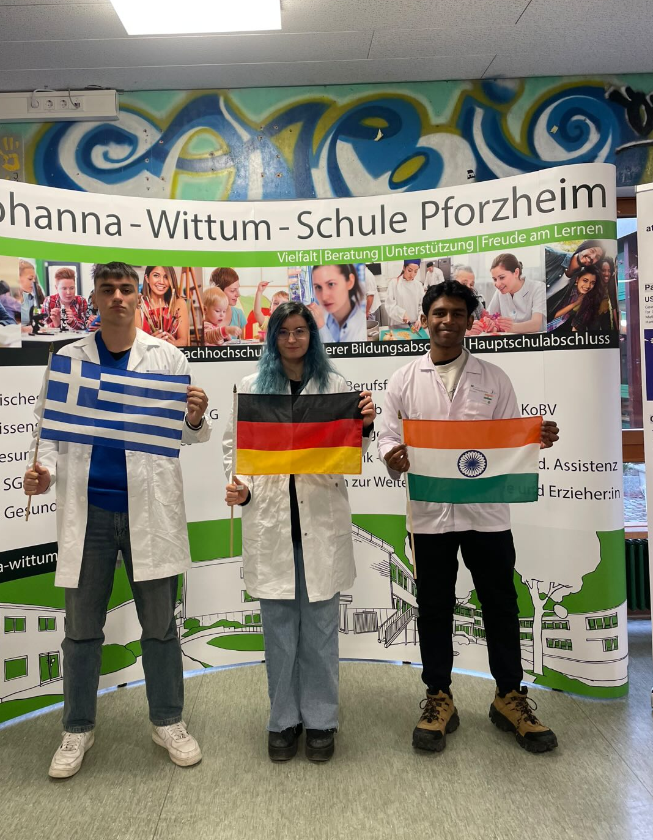
Work Group No 21
Krishang Mudaliar
Indian
George Tefarakis
Greek
Tanya Kyurkchieva
German
„flag“
„flag“
„group picture“
„flag“

Slide 3
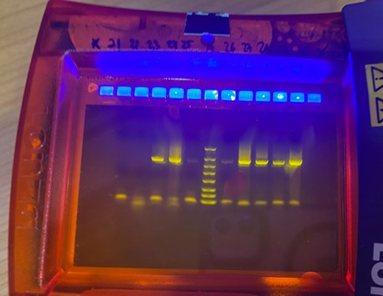
PCR Result – Gel Electrophoresis
OBSERVATION: we don´t see a band on ∼ 1500 bp, and there is presence of primers at the bottom
EVALUATION: the 16S rRNA gene was not amplified
CONCLUSION: the PCR was not successful

Slide 4
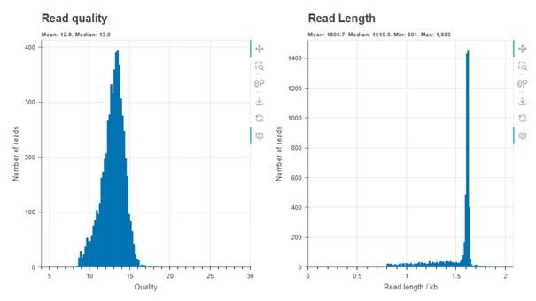
Evaluation by Epi2ME
OBSERVATION: the system read our DNA
EVALUATION: number of reads around 400 at 1400 bps ,0.8 to 1.7 kb length and quality was estimated around 8 to 17. The Median was 12.5.
CONCLUSION: we can continue with investigating the species of bacteria

Slide 5
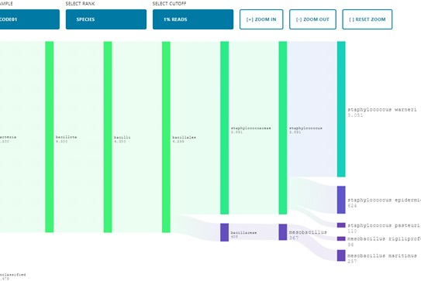
Evaluation by Epi2ME
OBSERVATION: the system identified particular species of bacteria
EVALUATION: (Varieties and their Quantification)
Staphylococcus werneri (3,051)
Staphylococcus epidermidis(624)
CONCLUSION: we conclude our sample was taken from Europe, North America and Mediterranean

Slide 6
Top 5 represented bacteria for the Indian Microbiome
order | name | quantity [No. of Reads]
1. | Staphylococcus werneri | 3,051
2. | Staphylococcus epidermidis | 624
3. | Mesobacillus maritimus | 257
4. | Staphylococcus pasteuri | 110
5. | Mesobacillus rigiliprofundi | 96
Notes:
N is an absolute number

Slide 7
Microbiome Samples from India (After arriving in Germany)
BEFORE
order | Name | quantity [% or n]
1.
2.
3.
4.
5.
AFTER
order | name | quantity [No. of Reads]
1. | Staphylococcus werneri | 3,051
2. | Staphylococcus epidermidis | 624
3. | Mesobacillus maritimus | 257
4. | Staphylococcus pasteuri | 110
5. | Mesobacillus rigilprofundi | 96

Slide 8
Thank you for your attention!

