Slide 1
Summary of Results from Group 8
Investigated Microbiome India after Arrival

Slide 2
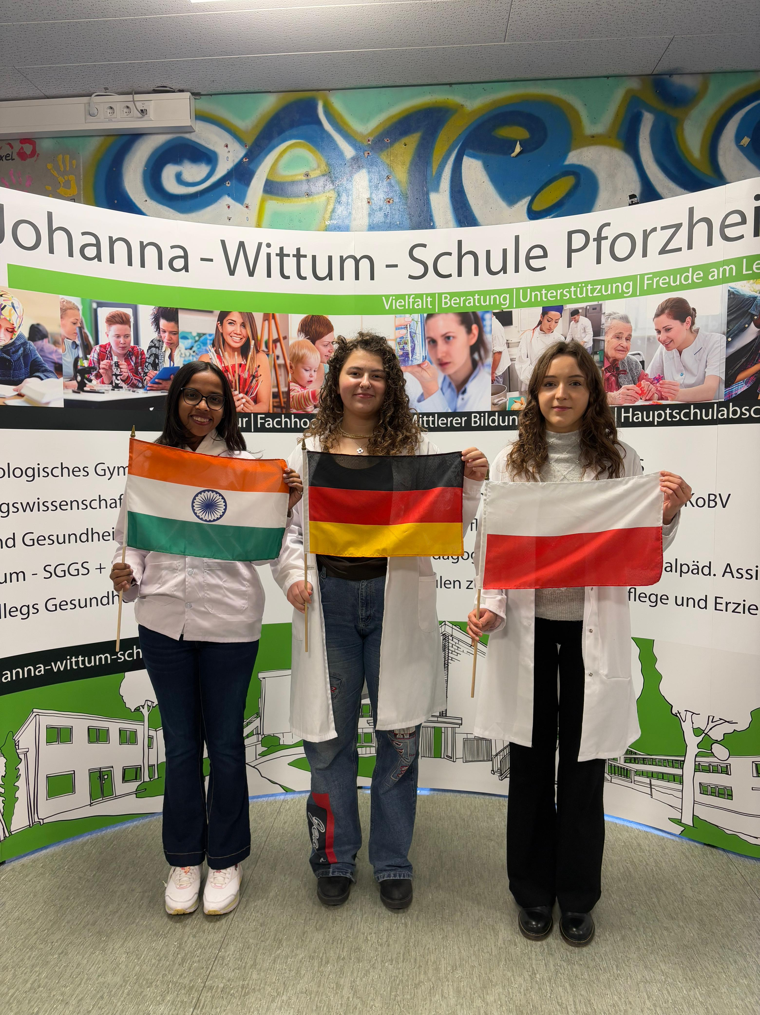
Group no. 8
Oliwia Olczyk
Poland
Nabhangi Deshkar
India
Selin Müller [Mentor]
Germany

Slide 3
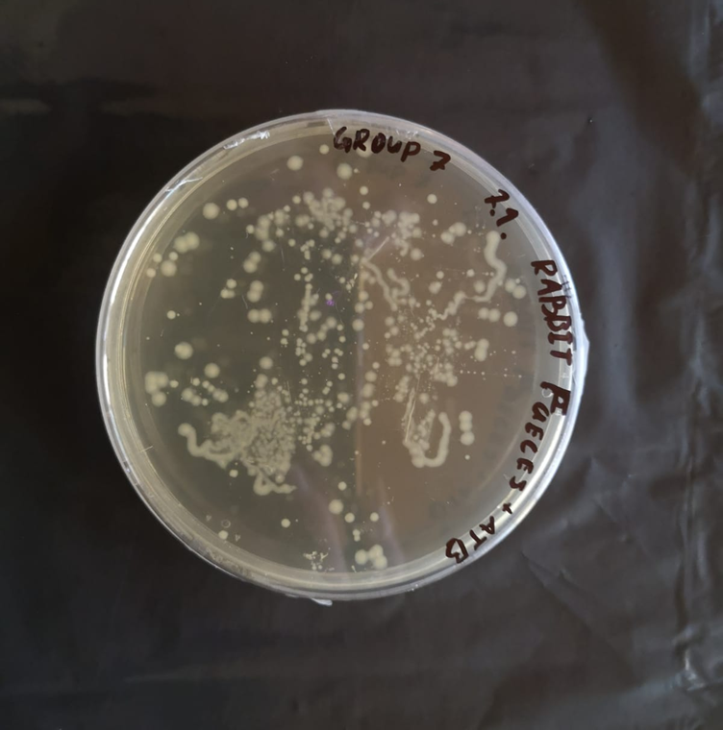
Photo of petri dish with investigated microbiome from Indian students taken in Germany
Notes:
Groups with finger microbiome have the information which sample did they get
Groups with different microbiome have to figure out which sample they got, so the name on the petri dish should be hidden

Slide 4
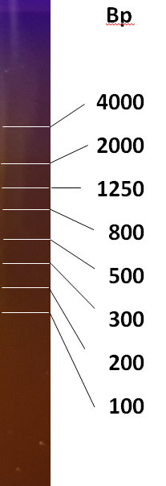
PCR Result – Gel Electrophoresis
OBSERVATION: we see a band on ∼ 1500 bp and primers at the bottom
EVALUATION: the 16S rRNA gene was amplified
1500 bp
CONCLUSION: the PCR was successfull
G8
M

Slide 5
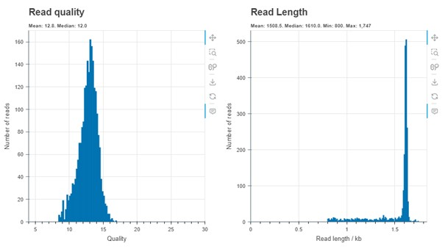
Evaluation by Epi2ME
OBSERVATION: the system read our DNA
EVALUATION: read length
[~1.6 kb] and read quality [12.8]
CONCLUSION: we can continue with investigating the species of bacteria

Slide 6
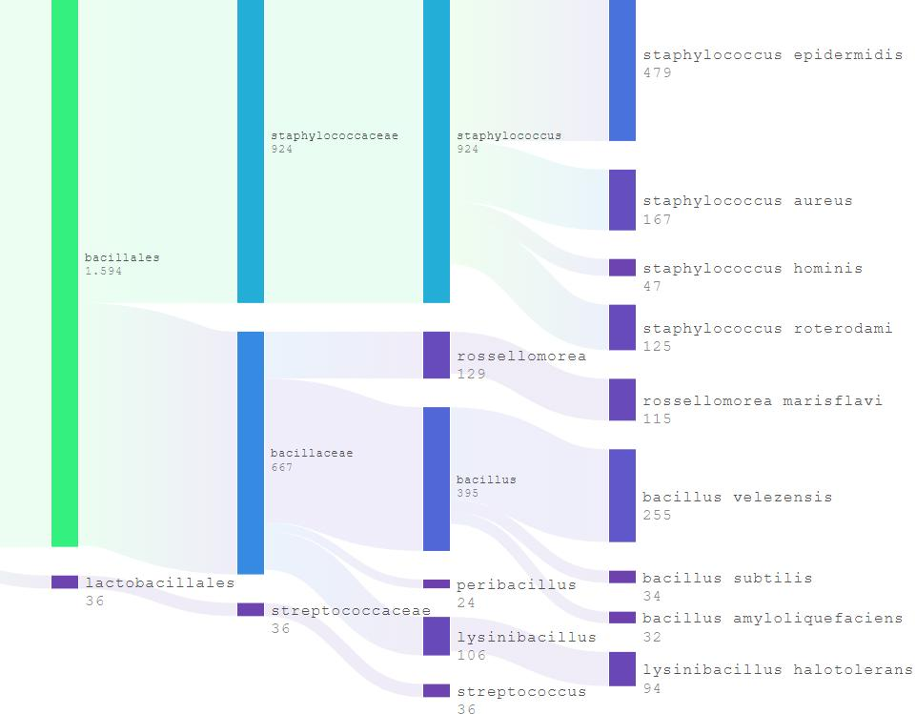
Evaluation by Epi2ME
OBSERVATION: the system identified species of bacteria: Staphylococcus and Bacillus
EVALUATION: amount of different bacteria (9), names of the species with higher representation, quantity
CONCLUSION: we conclude our sample was taken from the right thumb of students from India in Germany

Slide 7
Top 5 represented bacteria
order | name | quantity [% or n]
1. | Staphylococcus epidermidis | 479
2. | Bacillus velezensis | 255
3. | Staphylococcus aureus | 167
4. | Staphylococcus roterodami | 125
5. | Rossellomorea marisflavi | 115
Notes:
N is an absolute number

Slide 8
Comparison of finger microbiomes depending on location
BEFORE
order | name | quantity [% or n]
1.
2.
3.
4.
5.
AFTER
order | name | quantity [% or n]
1. | Staphylococcus epidermidis | 479
2. | Bacillus velezensis | 255
3. | Staphylococcus aureus | 167
4. | Staphylococcus roterodami | 125
5. | Rossellomorea marisflavi | 115

Slide 9
Thank you for your attention!

