Slide 1
Group 38 Results
Investigated Microbiome: Czech sourdough microbiome

Slide 2
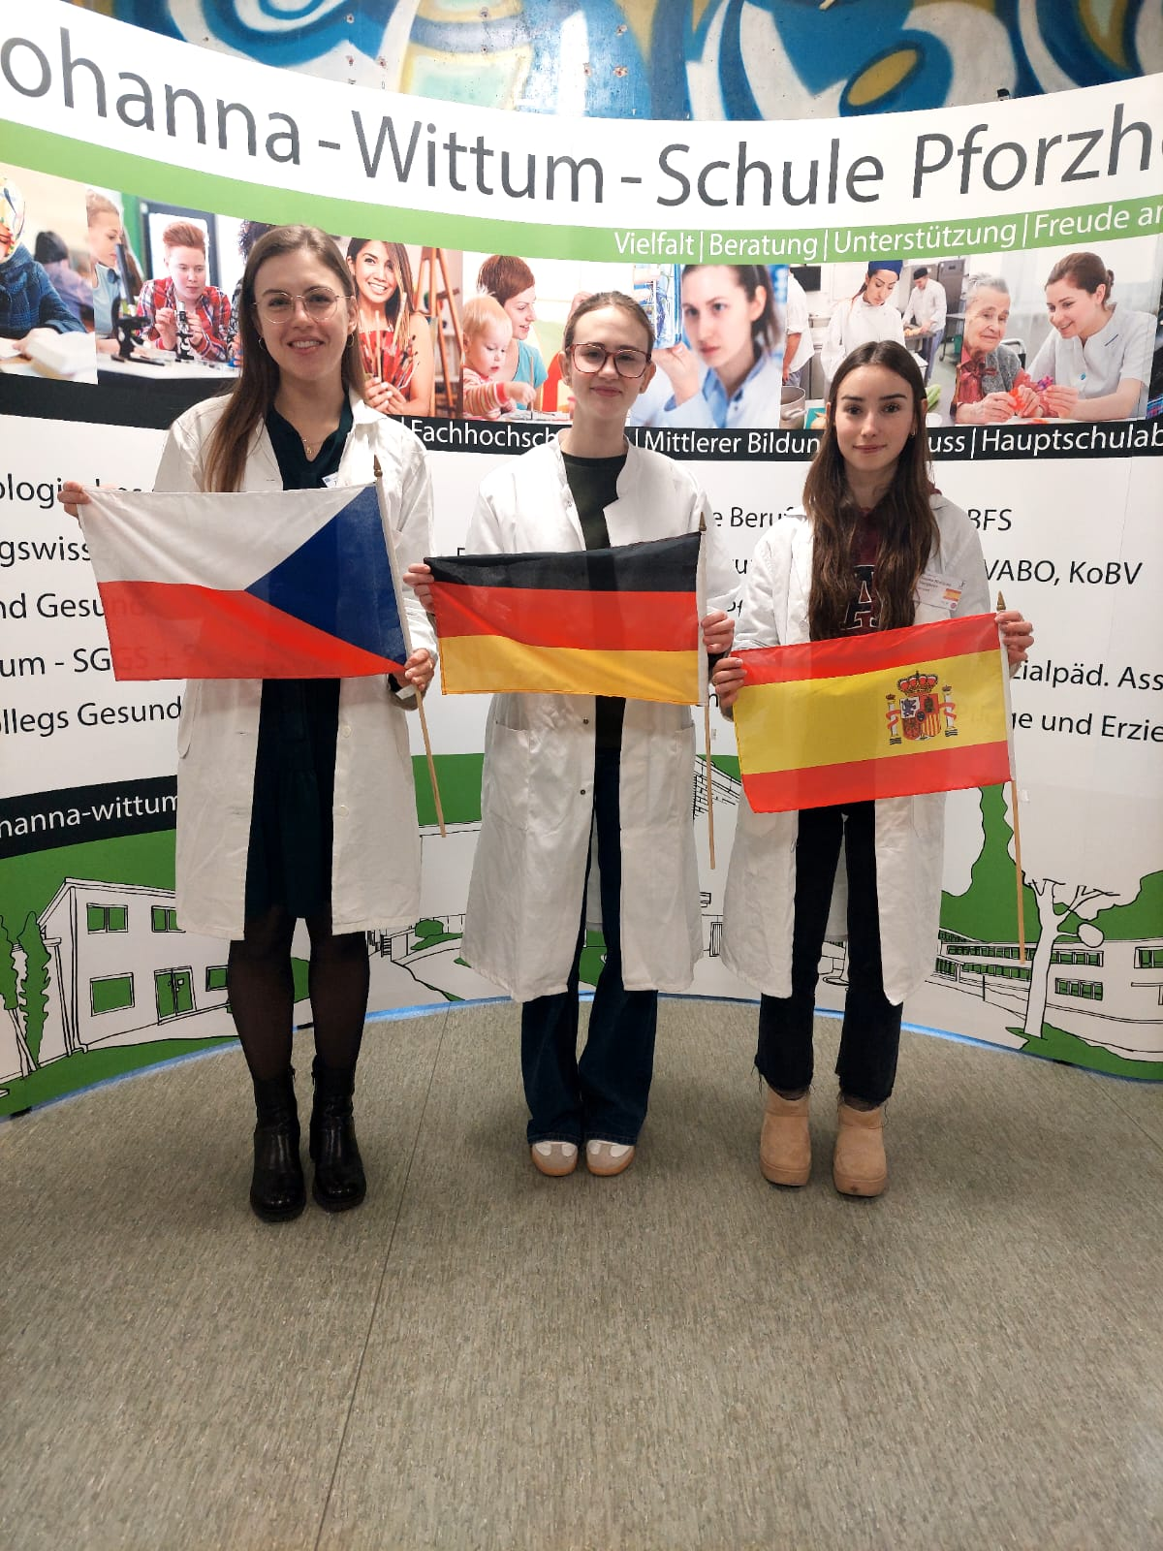
Work group 38 + presentation of group members
Paula Bräuner (mentor)
German
Zuzana Žáčková (teacher)
Czech
Daniela Rodriguez
Marigomez (student)
Spanish

Slide 3
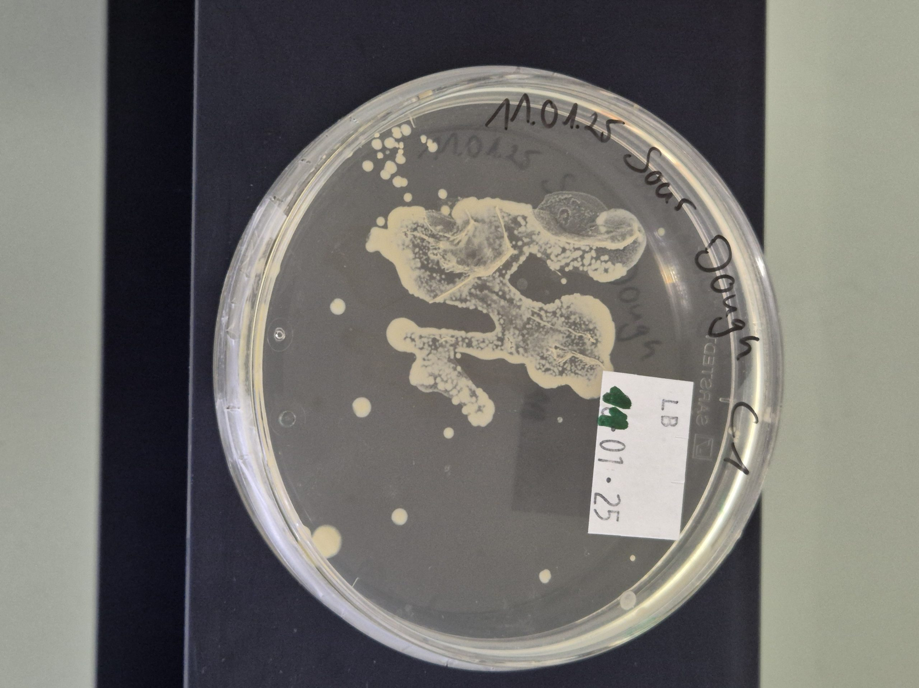
Petri dish with Czech sourdough microbiome
Notes:
Groups with finger microbiome have the information which sample did they get
Groups with different microbiome have to figure out which sample they got, so the name on the petri dish should be hidden

Slide 4
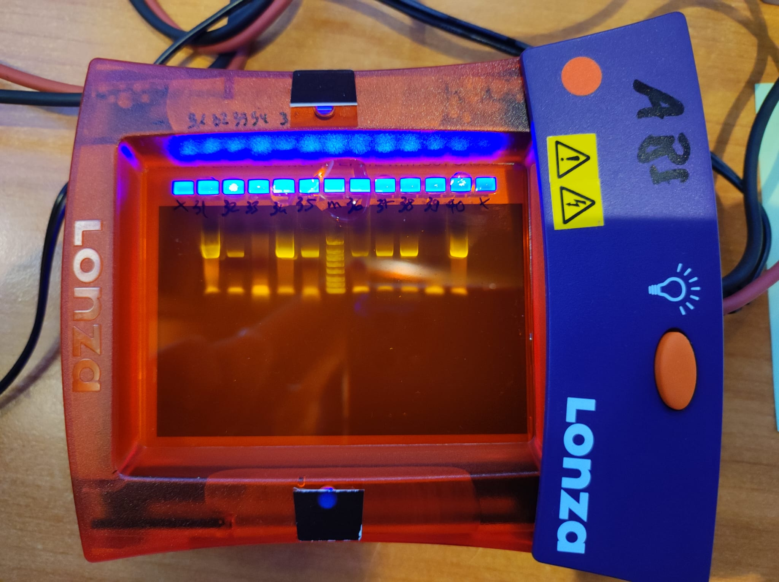
PCR Result – Gel Electrophoresis
OBSERVATION: we see a band on ∼ 1500 bp, and primers at the bottom
¨M
38
EVALUATION: the 16S gene was amplified
CONCLUSION: the PCR was successfull

Slide 5
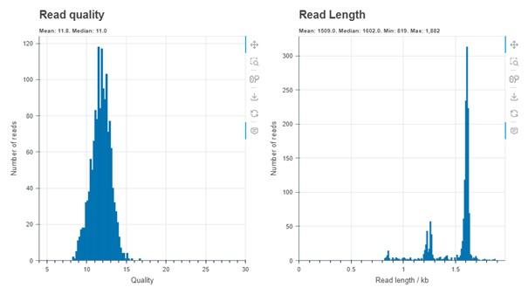
Evaluation by Epi2ME
OBSERVATION: the system read our DNA
EVALUATION:
read quality is mostly between 9 and 15
Read length is mostly between 1500 and 1700
CONCLUSION: reads were successful, so we can continue with investigating the species of bacteria

Slide 6
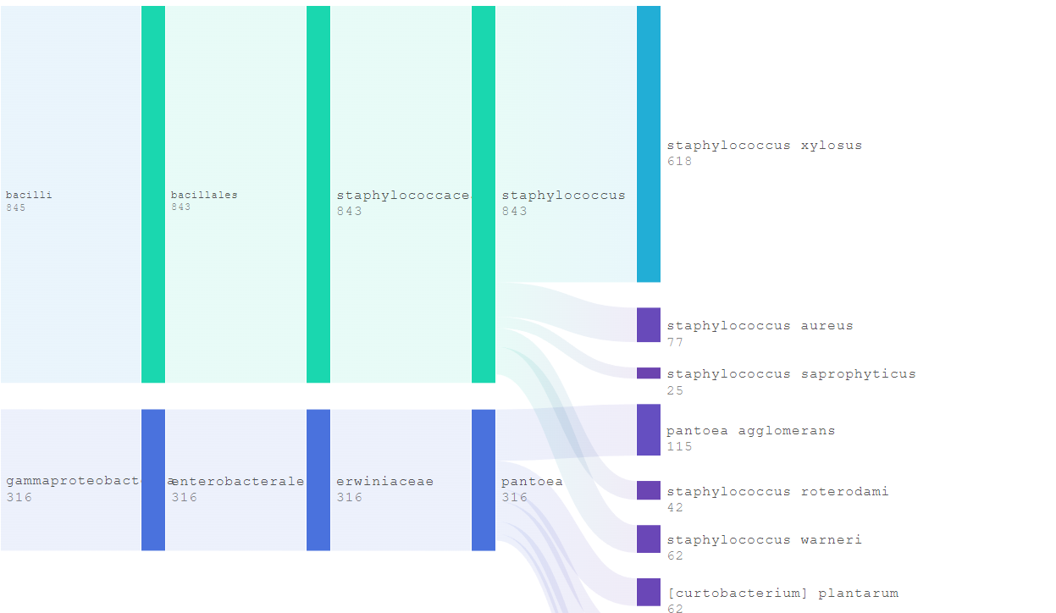
Evaluation by Epi2ME
OBSERVATION: the system identified particular species of bacteria
EVALUATION: 7 species of bacteria were found and the most bacteria belong to the species staphylococcus xylosus, staphylococcus aureus and pantoae agglomerans
CONCLUSION: we know our sample was taken from sourdough, so all the bacteria species can be found in the plants and soil

Slide 7
Top 5 represented bacteria
order | name | quantity
1. | staphylococcus xylosus | 618
2. | pantoea agglomerans | 115
3. | staphylococcus aureus | 77
4. | staphylococcus warneri | 62
5. | (curtobacterium) planatrum | 62
Notes:
N is an absolute number

Slide 8
Thank you for your attention!

