Slide 1
Summary of Results from Group 27
Investigated Microbiome Mock Standard

Slide 2
Group number 27
Pruthvi Appa Karande
Indian
Xiaolu Ma
Chinese
Danica Antunovic
Germany
„flag“
„flag“
„group picture“
„flag“

Slide 3
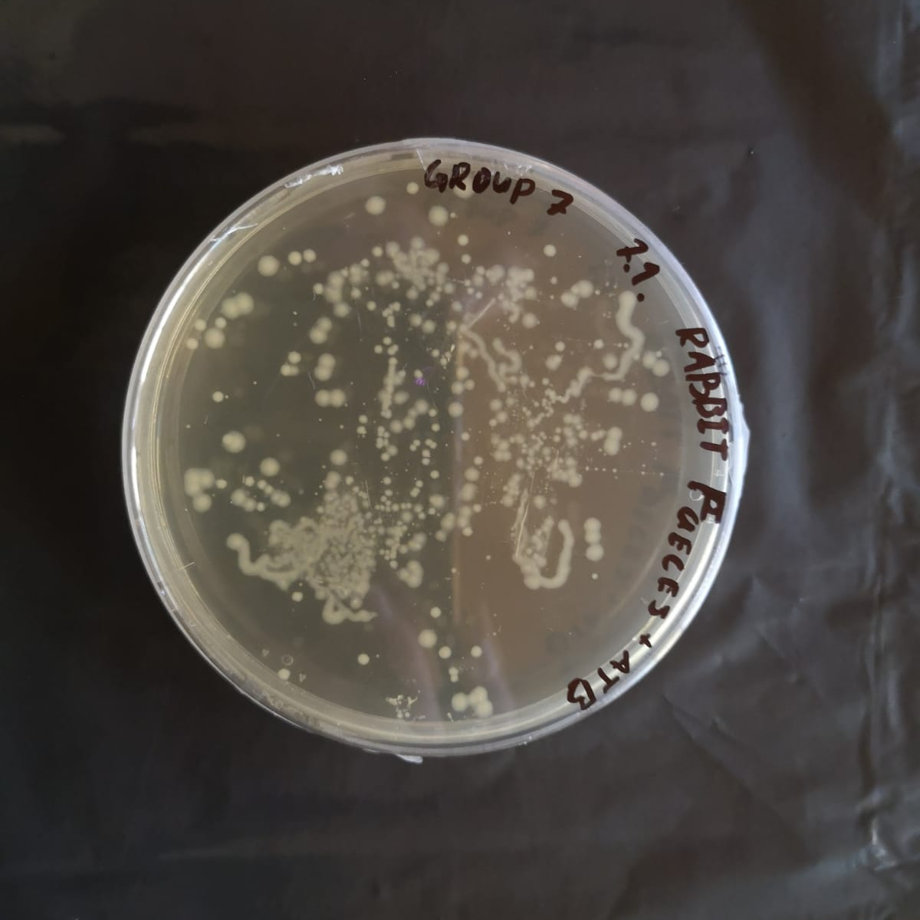
Photo of petri dish with investigated microbiome (if available)
Notes:
Groups with finger microbiome have the information which sample did they get
Groups with different microbiome have to figure out which sample they got, so the name on the petri dish should be hidden

Slide 4
PCR Result – Gel Electrophoresis
M
G27
OBSERVATION: we see a band on 1500 bp, and primers at the bottom.
EVALUATION: the 16S gene was amplified
CONCLUSION: the PCR was successful

Slide 5
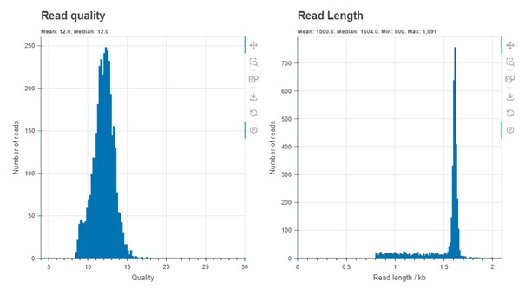
Evaluation by Epi2ME
OBSERVATION: the system read our DNA
EVALUATION: read lenght on average 1500 bp and quality was on average 12.0 -> good quality of reads
CONCLUSION: we can continue with investigating the species of bacteria

Slide 6
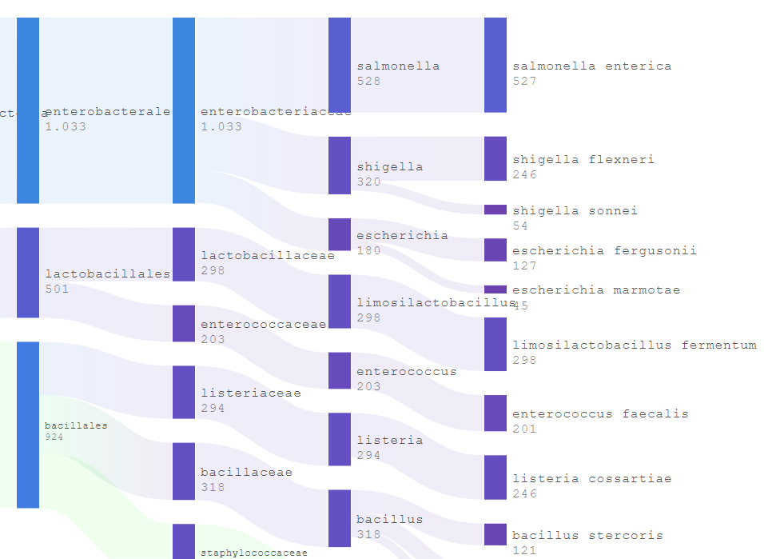
Evaluation by Epi2ME
OBSERVATION: the system identified 13 particular species of bacteria
EVALUATION: 13 different species bacteria, most promient one is Salmonella enterias

Slide 7
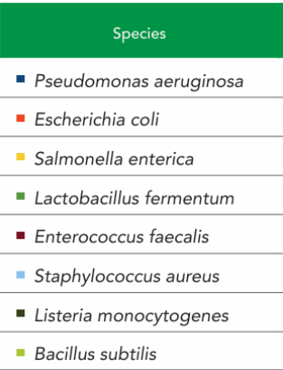
Top 5 represented bacteria
order | name | quantity [% or n]
1. | Salmonella enterca | 537
2. | Limosilactobacillus fermentum | 258
3. | Listeria cossartiae | 246
4. | Shigelle flexneri | 244
5. | Enterococcus faecalis | 201
CONCLUSION: We were checking, if the method is working correctly by using a standard from ZymoBIOMICS® Microbial Community Standard and there may occur innacuracies determining the species but the genus must match. In our cases the genus matches with most of the results. Therefore the method is working.
Notes:
N is an absolute number

Slide 8
Thank you for your attention!
धन्यवाद
谢谢

