Slide 1
Summary of Results from Group 16
Investigated Microbiome Poland before Arrival in Pforzheim

Slide 2
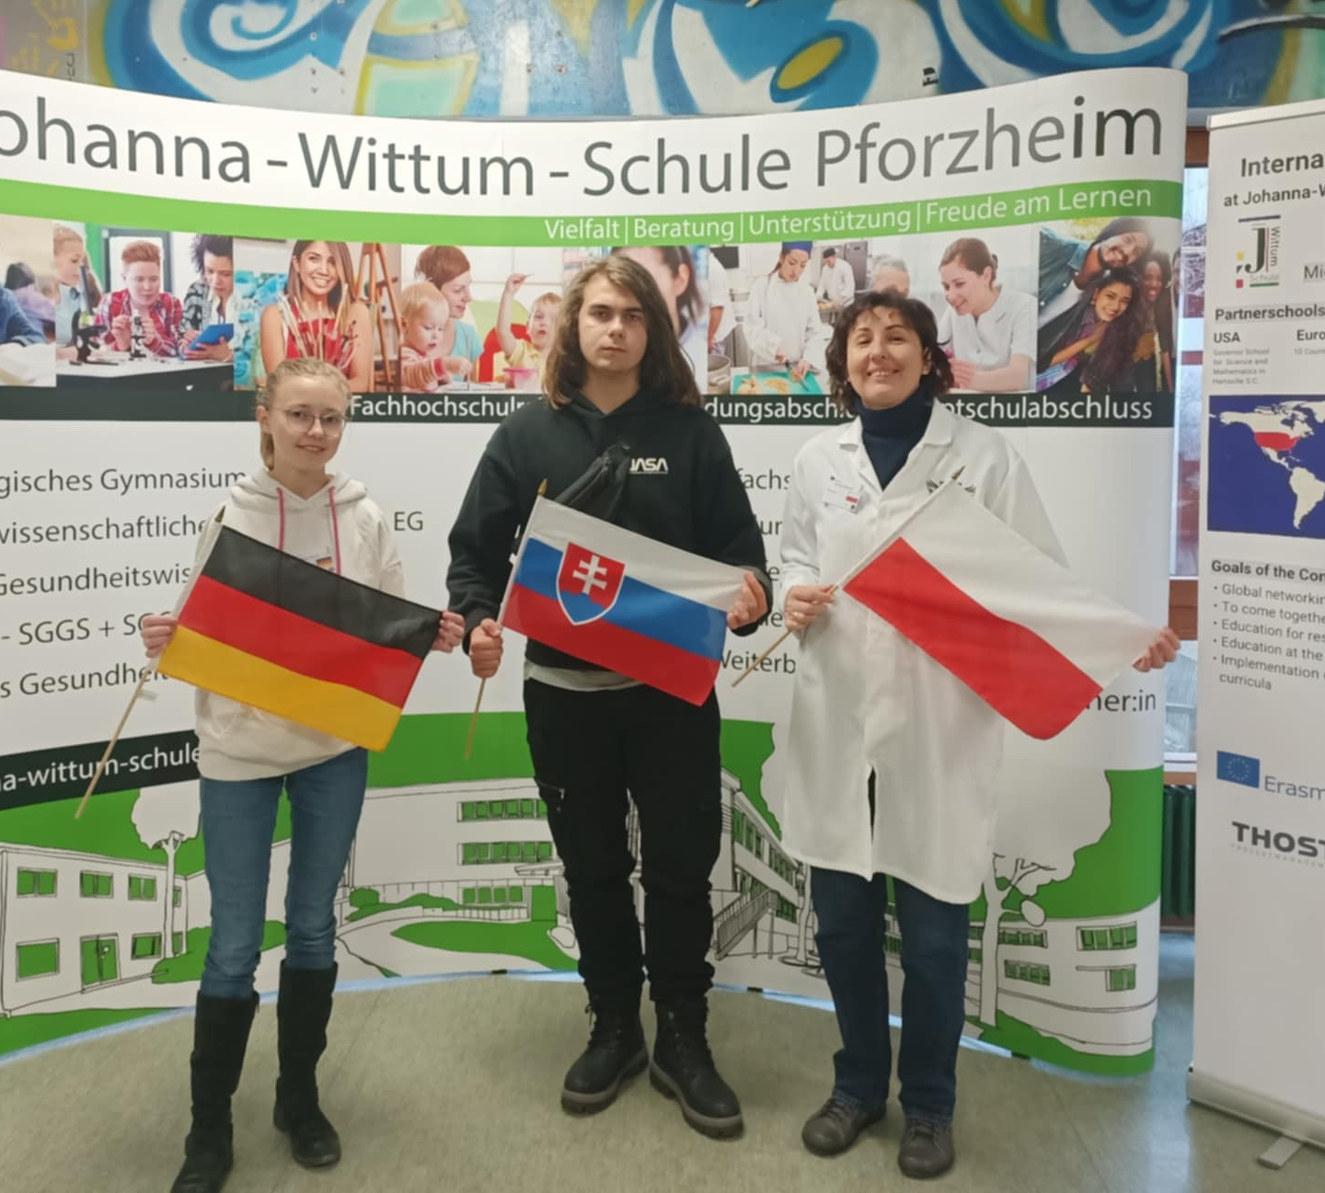
Group 16 members
Timotej Gonda
Slovak
Renata Stencel
Polish
Maya Sturn
German
„flag“
„flag“
„group picture“
„flag“

Slide 3
Photo of petri dish - Poland before
Notes:
Groups with finger microbiome have the information which sample did they get
Groups with different microbiome have to figure out which sample they got, so the name on the petri dish should be hidden

Slide 4
PCR Result – Gel Electrophoresis
G16
OBSERVATION: we see a band on ~ 1500 bp, and primers at the bottom
2000 bp
1250 bp
EVALUATION: the 16S gene was amplified
CONCLUSION: the PCR was successful

Slide 5
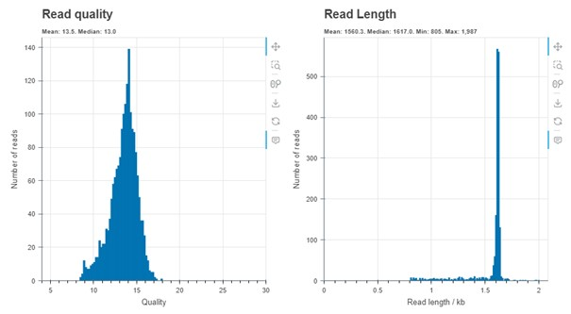
Evaluation by Epi2ME
OBSERVATION: the system read our DNA
EVALUATION: average quality of 14 and length of 1.6 kb
CONCLUSION: we can continue with investigating the species of bacteria

Slide 6
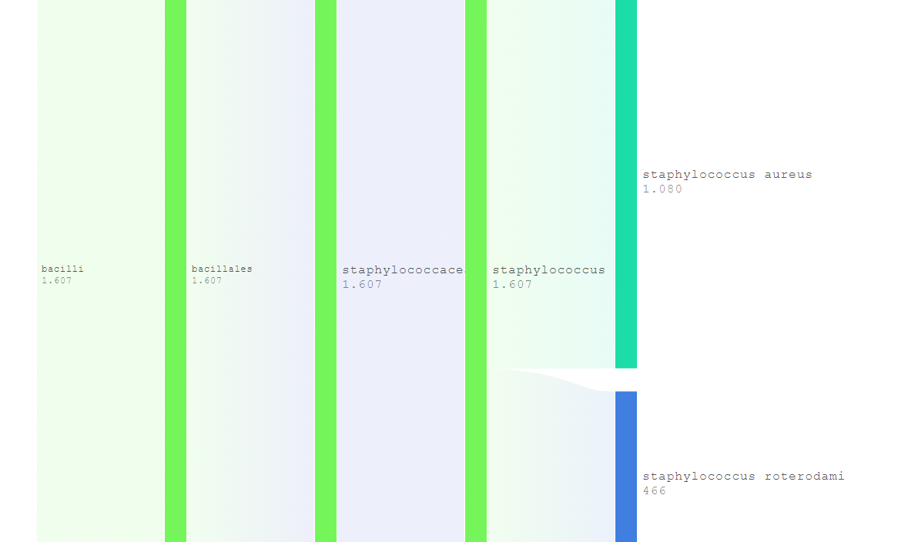
Evaluation by Epi2ME
OBSERVATION: the system identified only species of Staphylococcus
EVALUATION: majority of our bacteria were Staphylococcus aureus
CONCLUSION: this is an unusual microbiome composition, only found in special conditions

Slide 7
Top 3 represented bacteria
order | name | quantity [n]
1. | Staphylococcus aureus | 1080
2. | Staphylococcus roterodami | 466
3. | Staphylococcus hominis | 22
Notes:
N is an absolute number

Slide 8
Comparison of finger microbiomes depending on location
BEFORE
order | name | quantity [n]
1. | Staphylococcus aureus | 1080
2. | Staphylococcus roterodami | 466
3. | Staphylococcus hominis | 22
AFTER
order | name | quantity [% or n]
1.
2.
3.
4.
5.

Slide 9
Thank you for your attention!

