Slide 1
Summary of results from group 8
Fabian Klingel, Helene Imhoff
Investigated Microbiome Spain before Arrival in Pforzheim

Slide 2
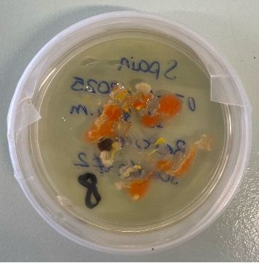
Photo of petri dish with Spain before
Notes:
Groups with finger microbiome have the information which sample did they get
Groups with different microbiome have to figure out which sample they got, so the name on the petri dish should be hidden

Slide 3
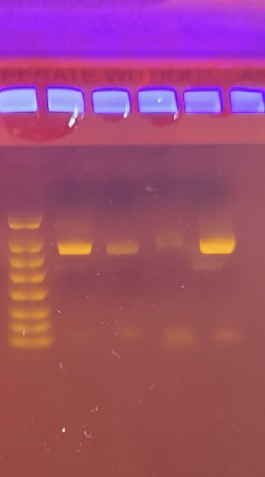
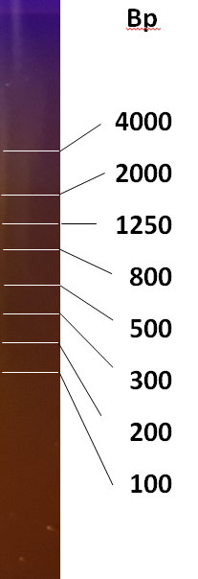
PCR Result – Gel Electrophoresis
M
OBSERVATION: we see a band on ∼ 1500 bp, and primers at the bottom
EVALUATION: the 16S rRNA gene was amplified
CONCLUSION: the PCR was successfull

Slide 4
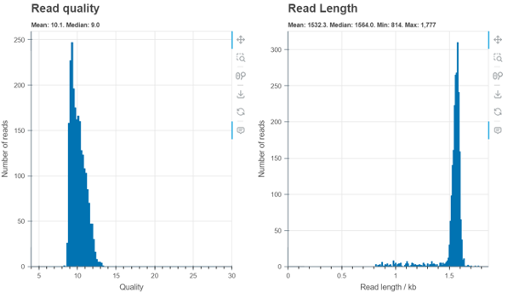
Evaluation by Epi2ME
OBSERVATION: the system read our DNA
EVALUATION: length 1532.3bp and quality 10.1
CONCLUSION: we can continue with investigating the species of bacteria
10.1
1532.3

Slide 5
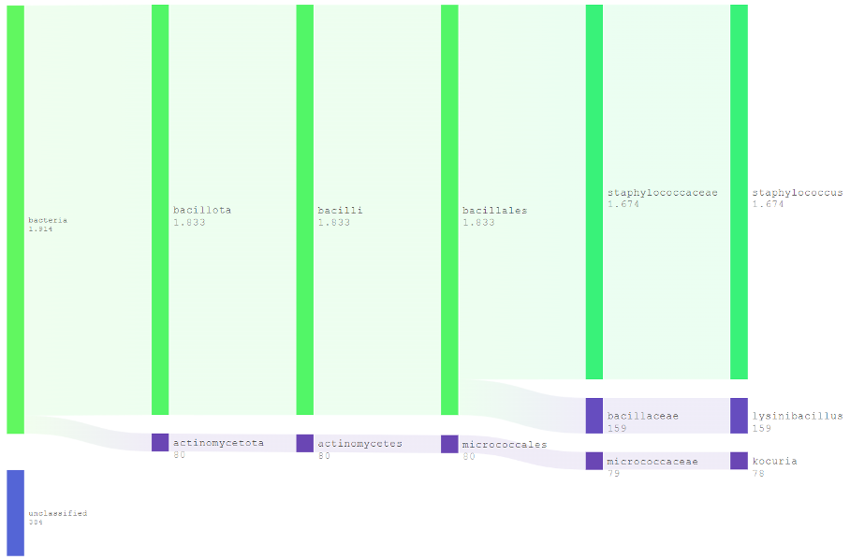
Evaluation by Epi2ME
OBSERVATION: the system identified particular species of bacteria
EVALUATION: 3 species of bacteria, staphylococcus (1.674 reads), lysinibacillus (159 reads), kocuria (78 reads) and (384 reads) unclassified
CONCLUSION: we conclude our sample was taken from the skin. These bacteria come from ground, food and animals

Slide 6
Top 5 represented bacteria
order | name | quantity [% or n]
1. | Staphylococcus | 1.674
2. | Lysinibacillus | 159
3. | Kocuria | 78
4.
5.
Notes:
N is an absolute number

Slide 7
Comparison of finger microbiomes depending on location
(compare top 5 bacteria species in samples before and after arrival to Germany, fill the table „BEFORE“ or „AFTER“ depending on your sample)
BEFORE
order | name | quantity [% or n]
1. | Staphylococcus | 1.674
2. | Lysinibacillus | 159
3. | Kocuria | 78
4.
5.
AFTER (Group 9)
order | name | quantity [% or n]
1. | Staphylococcus Warner | 1852
2. | Staphylococcus pasteuri | 278
3. | Staphylococcus Borreliose | 194
4. | Staphylococcus tyaiwanensis | 169
5. | Staphylococcus epidermis | 120

Slide 8
Thank you for your attention!

