Slide 1
Summary of results from group X

Slide 2
Slide 1: group number + presentation of group members
Name 1
Nationality
Name 2
Nationality
Name 3
Nationality
„flag“
„flag“
„group picture“
„flag“

Slide 3
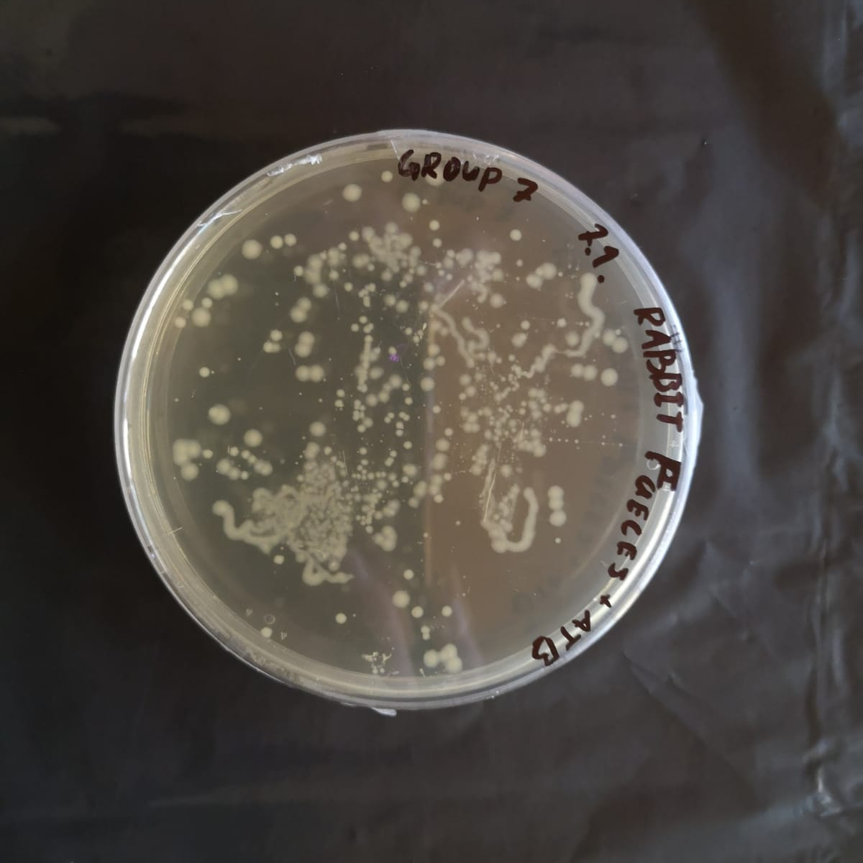
Photo of petri dish with investigated microbiome
(if available)
Notes:
Groups with finger microbiome have the information which sample did they get
Groups with different microbiome have to figure out which sample they got, so the name on the petri dish should be hidden

Slide 4
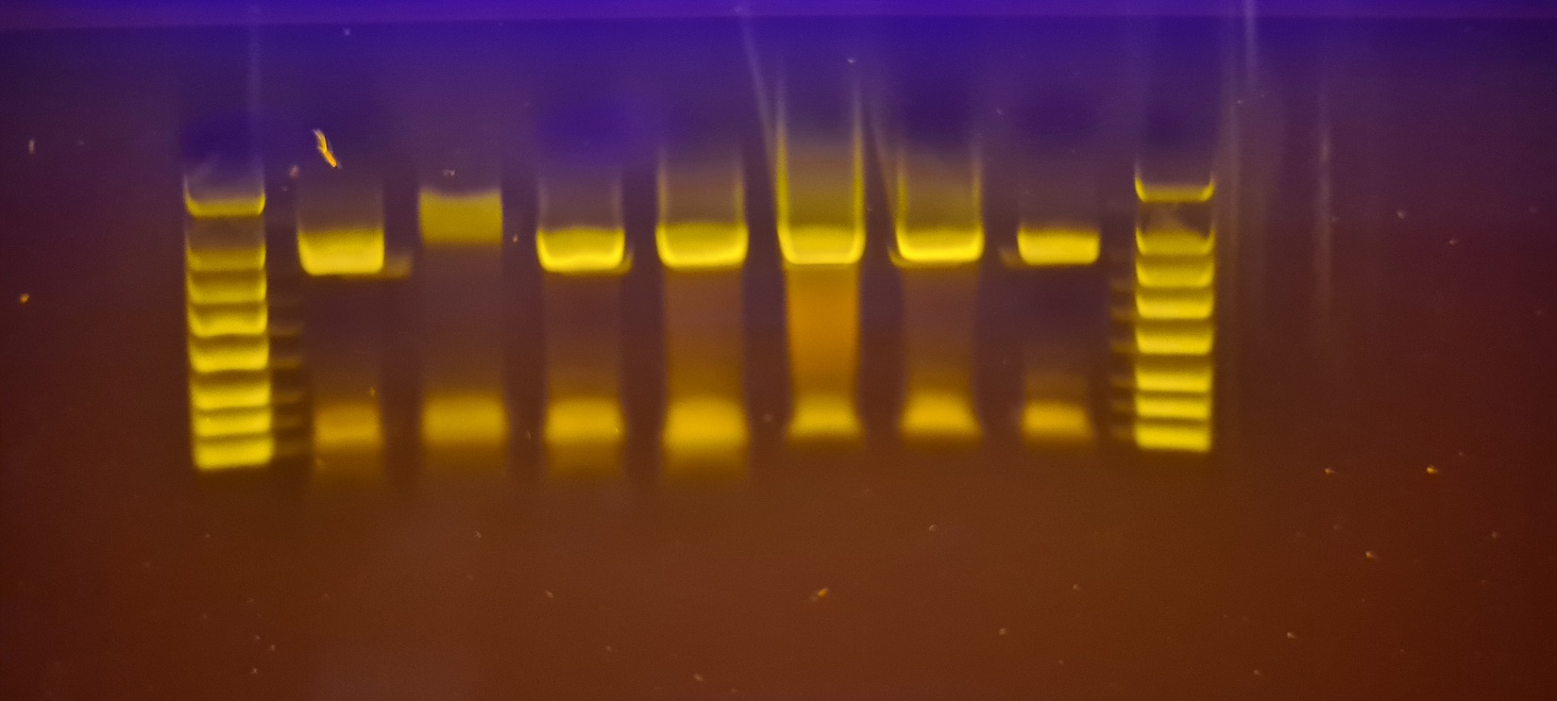
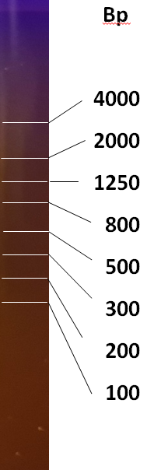
PCR Result – Gel Electrophoresis
OBSERVATION: we (don´t) see a band on ∼ 1500 bp, and primers at the front/bottom
M
G1
EVALUATION: the 16S gene was (wasn´t) amplified
CONCLUSION: the PCR was (wasn´t) successfull

Slide 5
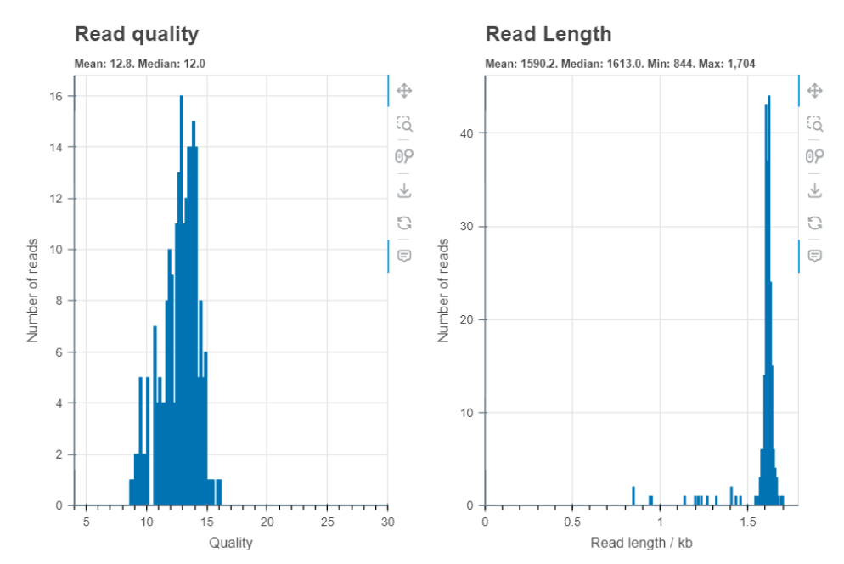
Evaluation by Epi2ME
OBSERVATION: the system read our DNA
EVALUATION: number of reads, length and quality
CONCLUSION: we can (can´t) continue with investigating the species of bacteria

Slide 6
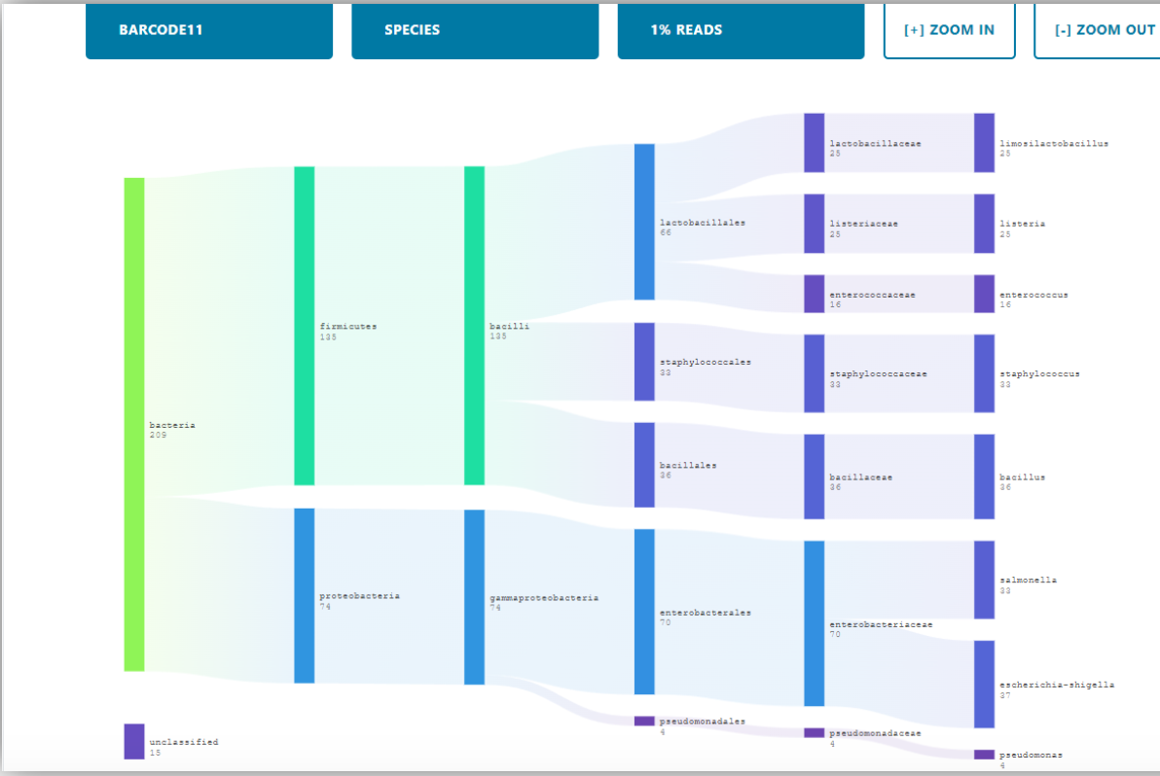
Evaluation by Epi2ME
OBSERVATION: the system identified particular species of bacteria
EVALUATION: amount of different bacteria, names of the species with higher representation, quantity
CONCLUSION: we conclude our sample was taken from (the place depending on information about bacteria from the internet)

Slide 7
Top 5 represented bacteria
order | name | quantity [% or n]
1.
2.
3.
4.
5.
Notes:
N is an absolute number

Slide 8
Only for groups with finger microbiome
!!!

Slide 9
Comparison of finger microbiomes depending on location
(compare top 5 bacteria species in samples before and after arrival to Germany, fill the table „BEFORE“ or „AFTER“ depending on your sample)
BEFORE
order | name | quantity [% or n]
1.
2.
3.
4.
5.
AFTER
order | name | quantity [% or n]
1.
2.
3.
4.
5.

Slide 10
Thank you for your attention!

