Slide 1
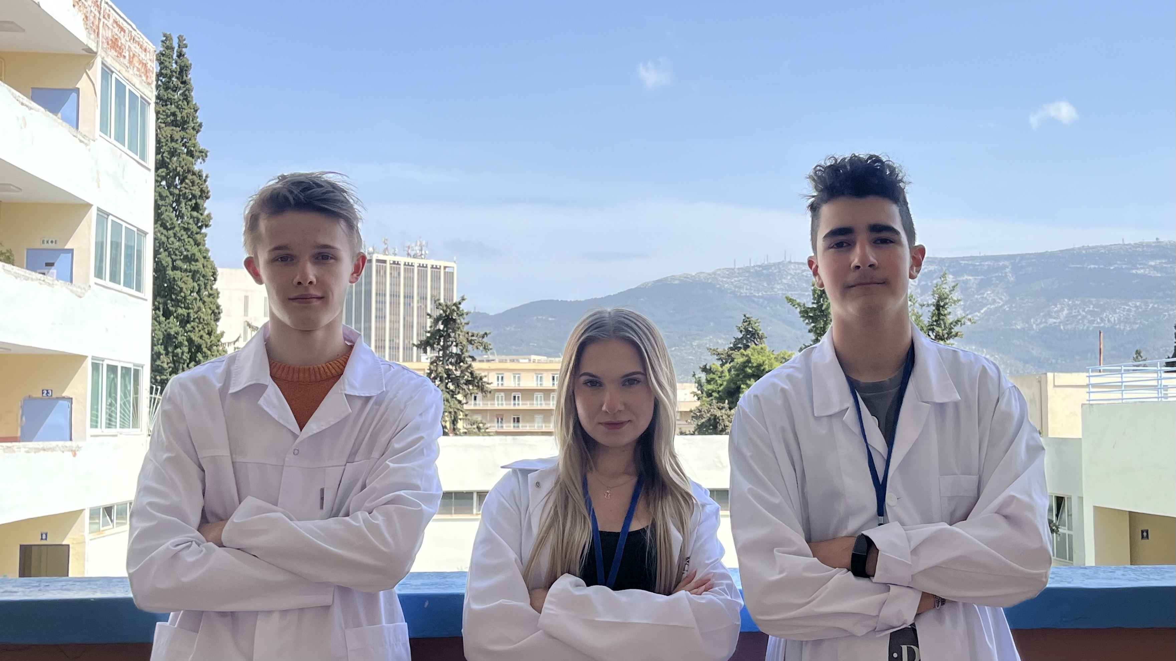
Group number: 2
Giannis Krilis
Greece
Maja Leśnikowska
Poland
Rapolas Sarcevicius
Lithuania

Slide 2
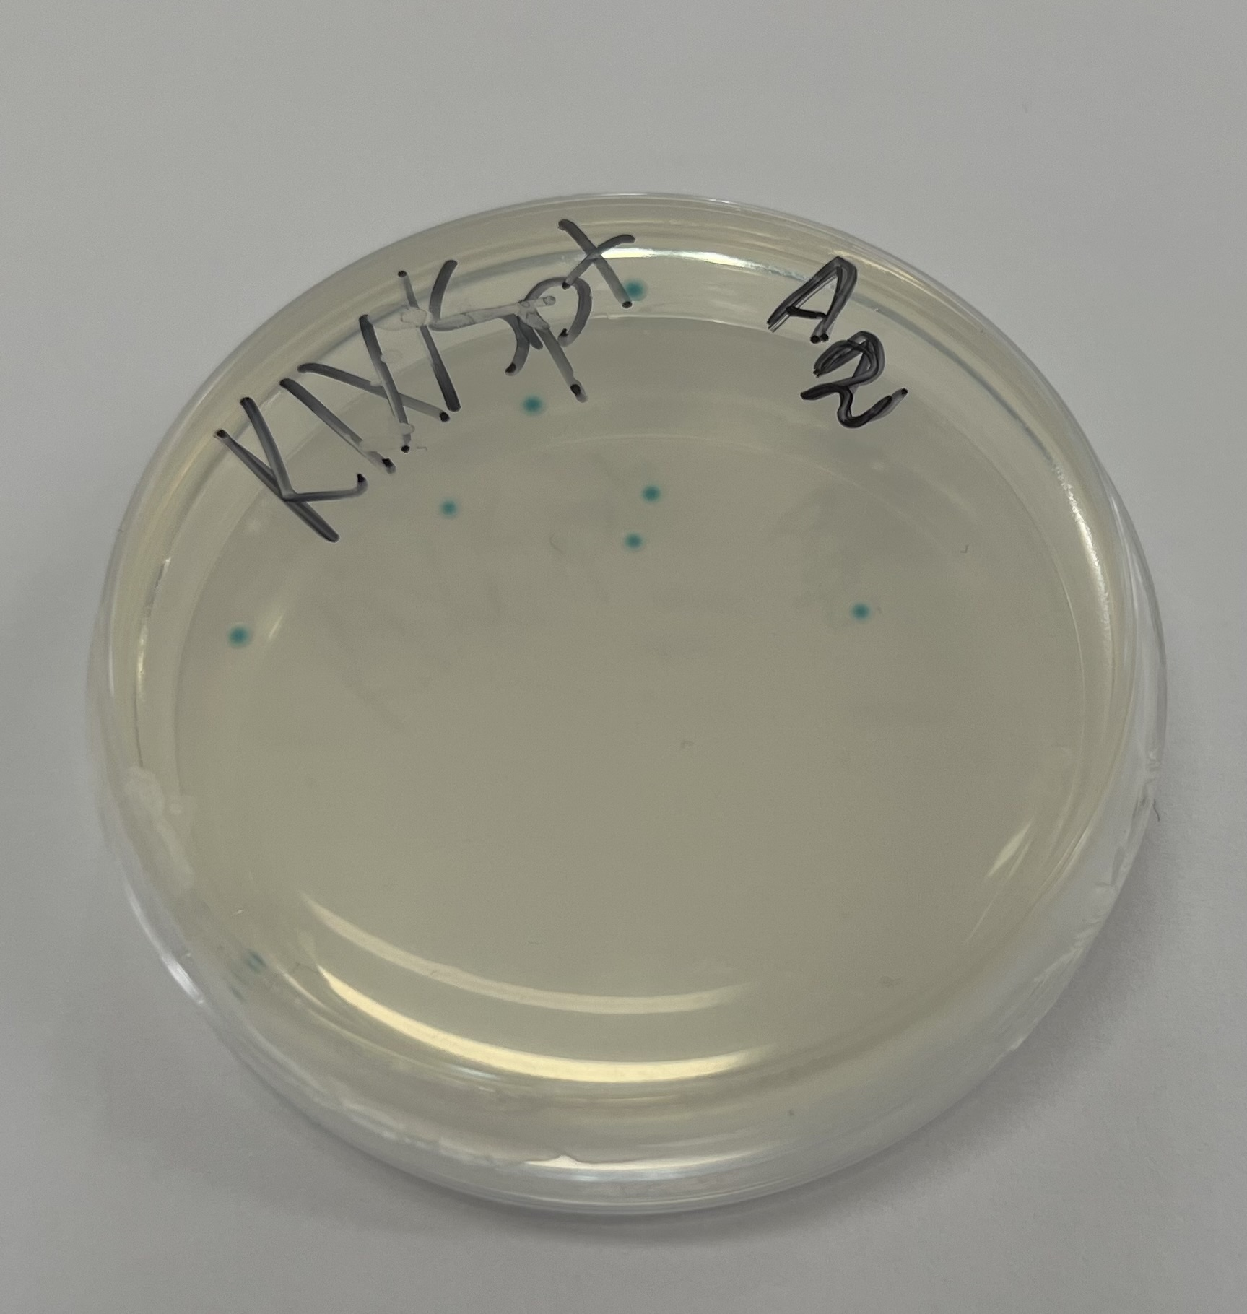
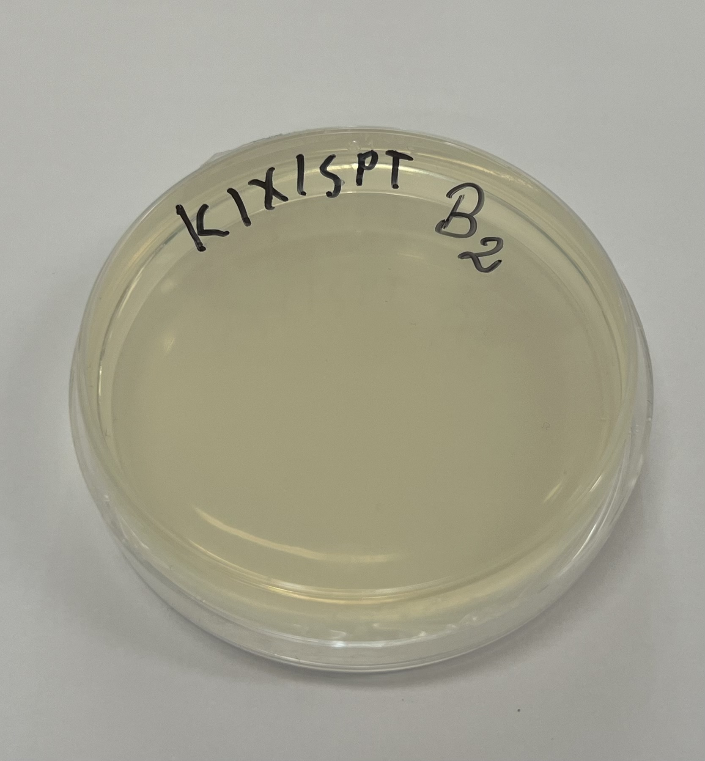
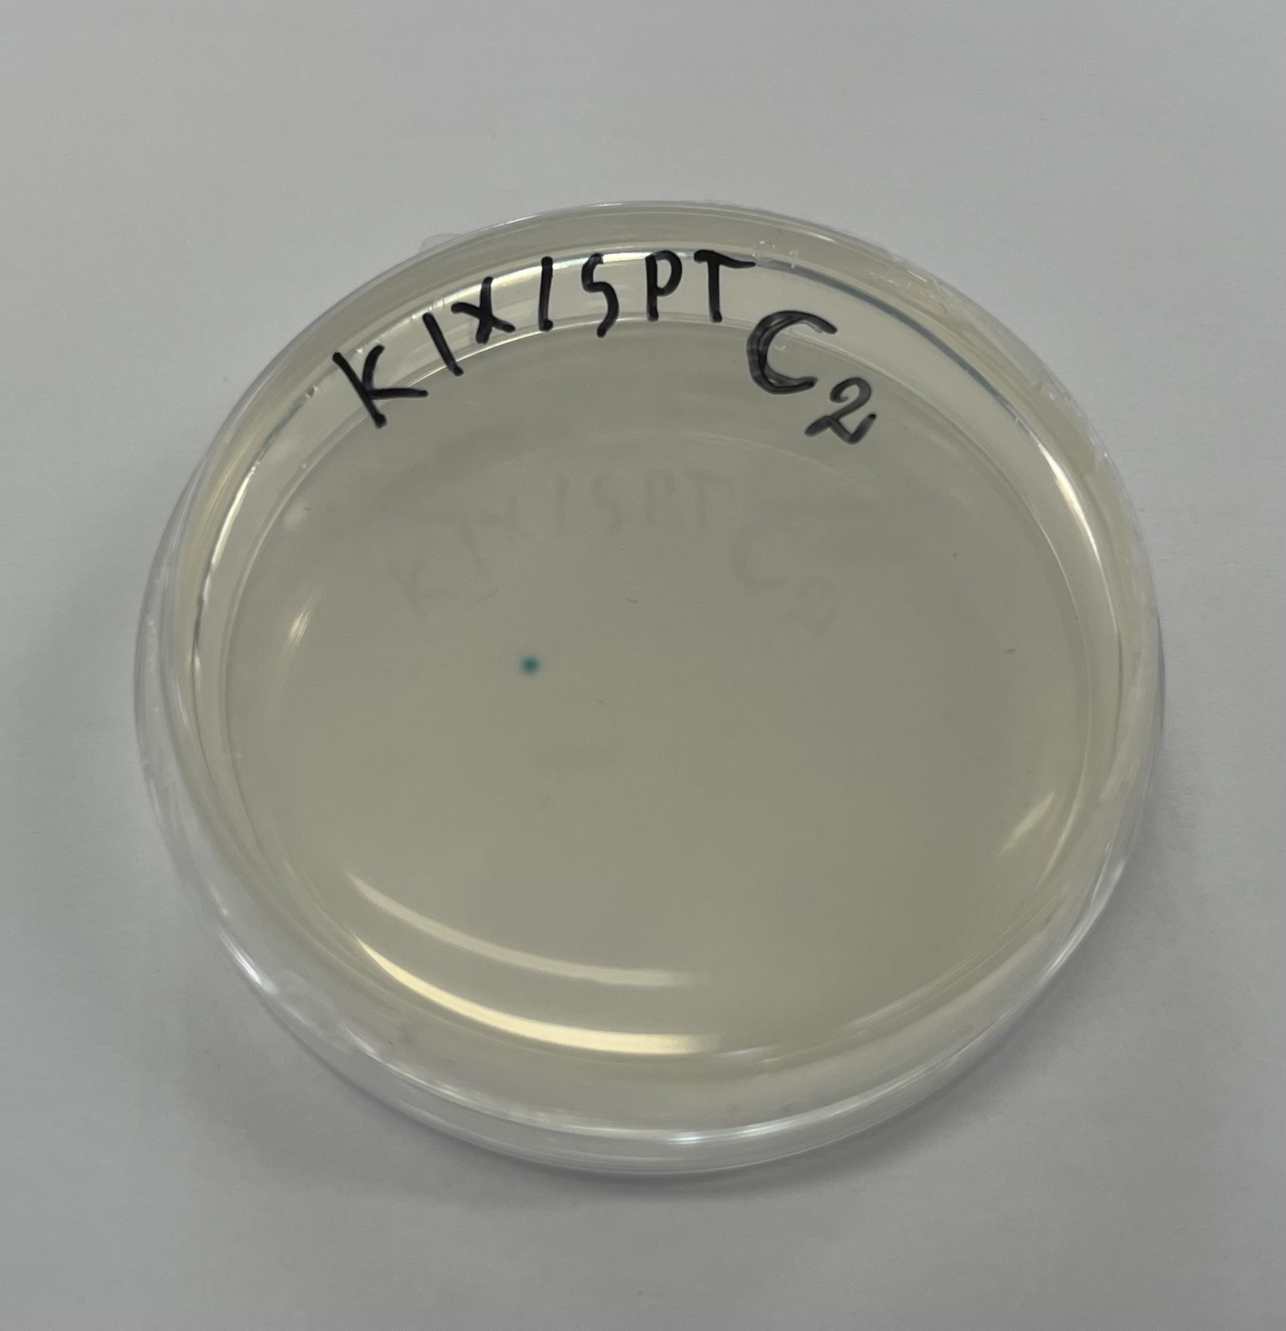
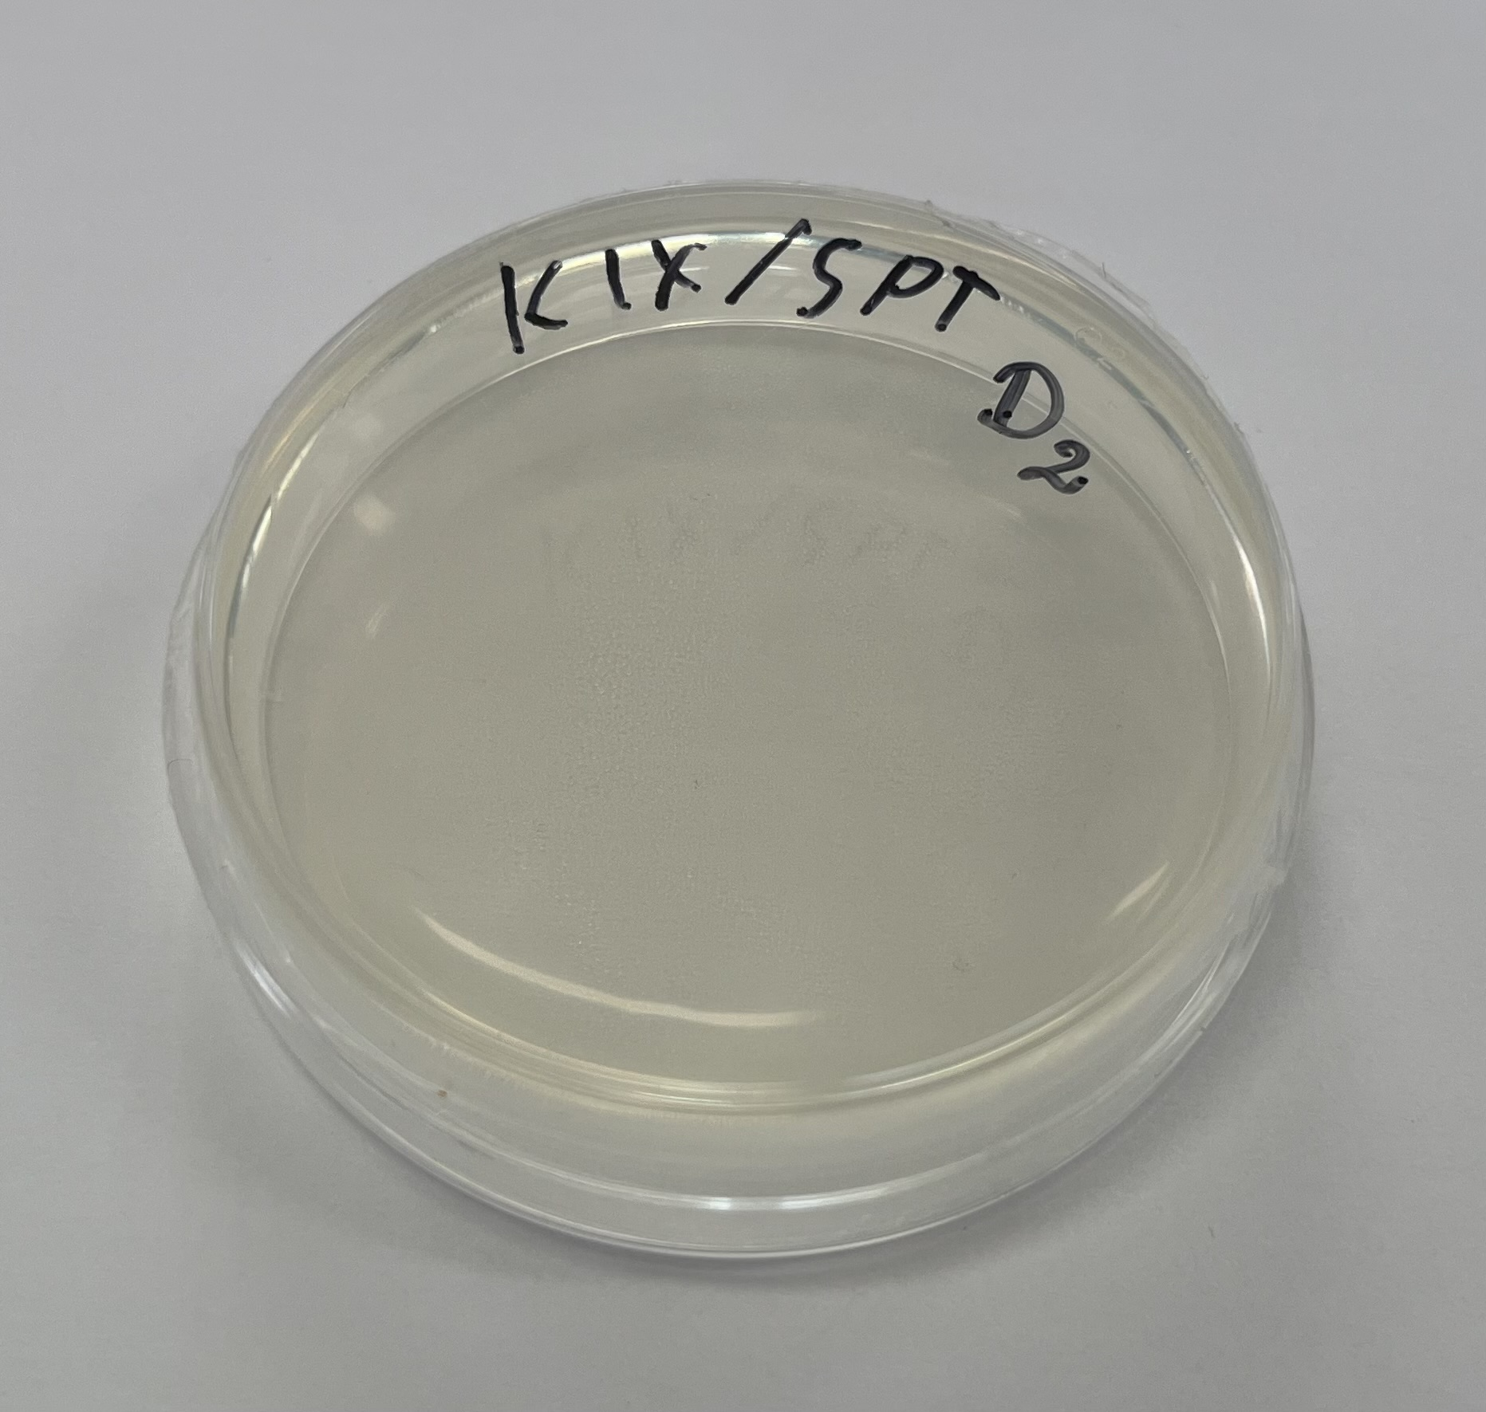
Observation of part 1 of the experiment
A: OBSERVATION
– several blue dots appeared
B: OBSERVATION
– clear nutrient, no dots visible
C: OBSERVATION
– single blue dot appeared
D: OBSERVATION
– clear nutrient, no dots visible

Slide 3
Result of part 1 of the experiment
A: RESULT
– cut was not made; blue colonies grew
B: RESULT
– cut was made; HDR was off; bacteria died
C: RESULT
– cut was not made; blue colony grew
D: RESULT
– bacteria did not grow; unsuccessful attempt

Slide 4
Conclusion of part 1 of the experiment
A: CONCLUSION
– lacZ gene unedited; functional
B: CONCLUSION
– lacZ gene edited; non functional
C: CONCLUSION
– lacZ gene unedited; functional
D: CONCLUSION
– tranformation did not happen – possible reasons:
wrongly marked petri dish – no arabinose in the nutrient
too little bacteria was used – all failed to transform
wrongly marked tube with pDG

Slide 5
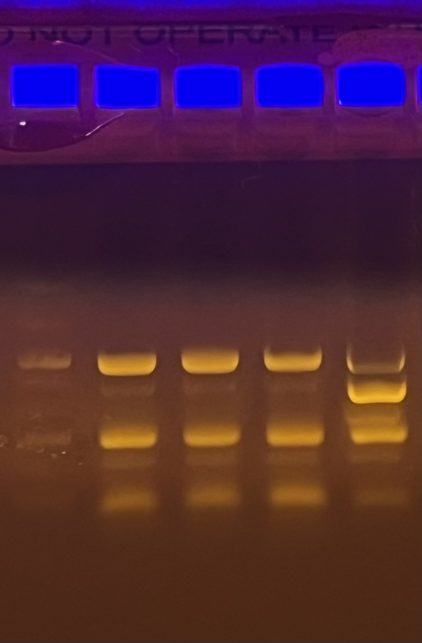
Observation of part 2 of the experiment – Electrophoresis
A: OBSERVATION
– the line was on the 1100 bp level
C: OBSERVATION
– the line was on the 1100 bp level
A1
B1
C
A

Slide 6
Result of part 2 of the experiment – Electrophoresis
A: RESULT
– the fragment was 1100 bp long
C: RESULT
– the fragment was 1100 bp long

Slide 7
Conclusion of part 2 of the experiment – Electrophoresis
A: CONCLUSION
– lacZ gene functional
C: CONCLUSION
– lacZ gene functional

Slide 8
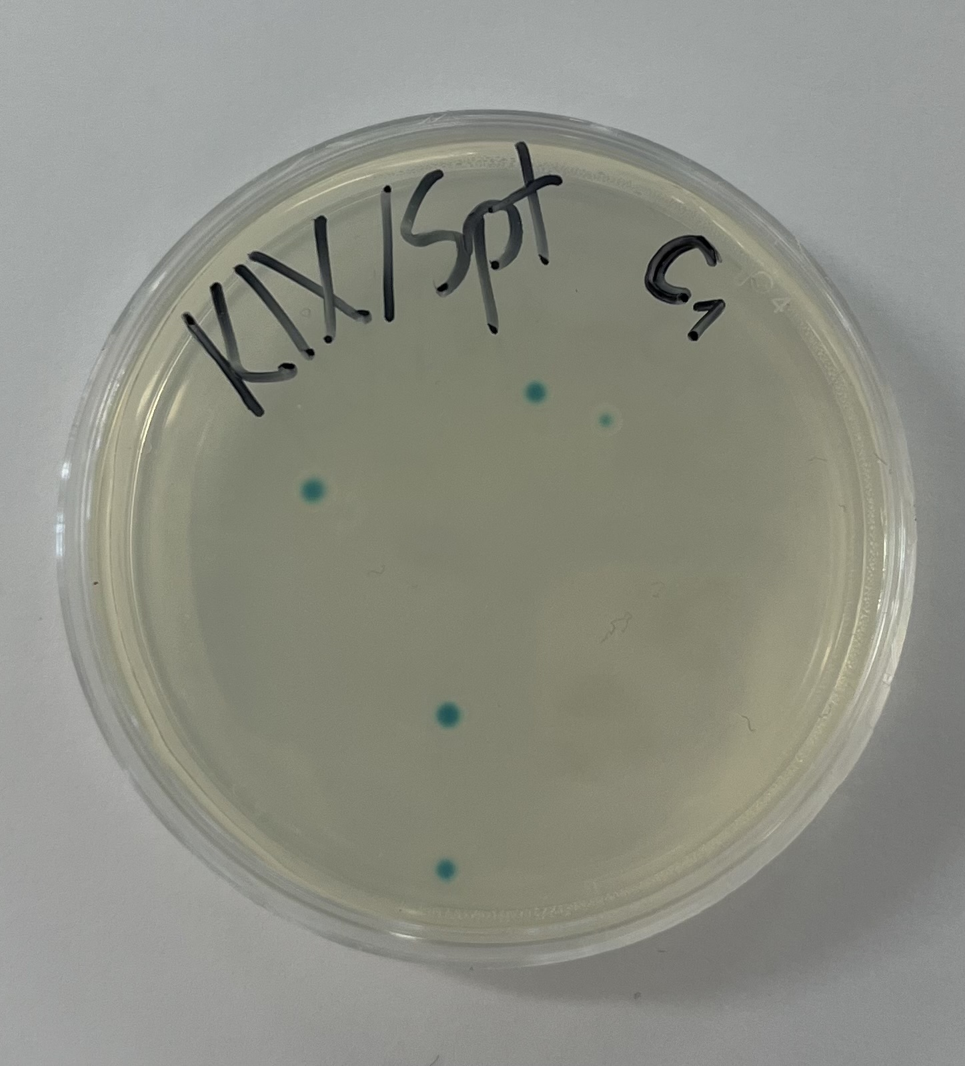
Observation of white ring sample
White ring surrounded blue part of the colony
White ring had the same width from all sides
In electrophoresis, the line was on the 1100 bp level
WHITE RING

Slide 9
Result of white ring sample
The fragment was 1100 bp long
The fragment was as long as the one from blue part of the colony

Slide 10
Conclusion of white ring sample
Both blue and white part of the colony were the same bacteria
The part of the colony in the centre used all the X-Gal available, causing the white ring to appear

Slide 11
Summary of experiments
A:
Blue colonies visible
lacZ gene unedited, functional
1100 bp long
B:
No colonies visible
lacZ gene edited, HDR off
Bacteria died
C:
Blue colony visible
lacZ gene unedited, functional
1100 bp long
D:
No colonies visible
Transformation did not occur
Attempt unsuccessful
White ring sample:
White ring surrounded blue part of the colony
lacZ gene unedited, functional
1100 bp long

