Slide 1
Summary of results from group 14

Slide 2
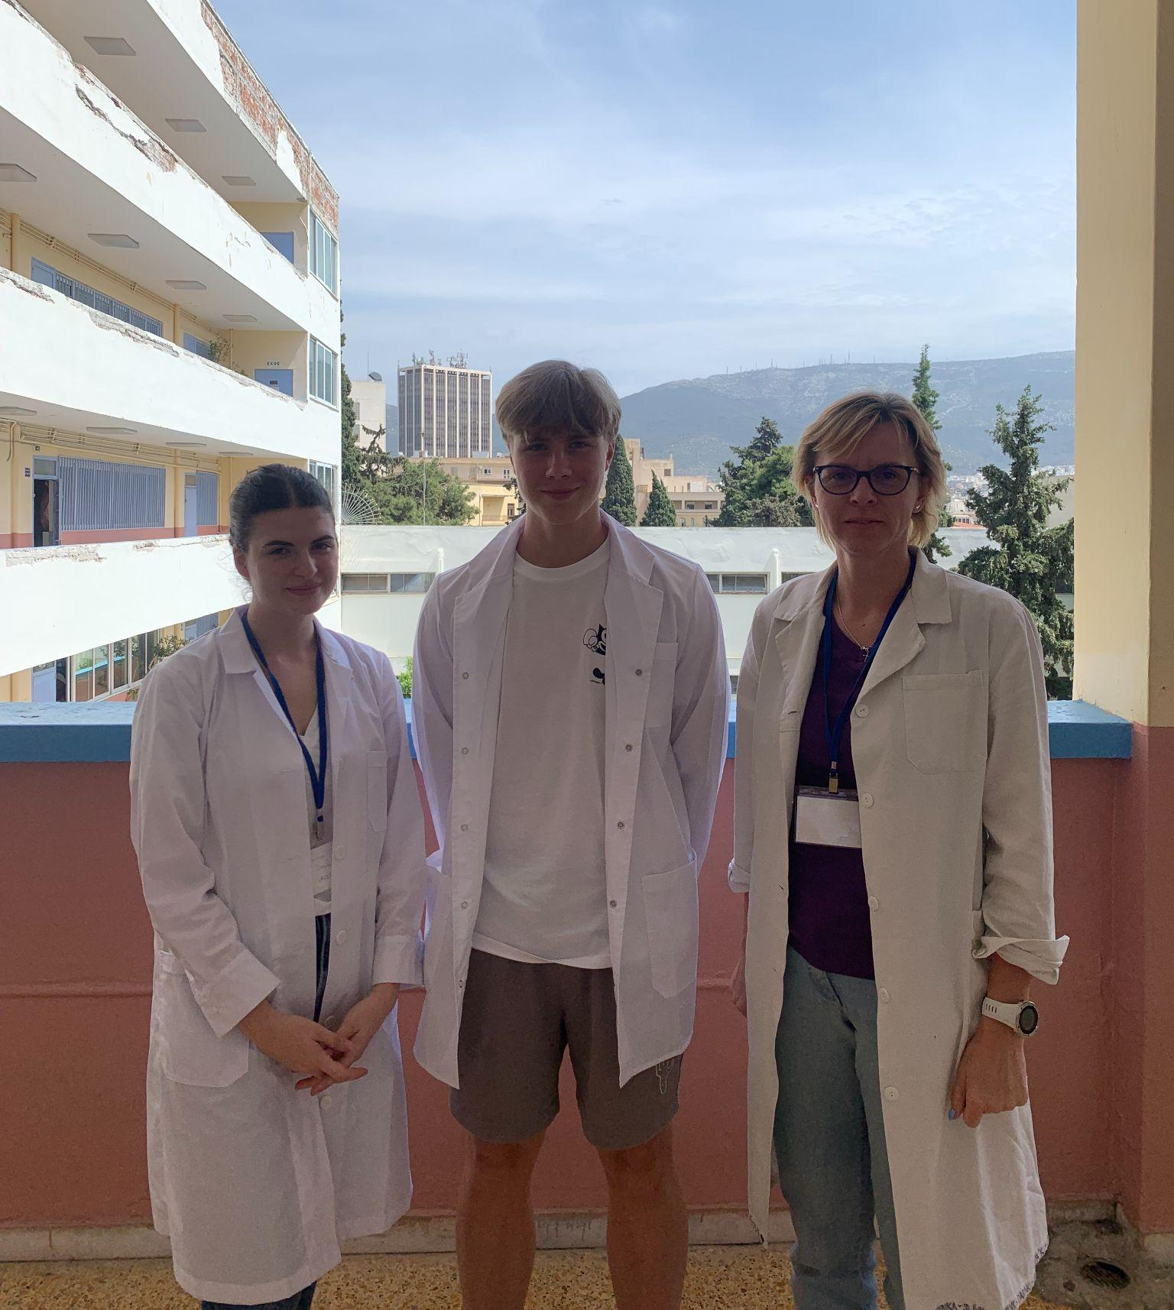
Group 14
Dovydas Tamosaitis
Lithuania
Lucia Bizoňová
Slovakia
Kristina Dinkollari
Greece

Slide 3
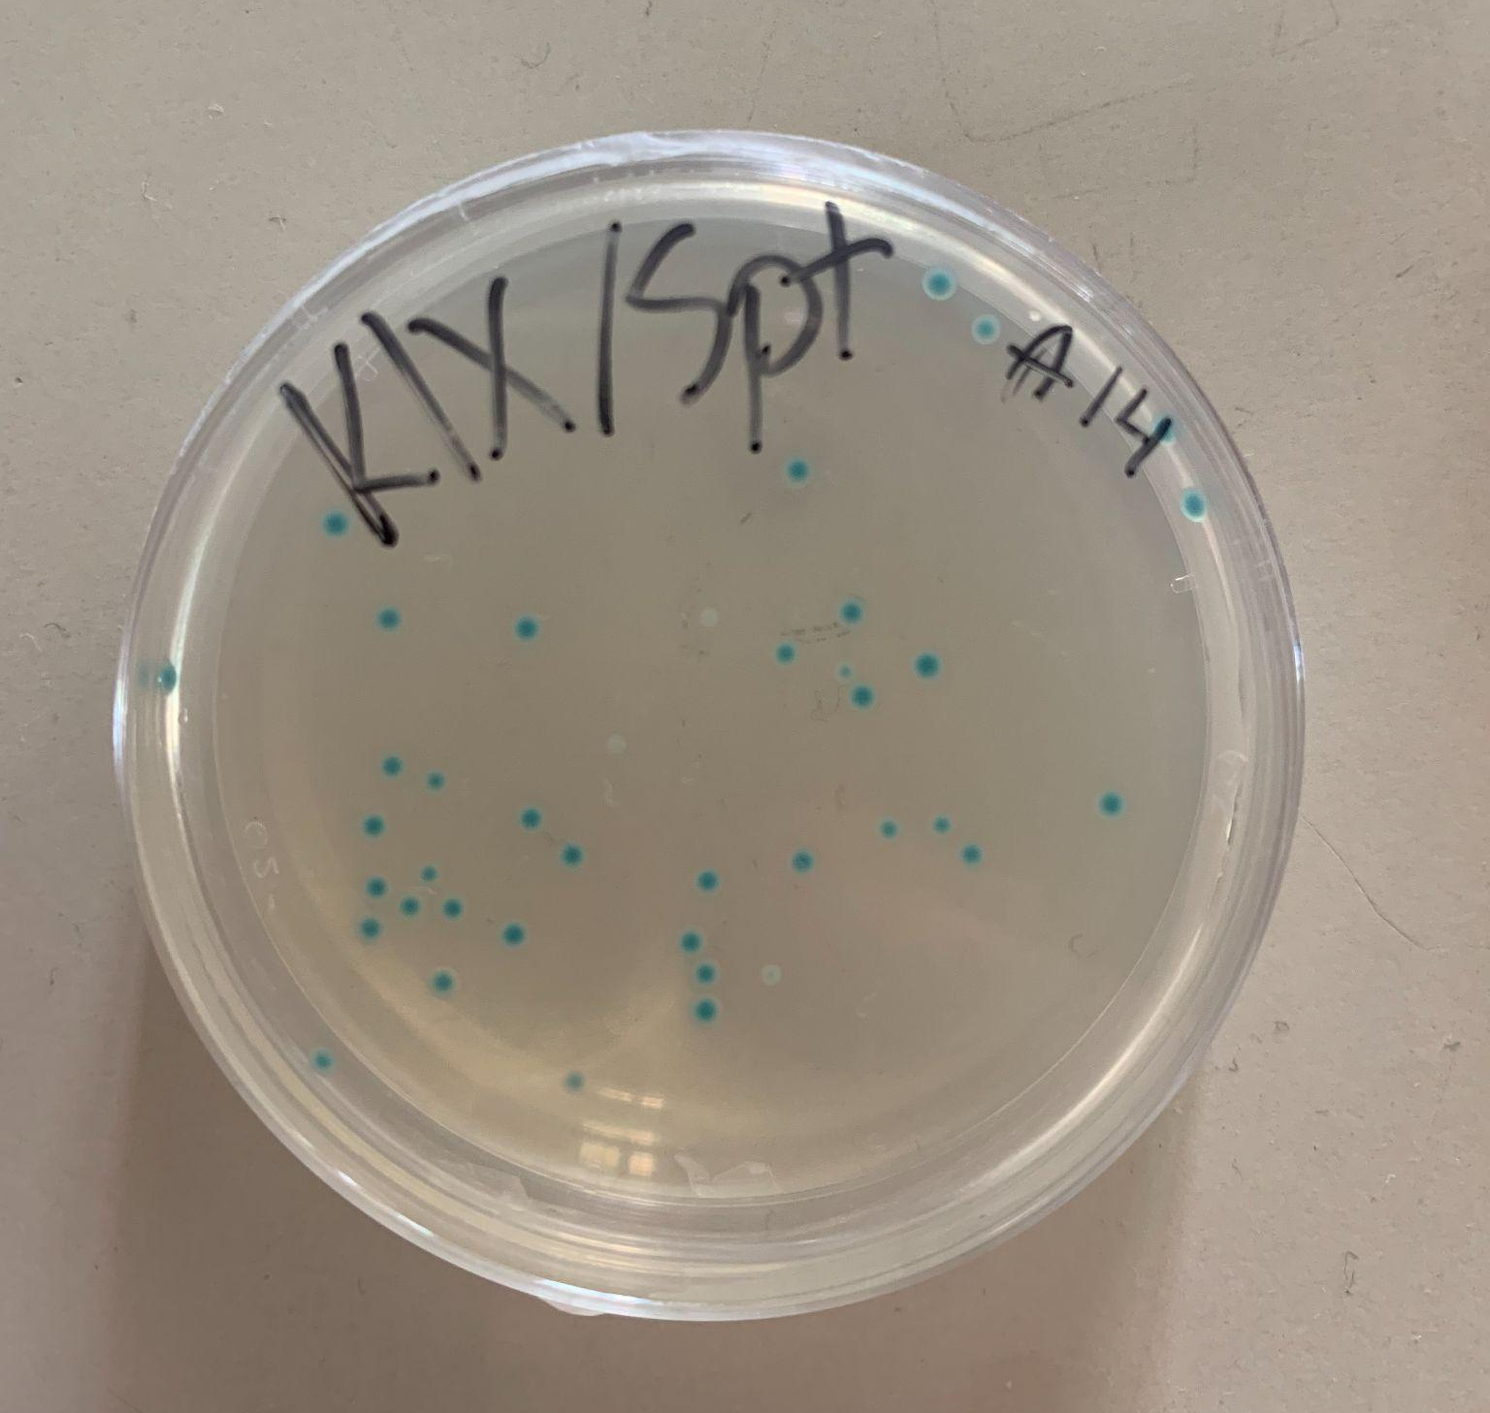
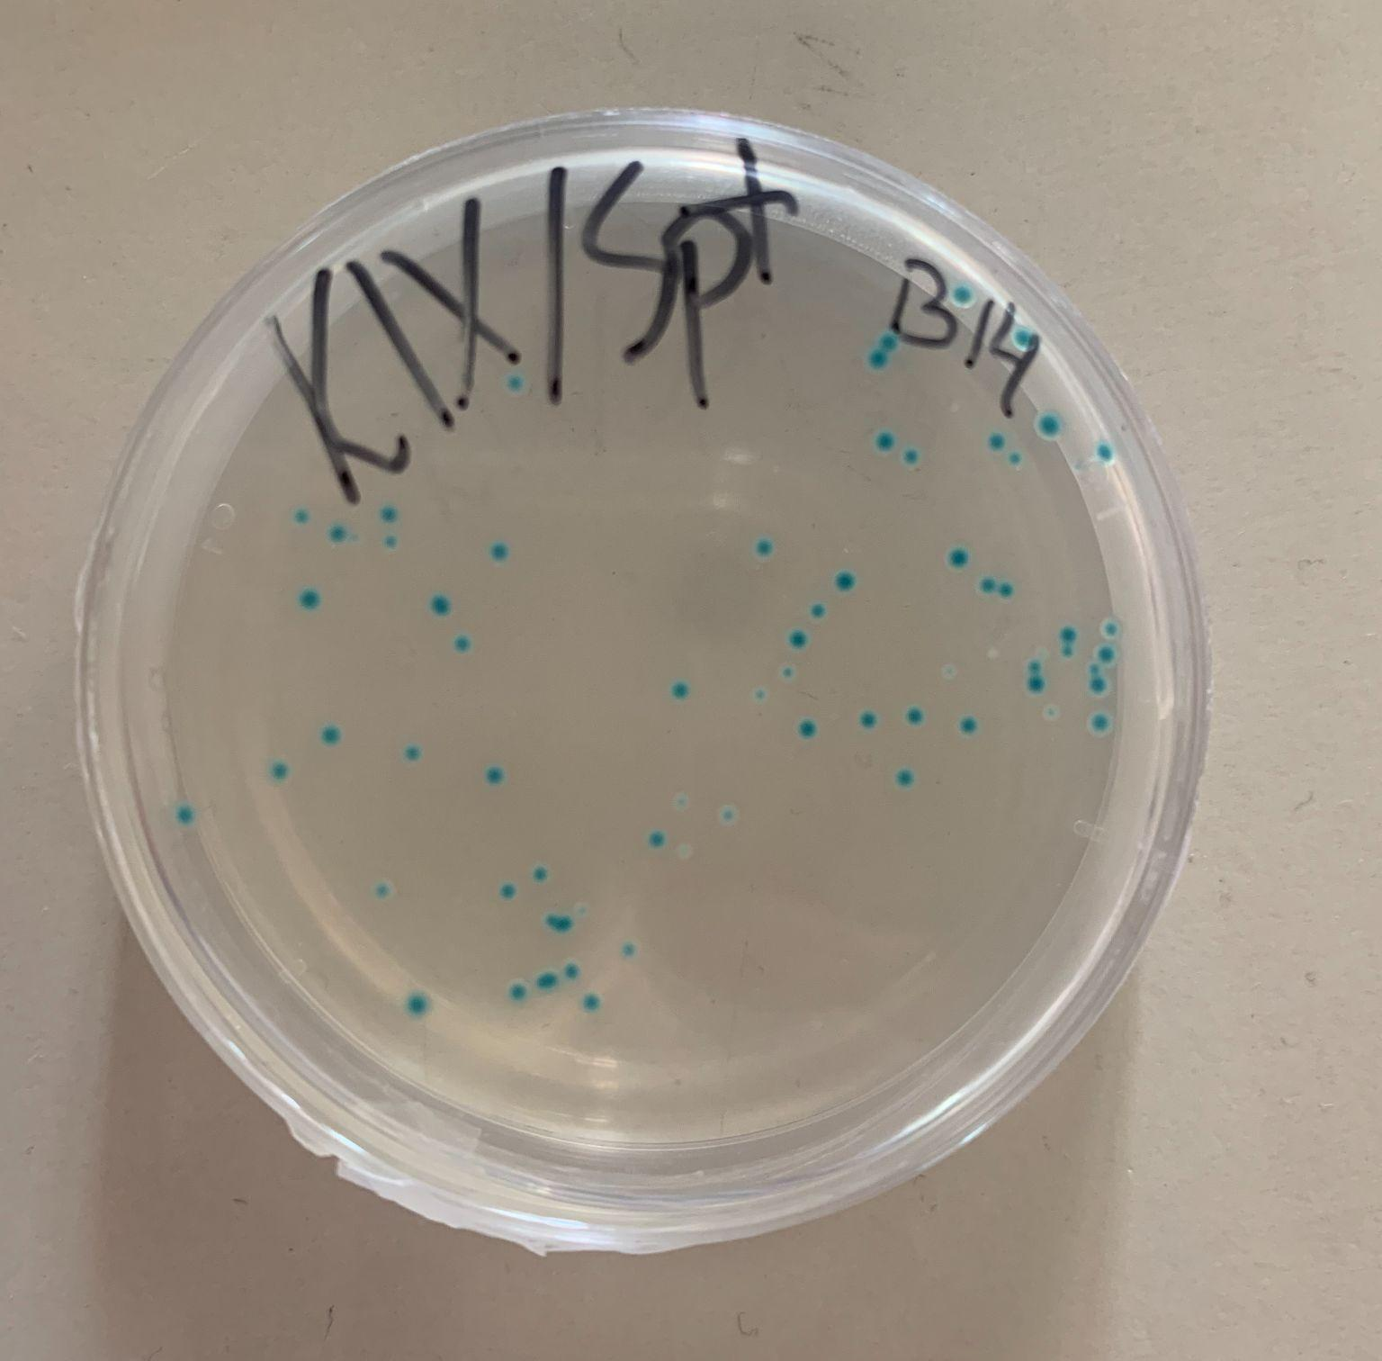
Observation of 1. experiment (E1) – geneediting by CRISPR/Cas9
A1
A1: OBSERVATION
– blue bacteria colonies
B1: OBSERVATION
– blue bacteria colonies
B1

Slide 4
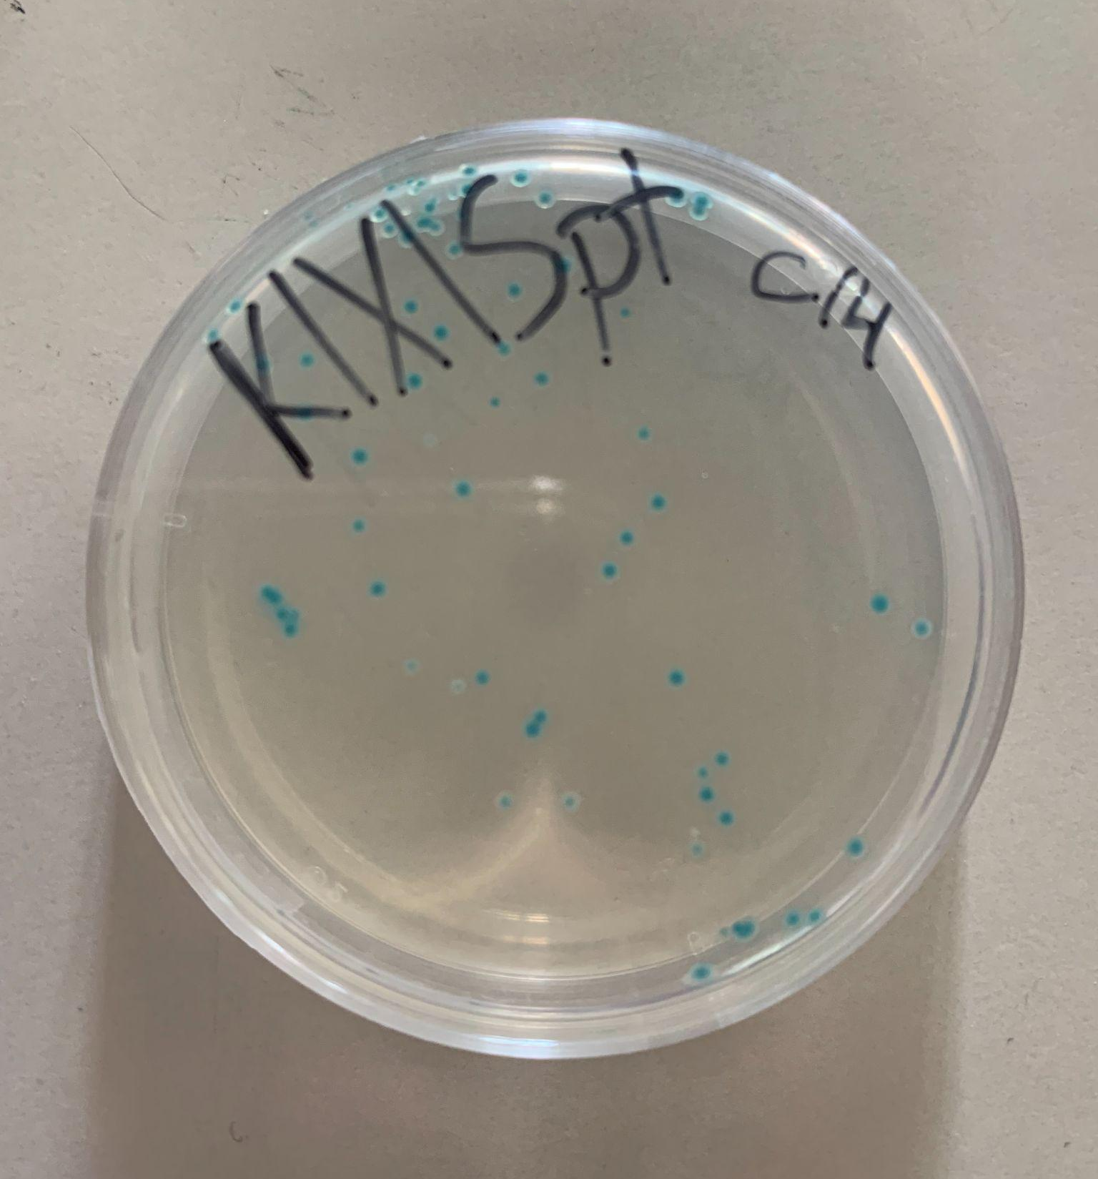
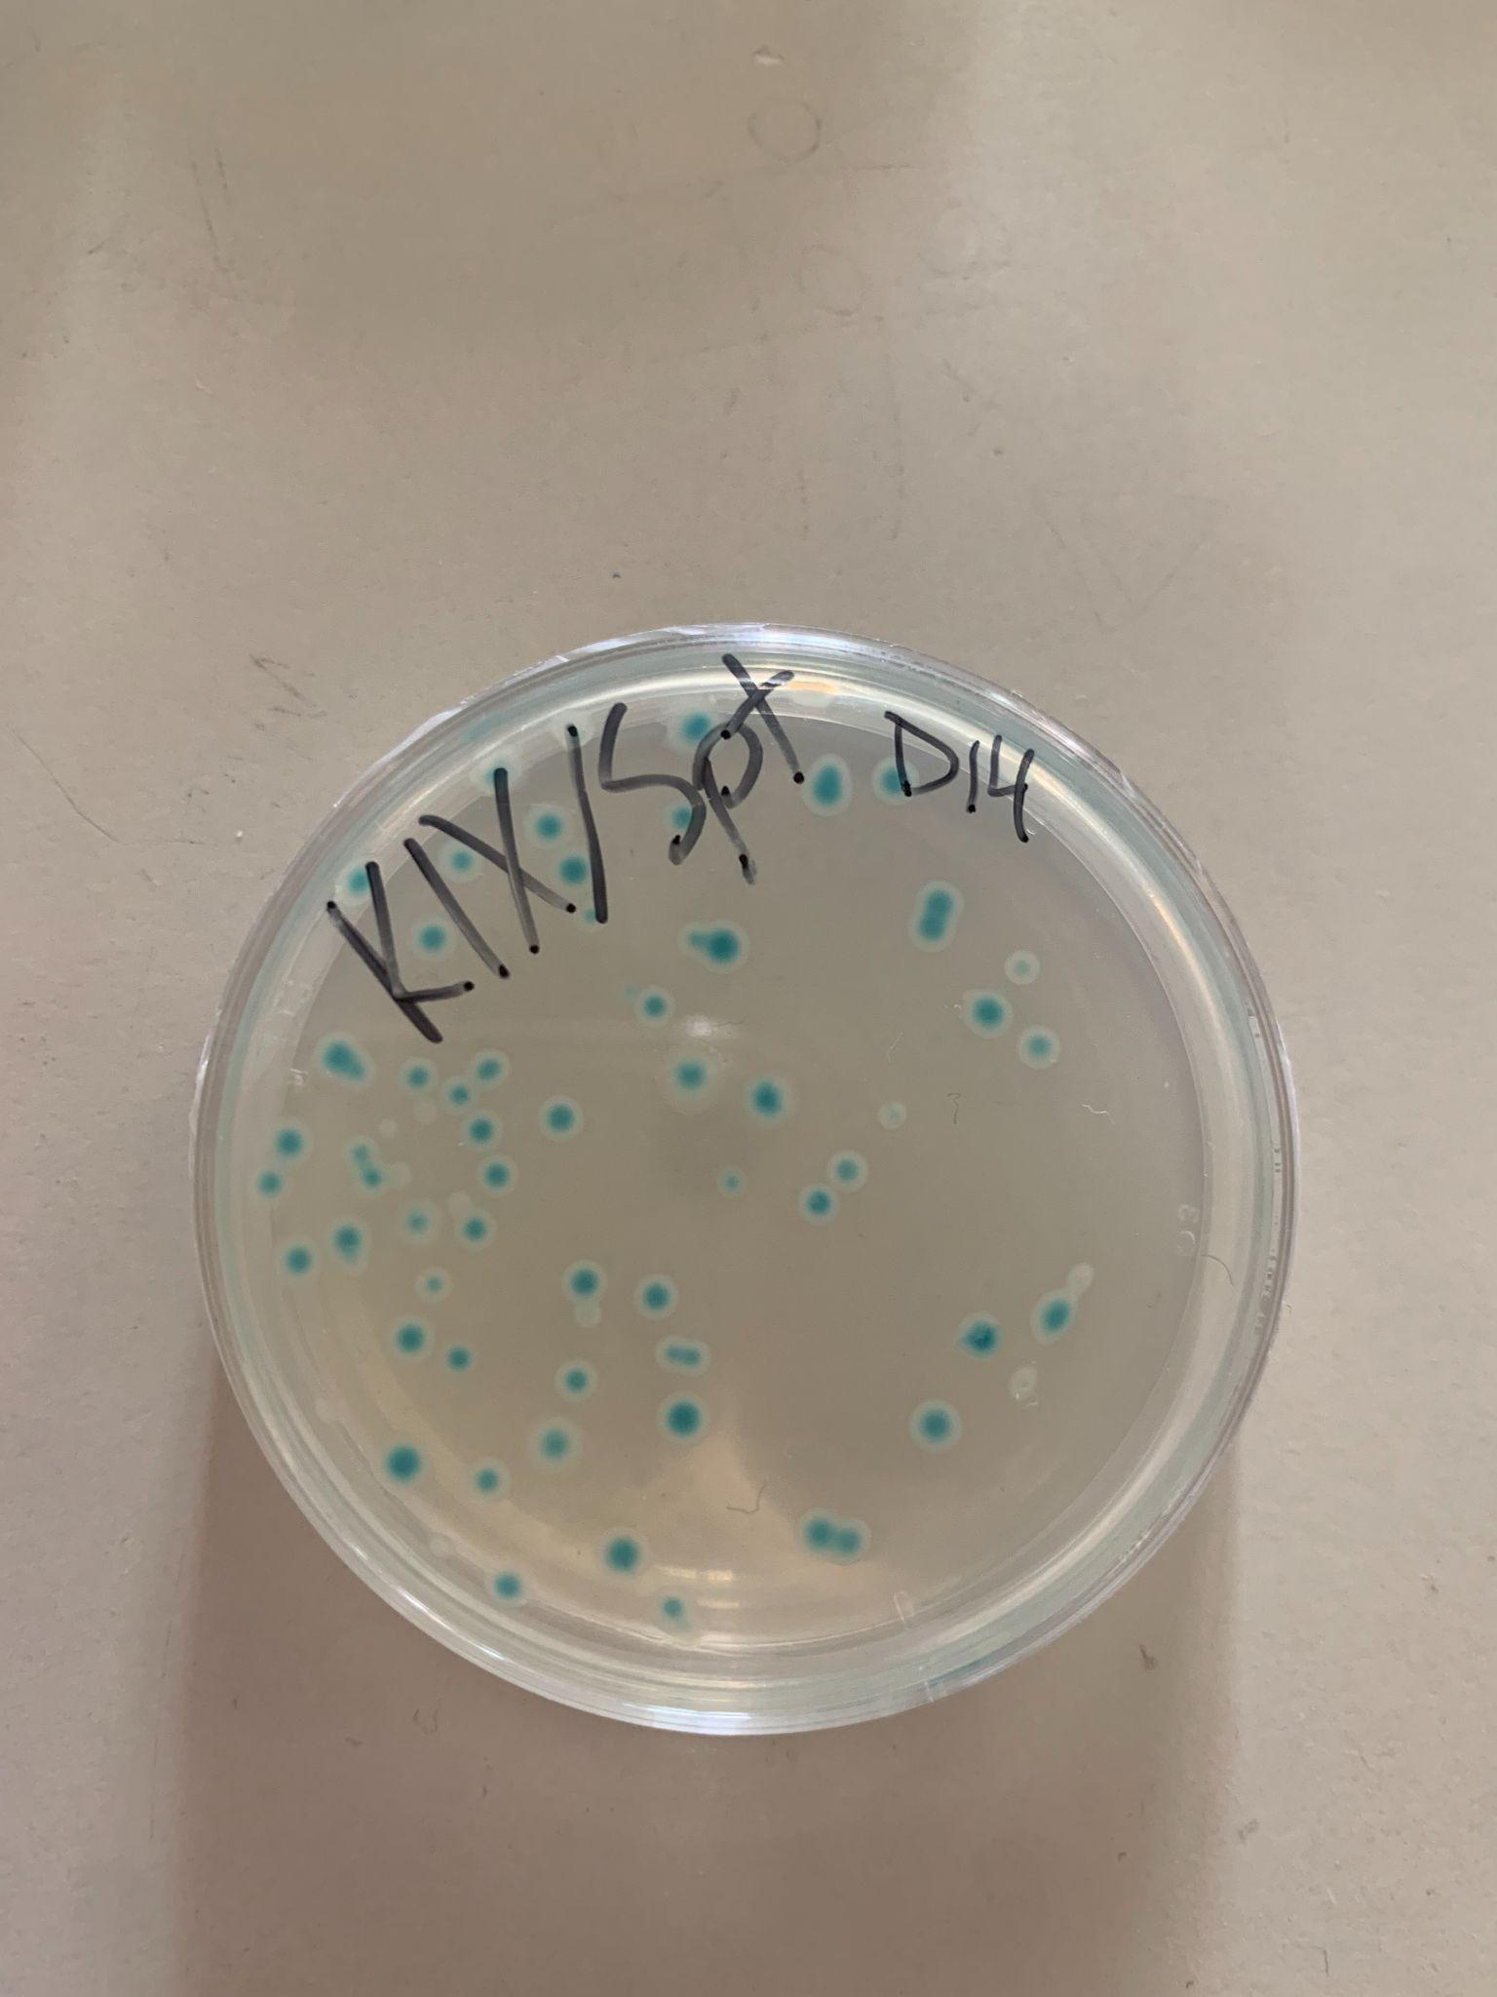
Observation of 1. experiment (E1) – geneediting by CRISPR/Cas9
C1
C1: OBSERVATION
– blue bacteria colonies
D1: OBSERVATION
– blue bacteria colonies with a big white ring around them.
D1

Slide 5
Result of 1. experiment (E1) – geneediting by CRISPR/Cas9
A1
A1: RESULT
– The bacteria took up the pLZDonor Plasmid
B1: RESULT
– The bacteria grown in the B plate took up a new plasmid but not the pLZDonor Guide Plasmid
B1

Slide 6
Result of 1. experiment (E1) – geneediting by CRISPR/Cas9
C1
C1: RESULT
– The bacteria took up the pLZDonor Plasmid
D1: RESULT
– The bacteria grown in the D plate took up a new plasmid but not the pLZDonor Guide Plasmid
D1

Slide 7
Conclusion of 1. experiment (E1) – geneediting by CRISPR/Cas9
A1: CONCLUSION
– Bacteria survived and grew in the KIX/SPT plate, because bacteria took up the pLZDonor Plasmid; bacteria remained blue and lacZ-gene is working
B1: CONCLUSION
– Definitely: bacteria took up a new plasmid, It was not the pLZDonor Guide Plasmid.
– Hypothesis: 1) Contamination of B1 plate with other sample; 2) Mix up between the pD and pDG tube during the experiment
A1
B1

Slide 8
Conclusion of 1. experiment (E1) – geneediting by CRISPR/Cas9
C1: CONCLUSION
– Bacteria survived and grew in the KIX/SPT plate, because bacteria took up the pLZDonor Plasmid; bacteria remained blue and lacZ-gene is working
D1: CONCLUSION
– Definitely: bacteria took up a new plasmid, it was not the pLZDonor Guide Plasmid.
– Hypothesis: 1) Contamination of B1 plate with other sample; 2) Mix up between the pD and pDG tube during the experiment
C1
D1

Slide 9
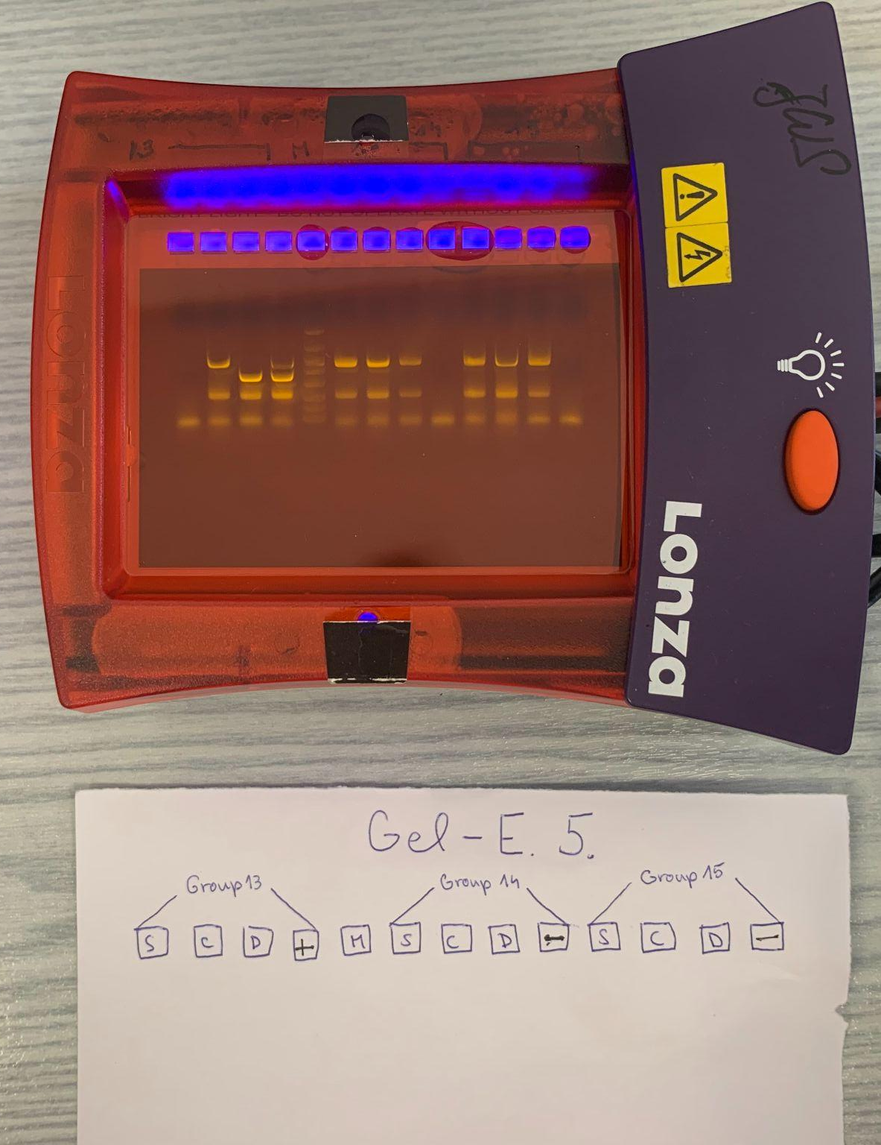
Observation of 2. experiment (E2) – Evidence for CRISPR/Cas9 In-Vivo-Geneediting by PCR
S sample (DNA of C1): OBSERVATION
– 3 visible bands, same height as others
C sample (DNA of B1): OBSERVATION
– 3 visible bands, same height as others
D sample (DNA of D1): OBSERVATION
– 3 visible bands, same height as others

Slide 10
Result of 2. experiment (E2) – Evidence for CRISPR/Cas9 In-Vivo-Geneediting by PCR
S sample (DNA of C1): RESULT
– Length of DNA is 1100 bp
C sample (DNA of B1): RESULT
– Length of DNA is 1100 bp
D sample (DNA of D1): RESULT
– Length of DNA is 1100 bp

Slide 11
Conclusion of 2. experiment (E2) – Evidence for CRISPR/Cas9 In-Vivo-Geneediting by PCR
S sample (DNA of C1): CONCLUSION
– The DNA of all the samples is the same, cut was not made, pLZDonor Plasmid is taken in.
C sample (DNA of B1): CONCLUSION
– The DNA of all the samples is the same, DNA cut was not made, new plasmid taken in.
D sample (DNA of D1): CONCLUSION
– The DNA of all the samples is the same, DNA cut was not made, new plasmid taken in.

Slide 12
Summary of experiments E1 and E2
A1:
E1: blue bacteria colonies with pLZDonor Plasmid
E2: —
→ Successful transformation
B1 (sample C in E2):
E1: blue bacteria colonies with a new plasmid
E2: the DNA is the same as other samples
→ Transformed plasmid was not pLZDonor Guide Plasmid
C1 (sample S in E2):
E1: blue bacteria colonies with pLZDonor Plasmid
E2: the DNA is the same as other samples
→ Successful transformation
D1 (sample D in E2):
E1: blue bacteria colonies with a new plasmid
E2: the DNA is the same as other samples
→ Transformed plasmid was not pLZDonor Guide Plasmid

