Slide 1
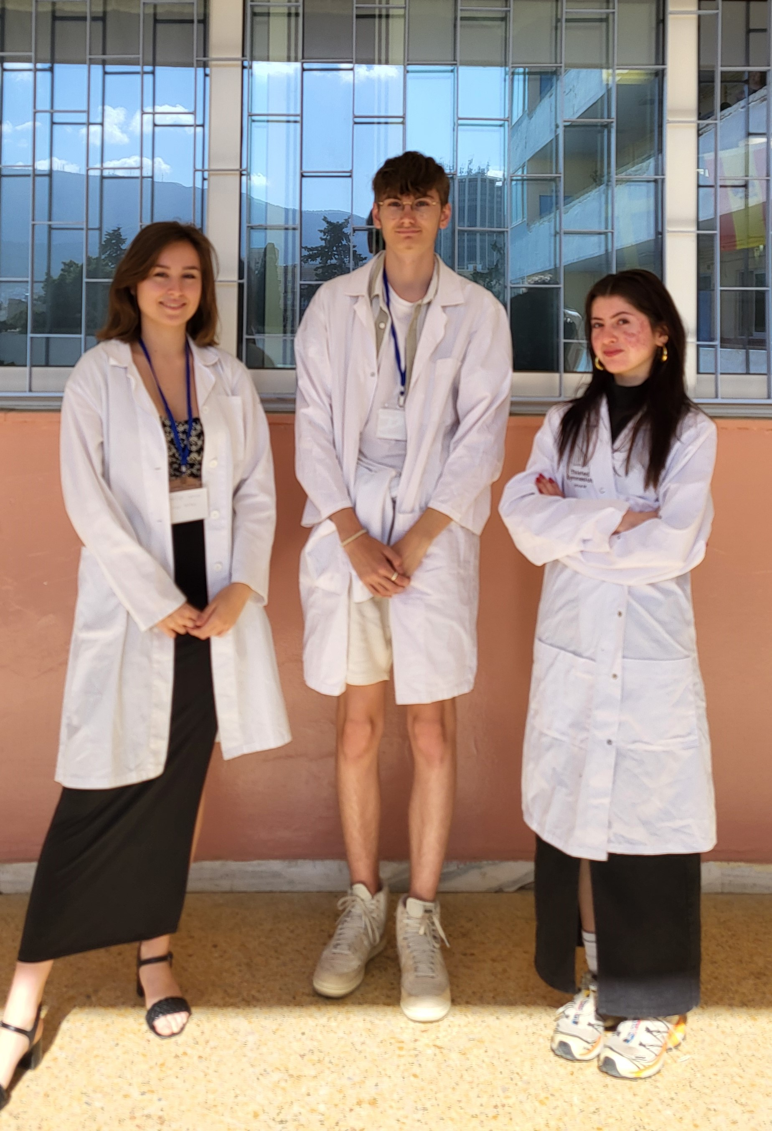
Group 5: Presentation of group members
Gabriella Pedersen
Denmark
Sam Brault
France
Anežka Jurková
Czech Republic

Slide 2
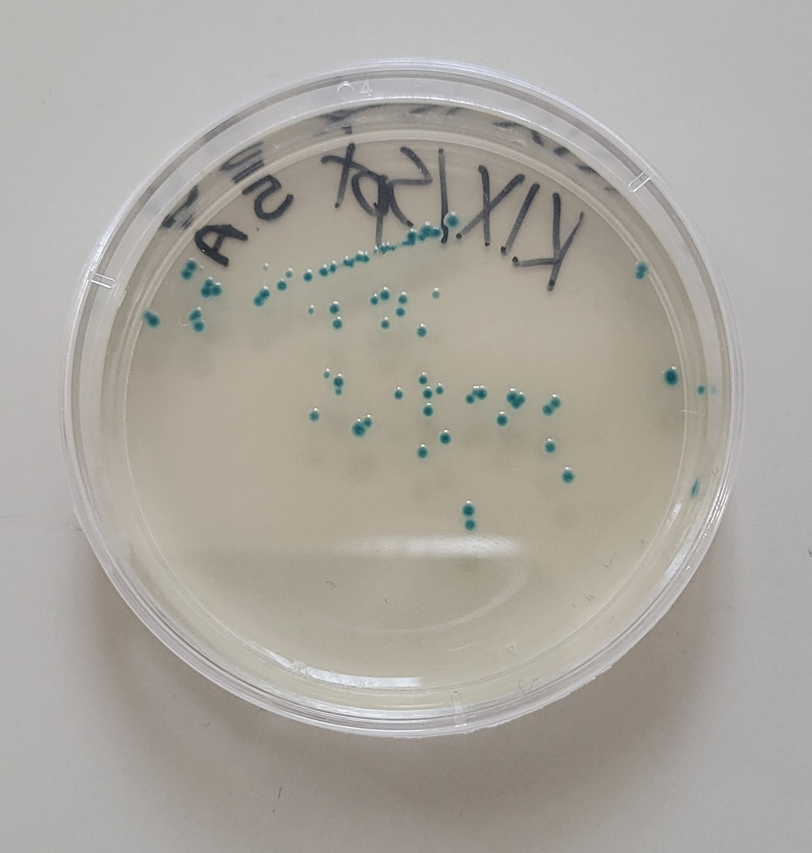
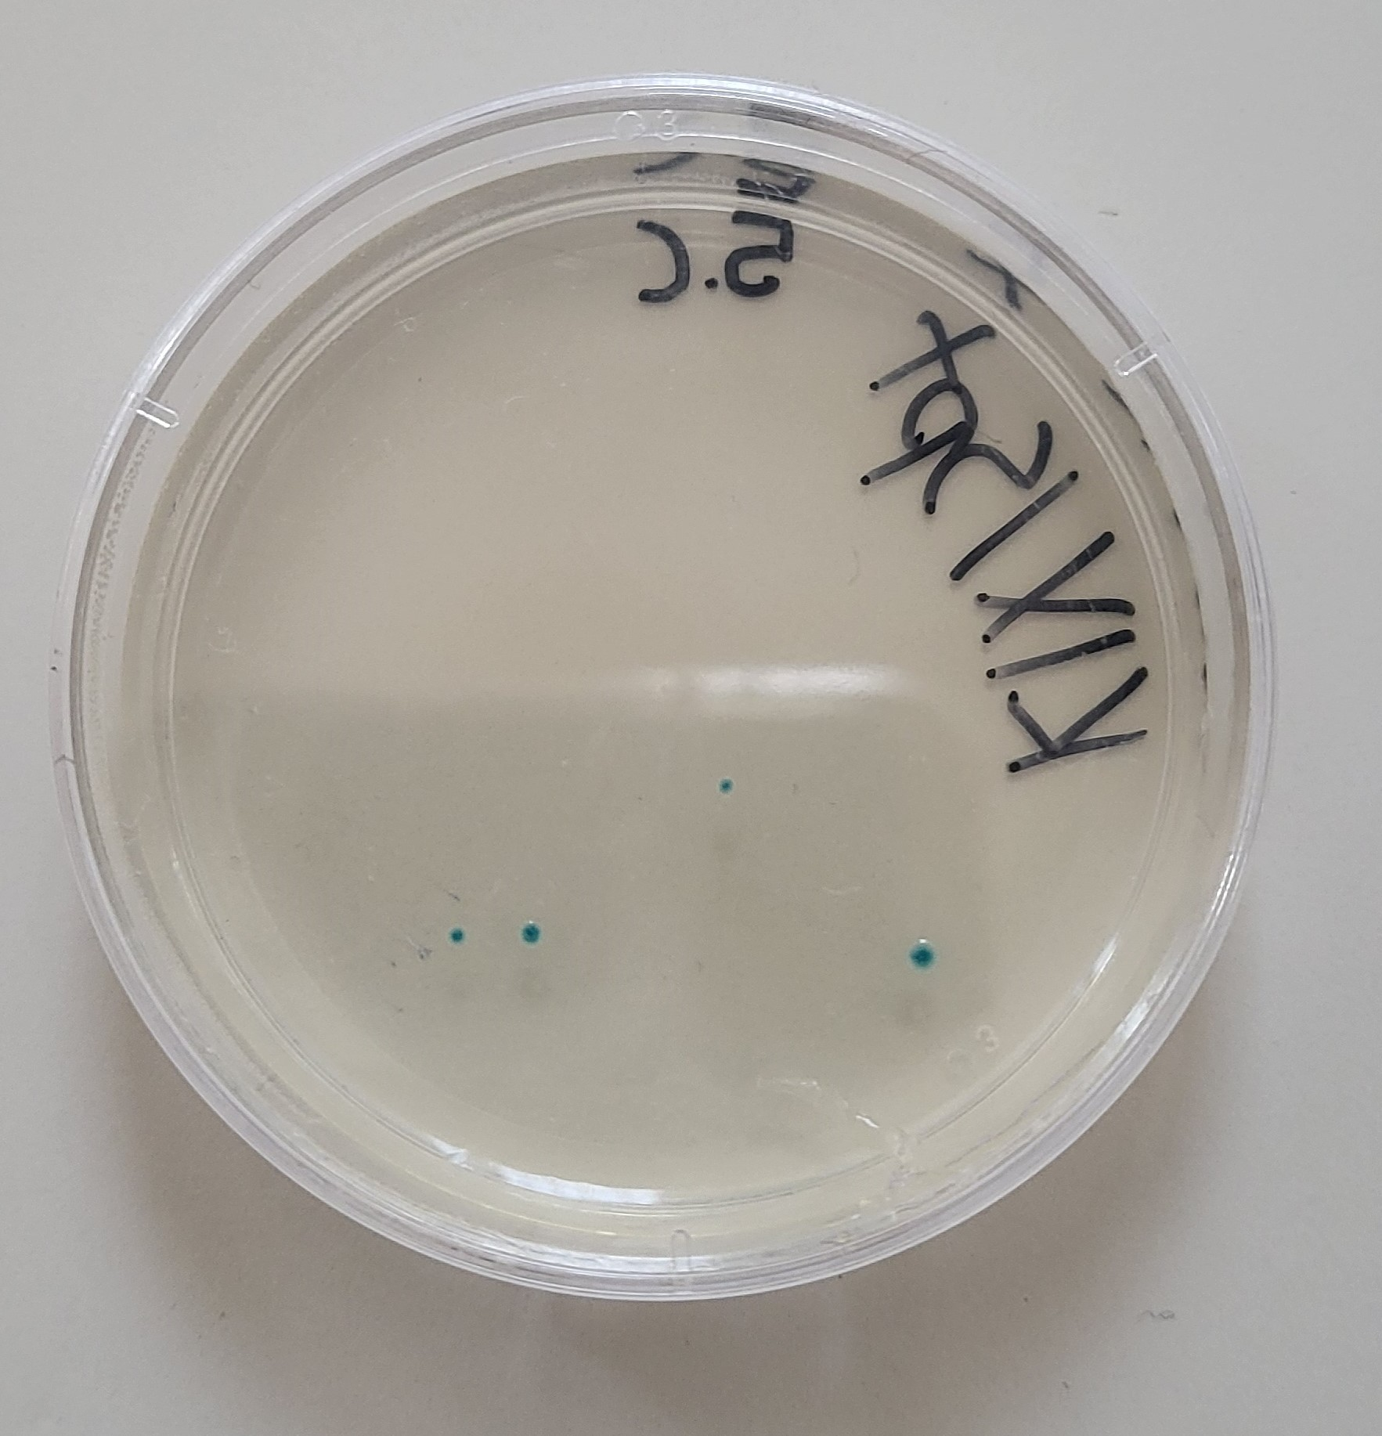
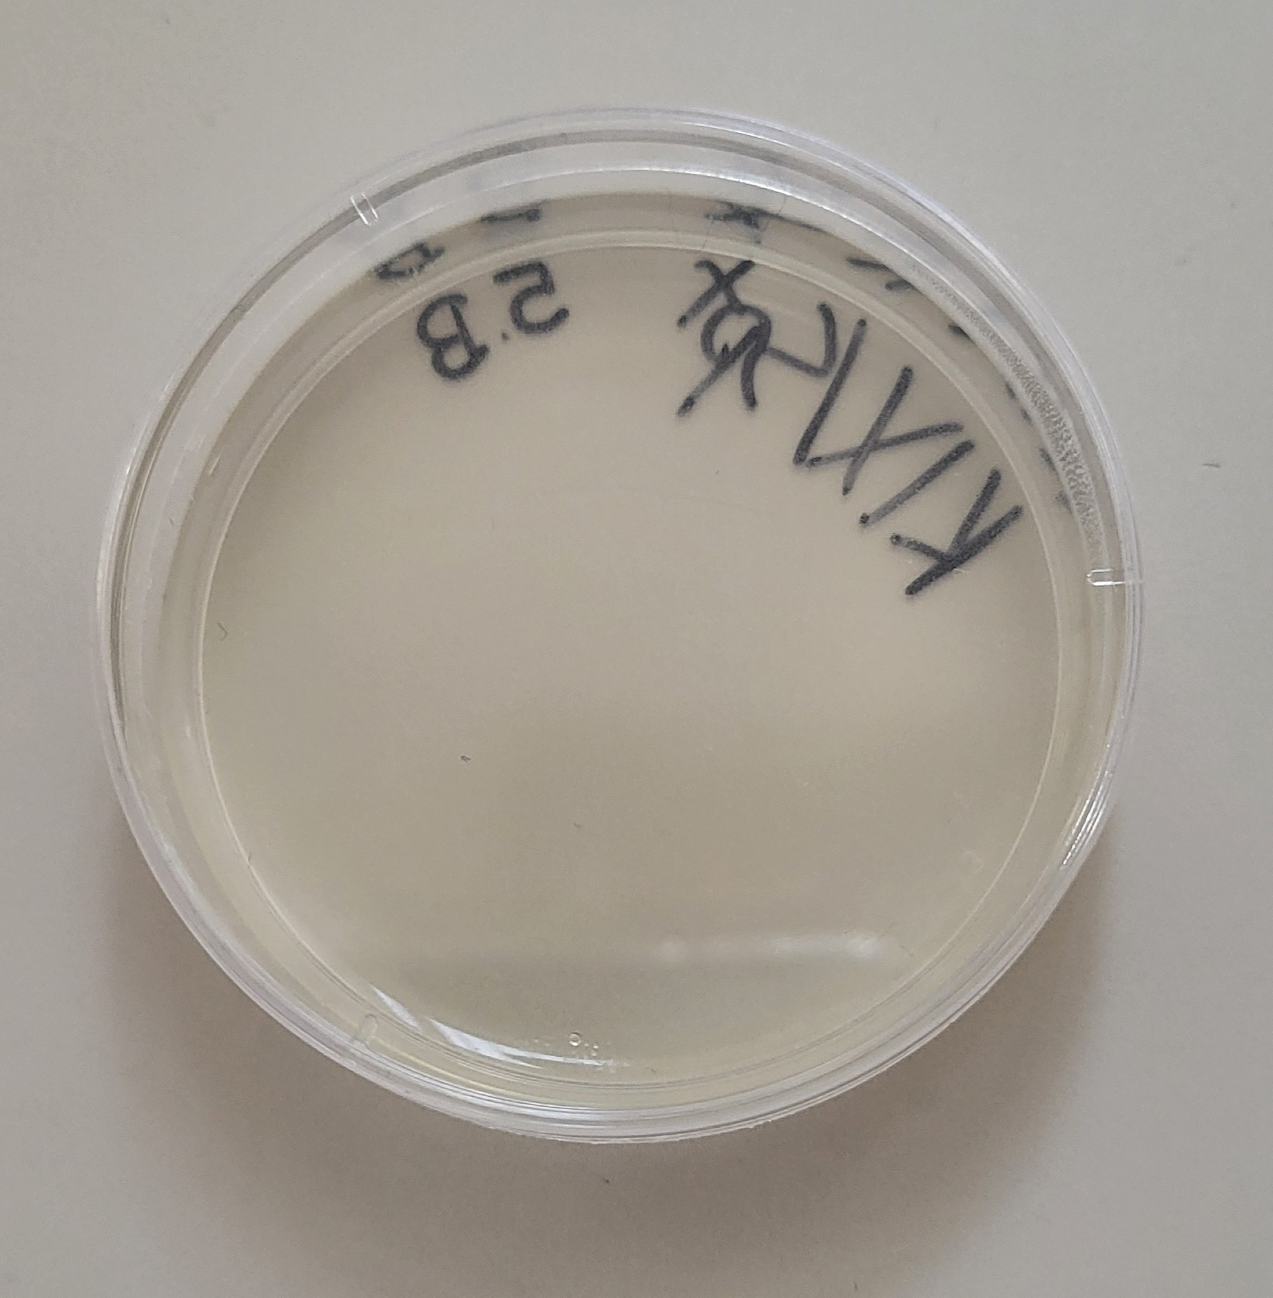
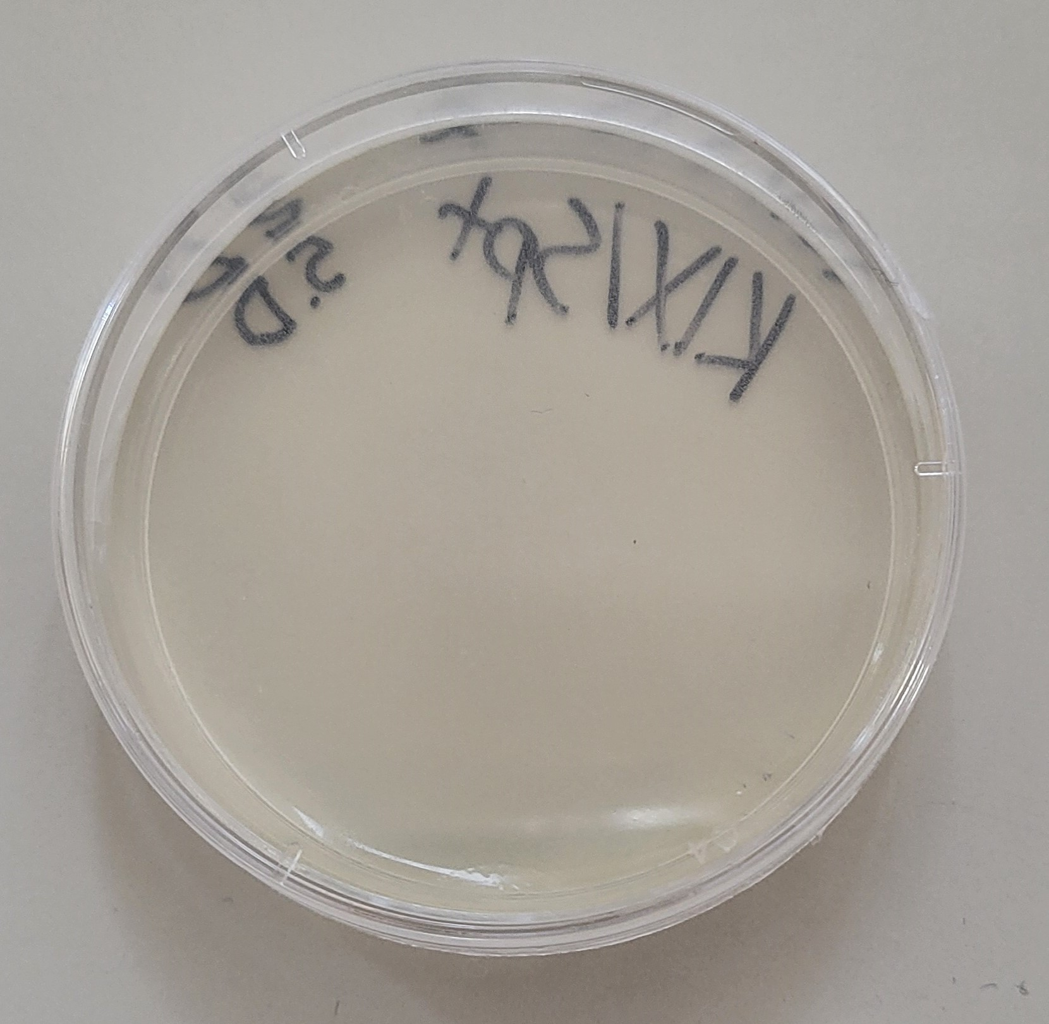
Step 1: Transformation of E. coli
A
C : C
- Blue colonies
-With arabinose/no gRNA
→no cut on lacZ-gene
A:
- Blue colonies
- No arabinose/no gRNA
→ no cut on lacZ-gene
B:
- No colonies
- No arabinose/with gRNA
→cut lacZ-gene but no
repair, bacteria died
B
D : D
-No colonies
-With arabinose/with gRNA
→Mistake: Possible error
with arabinose

Slide 3
Step 2: PCR
S/A
C

Slide 4
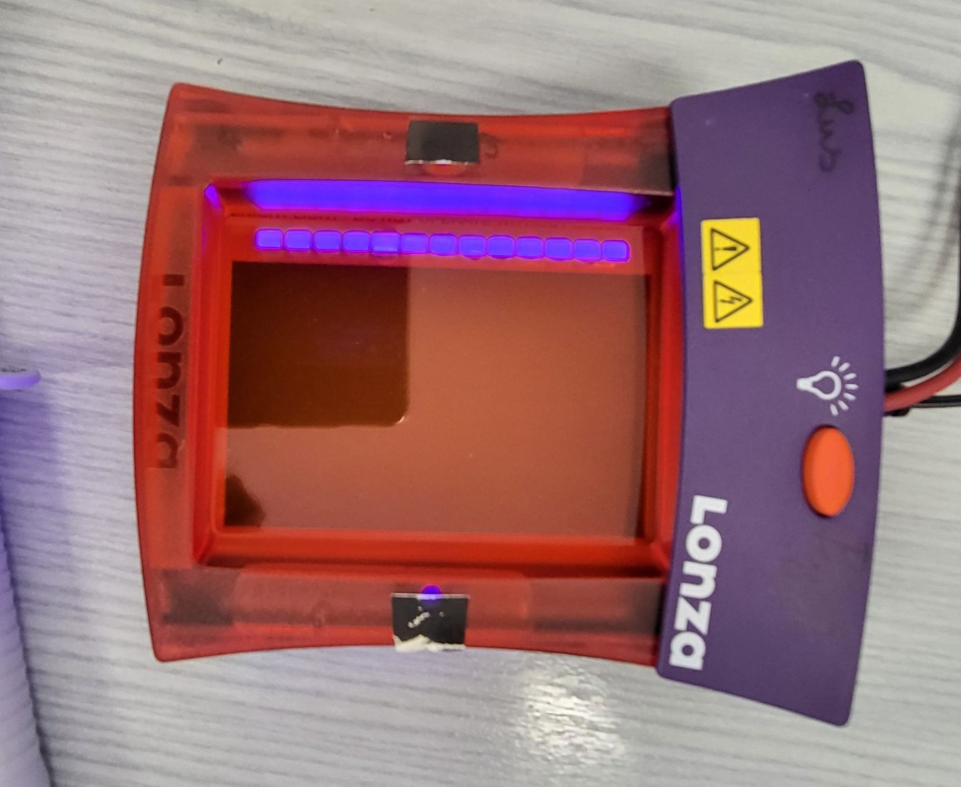
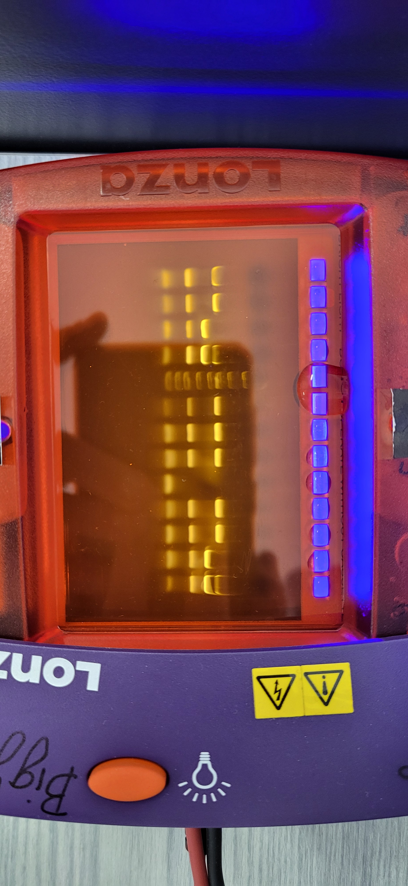
Step 2: Gel electrophoresis
S/A: Before experiment:
- 1100 bp, 350 bp and app. 20 bp
- full length lacZ-gene
C: After experiment:
- 1100 bp, 350 bp and app. 20 bp
- full length lacZ-gene
Negative control:
- app. 20 bp
A1
B1

Slide 5
Conclusion
A: RESULT
– Step 1: Blue colonies
-> no cut on lacZ-gene
– Step 2: Bands at 1100 bp, 350 bp, app. 20 bp
-> Proof of full length lacZ-gene
B: RESULT
– Step 1: No colonies
-> Repair system could not repair the cut -> dead

Slide 6
Conclusion
C: RESULT
– Step 1: Blue colonies
-> no cut on lacZ-gene
– Step 2: Bands at 1100 bp, 350 bp, app. 20 bp
-> Proof of full length lacZ-gene
D: RESULT
– Step 1: No colonies
-> Mistake happened – possibly killed the bacteria

