Slide 1
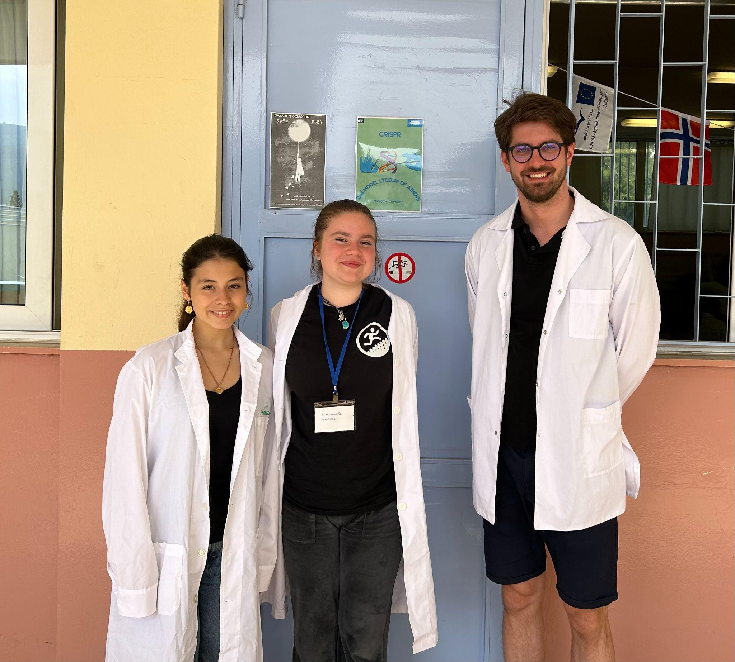
Group 18
Emmanouela Mastoraki
Greek - Mentor
Flag
Simas Ignatavičius
Lithuanian - Teacher
Flag
Zoi Natsi
Greek - Student
Flag

Slide 2
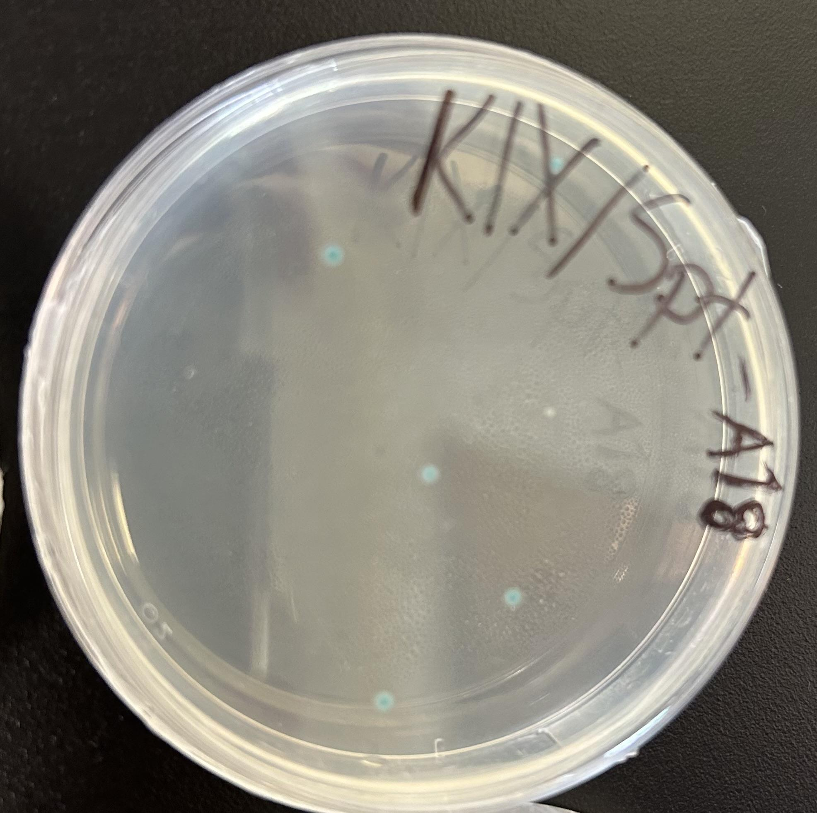
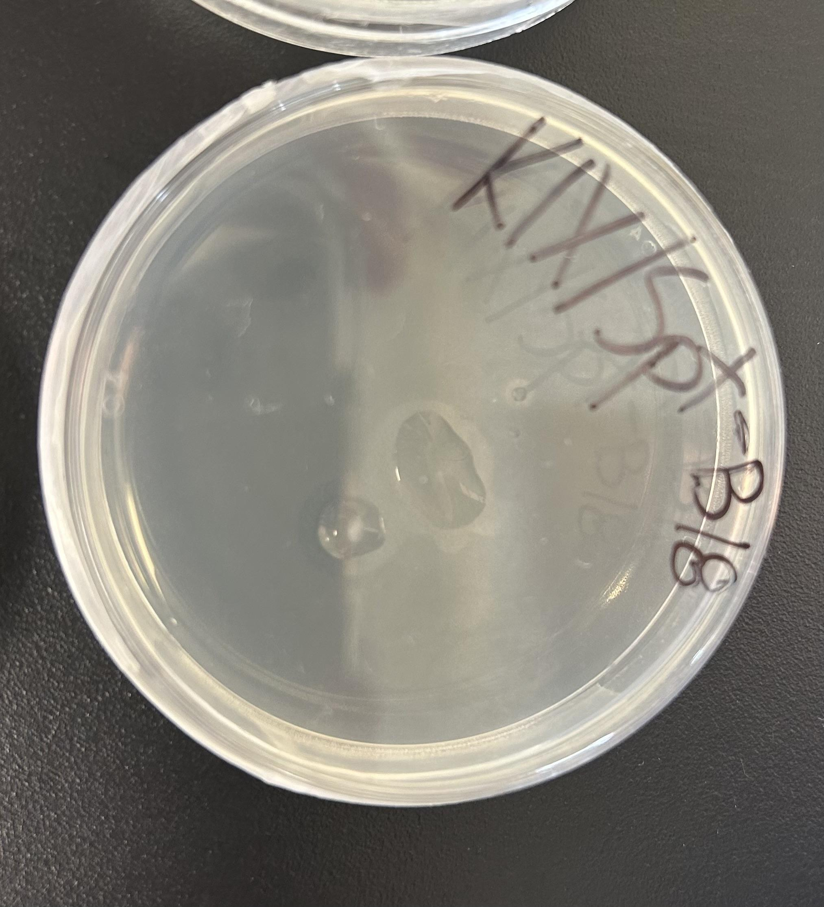
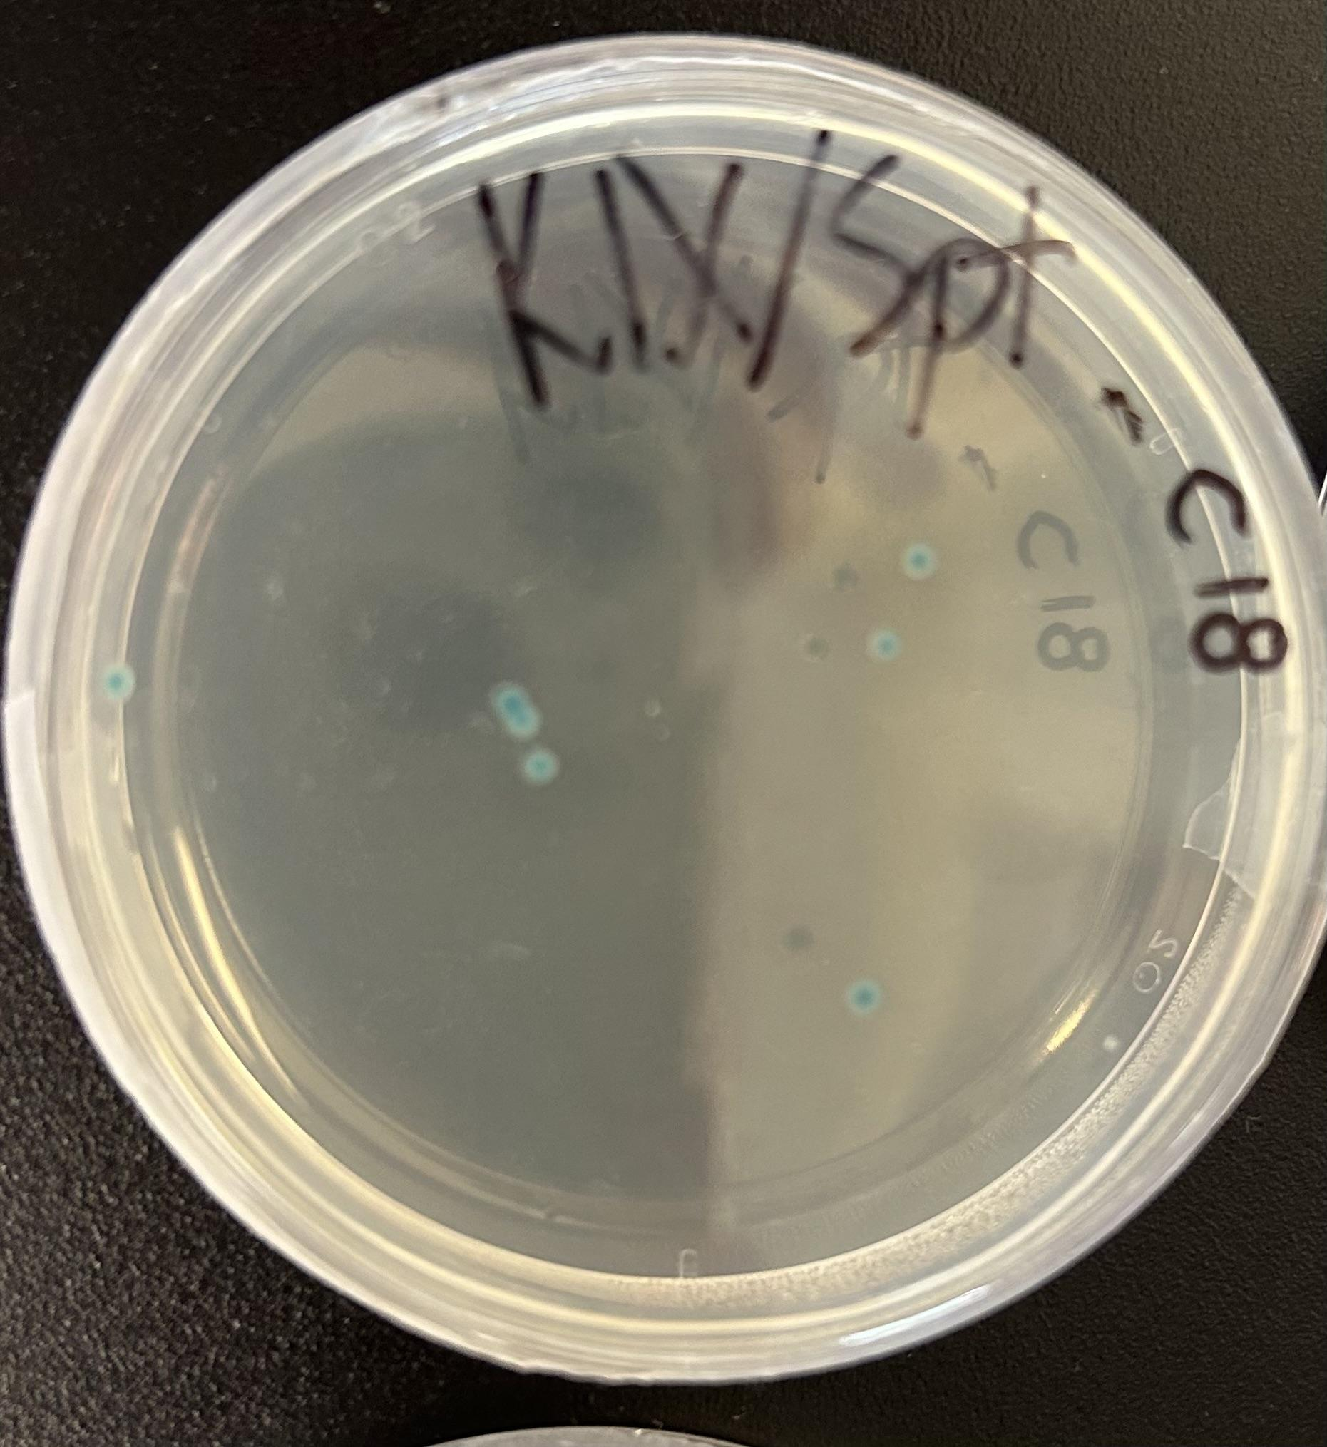
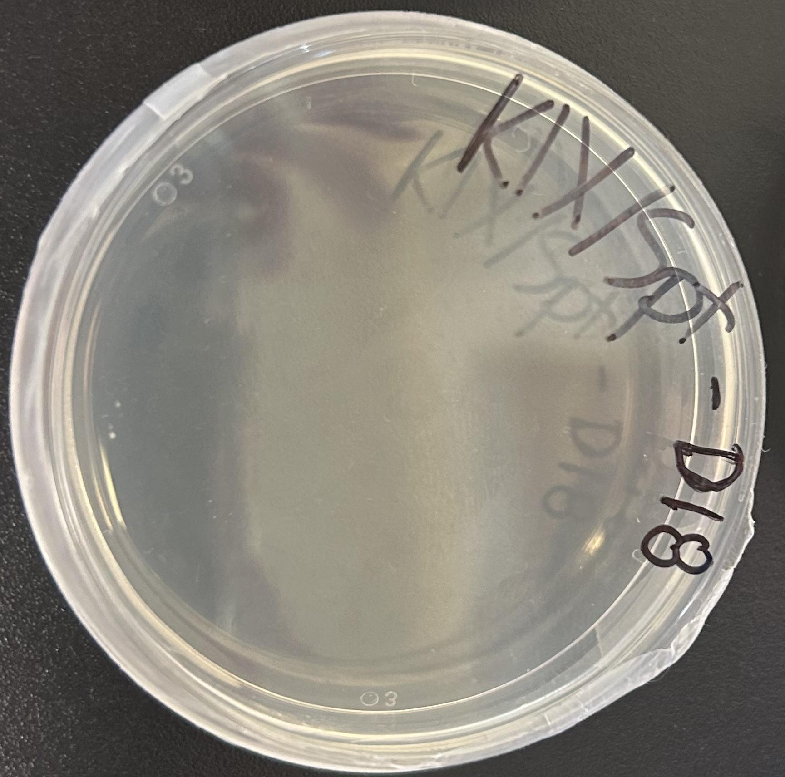
Evaluation of 1. experiment
Observation
A – Blue colonies
B – No colonies
C – Blue colonies
D – White colonies

Slide 4
Evaluation of 1. experiment
Results
A - Active lacz gene
B - Dead bacteria
C - Active lacz gene
D - Inactive lacz gene

Slide 5
Evaluation of 1. experiment
Conclusion
A –wild type bacteria
No cut made
B – dead bacteria
Cut was made, inactive HDR
C – wild type bacteria
No cut made
D – white bacteria
Repaired cut

Slide 6
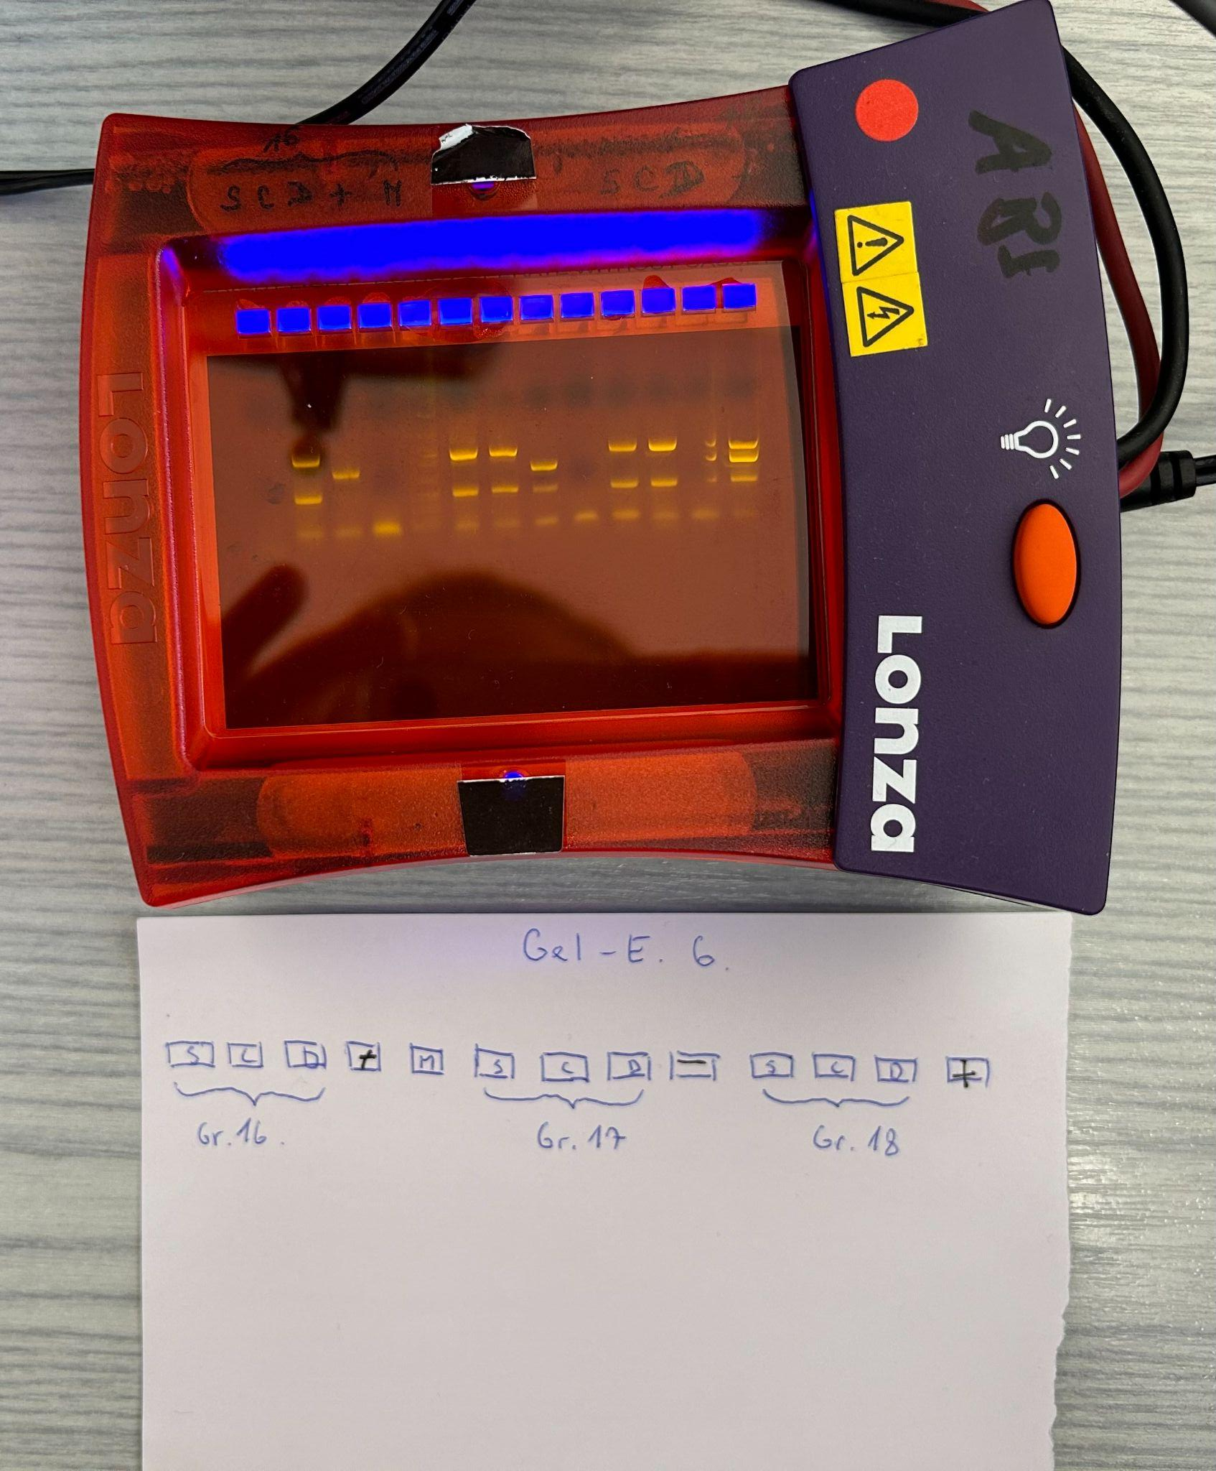
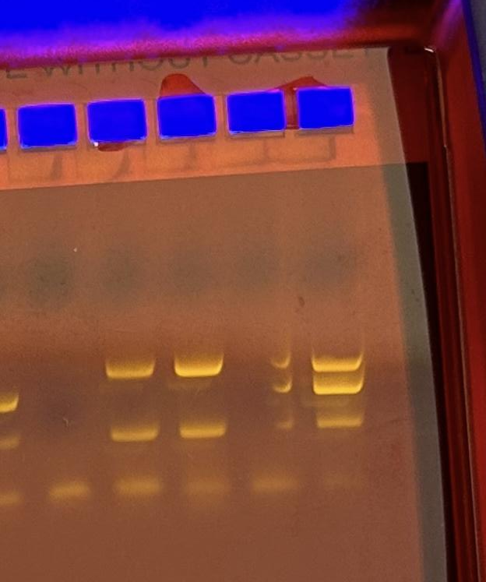
Evaluation of 2. experiment
Observation
S C D C+
S- Three bands of DNA
C- Three bands of DNA
D- Four bands of DNA
(C+)- Four bands of DNA
(D and C+ got mixed.)

Slide 7
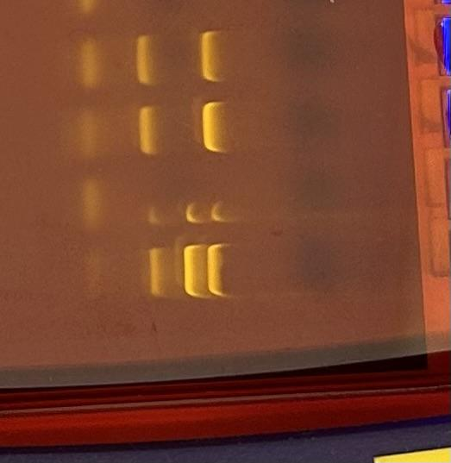
Evaluation of 2. experiment
Result
S C D C+
S- Band 1-1100 bp
Band 2-350 bp
Band 3-15-25 bp
C- Band 1- 1100 bp
Band 2- 350bp
Band 3- 15-25bp
D- Band 1-1100bp
Band 2-650bp
Band 3-350bp
Band 4-15-25bp
(C+)- Band1-1100bp
Band 2-650bp
Band 3-350bp
Band 4-15-25bp
S C D C+
1100bp
650bp
350bp
15-25bp

Slide 8
Evaluation of 2. experiment
Conclusion
S C D C+
S- 1100 bp
Wild type bacteria
C- 1100 bp
Wild type bacteria
D- 1100 bps, 650 bp
Both wild and edited DNA
(C+)- 1100 bps ,650 bp
Both wild and edited DNA
(D got contaminated by C+ DNA, that is why it appears that it contains DNA from both edited and unedited bacteria)
1100bp
650bp
350bp
15-25bp

Slide 9
Summary of experiments E1-E2
A/S- Unedited colonies
Blue color
1100 bp
B- No colonies
C- Unedited colonies
Blue color
1100bp
D- Edited colonies
White color
650bp (/1100bp because of the contamination)
S C D C+
1100bp
650bp
350bp
15-25bp

