Slide 1
Group 17
Mentor:
Šimon Šimko
Paticipants:
Zoe Giotaki
Pia Vigsø Lassen

Slide 2
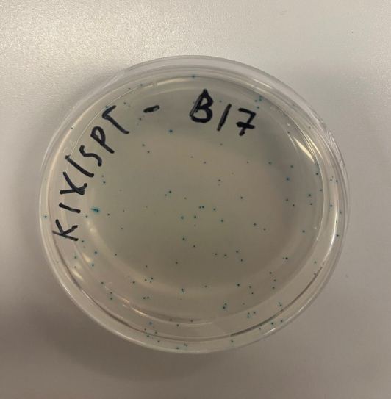
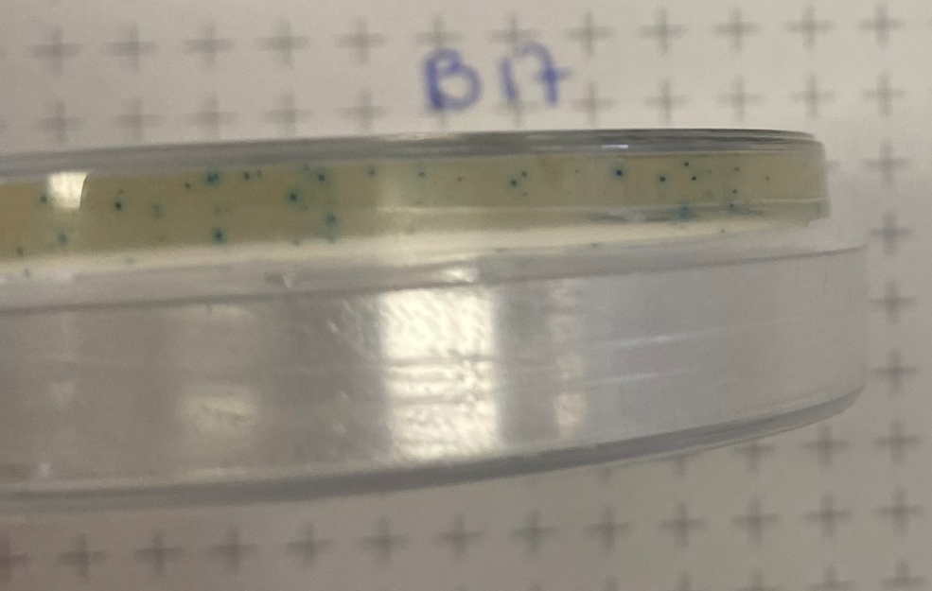
Experiment 1 – Observation (A+B)
A: Blue colonies both on the surface and inside the Agar
B: No colonies on the surface and blue colonies inside the Agar

Slide 3
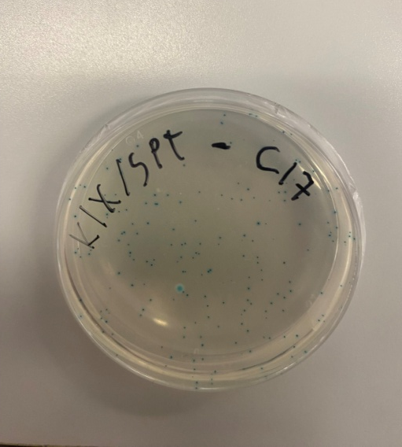
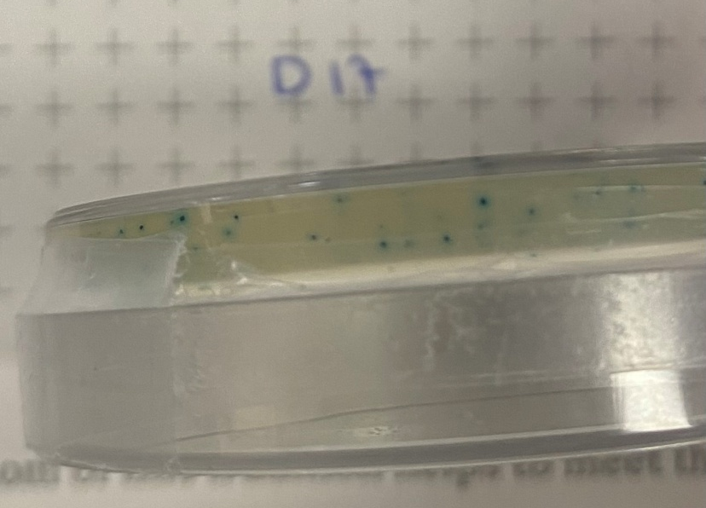
Experiment 1 – Observation (C+D)
C: 1blue colony on the surface and several blue colonies inside the Agar
D: a few white colonies on the surface and several blue colonies iinside the Agar

Slide 4
Experiment 1 - Results
A: The bacteria are alive and they have metabolized the X-lactose
B: There are no living bacteria
C: The bacteria are alive and they have metabolized the X-lactose
D: The bacteria are alive but they have not metabolized the X-lactose

Slide 5
Experiment 1 – Conclusion
A:
No cut in lacZ-gene because of the absence of Guide-RNA
intact lacZ-gene so bacteria can metabolize X-lactose
B:
cut in lacZ-gene because of the presence of Guide-RNA and absence of arabinose
inactive HDR
C:
No cut in lacZ-gene because of the absence of Guide-RNA
intact lacZ-gene so the bacteria can metabolize X-lactose
D:
cut in lacZ-gene because of the presence of Guide-RNA
active HDR because of the presence of arabinose
inactive lacZ-gene so cannot metabolize X-lactose

Slide 6
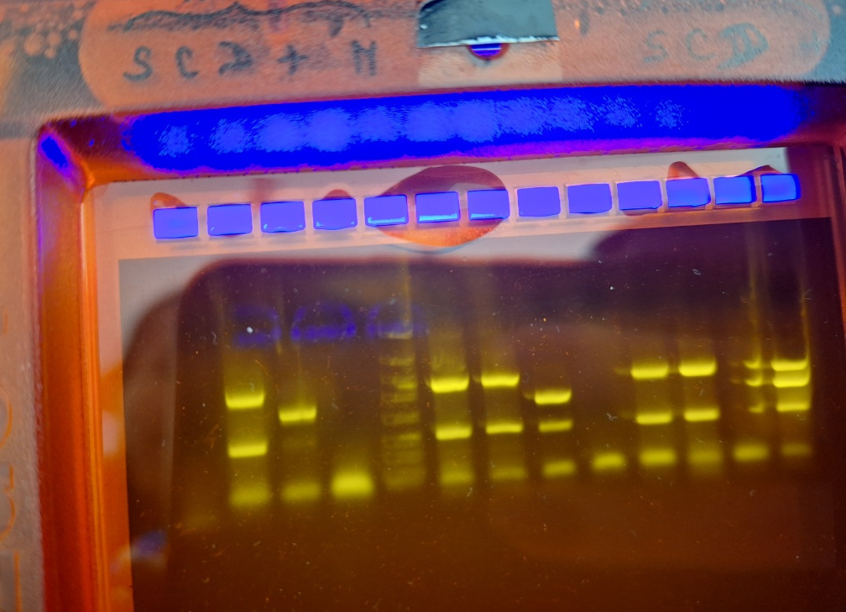
Experiment 2 - Observation
S & C: same band position in gel
D: Top band position lower than in S&C
Negative control: only contains bottom band

Slide 7
Experiment 2 - Results
S&C: band positions are on 1100 basepairs, 350 basepairs (chromosome DNA for control), 20 basepairs (primers)
D: band positions are on 650 basepairs, 350 basepairs(chromosome DNA for control), 20 basepairs (primers)
Negative control: band position is on 20 basepairs

Slide 8
Experiment 2 - Conclusion
S&C: 1100 basepairs mean that the DNA fragment is longer, meaning it has not been edited
D: 650 basepairs mean that the DNA fragment is shorter meaning it has been edited
Negative control: there are only 20 basepairs which are the primers because no DNA was added in them before the PCR

Slide 9
Summary
C: ARA but no g-RNA
no cut
Not edited
Blue color
1100 bp length
D: ARA and g-RNA
cut
Edited
White color
650bp length
A:
no ARA, no g-RNA
No cut
Not edited
Blue color
1100 bp length
B:
no ARA, but g-RNA
Cut
Not edited
No DNA to analyze

Slide 10
Thank you

