Slide 1
Summary of results from experiments: gene editing by CRISPR/Cas9 and electrophoresis

Slide 2
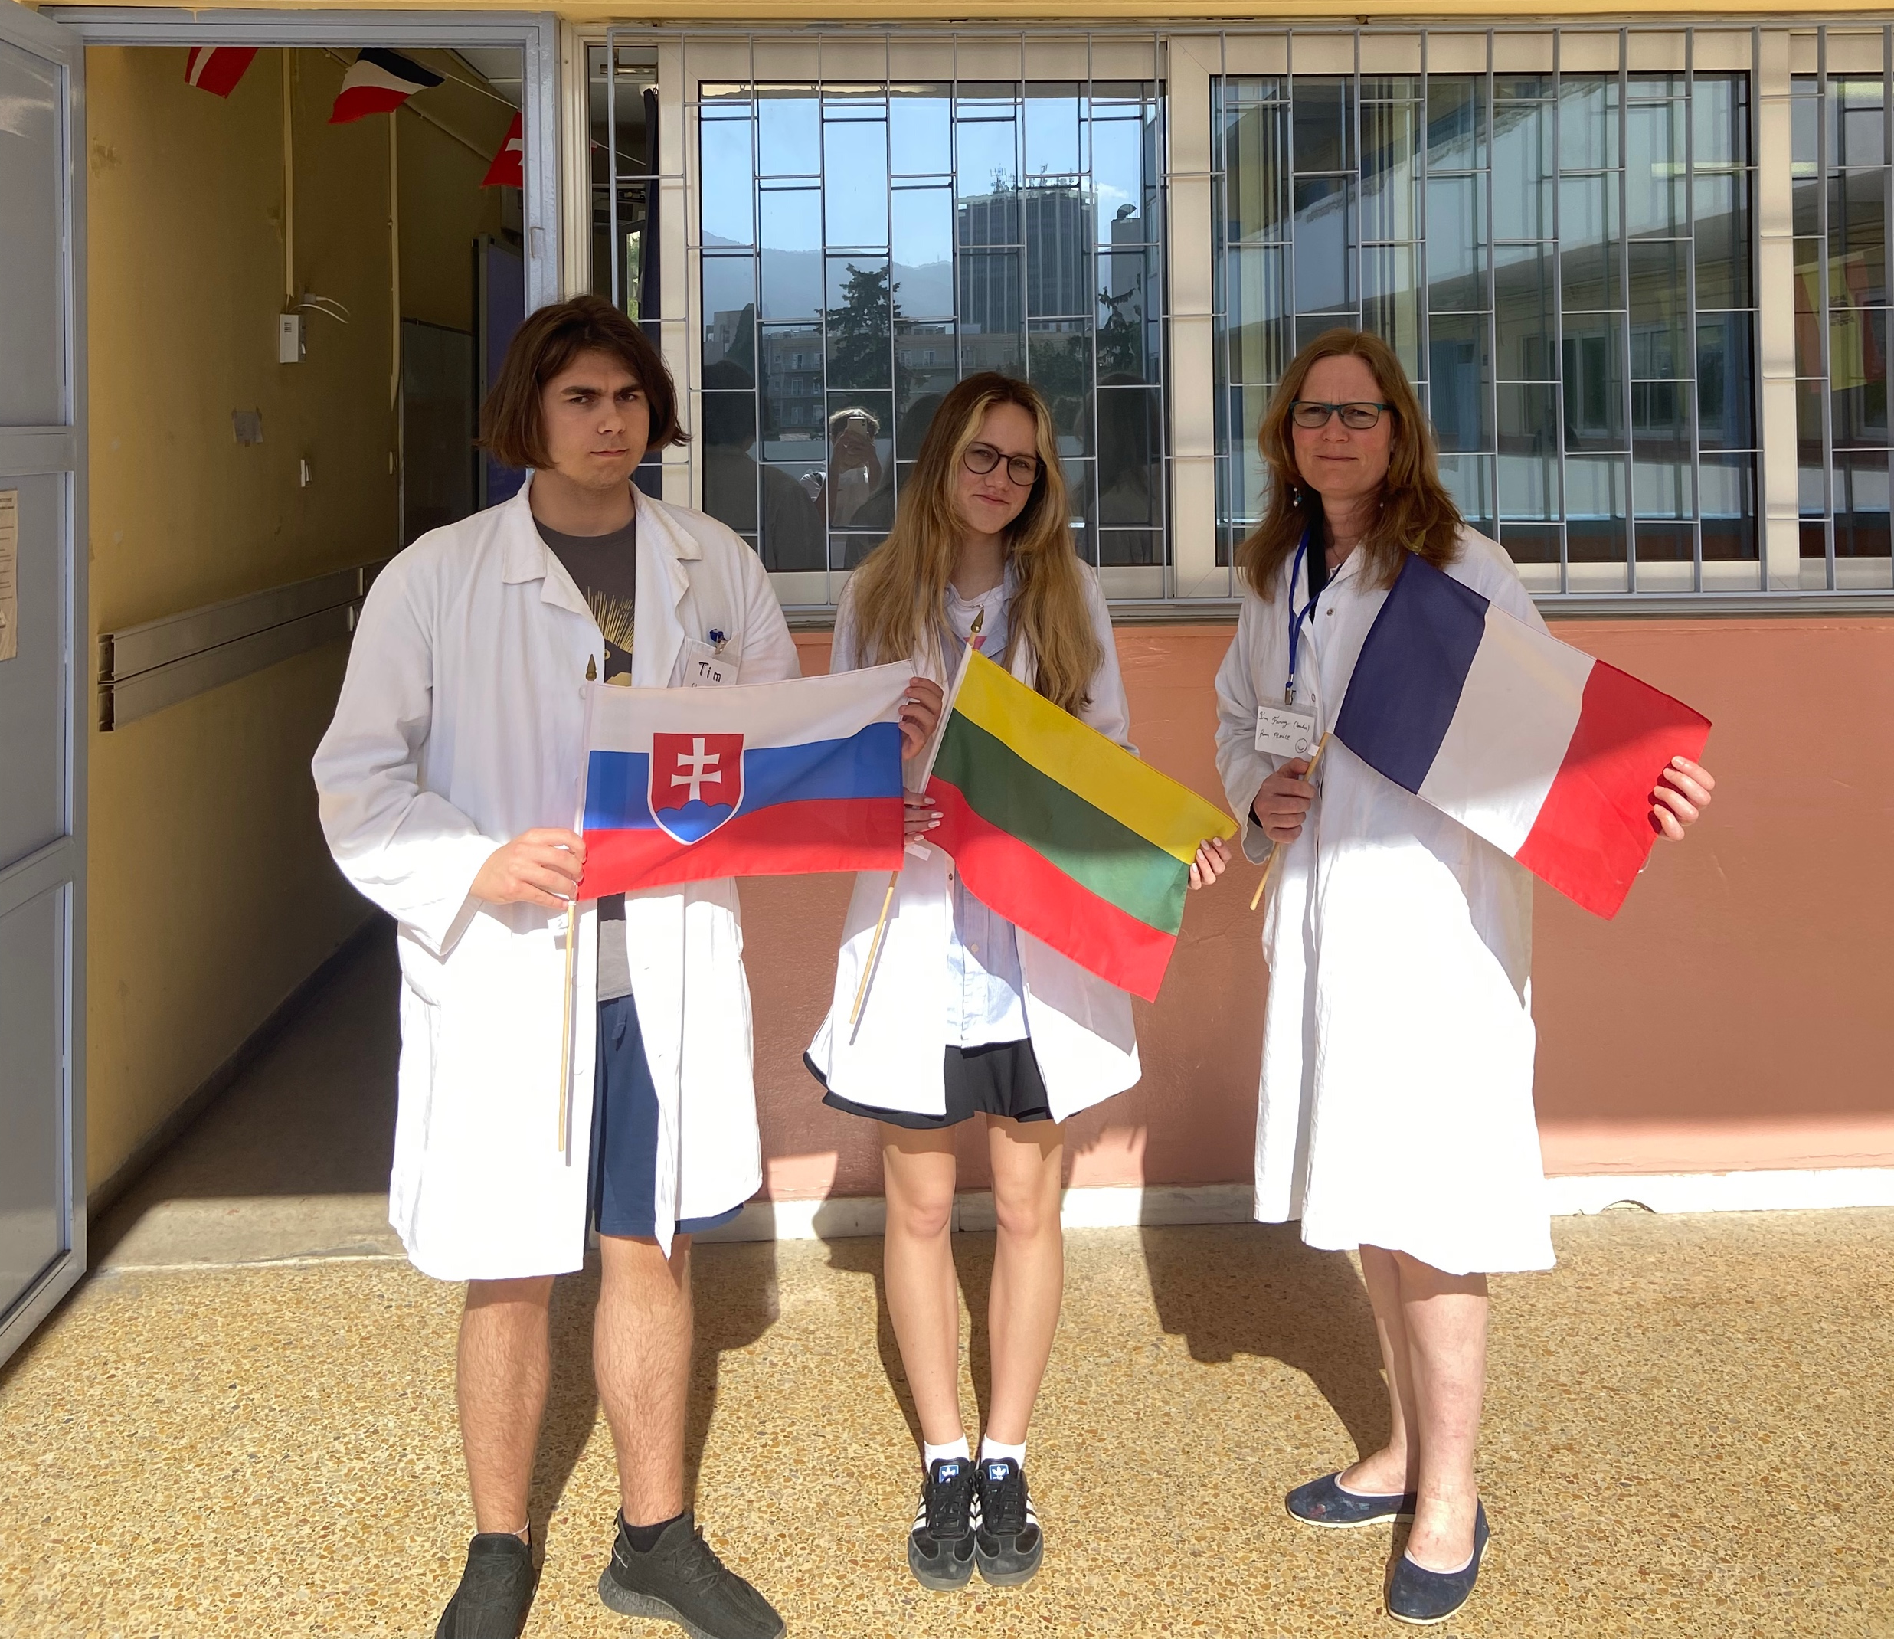
Information about group 15
Lina
Lithuania
Fanny
France
Timotej
Slovakia

Slide 3
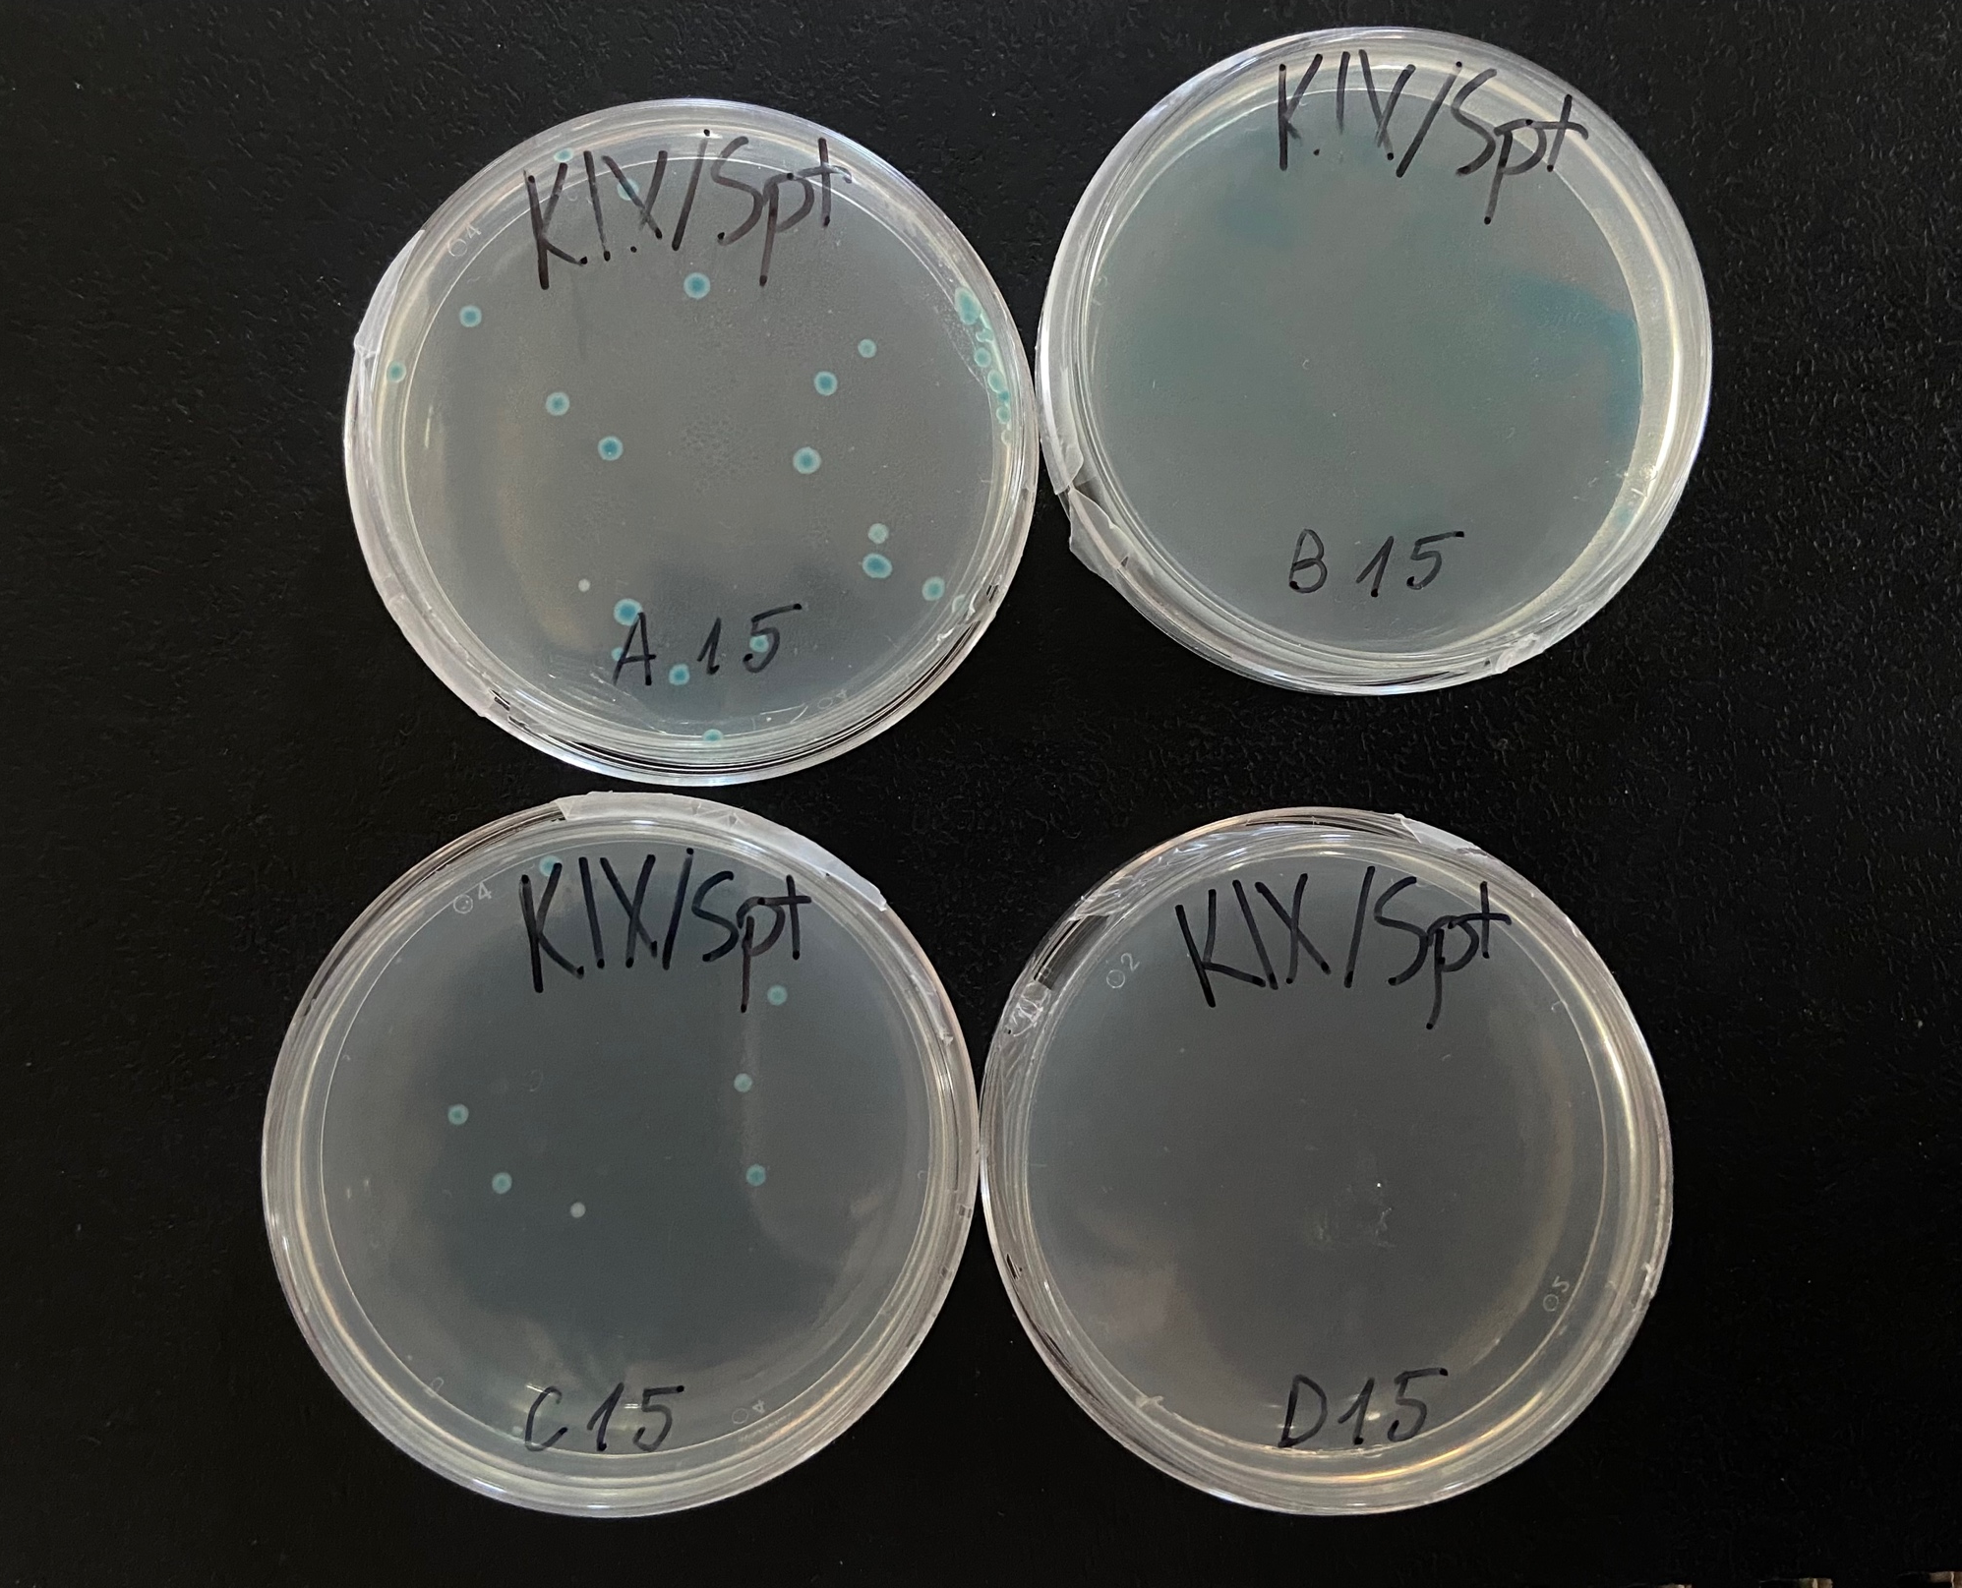
Observation of 1. experiment – gene editing by CRISPR
A: OBSERVATION
– the bacteria were blue
A
B
B: OBSERVATION
– a blue stain was left
C: OBSERVATION
– the bacteria were blue
C
D
D: OBSERVATION
– the bacteria didn‘t grow

Slide 4
Result of 1. experiment – gene editing by CRISPR
A: RESULT
– a cut wasn‘t made and the repair system didn‘t work
A
B
B: RESULT
– some bacteria survived
C: RESULT
– repair system worked, but the cut wasn‘t made
C
D
D: RESULT
– all bacteria died

Slide 5
Conclusion of 1. experiment – gene editing by CRISPR
A: CONCLUSION
– successful transformation: no gRNA in pD, so the gene wasn‘t edited
A
B
B: CONCLUSION
– unsuccessful transformation: some bacteria was not edited and it survived
C: CONCLUSION
– successful transformation: no gRNA, so the cut wasn‘t made (even though the repair system worked)
C
D
D: CONCLUSION
– unsuccessful transformation

Slide 6
Observation of 2. experiment – electrophoresis
A: OBSERVATION
- We can see 3 bands in the electrophoresis
C: OBSERVATION
- We can see 3 bands in the electrophoresis
B: OBSERVATION
- We can see 3 bands in the electrophoresis
B1
A1
A
C
B

Slide 7
Result of 2. experiment – electrophoresis
A: RESULT
The 1st band is around 1100 bp, 2nd around 350bp
C: RESULT
- The 1st band is around 1100 bp, 2nd around 350bp
B: RESULT
- The 1st band is around 1100 bp, 2nd around 350bp
B1
A1
A
C
B
1st
2nd

Slide 8
Conclusion of 2. experiment – electrophoresis
A: CONCLUSION
- In electrophoresis we can see the amplicon of the wild type lacZ gene and the amplicon of chromosome
C: CONCLUSION
- In electrophoresis we can see the amplicon of the wild type lacZ gene and the amplicon of chromosome
B: CONCLUSION
- In electrophoresis we can see the amplicon of the wild type lacZ gene and the amplicon of chromosome
B1
A1
A1
A
A
C
C
B
B
1st
2nd

Slide 9
Summary of experiments
A:
1: successful transformation
2: wild type / chromosome band
B:
1: unsuccessful transformation
2: wild type/chromosome band
C:
1: successful transformation
2: wild type/chromosome band
D:
1: unsuccessful transformation

