Slide 1
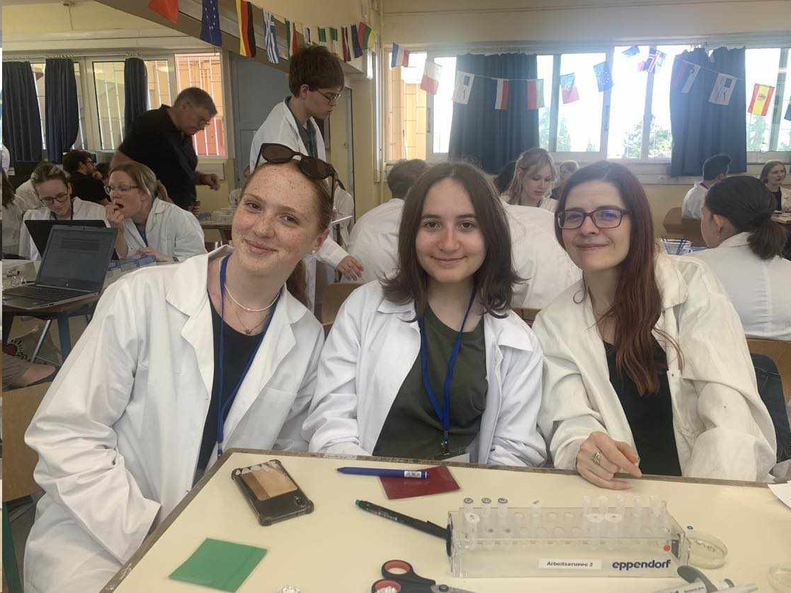
Group 11
Maud GUYOMARCH France
Małgorzata KUCHARSKA Poland
Hana MELCHEROVÁ Slovakia

Slide 2
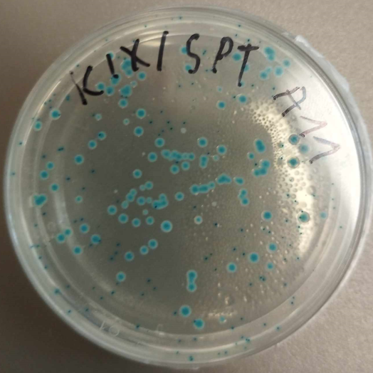
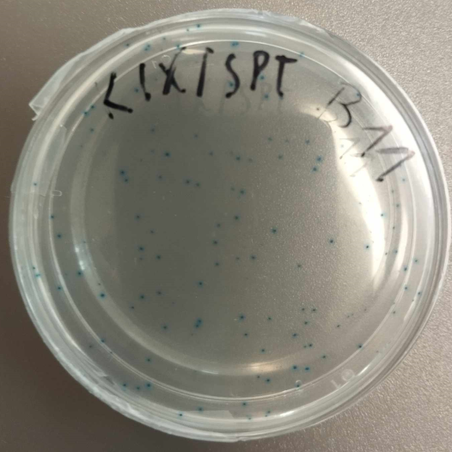
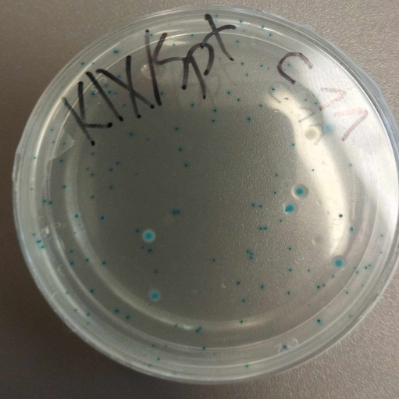
Gene editing + Blue-white screening
Observation:
A: blue colonies inside and on the top of agar
B: blue colonies inside agar
C: blue colonies inside and on the top of agar
D: blue colonies inside of agar
A B C D

Slide 3
Gene editing + Blue-white screening
Result:
A: ß-galactosidase is expressed, X-gal is split
B: No colonies on the top
C: ß-galactosidase is expressed, X-gal is split
D: No colonies on the top

Slide 4
Gene editing + Blue-white screening
Conlusion:
A: Wild type LacZ-gene, successfull transformation by pLZ-Donor
B: The cut was made but because of not active HDR system – not repaired
C: Wild type LacZ, successfull transformation by pLZ-Donor
D: Unsuccessfull transformation, no white colonies

Slide 5
PCR + Gel Electrophoresis
Observation:
B: No DNA present – only primers
C: DNA bands are present, 1100 bp, 350 bp, primers
D: No DNA present – only primers
M B C D + -

Slide 6
PCR + Gel Electrophoresis
Results:
B: No bacterial DNA present – dead bacteria
C: The bacteria have functional LacZ-gene
D: No bacterial DNA present – dead bacteria
M B C D + -

Slide 7
PCR + Gel Electrophoresis
Conclusion:
B: Cut was made – pLZ-DonorGuide, HDR didn´t work
C: The LacZ-gene was not edited – pLZ-Donor
D: Unsuccessfull transformation of pLZ-DonorGuide
M B C D + -

Slide 8
Thank you for your attention!

