Slide 1
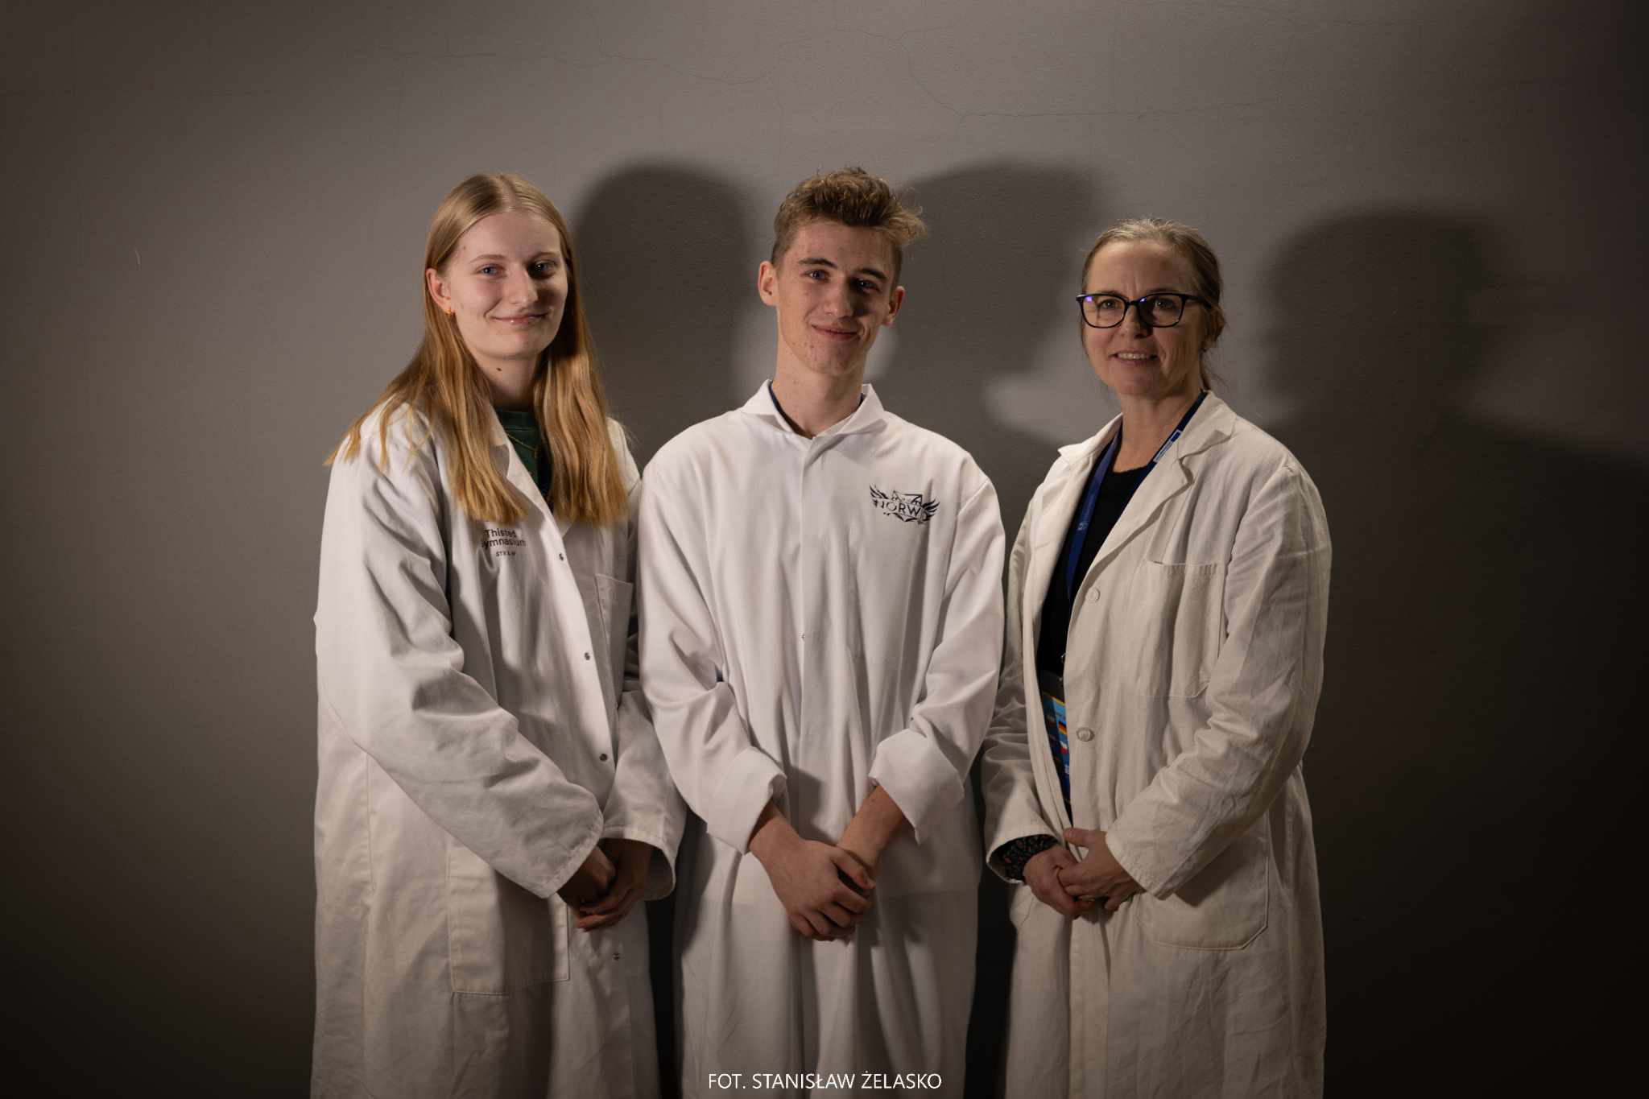
Group 9
Jakub Taranek
Poland
Sofie J. Aagaard
Denmark
Flag
Kate$\check{r}$ina Krumpholcová
Czech Republlic

Slide 2
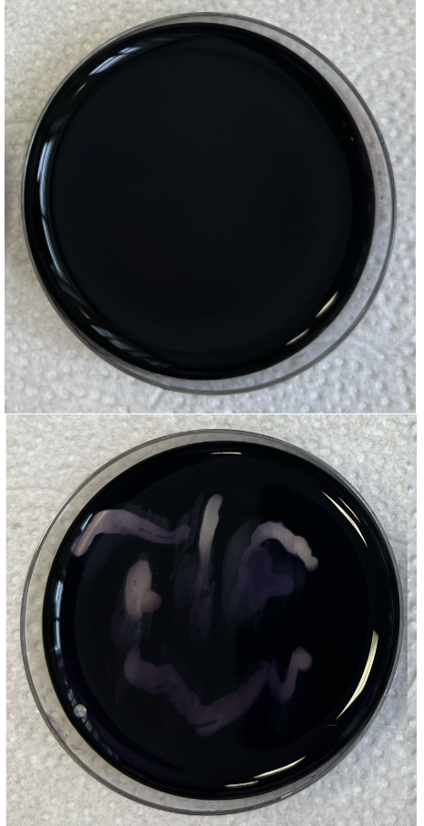
Result of 1. experiment - Starch Metabolism
A₄ has no smiley. B₄ has a smiley.
A₄ no smiley appear, cannot metabolise starch. B₄ smiley appear, can metabolise starch.
A₄ is E. coli, B₄ is Bacillus subtilis.
A₄
Observation:
Results:
Conclusion:
B₄

Slide 3
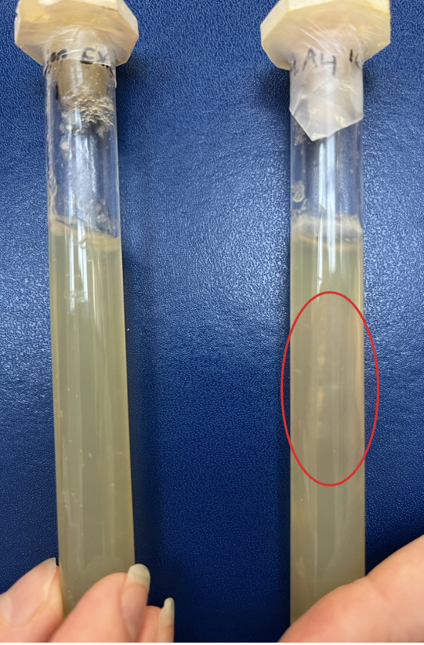
Result of 2. experiment – Oxygen Need
In tube A₄, bacteria top and inside In tube B₄, bacteria only top.
Tube A₄, top and inside, Facultative anaerobe. Tube B₄, only top, aerobe.
A₄ is E. coli, B₄ is Bacillus subtilis.
B₄
Observation:
Results:
Conclusion:
A₄

Slide 4
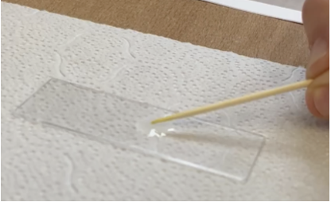
Result of 3. experiment – Gram Quick Test
A₄ liquid: Thick, with strings of DNA. B₄ liquid: Thin, no strings, potassium hydroxide.
A₄ is gram negative, thin cell wall. B₄ is gram positive, thick cell wall.
A₄ is E. coli, B₄ is Bacillus subtilis.
Observation:
Results:
Conclusion:
A₄
B₄

Slide 5
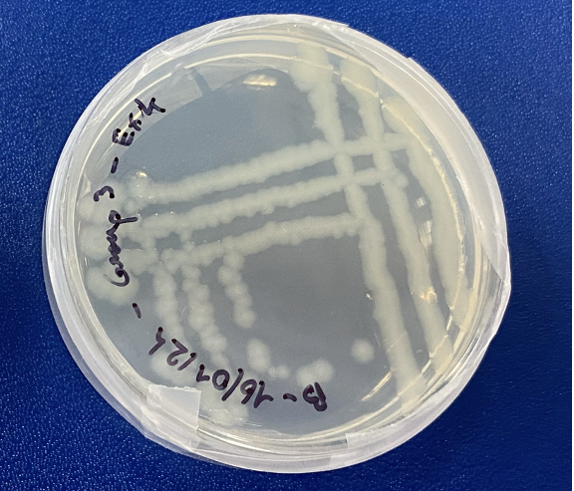
Result of 4. experiment – Production of Pure Culture
Pure colonies, last line.
Largest amount of bacteria in the first lines. Smallest amount of bacteria in the last line (snake/wave)

Slide 6
Conclusion
A₄
Cannot metabolise starch
Facultative anaerobe
Gram negative
→ E. coli
B₄
Can metabolise starch
Aerobe
Gram positive
→ Bacillus subtilis.

