Slide 1

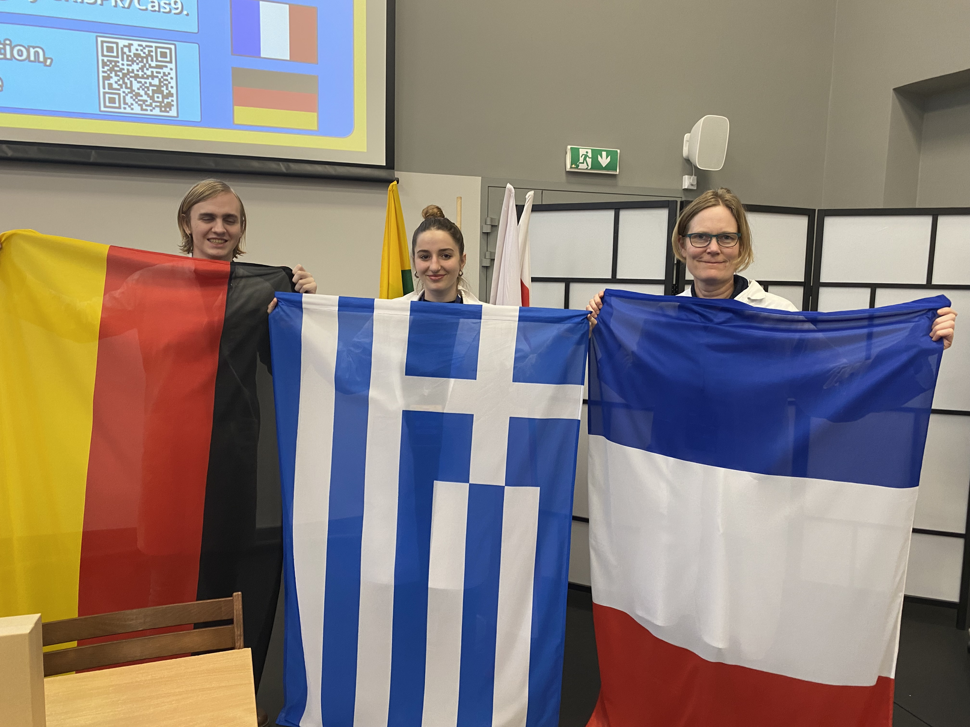






Group 13
Melina Baliou
Greek
Flag
Lukas Braun
German
Flag
Fanny Alory
French
Flag

Slide 2
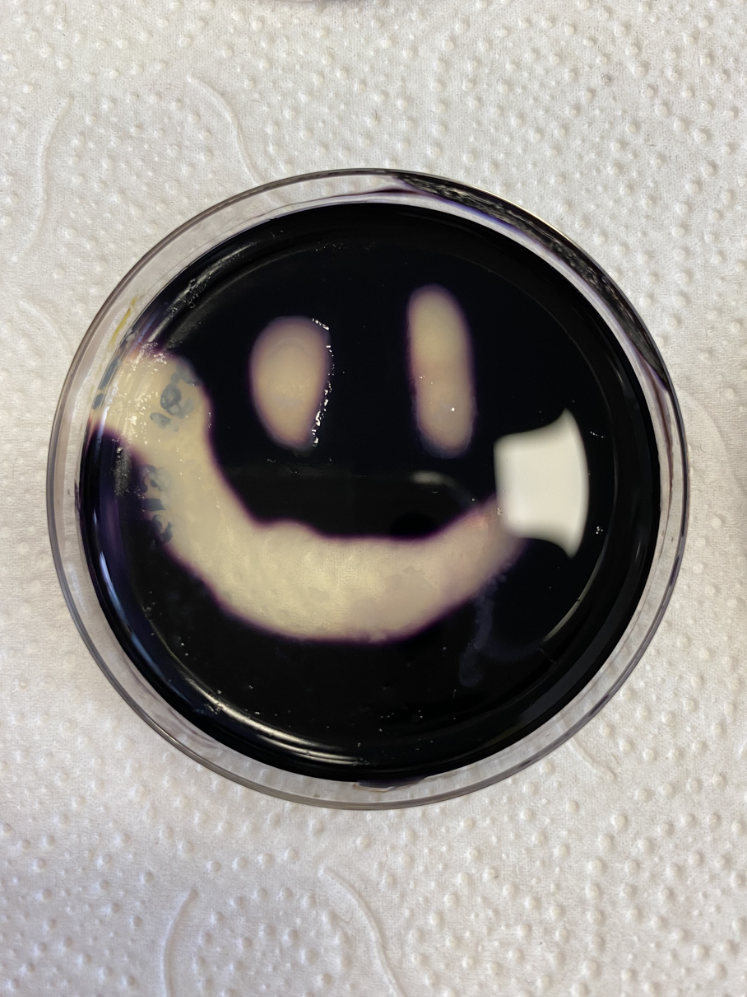
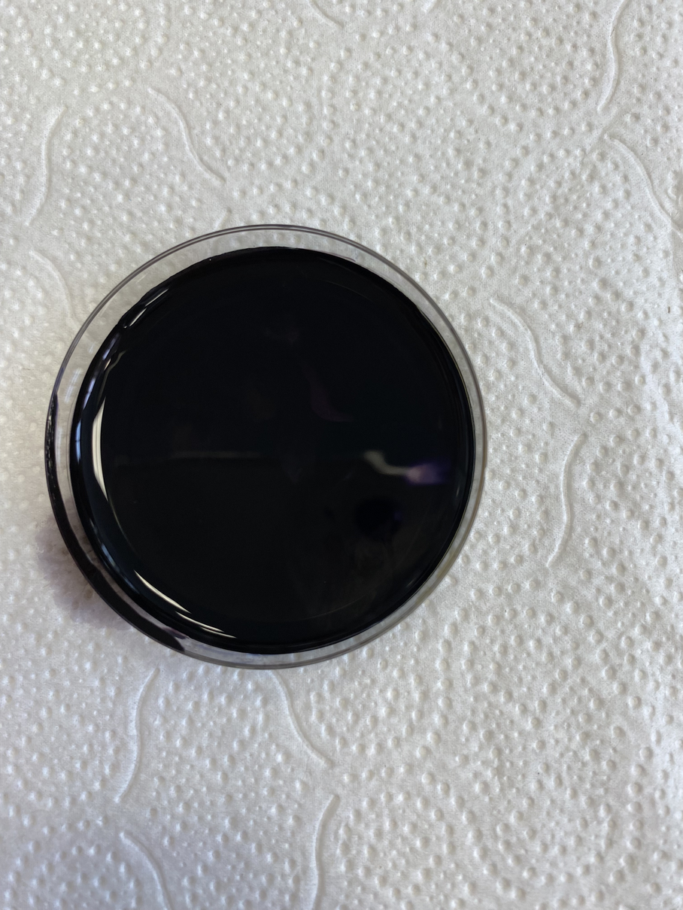
Result of 1st experiment - starch metabolism
A: A white area is visible, which means that the bacteria metabolised the starch.
→ Bacillus subtilis
  B: There is no area without the starch because the whole surface is black.
→E. coli
bacteria
A
B

Slide 3
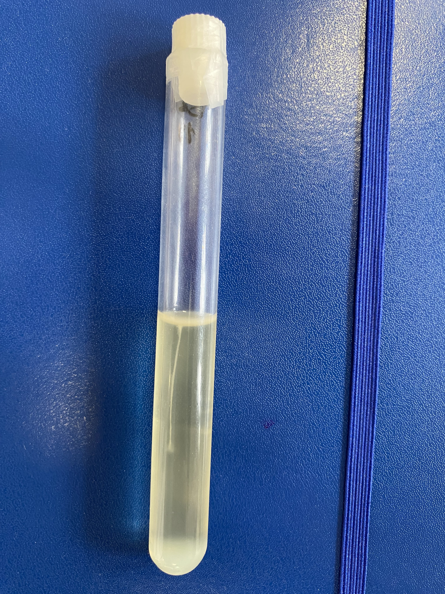
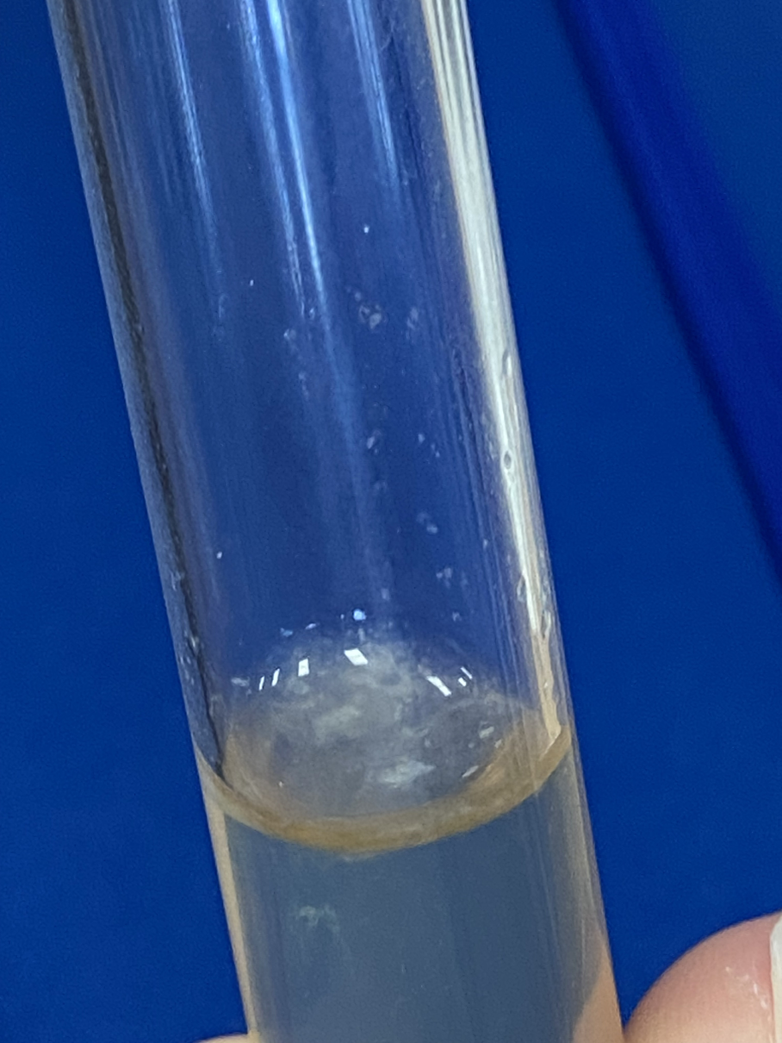
Result of 2nd experiment – oxygen need
  A: The bacteria need oxygen, so the colony grew only on the top (aerobe)
  → Bacillus subtilis
  B: The bacteria grew on top and the inside, signifying that it doesn't need oxygen to grow (facultative anaerobe)
→ E. coli
A
B

Slide 4
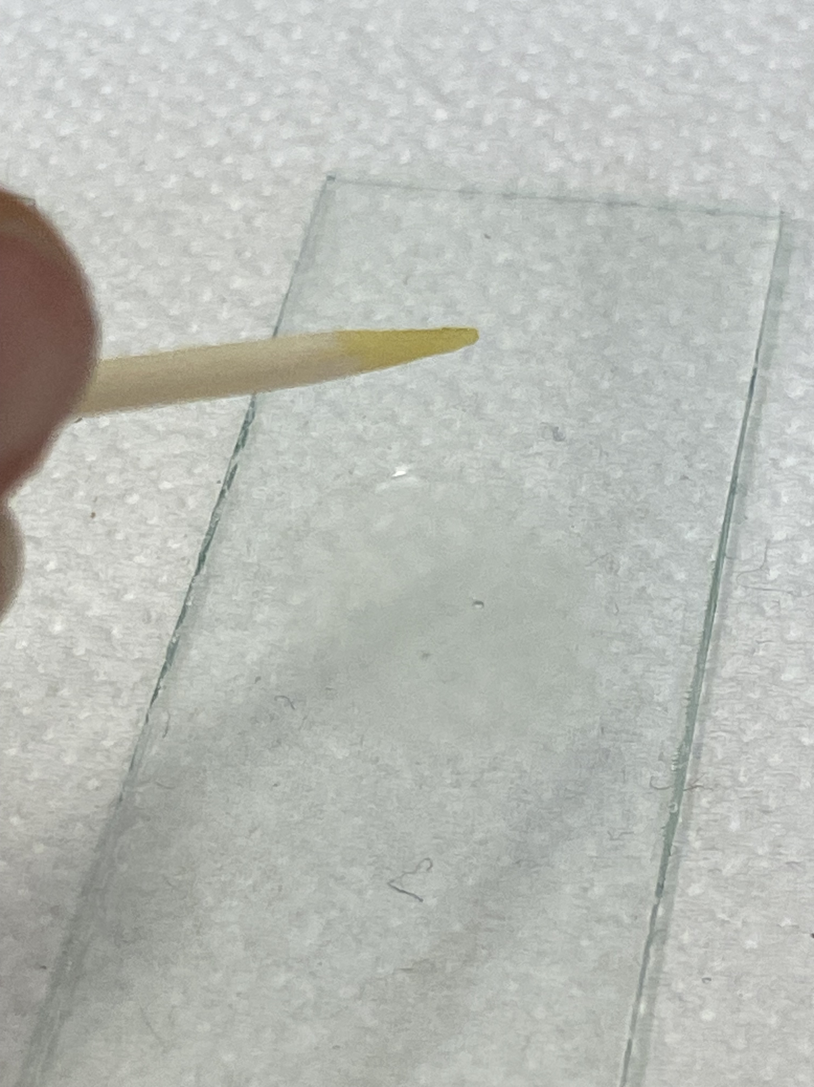
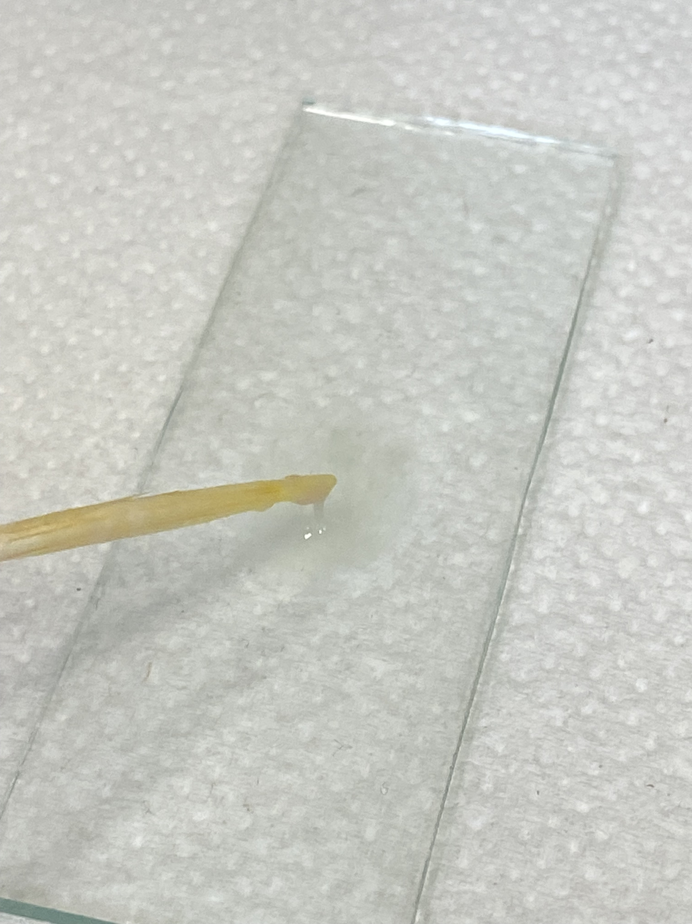
Result of 3rd experiment – Gram quick test
  A: Gram positive
- no string is visible which means that the cell walls weren’t destroyed (thick cell wall)
→ Bacillus subtilis
  B: Gram negative
- strings are visible, which means that the cell walls were destroyed (thin cell wall)
→ E. coli
A
B

Slide 5
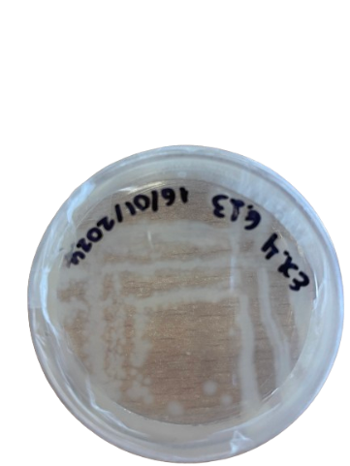
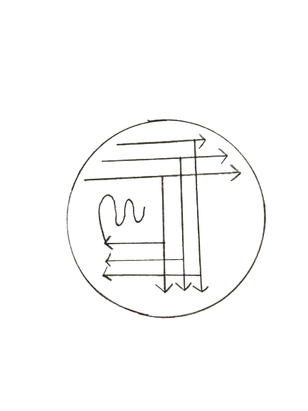
Result of 4th experiment – oxygen need
  Pure colonies are marked with a red arrow
  The smallest amount of bacteria will be at the end of the snake.
  The largest amount of bacteria will be in the area that the loop was first placed.
Pure colony

Slide 6
Final conclusion
Bacterium A:
Exp.1 : metabolises starch
Exp.2 : Aerobe
Exp. 3 : Gram positive
→ Bacillus subtilis
Bacterium B:
Exp.1 : doesn’t metabolise the starch
Exp.2 : Facultative anaerobe
Exp. 3 : Gram negative
→ Escherichia coli

