Slide 1
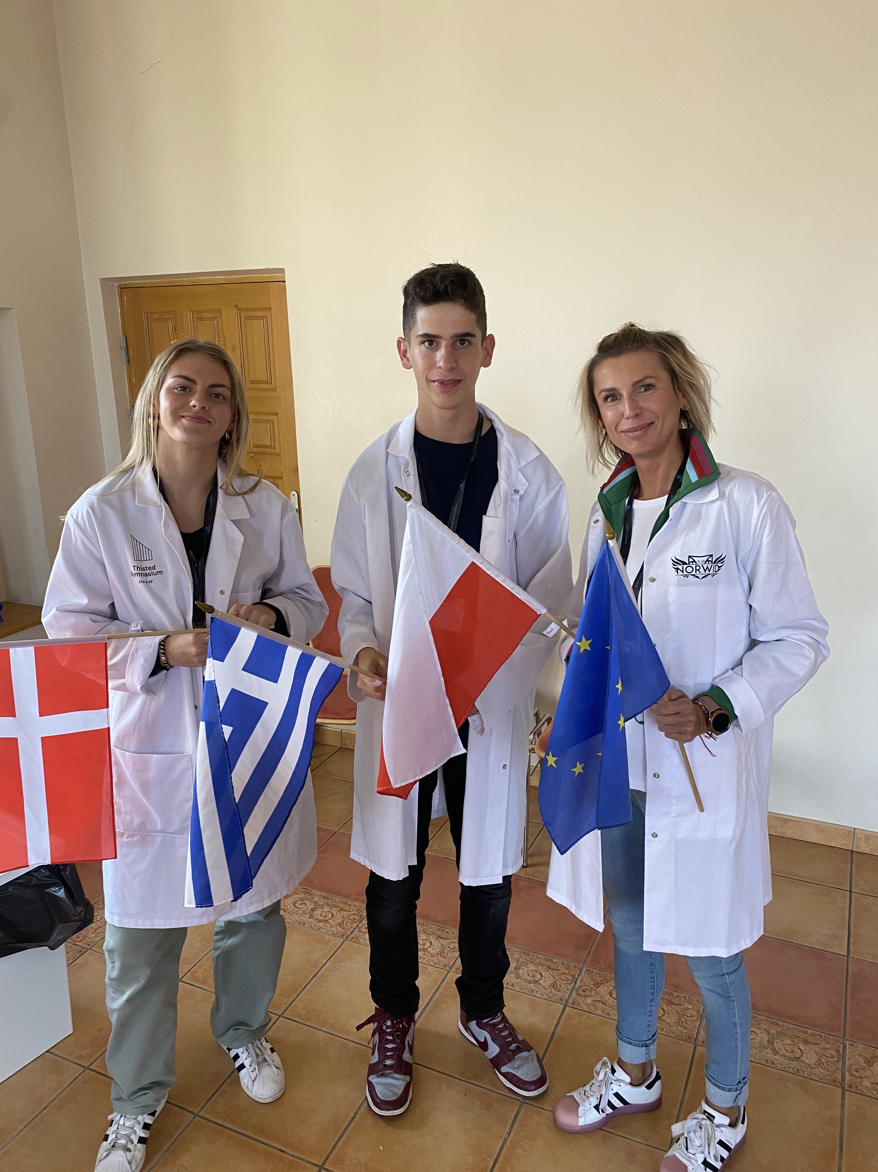
- Tilios Konstantinos - From Greece - 2nd standard high school of Athens
Mentor → Tilde Søe Bach
From Denmark
Thisted Gymnasium
- Anna Teper - From Poland - Norwid highschool

Slide 2
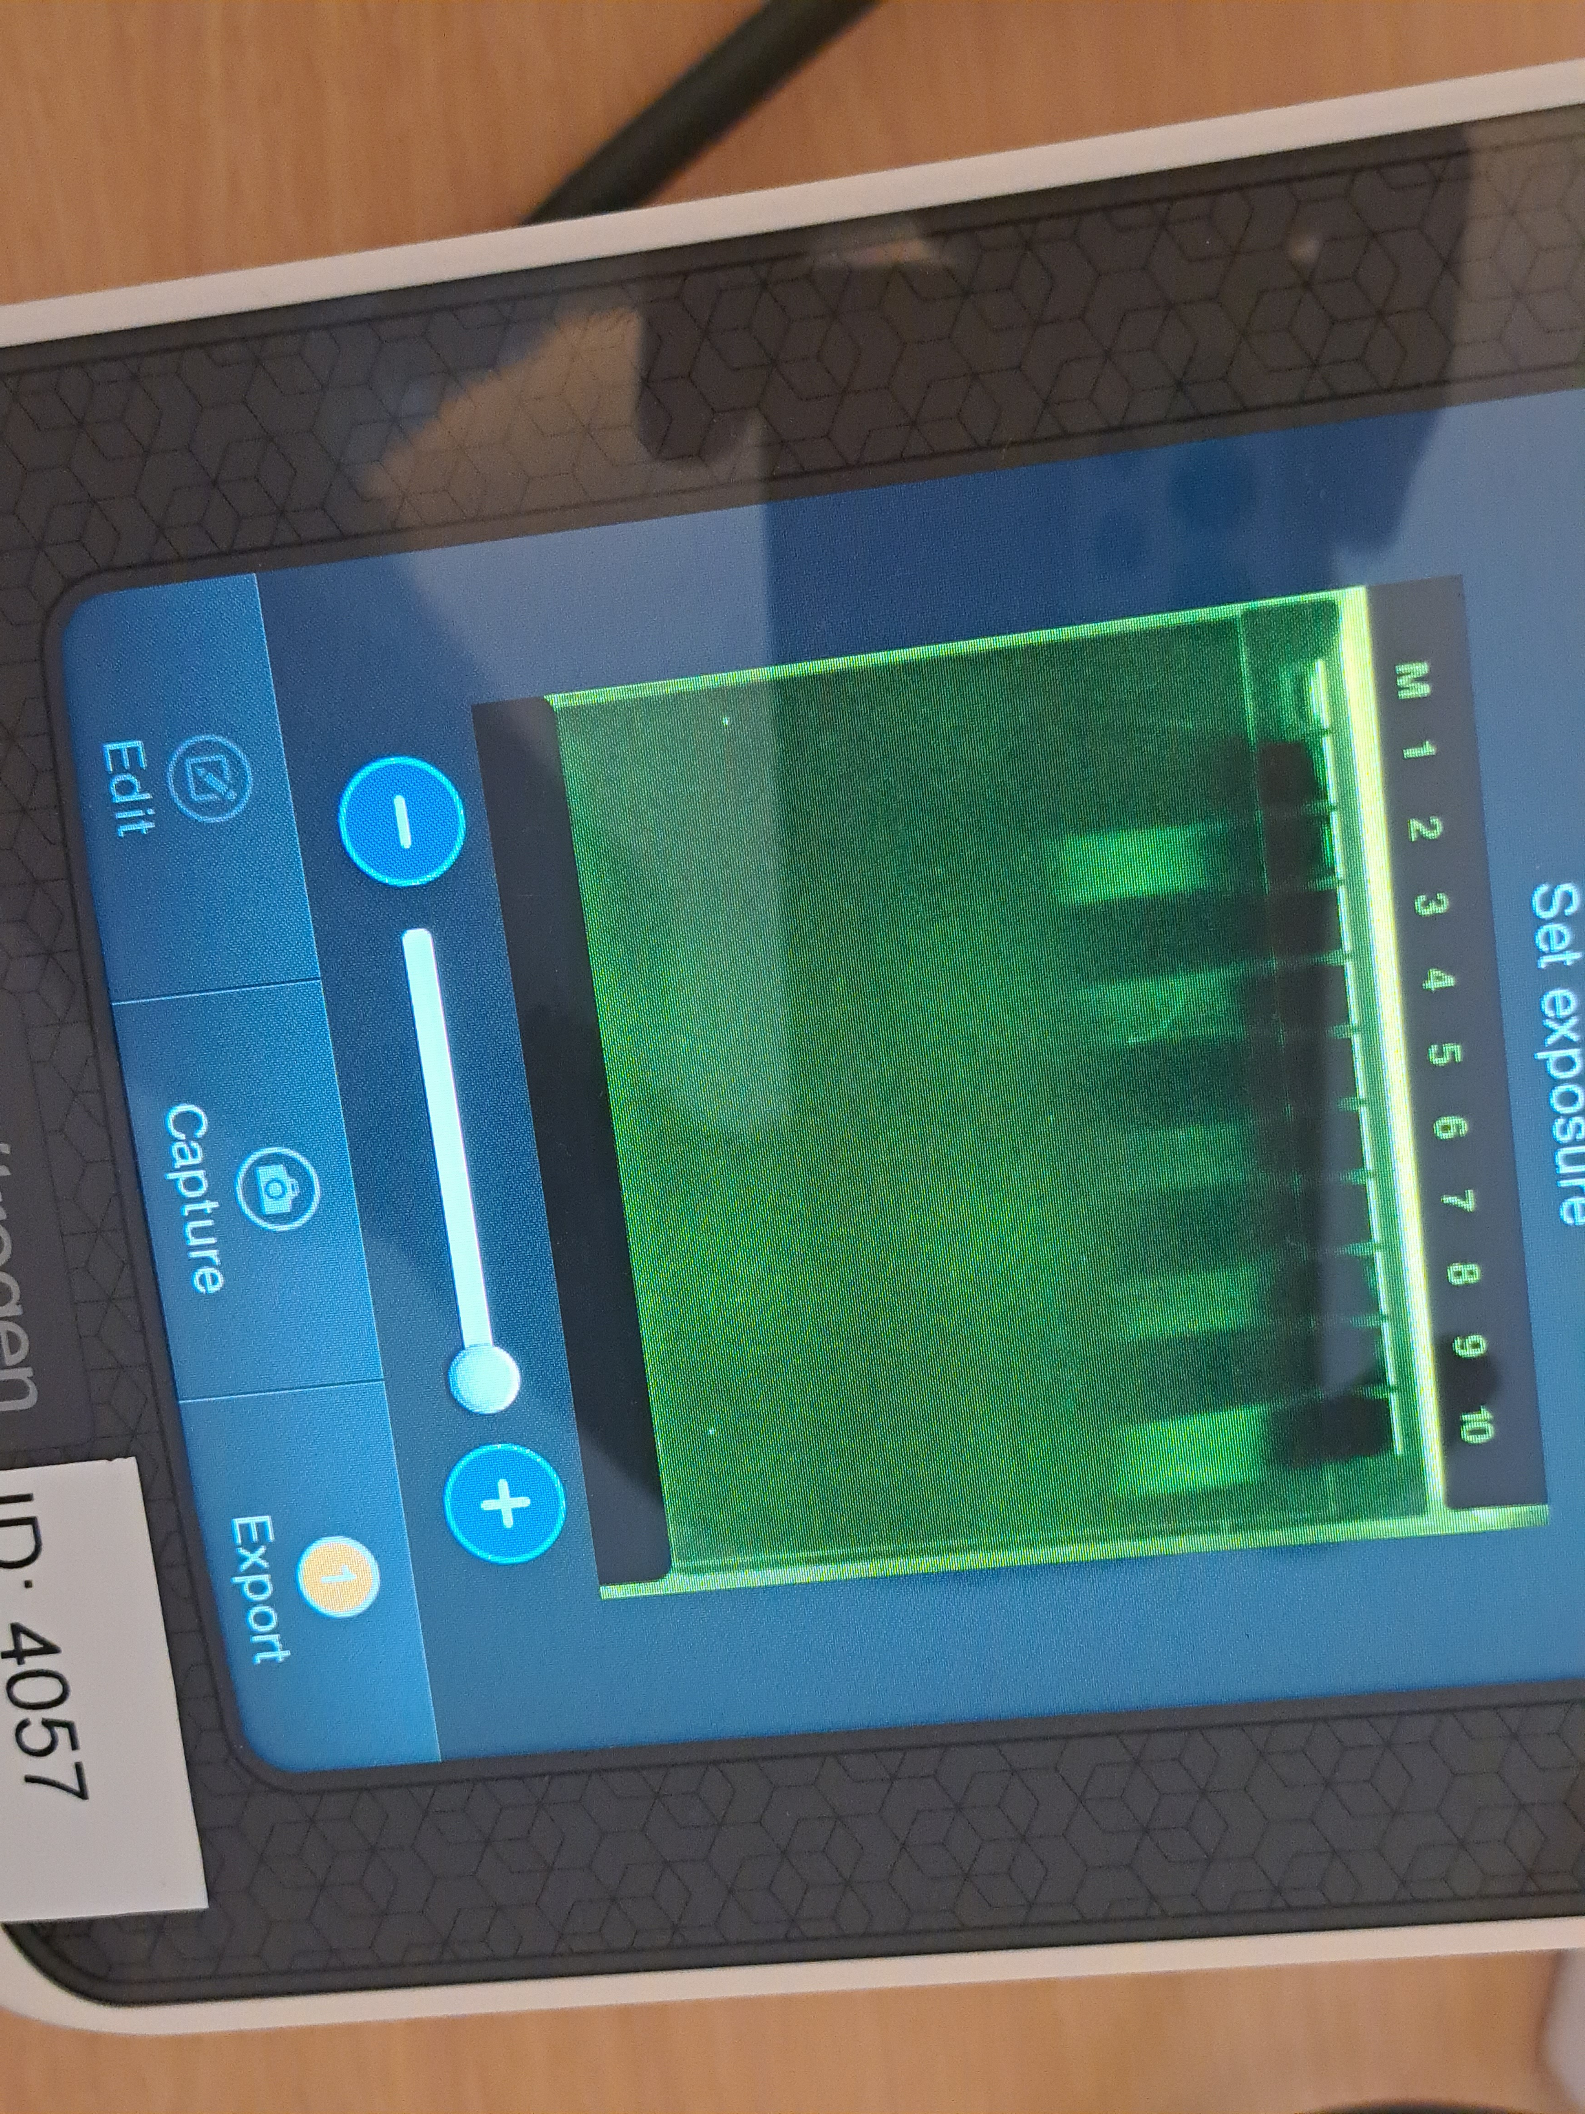
Results of CRISPR/Cas step 1
St0 – blanc control
In the St0 the well is blanc and we don’t see any bands
We slowed down the gRNA polymerase by putting it on ice
St1 – gRNA-polymerase
In the St1 the well was full of bands as we have expected
We incubated the St1 for one hour at 37° C
Which is the optimal temperture for the gRNA to synthesis

Slide 3
Conclusion of the gel eletrophoreses
(St0)
(St1)
→ Conclusion to summarize
The gRNA polymerase wouldn’t work on ice
Therefore we can conclude that the gRNA needs the optimal temperature (37° C) to work
To summarize we can conclude that we succeded with the polymerase because the gRNA worked

Slide 4
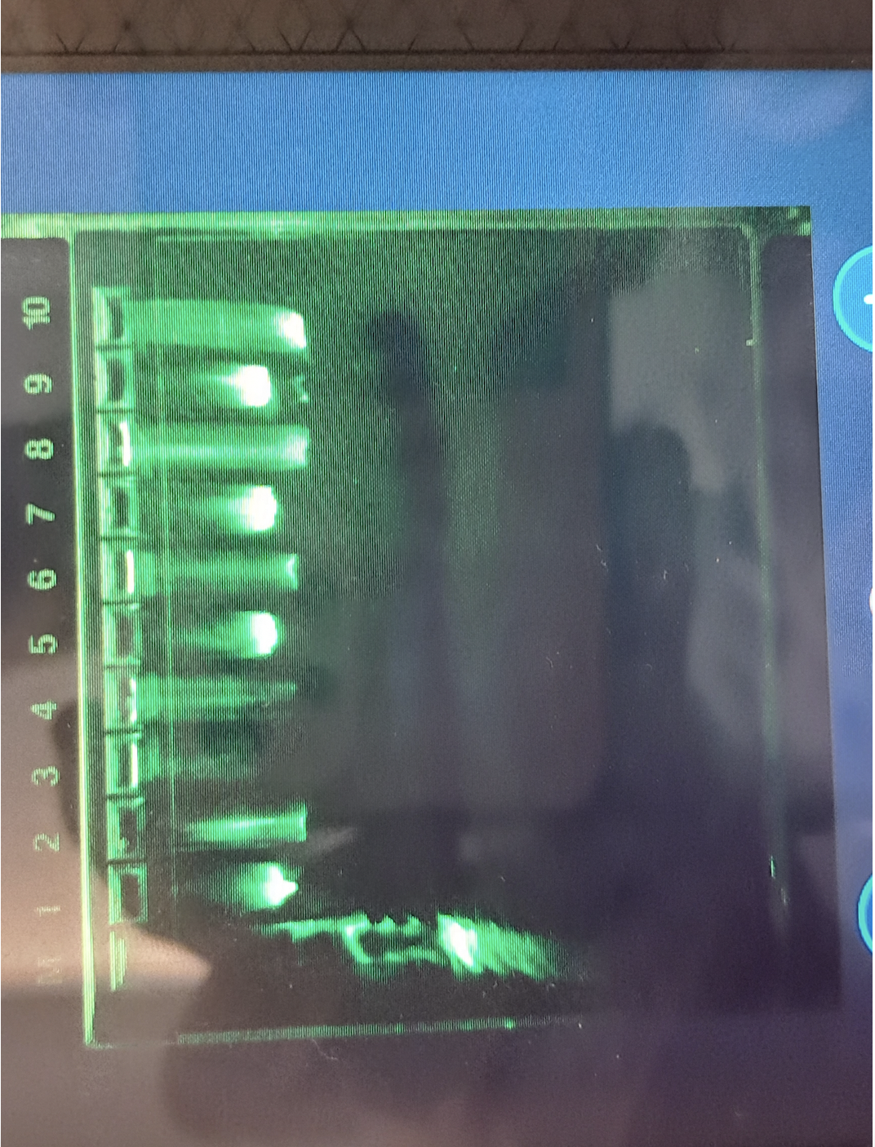
Results of CRISPR/Cas step 2
Samle 1 - the supercoiled plasmid pBR322 (9)
Sample 3 – the plasmid with the Cas9 and the gRNA (10)
We can see in sample 1 that there is not a cut in the plasmid, because the plasmid is only supercoiled in one spot
In sample 3 the plasmid has been linerized because it has been cutted

Slide 5
Conclusion
We can conclude there has been a cut in the plasmid, because the plasmid is linearized
But we’re not sure exactly where the cut has been done
Therefore we have to look at the sequence, so we can locate the cut

Slide 6
Results of sequencing
Overview of the sequencing :
We observed:
-The cut to the DNA has been succesfully made
-Out of 4361 Basepairs, the computer is unsure for only 95 positions
- The cut is in the begining
You can see that we have a little amount of DNA sequences bases
And there is one place where there isn’t any bases

Slide 7
Close up of sequence
PAM-sequence
Target DNA
- We get a more precisely and exact picture of where the cut has been done
The conclusion:
We can see where the cut in the DNA has been done
We wanted to cut only the 20 basepairs before the PAM-sequence but as you can see we ended up cutting more than expected
Another thing we can see is the 20 basepairs, which starts with the CGC
It ends with the TGG
We can see the PAM-sequence which is the TGG, and it’s marked with green

Slide 8
Thanks for your attention!

