Slide 1
Group 2 :
Mary O’Brien
Zoé Desseaux
Mentor: Viktorija Kazlauskaite

Slide 2
Results of CRISPR/Cas Step 1: gRNA synthesis
St0
St1
Observations and Conclusions:
Absense of band in lane 3 (St0)
gRNA unable to be synthesized
RNA polymerase inactivated by low temperature 0°C
Presence of band in lane 4 (St1)
gRNA was able to be synthesized
RNA polymerase active at 37°C

Slide 3
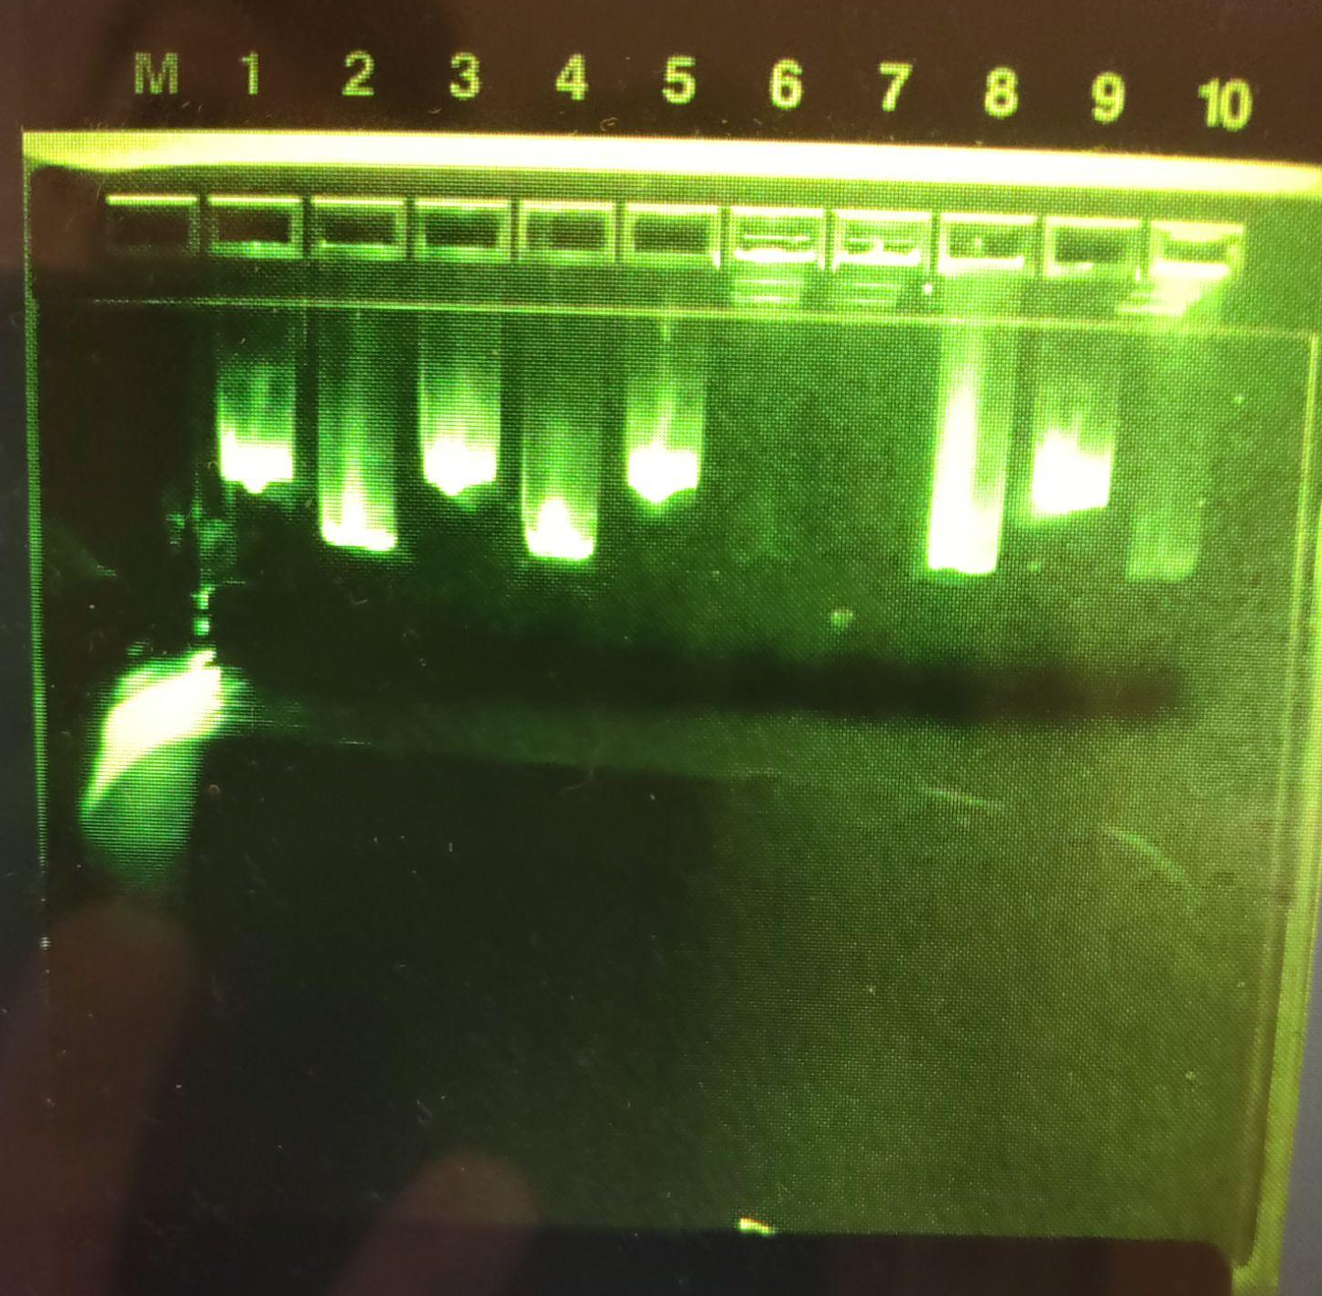
Results of CRISPR/Cas Step 2: Plasmid Cleavage
C2
3
Lane 3: Control 2 (Supercoiled + Cas9)
Presence of band in lane 3
Lane 4: Experimental (Supercoiled + Cas9 + gRNA)
Presence of band in lane 4
Hypothesis:
Supercoiled plasmid (lane 3) will travel farther than cut plasmid (lane 4)
Conclusion:
Possible explanation: Nicked plasmid? → did not travel as far as the cut DNA did

Slide 4
Results of DNA Sequencing Part 1
Overview image:
Blue arrow: CRISPR/Cas cut
No nucleotides read by the sequencer in this region → all strands of DNA were cut
Red Arrow: Blank sequences
Missing DNA unable to be aligned by software → less than 200bp
Orange arrow: mutations in the plasmid as compared to the NCBI sequence
Less DNA than other groups: lower concentration in mix
45 uncertainties out of 4361bp → 99% certainty

Slide 5
Results of DNA Sequencing Part 2
Target DNA sequence
PAM sequence
13 strands
Zoomed-in Image:
Red box: Target DNA sequence
20 nucleotides long
CRISPR/Cas cut occurred within the target region
Blue box: PAM sequence (TGG) → Marks target sites
Red Arrow: Blank sequences
Missing DNA unable to be aligned by software → less than 200bp

