Slide 1
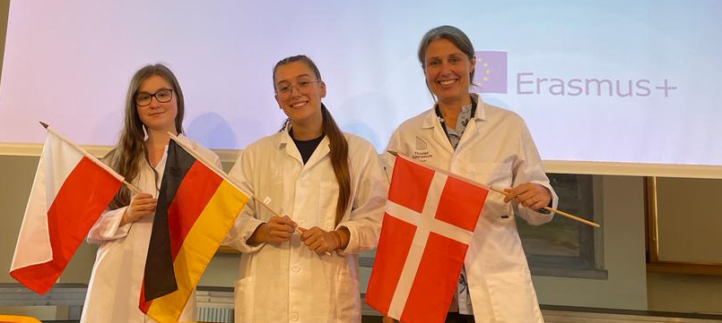
Group 19
Mentor:
Natalia from Poland
Group members:
Jule from Germany
Pia from Denmark

Slide 2
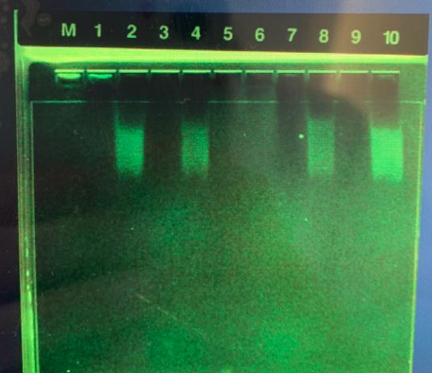
Result: Gel electrophoresis of synthesied gRNA
7: Control kept on ice
RNA-polymerase did not synthesise the gRNA because of low temperature
8: Test incubated at 37˚
RNA-polymerase synthesised gRNA at it’s optimal temperature

Slide 3
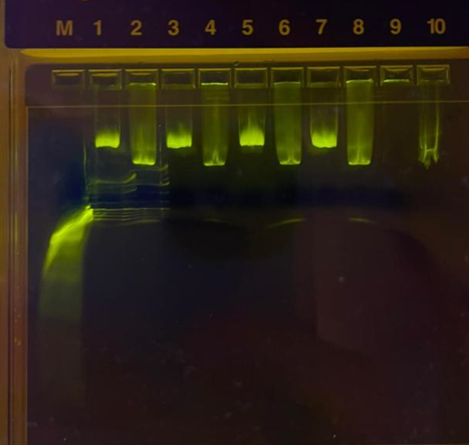
Result: Gel electrophoresis of Cas9-cutted plasmid
7: Control tube 2 without gRNA
Cas9 could not cut the plasmid without gRNA
8: Test tube 3 with both Cas9 and gRNA
Cas9 with gRNA cut the plasmid
The linearized plasmid travels faster through the gel compared to the uncut plasmid

Slide 4
Result: Oxford Nanopore sequencing of cut plasmid pBR322
Conklusion:
Maximal amount reads: 19
41 inaccurate bp out of 4361 bp – less than 1%
White areas are missing DNA

Slide 5
Result: Oxford Nanopore sequencing of cut plasmid pBR322
Conklusion:
All sequences DNA are cut i the target-area next to the PAM-sequence

Slide 6
Summery
We successfully synthesised gRNA
We successfully cut the plasmid with the Cas9-gRNA-complex
The cut was made in the target area

