Slide 1
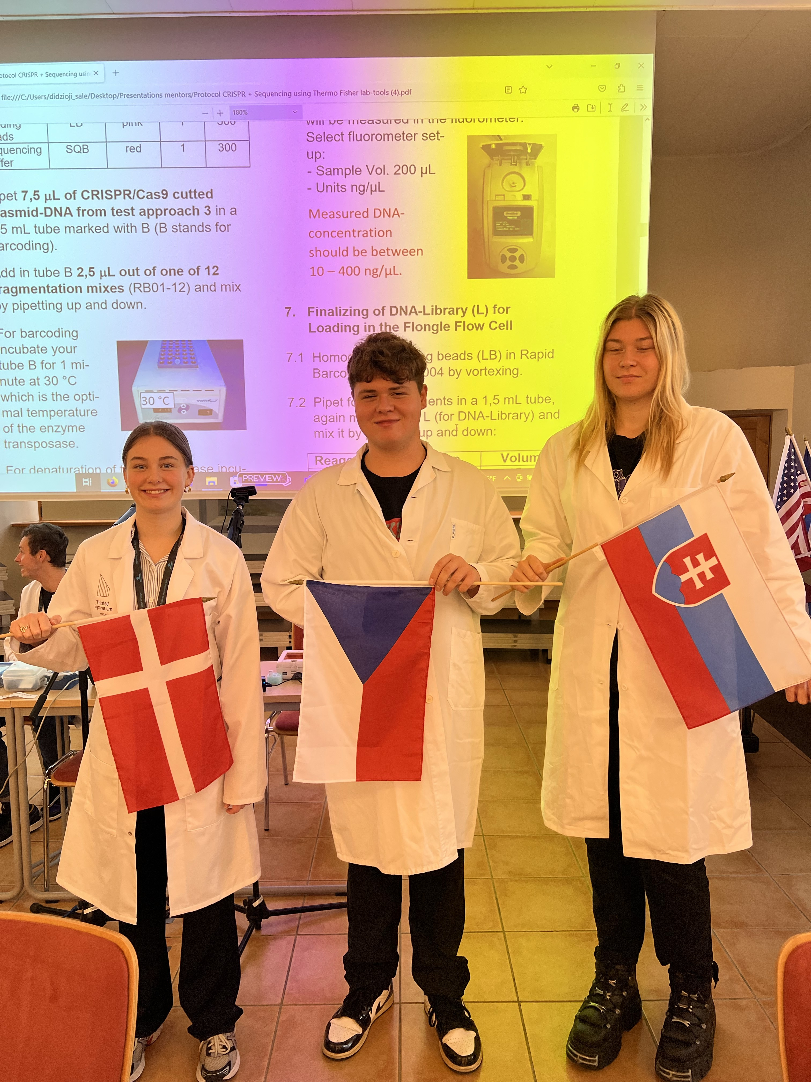
Group 10
Kirstine Vigsø Lassen from Denmark
Jiří Pol from Czech republic
Zoja Gutová from Slovakia

Slide 2
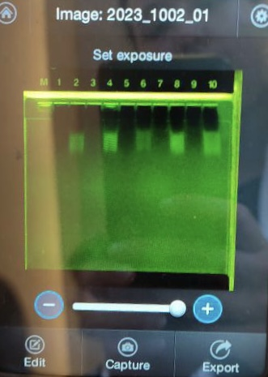
gRNA
Conclusion:
9: The control was kept on ice,
which leads to no gRNA is synthesized,
because of the low temperature.
10: The sample was icnubated at 37 ^C, which
is the perfect temperature for the
RNA-polymerase, which leads to gRNA being
synthesized

Slide 3
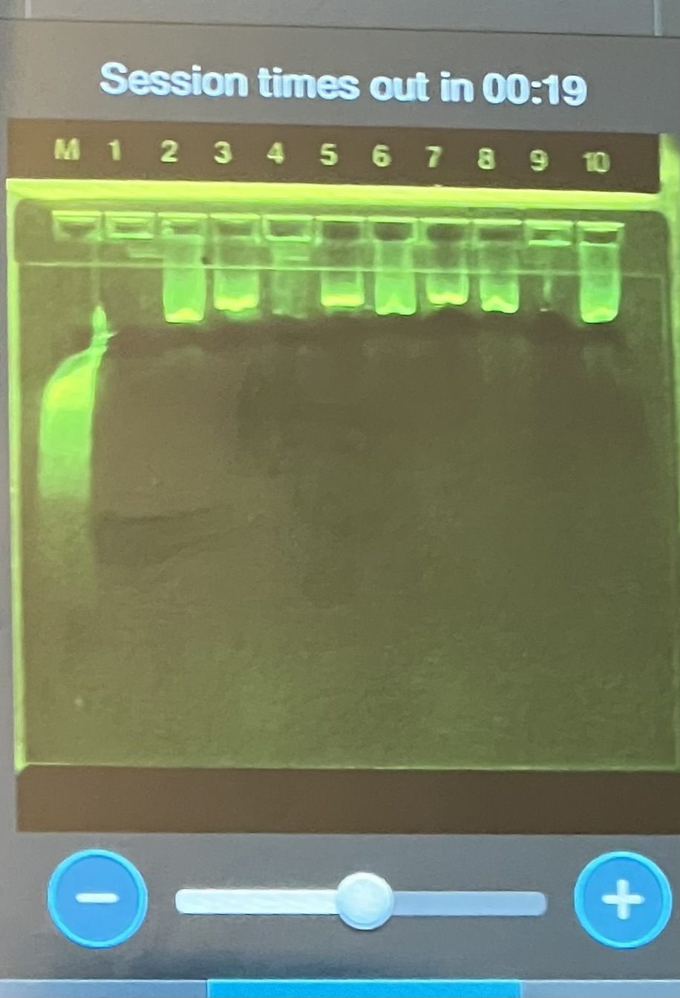
Plasmid
Conclusion:
9: The control used is number 2 (+cas,-gRNA),
but unfortunately it didn’t appear.
10: Linearized cutted plasmid pBR322 with Cas and gRNA.
We have compared it to the other groups.
Exp.: well number 8

Slide 4
Sequencing overview
Conclusion:
-Cas9 cut happened at full range
-5 plasmids were sequenced
-around 120 times was system unsure

Slide 5
Close up of sequence
Conclusion:
-cut was made around 660-700 base pairs
-gRNA and PAM sequence found in cut=succesfull cut
- cut between base 17 and 18 = 2 Guanins

Slide 6
Thank you for your attention!!!

