Slide 1
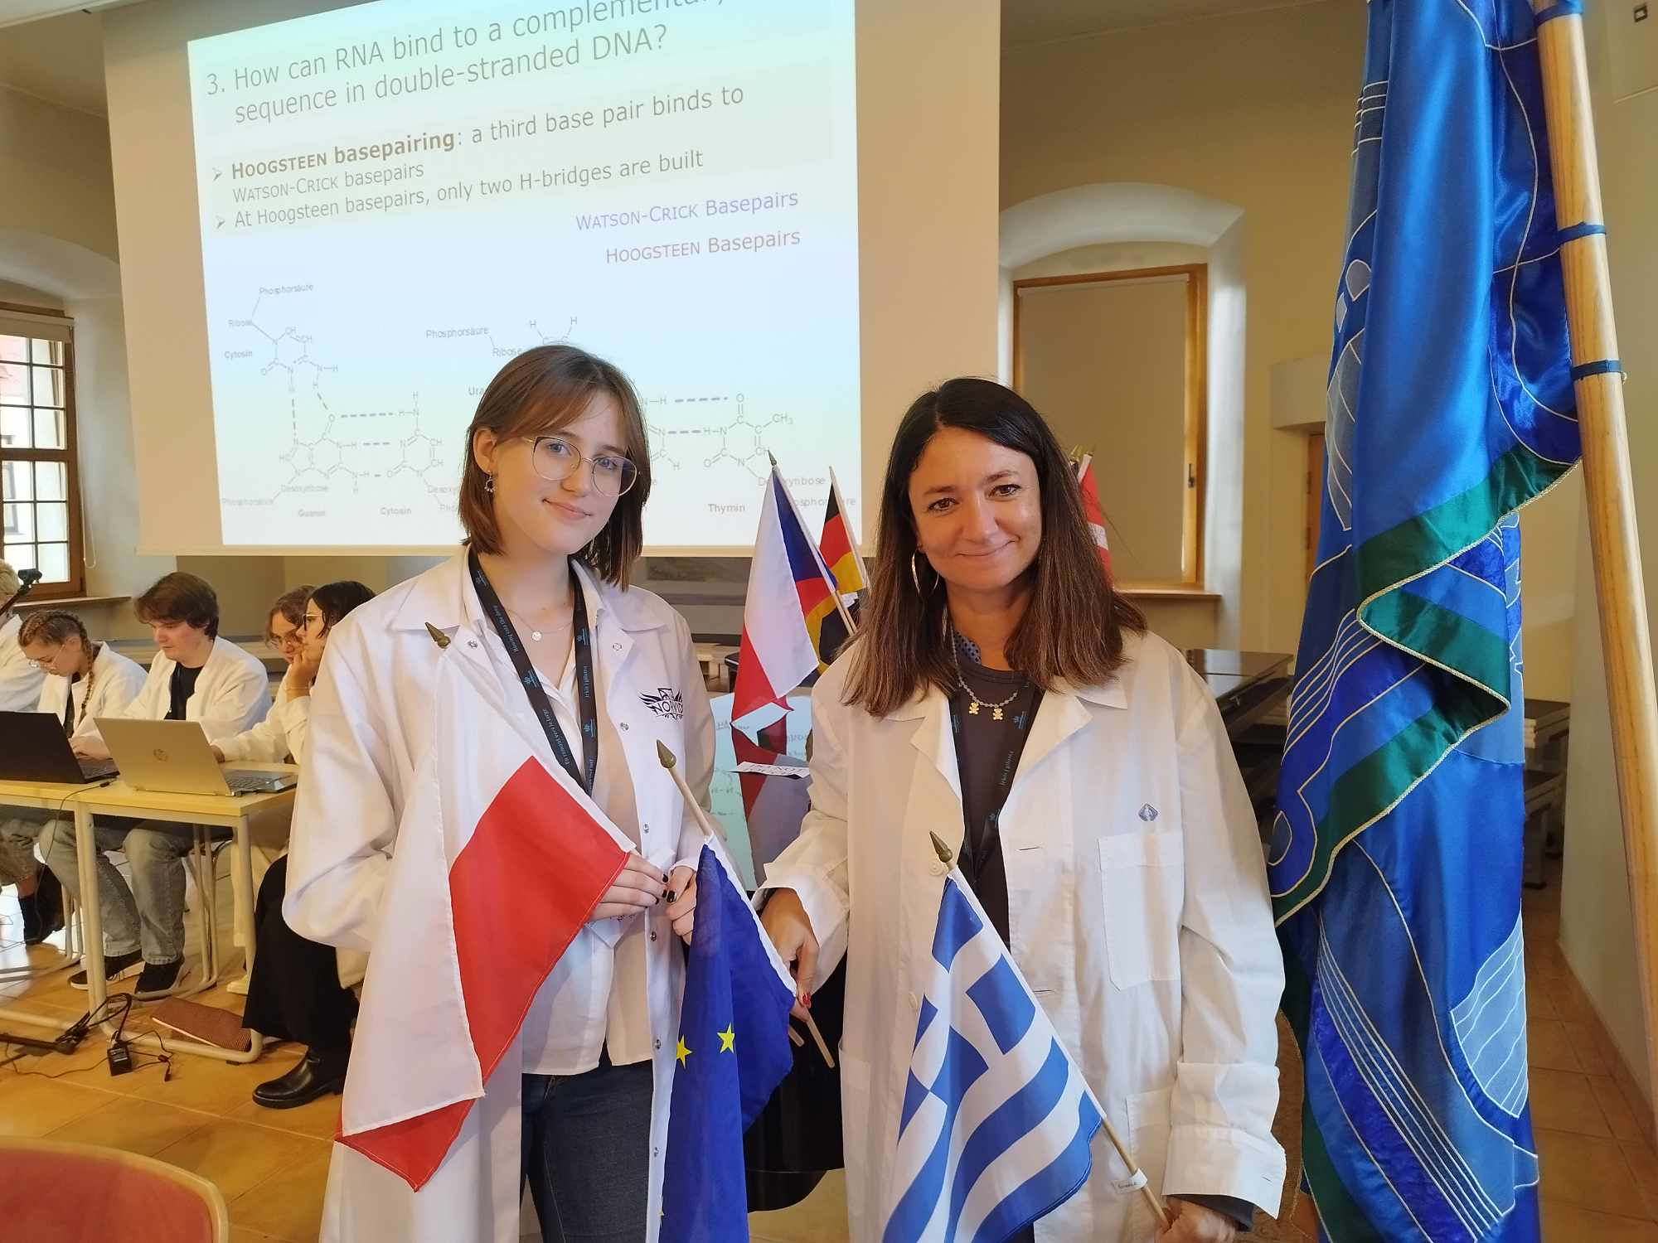
GROUP 18
Aleksandra Krawczyk
(mentor)
Katerina Tzavelopoulou

Slide 2
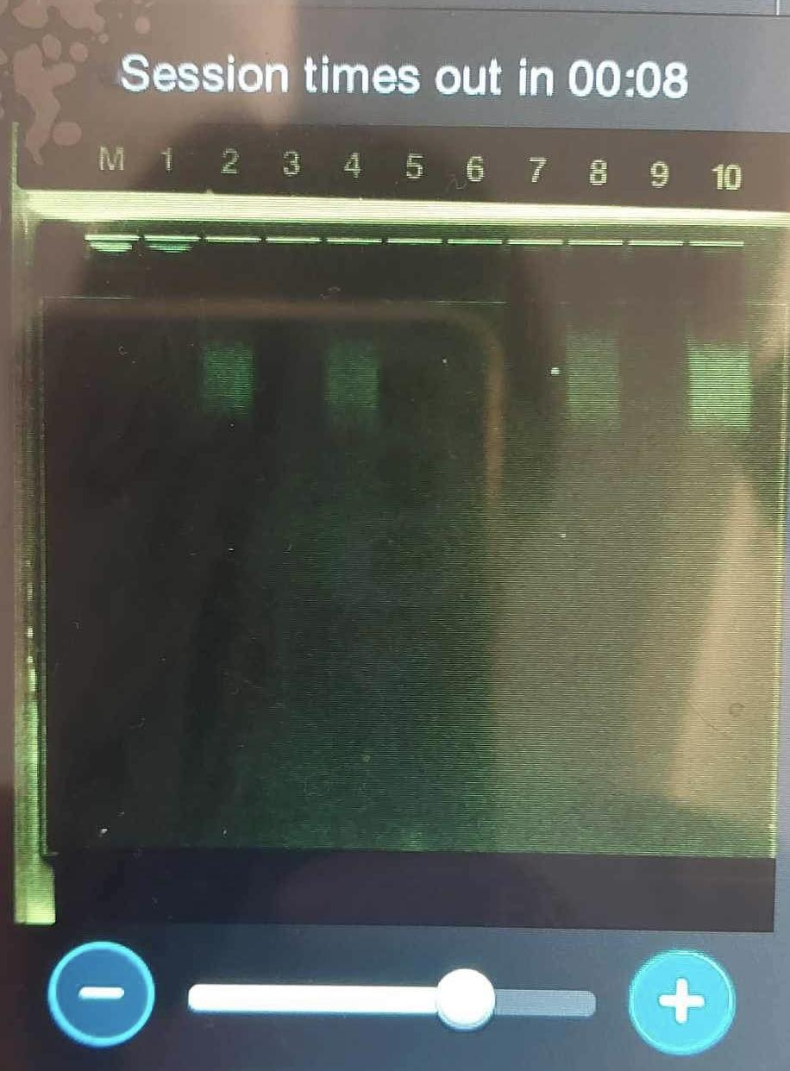
Production of gRNA
Conclusion:
We couldn’t synthesized gRNA, because by mistake we skipped one important step (2.4).

Slide 3
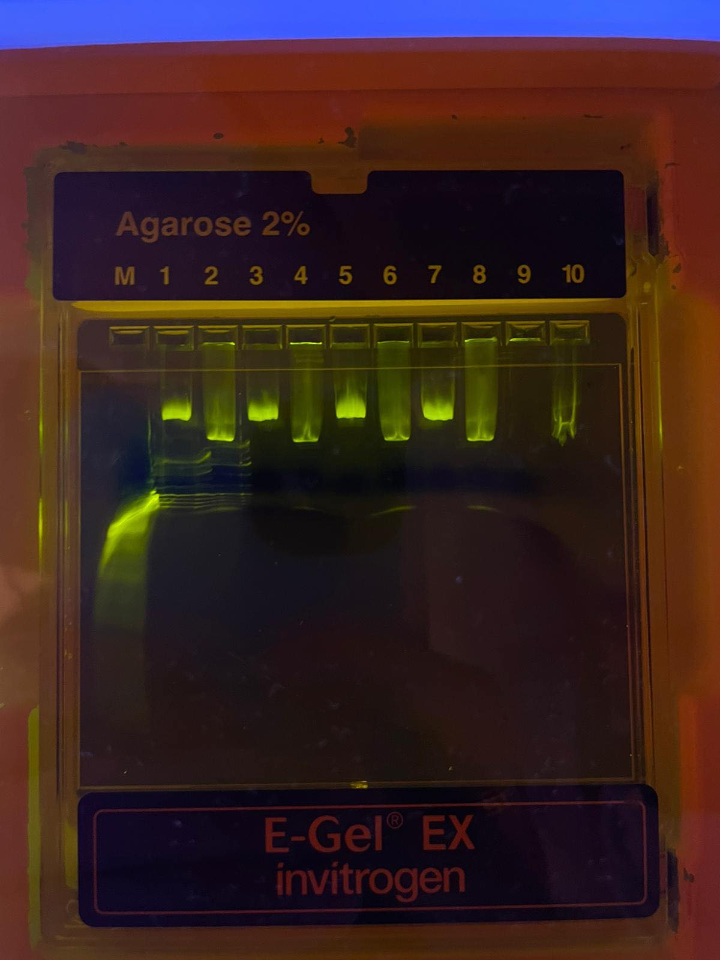
Electrophoresis of plasmid
As a control sample we used plasmid with Cas9, but without gRNA. As a test sample we used plasmid with gRNA and Cas9.
Conclusion:
The test sample (nr. 6) travels further than the control sample (nr. 5). We can deduct that the control sample contains the nicked plasmid form. In that case we know that our plasmid was cutted, because the cutted form travels faster through the gel than the nicked form.

Slide 4
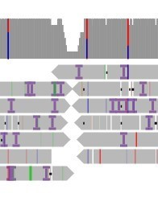
Sequencing overview
Conclusion:
As we can see there is a cut and the reaction was successful. One strand isn’t cutted. The computer isn’t sure about around 39 bases (out of 4361 bases).

Slide 5
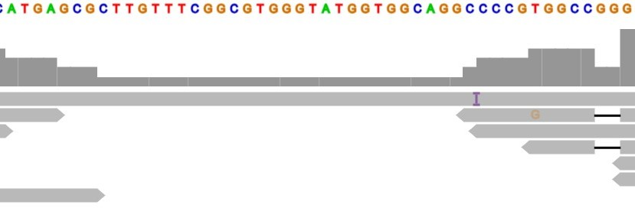
Close up of sequence
Conclusion:
We made a cut in the targeted place but we can see that the DNA strand is not entirely cutted.

